Slide 1
Discussion 7/14/2019

Slide 2
Recurrence Relation
Recurrence relations are used to determine the running time of recursive programs – recurrence relations themselves are recursive.
F( n ) = F(n -1) + F(n-2) , F(1) =1 , F(0) = 1 Fibbanocci Sequence

Slide 3
Divide and Conquer
Divide and Conquer is an algorithm strategy
Divide the input data into multiple pieces
Recurse into each piece
Join the answers together

Slide 4
Divide and Conquer
findMax(array):
part1 = lower half of array
part2 = upper half of array
max1 = findMax(part1)
max2 = findMax(part2)
return max(max1,max2)

Slide 5
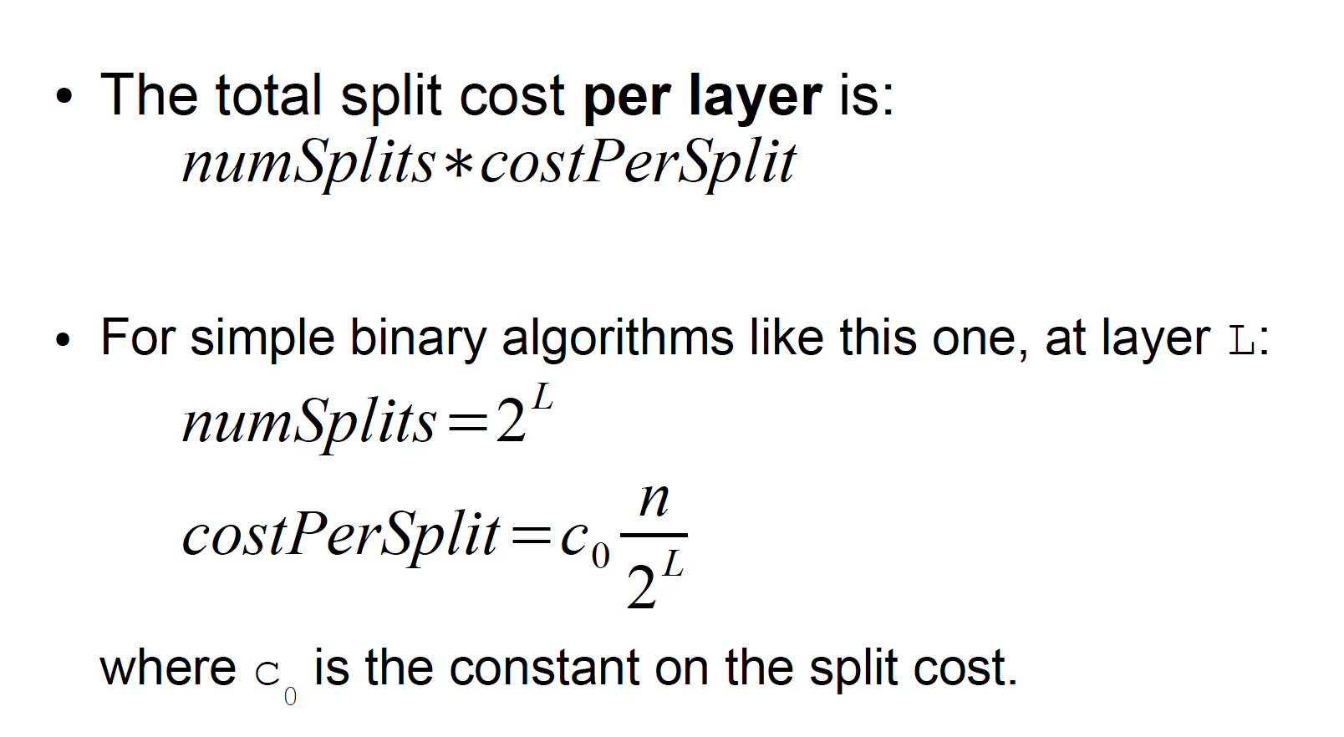
Figuring the Costs, Per Layer

Slide 6
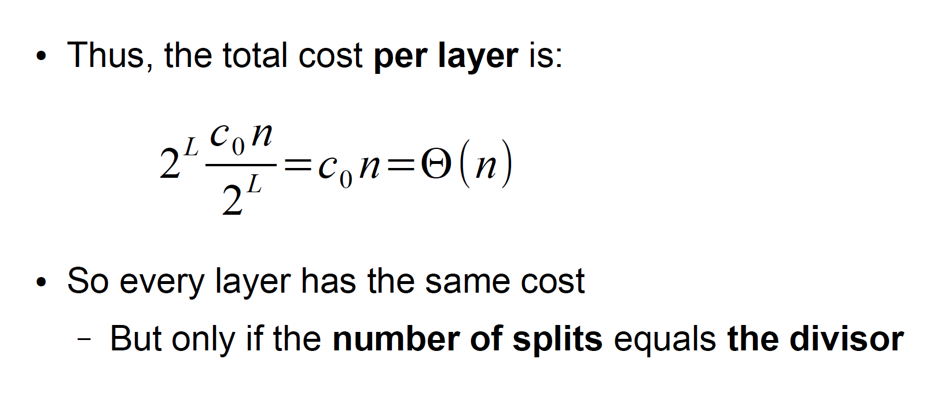
Figuring the Costs, Per Layer

Slide 7
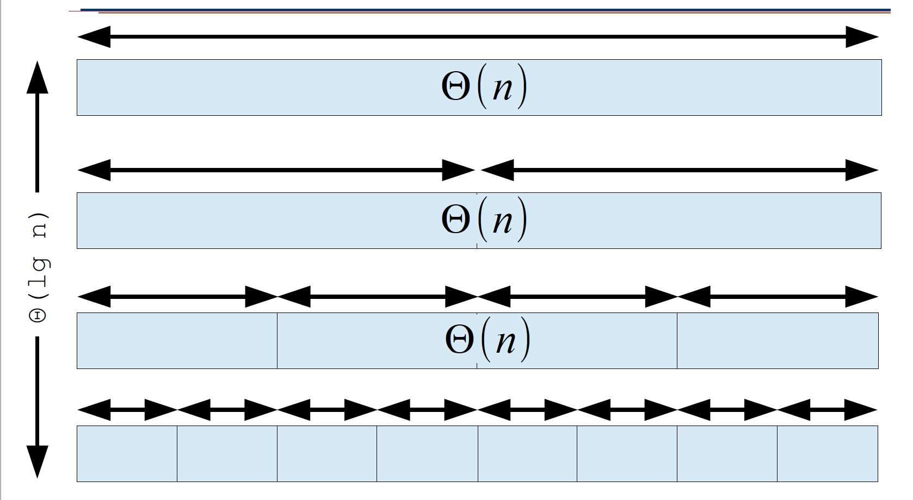
Thinking About Recursive Calls

Slide 8
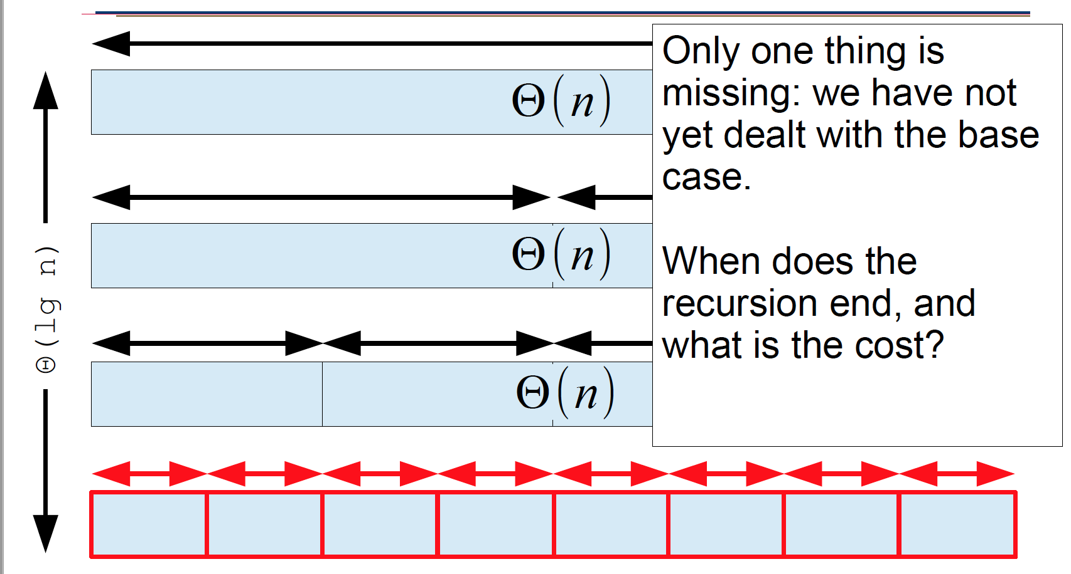
Thinking About Recursive Calls

Slide 9
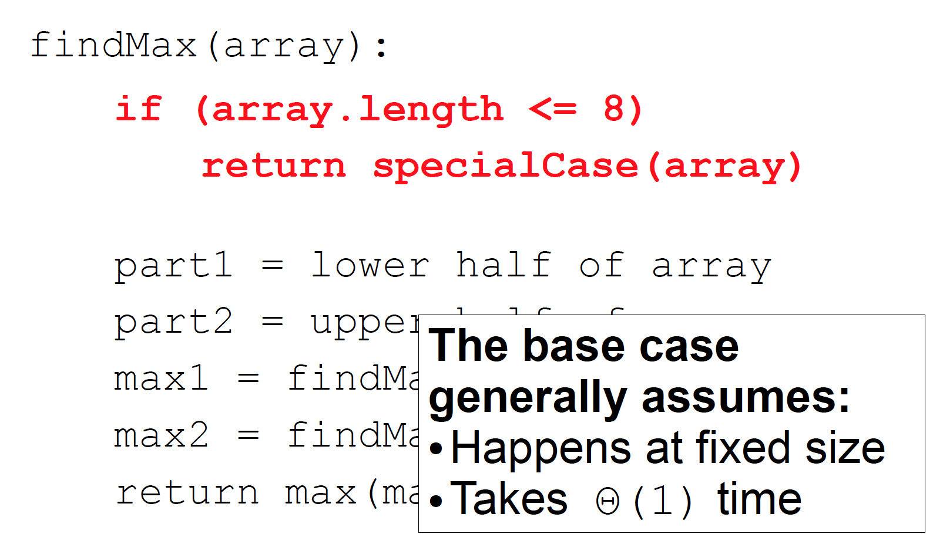
Divide and Conquer

Slide 10
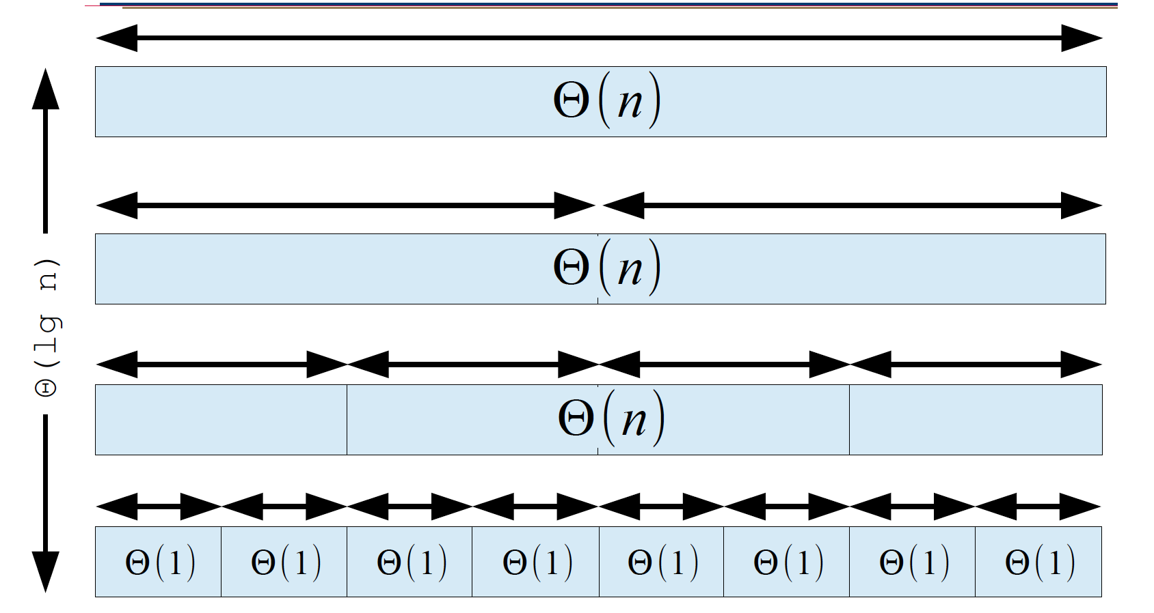
Thinking About Recursive Calls

Slide 11
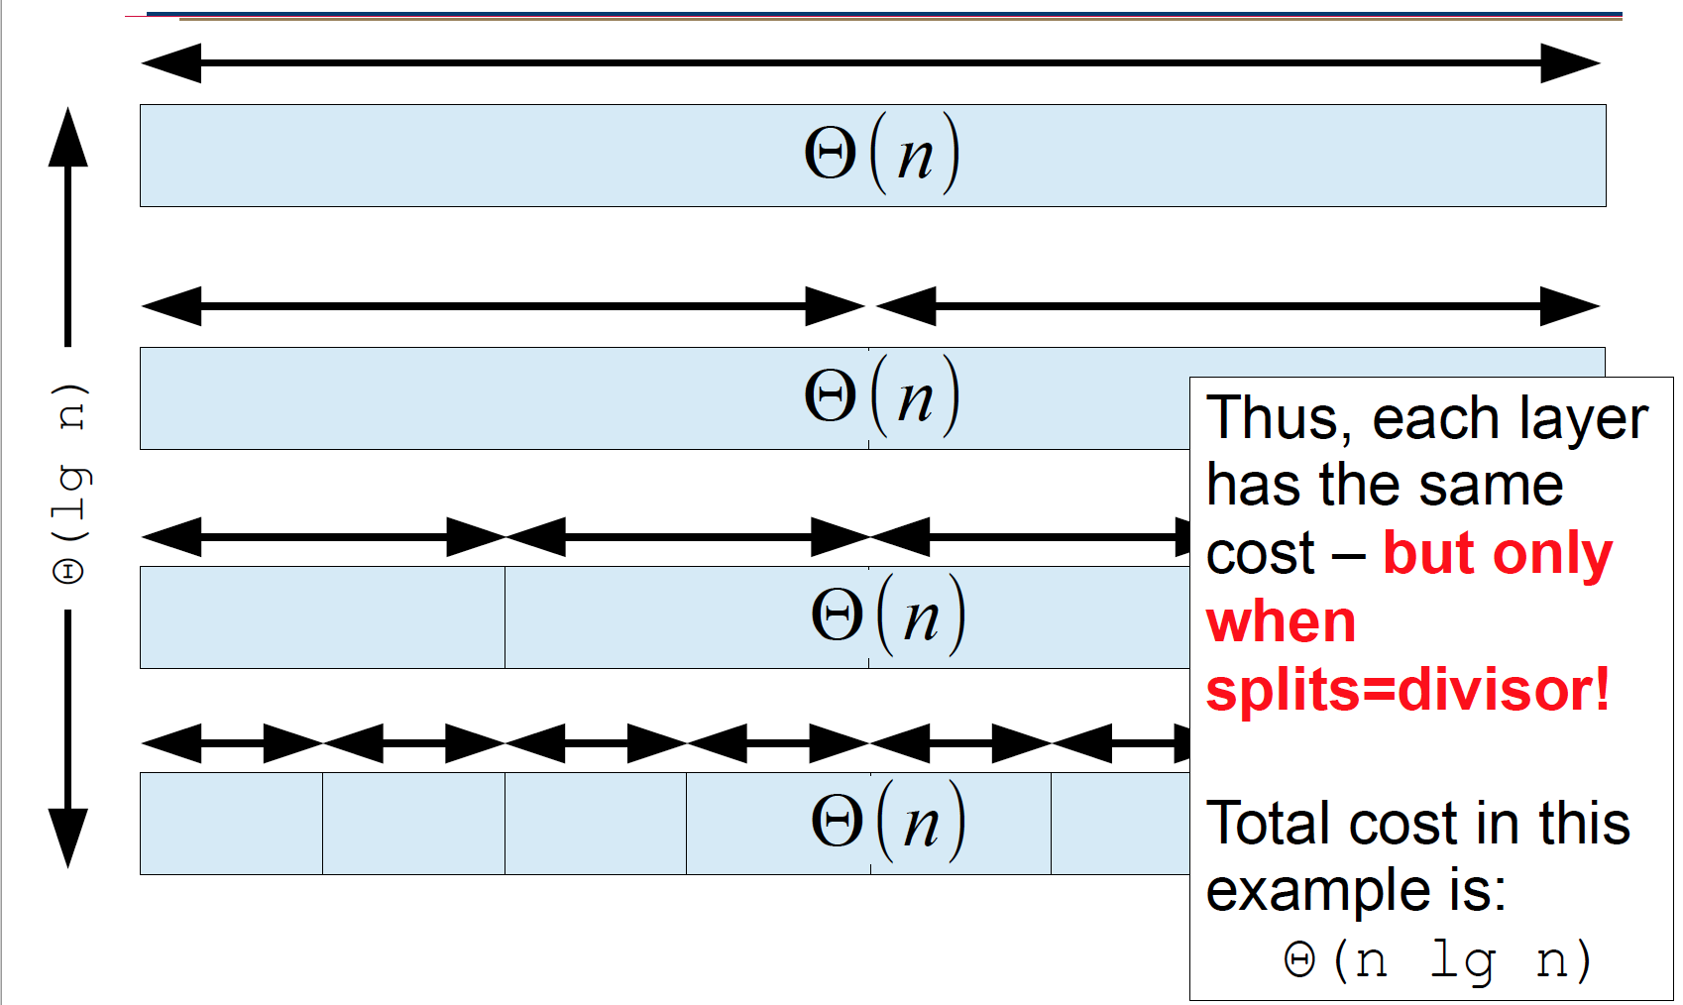
Thinking About Recursive Calls

Slide 12
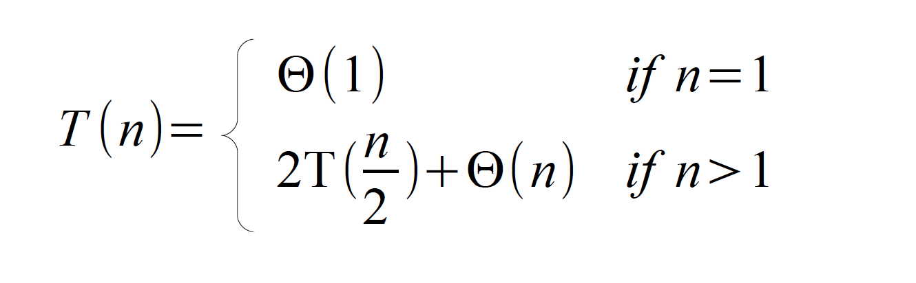
What is a Recurrence?
A “recurrence” is:
An equality (or inequality) describing cost
Defined recursively
Piecewise definition to handle base case

Slide 13
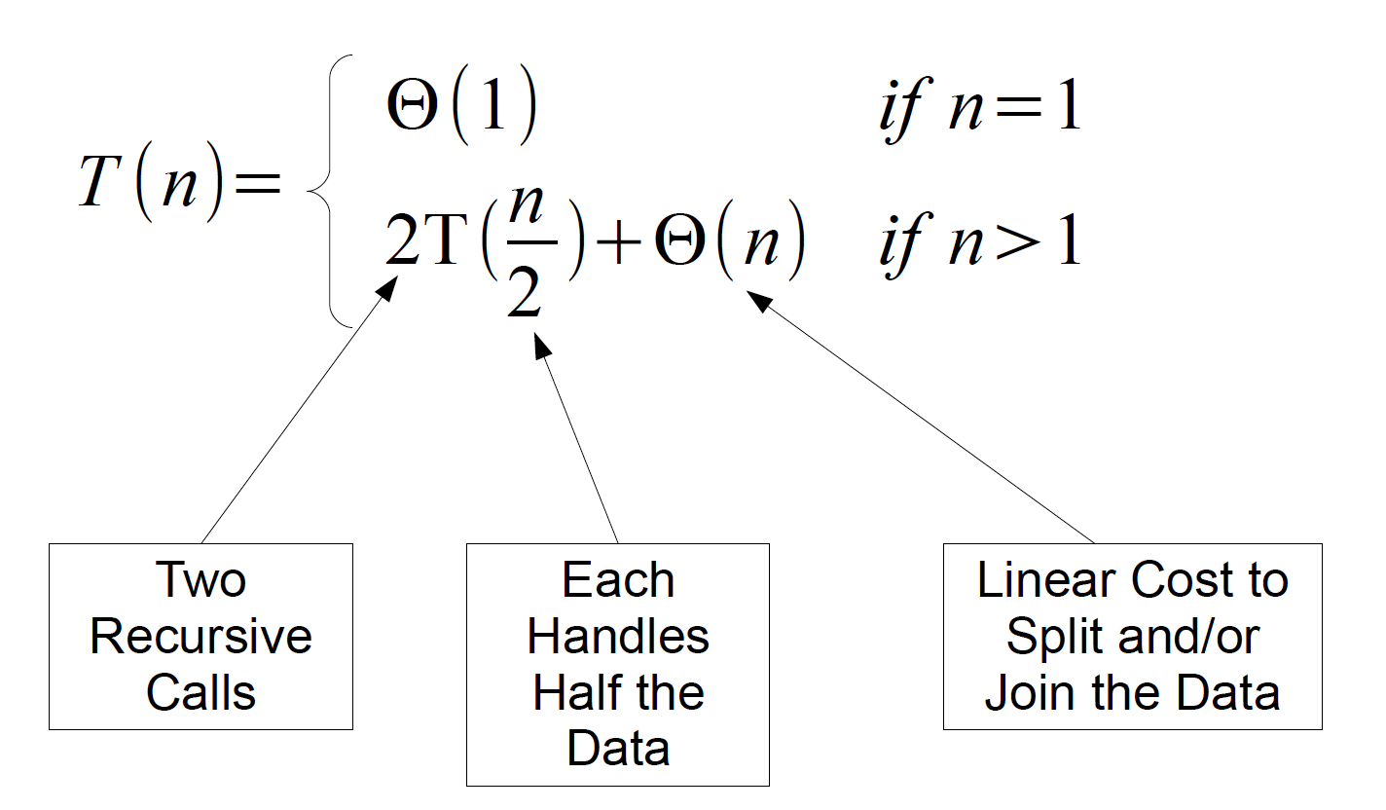
What is a Recurrence?

Slide 14
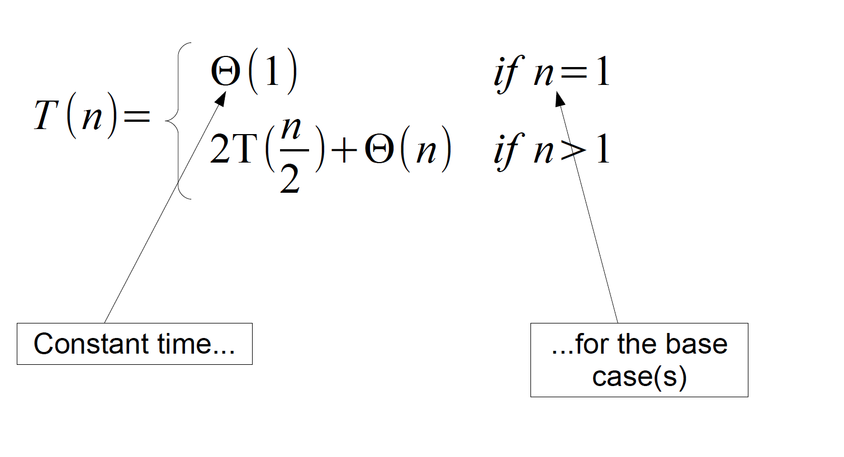
What is a Recurrence?

Slide 15
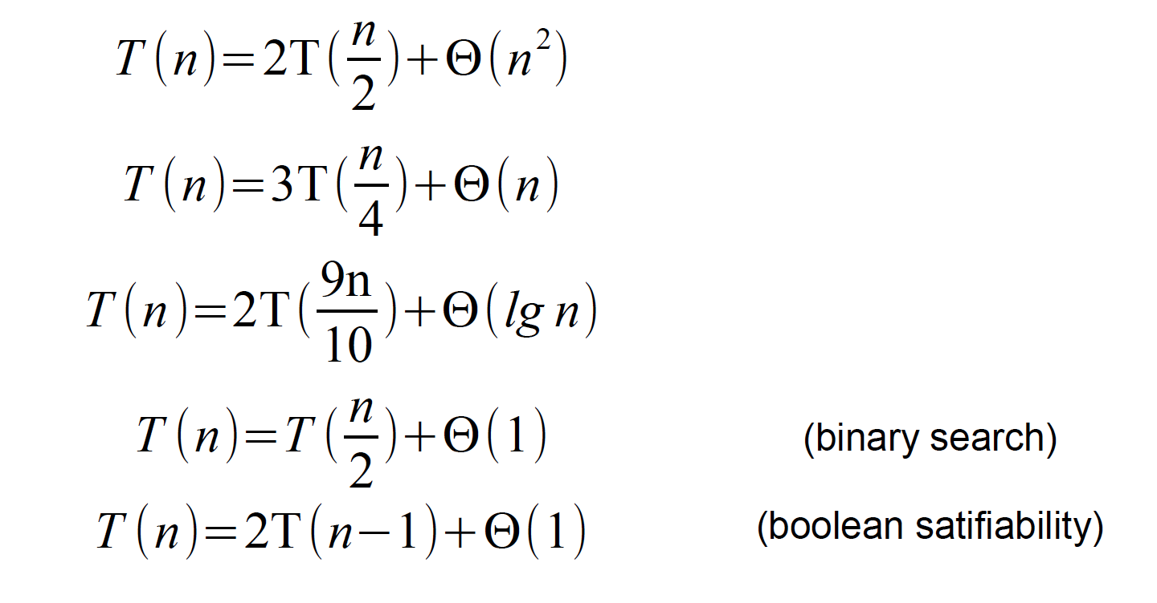
Generalizing

Slide 16
The Recursion Tree Method
To solve a recurrence using a recursion tree:
– Show the cost of each recursive call at each layer
– Sum each layer
– Sum the layers

Slide 17
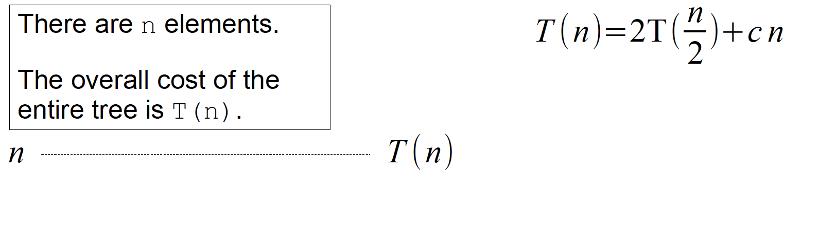
Building a Recursion Tree

Slide 18
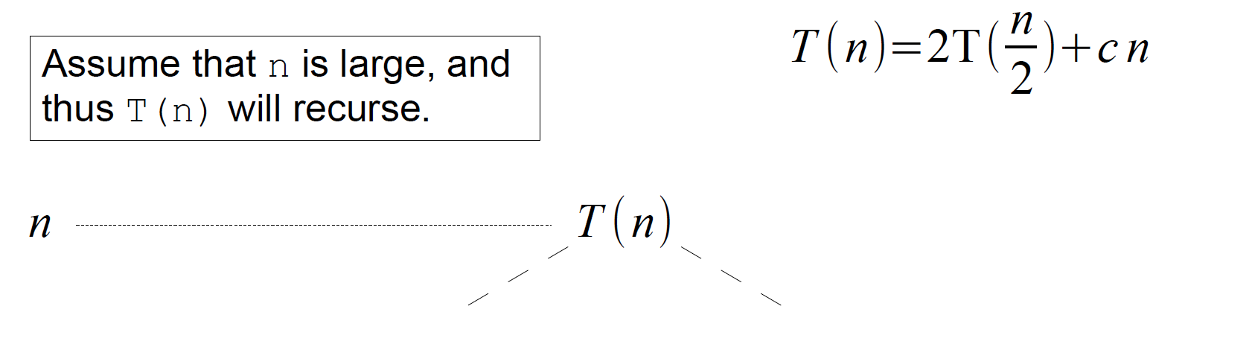
Building a Recursion Tree

Slide 19
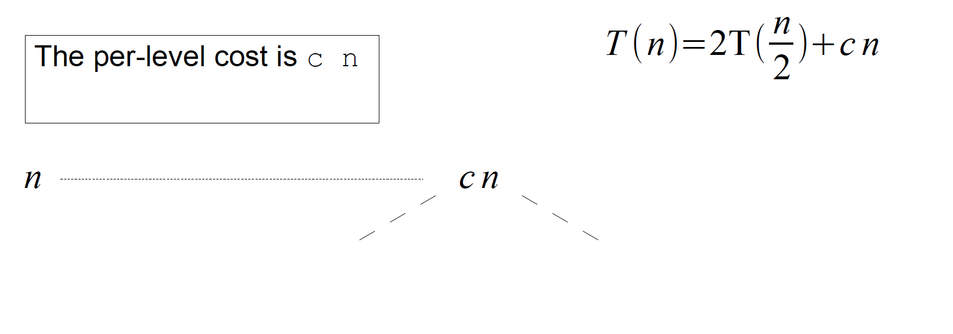
Building a Recursion Tree

Slide 20
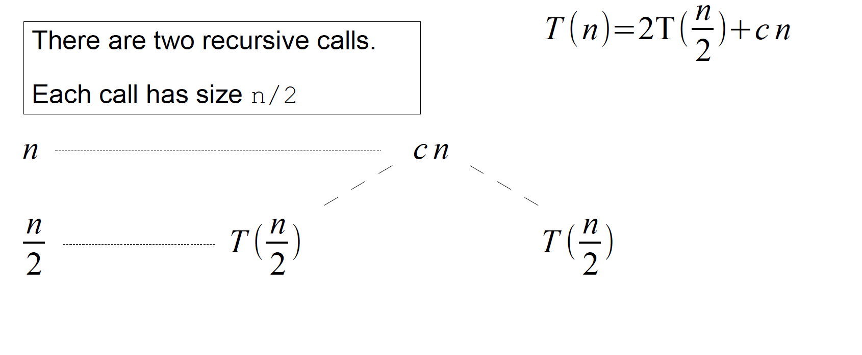
Building a Recursion Tree

Slide 21
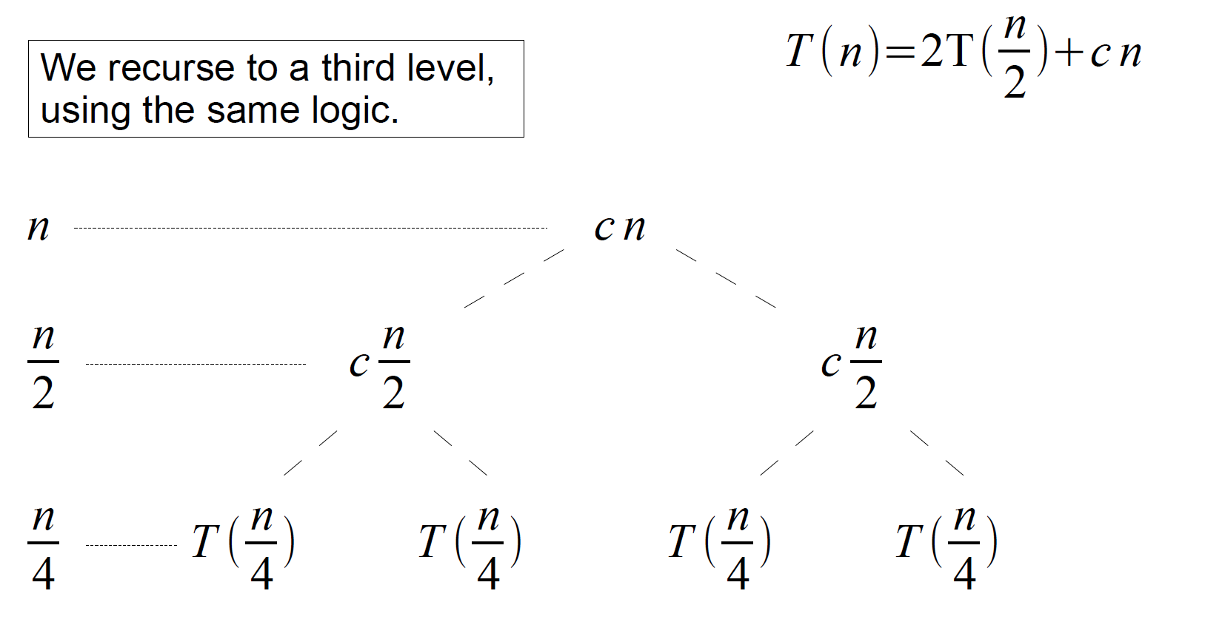
Building a Recursion Tree

Slide 22
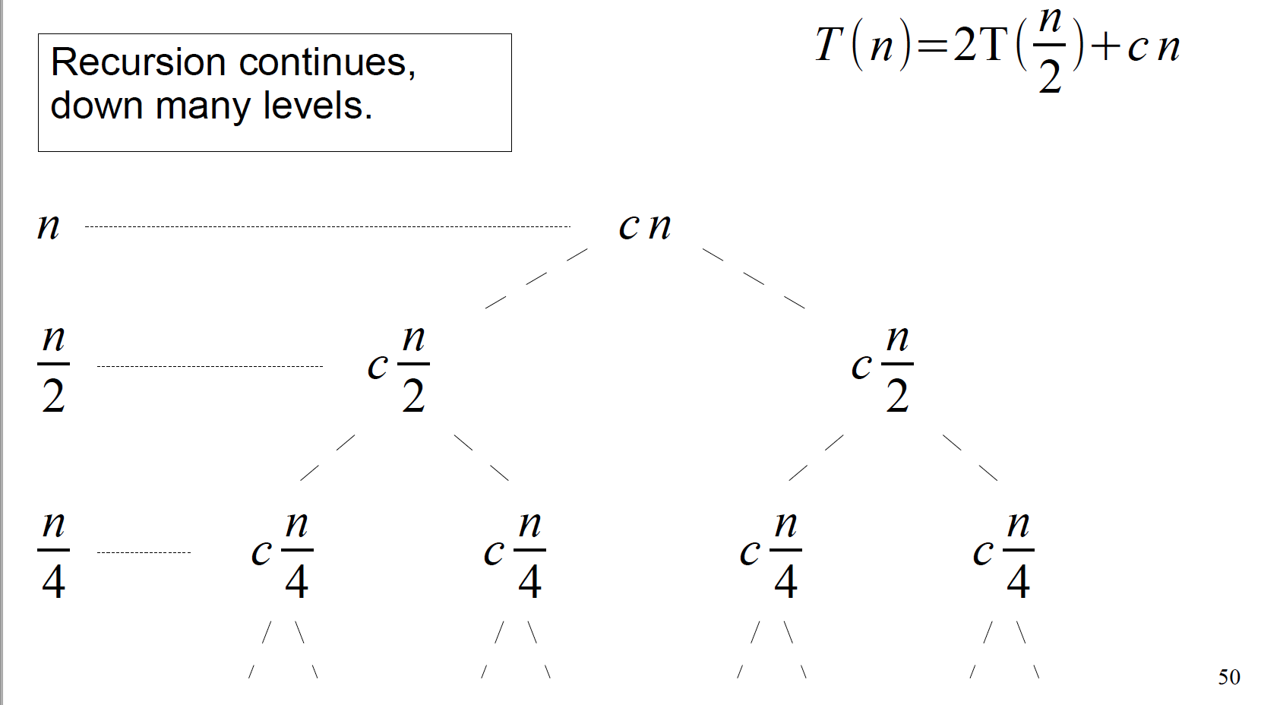
Building a Recursion Tree

Slide 23
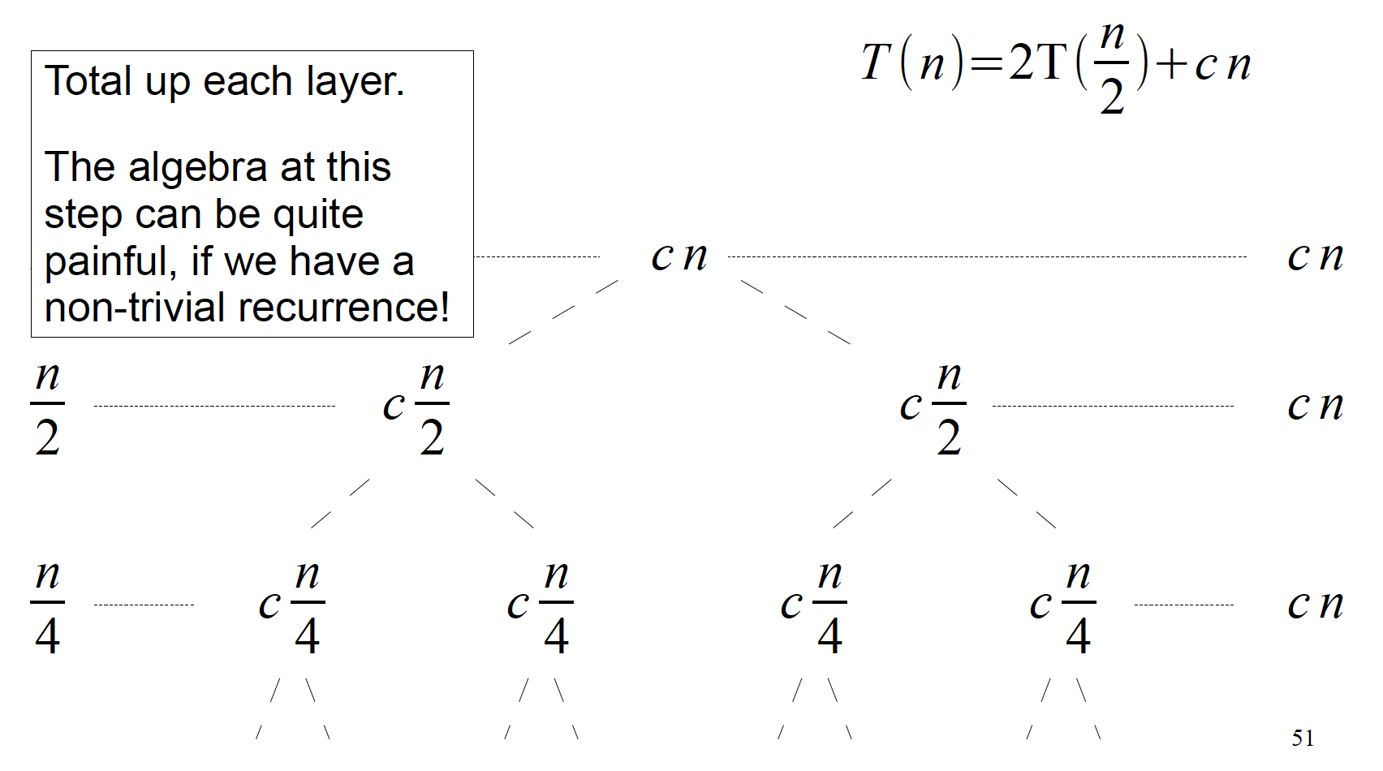
Building a Recursion Tree

Slide 24
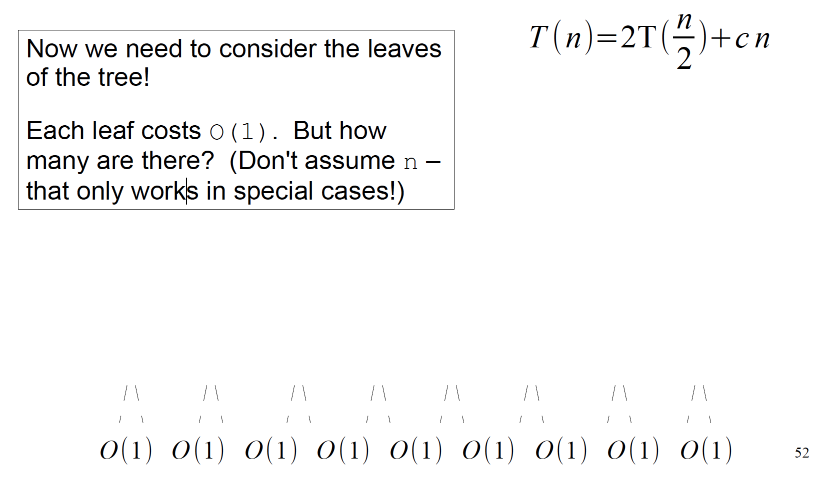
Building a Recursion Tree

Slide 25
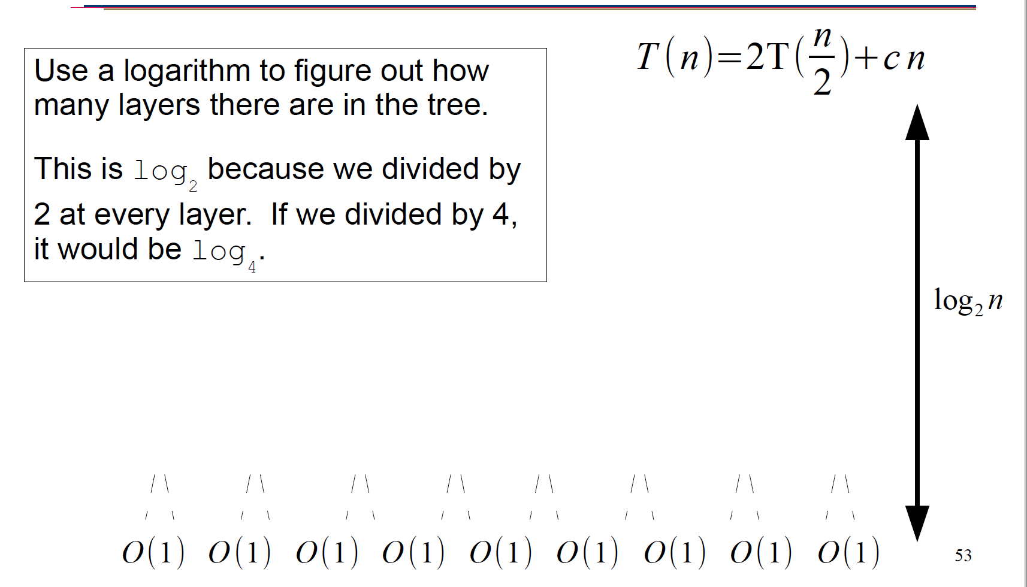
Building a Recursion Tree

Slide 26
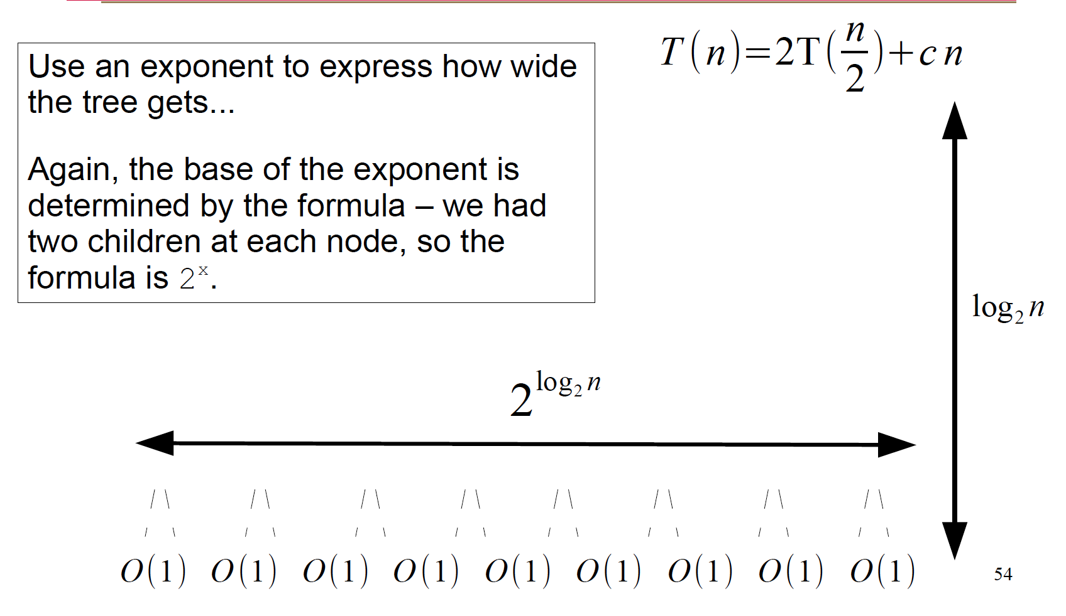
Building a Recursion Tree

Slide 27
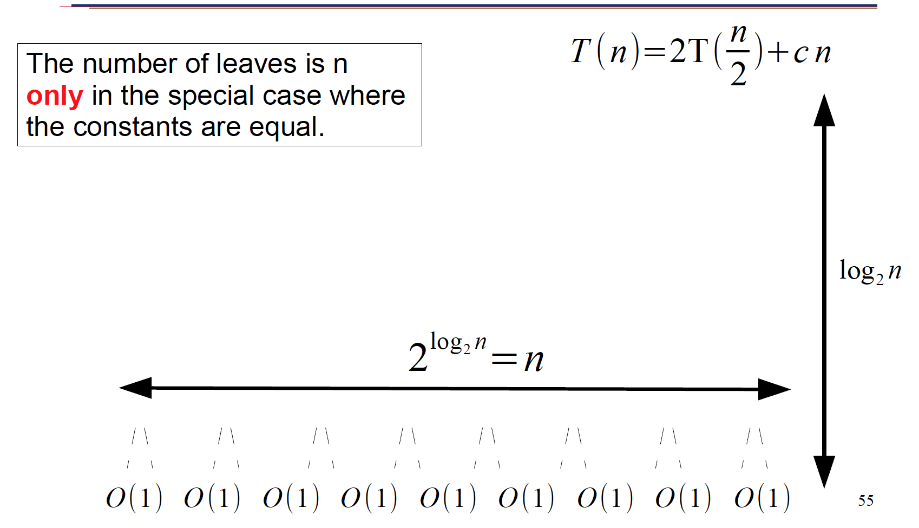
Building a Recursion Tree

Slide 28
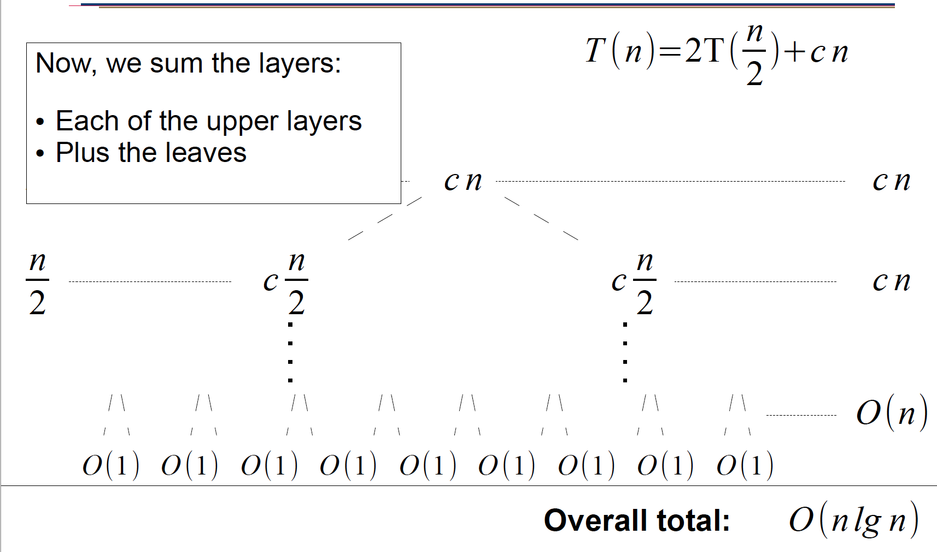
Building a Recursion Tree

Slide 29
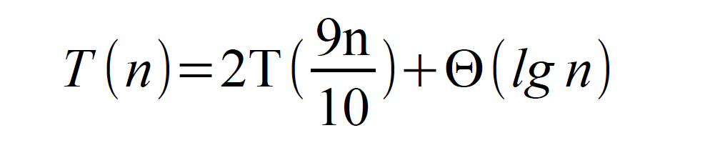
Building a Recursion Tree

Slide 30
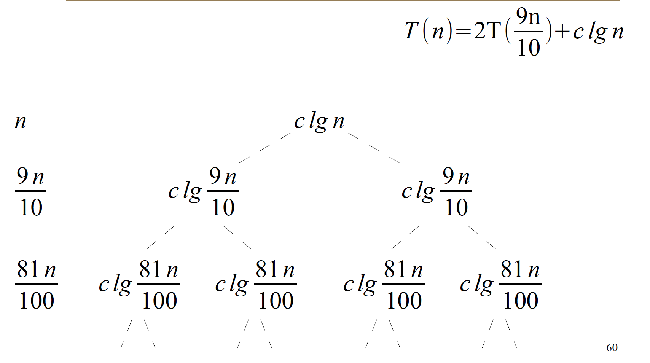
Building a Recursion Tree

Slide 31
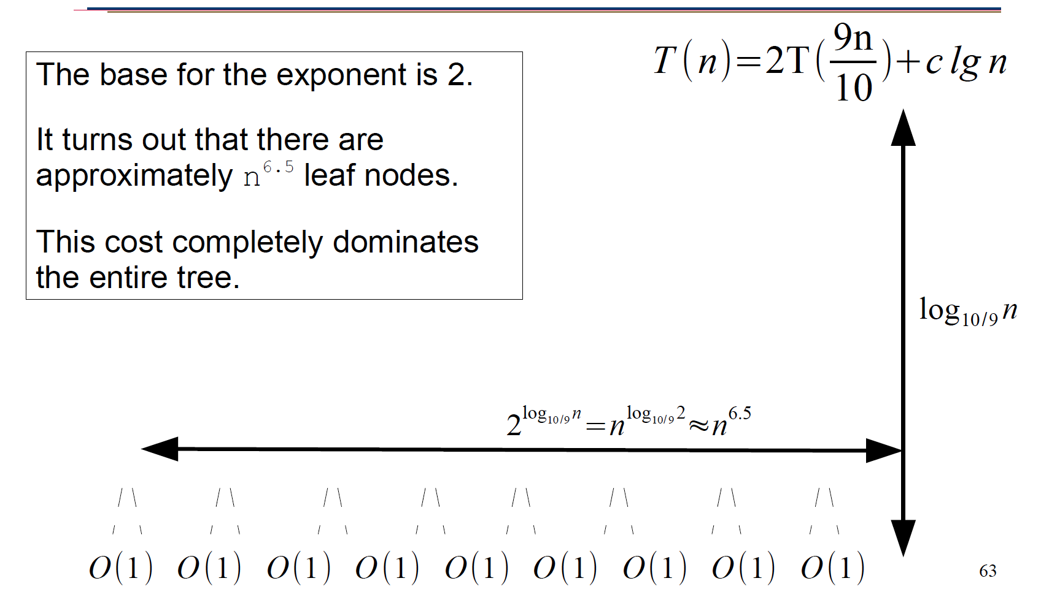
Building a Recursion Tree

Slide 32
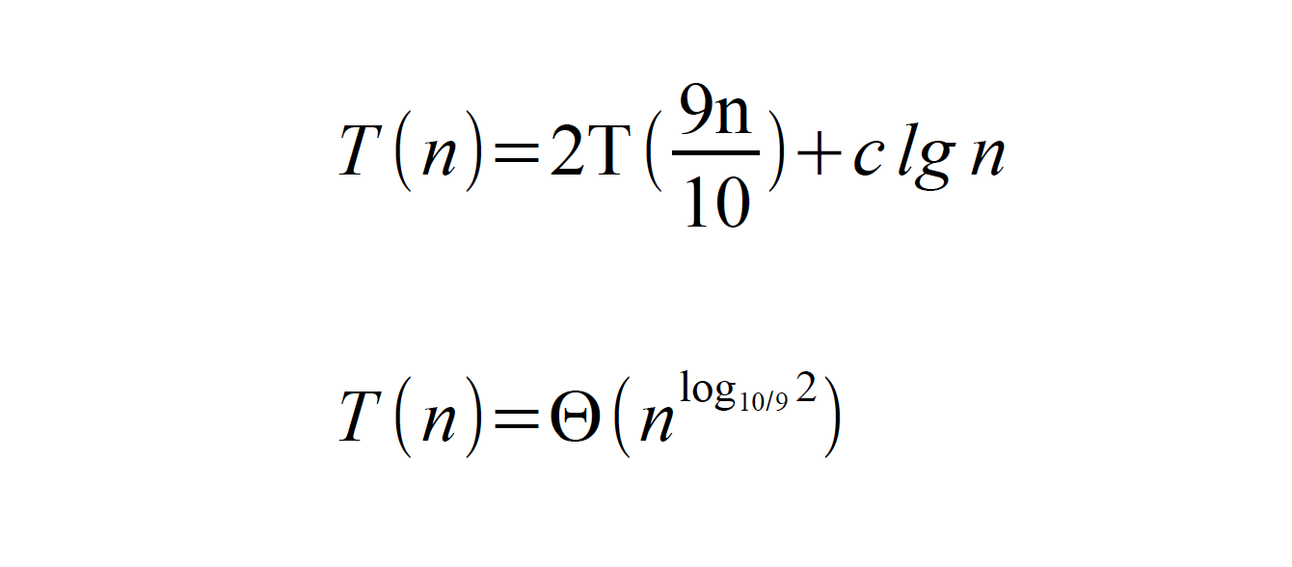
Building a Recursion Tree

Slide 33
Is a Recursion Tree Enough?
We used an approximation in our recursion tree
Do we trust our result?
We could solve it formally

Slide 34
The Master Method
Recursion trees and induction is hard!
Isn't there some easier way?
Welcome to the Master Method!

Slide 35
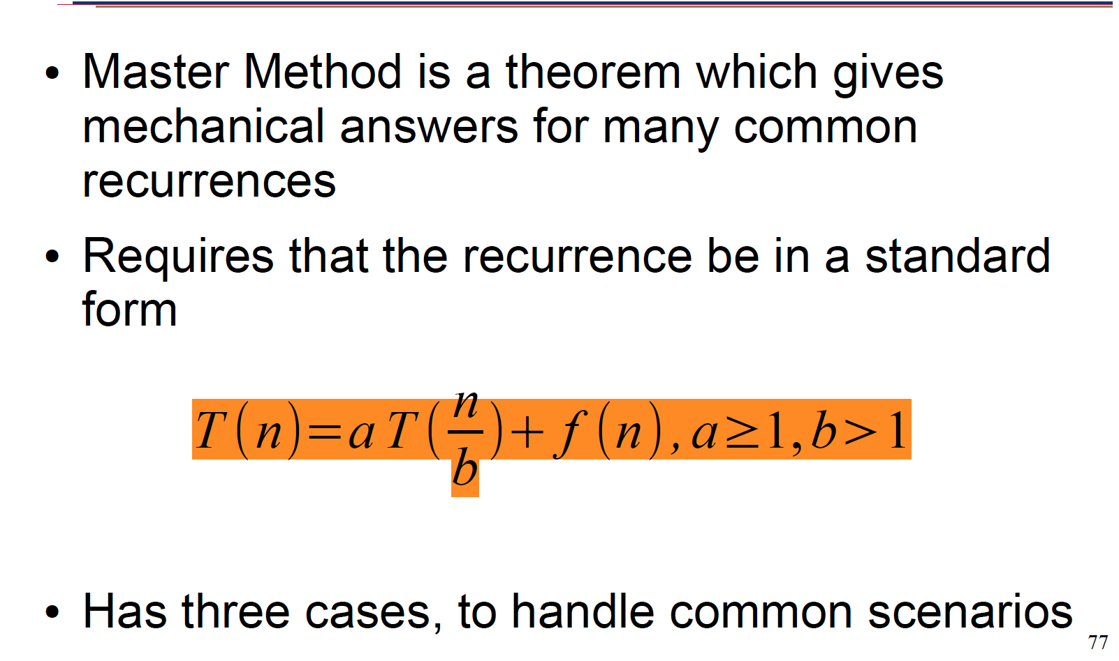
The Master Method

Slide 36
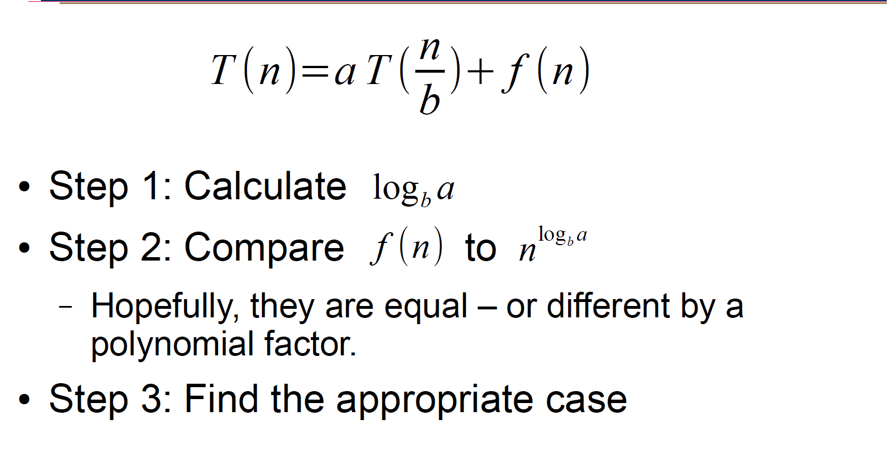
The Master Method

Slide 37
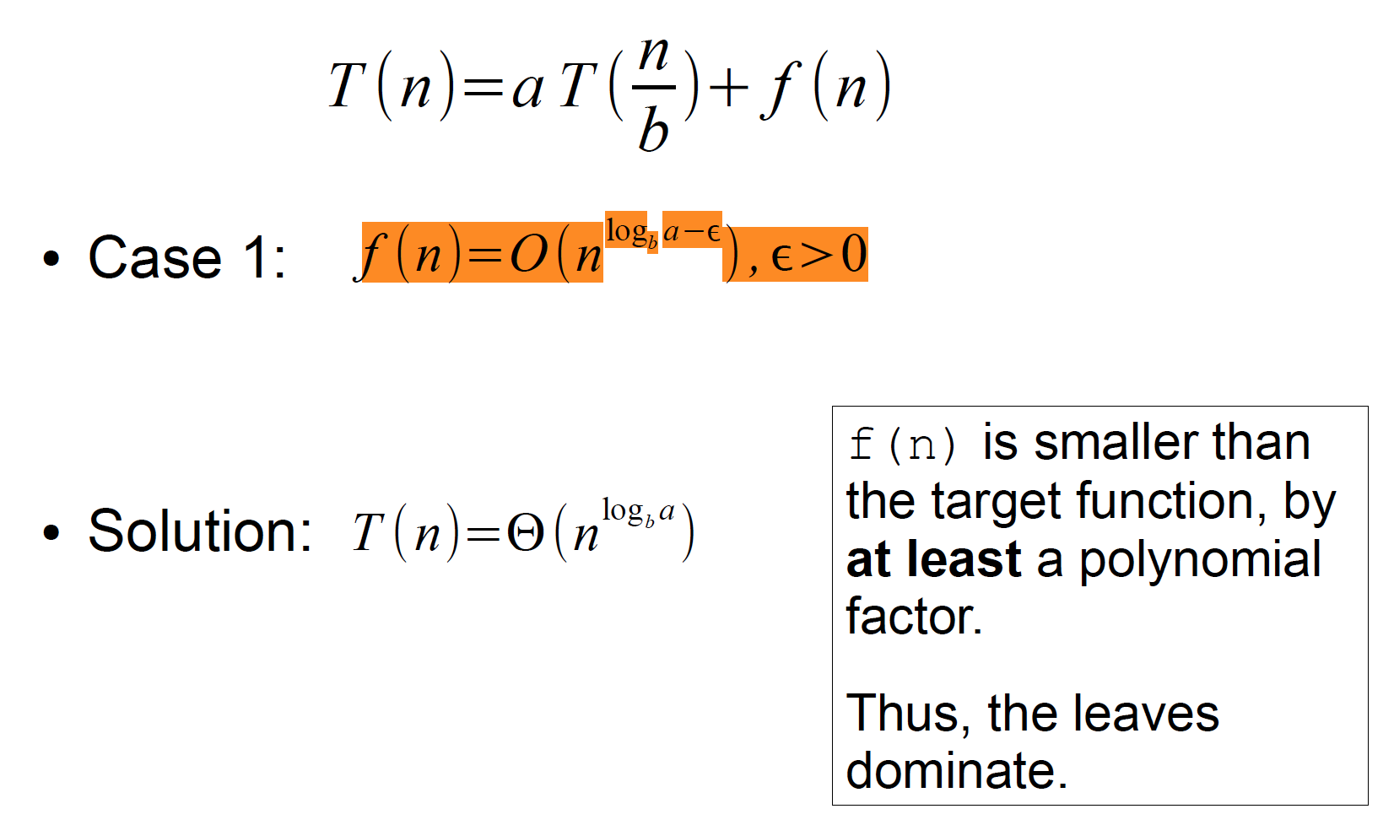
Master Method

Slide 38
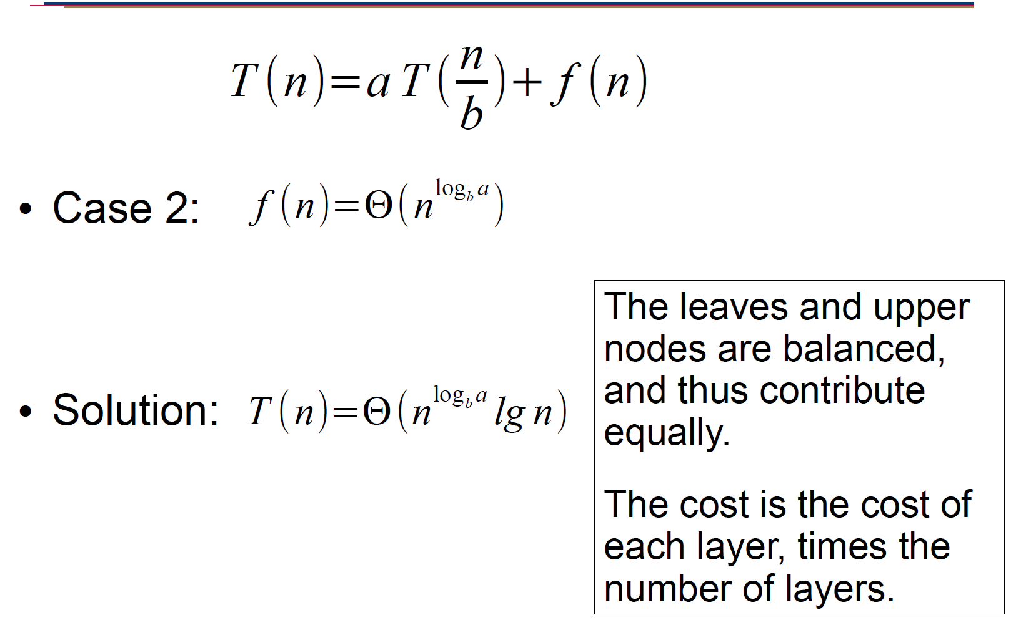
Master Method

Slide 39
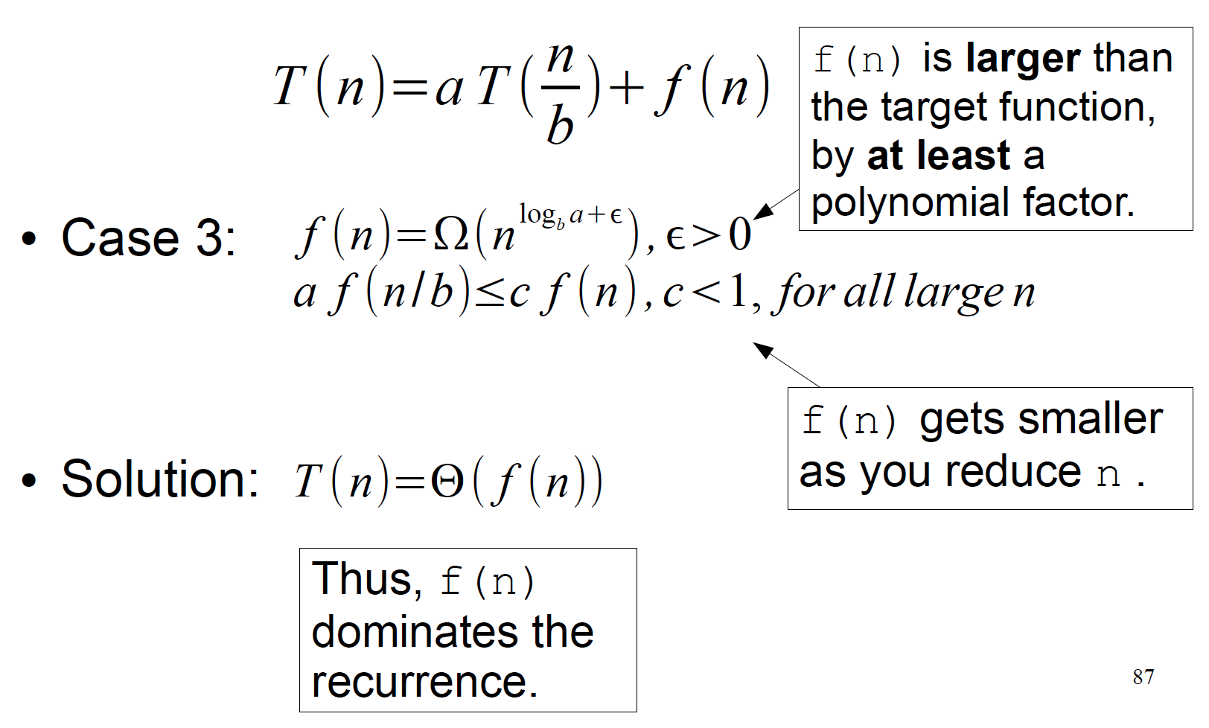
Master Method

Slide 40
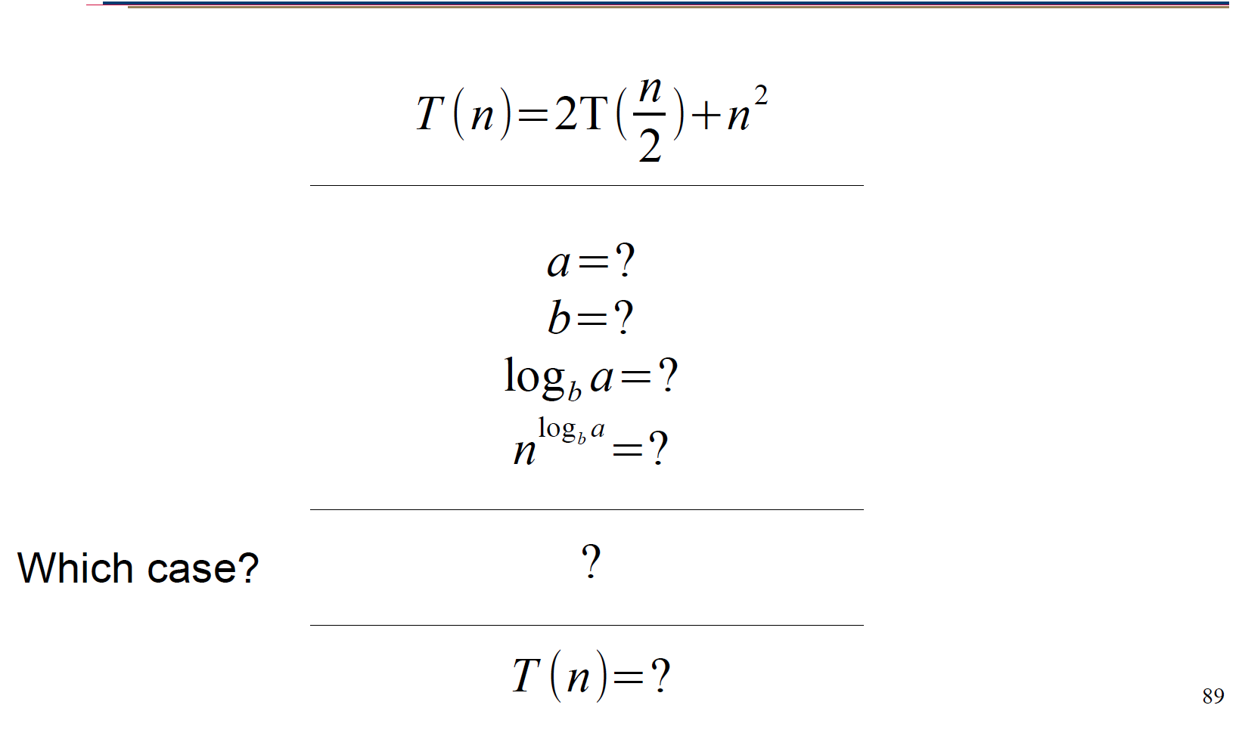
Master Method Examples

Slide 41
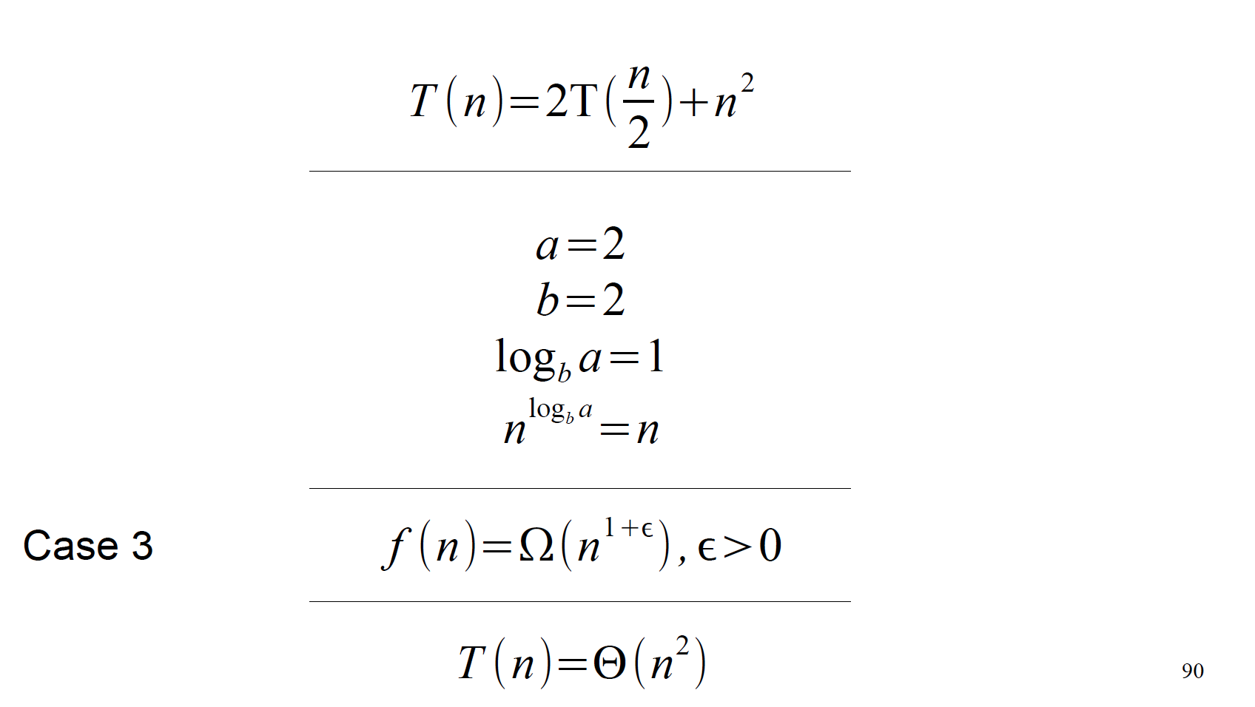
Master Method Examples

Slide 42
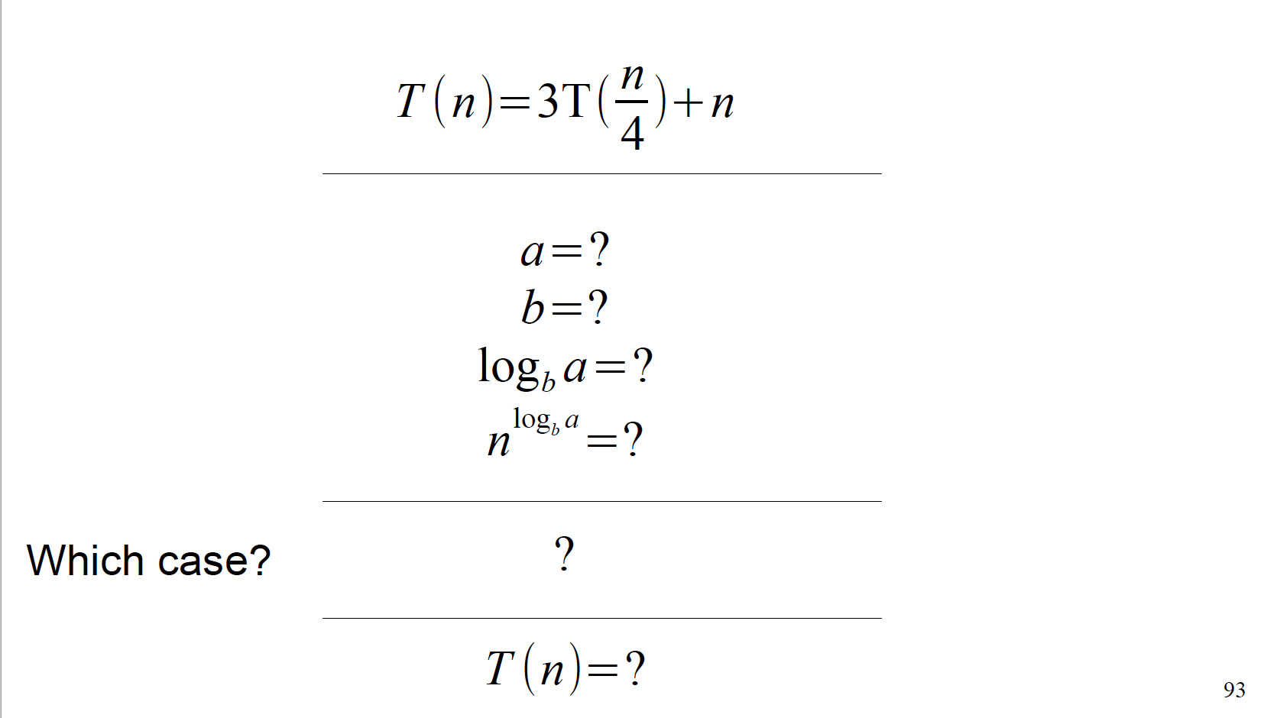
Master Method Examples

Slide 43
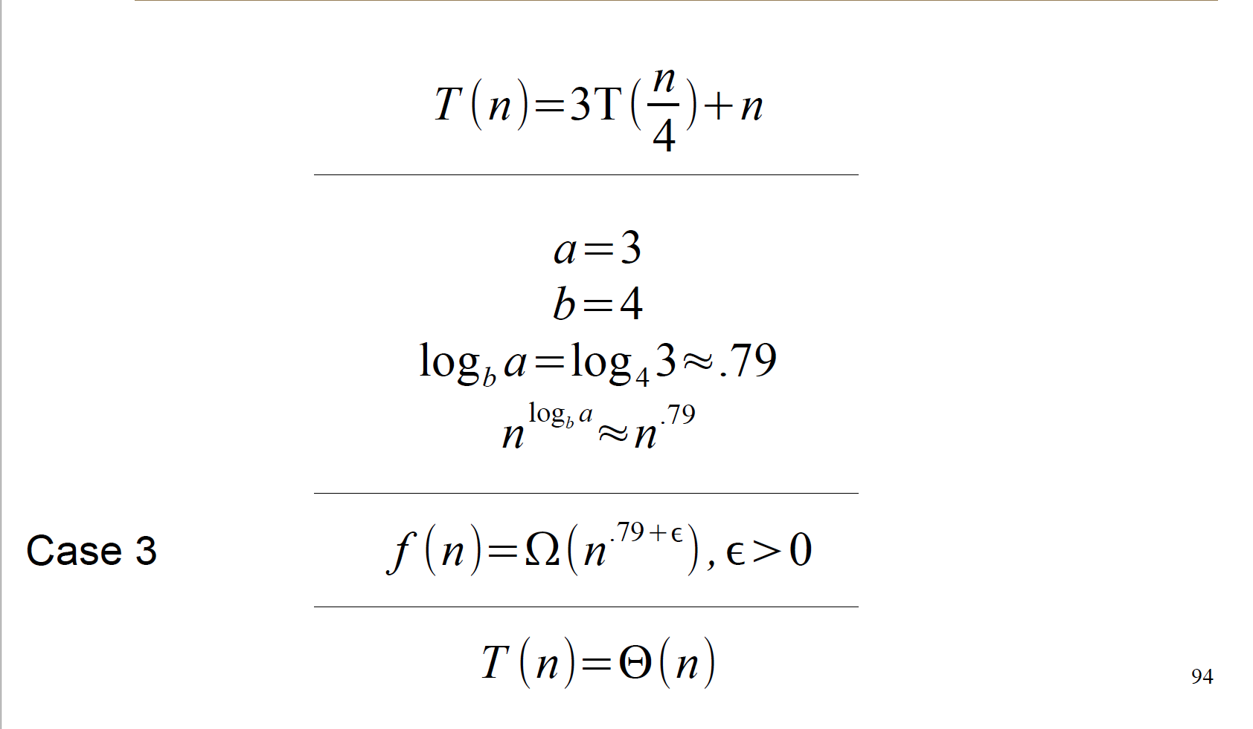
Master Method Examples

Slide 44
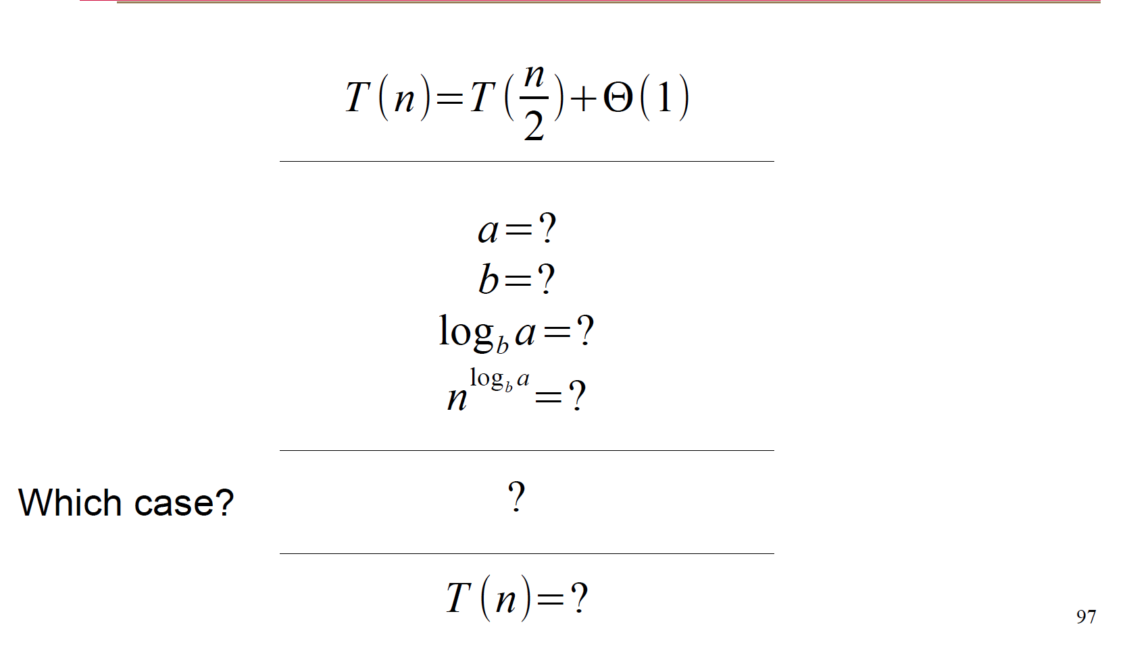
Master Method Examples

Slide 45
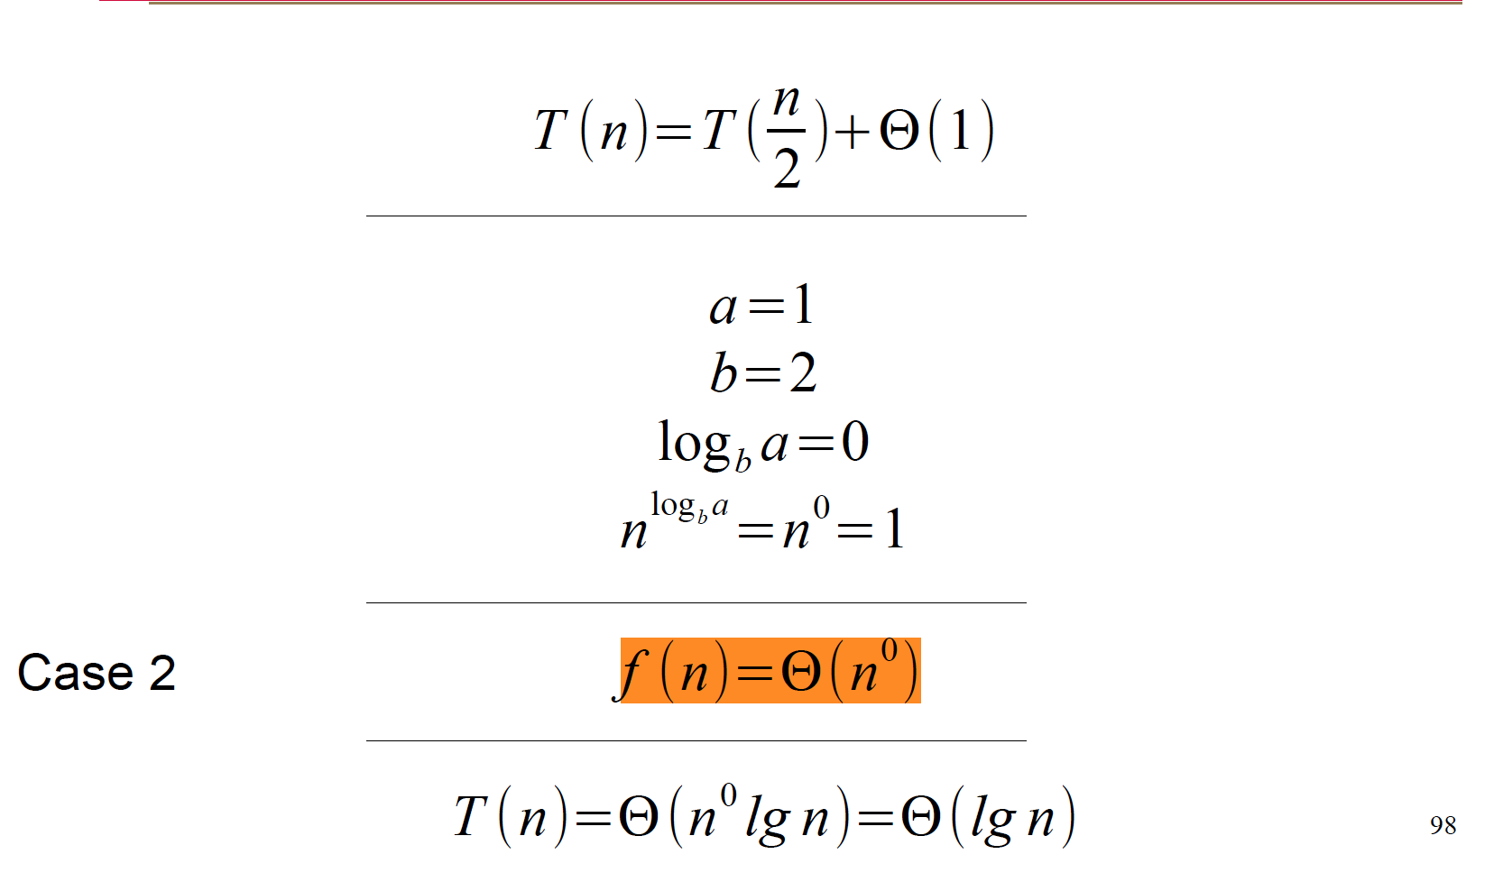
Master Method Examples

