Slide 1

Capstone II home prices
Presented by
Hao tran

Slide 2
Introduction
AB is an investment bank wants to understand how it should allocate dollars earmarked for investment into mortgage-backed securities.
AB wants to look into the factors that drive home prices for their investment.
Can they compete with home prices in the market?
Focus factors: one and two story house style with half bathrooms and full bathrooms.

Slide 3
Project Goal
Is there significantly difference in House style of one story and two story either of the following?
  Full Bathroom
  Half Bathroom

Slide 4
Hypotheses
Null Hypothesis 1 (H₀):
There is no significant difference in house style with full bath.
Alternate Hypothesis 1 (H_{a}):
There is significant difference in house style with full bath.
------------------------------------------------
Null Hypothesis 2 (H₀):
There is no significant difference in house style with half bath.
Alternate Hypothesis 2 (H_{a}):
There is significant difference in house style with half bath.

Slide 5
Process
Collect data on both one story and two story house style with full bath and half bath from provided data.
Conduct A/B style t test statistical analyses to see if there is any statistically significant difference between half bath or full bath of house style one story and two story.

Slide 6
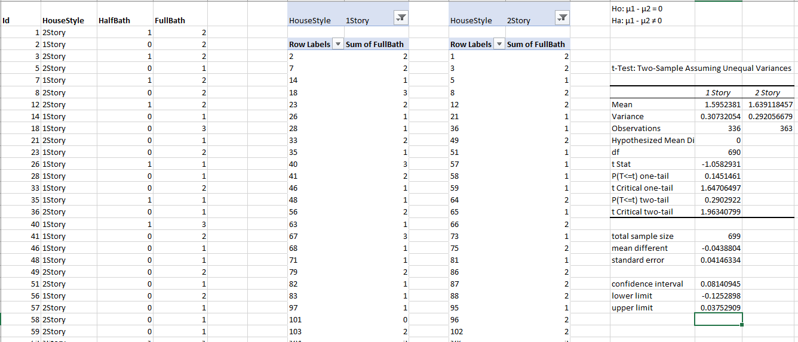
Analysis of Full Bath
With p = 0.29, this difference is not significant at the < 0.05 level. With 95% confidence, the difference is between -0.125 and 0.03 difference in means. The null hypothesis is not rejected.
Conclusion:
There is no significant difference between one story and two story house styles when it comes to houses with full bathrooms.

Slide 7
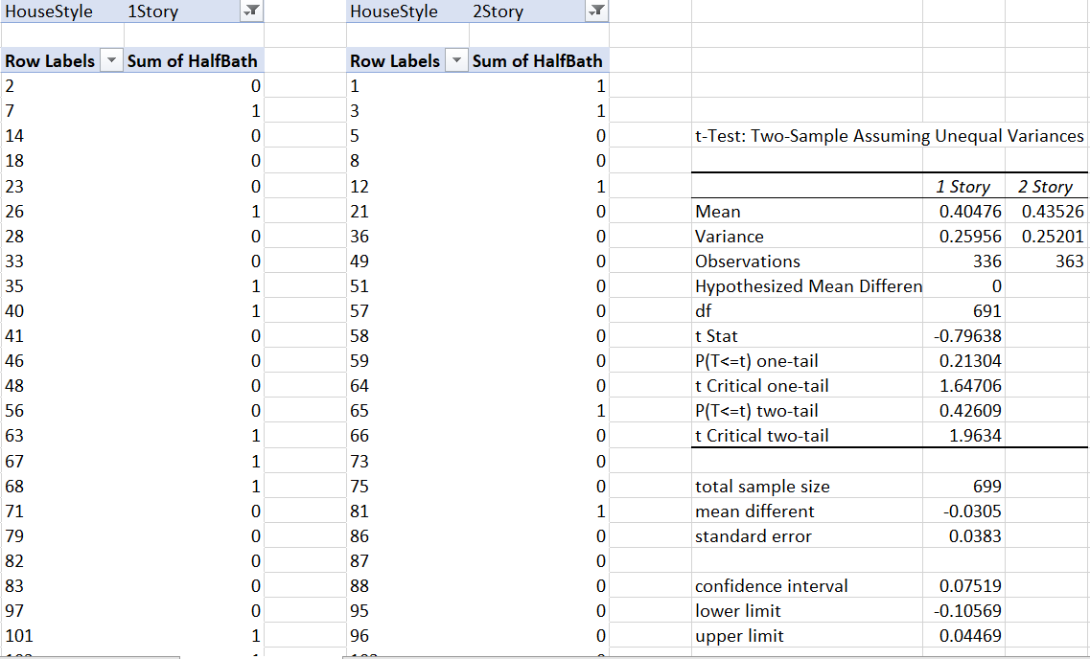
Analysis of half bath
With p = 0.426, this difference is not significant at the < 0.05 level. With 95% confidence, the difference is between -0.105 and 0.04 difference in means. The null hypothesis is not rejected.
Conclusion:
There is no significant difference between one story house and two story house styles with half bathrooms.

Slide 8
Recommendations:
The statistical analyses showed that one story and two story house style:
1. Does not have a significant impact on house style with full bath.
2. Does not have a significant impact on house style with half bath.
Recommendation:
Full bathroom house > half bathroom house in value.
Two story house with full bathroom > two story house with half bathroom in value.
Increase the house price for houses with full bath with one story and two story house.
Begin house market research to come up with good estimate for competitive price.

Slide 9
Q & A
THANK YOU

