Slide 1

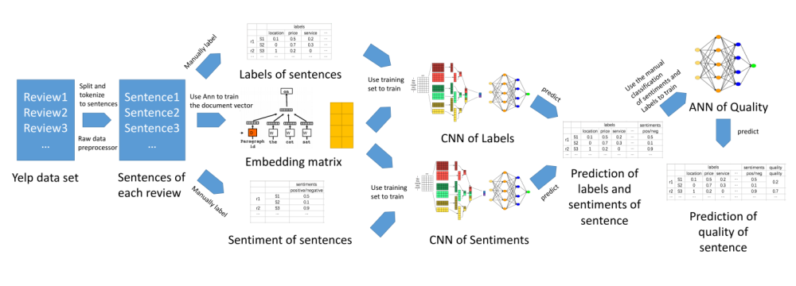
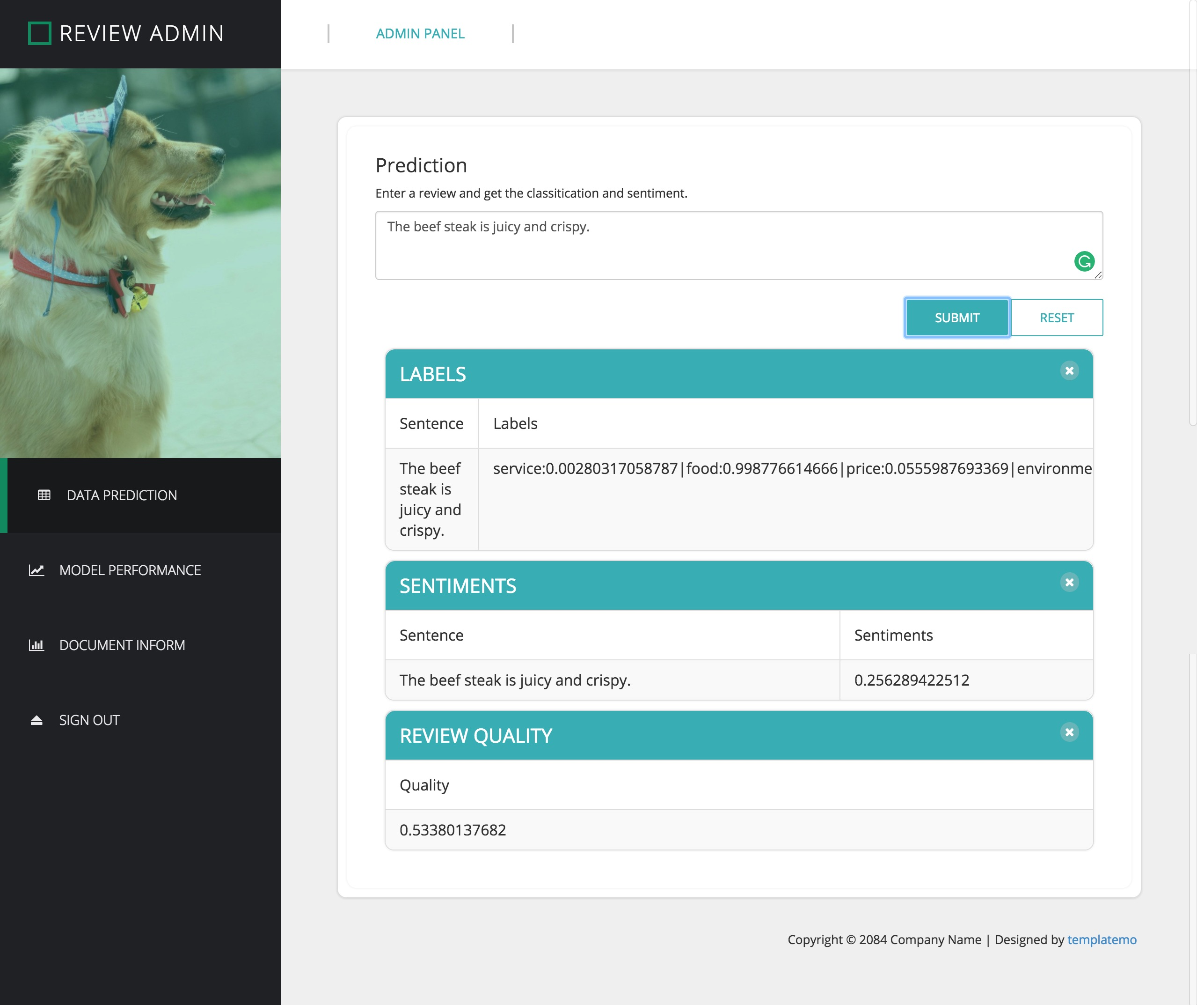
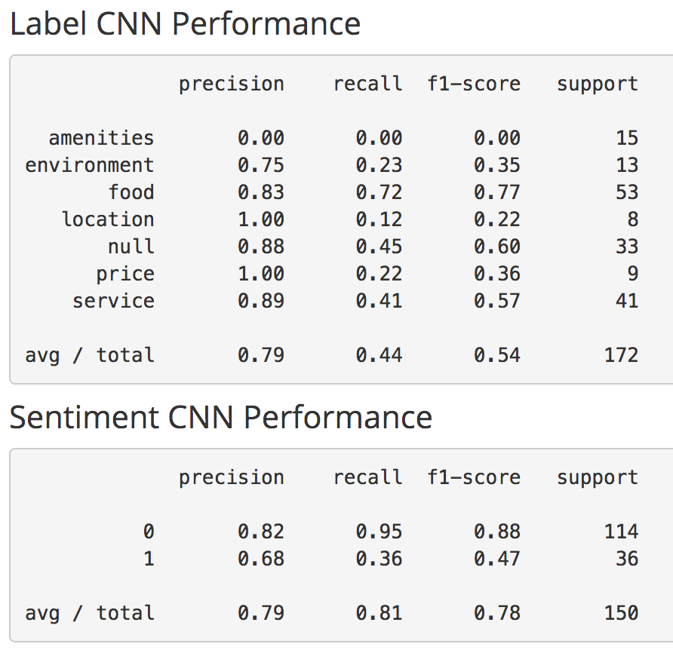
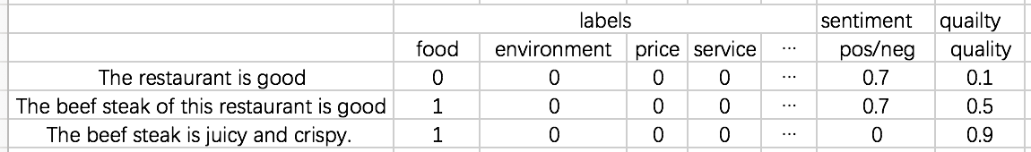
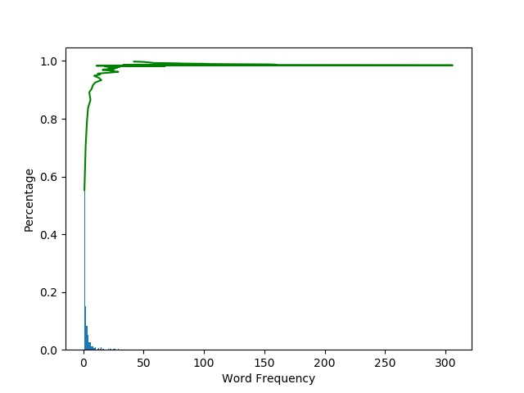
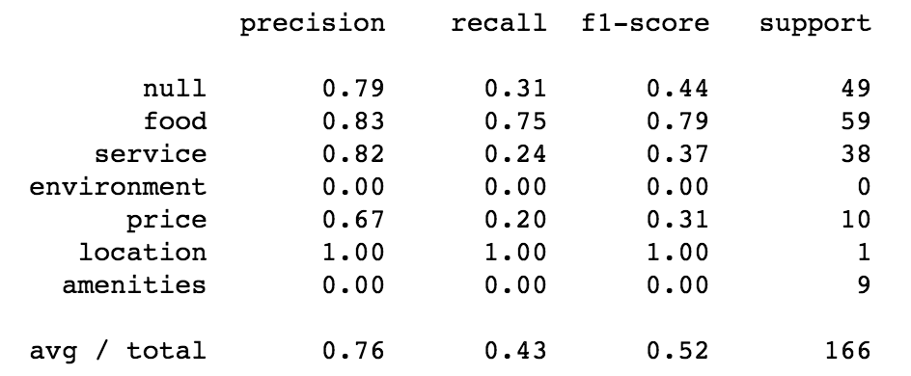
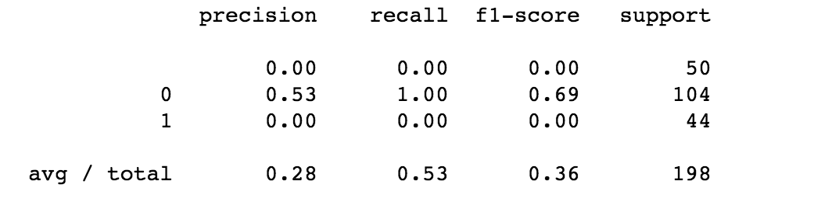
A Tool For Discovering High Quality Reviews
Zijing Huang, Po-Hsun Chen, Hao-Wei Chen & Chao Shu
Instructor: Rong Liu
Business Intelligence & Analytics
Motivation
For Customers:
Customers are more likely to read reviews with details instead of reviews that were written to just vent emotions.
For Companies:
  Objective reviews are helpful in improving their products.
  High-quality reviews can increase customer engagement and attract more users.
Introduction
Objective: A tool for discovering high quality reviews
High quality review: objective and supply insightful details about user experience.
Dataset: Yelp hotel and restaurant reviews
  Raw data: 4736897 reviews
  Data with labeled aspects and sentiment: 1132 sentences
Methodology: Deep learning with Convolutional Neural Networks (CNN) and Word Embedding
Approach
Use Yelp raw data to train word vectors that capture word semantics
Create a CNN to identify aspects from every sentence of a review
Train another CNN to detect sentiment of each sentence
Build an a neural network model to predict the quality of a review base on aspects and sentiment of its sentences.
Compare this approach with other models (SVM, Naïve Bayes …) and analyze the pros and cons of each model
Visualize the result through user interface and publish a python package (or a Restful API) for third party use
Methodology
High Quality vs. Low Quality
Result
Suppose we have the following 3 reviews.
Which can help you make a better decision.
The restaurant is good
The beef steak of this restaurant is good
The beef steak of this restaurant is juicy and crispy.
Intuitively, you may think the 3rd sentence is the best, because it gives more information and details about
why the restaurant is so good, and it is relatively objective. But how can we quantify the detail and sentiment of the reviews? Our answer is as below:
Prediction of review’s quality
Performance of CNN classification
The score of labels against a sentence represent the relativity between the sentence and the label. The score of sentiments represent how subjective the sentence is. If we have more score on labels and less score on sentiments, then we will have a review with higher quality.
Information about the document
Performance of Naïve Bayes classification
http://www.stevens.edu/howe/academics/graduate/business-intelligence-analytics

