Slide 1
CS 513 Data Mining
Final Presentation
Medical Appointment No Shows
Why do 22% of patients miss their scheduled appointments?
Zijing Huang, Po-Hsun Chen,
Hao-Wei Chen, Ben-Jen Cheng
Department of Computer Science
2017.12.05

Slide 2



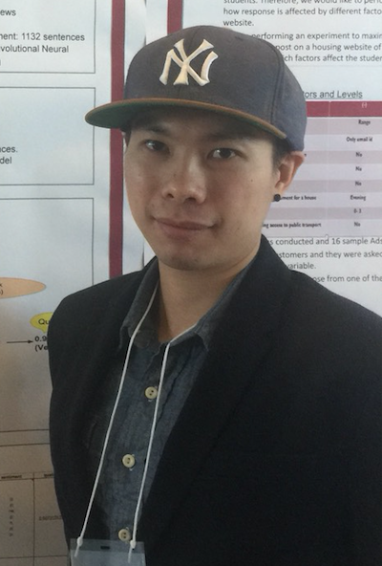
Presenters
Zijing Huang
Po-Hsun Chen
Ben-Jen Cheng
Hao-Wei Chen

Slide 3
Introduction (1/2)
The data includes 110527 medical appointments of the public healthcare of the capital city of Espirito Santo State - Vitoria - Brazil
The data contains patients’
Gender
Date of booking appointment
Schedule Date
Age
Whether or not having scholarship, hypertension, diabetes, alchoholism, handicap and getting text message received
The data are from Kaggle, dataset from: https://www.kaggle.com/joniarroba/noshowappointments/downloads/KaggleV2-May-2016.csv

Slide 4
Introduction (2/2)
Data Cleaning
Data Cleaning
Data Cleaning
Feature Selection
Building Model
KNN
Naive Bayes
C50
Random Forest
Neural Net
Conclusion

Slide 5
First Step: Data Cleaning (1/8)
1.0 Data Overview
Typos
Empty Values
Irrelevant or redundant parts of data
GOAL: Make sure all the data we need is accurate and will not influence the overall result.

Slide 6
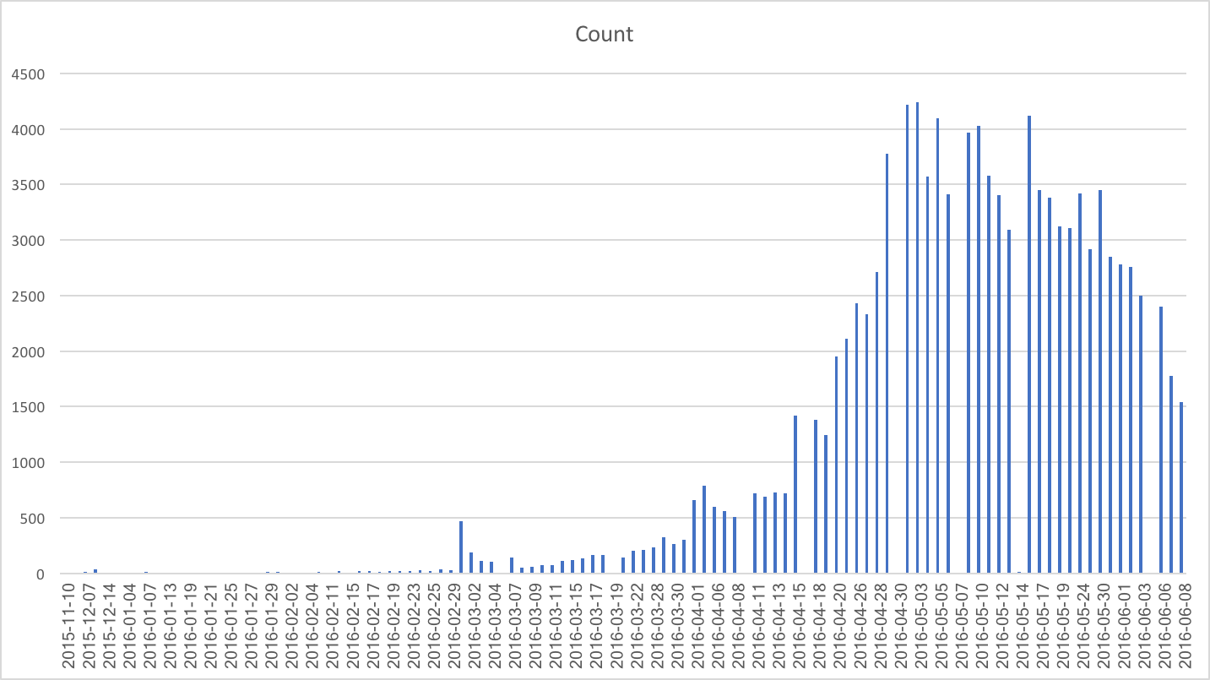
First Step: Data Cleaning (2/8)
1.1 ScheduledDay

Slide 7
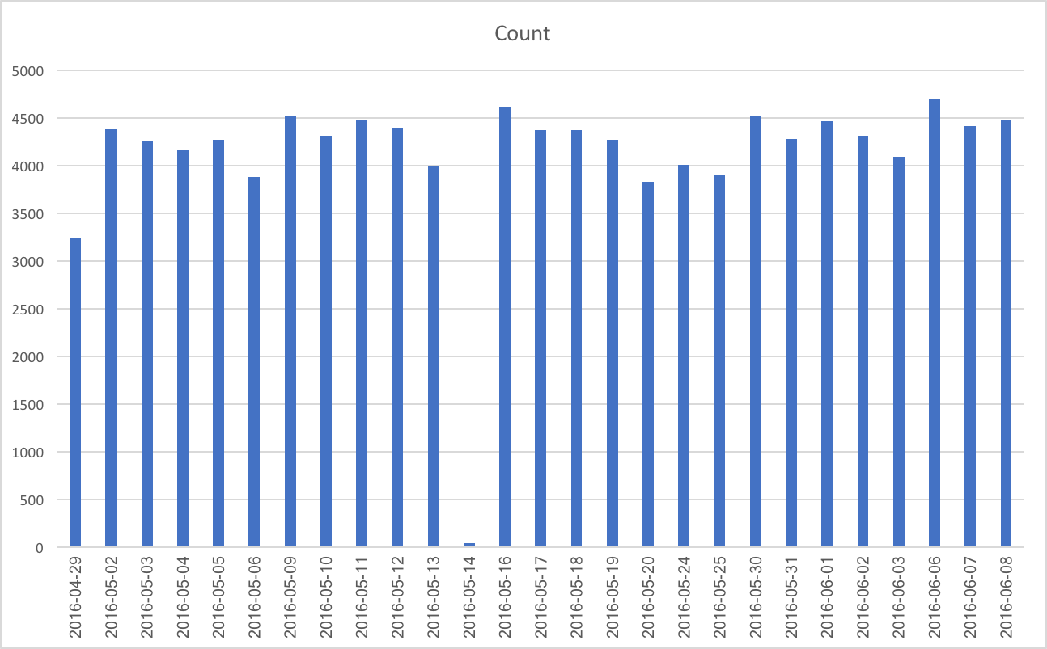
First Step: Data Cleaning (3/8)
1.2 AppointmentDay

Slide 8
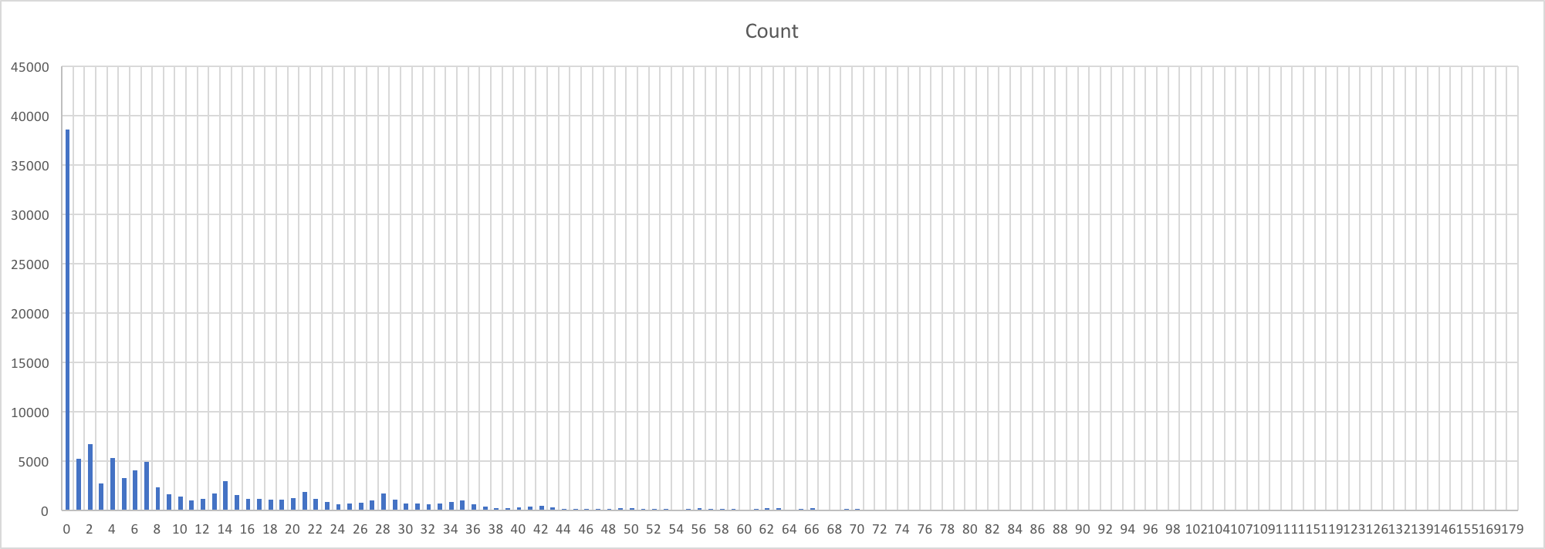
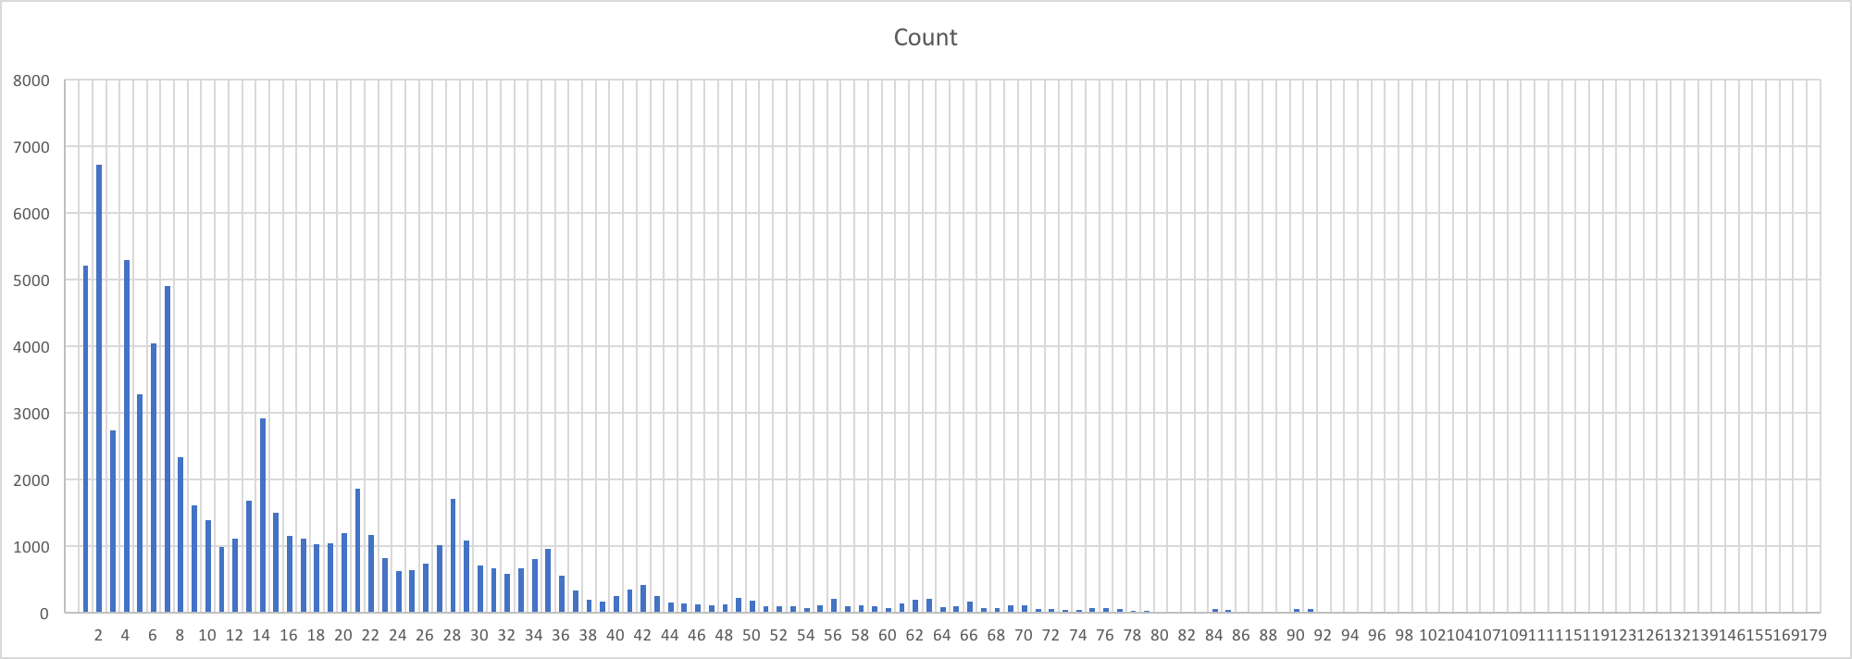
First Step: Data Cleaning (4/8)
1.3 Day interval between ScheduledDay & AppointmentDay
Exclude 0 interval (only for comparison)
Less than 100

Slide 9
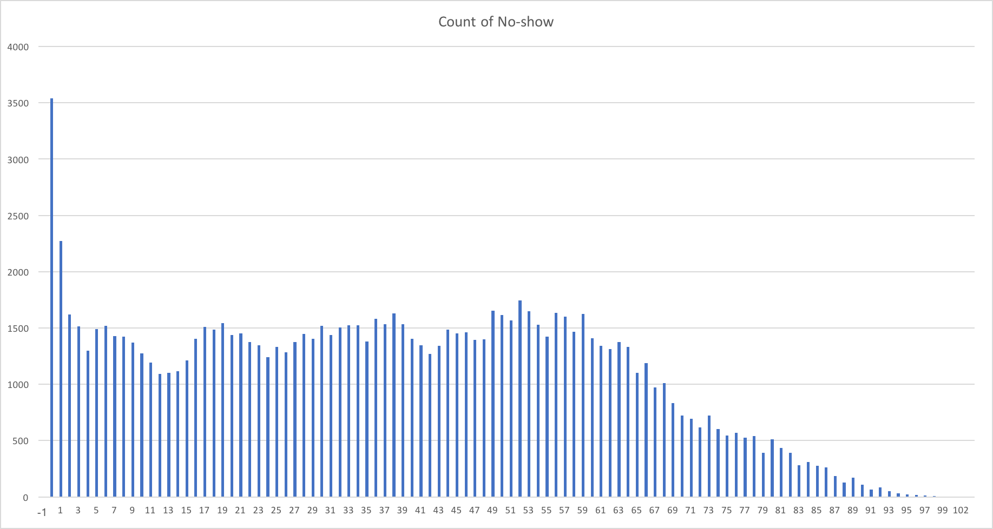
First Step: Data Cleaning (5/8)
1.4 Age

Slide 10
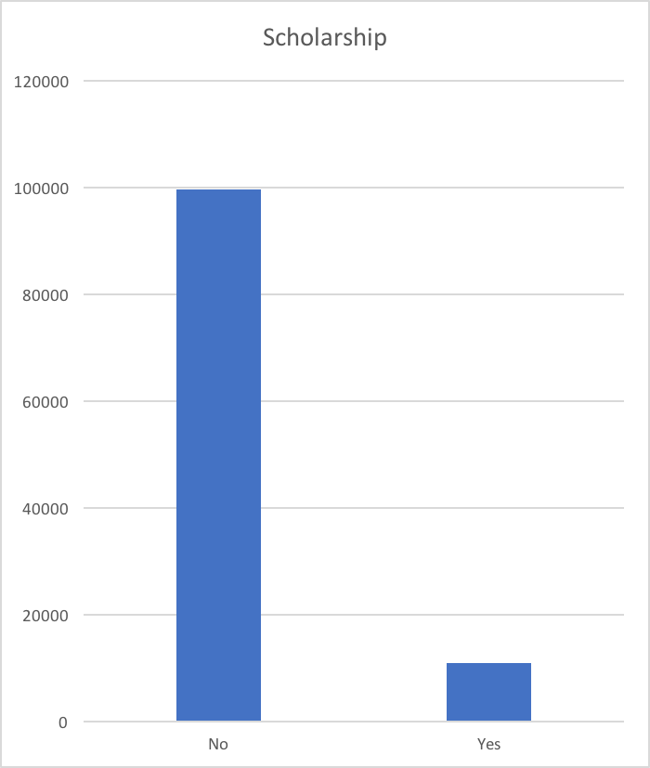
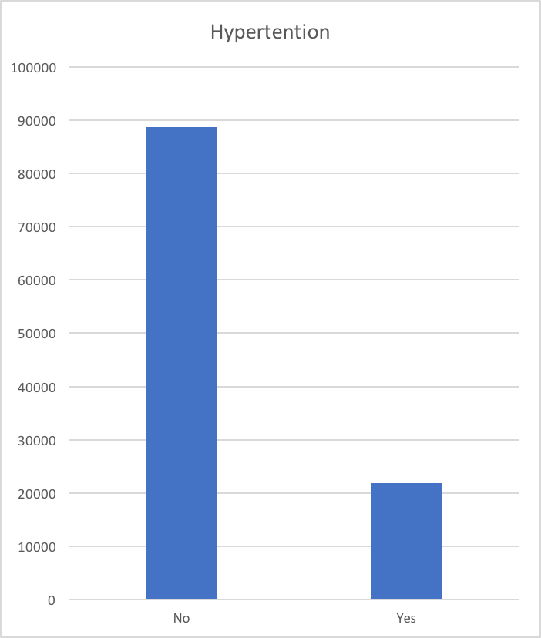
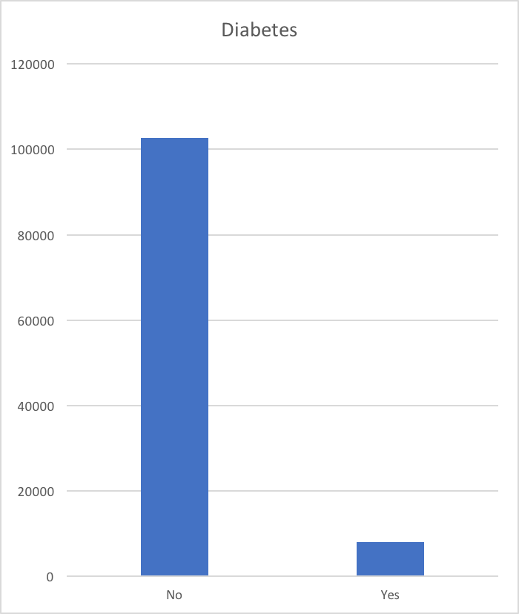
First Step: Data Cleaning (6/8)
1.5 Scholarship, Hypertension & Diabetes
Notes:
these charts shows how many patients have or have no scholarship, hypertension and diabetes.
Those are binary features

Slide 11
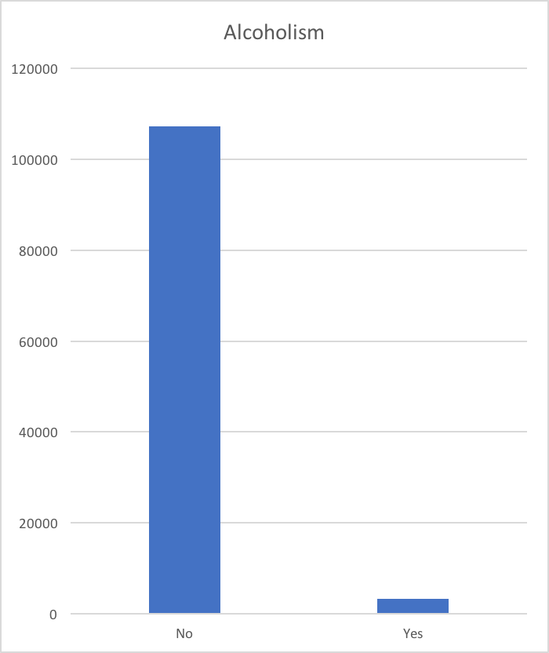
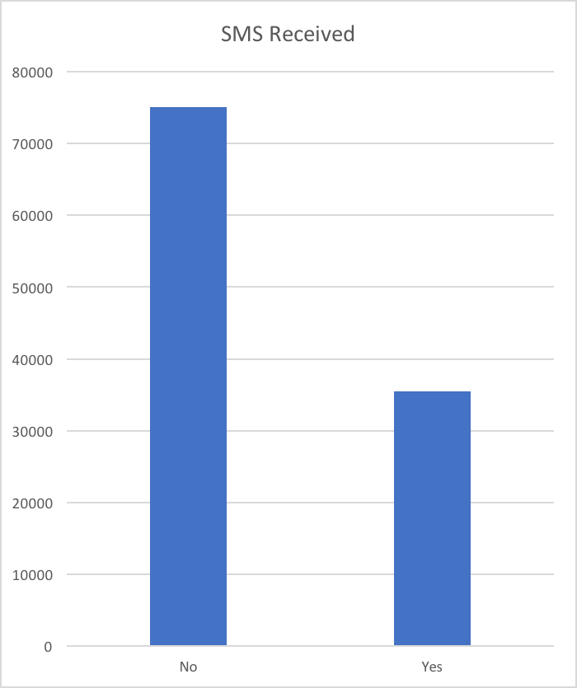
First Step: Data Cleaning (7/8)
1.6 Alcoholism & SMS_received
Notes:
These two charts show how many people have or have no alcoholism and message received before their appointment..

Slide 12
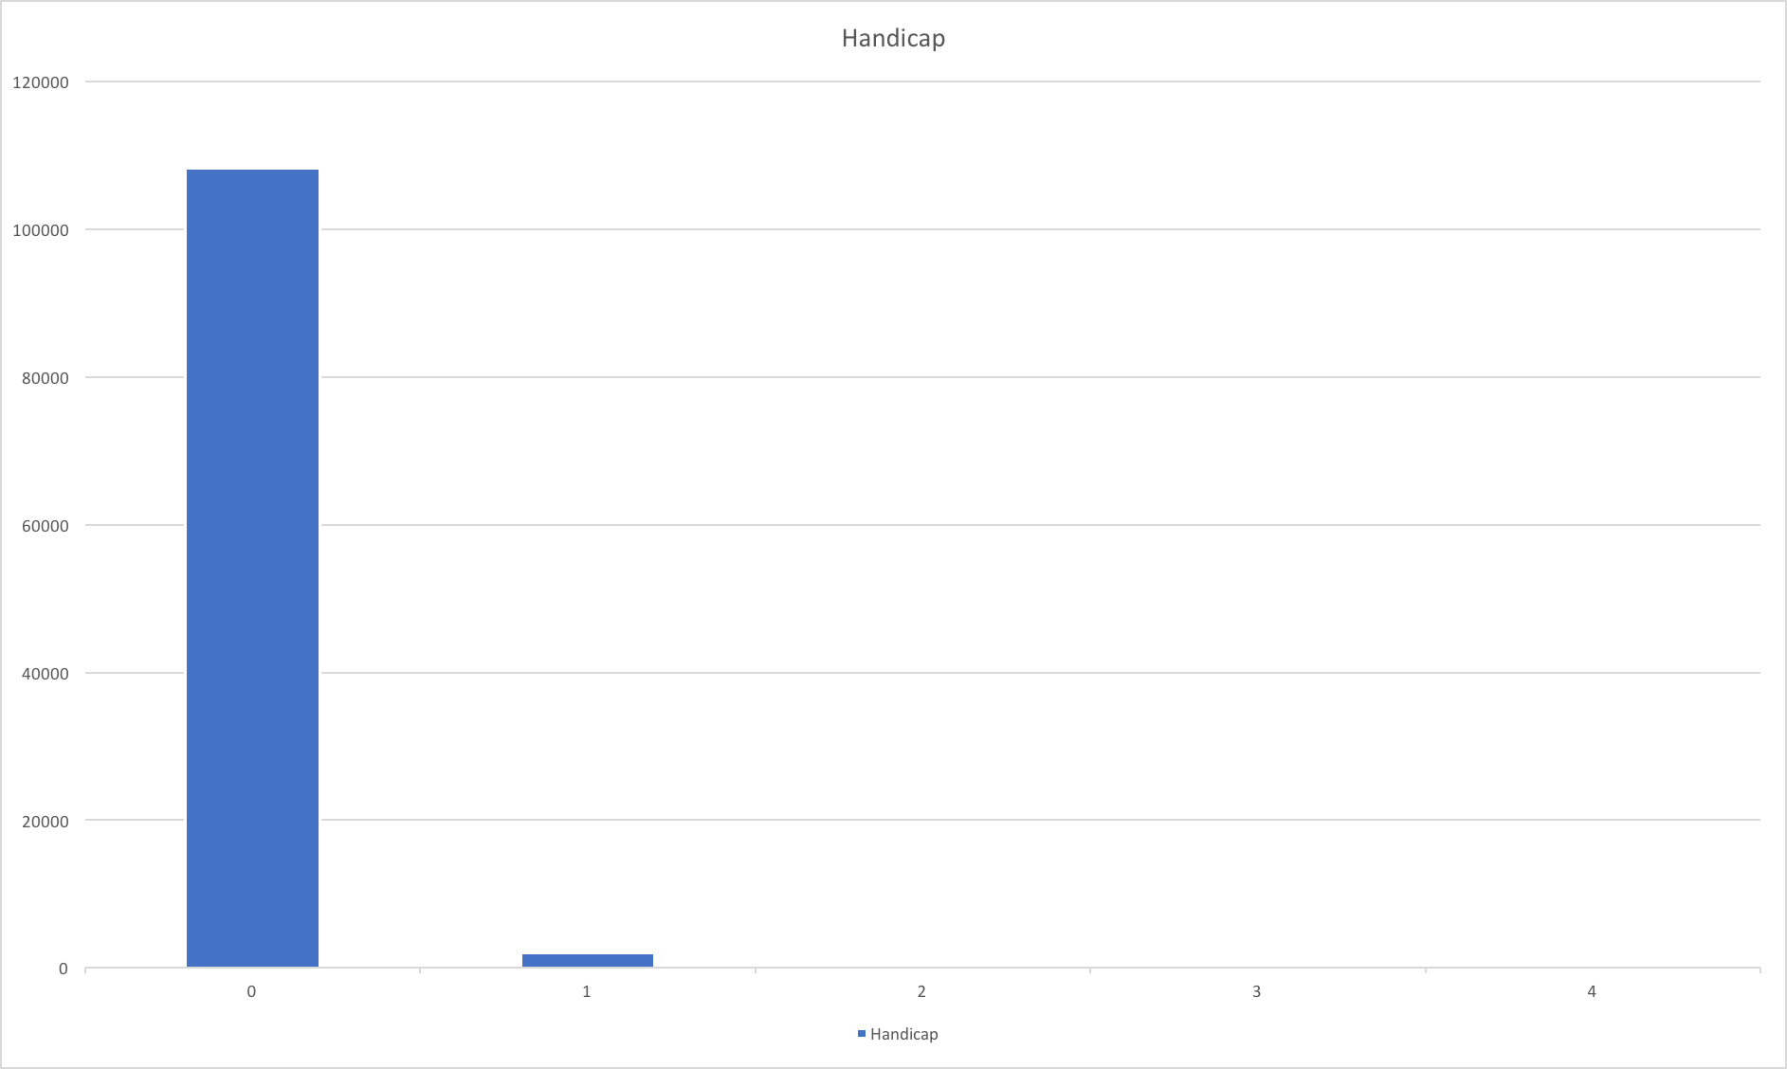
First Step: Data Cleaning (8/8)
1.7 Handicap
Notes:
Handicap is the total amount of handicaps a person presents, it is not binary.
But, there are only a few people have more than 1 of handicaps.

Slide 13
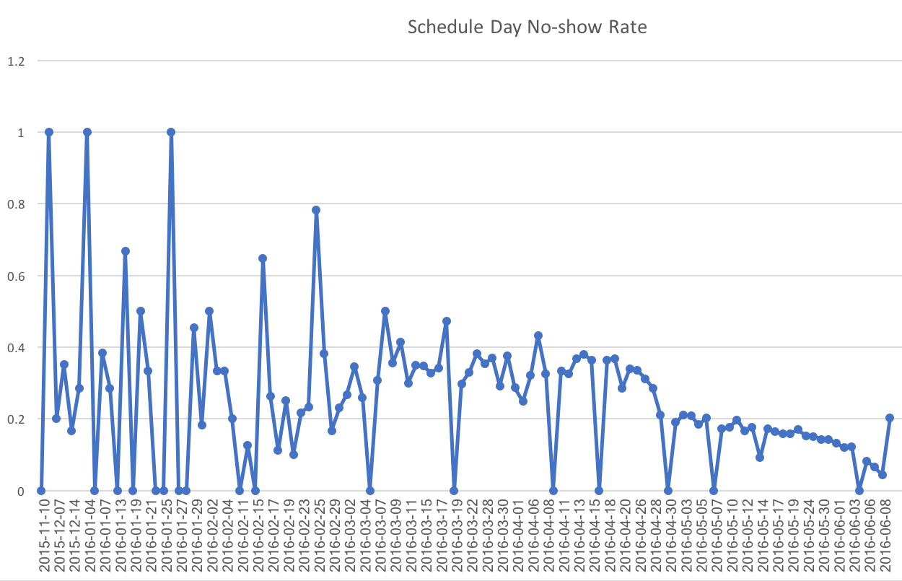
Second Step: Feature Selection (1/10)
2.1 Scheduled Day
Notes:
This chart shows the no show rate of each schedule day. It didn’t show any clear trend

Slide 14
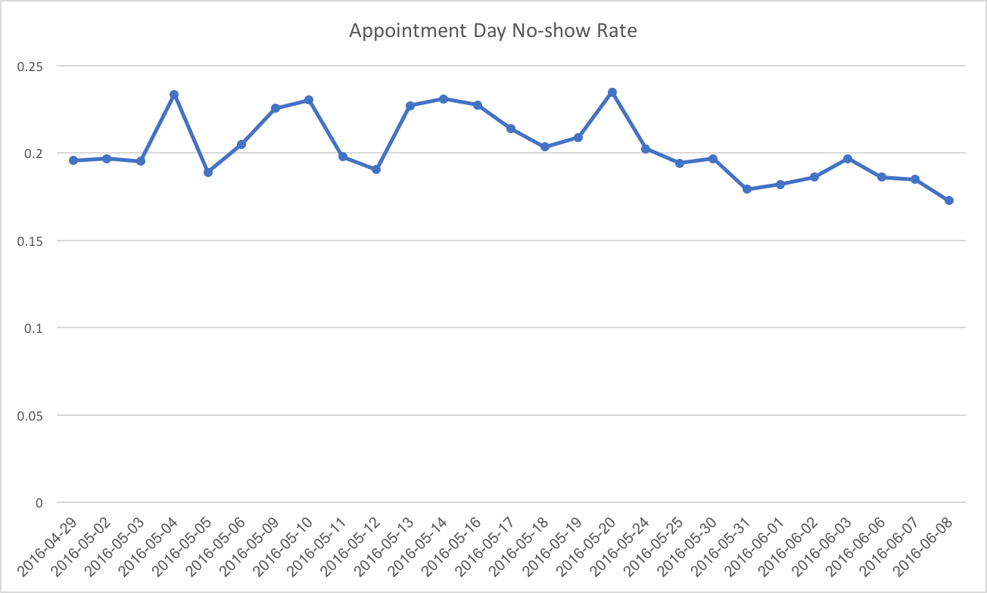
Second Step: Feature Selection (2/10)
2.2 Appointment Day
Notes:
This chart shows the no show rate of each appointment day. It didn’t show any clear trend also.

Slide 15
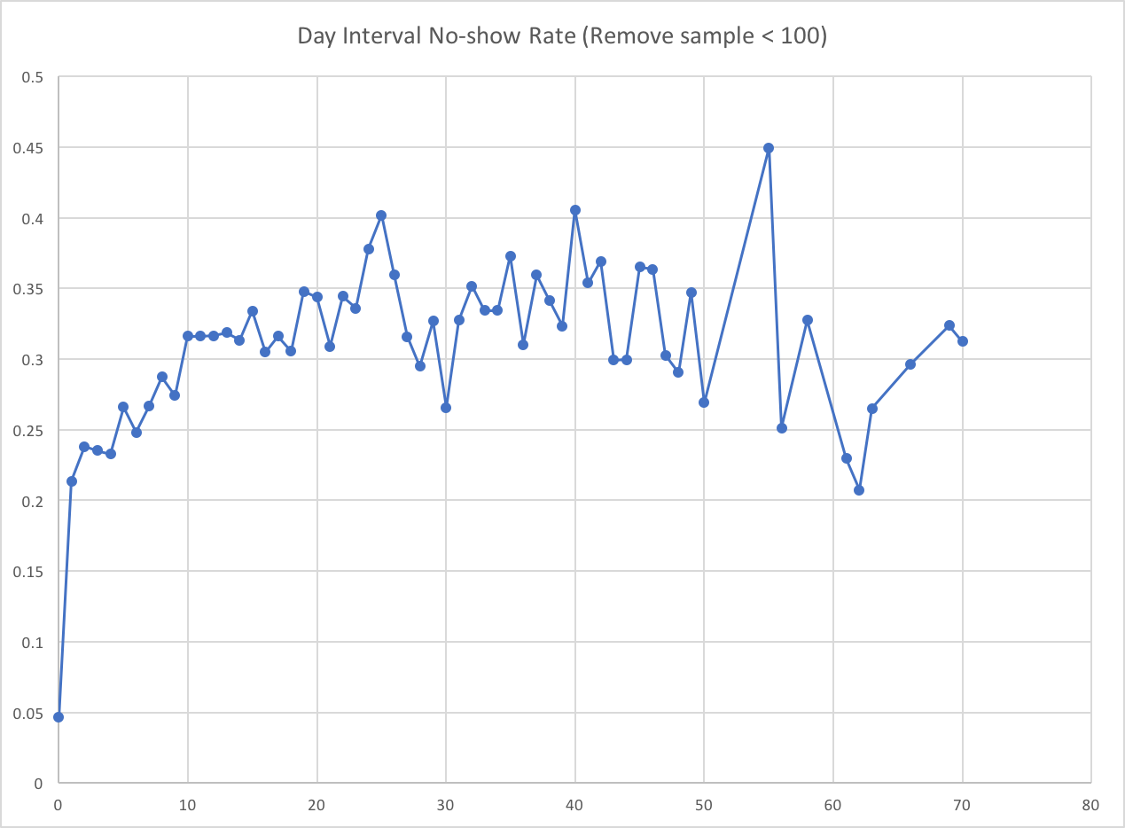
Second Step: Feature Selection (3/10)
2.3 Day interval between Scheduled Day & Appointment Day
Remove sample < 100
Notes:
This chart shows the no show rate of day interval. It shows an upward trend. When the interval is 0, we got the lowest no show rate.

Slide 16
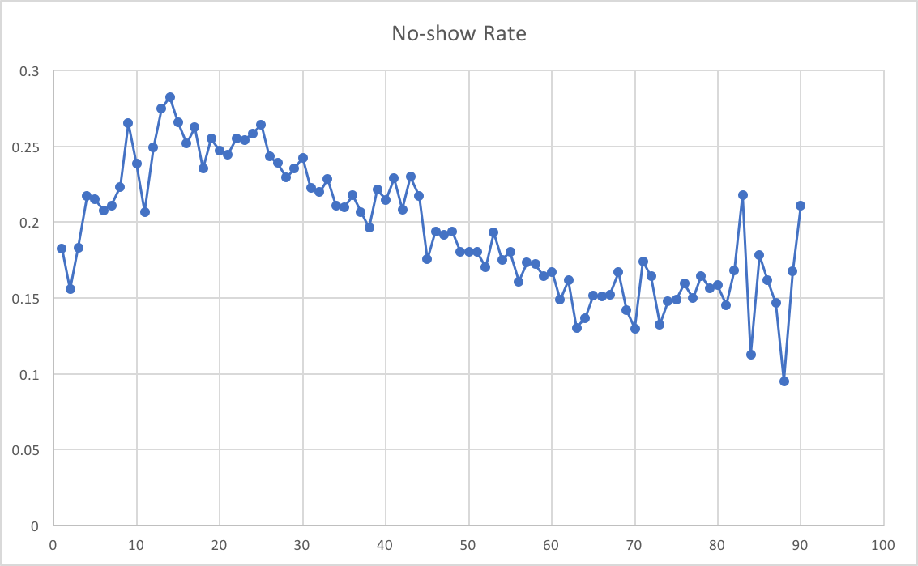
Second Step: Feature Selection (4/10)
2.4 Age
Remove age <=0 & sample < 100
Notes:
This chart shows the no show rate of age. It shows a downward trend when age is above 25.

Slide 17
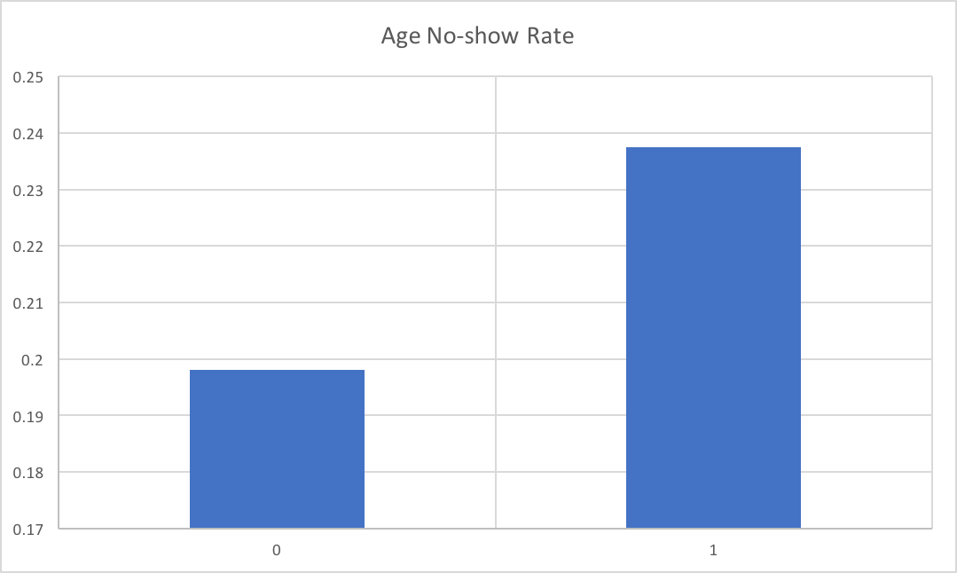
Second Step: Feature Selection (5/10)
2.5 Scholarship
0 means have no scholarship, 1 means do have scholarship
4% differs

Slide 18
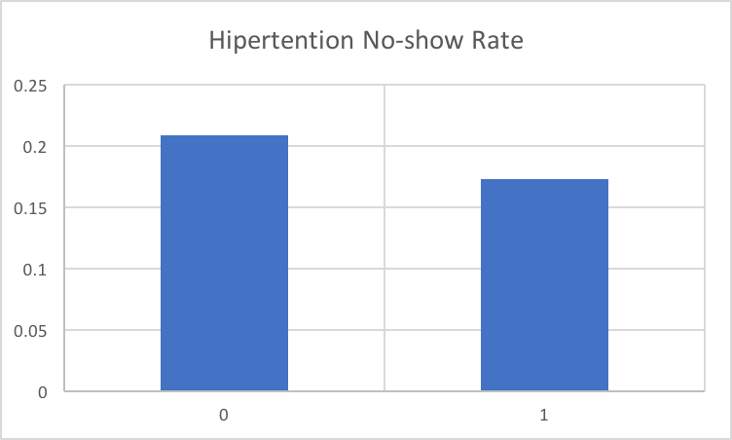
Second Step: Feature Selection (6/10)
2.6 Hypertension
0 means have no hypertension, 1 means do have hypertension

Slide 19
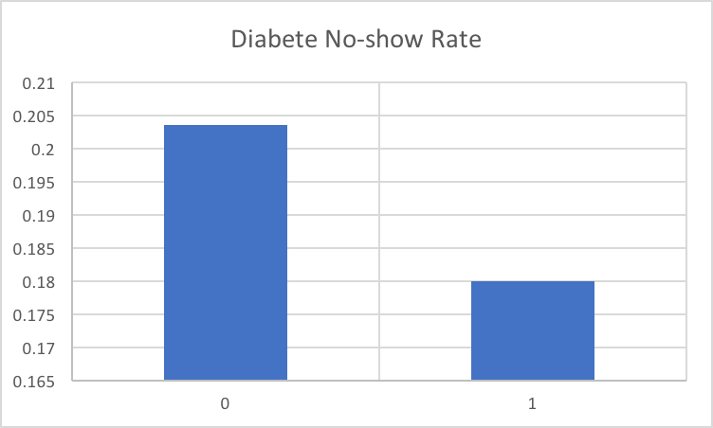
Second Step: Feature Selection (7/10)
2.7 Diabetes
0 means have no diabetes, 1 means do have diabetes
less than 2%

Slide 20
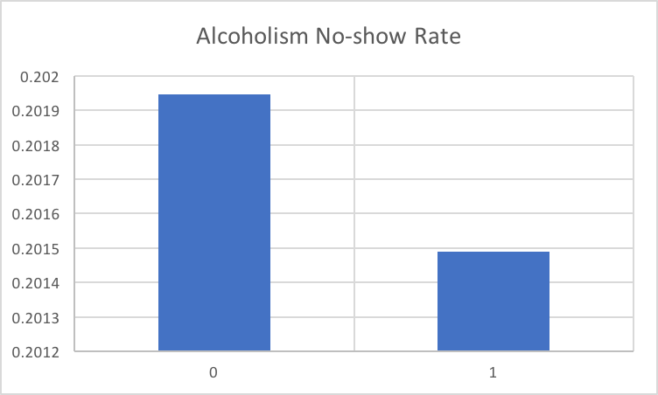
Second Step: Feature Selection (8/10)
2.8 Alcoholism
0 means have no alcoholism, 1 means do have alcoholism
only differs 0.04%

Slide 21
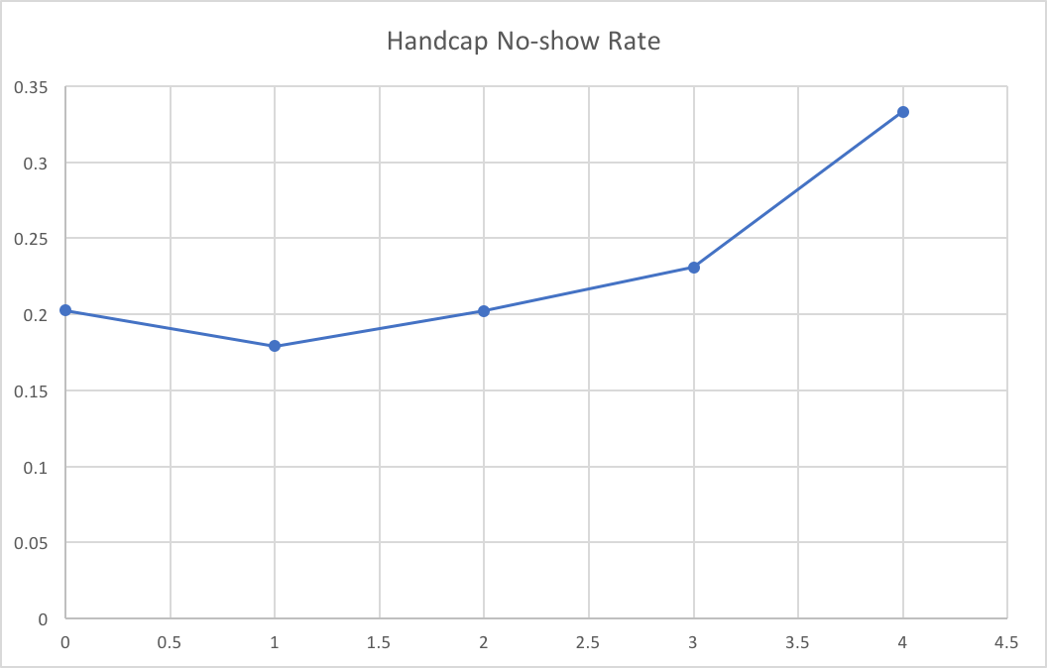
Second Step: Feature Selection (9/10)
2.9 Handicap
Handicap is the total amount of handicaps a person presents, it is not binary.

Slide 22
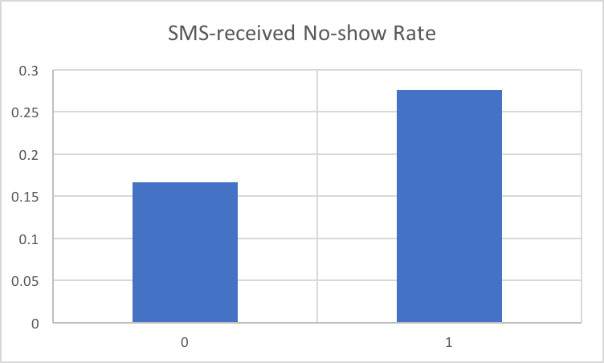
Second Step: Feature Selection (10/10)
2.10 SMS_received
0 means did not receive SMS, 1 means did receive SMS

Slide 23
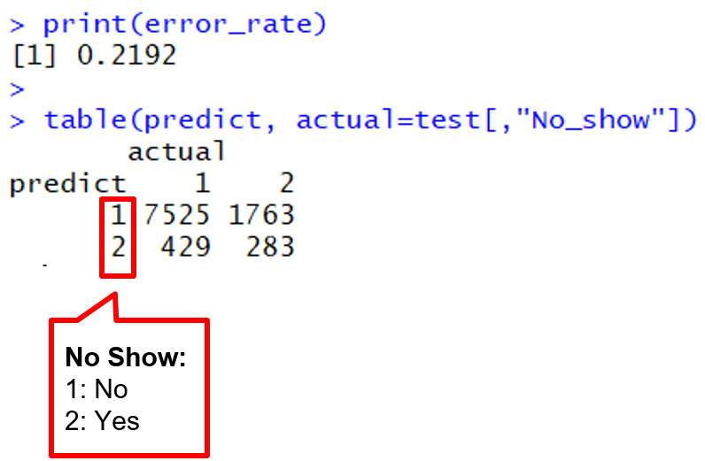
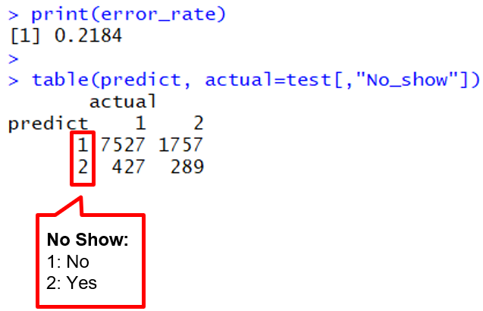
Third Step: Building Models (1/11)
3.1 KNN
9 Features:
Gender
Interval
Age
Scholarship
Hypertension
Diabetes
Alcoholism
Handicap
SMS_received
K = 8
30000 entries
70% Training set, 30% Test set
The performance of KNN:
Notes:
We use 9 features with min-max normalization to run knn.
We shuffle the data and using the first 30000 entries of data,
and split it into 70% as the training set and 30% as the test set.
We tried several k value and found that when k value between 6 to 10 we can get the best performance.
Let’s take a look at the confusion matrix.
There are seventeen hundred “Yes” was classified to “No” because the imbalance of the data set.
The error rate is 0.2192
In the previous feature selection process, we know the Age and Interval are the two most important features.
So we tripled the weight of Age and Interval, the error rate was reduced.
Then, we run knn 10 times by tuning the weight of both features from 1 to 10.

Slide 24
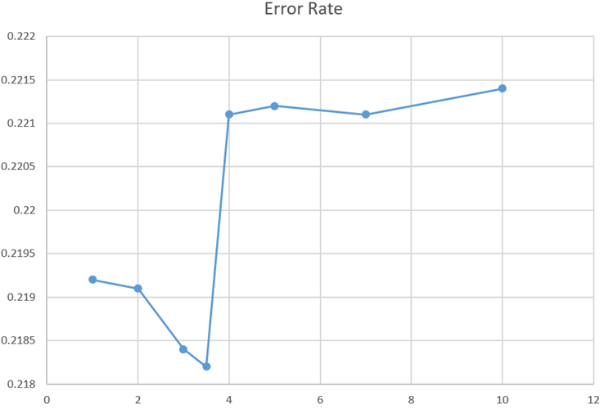
Third Step: Building Models (2/11)
3.1 KNN - Performance and Weights
Upper
means worse
The Weight of Age and Interval
Notes:
This plot shows how the error rate change
when we use different weight of Age and Interval between 1 and 10.
When the weight increased from 1 to 3.5, the error rate reduced.
It means the prediction performance becomes better.
As you can see.
But!! The error rate increased when the weight is higher than 4.
In other words,
It does not mean we can always get better performance by increasing the weight alone.
Instead, we should find the best point and changing the other factors.
In this case, we know the best weight of Age and Interval is around 3.5

Slide 25


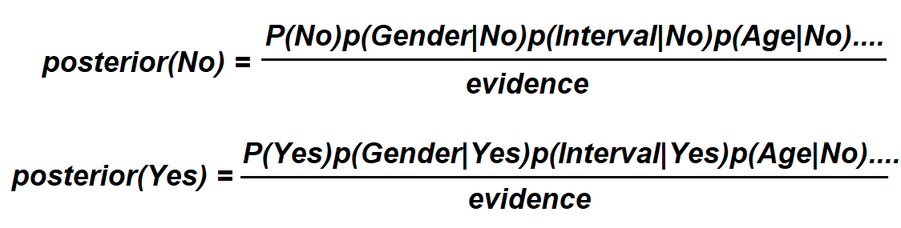
Third Step: Building Models (3/11)
3.2 Naïve Bayes
9 Features:
Gender
Interval
Age
Scholarship
Hypertension
Diabetes
Alcoholism
Handicap
SMS_received
All entries of data
70% training, 30% test
No Show
No
Yes
Notes:
We use nine features with min-max normalization to build our Naïve Bayes model.
Let’s take a look at the confusion matrix.
It is obvious that more than six thousand No Show data was classified incorrectly
Because there are only about 22% of no show records. And there is no decisive factors.
This data distribution is the limitation and makes our naive bayes model to predict the result closer to No.
The naive bayes model classifying data by comparing the posterior value of each class.
In this case, class was separated into “Yes” and “No”.
The disparity of the probability of “Yes” and “No” made it the most dominant factor.
This is the problem why so many data which marked “Yes” was classified incorrectly.
But, in fact, the performance of using Naive Bayes is much better than using knn.

Slide 26
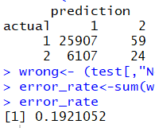
Third Step: Building Models (4/11)
3.2 Naïve Bayes
9 Features:
Gender
Interval
Age
Scholarship
Hypertension
Diabetes
Alcoholism
Handicap
SMS_received
All entries of data
70% training, 30% test
No Show
No
Yes
Notes:
We remove 5 un-important features and than build the naïve bayes model again.
Then, we use the same test data set. We got a slightly lower error rate.
which means this approach is effective.
But the same problem still occurs.
There are too many “Yes” data was classified to “No”.

Slide 27
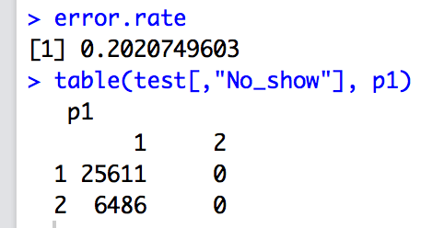
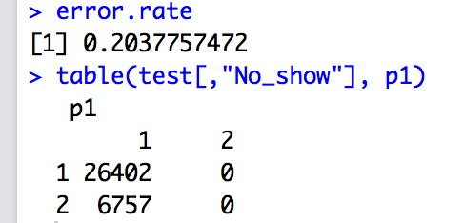
Third Step: Building Models (5/11)
3.3 C50
With all features normalized equally
With all features but Age and Interval 3 times heavier
Notes:
Let’s take a look at the decision trees.
Same with the previous method we take 70% as the training data, 30% as the test data. We generate the basic decision tree first with all features equally normalized. The error rate on test data is 20.21% and the confusion matrix is as shown in the picture.
Interestingly, we have such an error rate is because, C50 categorize all the patients as showing up. Even though the error rate has improved compare to KNN, but such an analyzation doesn’t have provide any helpful information.
We then generate the second decision tree by putting more wights on the Age and Interval features, since they are our most influential features so far. The result is the as the first one, every patient is predicted as will showing up.

Slide 28
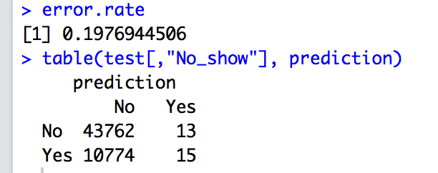
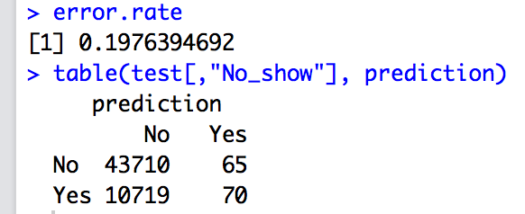
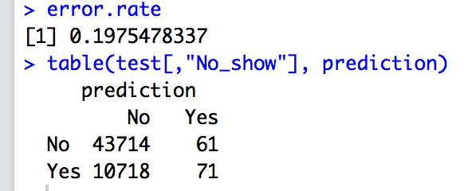
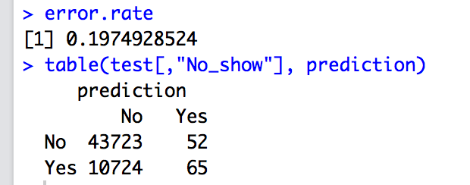
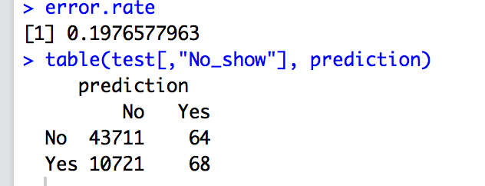
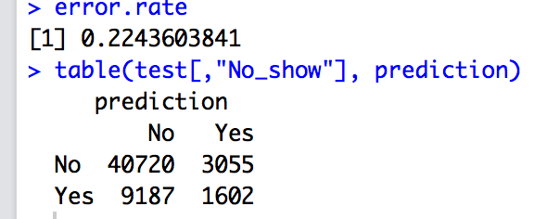
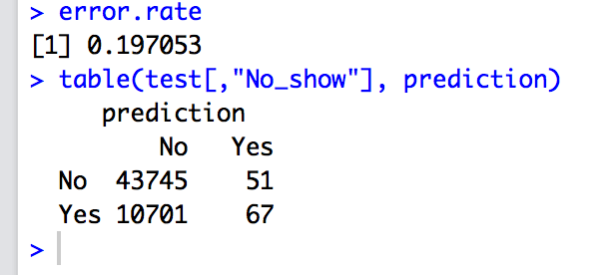
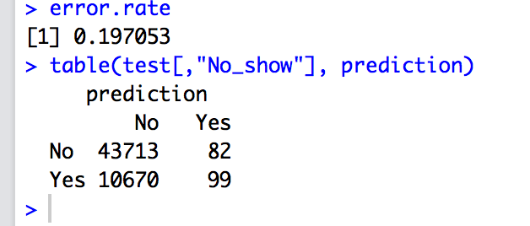
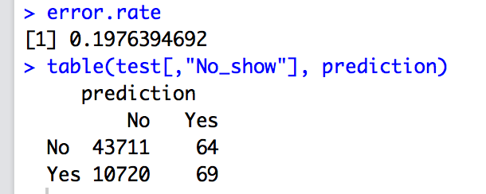
Third Step: Building Models (6/11)
3.4 Random Forest
Tuning variable
ntree, number of trees:
when 1000, err rate=19.70%
when 2000, err rate=19.70%
when 3000, err rate=19.76%
when 4000, err rate=19.76%
when 5000, err rate=19.77%
mtry: the number of features randomly selected at each split
when 1, err rate = 19.77%
when 2, err rate = 19.77%
when 3, err rate = 19.76%
when 6, err rate = 22.43%
when 9, err rate = 23.68%
nodesize
when 2, err rate = 19.77%
when 4, err rate = 19.76%
when 8, err rate = 19.75%
when 12, err rate = 19.74%
when 24, err rate = 19.75%
Notes:
Random forest, however, got us slightly better result.
First we tunning the model by trying out different number of trees. Our result show that 2000, 3000, 4000 and 5000 trees are no better than 1000 tree. Bur definitely increase the amount of time on building the model with more trees.
Second, we continue improving it by tweaking the mtry variable. mtry is the number of features randomly selected at each split, the default value is the square of the number of features. From 1 to 3 has no significant improvement, but it get dramatically more error once we set mtry to 6. So we stop at three.
Next we go to the nodesize variable. Nodesize is the number of terminal nodes for each tree, when it get larger, the trees are wider. In our experiement, we don’t see much effect by adjusting this variable. We only know that when it set to 12, our best result is 19.74%.
And the pictures here is just for proving we did run the models manually.
mtry: Number of variables randomly selected at each split.
nodesize: the number of terminal nodes, when it get larger, the trees are wider

Slide 29
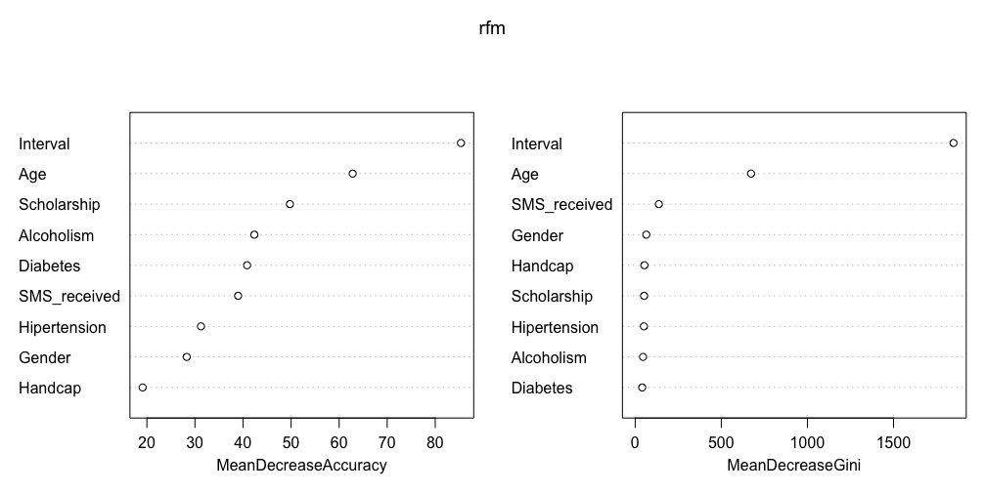
Third Step: Building Models (7/11)
3.4 Random Forest
MeanDecreaseAccuracy: By permuting this feature, how much accuracy will be decreased averagely
MeanDecreaseGini: How many Gini (the lower the purer) decreased by splitting this feature averagely
Notes:
Next is the features importance generated by random forest. The MeanDecreaseAccuracy is measured by, how much accuracy will be decreased by permuting a feature. The Gini on the other side is a measure of node impurity. Lower the Gini the purer the data. So MeanDecreaseGini means that by having this feature, how much Gini it decreas, in other words, how much it make the data better.
The outcome shows that the Interval and the Age are our two most important features, which is the same as we observed in the beginning.

Slide 30
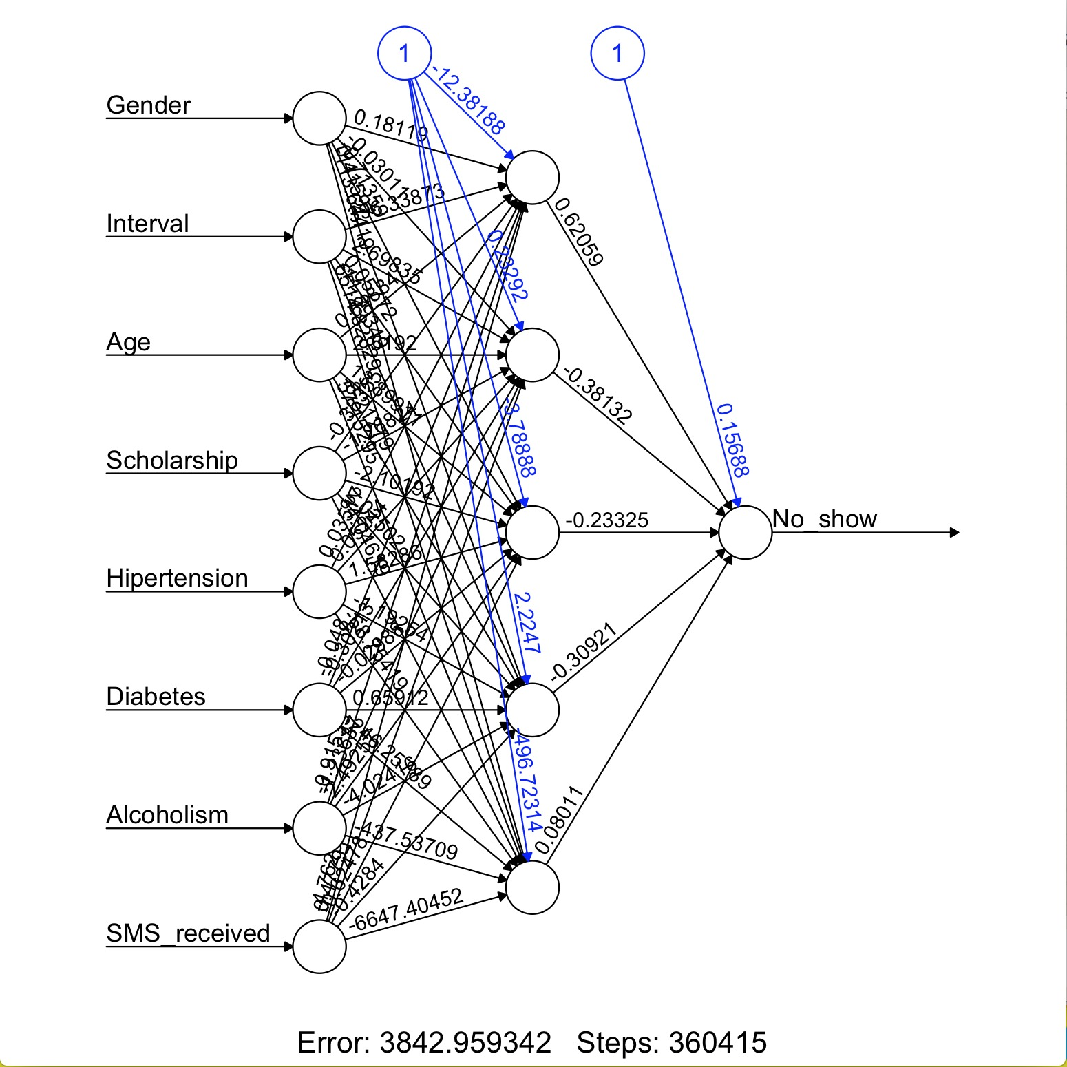
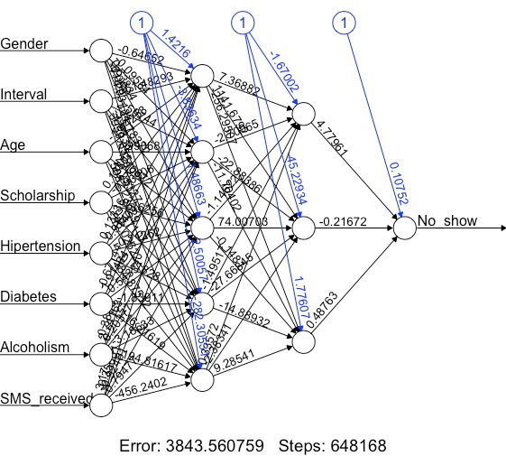
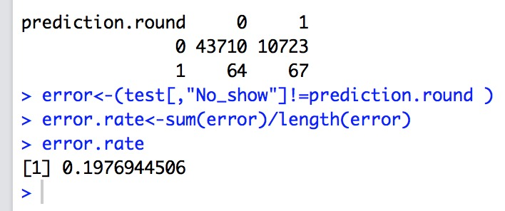
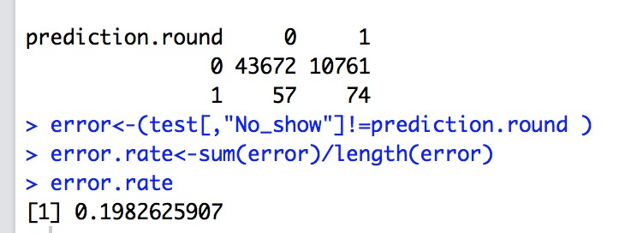
Third Step: Building Models (8/11)
3.5 Neural Network
Why do we choose Neural Net
Performance! Performance! Performance!

Slide 31
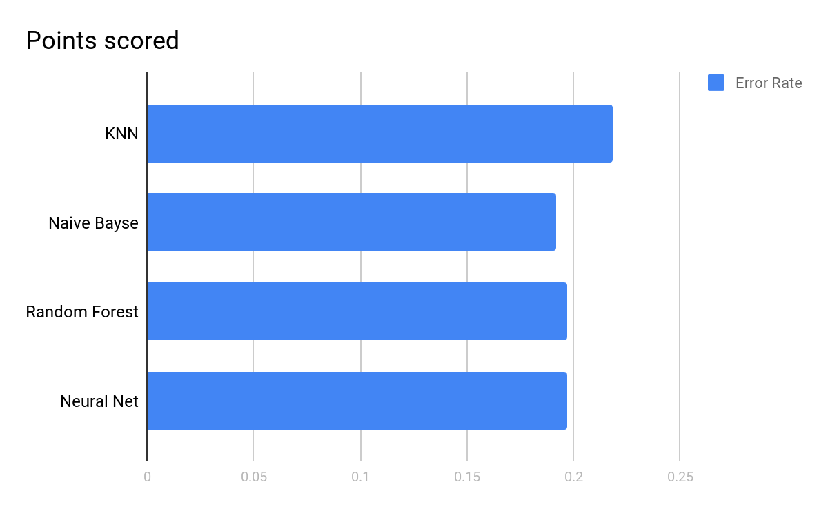
Third Step: Building Models (9/11)
3.5 Neural Network
comparison of different models

Slide 32
Third Step: Building Models (10/11)
3.5 Neural Network
How do we build Neural Net
Data Analyse
Data Cleaning
Attribute Normalization
Splitting Dataset
Evaluation
Validation
Train the Model
Build the Neural Network
formula | a symbolic description of the model to be fitted
data | a data frame containing the variables specified in formula.
hidden | a vector of integers specifying the number of hidden neurons (vertices) in each layer.
threshold | a numeric value specifying the threshold for the partial derivatives of the error function as stopping criteria.
stepmax | the maximum steps for the training of the neural network. Reaching this maximum leads to a stop of the neural network's training process.
err.fct | a differentiable function that is used for the calculation of the error.
act.fct | a differentiable function that is used for smoothing the result of the cross product of the covariate or neurons and the weights.

Slide 33
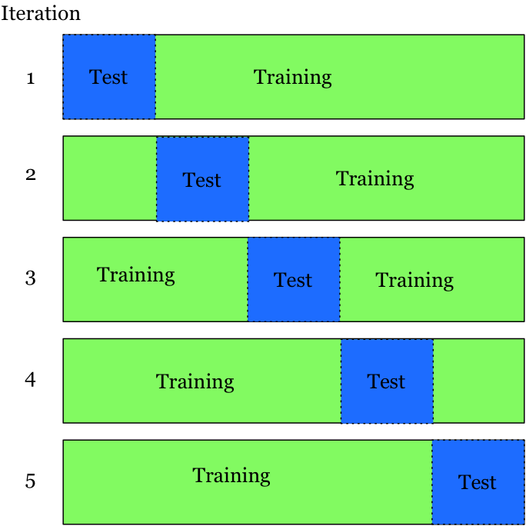
Third Step: Building Models (11/11)
3.5 Neural Network
Future work
K-fold cross validation
Sensitivity analysis
X1 mean
X2 mean
Z1 mean
X3 mean
X4 mean

Slide 34
Conclusion: business approach
1. Day Interval and Age are the most influential features
2. The day interval shorter, the patients more likely to show up
3. The patients between 10 and 20 years old is probably not to show up.
4. Patients who doesn’t receive a text message are more likely to show up.

Slide 35
What we learn from this project
Review the data before building models
Extreme values can affect final result (remove it!)
Feature selection is important, manually select is as effective as with using methodology
Sometimes the relationship between features and the prediction result is inexplicable
Precise prediction is not as easy as we think, our best error rate is 19.23% (Naïve Bayes)

