Slide 1
Deep Learning -
Reinforcement Learning
Done by
Nimmagadda Vineesh - P2123165
Lee Hao Wei - P2123037

Slide 2
Problem statement
For this assignment we are tasked with solving the Lunar Lander-v2 environment by open ai, a classic rocket trajectory optimization problem
Four discrete actions
Do nothing
Fire left orientation engine
Fire right orientation engine
Fire main engine
Each episode ends if the lander crashes , moves out of screen or when it is not awake that is when it does not move and does not collide with any other body
For this project we will be experimenting with four models: DQN , Double DQN, Duelling DQN and A2C
Challenge 1

Slide 3
DQN - Deep Q Network

Slide 4
DQN - Deep Q Network
Optimization of Q learning by alleviating memory requirements
Q learning uses look-up table to store state action pairs and their rewards
Requires a lot of memory
DQN uses neural network instead
Useful for approximating the reward for a state action pair efficiently
Challenge 1

Slide 5
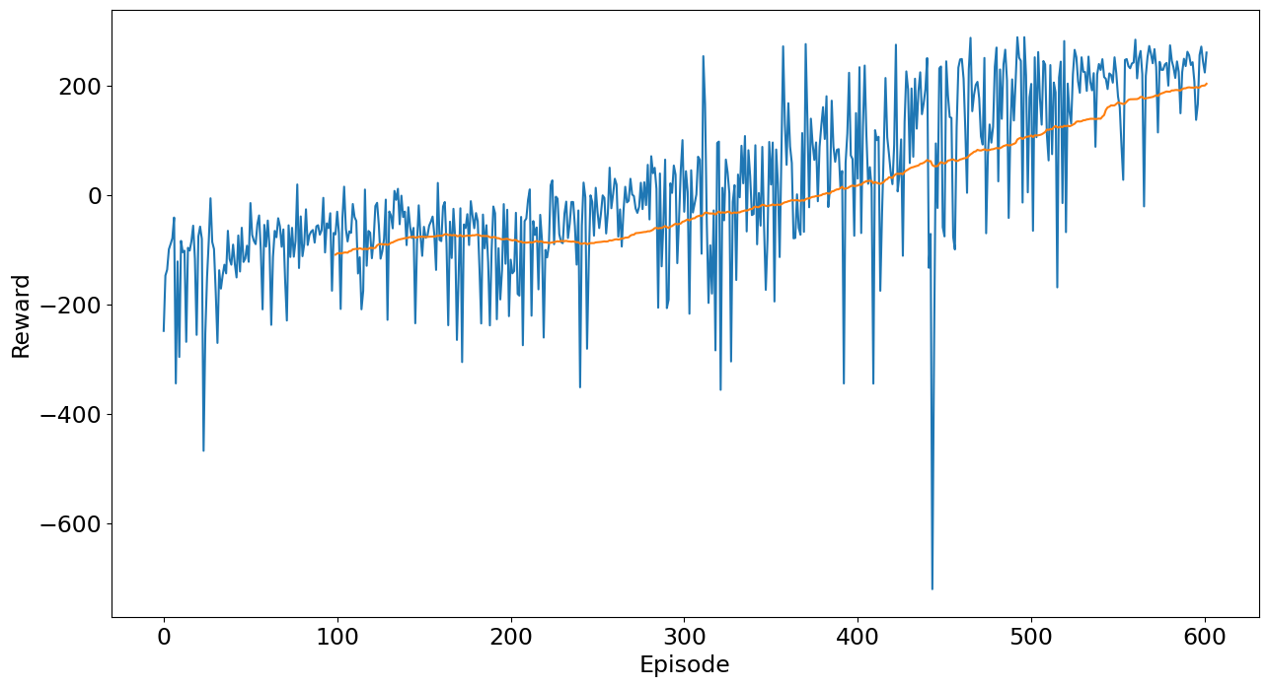
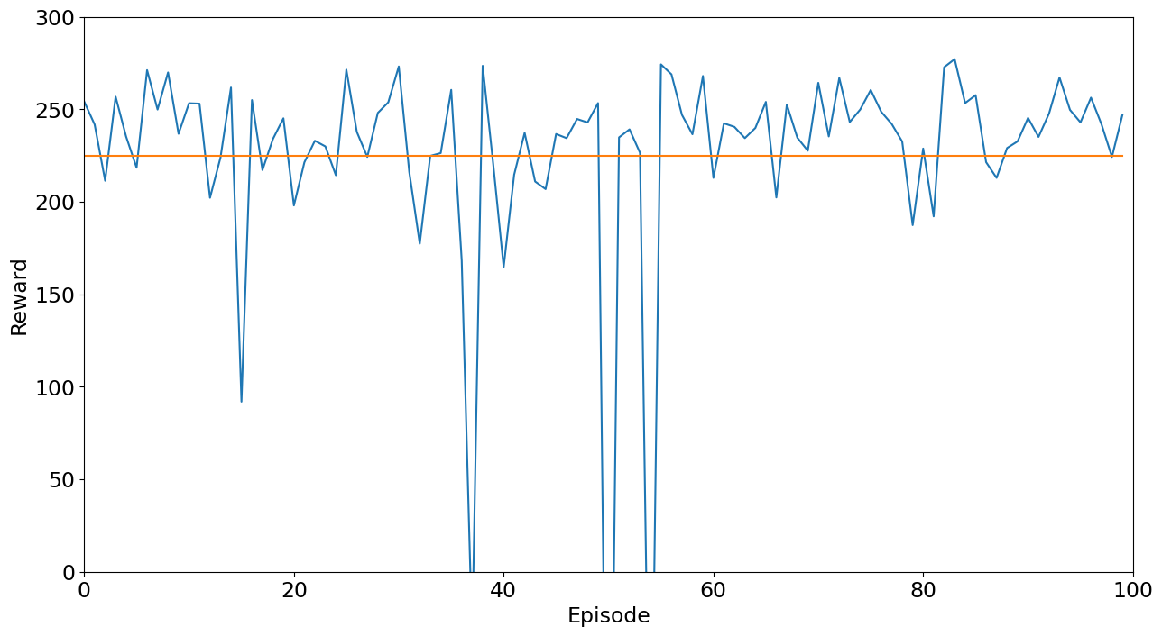
DQN - Results
Model trains steadily without being very volatile
Each episode takes very long due to the model often getting stuck
In testing phase model is largely stable with reward > 200 for most episodes
Model still does not perform well in some episodes
Might benefit from more training
Training results
Testing for 100 episodes

Slide 6
Double DQN -
Double Deep Q Network

Slide 7
Double DQN - Double Deep Q Network
Double DQN is an improvement of DQN
Although DQN manages to solve memory problem of Q learning it still has flaws
It overestimates the rewards for a particular state action pair which leads it to always pick that action in that particular state even though it might not be beneficial all the time
To solve this two neural networks are trained in Double DQN where one learns during experience relay like in DQN while another is copy of last episode’s model
Prevents the model from overestimating by using the second model’s more conservative estimate of rewards
Challenge 1

Slide 8
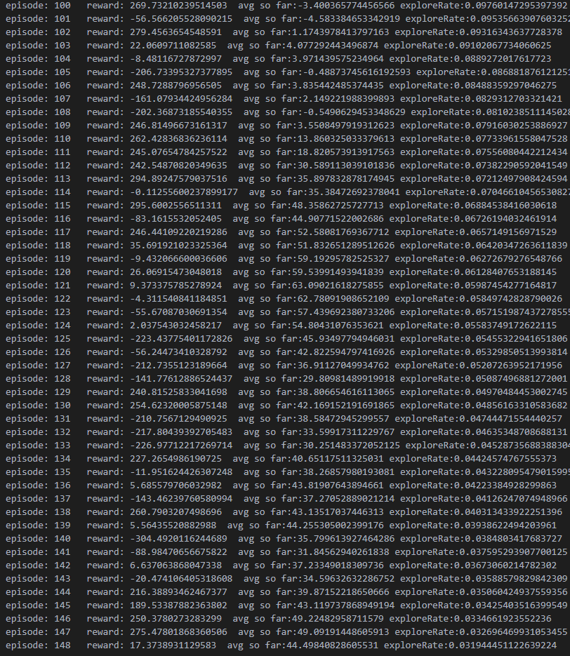
Double DQN - Results
This model was not able to finish training due to lack of continued access to lab PCs
However some insights can still be gained
As shown model was only able to train till episode 148 but was still able to achieve results comparable to DQN at ~400 episodes
However, each episode with Double DQN lasts longer
Shows that Double DQN improves the convergence speed by not overestimating rewards
From average rewards of each episode we can see that model is not very volatile and is steadily learning
Challenge 1

Slide 9
Duelling DQN -
Duelling Deep Q Network

Slide 10
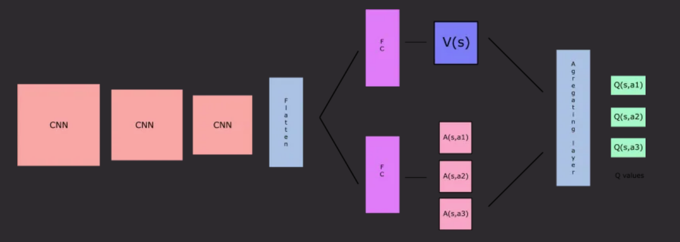
Duelling DQN
It is a variant of DQN
Separates the value function into two streams:
Value stream
Advantage stream

Slide 11
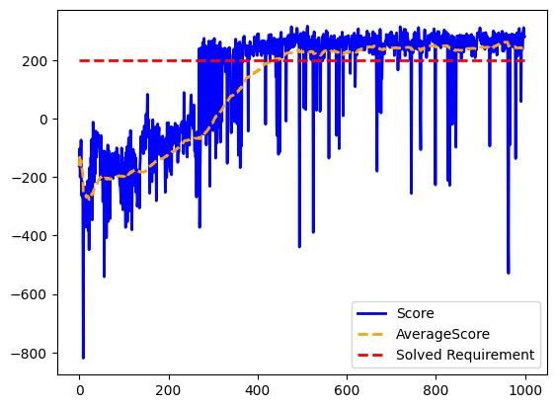
Duelling DQN - Results
Model trains steadily without being very volatile
The model trains relatively quick in comparison to the other two DQN variants
Does not take much memory
It manage to consistently achieve a average reward of above 200 after 290 episodes
It does have some dips throughout

Slide 12
A2C (Advantage Actor Critic)

Slide 13
A2C - What is A2C?
A2C is built from A3C
A3C but without the asynchronous part
Uses policy-based and value-based methods to solve a problem
Two neural networks:
Actor network
Critic network

Slide 14
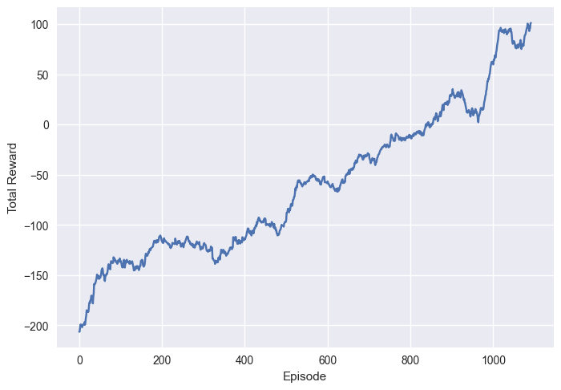
A2C - Results
The Reward Slowly Increases throughout the run
The Model was stopped early as the reward remain the same for a few episodes
It did not “Solve” Lunar Lander as the reward never achieve above the reward of 200

Slide 15
Summary
In summary, DQN manage to “solve” lunar lander, however the model takes a lot of memory and time to run in comparison to Duelling DQN, which also manage to “solve” lunar lander but is much more efficient. Therefore, Duelling DQN appears to be the best fit for this problem
Double DQN gives promising results as well but it uses much more memory and takes longer to train than Duelling DQN

