Slide 1
SAP Fiori apps Rapid-Deployment Solution V6.20
Release Note
SAP Rapid Deployment Solutions
July 6, 2015

Slide 2

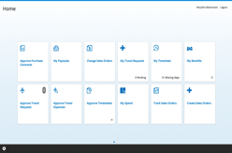
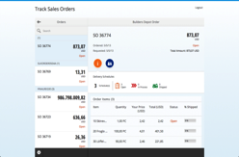




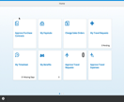
SAP Fiori apps rapid deployment solution
The SAP Fiori apps rapid-deployment solution features prepackaged, instant-value apps across multiple business functions. This package offers a choice to deploy one or many SAP Fiori apps with a predictable price and time with wide variety of optional services to choose from.
It allows now to deploy ANY SAP Fiori app, which was delivered by SAP, including SAP Fiori apps requiring the SAP HANA platform as a prerequisite.
Package Highlights
Extensibility: step by step documentation of how to hide, rename and add a field to a SAP Fiori app
Prerequisite checks for the customizing of an existing SAP backend system for some selected Fiori apps
Used SAP backend transactions specific for each SAP Fiori app
Using the SAP Fiori Reference Library
Integrate SAP Fiori apps in the SAP Enterprise Portal
This rapid-deployment solution can be implemented together with SAP Fiori Design rapid-deployment solution.

Slide 3
Key Scenarios/Scope item structure
# | Business Scenario | Scope Item ID | Comment
1 | SAP Fiori Transactional Apps Deployment | MEA | Core*
2 | SAP Fiori Analytical Apps Deployment | MEB | Core*
3 | SAP Fiori Factsheet Apps Deployment | MEC | Core*
4 | SAP Fiori Smart Business Enablement | MED | Optional**
5 | SAP Fiori Advanced Security Setup | MEE | Optional**
6 | SAP Fiori Integration with SAP Enterprise Portal | MEF | Optional**
7 | Mobilizing SAP Fiori Apps | MEU | Optional**
8 | SAP Fiori App Extensibility and Customization | MEV | Optional**
9 | SAP Fiori Launchpad Operation | MEW | Optional**
* Core scenarios: Customers may choose one or more of such scenarios. Of course within each scenario, customers would have further sup-options to choose one or more apps.
** Optional scenarios: Customers may optionally choose one or more of these peripheral scenarios on top of above mentioned Core scenarios.

Slide 4
What’s new?
New content:
  RDS-specific assets, for example Backend Prerequisite Checks added
  Fiori on Cloud, Trial Edition: added Best Practices
Updated building blocks/documents:
MF1 | Running an Application Standalone
EE1 | Usability enhancement on web dispatcher
EE2 | One Time Password enhancement for SAML2.0 SSO
MF6 | Jam Integration
Software Requirements | content updates

