Slide 1

Data Engineering
Homework #1
G. Gaglione – H. Zheng
A. A. 2024-2025

Slide 2
Computer science topic
Data Cleaning (first choice):
only 18 papers downloaded
Retrieval-Augmented Generation (RAG):
248 papers downloaded
Data Fusion:
114 papers downloaded

Slide 3
download_papers.py
By taking the name of the chosen topic, such as ‘Data Fusion’, this script automates the extraction of relevant research papers.
Key steps include:
Web Scraping: Utilizes requests and BeautifulSoup to fetch and parse HTML content from arXiv search results.
Data Cleaning: Implements functions to sanitize filenames by removing invalid characters.
HTML Validation: Checks if the URLs point to valid HTML documents before attempting to download.
Download Management: Saves the HTML content of the first 200 papers (and an additional 200) into a specified directory, while keeping track of downloaded files in a text document.
Error Handling: Includes error handling for timeouts and HTTP errors.
Rate Limiting: Introduces a delay between requests to avoid overwhelming the server.

Slide 4
extraction.py
This Python script automates the extraction of tables from HTML files of research papers.
Key steps include:
HTML Parsing: Utilizes BeautifulSoup and lxml to read and navigate the HTML content.
Table Extraction: Identifies and extracts all tables present in the HTML, along with their captions, footnotes, and relevant references.
Data Structuring: Organizes the extracted information into a structured JSON format for each paper based on its arXiv ID.
File Management: Saves the extracted data in a specified directory, creating a separate JSON file for each research paper.
Directory Processing: The script iterates through all HTML files in each previously created sources directory to automate the extraction process.

Slide 5
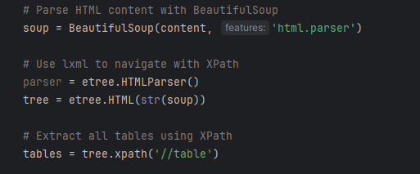

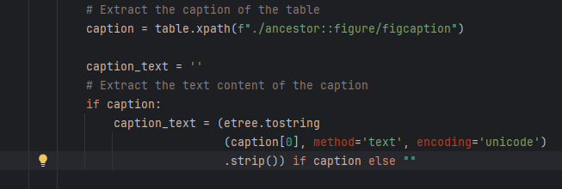
XPath
To extract all tables form one paper: //table
To extract the caption of the table: //table/ancestor::figure/figcaption

Slide 6
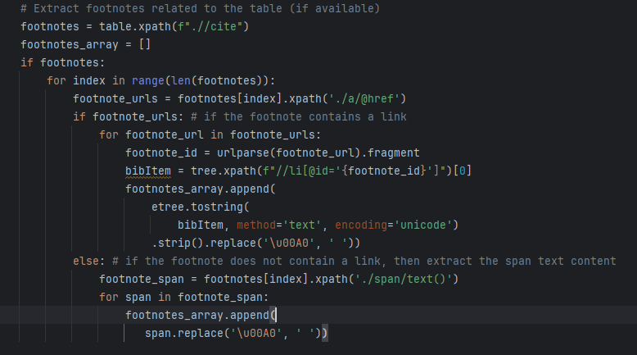
XPath
To extract footnotes related to the table: //table//cite
Extract the bibliography associated with each footnote using the id:

Slide 7
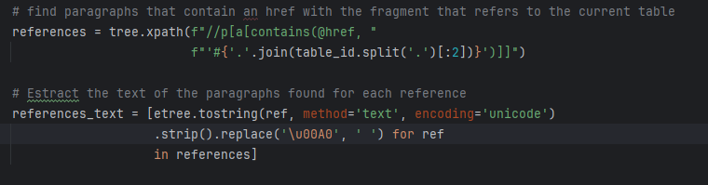
XPath
To extract paragraphs that contain an href with the fragment that refers to the current table:

Slide 8
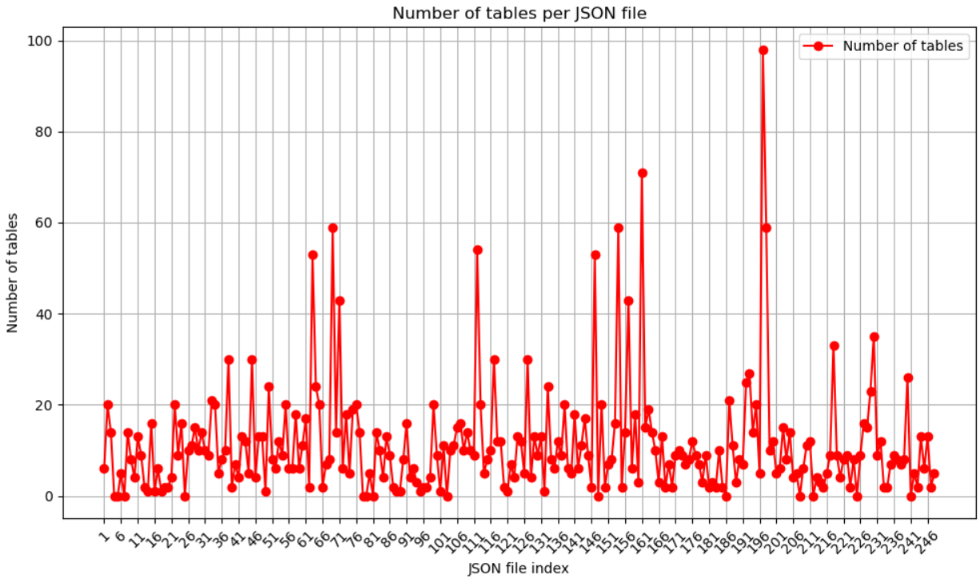
Distribution
RAG:

Slide 9
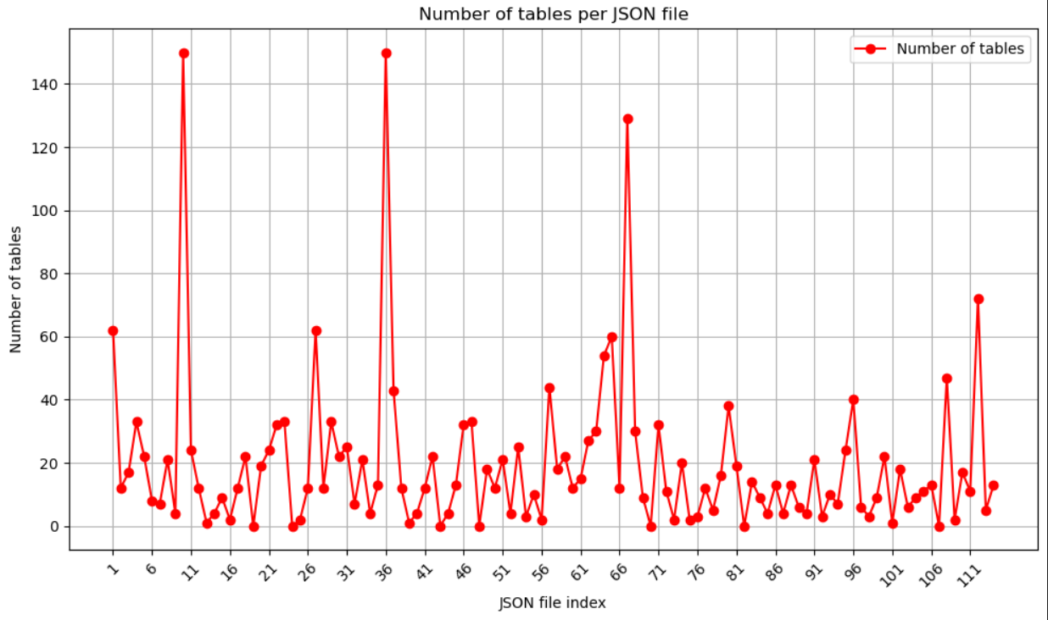
Distribution
Data Fusion:

Slide 10
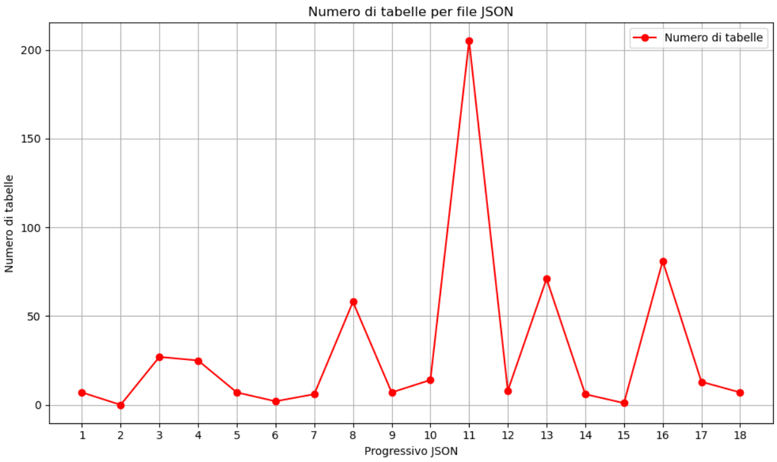
Distribution
Data Cleaning:

Slide 11
Total tables
Topic | # of tables | of which equations
Retrieval Augmented Generation | 2811 | 1091
Data Fusion | 2223 | 1636
Data Cleaning | 545 | 467

Slide 12
JSON with 0 tables
Topic | # of empty JSON files
Retrieval Augmented Generation | 14
Data Fusion | 7
Data Cleaning | 1

Slide 13
Average tables
Topic | Average number of tables per JSON file
Retrieval Augmented Generation | 11,33
Data Fusion | 19,5
Data Cleaning | 30,28

Slide 14
% tables with references
Topic | Percantage of tables with references
Retrieval Augmented Generation | 24,77%
Data Fusion | 34,82%
Data Cleaning | 58,06%

Slide 15
Tables with empty caption
Topic | Total numer of tables with empty caption | Total number of equations
Retrieval Augmented Generation | 1103 | 1091
Data Fusion | 1654 | 1636
Data Cleaning | 467 | 467

Slide 16
Average Number of References
Topic | Average Number of References per Table
Retrieval Augmented Generation | 0,87
Data Fusion | 0,51
Data Cleaning | 0,46

Slide 17
Challenges and difficulties
Data Extraction
(caption, Footnotes and References Handling, text cleaning)
Download process
(too many invalid paper links)

Slide 18
Learnt lessons
Importance of Data Standardization
Error Handling
Regular Expressions and XPath

Slide 19
Thank you for your attention!
Data Engineering
Homework #1
G. Gaglione – H. Zheng
A. A. 2024-2025

