Slide 1


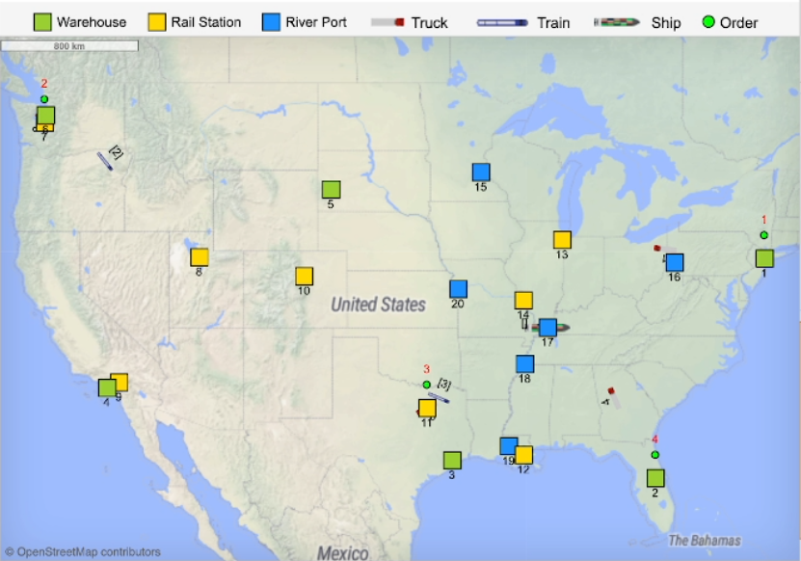

chatbot.recoil.ise.utk.edu
What's the best way to transport 200 containers from Houston to New York? I need it in 36 hours.
100%
The optimizer recommends a combined road-and-rail route to New York, balancing cost, time, and emissions. Containers first move by truck on two highway segments, then transfer to trains for the final legs. The total cost is about $60,320—with trucks accounting for nearly $44,000, trains adding modest operating costs, and around $14,500 in greenhouse gas taxes. This plan delivers on time at the lowest overall cost and environmental impact, as shown on the map below.

