Slide 1
The best location choice for opening a Pizza restaurant in Toronto.
Haowen Yang

Slide 2
Introduction
Our clients hope to open a Pizza restaurant in Toronto, and then aim to maximize the profits. What we can help is to choose a location in Toronto which tends to have a better future by using machine learning method.

Slide 3
Data source
The data set we used is all from foursquare, which is nearly the location information of different kinds of venues.
To begin with, we focus our potential objectives on Central Toronto, the region representing the very center of this city.
To get better turnover, we should try our best to avoid high density of the existed competitors.
Cluster all the venues in city center, which aim to cluster the city center into different sub-centers.

Slide 4
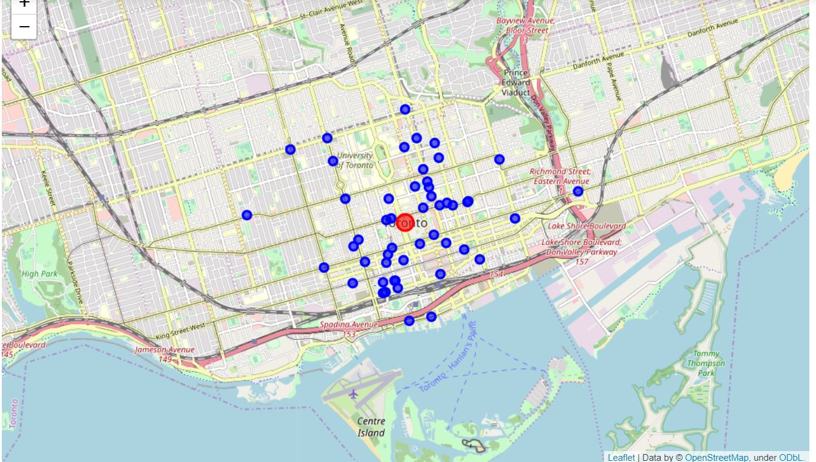
Methodology
Initially, we find the location of central Toronto, and zoom in. After which, we can get the location of all the Pizza restaurants

Slide 5
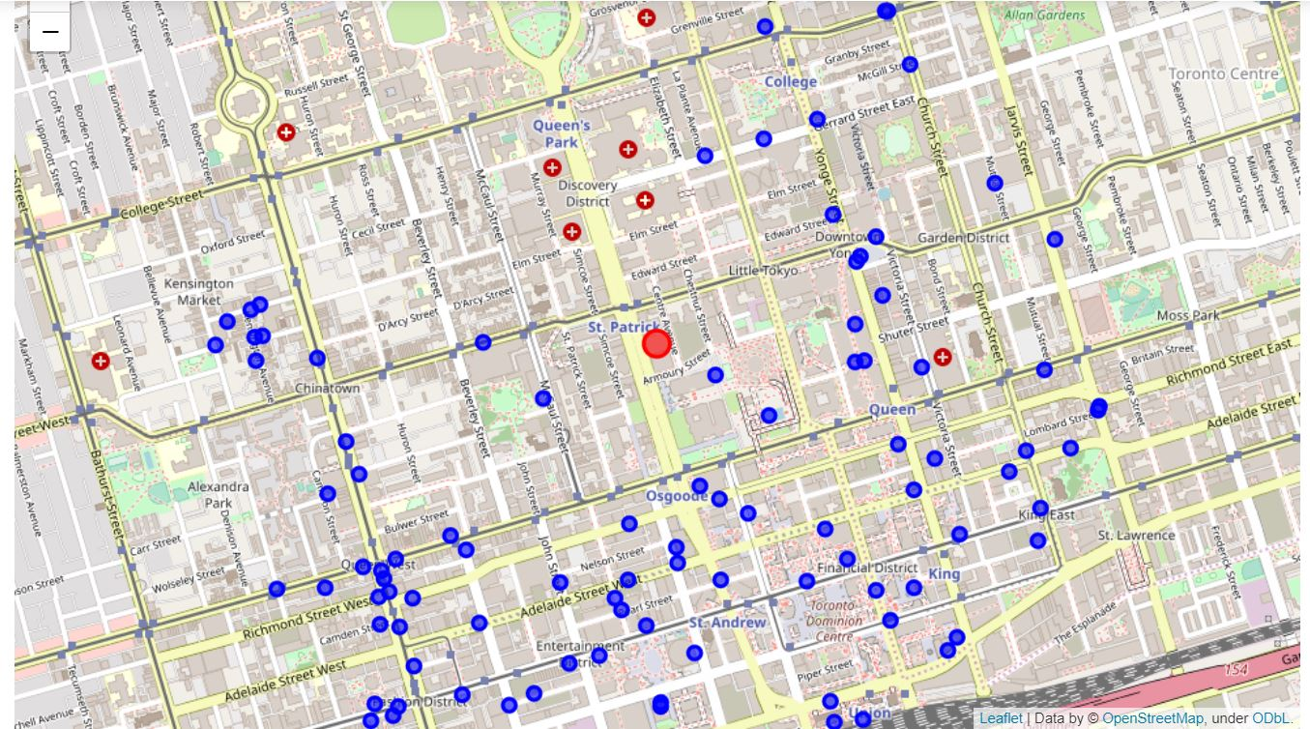
Methodology
we can consider the region with high density of different venues is prosperous region and is suitable to open a Pizza, and vice versa. The density distribution can be shown in right picture, where the red point is the location of city center and little blue points are venues.

Slide 6
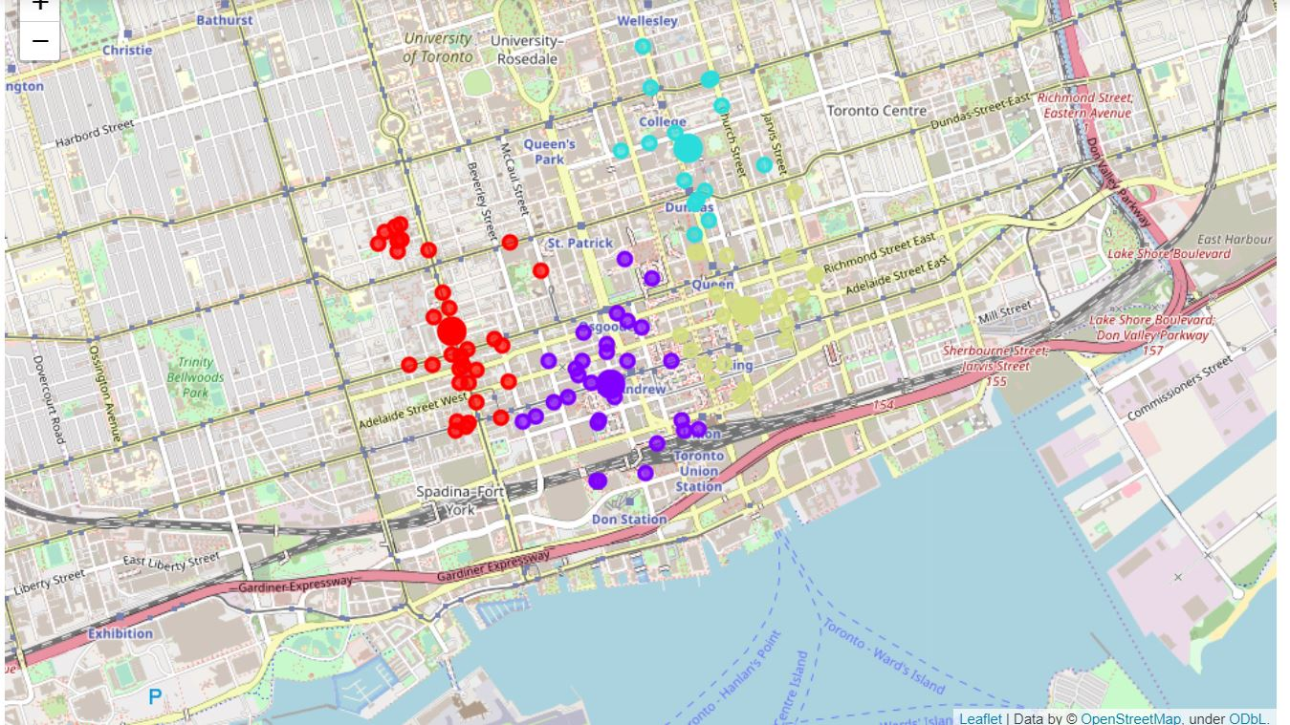
Methodology
What we want to do is clustering these points and forms four sub-regions, using K-Means. We set the parameter is 4 clusters in kmeans and get the figure3, where we can see the conclusion of clustering: the four different colors mean different clusters.

Slide 7
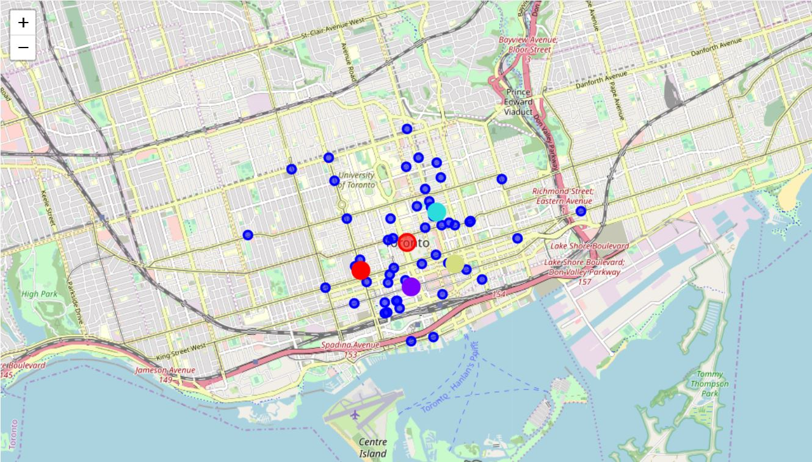
Results
We can notice the relationship between four sub-centers and our competitors. The little blue points are Pizza restaurants in Central Toronto.

Slide 8
Discussion
To discuss the final decision, we need some statistical information. Let’s first decide which point located in the most popular region, that is red
point with 33 venues, purple point with 29 venues, blue point with 15 venues and yellow one with 23 venues. Next, it is important to know the low-density region of competitors, that is yellow point with least competitors, and is considered the best location.
We can also get the distance between them and city center. Since the difference is small, we cam just ignore it.：

Slide 9
Conclusion
The concrete information is not enough in this report, for instance, we don’t consider the location which may induce the cost. In a nut shell, this is a prototype of the location choice problem and after considering more information, we can get a better model.
Notes:
在“幻灯片放映”模式下，选择箭头访问相应链接。

Slide 10
Thanks for watching.

