Slide 1
Bayesian Haplotype Inference for Multiple Linked Single Nucleotide
Polymorphisms
BIOS 560R
Fall 2012
Steve Qin

Slide 2
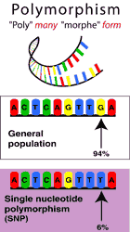
What is a SNP?

Slide 3
Notation
Allele: Alternative form of a gene
e.g., ABO blood group: A, B, O
for bi-allelic
A Major allele, or wild-type
a Minor allele, or mutant
Locus: The physical location of a gene

Slide 4
Haplotype
Definition: an ordered list of alleles of multiple linked loci on a single chromosome

Slide 5
Haplotype
Definition: an ordered list of alleles of multiple linked loci on a single chromosome
Marker loci
chromosome
  Status
  C 1 1 0 7 2 4 2 6
  C 1 1 0 7 0 4 8 4
  C 1 0 1 4 5 5 3 1
  C 1 0 1 7 5 4 5 2
  N 0 1 1 1 3 4 1 4
  N 1 0 0 7 3 7 9 1
  N 0 1 1 7 5 7 8 6
  N 1 0 0 2 4 3 2 3
A1 A2 A3 A4 A5 A6 A7 A8
Haplotypes

Slide 6
Genotype The set of genes present in an individual
  homozygous wild A/A
  homozygous mutant a/a
  heterozygous A/a

Slide 7
The Problem
We start with a collection of genotypes of tightly linked SNPs from a set of n individuals
Subject 1 AA BB cc
Subject 2 Aa BB cc
Subject 3 AA Bb Cc
Subject 4 aa BB Cc
Subject 5 Aa Bb CC
.
.
.

Slide 8
The Problem
We start with a collection of genotypes of tightly linked SNPs from a set of n individuals
A B c
A B c
Subject 1 AA BB cc
Subject 2 Aa BB cc
Subject 3 AA Bb Cc
Subject 4 aa BB Cc
Subject 5 Aa Bb CC
.
.
.

Slide 9
The Problem
We start with a collection of genotypes of tightly linked SNPs from a set of n individuals
Subject 1 AA BB cc
Subject 2 Aa BB cc
Subject 3 AA Bb Cc
Subject 4 aa BB Cc
Subject 5 Aa Bb CC
.
.
.
A B c
a B c

Slide 10
The Problem
We start with a collection of genotypes of tightly linked SNPs from a set of n individuals
Subject 1 AA BB cc
Subject 2 Aa BB cc
Subject 3 AA Bb Cc
Subject 4 aa BB Cc
Subject 5 Aa Bb Cc
.
.
.
A B C
A b c
or
A B c
A b C

Slide 11
The Problem
We start with a collection of genotypes of tightly linked SNPs from a set of n individuals
Subject 1 AA BB cc
Subject 2 Aa BB cc
Subject 3 AA Bb Cc
Subject 4 aa Bb Cc
Subject 5 Aa Bb Cc
.
.
.
a B C
a b c
or
a B c
a b C

Slide 12
The Problem
We start with a collection of genotypes of tightly linked SNPs from a set of n individuals
Subject 1 AA BB cc
Subject 2 Aa BB cc
Subject 3 AA Bb Cc
Subject 4 aa BB Cc
Subject 5 Aa Bb Cc
.
.
.
A B C
a b c
or
A B c
a b C
or
A b C
a B c
or
A b c
a B C

Slide 13
Gibbs Sampler
Haplotype
Frequency
T T A C C --- θ₁
T T A C G --- θ₂
T T A G C --- θ₃
T T A G G --- θ₄
T T C C C --- θ₅
T T C C G --- θ₆
T T C G C --- θ₇
T T C G G --- θ₈
Each individual’s two haplotypes are treated as random draws from a pool of haplotypes with unknown frequencies.

Slide 14
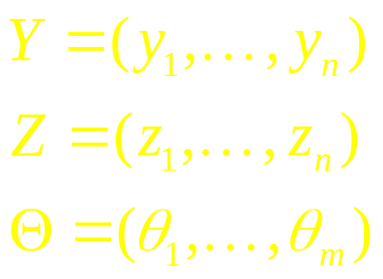
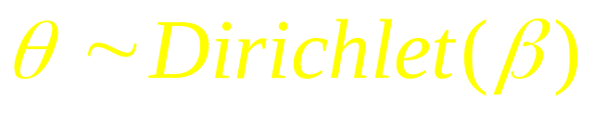
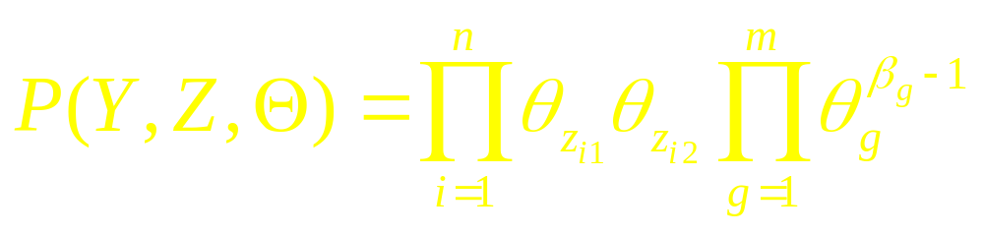
Bayesian Inference
Genotype
Haplotype
Frequency
Prior

Slide 15

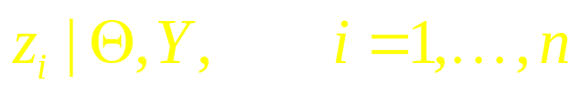




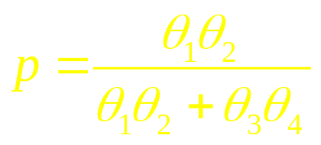
Conditional Distributions
Parameters of interest: (Z, )
Conditional distribution for Gibbs Sampler:
A B C
a b C
Subject 1 Aa Bb CC
A b C
a B C

Slide 16
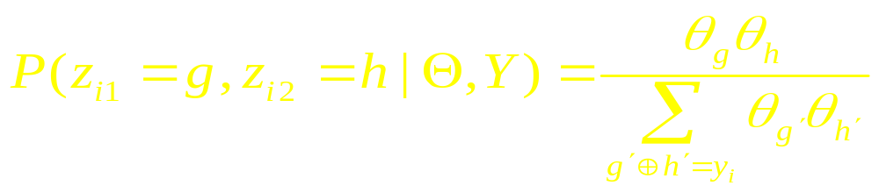

Conditional Distributions
Parameters of interest: (Z, )
Conditional distribution for Gibbs Sampler:
A B C n₁+β₁
A B c n₂+β₂
A b C n₃+β₃
A b b n₄+β₄
a B C n₅+β₅

Slide 17
Conditional Distributions
Parameters of interest: (Z, )
Conditional distribution for Gibbs Sampler:

Slide 18

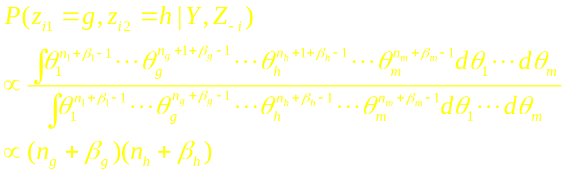
Predictive Updating
Treat as nuisance parameter and integrate it out
Conditional distribution for Gibbs Sampler:
Liu, JASA, 1994; Chen and Liu, JRSSB, 1996

Slide 19
References
Niu T, Qin ZS, Xu X, Liu JS (2002) Bayesian haplotype inference for multiple linked single-nucleotide polymorphisms. Am J Hum Genet 70:157-69.
Qin, Z.S., Niu, T. and Liu, J.S. (2002) Partition-Ligation EM Algorithm for Haplotype Inference with Single Nucleotide Polymorphisms. Am J Hum Genet 71 1242-1247.

