Slide 1
Advanced Statistical Computing
Fall 2016
Steve Qin

Slide 2
Markov Chain Monte Carlo
The goal is to generates sequence of random samples from an arbitrary probability density function (usually high dimensional),
The sequence of random samples form a Markov chain,
The purpose is simulation (Monte Carlo).

Slide 3
Motivation
Generate iid r.v. from high-dimensional arbitrary distributions is extremely difficult.
Drop the “independent” requirement.
How about also drop the “identically distributed” requirement?

Slide 4
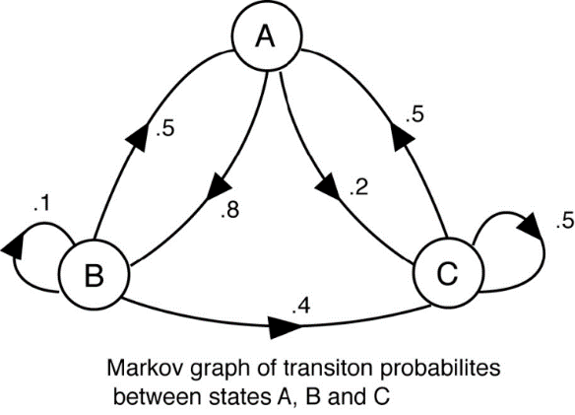
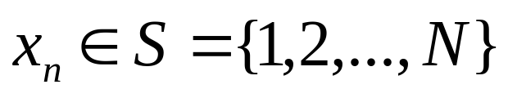
Markov chain
Assume a finite state, discrete Markov chain with N different states.
Random process X_{n}, n = 0,1,2,…
Markov property,
Time-homogeneous
Order
  Future state depends on the past m states.

Slide 5
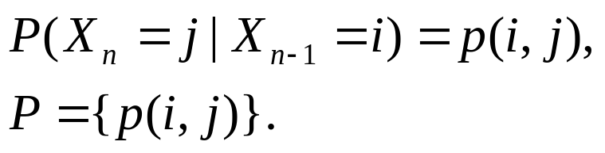
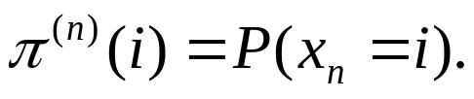

Key parameters
Transition matrix
Initial probability distribution π⁽⁰⁾
Stationary distribution (invariant/equilibrium)

Slide 6
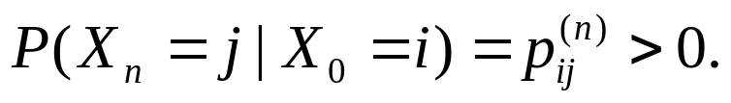
Reducibility
A state j is accessible from state i (written i→ j) if
A Markov chain is irreducible if it is possible to get to any state from any state.

Slide 7
Recurrence
A state i is transient if given that we start in state i, there is a non-zero probability that we will never return to i. State i is recurrent if it is not transient.

Slide 8
Ergodicity
A state i is ergodic if it is aperiodic and positive recurrent. If all states in an irreducible Markov chain are ergodic, the chain is ergodic.

Slide 9

Reversible Markov chains
Consider an ergodic Markov chain that converges to an invariant distribution π. A Markov chain is reversible if for all x, y ϵ S,
which is known as the detailed balance equation.
An ergodic chain in equilibrium and satisfying the detailed balance condition has π as its unique stationary distribution.

Slide 10
Markov Chain Monte Carlo
The goal is to generates sequence of random samples from an arbitrary probability density function (usually high dimensional),
The sequence of random samples form a Markov chain,
in Markov chain, P → π
in MCMC, π → P.

Slide 11
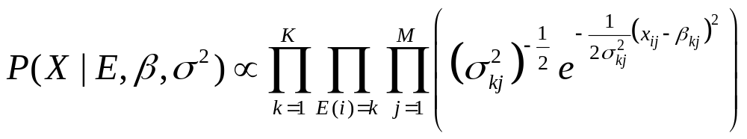
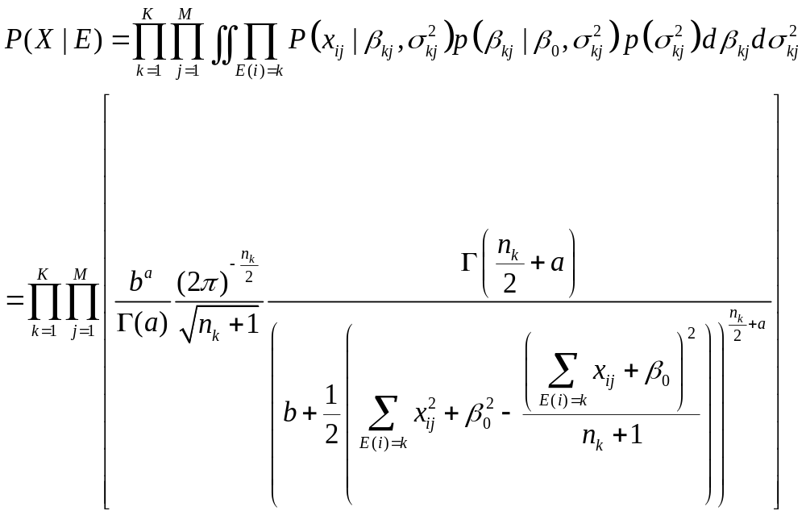
Examples

Slide 12
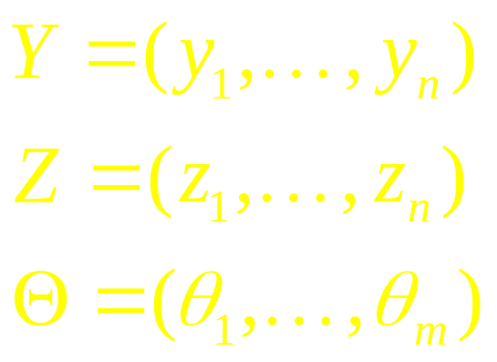
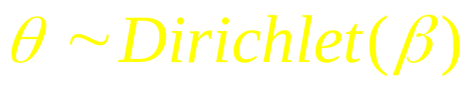
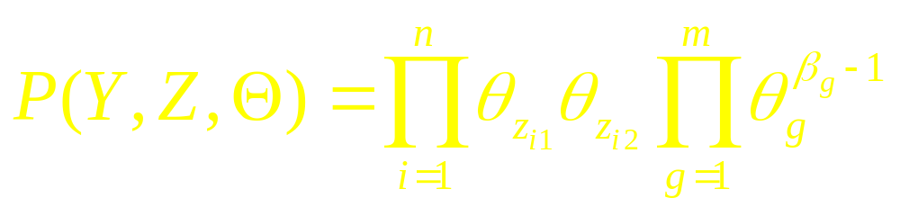
Bayesian Inference
Genotype
Haplotype
Frequency
Prior

Slide 13
History
Metropolis, N., Rosenbluth, A. W., Rosenbluth, M. N., Teller, A. H. and Teller, E. (1953).
Equation of state calculations by fast computing machines. Journal of Chemical Physics, 21, 1087–1092.

Slide 14
Metropolis algorithm
Direct sampling from the target distribution is difficult,
Generating candidate draws from a proposal distribution,
These draws then “corrected” so that asymptotically, they can be viewed as random samples from the desired target distribution.

Slide 15
Pseudo code
Initialize X₀,
Repeat
  Sample Y ~ q(x,.),
  Sample U ~ Uniform (0,1),
  If U ≤ α (X,Y), set X_{i} = y,
  Otherwise X_{i} = x.

Slide 16
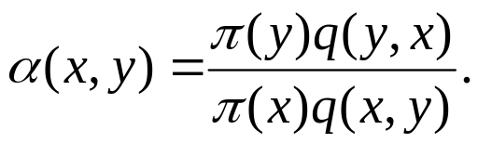
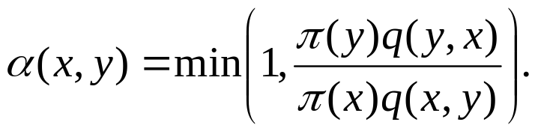
An informal derivation
Find α (X,Y):
Joint density of current Markov chain state and the proposal is g(x,y) = q(x,y)π(x)
Suppose q satisfies detail balance
q(x,y) π(x) = q(y,x)π(y)
If q(x,y) π(x) > q(y,x)π(y), introduce
α(x,y) < 1 and α(y,x) =1
hence
If q(x,y) π(x) > q(y,x)π(y), …
The probability of acceptance is

Slide 17
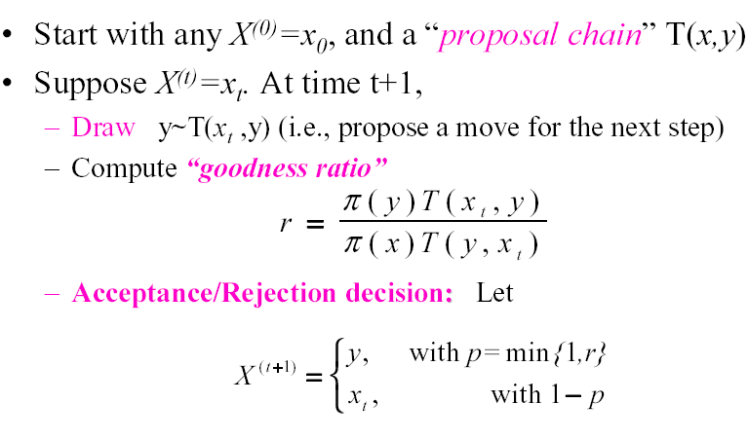
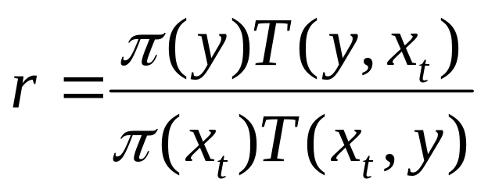
Metropolis-Hastings Algorithm

Slide 18
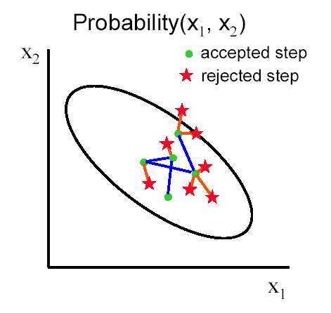
Remarks
Relies only on calculation of target pdf up to a normalizing constant.

Slide 19
Remarks
How to choose a good proposal function is crucial.
Sometimes tuning is needed.
  Rule of thumb: 30% acceptance rate
Convergence is slow for high dimensional cases.

Slide 20
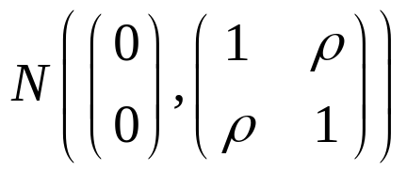
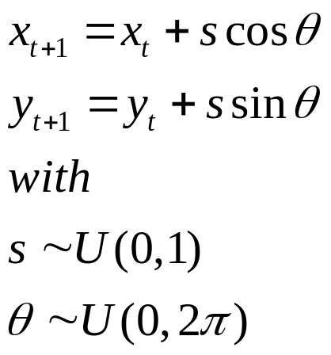
Illustration of Metropolis-Hastings
Suppose we try to sample from a bi-variate normal distributions.
Start from (0, 0)
Proposed move at each step is a two dimensional random walk

Slide 21
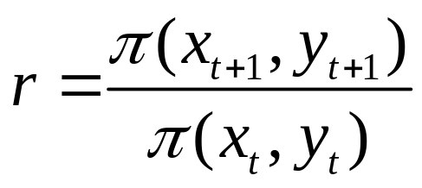
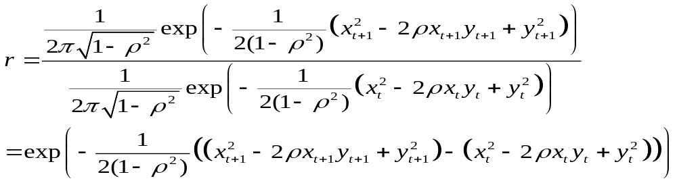
Illustration of Metropolis-Hastings
At each step, calculate
since

Slide 22
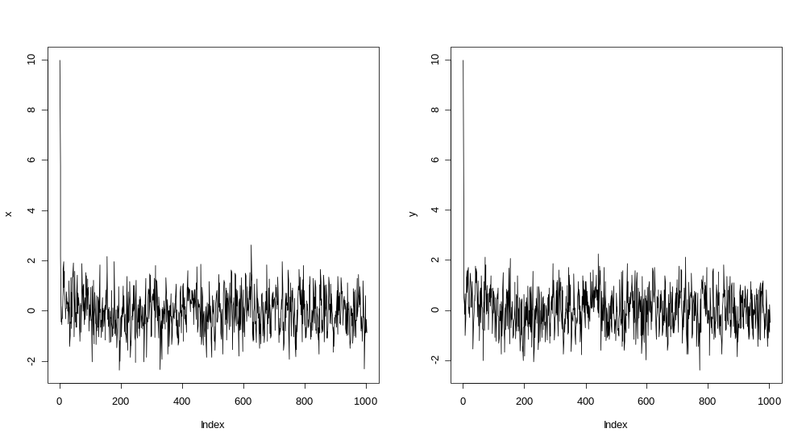
Convergence
Trace plot Good

Slide 23
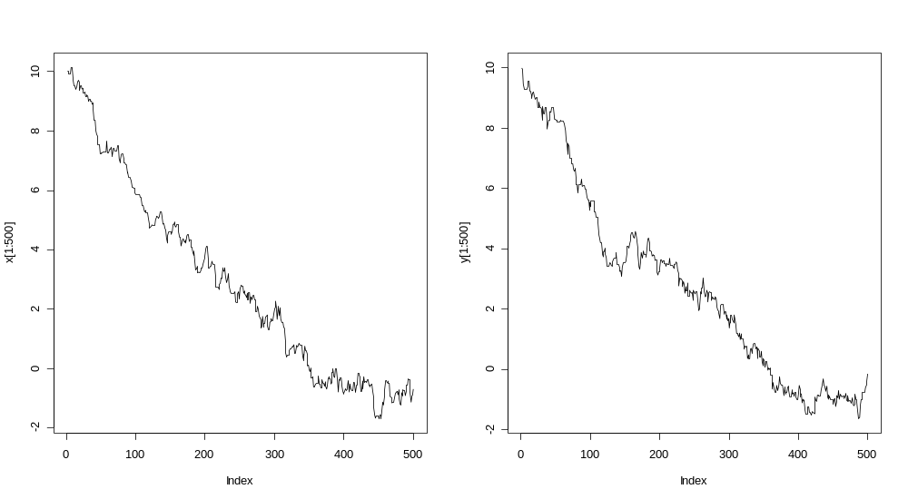
Convergence
Trace plot Bad

Slide 24
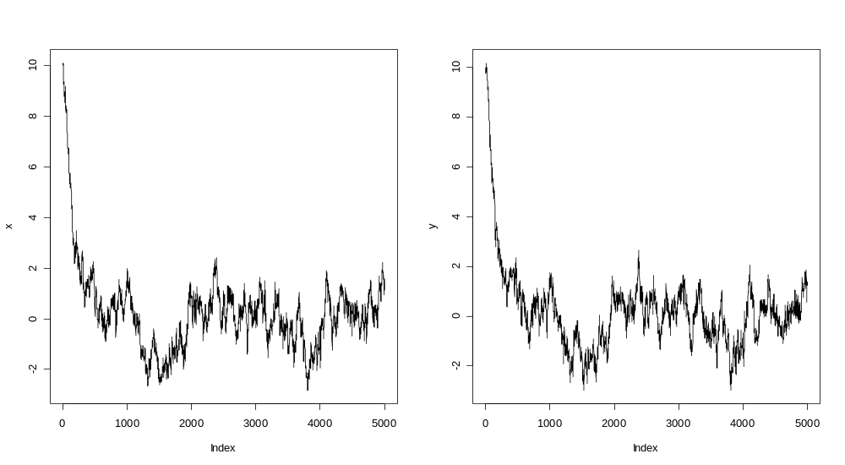
Convergence
Trace plot

Slide 25
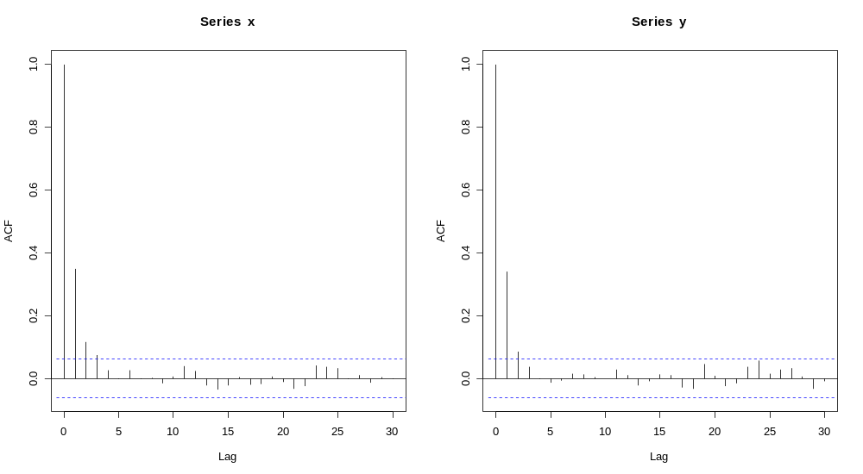
Convergence
Autocorrelation plot Good

Slide 26
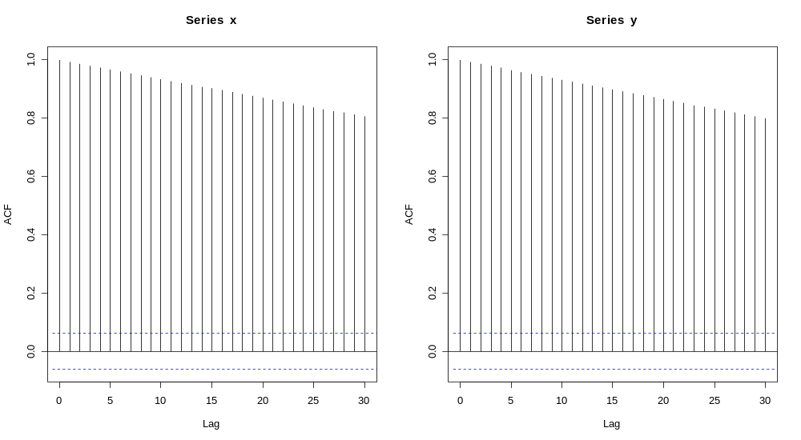
Convergence
s = 0.5
Autocorrelation plot Bad

Slide 27
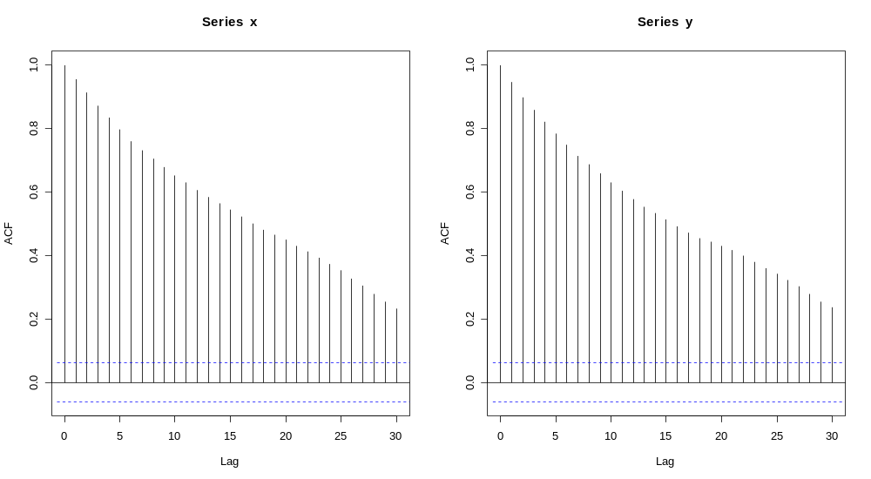
Convergence
s = 3.0
Autocorrelation plot Okay

Slide 28
References
Metropolis et al. 1953,
Hastings 1973,
Tutorial paper:
Chib and Greenberg (1995). Understanding the Metropolis--Hastings Algorithm. The American Statistician 49, 327-335.

Slide 29
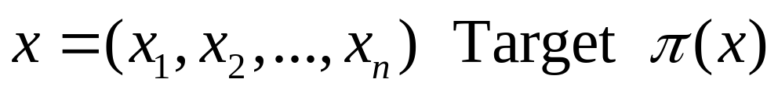
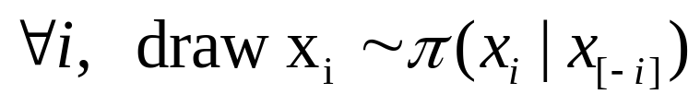
Gibbs Sampler
Purpose: Draw random samples form a joint distribution (high dimensional)
Method: Iterative conditional sampling

Slide 30
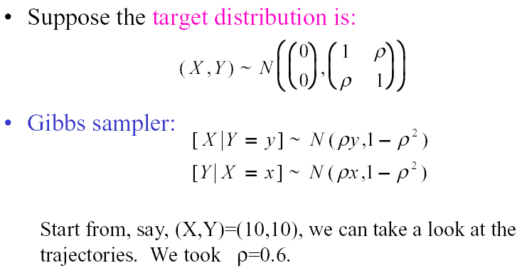
Illustration of Gibbs Sampler

Slide 31
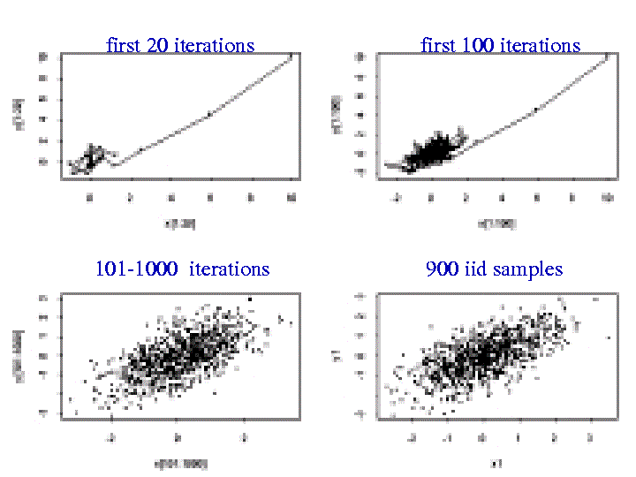

Slide 32
References
Geman and Geman 1984,
Gelfand and Smith 1990,
Tutorial paper:
Casella and George (1992). Explaining the Gibbs sampler. The American Statistician, 46, 167-174.

Slide 33
Remarks
Gibbs Sampler is a special case of Metropolis-Hastings
Compare to EM algorithm, Gibbs sampler and Metropolis-Hastings are stochastic procedures
Verify convergence of the sequence
Require Burn in
Use multiple chains

Slide 34
References
Geman and Geman 1984,
Gelfand and Smith 1990,
Tutorial paper:
Casella and George (1992). Explaining the Gibbs sampler. The American Statistician, 46, 167-174.

