Slide 1
Advanced Statistical Computing
Fall 2016
Steve Qin

Slide 2
Outline
Slice sampler
Reversible jump
Parallel tempering
Collapsing, predictive updating
Sequential Monte Carlo
Convergence checking

Slide 3
Fundamental theorem of simulation
Simulating X ~ f(x) is equivalent to simulating
(X,U) ~ Uniform{(x,u): 0 < u < f(x)}.
f is the marginal density of the joint distribution.

Slide 4
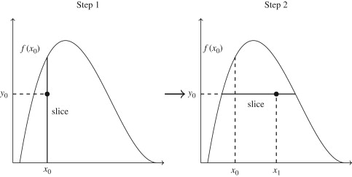



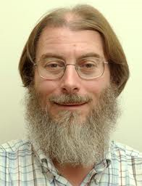

Slice sampler
2D slice sampler
At iteration t, simulate
  1.
  2. with
Neal (1997), Damien et al. (1999)

Slide 5
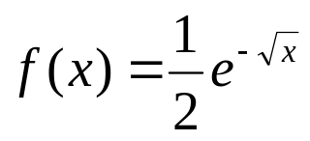
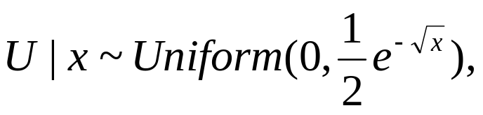

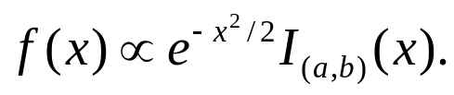
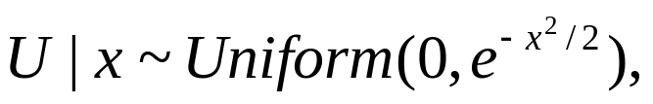
Examples
Simple slice sampler.
density function for x > 0.
Truncated normal distribution.

Slide 6
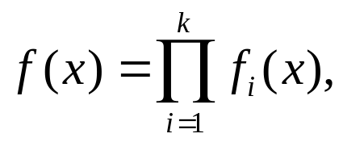
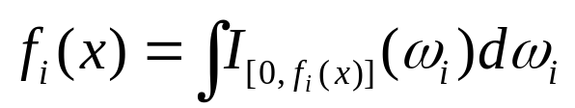
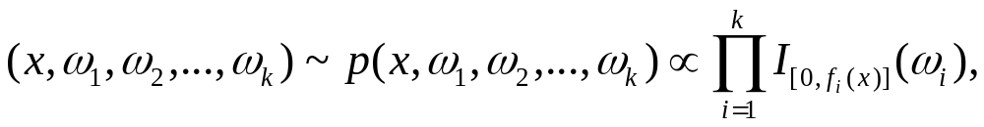
The general slice sampler
Suppose
Introduce auxiliary variables ω_{i}, such that
f is the marginal distribution of the joint dist

Slide 7



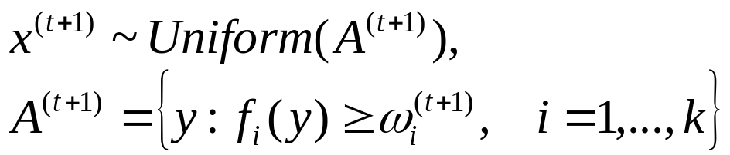
Slice sampler algorithm
At iteration t+1, simulate
1.
2.
…
k.
k+1. where

Slide 8
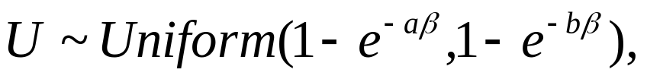
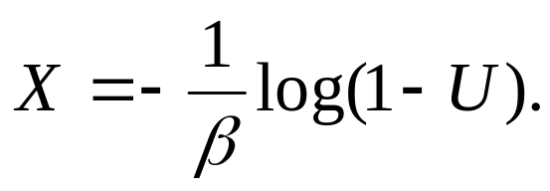

Examples
Truncated exponential E(β,a,b)
Sample and set
B(β,a,b)
Sample Y from the above distribution, and set

Slide 9
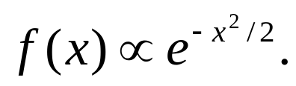
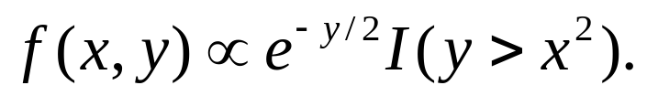

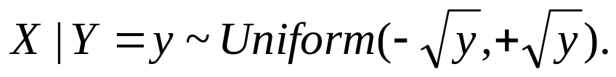
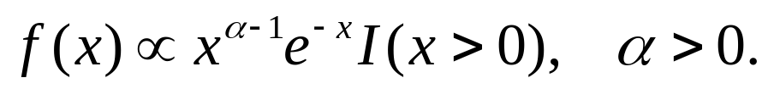
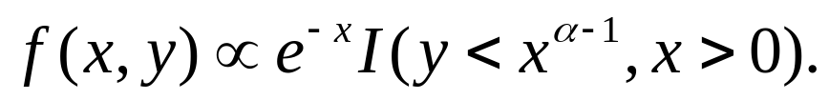

Examples
Standard normal
introduce latent variable Y > 0,
Gamma
introduce latent variable Y > 0,

Slide 10
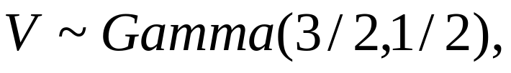
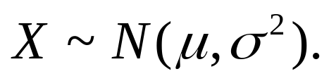
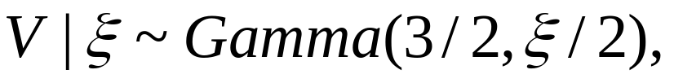
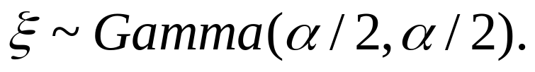
Scale mixture of uniforms
Normal
If
then
student-t

Slide 11
Related algorithms
Auxiliary variable algorithm
  Edwards and Sokal (1988)
Swendson and Wang
  Swendson and Wang (1987)

Slide 12
Reversible jump
Motivation: variable dimension models
a “model where one of the things you do not know is the number of things you do not know.” –Peter Green.
Bayesian model comparison and model selection.

Slide 13
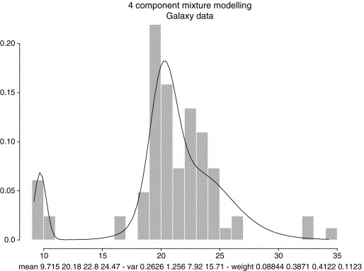
An example
Mixture modeling
Number of components
Order of an AR (p) model

Slide 14
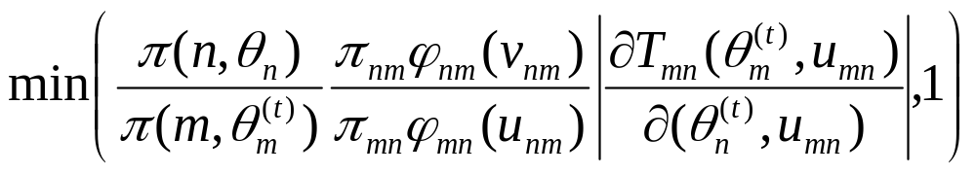
Green’s algorithm
At iteration t, if x^{(t)} = (m,θ_{m}^{(t)}),
  Select model M_{n} with probability π_{mn}
  Generate u_{mn} ~ φ_{mn}(u)
  Set (θ_{n} ,v_{nm}) ~ T_{mn}(θ_{m}^{(t)}, ,u_{mn})
  Take θ_{n}^{(t)} = θ_{n} with probability

Slide 15
Remarks
The clever idea of RJMCMC is to supplement “smaller” space with artificial space.
Dimension matching transform T_{mn} is flexible, but quite difficult to create and optimize, a serious drawback of the method.
Methodologically brilliant but difficult to implement.

Slide 16
Convergence check
Trace plot
Autocorrelation plot
Gelman and Rubin convergence measure r.

Slide 17
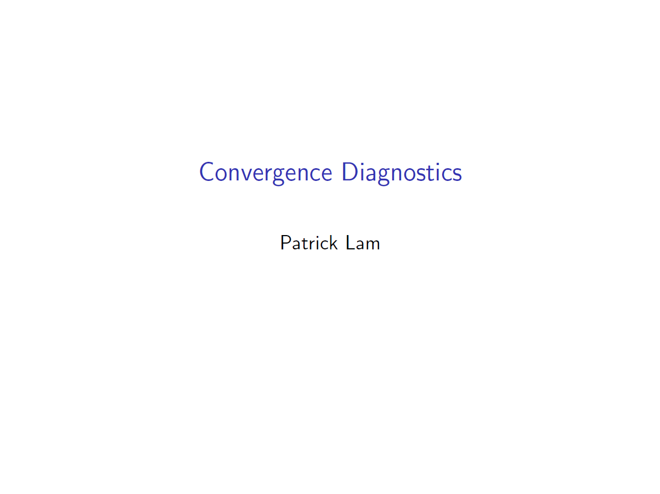

Slide 18
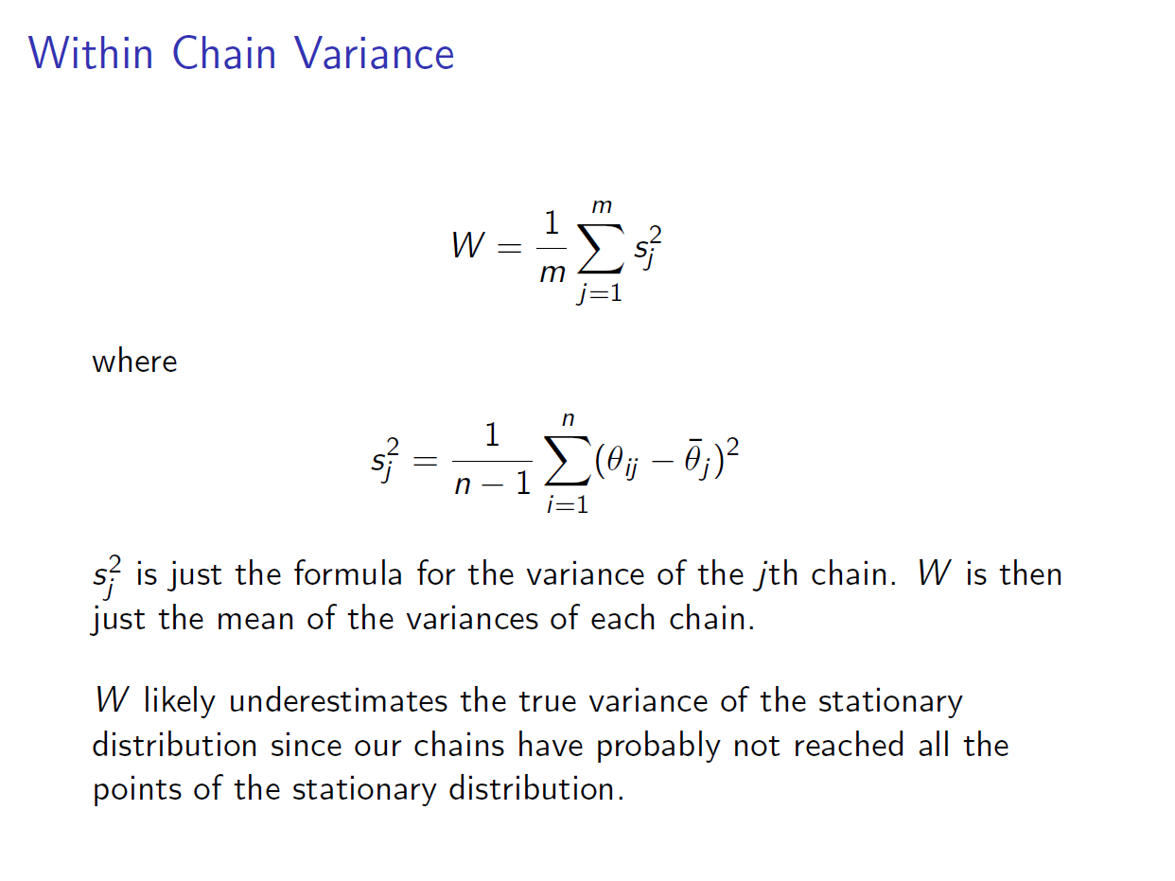

Slide 19
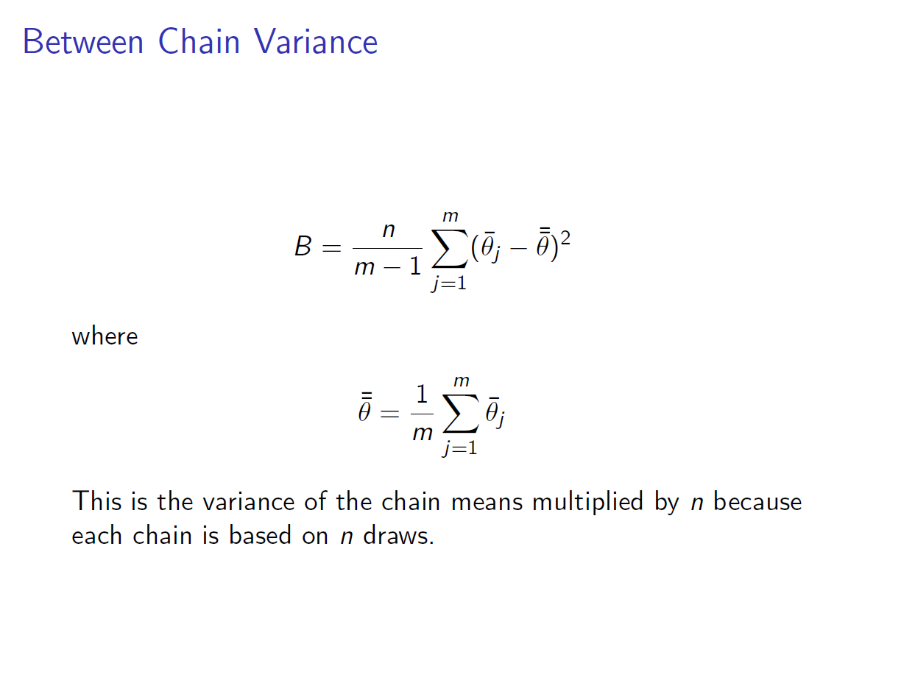

Slide 20
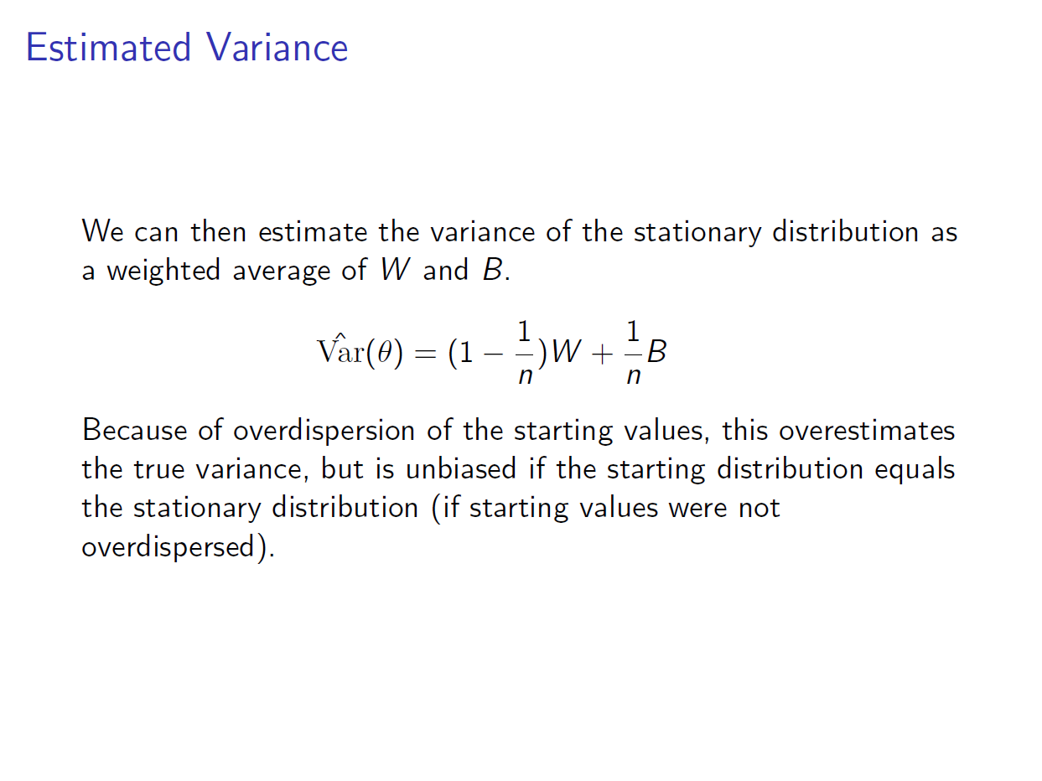

Slide 21
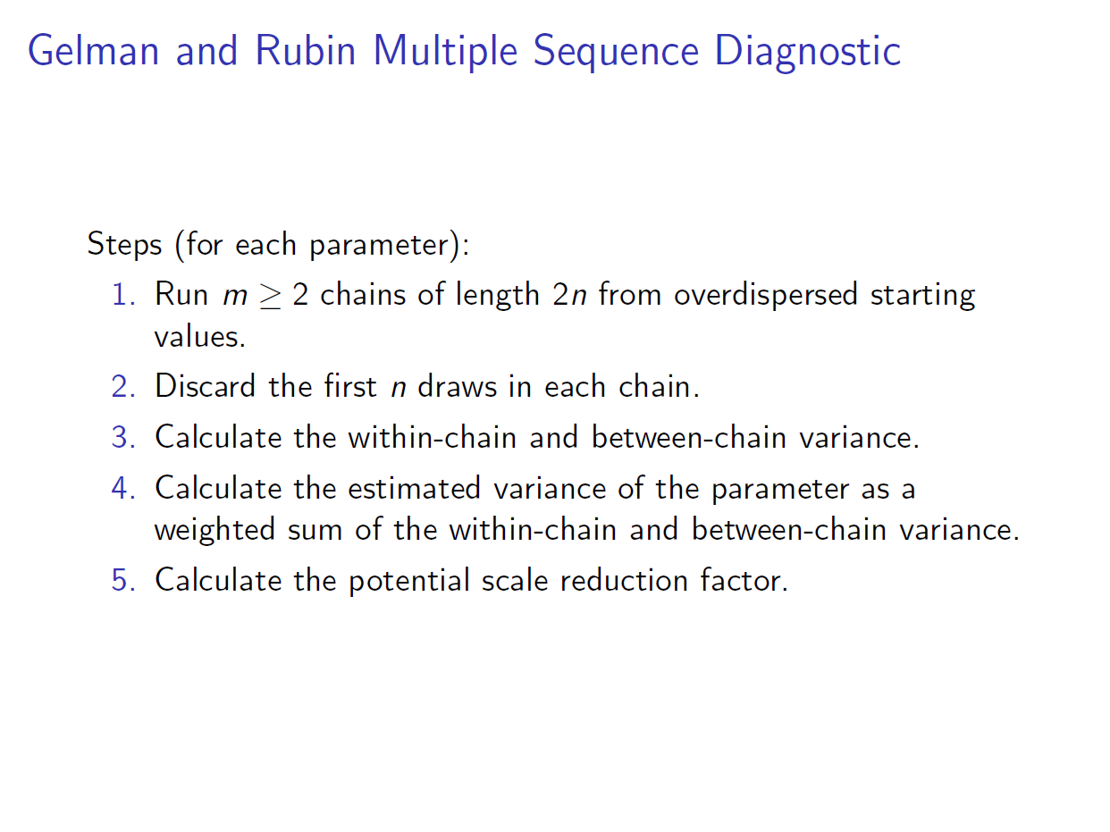

Slide 22
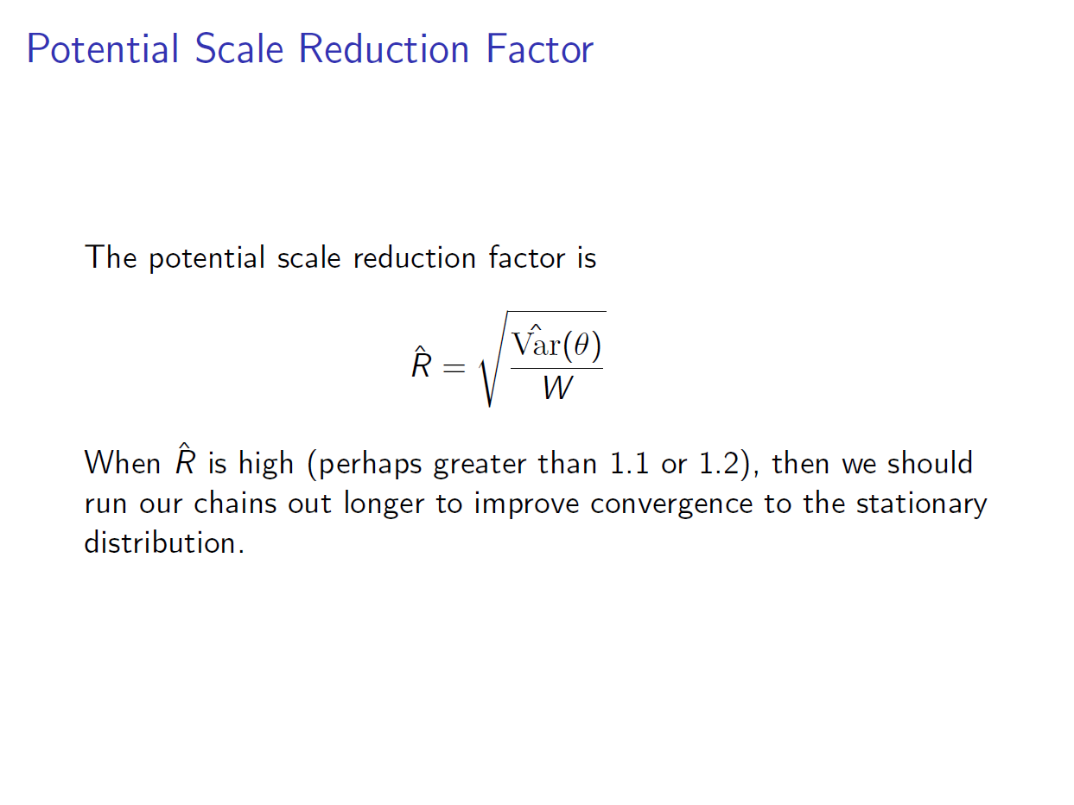

Slide 23
