Slide 1
Advanced Statistical Computing
Fall 2012
Lecture 4
Steve Qin

Slide 2
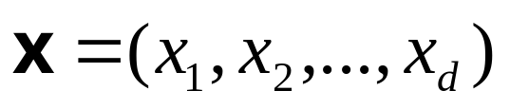
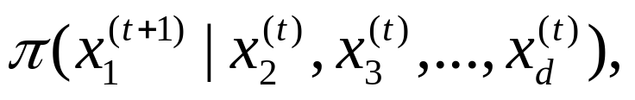

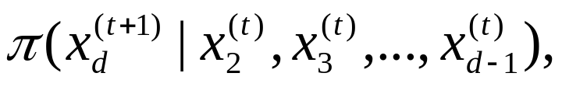

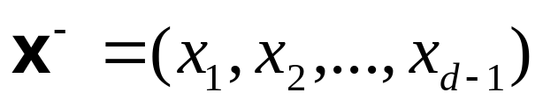
Collapsing and grouping
Want to sample from
Regular Gibbs sampler:
  Sample x₁^{(t+1)} from
  Sample x₂^{(t+1)} from
  …
  Sample x_{d}^{(t+1)} from
Alternatively:
  Grouping:
  Collapsing, i.e., integrate out x_{d}:

Slide 3
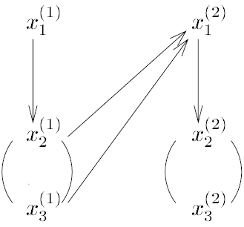
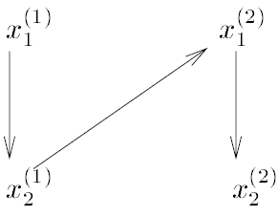
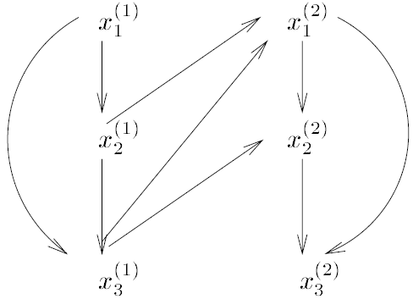
The three-schemes
standard
grouping
collapsing

Slide 4

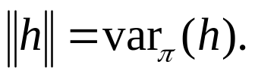
Some theory
Hilbert space L₂(π) of functions h().
Define thus
Define forward operator F as
The convergence of Markov chains is tied to the norms of the corresponding forward operators.

Slide 5
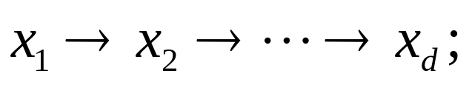
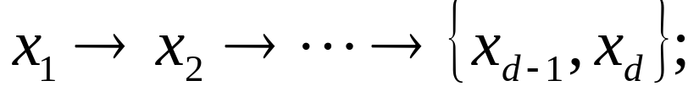
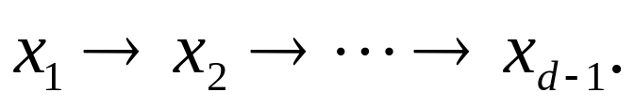
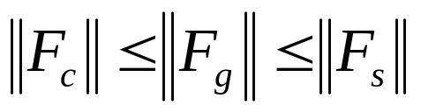
Three-scheme theorem
Standard F_{s}:
Grouping F_{g}:
Collapsing F_{c}:
Theorem The norms of the three forward operators are ordered as

Slide 6

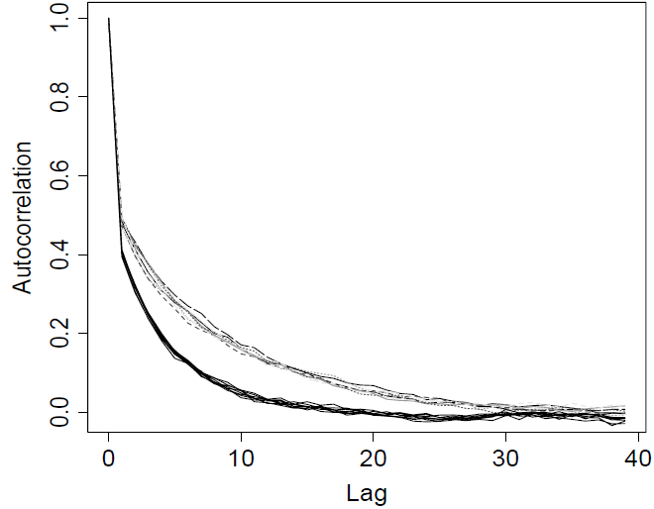
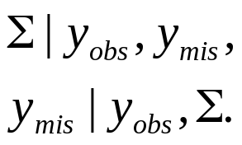

Examples
Murray’s data
Bivariate Gaussian with mean 0 and unknown covariance matrix Σ
standard collapsing

Slide 7
Remarks
Avoid introducing unnecessary parameters into a Gibbs sampler,
Do as much analytical work as possible,
However, introducing some clever auxiliary variables can greatly improve computation efficiency.

Slide 8
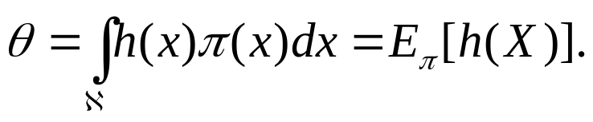
Sequential Monte Carlo
We wish to evaluate an integral
assume h(x) ≥ 0.
Riemann sum (on grid points) as approximation.
Alternatively, use Monte Carlo. Select random samples uniformly on its support.

Slide 9
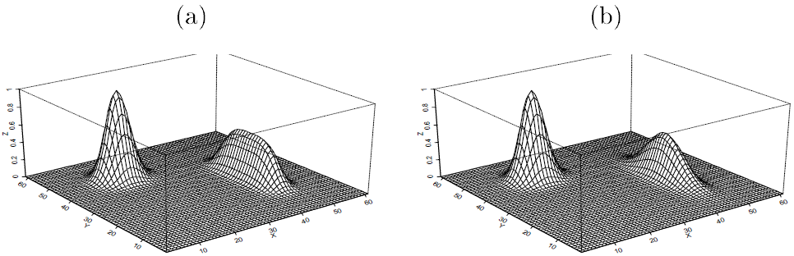
An example
Both grid-point method and vanilla Monte Carlo methods wasted resources on “boring” desert area.

Slide 10
The basic idea
Marshall (1956) suggested that one should focus on the region(s) of “importance” so as to save computational resources—importance sampling.
Essential in high-dimensional models.

Slide 11
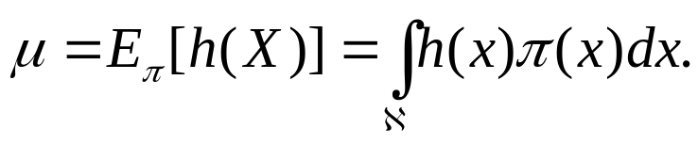

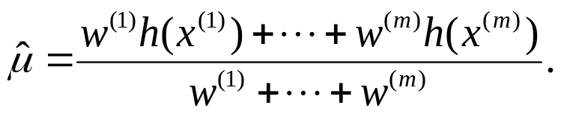

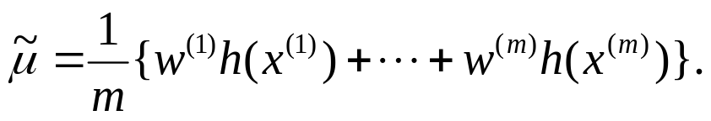
The algorithm
To evaluate
  Draw from a trial distribution g().
  Calculate the importance weight
  Approximate μ by
Remark: is better than the unbiased estimator
why?

Slide 12
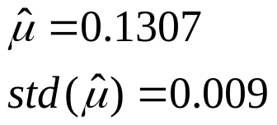
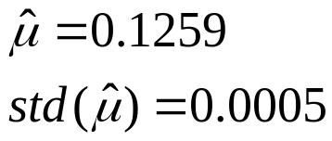
An example (cont.)
Use proposal function
with (x,y) ϵ [−1,1] x [−1,1], a truncated mixture of bivariate Gaussian
Vanilla Monte Carlo Importance Sampling

Slide 13
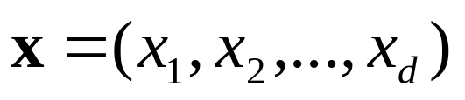
Sequential importance sampling
For high dimensional problem, how to design trial distribution is challenging.
Suppose the target density of
can be decomposed as
then constructed trial density as

Slide 14
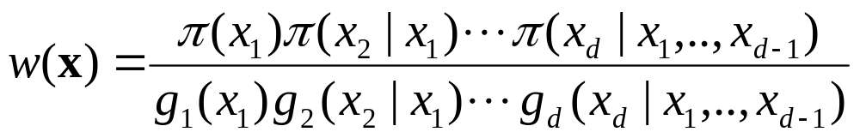
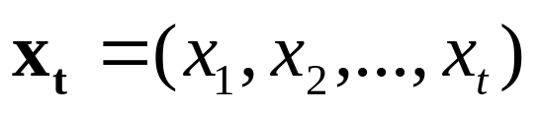
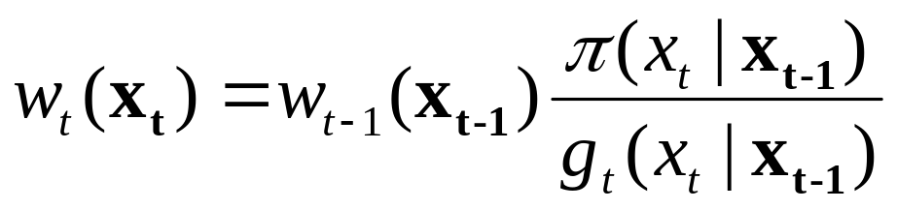
Sequential importance sampling
Suggest a recursive way of computing and monitoring importance weight. Denote
then we have

Slide 15
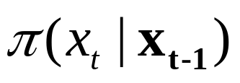
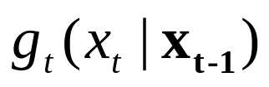
Sequential importance sampling
Advantages of the recursion scheme
  Can stop generating further components of x if the partial weight is too small.
  Can take advantage of in designing
However, the scheme is impractical since requires the knowledge of marginal distribution π(x_{t}).

Slide 16
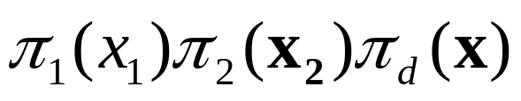
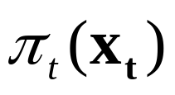
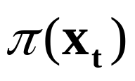
Sequential importance sampling
Add another layer of complexity:
Introduce a sequence of “auxiliary distributions” such that
is a reasonable approximation of the marginal distribution , for t = 1,…,d -1 and π_{d} = π.
Note the π_{d} are only required to be known up to a normalizing constant.

Slide 17
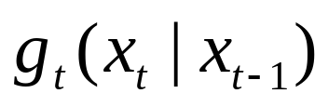
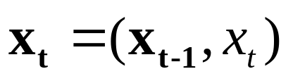
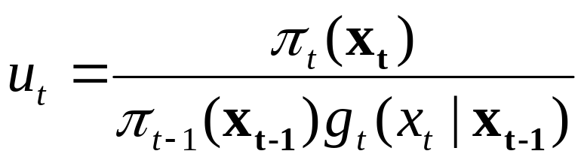
The SIS procedure
For t = 2,…,d,
Draw X_{t} = x_{t} from , and let
Compute
and let w_{t} = w_{t -1} u_{t}
u_{t} : incremental weight.
The key idea is to breaks a difficult task into manageable pieces.
If w_{t} is getting too small, reject.

Slide 18
An application example of SIS
Assume
  Constant population size N,
  Evolve in non-overlapping generation,
  The chromosomal region is sufficiently small,
  No recombination,
  “haplotype”: each chromosome only has one parent.

Slide 19

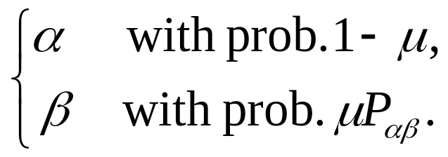
Population genetics example
Notation:
  E: set of all possible genetic types,
  μ: mutation rate per chromosome per generation,
  : the mutation transition matrix,
  If a parental segment of type α ϵ E,
  its progeny is

Slide 20
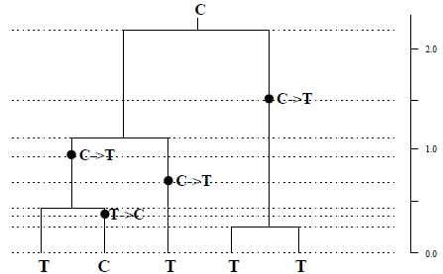
Example data
From Stephens and Donnelly (2000)
E={C,T}
The history H = (H_{-k}, H_{-(k-1)},…, H₋₁, H₀)
= ({C}, {C,C}, {C,T}, {C,C,T}, {C,T,T}, {T,T,T},
{T,T,T,T}, {C,T,T,T,T}, {C,T,T,T,T})

Slide 21
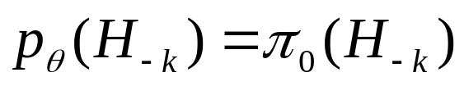
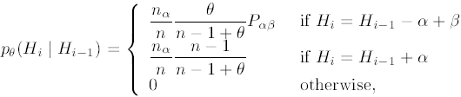
Coalescence example
Use H = (H_{-m},…, H₋₁, H₀) to denote the whole ancestral history (unobserved) of the 5 individuals.
Compute the likelihood function
, π₀ is the stationary distribution of P.

Slide 22

Coalescence calculation
For i = -(k-1),…,0

Slide 23
Notations
n is the sample size at generation H_{i-1}
n_{α} is the number of chromosome of type α in the sample.
θ=2Nμ/ν.
N population size.
ν² is the variance of the number of progeny of a random chromosome.

Slide 24

Strategies to estimate θ
To get MLE, we need to compute likelihood
Naïve Monte Carlo won’t work because of compatibility issue.
An alternative is to simulate H backward starting from H₀ and use weight to correct bias.

Slide 25
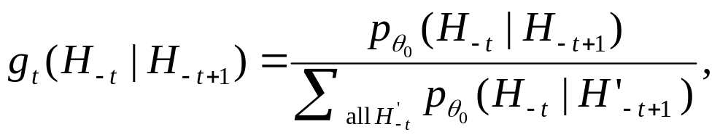
An SIS approach
Simulate H₋₁, H₋₁,…, from a trial distribution built up sequentially by revering the forward sampling probability at a fixed θ₀. That is, for i =1,…,k, we have
the final trial distribution

Slide 26
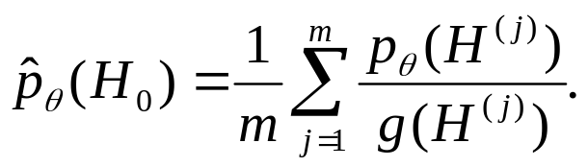
An SIS approach
By simulating from g() multiple copies of the history, H^{(j)} , j=1,…,m, we can approximate the likelihood function as
Note the choice of θ₀ can influence the final result.

Slide 27
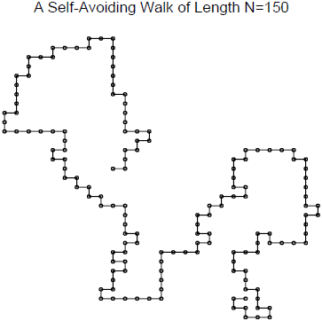
Other examples of SIS
Growing a polymer
  Self avoid walk
Sequential imputation for statistical missing data problem.
More and details of these examples, see
Liu 2001.

Slide 28
Future topics
Multigrid Monte Carlo (MGMC), density-scaling Monte Carlo, hybrid Monte Carlo (HMC), evolutionary Monte Carlo, exchange Monte Carlo.
Cluster method, data augmentation. Parameter expansion, multicanonical sampling, umbrella sampling, simulated tempering, multi-try Metropolis, particle filtering, …

