Slide 1
Diagnosing the categories of non-small cell lung cancer
ST7014-Haoxiang Xu

Slide 2
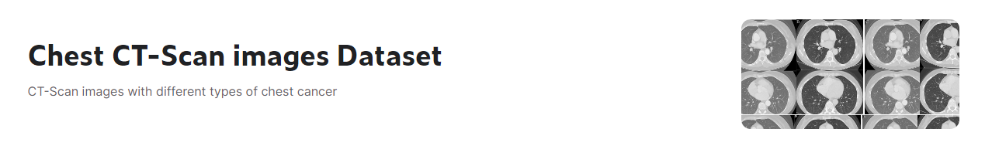
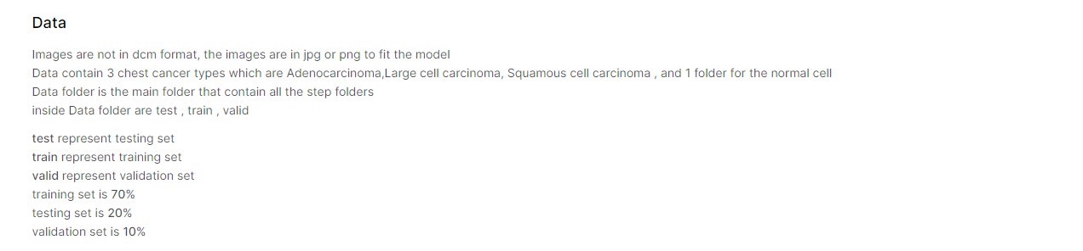
About the Dataset
https://www.kaggle.com/datasets/mohamedhanyyy/chest-ctscan-images/code

Slide 3
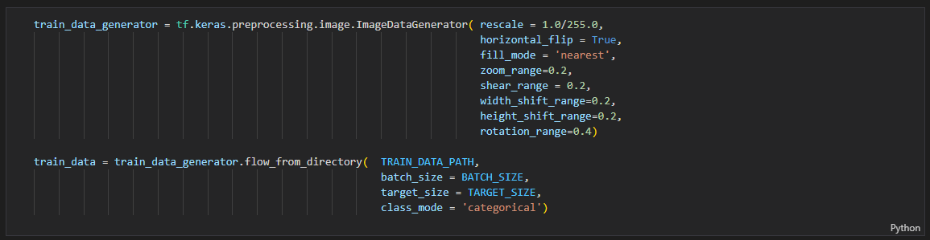
Dataset Preprocessing
- Normalization
- Applying transformations

Slide 4
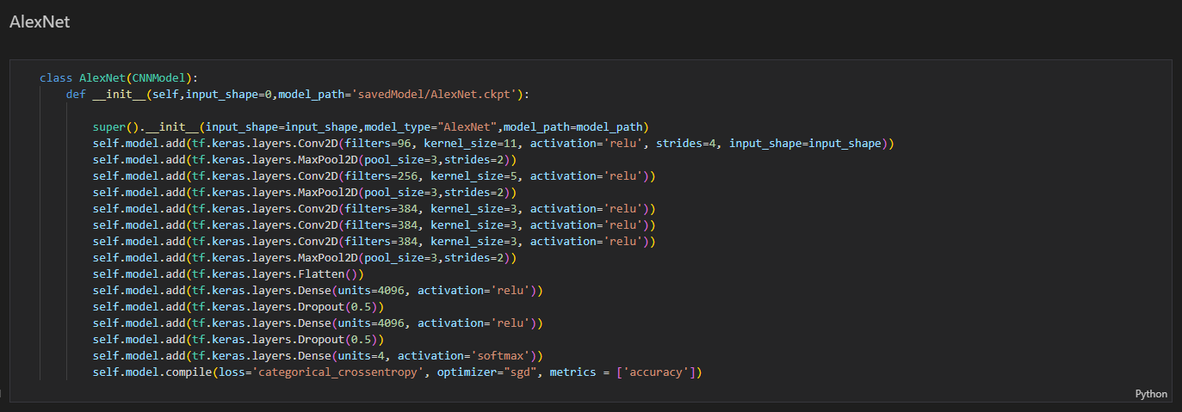
Implementation of AlexNet

Slide 5
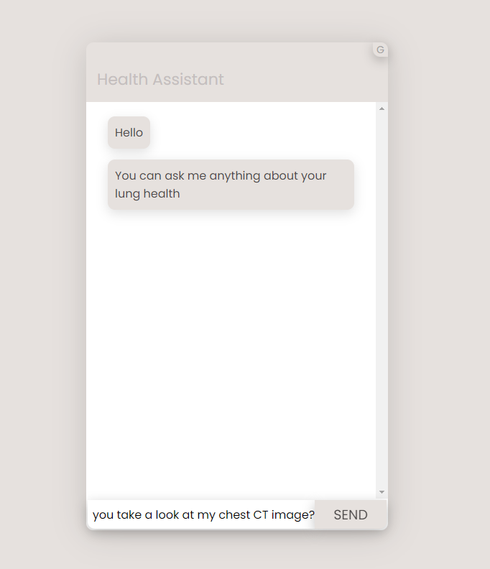
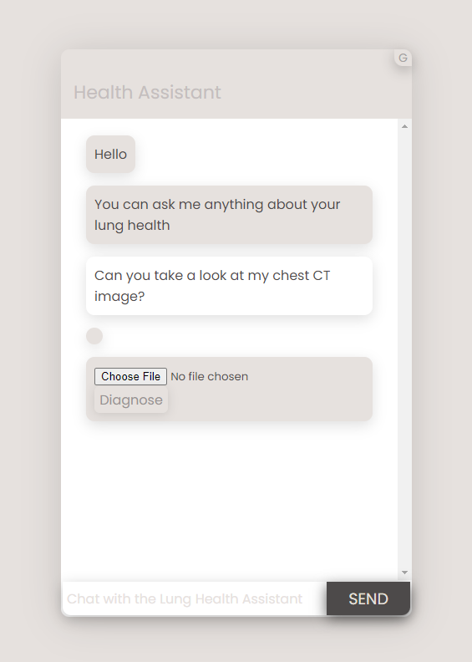
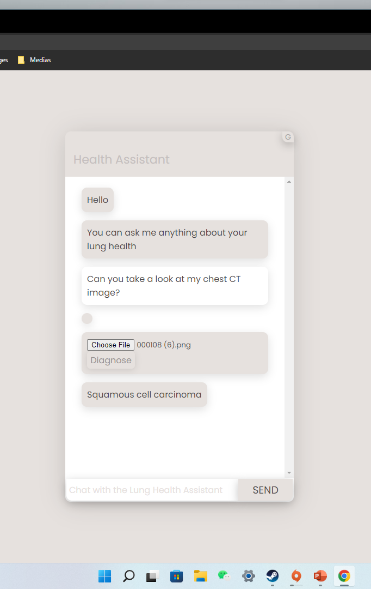
Web-based Chatbot GUI

Slide 6
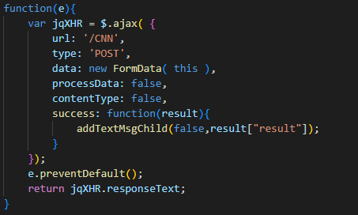
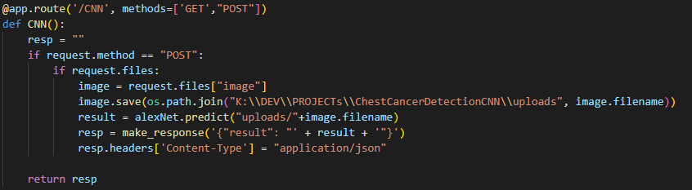
Flask Python Web application
Prediction
- JavaScript send POST request
- Python receive POST request
- Images goes to CNN
- Python send result back to JavaScript
- JavaScript modifies HTML page
Sever
- Create CNN object
- Loads trained weight for neurons
- Waiting for prediction request

Slide 7
Credits
Krizhevsky, Alex; Sutskever, Ilya; Hinton, Geoffrey E. (2017-05-24). "ImageNet classification with deep convolutional neural networks" (PDF). Communications of the ACM. 60 (6): 84–90. doi:10.1145/3065386. ISSN 0001-0782. S2CID 195908774.
https://www.kaggle.com/datasets/mohamedhanyyy/chest-ctscan-images/code
https://www.superdatascience.com/the-ultimate-guide-to-convolutional-neural-networks-cnn/

