Slide 1
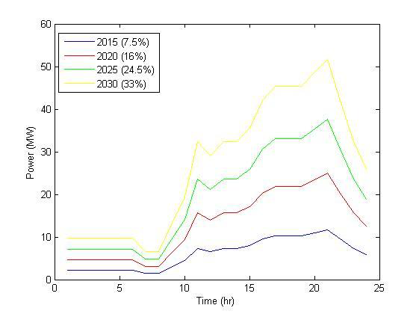
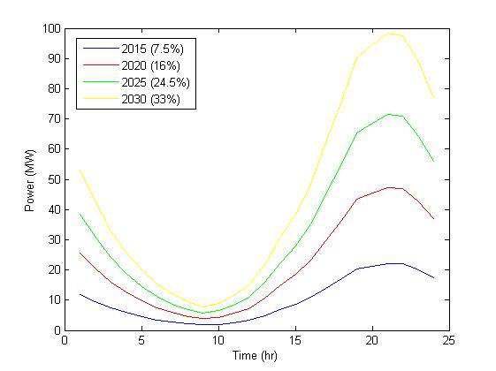
Commercial Sites
0: 19
1-6: 7.1
7-8: 5
9: 9
10: 13.5
11: 23.4
12: 21.1
13-14: 23.4
15: 25.7
16: 31.8
17-19: 33.2
20: 35.2
21: 37.5
22: 29.5
23: 23.6
Residential Sites
0: 56.5
1: 39.2
2: 31
3: 24
4: 18.6
5: 14.3
6: 11.1
7: 8.6
8: 7
9: 6
10: 7
11: 8.8
12: 11.1
13: 16
14: 22
15: 28.4
16: 35.2
17: 45.1
18: 55.7
19: 65
20: 68.6
21: 72
22: 70
23: 64

