Slide 1

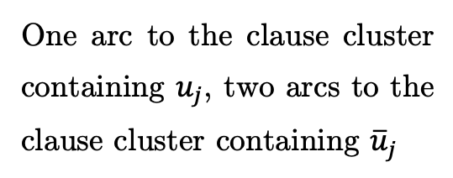




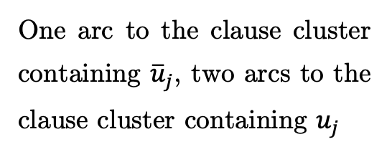

One arc to the clause cluster containing $u_{j}$, two arcs to the clause cluster containing ${\overline{u}}_{j}$
$$u_{j2}$$
$$⋮$$
$$u_{j1}$$
One arc to the clause cluster containing ${\overline{u}}_{j}$, two arcs to the clause cluster containing $u_{j}$
$$u_{j3}$$
$$⋮$$
$$T$$

Slide 2

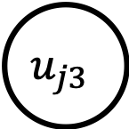
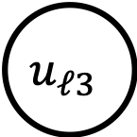

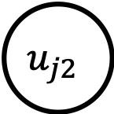
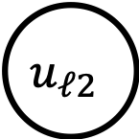

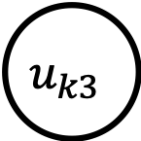
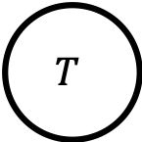
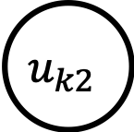

$$u_{j2}$$
$i$-th clause
$$u_{j3}$$
$$c_{ij}$$
$$u_{k2}$$
$$T$$
$$c_{ik}$$
$$u_{k3}$$
$$u_{ℓ2}$$
$$c_{iℓ}$$
$$u_{ℓ3}$$

Slide 3
$$u_{j2}$$
$i$-th clause
$$u_{j3}$$
$$c_{ij}$$
$$u_{k2}$$
$$T$$
$$c_{ik}$$
$$u_{k3}$$
$$u_{ℓ2}$$
$$c_{iℓ}$$
$$u_{ℓ3}$$

Slide 4
2
2
1
3
3
S
1
2
T

Slide 5
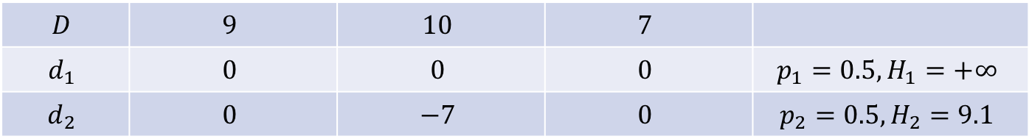
S
1
2
3
T
$$D$$ | $$9$$ | $$10$$ | $$7$$
$$d_{1}$$ | $$0$$ | $$0$$ | $$0$$ | $$p_{1}=0.5, H_{1}=+∞$$
$$d_{2}$$ | $$0$$ | $$−7$$ | $$0$$ | $$p_{2}=0.5, H_{2}=9.1$$

Slide 6
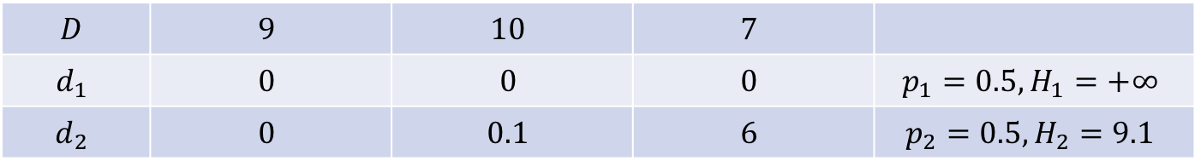
S
1
2
3
T
$$D$$ | $$9$$ | $$10$$ | $$7$$
$$d_{1}$$ | $$0$$ | $$0$$ | $$0$$ | $$p_{1}=0.5, H_{1}=+∞$$
$$d_{2}$$ | $$0$$ | $$0.1$$ | $$6$$ | $$p_{2}=0.5, H_{2}=9.1$$

Slide 7
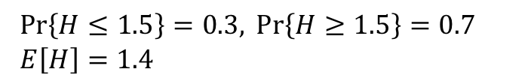
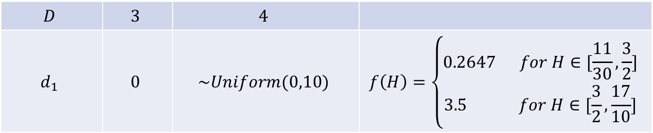
S
1
2
T
$$D$$ | $$3$$ | $$4$$
$$d_{1}$$ | $$0$$ | $$\sim Uniform(0,10)$$ | $$f\left(H\right)=\left\{\begin{aligned}0.2647 for H∈[\frac{11}{30},\frac{3}{2}] \\ 3.5 for H∈[\frac{3}{2},\frac{17}{10}]\end{aligned}\right.$$
$\operatorname{Pr}\left\{H≤1.5\right\}=0.3, \operatorname{Pr}\left\{H≥1.5\right\}=0.7$
$E\left[H\right]=1.4$

Slide 8
3
6
1
N
4
7
2
5

Slide 9



H
$$D_{1}=1$$
$$D_{3}=1$$
$$D_{2}=1$$

Slide 10
1
2
…
…
3
…
…
…
…
4
…
…
…
…
1
2
…
3
…
…
4
…
…
…

Slide 11





$$t_{N}^{0}=4.2$$
$$D_{1}=1.7$$
$$D_{2}=2, e_{21}=0.5$$
$$B=1$$
$$D_{3}=1.5$$

Slide 12





H = 1.5
$$t_{N}^{1}=5.7$$
$$D_{1}=1.7$$
$$D_{2}=2, d_{2}^{1}=0.5$$
$$D_{3}=1.5, d_{3}^{1}=1.5$$
$$e_{31}=0.5$$

Slide 13








$$t_{T}^{0}=21$$
$$D_{1}=9$$
$$D_{2}=10, e_{21}=0.5$$
$$D_{3}=7$$
$$D_{1}=9$$
$$D_{2}=10, e_{21}=0.5$$
$$D_{3}=7,d_{3}^{1}=6$$
H = 9.1
$$t_{T}^{1}=27$$

Slide 14







$$t_{N}^{0}=21.1$$
$$D_{1}=9$$
$$D_{2}=10, e_{21}=0.5$$
$$D_{3}=7$$
$$D_{1}=9$$
$$D_{2}=10,d_{2}^{1}=0.1$$
$$D_{3}=7,d_{3}^{1}=6$$
$$e_{31}=0.5$$
H = 9.1
$$t_{N}^{1}=25.7$$

Slide 15
S
1
2
3
4
5
T

Slide 16
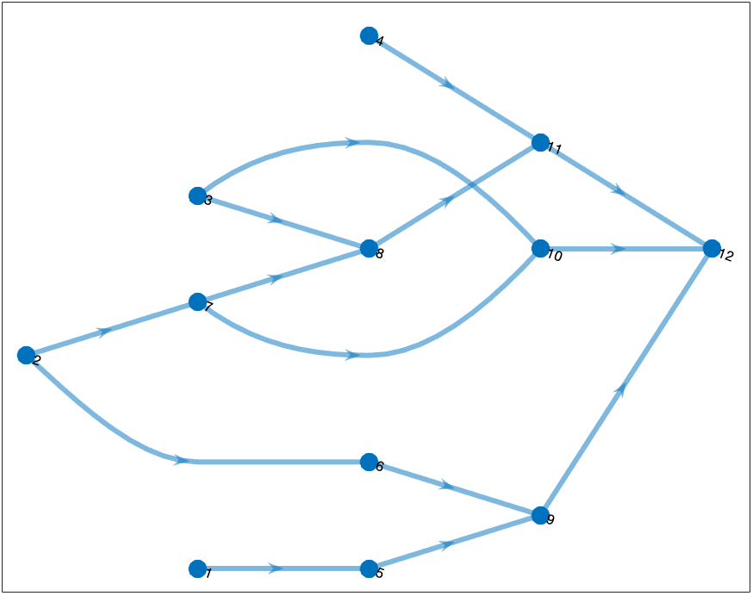

Slide 17
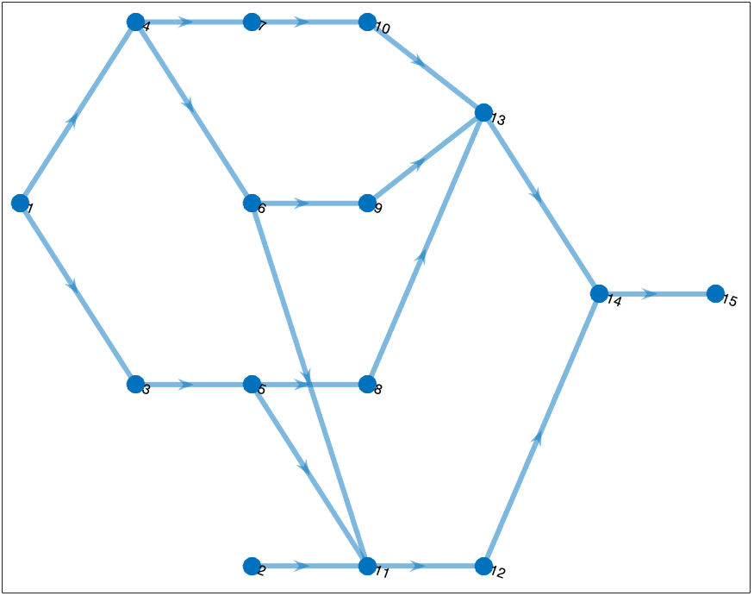

Slide 18
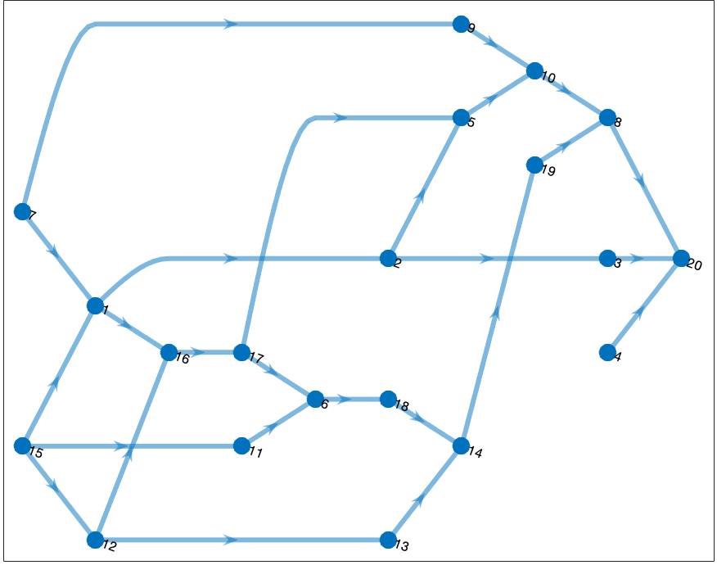

Slide 19
