Slide 1


LLM Agents for Chip Design
Haoxing (Mark) Ren, Director of Design Automation Research, NVIDIA
08/25/2024
Notes:
Haixian and Hans’ tutoirals mentioned some aspects of Agent. Here we will give a relative more complete coverage of Agent.
As I mentioned in the introduction session, AI can provide design assistance in Know-how assistance, cod gen assistance, and Task automation.
I believe agent can enhance these assistance capabilities.

Slide 2
Agent Advantage
Non-agentic
41.7%
Agentic
67.3% (VerilogCoder)
LLama3
Non-agentic
60.3%
Agentic
94.2% (VerilogCoder)
GPT4turbo
Pass@1 (%)
VerilogEval (Human)
C.-T. Ho et al, VerilogCoder: Autonomous Verilog Coding Agents with Graph-based Planning and Abstract Syntax Tree (AST)-based Waveform Tracing Tool
2
Notes:
Let’s look at Agent performance on verilogEval benchmark which Hanxian mentioned in the previous talk.
The VerilogCoder agent, which is a sophisticated agent, can achieve significant better than non-agentic approach.
Using GPT4turbo as LLM, VerilgCoder achieve 94.2% pass rate, almost solving all problems in the benchmark. It is significantly higher than non-agent GPT4turbo pass rate, which is the previous state-of-the-art results. Other Fine tuned LLM model seldom exceed gpt4turbo.
The additional solved questions are reasonably complex; includes state machine, kaunauh map, waveform, etc. Some of the problems are not straightforward for human to solve either.
Evan using Llama3 as base mode, VerilogCoder agent is also signifincalty better than non-agentic approach. This shows the robustness of agentic approach.
In the rest of the talk, I will first introduce the key concepts of agent.
Then I will introduce several use cases of agents in chip design.

Slide 3





Agentic Concepts
Non-Agentic
Agentic
Complex Question
Simple Question
Planning
LLM
LLM
Memory
Tools
Answer
Answer
Single Agent
Multi-Agent
3
Notes:
Let’s illustrate some key Agentic concepts
First, let’s look at the non-agentic way.
Given a question, usually a simple one, the LLM will provide answer directly.
However, what if the question is complext enough that can not be solved by non-agentic method.
How do human solve complex problems? Problem decomposition
We can solve a complex problem step by step, this is called agent planning.
Because agent can run many steps, to keep stateful information within each step, we need agent memory
In order to solve hard problems we also need to leverage tools for computing tasks or interacting with enviornment
Planing, memory and tools all depend on LLM as core engine to operate.
This is a basic framework for single agent. We can actually connect multiple agents together to form a multi-agent system. Each agent play a different role solving different parts of the problems. It is another form of decomposition.
Now let’s loos at these concepts in detail.

Slide 4
Planning
Without feedback
Chain-of-Thought
Tree-of-Thought
With feedback
ReACT
Self-Reflection
4
Notes:
First, let’s review how agent planning is done.
And there are two ways of planning, with feedback or without feedback.
Chain-of-Though planning and Tree-of-Thought planning are without feedback,
While ReACT and Self-Reflection are with feedback.
Now let’s study them in detail.

Slide 5
Planning – Without Feedback
Chain-of-Thought (CoT): Step-by-step planning with one-shot task decomposition
Explicit Instruction
Demonstrative Examples
Design a RISC-V processor core, follow the following steps:
1. define the microarchitecture of the processor.
2. give the function specification of each microarchitecture component.
3. Implement each function in RTL
Implement a SPARC processor core :
The SPARC processor core is divided into 7 main blocks: Instruction fetch unit (IFU), Execution unit (EXU), Load/Store unit (LSU), …
IFU: The instruction fetch unit (IFU) is responsible for maintaining the program counters (PC) of different threads and fetching the corresponding instructions.
…
RTL code for IFU: …
Now design a RISC-V processor core:
Implicit Instruction
Design a RISC-V processor core. Let’s think step by step as a design engineer.
J. Wei et al, Chain-of-Thought Prompting Elicits Reasoning in Large Language Models
5
Notes:
Chain-of-Thought is a very commonly used planning method.
It plans all the steps in one shot task decomposition.
There are three ways to prompt the model to generate chain-of-though plan.

Slide 6
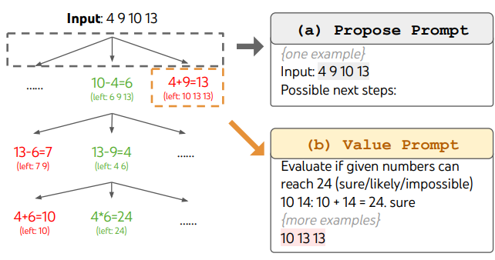
Planning – Without Feedback
Tree-of-Thought (ToT): plan one step at a time, choose best from multiple choices at each step, extend with BFS or DFS, or Graph
Problem
use 4 numbers and basic arithmetic operations (+-*/) to obtain 24
Propose
Step 1-1
Step 1-2
Step 1-3
Evaluate
Choose 1-2
Propose
Step 2-1
Step 2-2
Evaluate
Choose 2-1
S. Yao et al, Tree of Thoughts: Deliberate Problem Solving with Large Language Models
6
Notes:
One shot plan can have difficult to compicated tasks. We often need to adjust plan on the way.
Therefore, Tree-of-Thought makes plan one step a time, at each step, it makes LLM proposes several potential next steps, and evaluate each to find the best step to execute.
The planning process is like search in a tree structure. Therefore it can apply common search algorithm such as BFS or DFS. In addition, people extend tree structure into graph structures to make even more complicated plans.

Slide 7
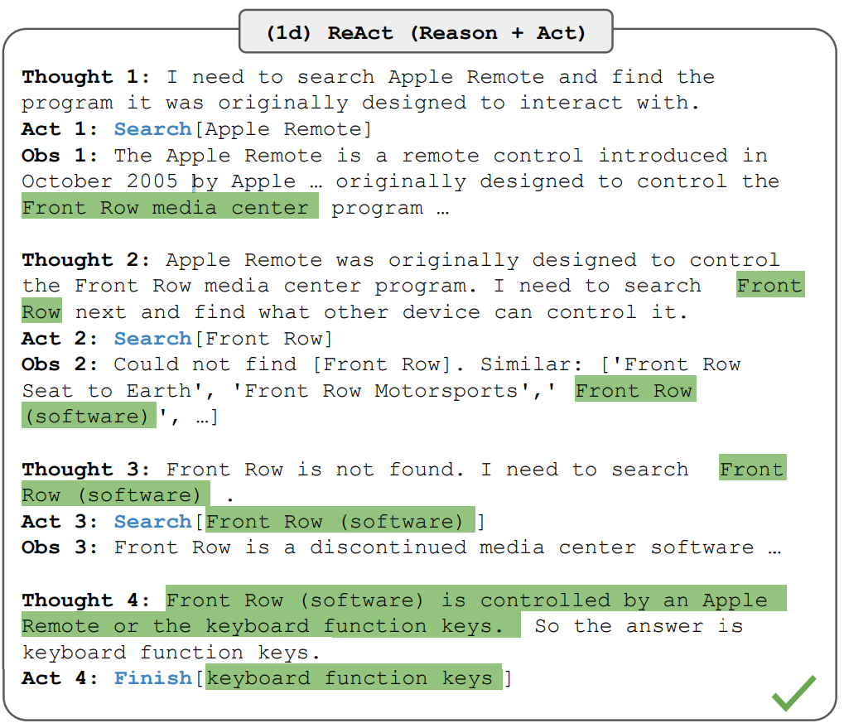
Planning – With Feedback
Ground planning with environment feedback
ReACT: Thought, Action and Observation
Problem
Thoughts
Action
Env
Observation
S. Yao et al, ReAct: Synergizing Reasoning and Acting in Language Models
7
Notes:
LLM will hallucinate, and also it is not good at some tasks such as calculation, sometime it needs latest data from user, therefore planning without feedback would be difficult for these situations. Agent can talk to the environment to perform calculations, retrieve the latest data as well as ground with relevant truth. That is why agent often plan with feedback from the environment.
The ReACT method is a basic method for planning with feedback. Since it needs feedback, it can only plan step by step. Each step, it would reason about the current state and generate action to interact with the env then receive observations from the env after the action.
It is one of the most commonly used planning method in agent.

Slide 8
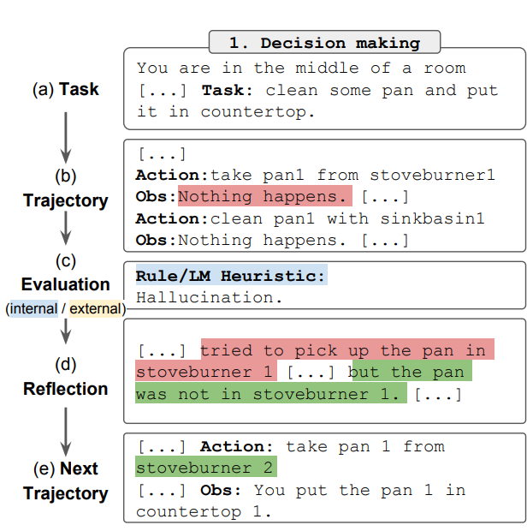
Planning – With Feedback
Self-reflection: Plan with feedback from accumulated experience
Env
Problem
ReACT Agent
Long term experience
Short term Trajectories
Self-Reflection
Evaluator
N. Shinn et al, Reflexion: Language Agents with Verbal Reinforcement Learning
8
Notes:
ReACT feedback is only from env. It is reactively and did not fully leverage agent’s memory capability.
Self-reflection allows agent to learn feedback from accumulated experience.
What is accumulated experience? They are the conversation histories of previous agent prompts and interactions with env. Self-reflection can analyze these conversation history to come up with rules to improve the next experiment. These rules are saved in the long term experience memory for agent to use in the future.

Slide 9
Memory
Mechanics
In context → context limit
External files → archive
External vector DB → RAG
Structure memory (e.g. Knowledge Graph) → search
Scope
Local → for single agent
Global → for all agents in the system
Short term/Long term
Operation
Read/Write/Reflection
9
Notes:
Memory is needed to help agent remember its state as well as to store experiences for self-reflection.
Here we briefly introduce some attributes of the memory.
First, how is memory implemented,
Second, what is the scope of the memory
And finally, what operations memory should support

Slide 10
Tools
{API: “Calculator”, Description: “calculate a math equation”, Input: “string”, Output: “string”}
Can you calculate 77 * 89?
APP
LLM
Prompt + Tool Definition
Calculator ( “77 * 89” )
Response: Tool Calls
Execute Tools
Can you calculate 77*89? Calculator (“77*89”), “6853”
77*89 = 6853
Prompt + Tool Results
Sure, the answer is 6853.
Response
10
Notes:
LLM is not good at many things, for example math
LLM can not interact with external env, need tools to do it
Modern LLMs have been trained to call tools when necessary if the tools are specified in the context
The procedure of calling Tools is like following:
First, second, third, lastly.

Slide 11
Two Agent Conversation
Connecting Agents to form conversations
Implicit task decomposition by roles
Your name is Joe and you are a part of a duo of comedians.
Cathy, tell me a joke.
Your name is Cathy and you are a part of a duo of comedians.
Sure, here's one for you: Why don't scientists trust atoms? Because they make up everything!
Good one, Cathy! Here's one for you:
Why was the math book sad?
Because it had too many problems!
11
Notes:
Previously we discussed planning, memory and tools, which are components of a single agent
Agents can be connected together to form multi-agent system
For example, we can connect them and let them have conversation together.
LLM is trained with conversation skills, therefore, once connected there input and output, they can do free form conversation
This is an implicit task decomposition. We only ask each agent to behave like a specific role, then they will automatically accomplish the task collaboratively.
No need to explain example

Slide 12
Group Chat
Chat manager orchestrates chat
Add 1 to each input number
Read the above conversation. Then select the next role from {add, muliplier} to play.
My number is 3, I want to turn it into 8.
4
Adder Agent
4
Multiple each input number by 2
Chat Manager
8
Multiplier Agent
12
Notes:
When there are more than two agent, usually there is a chat manager to direct conversation traffic.
The chat manager should be aware of role of each agent, and will take turn talk to each agent
It could use its own intelligence to decide which agent to talk to or you use predefined algorithm like round robin.
No need to explain example

Slide 13
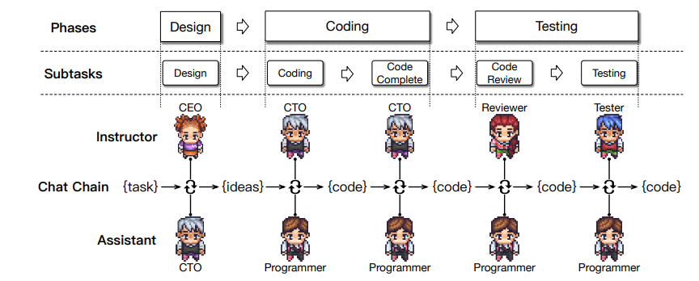
Task flow
Sequence of multiple tasks implemented by agent chats
Explicit task decomposition
C. Qian et al, ChatDev: Communicative Agents for Software Development
13
Notes:
When we have specific plan to for the agent to execute, we can connect agent according a predefined task flow
For example, a software development task include Design, coding and testing phases, and each phase might have some subtasks. The taskflow should follow the sequence of phases and sub tasks.
This is a form of explicit task decomposition. Unlike previous multi agent system which have its agents just talk to each other without explicit task definition for each agent.
You can even use these two methods together. For example, use two agents conversation to accomplish each subtask in the task flow. This is actually a common practice in agent design.

Slide 14
Timing Report Analysis
Task: Compare timing reports of two runs [datecode] to provide key takeaways and design QoR summary
Timing reports:
================================================================================
| | | Slack distribution
| Corner datecode |WNS TNS FEP | 0 -0.05 -0.015 -0.02 -0.025
================================================================================
|c1 2024Mar13 | -0.46 -8.155 63 | 9 1 4 2 2
|c1 2024Mar21 | -0.432 -7.861 49 | 5 1 3 0 2
|c2 2024Mar13 | -0.28 -1.453 22 | 0 3 0 2 0
|c2 2024Mar21 | -0.254 -1.97 22 | 1 0 0 1 0
Analysis:
The datecode <> generally shows improvement in TNS and FEP in all corners, …
However, the WNS degrades in most corners, …
The slack distribution shows improvement in all corners, …
The corner <> still suffers many timing violations,...
14
Notes:
Ok, we complete the introduction of key LLM agent concepts, let’s see some real use cases.
The first one is a simple use case. We will design an agent to analyze timing report.
This timing report includes information like : corners, datacode, which is the timestamp of a particular timing run, and a list of timing metrics, including WNS, TNS, FEP and slack distributions.
The goal of this analysis is to identify which timing run has betrer timing charistics, and provide high level takeaways and design QoR summarys like this.

Slide 15
Tools and Prompts
Tools
CoT prompting
Let’s think step by step.
Firstly, analyze the change of WNS, and TNS for all designs in all PVT corners tables of these two "datecode" settings and explain with numbers using tools.
Secondly, comparing "FEP" of two datecode settings in all PVT corners tables.
Thirdly, analyze the slack distribution to identify the distribution of "slack less than 0" paths.
Finally, summarize the analysis in the following aspects:
1. Provide key takeaways, comparison, and suggestions with bullet points of the two "datecode" settings based on previous steps.
2. Identify the corner which still suffers many timing violations if any.
You need to use the provided tools to analyze the timing metrics! You are not good at math!
timing_metric_calculation_tool :
Calculate changes in WNS, TNS, or FEP
slack_distribution_calculation_tool: Calculate changes in the slack distribution
Action
Observation
Reasoning:
Thoughts
ReACT
15
Notes:
Because LLM not good at math, we need to build some tools to help it.
The tools include a timing metric calculation tool which calculate the changes in one of the timing metrics,
The other tools is a slack distribution tool which calculate the changes in slack distribution
For planning, we use simple CoT and ReACT. The CoT instruct LLM to first , second, third, and finally … The ReACT will call the given tools based on CoT instruction.
Note that different planning methods are used, which is commonly used to ensure quality.

Slide 16
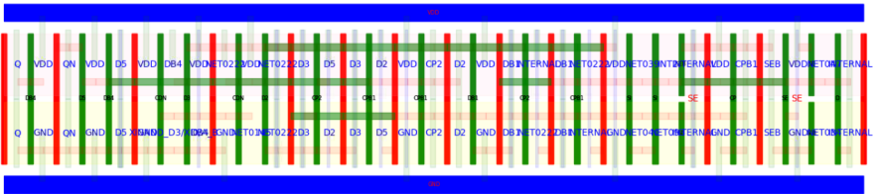
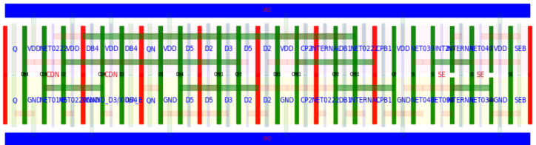
Device Clustering for Standard Cell Layout
Task: Improve device clustering constraints for cell layout generator
Cluster 1:
XXI_DB_QN/X0/M_IPA
…
Cluster 2:
XXI_CPB1/X10/M_IPA
…
Original Layout
Cluster 1:
XM_MP0_PFB0
…
Cluster 2:
XM_MP_SEB
…
Cluster 3:
XXI_DB4_Q/X10/M_IPA
Better Layout
Cell Spice Netlist
16
Notes:
The second use case is kind of special, it tries to leverage LLM for design optimization.
We try to ask LLM to assist in finding optimal device cluster for standard cell layout.
Cell layout generator often leverage cluster constraint to optimize the layout.
different cluster definition can result in different layout.
Compared to the previous use case, It certainly requires a lot of more domain knowledge for LLM to do a good job

Slide 17
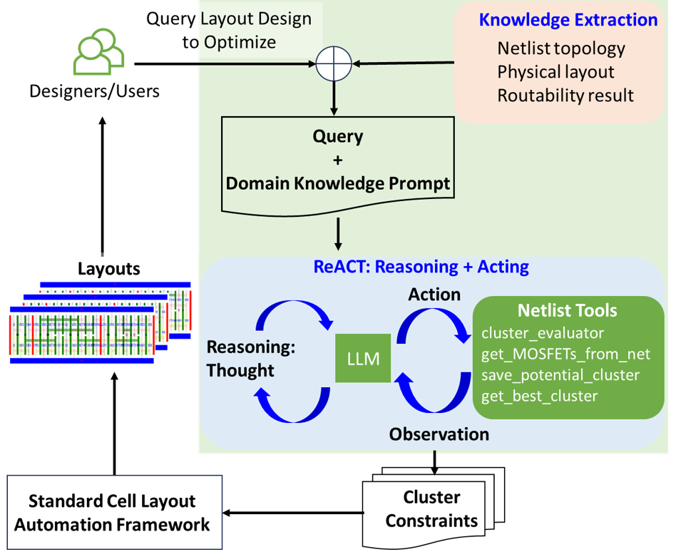
Device Clustering Optimization Agent
Domain knowledge + ReACT
Domain knowledge extraction
Identify important and problematic nets with previous layout
Tools
Cluster evaluator
Get group devices from nets
Save cluster (Memory)
Get the best clusters (Memory)
Achieved 5% area reduction
C.-T. Ho et al, Large Language Model (LLM) for Standard Cell Layout Design Optimization
17
Notes:
Therefore we will have an extensive knowledge extraction step in the agent flow.
Knowledge such as netlist topology, physical layout and previous routability results are extracted and provided to agent as context
For example, important and problematic nets are identified
With the knowledge, the agent will then use a regular ReACT flow to call customed tools to accomplish the task
Tools include analysis tools and memory related tools: The analysis tools will compute clustering score as feedback to the agent, as well as netlist analysis tools for agent to locate potential clusters, The memory related tools include tools to save a cluster proposal as well as tools to retrieve the best cluster found.
Achieved good results

Slide 18
Device Clustering Optimization Agent
Domain knowledge:
Important Net: NET0222 (5 source and drain terminals, 3 PMOS, 2NMOS)
Thought:
By identifying the nets with the most connections and resolving the issues with problematic nets, I can improve the score.
Action:
get_MOSFETs_from_net(NET0222)
# returns XM_MP1_PFB, …
cluster_evaluation(XM_MP1_PFB,…)
Observation:
The MOSFETs connected to XM_MP1_PFB …
Cluster score : 0.4875
Action:
save_cluster(XM_MP1_PFB,…)
Thought:
I should save this potential cluster and continue searching for more potential clusters.
18
Notes:
Here is an example on how agent is leveraling domain knowledge and tools to perform optimization.
First, the domain knowledge inform the agent, a particular net is important
Then the agent thinks it should call a tool to analyze this net and its connected device
The tool will return the new clustering score to the agent, which will decide to either save this cluster proposal or abandom it.
It is interesting to see that the agent is able to reason through these tasks given only limited instructions on how to perform optimization.

Slide 19
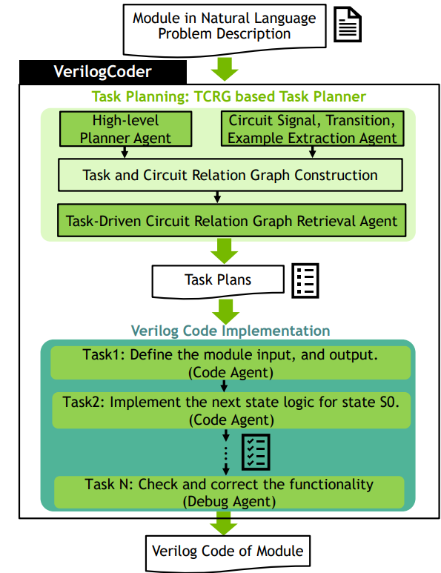
VerilogCoder Agent
Improve SOTA on VerilogEval(Human) from 60.3% to 94.2%
Task-Flow Driven Multi-Agents with specialized tools
Task Planning
Task-Driven Circuit Relation Graph (TCRG)
Code Implementation
AST-guided waveform debugging tool
C.-T. Ho et al, VerilogCoder: Autonomous Verilog Coding Agents with Graph-based Planning and Abstract Syntax Tree (AST)-based Waveform Tracing Tool
19
Notes:
Finally, let’s revisit the Verilog generation use case, which gives super good results on VerilogEVal
Compared to previous two use case, this is a more complicated use case.
It uses Multi agents, task flow, custom knowledge graph as well custom tools
At high level, it has two stages. it has a task planning stage and a Verilog code implementation stage. The planning stage will generate a plan with multiple tasks for the code implement stage to implement. The planning stage leverages a custom knowledge graph called TCRG – task-driven circuit relation graph to generate detailed task specification, and the implementation stage leverages a tools called AST guided waveform debug tool to debug the mismatch.
Let’s look at details of each stage.

Slide 20
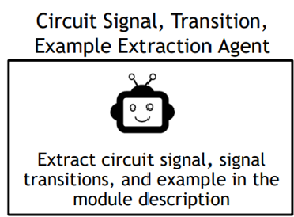
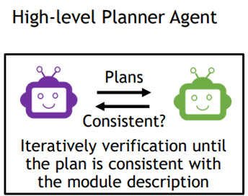
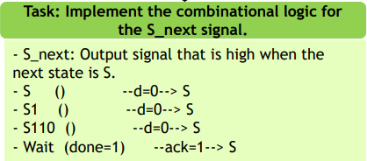
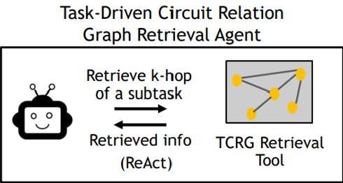
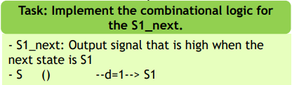
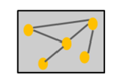
Task Planning
details
20
Notes:
In task planning, first a two-agent system is used to generate task plan from specification
One agent is responsible for plan generation and another for verification
However, this generated plan is usually not detailed enough for accurate code generation, so we need to add more specifics from spec
This is accomplished by additional two agents, one will extract the relevant circuit information and build a TCRG graph
The other will relate the task with nodes in the graph and extract those nodes and add them as spec details to the task specification.
Now the task specification is more complete for the implementation stage.

Slide 21
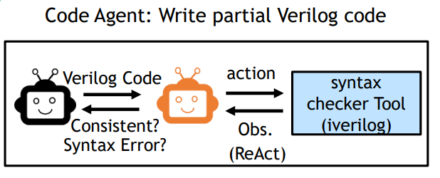
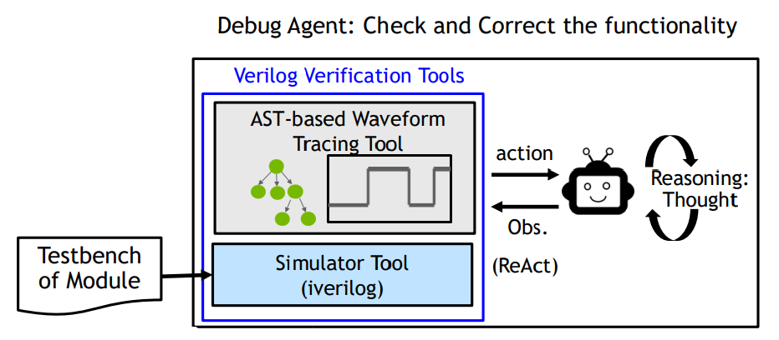
Code Implementation
Writing code for each task
Debug final code
21
Notes:
Given planed tasks, another two agent chat is used to generate code. One of the agents writes the code, and the other one fixes Syntax error using an open-source Verilog simulator iverilog. Syntax checking is done with ReACT.
Once all the code generation sub tasks are complete, the complete Verilog code will be sent to the debug agent, which leverage ReACT and an AST-based waveform tracing tools to identify bug.

Slide 22
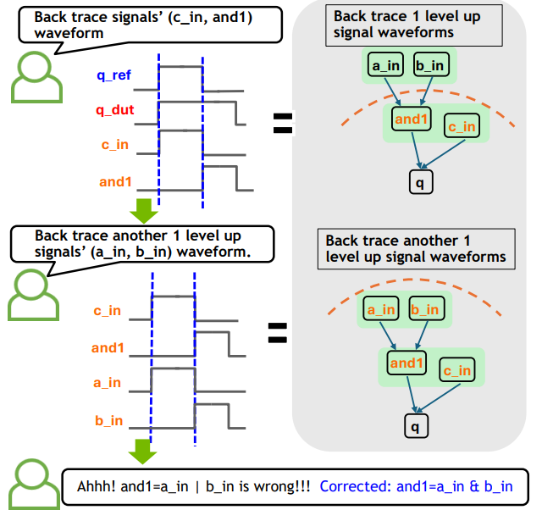
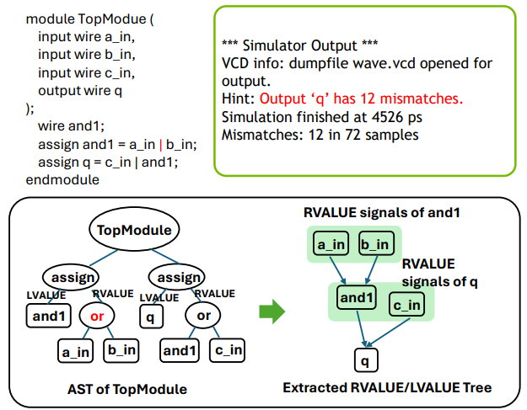
Debug with AST-Guided Waveforms
Use AST to extract relevant signal traces for debug with ReACT
22
Notes:
Here is how the AST –guided waveform tracing tools works.
Given a simulation error, the AST analysis will figure out which signals cause the mismatch with golden answer,
It will then add the traces of those signals to the prompt and ask LLM to figure out a potential bug
If LLM can not find a potential bug, it will increase it AST search radius to find more signals to extract waveforms for analysis until the bug is resolved.

Slide 23
Closing Thoughts
What problems can be solved with agent today?
Design generation, debugging, review/analysis, optimization
Can be decomposed into tasks with low to medium intellectual effort
Increase productivity, make designer’s life easier
Extensive domain capability required to build useful agents for chip design
Diverse design knowledge: Logic design, physical design, verification, analog design, etc.
Diverse set of tool commands and file formats: PrimeTime, ICC2, Innovus, reports, LEF/DEF, etc.
Agent capability comes from the designer’s insights and specialized tools
Can agent become intelligent enough to solve hard design problems?
23
Notes:
I think as we scale system complexity from LLM to singal agent to multi agent, we notice signicant capability enhancements. So perhaps the future agent systems built with many agents as well customized tools would be capable of solving those hard problems. We can also aim to improve the efficiency of agent system by training domain specific models for agent to use, but these are future research topics.

