Slide 1
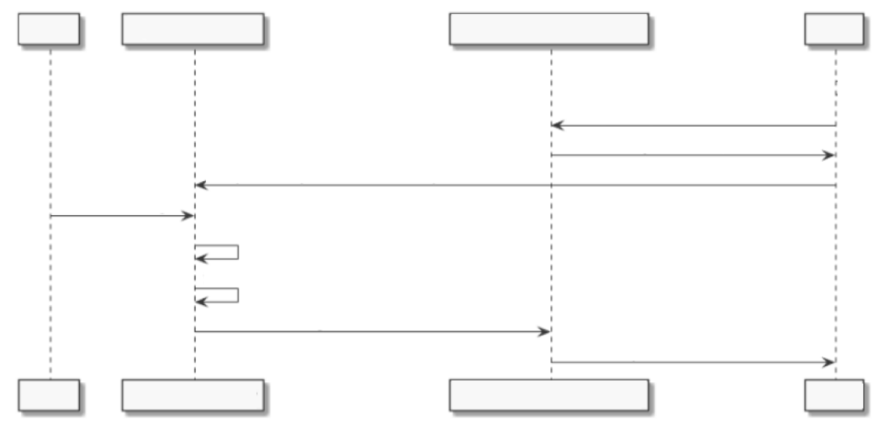
User A
Agora Chat Server
APNs
User B
1. Request a push token (device token).
2. Return the push token (device token).
3. Upload the push certificate and the push token (device token).
4. Send a message.
5. Check whether User B is online.
6. Determine whether APN is used by User B.
7. Send the message.
8. Send the push notification.
User A
Agora Chat Server
APNs
User B

Slide 2
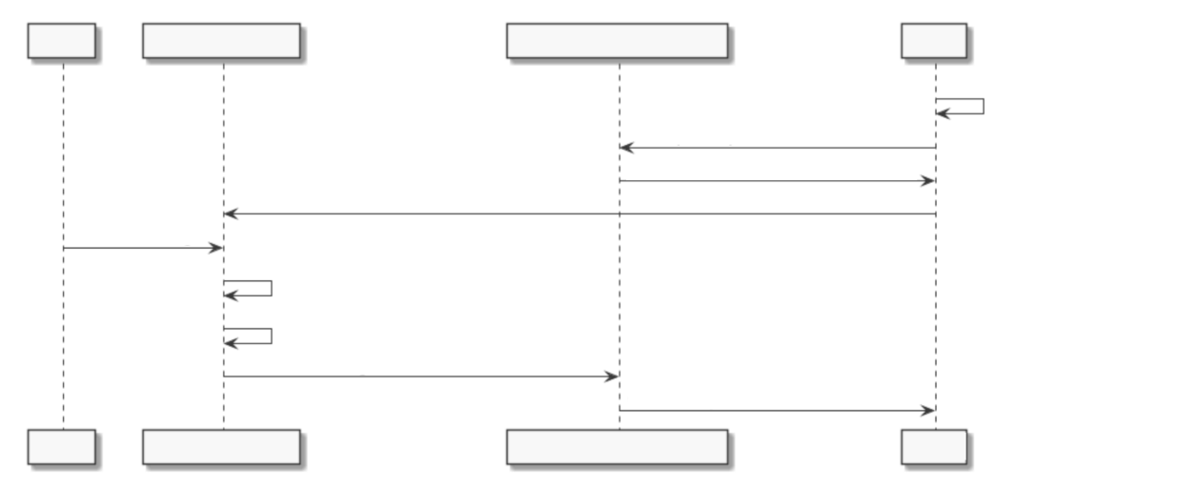
User A
Agora Chat Server
FCM
User B
1. Initialize the FCM SDK to
check whether FCM is used.
2. Request a push token (device token).
3. Return the push token (device token).
4. Upload the push certificate and the push token (device token).
5. Send a message.
6. Check whether User B is online.
7. Determine whether FCM is used by User B.
8. Send the message.
9. Send the push notification.
User A
Agora Chat Server
FCM
User B

