Slide 1
Simple and Accurate:
Body Fat Percentage Prediction
Jack Bressett, Yizhe Ge, Haoyang Yan
Final Model:
Body Fat % = 1.626*Abdomen (Inches) - 0.572*Height (Inches)

Slide 2
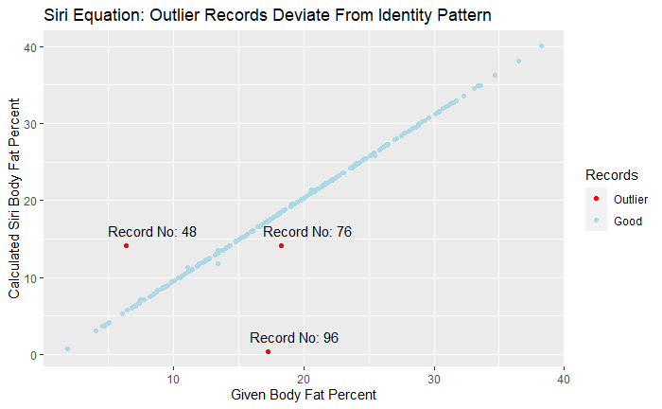
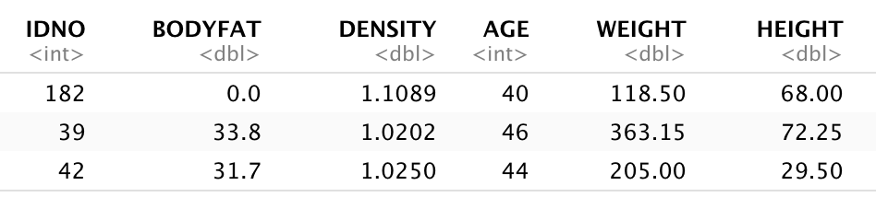
Summary of Data Cleaning
Three records with extreme values
Three Siri outliers
STAT 628 Module 2

Slide 3
Model Selection: Reverse Stepwise Regression
Model Name | Factor | R-Squared
Full Model | BODYFAT~AGE+WEIGHT+HEIGHT+NECK+CHEST+ABDOMEN+HIP+THIGH+KNEE+ANKLE+BICEPS+FOREARM+WRIST | 0.7468
Reduced Model | BODYFAT~AGE+HEIGHT+CHEST+ABDOMEN+BICEPS+WRIST+NECK | 0.7417
(Keep Most Important Factors) | BODYFAT~HEIGHT+ABDOMEN+WRIST | 0.7285
Simplest Model | BODYFAT~ABDOMEN | 0.6751
(Final Model) | BODYFAT~ABDOMEN+HEIGHT | 0.7078
(Final Model No Intercept) | BODYFAT~0+ABDOMEN+HEIGHT | 0.9596 (Inflated and not directly comparable)

Slide 4
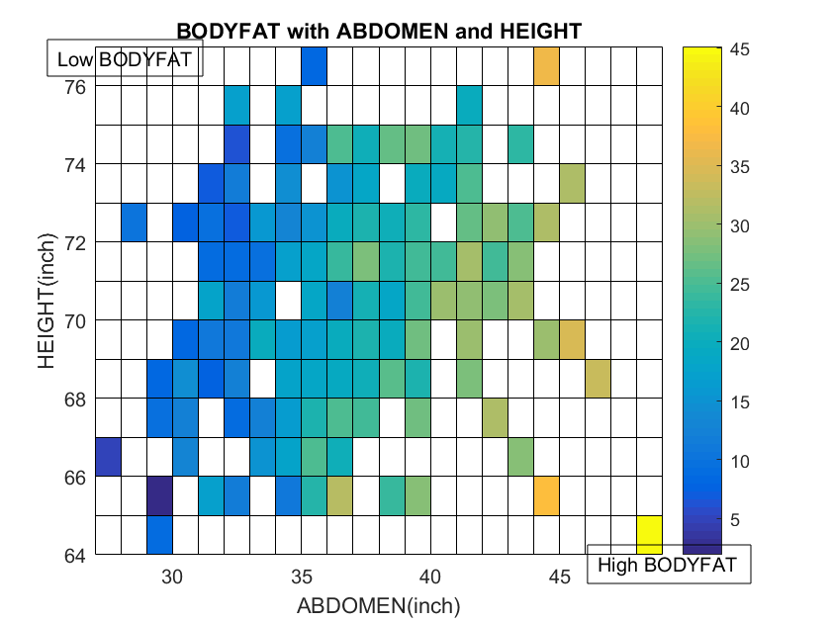
Model Selection: Verifying key features and trends
Clear trend from top left corner to bottom right corner in heatmap of two "best" features

Slide 5
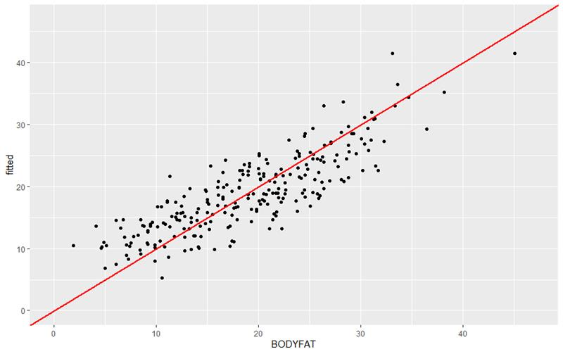
Model Evaluation: Real V Fit
Model Overpredicts Low Body Fat Percentages and Underpredicts High Body Fat Percentages
A weakness of the simplicity of the model
Shiny app:
https://haoyangyan.shinyapps.io/bodyfatshiny/

Slide 6
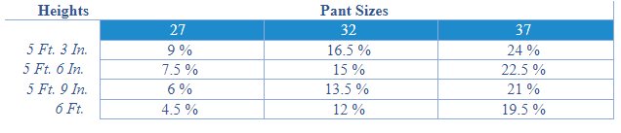
Final Model: Significant and Simple
Body Fat % = 1.626*Abdomen (Inches) - 0.572*Height (Inches)
1 In increase in Abdomen is 1.626 percent increase to body fat percent
1 In increase in Height decreases body fat percent by .572 percent
Rule of Thumb:
Abdomen (In) = Pant Size
Body Fat % ≈ 1.5*(Pant Size) - 0.5*Height (Inches)

Slide 7
Statistical Properties of Model
Coefficient/Model Properties
Abdomen and Height coefficients are significant at 0.05 based on two-sided t-test with p-values: < 2e^-16
Overall model is significant at 0.05 based on F-test with p-value: < 2e^-16
Height coefficient is negative, suggesting people "thin out" as they get taller
With an intercept the model has an R^2 of .7078, this is only slightly smaller than the full model's R^2 of .7468
Model Assumptions
Errors appear normally distributed from the Q-Q plot
The residuals v fits plot indicates residuals lack any distinct pattern
Heteroskedasticity appears to be constant or minimal

