Slide 1

Chapter 5: Advanced SQL
Database System Concepts, 6th Ed.
©Silberschatz, Korth and Sudarshan
See www.db-book.com for conditions on re-use

Slide 2
Chapter 5: Advanced SQL
ν
ν
ν
ν
ν
Accessing SQL From a Programming Language Functions and Procedures
Triggers
**Recursive Queries
**Advanced Aggregation Features

Slide 3
Accessing SQL from a Programming Language
A database programmer must have access to a general-purpose programming language for at least two reasons
ν
Not all queries can be expressed in SQL, since SQL does not provide the full expressive power of a general-purpose language.
Non-declarative actions -- such as printing a report, interacting with a user, or sending the results of a query to a graphical user interface -- cannot be done from within SQL.
ν

Slide 4
Accessing SQL from a Programming Language (Cont.)
There are two approaches to accessing database from a general-purpose programming language
ν
API （ Application Program Interface ） - - A general- purpose program can connect to and communicate with a database server using a collection of functions.
Embedded SQL -- provides a means by which a program can interact with a database server.
ν
λ
The SQL statements are translated at compile time into function calls.
At runtime, these function calls connect to the database using an API that provides dynamic SQL facilities.
λ

Slide 5
JDBC and ODBC
ν
API (application-program interface) for a program to interact with a database server
Application makes calls to
ν
λ
Connect with the database server
Send SQL commands to the database server
Fetch tuples of result one-by-one into program variables
λ
λ
ν
ν
ν
ν
ν
ODBC (Open Database Connectivity) works with C, C++, C# JDBC (Java Database Connectivity) works with Java Embedded SQL in C
SQLJ - embedded SQL in Java
JPA(Java Persistence API) - OR mapping of Java
zhichao
2021-03-29 05:27:36
--------------------------------------------
Base

Slide 6
JDBC
ν
JDBC is a Java API for communicating with database systems supporting SQL.
JDBC supports a variety of features for querying and updating data, and for retrieving query results.
JDBC also supports metadata retrieval, such as querying about relations present in the database and the names and types of relation attributes.
Model for communicating with the database:
ν
ν
ν
λ
Open a connection
Create a “statement” object
Execute queries using the Statement object to send queries and fetch results
Exception mechanism to handle errors
λ
λ
λ

Slide 7
JDBC Code
public static void JDBCexample(String dbid, String userid, String passwd)
{
try {
Connection conn = DriverManager.getConnection( "jdbc:oracle:thin:@db.yale.edu:2000:univdb", userid, passwd);
Statement stmt = conn.createStatement();
… Do Actual Work …. stmt.close();
conn.close();
}
catch (SQLException sqle) { System.out.println("SQLException : " + sqle);
}
}

Slide 8
JDBC Code (Cont.)
ν
Update to database try {
stmt.executeUpdate(
"insert into instructor values(’77987’, ’Kim’, ’Physics’, 98000)");
} catch (SQLException sqle)
{
System.out.println("Could not insert tuple. " + sqle);
}
ν
Execute query and fetch and print results ResultSet rset = stmt.executeQuery(
"select dept_name, avg (salary) from instructor
group by dept_name");
while (rset.next()) { System.out.println(rset.getString("dept_name") + " " +
rset.getFloat(2));
}
Notes:
ResultSet 代表返回的集合
next 一次取一行
getString取到dept_name的值，它正好是字符串
getFloat(2) 表示返回的行第二列，而第二列正好是浮点数，所以getFloat

Slide 9
JDBC Code Details
ν
Getting result fields:
λ
rset.getString(“dept_name”) and rset.getString(1) equivalent if dept_name is the first argument of select result.
Dealing with Null values
ν
λ
int a = rset.getInt(“a”);
if (rset.wasNull()) Systems.out.println(“Got null value”);

Slide 10
Prepared Statement
ν
PreparedStatement pStmt = conn.prepareStatement(
"insert into instructor values(?,?,?,?)");
pStmt.setString(1, "88877"); pStmt.setString(3, "Finance"); pStmt.executeUpdate(); pStmt.setString(1, "88878"); pStmt.executeUpdate();
pStmt.setString(2, "Perry"); pStmt.setInt(4, 125000);
ν
WARNING: always use prepared statements when taking an input from the user and adding it to a query
λ
NEVER create a query by concatenating strings which you get as inputs
"insert into instructor values(’ " + ID + " ’, ’ " + name + " ’, " +
" ’ " + dept name + " ’, " + salary + ")"
What if name is “D’Souza”?
λ
λ
Notes:
prepare做语法检查，语义检查，权限检查，查询优化
？表示占位符
上面的set始终修改的是同一条语句，
prepare的方便之处，是一次编译多次执行，避免多次进行语法检查。。。
prepare之后可以避免信息安全的攻击

Slide 11
SQL Injection(SQL 注入 )
ν
Suppose query is constructed using
λ
"select * from instructor where name = ’" + name + “ ’ "
ν
Suppose the user, instead of entering a name, enters:
λ
X’ or ’Y’ = ’Y
ν
then the resulting string of the statement becomes:
λ
"select * from instructor where name = ’" + "X’ or ’Y’ = ’Y" + “’" which is:
select * from instructor where name = ’X’ or ’Y’ = ’Y’ User could have even used
X’; update instructor set salary = salary + 10000;
then →
select * from instructor where name = ’X’; update instructor set salary = salary + 10000;
λ
λ
ν
Always use prepared statements, with user inputs as parameters

Slide 12
Metadata Features
ν
ν
ResultSet metadata
E.g., after executing query to get a ResultSet rs:
ResultSetMetaData rsmd = rs.getMetaData(); for(int i = 1; i <= rsmd.getColumnCount(); i++) {
System.out.println(rsmd.getColumnName(i)); System.out.println(rsmd.getColumnTypeName(i));
}
How is this useful?
λ
ν

Slide 13
Metadata (Cont)
ν
ν
Database metadata
DatabaseMetaData dbmd = conn.getMetaData();
ResultSet rs = dbmd.getColumns(null, "univdb", "department", "%");
// Arguments to getColumns: Catalog, Schema-pattern, Table-pattern,
// and Column-Pattern
// Returns: One row for each column; row has a number of attributes
// such as COLUMN_NAME, TYPE_NAME while( rs.next()) {
System.out.println(rs.getString("COLUMN_NAME"),
rs.getString("TYPE_NAME");
}
And where is this useful?
ν

Slide 14
Transaction Control in JDBC
ν
By default, each SQL statement is treated as a separate transaction that is committed automatically
λ
bad idea for transactions with multiple updates
ν
Can turn off automatic commit on a connection
λ
conn.setAutoCommit(false);
ν
Transactions must then be committed or rolled back explicitly
λ
conn.commit(); or conn.rollback();
λ
ν
conn.setAutoCommit(true) turns on automatic commit.

Slide 15
JDBC Resources
ν
JDBC Basics Tutorial
λ
https://docs.oracle.com/javase/tutorial/jdbc/index.html

Slide 16
SQLJ
ν
ν
JDBC is overly dynamic, errors cannot be caught by compiler SQLJ: embedded SQL in Java
λ
#sql iterator deptInfoIter ( String dept_name, int avgSal); deptInfoIter iter = null;
#sql iter = { select dept_name, avg(salary) from instructor group by dept name };
while (iter.next()) {
String deptName = iter.dept_name(); int avgSal = iter.avgSal();
System.out.println(deptName + " " + avgSal);
}
iter.close();

Slide 17
SQLJ Resources
ν
ν
SQLJ Developer's Guide
https://docs.oracle.com/en/database/oracle/oracle-database/20/jsqlj/toc.htm

Slide 18
ODBC
ν
Open DataBase Connectivity(ODBC) standard
λ
standard for application program to communicate with a database server.
application program interface (API) to
open a connection with a database,
send queries and updates,
get back results.
λ
ν
ν
Applications such as GUI, spreadsheets, etc. can use ODBC
Was defined originally for Basic and C, versions available for many languages.

Slide 19
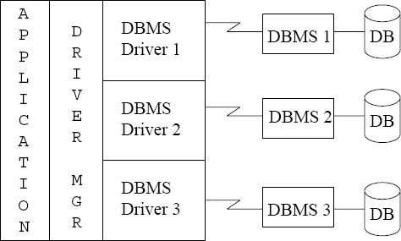
ODBC (Cont.)
ν
Each database system supporting ODBC provides a "driver" library that must be linked with the client program.

Slide 20
ODBC (Cont.)
ν
Each database system supporting ODBC provides a "driver" library that must be linked with the client program.
When client program makes an ODBC API call, the code in the library communicates with the server to carry out the requested action, and fetch results.
ODBC program first allocates an SQL environment, then a database connection handle.
Opens database connection using SQLConnect(). Parameters for SQLConnect:
ν
ν
ν
λ
connection handle,
the server to which to connect the user identifier,
password
λ
λ
λ
ν
Must also specify types of arguments:
λ
SQL_NTS denotes previous argument is a null-terminated string.

Slide 21
ODBC Code
ν
int ODBCexample()
{
RETCODE error;
HENV env; /* environment */
HDBC conn; /* database connection */ SQLAllocEnv(&env); SQLAllocConnect(env, &conn);
SQLConnect(conn, “db.yale.edu", SQL_NTS, "avi", SQL_NTS, "avipasswd", SQL_NTS);
{ …. Do actual work … }
SQLDisconnect(conn); SQLFreeConnect(conn); SQLFreeEnv(env);
}

Slide 22
ODBC Code (Cont.)
ν
ν
ν
Program sends SQL commands to database by using SQLExecDirect Result tuples are fetched using SQLFetch()
SQLBindCol() binds C language variables to attributes of the query result
λ
When a tuple is fetched, its attribute values are automatically stored in corresponding C variables.
Arguments to SQLBindCol()
ODBC stmt variable, attribute position in query result
The type conversion from SQL to C.
The address of the variable.
For variable-length types like character arrays,
The maximum length of the variable
Location to store actual length when a tuple is fetched.
Note: A negative value returned for the length field indicates null value
λ
ν
Good programming requires checking results of every function call for errors; we have omitted most checks for brevity.

Slide 23
ODBC Code (Cont.)
Main body of program
char deptname[80]; float salary;
int lenOut1, lenOut2; HSTMT stmt;
char * sqlquery = "select dept_name, sum (salary)
from instructor
group by dept_name"; SQLAllocStmt(conn, &stmt);
error = SQLExecDirect(stmt, sqlquery, SQL_NTS); if (error == SQL SUCCESS) {
SQLBindCol(stmt, 1, SQL_C_CHAR, deptname , 80, &lenOut1);
SQLBindCol(stmt, 2, SQL_C_FLOAT, &salary, 0 , &lenOut2); while (SQLFetch(stmt) == SQL_SUCCESS) {
printf (" %s %g\n", deptname, salary);
}
}
SQLFreeStmt(stmt, SQL_DROP);
ν
Notes:
&lenOut 实际返回的长度
不是字符串length都填0

Slide 24
ODBC Prepared Statements
ν
Prepared Statement
λ
SQL statement prepared: compiled at the database
Can have placeholders: E.g. insert into account values(?,?,?) Repeatedly executed with actual values for the placeholders
λ
λ
ν
To prepare a statement SQLPrepare(stmt, <SQL String>);
To bind parameters SQLBindParameter(stmt, <parameter#>,
… type information and value omitted for simplicity..)
To execute the statement retcode = SQLExecute( stmt);
ν
ν

Slide 25
More ODBC Features
ν
Metadata features
λ
finding all the relations in the database and
finding the names and types of columns of a query result or a relation in the database.
λ
ν
By default, each SQL statement is treated as a separate transaction that is committed automatically.
λ
Can turn off automatic commit on a connection
SQLSetConnectOption(conn, SQL_AUTOCOMMIT, 0)}
Transactions must then be committed or rolled back explicitly by
SQLTransact(conn, SQL_COMMIT) or
SQLTransact(conn, SQL_ROLLBACK)
λ
5.27

Slide 26
ODBC Resources
ν
ν
Oracle Database Programmer's Guide - Embedded SQL
https://docs.oracle.com/cd/E17952_01/connector-odbc-en/ index.html

Slide 27
Embedded SQL
ν
The SQL standard defines embeddings of SQL in a variety of programming languages such as C, C++, Java, Fortran, and PL/1,
A language to which SQL queries are embedded is referred to as a host language, and the SQL structures permitted in the host language comprise embedded SQL.
The basic form of these languages follows that of the System R embedding of SQL into PL/1.
EXEC SQL statement is used in the host language to identify embedded SQL request to the preprocessor
EXEC SQL <embedded SQL statement >; Note: this varies by language:
ν
ν
ν
λ
In some languages, like COBOL, the semicolon is replaced with END-EXEC
In Java embedding uses # SQL { …. };
λ

Slide 28
Embedded SQL (Cont.)
ν
Before executing any SQL statements, the program must first connect to the database. This is done using:
EXEC-SQL connect to server user user-name using password;
Here, server identifies the server to which a connection is to be established.
Variables of the host language can be used within embedded SQL statements. They are preceded by a colon (:) to distinguish from SQL variables (e.g., :credit_amount )
Host Variables used as above must be declared within DECLARE section, as illustrated below. The syntax for declaring the variables, however, follows the usual host language syntax.
EXEC-SQL BEGIN DECLARE SECTION
int credit-amount ;
EXEC-SQL END DECLARE SECTION;
ν
ν

Slide 29
Embedded SQL (Cont.)
ν
To write an embedded SQL query, we use the
declare c cursor for <SQL query>
statement. The variable c is used to identify the query Example:
ν
λ
From within a host language, find the ID and name of students who have completed more than the number of credits stored in variable credit_amount in the host langue
Specify the query in SQL as follows: EXEC SQL
declare c cursor for select ID, name from student
where tot_cred > :credit_amount;
λ

Slide 30
Embedded SQL (Cont.)
ν
The open statement for our example is as follows: EXEC SQL open c ;
This statement causes the database system to execute the query and to save the results within a temporary relation. The query uses the value of the host-language variable credit- amount at the time the open statement is executed.
The fetch statement causes the values of one tuple in the query result to be placed on host language variables.
EXEC SQL fetch c into :si, :sn ；
ν
Repeated calls to fetch get successive tuples in the query result

Slide 31
Embedded SQL (Cont.)
ν
A variable called SQLSTATE in the SQL communication area (SQLCA) gets set to '02000' to indicate no more data is available
The close statement causes the database system to delete the temporary relation that holds the result of the query.
EXEC SQL close c ;
ν

Slide 32
Updates Through Embedded SQL
ν
Embedded SQL expressions for database modification (update, insert, and
delete)
Can update tuples fetched by cursor by declaring that the cursor is for update
EXEC SQL
declare c cursor for select *
from instructor
where dept_name = 'Music'
for update
We then iterate through the tuples by performing fetch operations on the cursor , and after fetching each tuple we execute the following code:
update instructor
set salary = salary + 1000
where current of c
ν
ν

Slide 33
Embedded SQL Resources
ν
ν
Oracle Database Programmer's Guide - Embedded SQL
https://docs.oracle.com/en/database/oracle/oracle-database/20/ lnpcc/embedded-SQL.html#GUID-C671CABF-202A-4503-A16B- DC78D3F1AB13

Slide 34
Procedural Constructs in SQL

Slide 35
Procedural Extensions and Stored Procedures
ν
SQL provides a module language
λ
Permits definition of procedures in SQL, with if-then-else statements, for and while loops, etc.
Stored Procedures
ν
λ
Can store procedures in the database
then execute them using the call statement
permit external applications to operate on the database without knowing about internal details
λ
λ

Slide 36
Functions and Procedures
ν
Functions and procedures allow “business logic” to be stored in the database and executed from SQL statements.
These can be defined either by the procedural component of SQL or by an external programming language such as Java, C, or C++.
The syntax we present here is defined by the SQL standard.
ν
ν
λ
Most databases implement nonstandard versions of this syntax.

Slide 37
SQL Functions
ν
Define a function that, given the name of a department, returns the count of the number of instructors in that department.
create function dept_count (dept_name varchar(20)) returns integer
begin
declare d_count integer; select count (* ) into d_count from instructor
where instructor.dept_name = dept_name
return d_count;
end
Find the department name and budget of all departments with more that 12 instructors.
select dept_name, budget
from department
where dept_count (dept_name ) > 1
ν

Slide 38
Table Functions
ν
ν
SQL:2003 added functions that return a relation as a result Example: Return all accounts owned by a given customer create function instructors_of (dept_name char(20) )
returns table ( ID varchar(5),
name varchar(20), dept_name varchar(20), salary numeric(8,2))
return table
(select ID, name, dept_name, salary
from instructor
where instructor.dept_name = instructors_of.dept_name)
Usage
select *
from table (instructors_of (‘Music’))
ν

Slide 39
SQL Procedures
ν
The dept_count function could instead be written as procedure:
create procedure dept_count_proc (in dept_name varchar(20),
out d_count integer)
begin
select count(*) into d_count
from instructor
where instructor.dept_name = dept_count_proc.dept_name
end
ν
Procedures can be invoked either from an SQL procedure or from embedded SQL, using the call statement.
declare d_count integer;
call dept_count_proc( ‘Physics’, d_count);
Procedures and functions can be invoked also from dynamic SQL

Slide 40
Procedural Constructs
ν
Warning: most database systems implement their own variant of the standard syntax below
λ
read your system manual to see what works on your system
ν
Compound statement: begin … end,
λ
May contain multiple SQL statements between begin and end. Local variables can be declared within a compound statements
λ
ν
While and repeat statements :
declare n integer default 0;
while n < 10 do
set n = n + 1
end while
repeat
set n = n – 1
until n = 0
end repeat

Slide 41
Procedural Constructs (Cont.)
ν
For loop
λ
Permits iteration over all results of a query Example:
λ
declare n integer default 0;
for r as
select budget from department
where dept_name = ‘Music’
do
set n = n - r.budget
end for
Notes:
for r 对记录的每一行进行循环

Slide 42
Procedural Constructs (cont.)
ν
Conditional statements (if-then-else)
if boolean expression
then statement or compound statement
elseif boolean expression
then statement or compound statement
else statement or compound statement
end if
ν
SQL:1999 also supports a case statement similar to C case statement

Slide 43
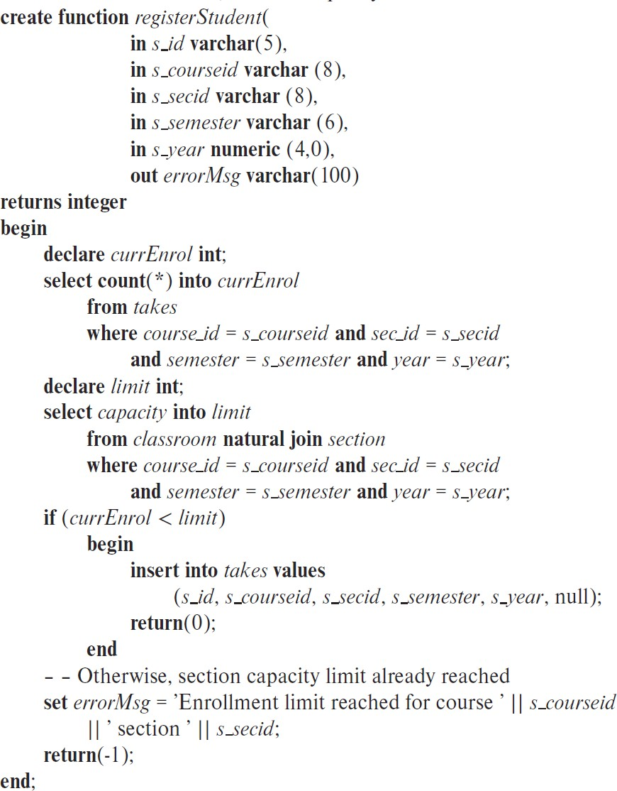
Example procedure
– Registers a student after ensuring
– classroom capacity is not exceeded.
– Returns 0 on success, and -1 if
– capacity is exceeded.
5.46
Notes:
return 0 表示成功，这段程序就jieshule
如果没有return，那么就意味着if判断条件为false，因此后面设置错误信息

Slide 44
External Language Functions/Procedures
ν
SQL:1999 permits the use of functions and procedures written in other languages such as C or C++
Declaring external language procedures and functions
ν
create procedure dept_count_proc(in dept_name varchar(20),
out count integer)
language C
external name ’ /usr/avi/bin/dept_count_proc’
create function dept_count(dept_name varchar(20)) returns integer
language C
external name ‘/usr/avi/bin/dept_count’
Notes:
出于效率的考虑，可以用C语言里面写程序，然后在SQL中call它

Slide 45
External Language Routines (Cont.)
ν
Benefits of external language functions/procedures:
λ
more efficient for many operations, and more expressive power.
Drawbacks
ν
λ
Code to implement function may need to be loaded into database system and executed in the database system’s address space.
risk of accidental corruption of database structures
security risk, allowing users access to unauthorized data
There are alternatives, which give good security at the cost of potentially worse performance.
Direct execution in the database system’s space is used when efficiency is more important than security.
λ
λ

Slide 46
Security with External Language Routines
ν
To deal with security problems
λ
Use sandbox techniques
that is use a safe language like Java, which cannot be used to access/damage other parts of the database code.
λ
Or, run external language functions/procedures in a separate process, with no access to the database process’ memory.
Parameters and results communicated via inter-process communication
Both have performance overheads
Many database systems support both above approaches as well as direct executing in database system address space.
ν
ν

Slide 47
Triggers

Slide 48
Triggers
ν
A trigger is a statement that is executed automatically by the system as a side effect of a modification to the database.
Trigger - ECA rule
E: Event （ insert, delete ， update ）
C: Condition A: Action
To design a trigger mechanism, we must:
Specify the conditions under which the trigger is to be executed.
Specify the actions to be taken when the trigger executes.
Triggers introduced to SQL standard in SQL:1999, but supported even earlier using non-standard syntax by most databases.
ν
λ
λ
λ
ν
λ
λ
ν

Slide 49
Trigger Example
ν
account_log(account, amount, datetime)
ν
create trigger account_trigger after update on account(balance)
referencing new row as nrow
referencing old row as orow
for each row
when nrow.balance - orow.balance > =200000 or
orow.balance -nrow.balance >=50000
begin
insert into account_log values (nrow.account-number,
nrow.balance-orow.balance , current_time() )
end
Notes:
for each row 表明 account(balance) 每一行中做修改都会触发一次trigger

Slide 50
Triggering Events and Actions in SQL
ν
ν
Triggering event can be insert, delete or update
Triggers on update can be restricted to specific attributes
λ
E.g., after update of takes on grade
ν
Values of attributes before and after an update can be referenced
λ
referencing old row as : for deletes and updates
referencing new row as : for inserts and updates
λ
ν
Triggers can be activated before an event, which can serve as extra constraints. E.g. convert blank grades to null.
create trigger setnull_trigger before update of takes
referencing new row as nrow
for each row
when (nrow.grade = ‘ ‘)
begin atomic
set nrow.grade = null; end;

Slide 51
Trigger to Maintain credits_earned value
ν
create trigger credits_earned after update of takes on (grade)
referencing new row as nrow
referencing old row as orow
for each row
when nrow.grade <> ’F’ and nrow.grade is not null and (orow.grade = ’F’ or orow.grade is null)
begin atomic update student
set tot_cred= tot_cred + (select credits
from course
where course.course_id= nrow.course_id)
where student.id = nrow.id;
end;
Notes:
atomic 表明后面的部分作为一个事务来执行，要么都执行，要么都不执行
trigger 不应该经常用，上面这个trigger的功能可以用一个函数来实现

Slide 52
Statement Level Triggers
ν
Instead of executing a separate action for each affected row, a single action can be executed for all rows affected by a transaction
λ
Use for each statement instead of for each row
Use
table
λ
referencing old table or referencing new
to refer to temporary tables (called transition
tables) containing the affected rows
Can be more efficient when dealing with SQL statements that update a large number of rows
λ

Slide 53
Statement Level Triggers
ν
ν
register(sid, cno, score)
create trigger score_trigger after update on register(score)
referencing new table as ntable
for each statement
when some( select average(score)
from ntable
group by cno) < 60
begin
rollback
end

Slide 54
When Not To Use Triggers
ν
Triggers were used earlier for tasks such as
λ
maintaining summary data (e.g., total salary of each department)
Replicating databases by recording changes to special relations (called change or delta relations) and having a separate process that applies the changes over to a replica
λ
ν
There are better ways of doing these now:
λ
Databases today provide built in materialized view facilities to maintain summary data
Databases provide built-in support for replication
λ
ν
Encapsulation facilities can be used instead of triggers in many cases
λ
Define methods to update fields
Carry out actions as part of the update methods instead of through a trigger
λ

Slide 55
When Not To Use Triggers
ν
Risk of unintended execution of triggers, for example, when
λ
loading data from a backup copy replicating updates at a remote site
Trigger execution can be disabled before such actions.
λ
λ
ν
Other risks with triggers:
λ
Error leading to failure of critical transactions that set off the trigger
Cascading execution
λ

Slide 56
Recursive Queries

Slide 57
Recursion in SQL
ν
ν
SQL:1999 permits recursive view definition
Example: find which courses are a prerequisite, whether directly or indirectly, for a specific course
with recursive rec_prereq(course_id, prereq_id) as (
select course_id, prereq_id
from prereq
union
select rec_prereq.course_id, prereq.prereq_id,
from rec_prereq, prereq
where rec_prereq.prereq_id = prereq.course_id
)
select ∗
from rec_prereq;
This example view, rec_prereq, is called the transitive closure of the prereq relation

Slide 58
The Power of Recursion
ν
Recursive views make it possible to write queries, such as transitive closure queries, that cannot be written without recursion or iteration.
λ
Intuition: Without recursion, a non-recursive non-iterative program can perform only a fixed number of joins of prereq with itself
This can give only a fixed number of levels of prerequisites.
Given a fixed non-recursive query, we can construct a database with a greater number of levels of prerequisites on which the query will not work
Alternative: write a procedure to iterate as many times as required
– See procedure findAllPrereqs in book on Page.189

Slide 59
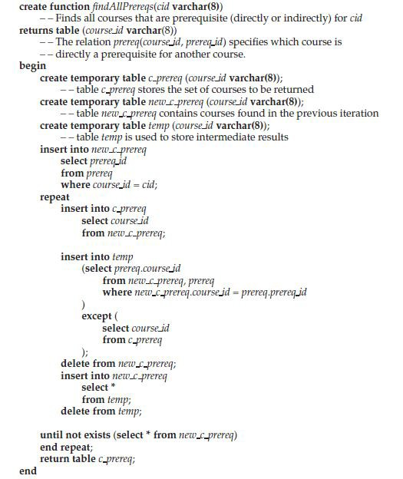
The Power of Recursion

Slide 60
OLAP**

Slide 61
Data Analysis and OLAP
ν
Online Analytical Processing (OLAP)
λ
Interactive analysis of data, allowing data to be summarized and viewed in different ways in an online fashion (with negligible delay)
Data that can be modeled as dimension attributes and measure attributes are called multidimensional data.
ν
λ
Measure attributes
measure some value
can be aggregated upon
e.g., the attribute number of the sales relation
Dimension attributes
define the dimensions on which measure attributes (or aggregates thereof) are viewed
e.g., attributes item_name, color, and size of the sales relation
λ

Slide 62

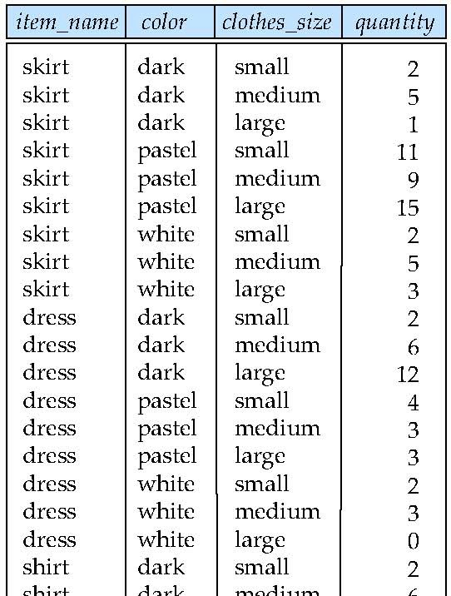
Example sales relation
...
...
...
...
...
5..7.6.
...
...
Database System Concepts - 6th Edition
©Silberschatz, Korth and Sudarshan

Slide 63
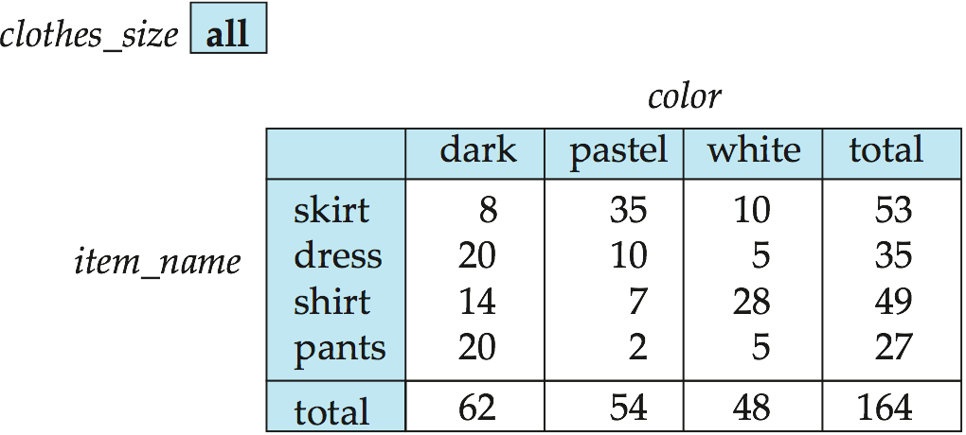
Cross Tabulation of sales by item_name and color
ν
The table above is an example of a cross-tabulation (cross-tab), also referred to as a pivot-table.
λ
Values for one of the dimension attributes form the row headers Values for another dimension attribute form the column headers Other dimension attributes are listed on top
Values in individual cells are (aggregates of) the values of the dimension attributes that specify the cell.
λ
λ
λ

Slide 64

Data Cube
ν
ν
ν
A data cube is a multidimensional generalization of a cross-tab Can have n dimensions; we show 3 below
Cross-tabs can be used as views on a data cube

Slide 65
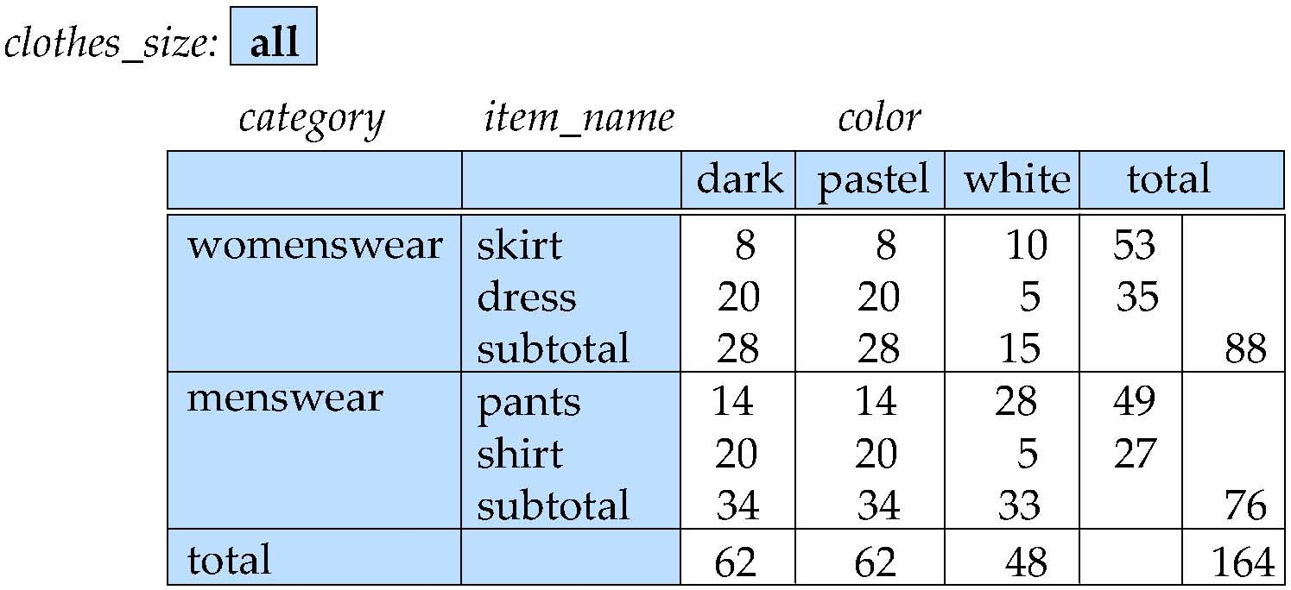
Cross Tabulation With Hierarchy
ν
Cross-tabs can be easily extended to deal with hierarchies
Can drill down or roll up on a hierarchy

Slide 66
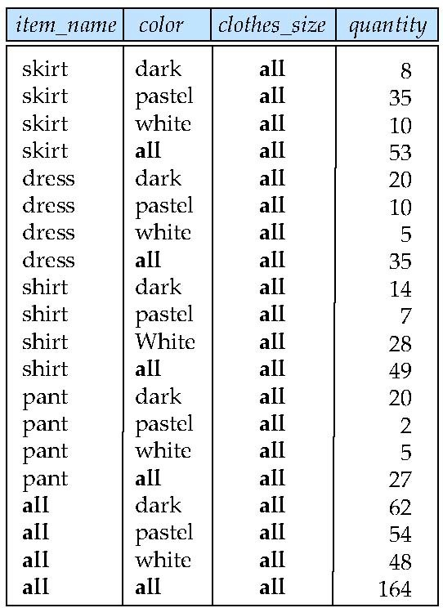
Relational Representation of Cross-tabs
ν
Cross-tabs can be represented as relations
We use the value all is used to represent aggregates.
The SQL standard actually uses null values in place of all despite confusion with regular null values.
●

Slide 67
Extended Aggregation to Support OLAP
ν
The cube operation computes union of group by’s on every subset of the specified attributes
Example relation for this section
sales(item_name, color, clothes_size, quantity)
E.g. consider the query
select item_name, color, size, sum(number) from sales
group by cube(item_name, color, size)
This computes the union of eight different groupings of the sales relation:
{ (item_name, color, size), (item_name, color),
ν
ν
(item_name, size), (item_name), (size),
(color, size),
(color),
( ) }
where ( ) denotes an empty group by list.
For each grouping, the result contains the null value for attributes not present in the grouping.
ν

Slide 68
Extended Aggregation (Cont.)
ν
The rollup construct generates union on every prefix of specified list of attributes
E.g.,
select item_name, color, size, sum(number) from sales
group by rollup(item_name, color, size)
Generates union of four groupings:
{ (item_name, color, size), (item_name, color), (item_name), ( ) }
Rollup can be used to generate aggregates at multiple levels of a hierarchy.
E.g., suppose table itemcategory(item_name, category) gives the category of each item. Then
select category, item_name, sum(number) from sales, itemcategory
where sales.item_name = itemcategory.item_name
group by rollup(category, item_name)
would give a hierarchical summary by item_name and by category.
ν
ν
ν

Slide 69
Extended Aggregation (Cont.)
ν
Multiple rollups and cubes can be used in a single group by clause
λ
Each generates set of group by lists, cross product of sets gives overall set of group by lists
E.g.,
select item_name, color, size, sum(number) from sales
group by rollup(item_name), rollup(color, size)
generates the groupings
{item_name, ()} X {(color, size), (color), ()}
= { (item_name, color, size), (item_name, color), (item_name), (color, size), (color), ( ) }
ν

Slide 70
Online Analytical Processing Operations
ν
ν
Pivoting: changing the dimensions used in a cross-tab is called
Slicing: creating a cross-tab for fixed values only
λ
Sometimes called dicing, particularly when values for multiple dimensions are fixed.
Rollup: moving from finer-granularity data to a coarser granularity
Drill down: The opposite operation - that of moving from coarser-granularity data to finer-granularity data
ν
ν

Slide 71
End of Chapter
Database System Concepts, 6th Ed.
©Silberschatz, Korth and Sudarshan
See www.db-book.com for conditions on re-use

Slide 72
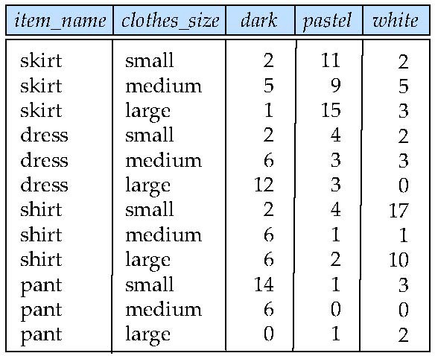
Figure 5.22

Slide 73
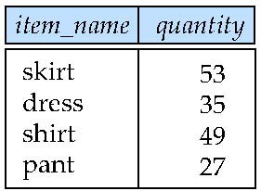
Figure 5.23

Slide 74
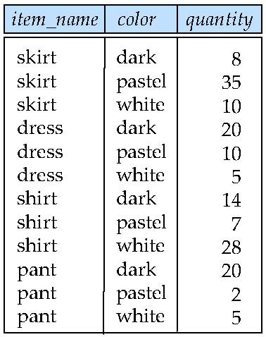
Figure 5.24

Slide 75
Another Recursion Example
ν
Given relation
manager(employee_name, manager_name)
Find all employee-manager pairs, where the employee reports to the manager directly or indirectly (that is manager’s manager, manager’s manager’s manager, etc.)
with recursive empl (employee_name, manager_name ) as (
select employee_name, manager_name
ν
from manager
union
select manager.employee_name, empl.manager_name
from manager, empl
where manager.manager_name = empl.employe_name)
select *
from empl
This example view, empl, is the transitive closure of the manager
relation

Slide 76
Merge statement (now in Chapter 24)
ν
ν
Merge construct allows batch processing of updates.
Example: relation funds_received (account_number, amount ) has batch of deposits to be added to the proper account in the account relation
merge into account as A
using (select *
from funds_received as F )
on (A.account_number = F.account_number )
when matched then
update set balance = balance + F.amount

