Slide 1
Recovery System
Failure Classification
Storage Structure
Log-Based Recovery
Recovery Algorithms
Buffer Management
ARIES Recovery Algorithm

Slide 2
Failure Classification
Transaction failure :
Logical errors: transaction cannot complete due to some internal error condition
System errors: the database system must terminate an active transaction due to an error condition (e.g., deadlock)
System crash: a power failure or other hardware or software failure causes the system to crash.
Fail-stop assumption: non-volatile storage contents are assumed to not be corrupted by system crash
Database systems have numerous integrity checks to prevent corruption of disk data
Disk failure: a head crash or similar disk failure destroys all or part of disk storage
Destruction is assumed to be detectable: disk drives use checksums to detect failures

Slide 3
Recovery Algorithms
Recovery algorithms are techniques to ensure database consistency and transaction atomicity and durability despite failures
Focus of this chapter
Recovery algorithms have two parts
Actions taken during normal transaction processing to ensure enough information exists to recover from failures
Actions taken after a failure to recover the database contents to a state that ensures atomicity, consistency and durability

Slide 4
Transaction State
Active – the initial state; the transaction stays in this state while it is executing
Partially committed – after the final statement has been executed.
Failed -- after the discovery that normal execution can no longer proceed.
Aborted – after the transaction has been rolled back and the database restored to its state prior to the start of the transaction. Two options after it has been aborted:
Restart the transaction
can be done only if no internal logical error
Kill the transaction
Committed – after successful completion.

Slide 5
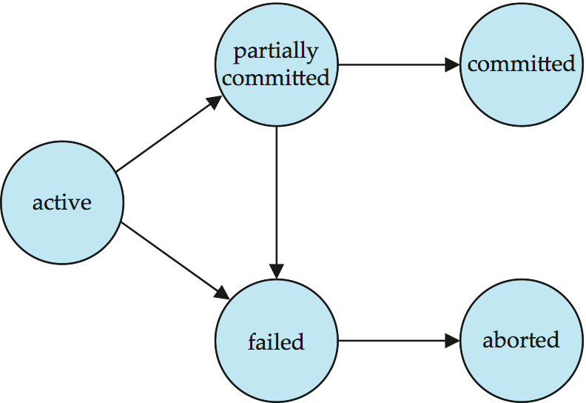
Transaction State (Cont.)
Single step

Slide 6
Storage Structure
Volatile storage:
does not survive system crashes
examples: main memory, cache memory
Nonvolatile storage:
survives system crashes
examples: disk, tape, flash memory, non-volatile (battery backed up) RAM
But may still fail, losing data
Stable storage:
a mythical form of storage that survives all failures
approximated by maintaining multiple copies on distinct nonvolatile media

Slide 7
Data Access
Physical blocks are those blocks residing on the disk.
Buffer blocks are the blocks residing temporarily in main memory.
Block movements between disk and main memory are initiated through the following two operations:
input(B) transfers the physical block B to main memory.
output(B) transfers the buffer block B to the disk, and replaces the appropriate physical block there.
Each transaction T_{i} has its private work-area in which local copies of all data items accessed and updated by it are kept.
T_{i}'s local copy of a data item X is called x_{i}.
We assume, for simplicity, that each data item fits in, and is stored inside, a single block.
This is one of the most important assumption in database system.

Slide 8
Example of Data Access
buffer
Buffer Block A
input(A)
x
Buffer Block B
A
Y
output(B)
B
read(X)
write(Y)
x₂
disk
x₁
y₁
work area
of T₁
work area
of T₂
memory

Slide 9
Data Access (Cont.)
Transaction transfers data items between system buffer blocks and its private work-area using the following operations :
read(X) assigns the value of data item X to the local variable x_{i}.
write(X) assigns the value of local variable x_{i} to data item {X} in the buffer block.
both these commands may necessitate the issue of an input(B_{X}) instruction before the assignment, if the block B_{X} in which X resides is not already in memory.
Transactions
Perform read(X) while accessing X for the first time;
All subsequent accesses are to the local copy.
write(X) can be executed at any time before the transaction commits
output(B_{X}) need not immediately follow write(X). System can perform the output operation when it deems fit.
The buffer manager needs the memory space for other purposes.
The database system wishes to reflect the change to database.

Slide 10
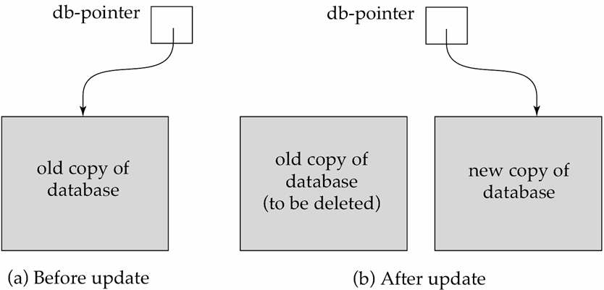
Recovery and Atomicity
To ensure atomicity despite failures
we first output information describing the modifications to stable storage without modifying the database itself.
Then make the modification to database at commit point, or remove all the modification if the transaction failed (rollback)
We study log-based recovery mechanisms in detail
Key concepts, and the actual recovery algorithm
We assume (initially) that transactions run serially, but the actual recovery algorithm need work together with concurrency control.
Less used alternative: shadow-copy and shadow-paging

Slide 11
Log-Based Recovery
A log is kept on stable storage.
The log is a sequence of log records, and maintains a record of update activities on the database.
When transaction T_{i} starts, it registers itself by writing a <T_{i} start>log record
Before T_{i} executes write(X), a log record <Ti, X, V1, V2> is written, where V₁ is the value of X before the write, and V₂ is the value to be written to X.
T_{i} has performed a write on data item X_{j} X_{j} had old value V₁ before the write, and will have new value V₂ after the write.
When T_{i} finishes it last statement, the log record <T_{i} commit> is written.
The log must reside in stable storage.
For now, we assume that every log record is written to the end of long file on stable storage as soon as it created.
Two approaches using logs
Deferred database modification
Immediate database modification
Notes:
提交之前，旧数据怎么找回来
提交之后，新数据别丢了

Slide 12
Update transaction
Possible inconsistency of an update transaction failure
The new value is not safe while the transaction commits.
Can not protect the committed value if a failure occurs.
The old value is not safe before the transaction commits.
Can not rollback to old value if a failure occurs before the commit.
提交之前旧数据不安全
Two rules for update transaction
Commit rule: The new value must be written to non-volatile storage (Database or log file) before the transaction commit.
Logging rule: The old value must be written to log file if the new value is written to database.

Slide 13
Update transaction (Cont.)
Possible approaches based on the update rules
The new value be written to database totally before commit.
Logging rule: Write old value to log file.
No redo is needed. (All modification have been written to DB)
Low concurrency.
The new value be written to database after commit.
Commit rule: Write new values to log file before commit.
Logging rule: no need to write old value to log file.
No undo is needed. ( The old value is safe before commit)
Better concurrency. - Deferred database modification
The new value start to be written to database before commit, and do not require to be finished before commit.
Commit rule: Write new values to log file before commit.
Logging rule: Write old value to log file.
Best concurrency. - Immediate database modification

Slide 14
Transaction Commit
A transaction is said to have committed when its commit log record is output to stable storage
all previous log records of the transaction must have been output already
Writes performed by a transaction may still be in the buffer when the transaction commits, and may be output later

Slide 15
Deferred Database Modification
The deferred database modification scheme records all modifications to the log, but defers all the writes to after commit.
Assume that transactions execute serially
Transaction starts by writing <T_{i} start> record to log.
A write(X) operation results in a log record <T_{i}, X, V> being written, where V is the new value for X
Note: old value is not needed for this scheme
The write is not performed on X at this time, but is deferred.
When T_{i} partially commits, <T_{i} commit> is written to the log
Finally, the log records are read and used to actually execute the previously deferred writes.

Slide 16
Deferred Database Modification (Cont.)
During recovery after a crash, a transaction needs to be redone if and only if both <T_{i} start> and<T_{i} commit> are there in the log.
Redoing a transaction T_{i} ( redoT_{i}) sets the value of all data items updated by the transaction to the new values.
Crashes can occur while
the transaction is executing the original updates, or
while recovery action is being taken
The redo operation must be idempotent; that is, executing several times must be equivalent to executing once.
example transactions T₀ and T₁ (T₀ executes before T₁):
T₀: read (A) T₁ : read (C)
A: - A - 50 C:- C- 100
Write (A) write (C)
read (B)
B:- B + 50
write (B)

Slide 17
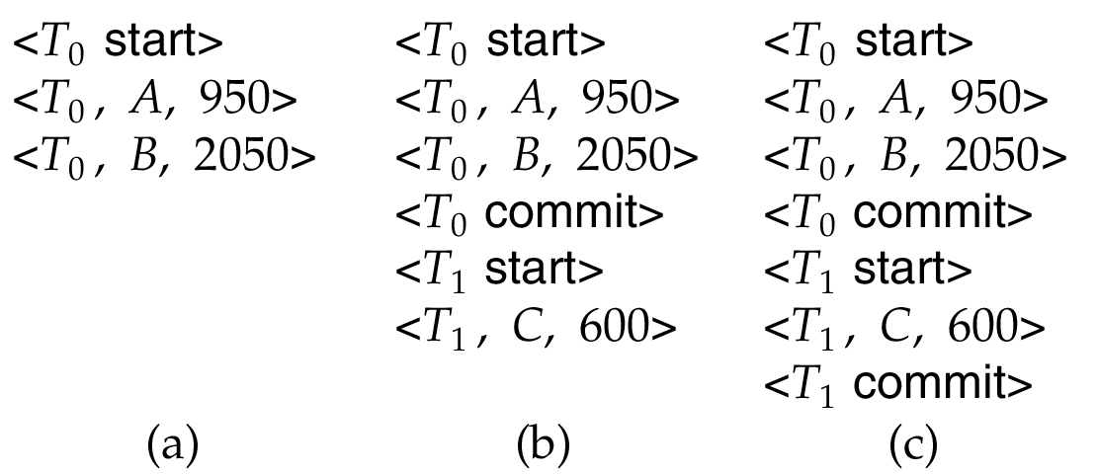
Deferred Database Modification (Cont.)
Below we show the log as it appears at three instances of time.
If log on stable storage at time of crash is as in case:
(a) No redo actions need to be taken
(b) redo(T₀) must be performed since <T₀ commit> is present
(c) redo(T₀) must be performed followed by redo(T₁) since
<T₀ commit> and <T_{i} commit> are present

Slide 18
Immediate Database Modification
The immediate database modification scheme allows database updates of an uncommitted transaction to be made as the writes are issued
since undoing may be needed, update logs must have both old value and new value
Update log record must be written before database item is written
We assume that the log record is output directly to stable storage
Can be extended to postpone log record output, so long as prior to execution of an output(B) operation for a data block B, all log records corresponding to items B must be flushed to stable storage
Output of updated blocks can take place at any time before or after transaction commit
Order in which blocks are output can be different from the order in which they are written.

Slide 19
Immediate Database Modification Example
x₁
Log Write Output
<T₀ start>
<T₀, A, 1000, 950>
T_{o}, B, 2000, 2050
A = 950
B = 2050
<T₀ commit>
<T₁ start>
<T₁, C, 700, 600>
C = 600
B_{B}, B_{C}
<T₁ commit>
B_{A}
Note: B_{X} denotes block containing X.

Slide 20
Immediate Database Modification (Cont.)
Recovery procedure has two operations instead of one:
undo(T_{i}) restores the value of all data items updated by T_{i} to their old values, going backwards from the last log record for T_{i}
redo(T_{i}) sets the value of all data items updated by T_{i} to the new values, going forward from the first log record for T_{i}
Both operations must be idempotent
That is, even if the operation is executed multiple times the effect is the same as if it is executed once
Needed since operations may get re-executed during recovery
When recovering after failure:
Transaction T_{i} needs to be undone if the log contains the record <T_{i} start>, but does not contain the record <T_{i} commit>.
Transaction T_{i} needs to be redone if the log contains both the record <T_{i} start> and the record <T_{i} commit>.

Slide 21
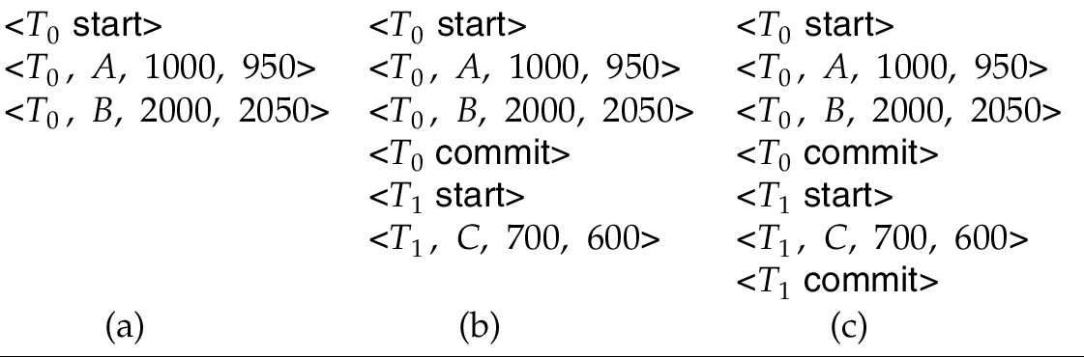
Immediate DB Modification Recovery Example
Below we show the log as it appears at three instances of time.
Recovery actions in each case above are:
(a) undo (T₀): B is restored to 2000 and A to 1000. undo顺序：从尾到头
(b) undo (T₁) and redo (T₀): C is restored to 700, and then A and B are
set to 950 and 2050 respectively.
(c) redo (T₀) and redo (T₁): A and B are set to 950 and 2050
respectively. Then C is set to 600 redo顺序：从尾到头

Slide 22
Concurrency Control and Recovery
With concurrent transactions, all transactions share a single disk buffer and a single log
A buffer block can have data items updated by one or more transactions
We assume that:
if a transaction T_{i} has modified an item, no other transaction can modify the same item until T_{i} has committed or aborted
No lost modification: the updates of uncommitted transactions should not be updated by any other transactions.
Can be ensured by obtaining exclusive locks on updated items and holding the locks till end of transaction (strict two-phase locking)
Log records of different transactions may be interspersed in the log.

Slide 23
Checkpoints
Problems in recovery procedure as discussed earlier :
searching the entire log is time-consuming
we might unnecessarily redo transactions which have already output their updates to the database.
Streamline recovery procedure by periodically performing checkpointing
Output all log records currently residing in main memory onto stable storage.
Output all modified buffer blocks to the disk.
Write a log record < checkpoint L> onto stable storage, where L is a list of all transactions active at the time of checkpoint.
Transactions are not allowed to perform any update actions while a checkpoint is in progress.

Slide 24
Checkpoints (Cont.)
During recovery we need to consider only the most recent transaction T_{i} that started before the checkpoint, and transactions that started after T_{i}.
Scan backwards from end of log to find the most recent <checkpoint L> record
Only transactions that are in L or started after the checkpoint need to be redone or undone
Transactions that committed or aborted before the checkpoint already have all their updates output to stable storage.
Some earlier part of the log may be needed for undo operations
Continue scanning backwards till a record <T_{i} start> is found for every transaction T_{i} in L.
Parts of log prior to earliest <T_{i} start> record above are not needed for recovery, and can be erased whenever desired.

Slide 25
Example of Checkpoints
T_{c}
T_{f}
T₁ can be ignored (updates already output to disk due to checkpoint)
T₂ and T₃ redone.
T₄ undone
T₁
T₂
T₃
T₄
checkpoint
system failure

Slide 26
Recovery Algorithm
Logging (during normal operation):
<T_{i} start> at transaction start
<T_{i}, X_{j}, V₁, V₂> for each update, and
<T_{i} commit> at transaction end
Transaction rollback (during normal operation)
Let T_{i} be the transaction to be rolled back
Scan log backwards from the end, and for each log record of T_{i} of the form <T_{i}, X_{j}, V₁, V₂>
perform the undo by writing V₁ to X_{j},
write a log record <T_{i} , X_{j}, V₁>
such log records are called compensation log records
Once the record <T_{i} start> is found stop the scan and write the log record <T_{i} abort>

Slide 27
Recovery Algorithm (Cont.)
Recovery from failure: Two phases
Redo phase: replay updates of all transactions, whether they committed, aborted, or are incomplete
Undo phase: undo all incomplete transactions
Redo phase:
Find last <checkpoint L> record, and set undo-list to L.
Scan forward from above <checkpoint L> record
Whenever a record <T_{i}, X_{j}, V₁, V₂> or <T_{i}, X_{j}, V₂> is found, redo it by writing V₂ to X_{j}
Whenever a log record <T_{i} start> is found, add T_{i} to undo-list
Whenever a log record <T_{i} commit> or <T_{i} abort> is found, remove T_{i} from undo-list

Slide 28
Recovery Algorithm (Cont.)
Undo phase:
Scan log backwards from end
Whenever a log record <T_{i}, X_{j}, V₁, V₂> is found where T_{i} is in undo-list perform same actions as for transaction rollback:
perform undo by writing V₁ to X_{j}.
write a log record <T_{i} , X_{j}, V₁>
Whenever a log record <T_{i} start> is found where T_{i} is in undo-list,
Write a log record <T_{i} abort>
Remove T_{i} from undo-list
Stop when undo-list is empty
i.e. <T_{i} start> has been found for every transaction in undo-list
After undo phase completes, normal transaction processing can commence

Slide 29
Example of Recovery

Slide 30
Log Record Buffering
Log record buffering: log records are buffered in main memory, instead of of being output directly to stable storage.
Log records are output to stable storage when a block of log records in the buffer is full, or a log force operation is executed.
Log force is performed to commit a transaction by forcing all its log records (including the commit record) to stable storage.
Several log records can thus be output using a single output operation, reducing the I/O cost.

Slide 31
Log Record Buffering (Cont.)
The rules below must be followed if log records are buffered:
Log records are output to stable storage in the order in which they are created.
Transaction T_{i} enters the commit state only when the log record <T_{i} commit> has been output to stable storage.
Before a block of data in main memory is output to the database, all log records pertaining to data in that block must have been output to stable storage.
This rule is called the write-ahead logging or WAL rule
Strictly speaking WAL only requires undo information to be output

Slide 32
Database Buffering
Database maintains an in-memory buffer of data blocks
When a new block is needed, if buffer is full an existing block needs to be removed from buffer
If the block chosen for removal has been updated, it must be output to disk
As a result of the write-ahead logging rule, if a block with uncommitted updates is output to disk, log records with undo information for the updates are output to the log on stable storage first.
The recovery algorithm supports the no-force policy: i.e., updated blocks need not be written to disk when transaction commits
force policy: requires updated blocks to be written at commit
The recovery algorithm supports the steal policy: i.e., blocks containing updates of uncommitted transactions can be written to disk, even before the transaction commits
Both no-force policy and steal policy can improve the concurrency performance of the system.

Slide 33
Database Buffering (Cont.)
No updates should be in progress on a block when it is output to disk. Can be ensured as follows.
Before writing a data item, transaction acquires exclusive lock on block containing the data item
Lock can be released once the write is completed.
Such locks held for short duration are called latches.
Algorithm of output a block to disk
Acquire an exclusive latch on the block
Ensures no transaction is preforming a write on the block.
Perform a log flush: Output log records to stable storage until all log records pertaining to the block have been output.
Output the block to disk
Release the latch on the block

Slide 34
Buffer Management (Cont.)
Database buffer can be implemented either
in an area of real main-memory reserved for the database, or
in virtual memory
Implementing buffer in reserved main-memory has drawbacks:
Memory is partitioned before-hand between database buffer and applications, limiting flexibility.
Needs may change, and although operating system knows best how memory should be divided up at any time, it cannot change the partitioning of memory.

Slide 35
Buffer Management (Cont.)
Database buffers are generally implemented in virtual memory in spite of some drawbacks:
When operating system needs to evict a page that has been modified, to make space for another page, the page is written to swap space on disk.
When database decides to write buffer page to disk, buffer page may be in swap space, and may have to be read from swap space on disk and output to the database on disk, resulting in extra I/O!
Known as dual paging problem.
Ideally when swapping out a database buffer page, operating system should pass control to database, which in turn outputs page to database instead of to swap space (making sure to output log records first)
Dual paging can thus be avoided, but common operating systems do not support such functionality.

Slide 36
Fuzzy Checkpointing
To avoid long interruption of normal processing during checkpointing, allow updates to happen during checkpointing
Fuzzy checkpointing is done as follows:
Temporarily stop all updates by transactions
Write a <checkpoint L> log record and force log to stable storage
Note list M of modified buffer blocks
Now permit transactions to proceed with their actions
Output to disk all modified buffer blocks in list M
blocks should not be updated while being output
Follow WAL: all log records pertaining to a block must be output before the block is output
Store a pointer to the checkpoint record in a fixed position last_checkpoint on disk
Notes:
36

Slide 37
Fuzzy Checkpointing (Cont.)
When recovering using a fuzzy checkpoint, start scan from the checkpoint record pointed to by last_checkpoint
Log records before last_checkpoint have their updates reflected in database on disk, and need not be redone.
Incomplete checkpoints, where system had crashed while performing checkpoint, are handled safely
……
<checkpoint L>
…..
<checkpoint L>
…..
last_checkpoint
Log
Notes:
37

Slide 38
Failure with Loss of Nonvolatile Storage
So far we assumed no loss of non-volatile storage
Technique similar to checkpointing used to deal with loss of non-volatile storage
Periodically dump the entire content of the database to stable storage
No transaction may be active during the dump procedure; a procedure similar to checkpointing must take place
Output all log records currently residing in main memory onto stable storage.
Output all buffer blocks onto the disk.
Copy the contents of the database to stable storage.
Output a record <dump> to log on stable storage.
To recover from disk failure
restore database from most recent dump.
Consult the log and redo all transactions that committed after the dump
Can be extended to allow transactions to be active during dump; known as fuzzy dump or online dump

Slide 39
Early Lock Release and Logical Undo
Support for high-concurrency locking techniques, such as those used for B⁺-tree concurrency control, which release locks early
They cannot be undone by restoring old values (physical undo), since once a lock is released, other transactions may have updated the B⁺-tree.
Instead, insertions (resp. deletions) are undone by executing a deletion (resp. insertion) operation (known as logical undo).
For such operations, undo log records should contain the undo operation to be executed
Such logging is called logical undo logging, in contrast to physical undo logging
Operations are called logical operations
Other examples:
delete of tuple, to undo insert of tuple
allows early lock release on space allocation information
subtract amount deposited, to undo deposit
allows early lock release on bank balance

Slide 40
Logical Undo Logging
Operation logging is done as follows:
When operation starts, log <Ti, Oj, operation-begin>. Here O_{j} is a unique identifier of the operation instance.
While operation is executing, normal log records with physical redo and physical undo information are logged.
When operation completes, <Ti, Oj, operation-end, U> is logged, where U contains information needed to perform a logical undo information.
Example: insert of (key, record-id) pair (K5, RID7) into index I9
<T1, O1, operation-begin>
….
<T1, X, 10, K5>
<T1, Y, 45, RID7>
<T1, O1, operation-end, (delete I9, K5, RID7)>
Physical redo of steps in insert

Slide 41
Recovery with Logical Undo Logging
If crash/rollback occurs before operation completes:
the operation-end log record is not found, and
the physical undo information is used to undo operation.
If crash/rollback occurs after the operation completes:
the operation-end log record is found, and in this case
logical undo is performed using U; the physical undo information for the operation is ignored.
Redo of operation (after crash) still uses physical redo information even for operations with logical undo
Logical redo is very complicated since database state on disk may not be “operation consistent” when recovery starts
A physical log record is idempotent
Physical redo logging does not conflict with early lock release

Slide 42
Transaction Rollback with Logical Undo
Rollback of transaction T_{i} is done as follows:
Scan the log backwards
If a log record <T_{i}, X, V₁, V₂> is found, perform the undo and log a al <T_{i}, X, V₁>.
If a <T_{i}, O_{j}, operation-end, U> record is found
Rollback the operation logically using the undo information U.
Updates performed during roll back are logged just like during normal operation execution.
At the end of the operation rollback, instead of logging an operation-end record, generate a record
<T_{i}, O_{j}, operation-abort>.
Skip all preceding log records (including physical undo record) for T_{i} until the record <T_{i}, O_{j} operation-begin> is found

Slide 43
Transaction Rollback with Logical Undo (Cont.)
Transaction rollback, scanning the log backwards (cont.):
If a redo-only record is found ignore it
If a <T_{i}, O_{j}, operation-abort> record is found:
skip all preceding log records for T_{i} until the record <T_{i}, O_{j}, operation-begin> is found.
Stop the scan when the record <T_{i}, start> is found
Add a <T_{i}, abort> record to the log
Some points to note:
Cases 3 and 4 above can occur only if the database crashes while a transaction is being rolled back.
Skipping of log records as in case 4 is important to prevent multiple rollback of the same operation.

Slide 44
Transaction Rollback with Logical Undo
Transaction rollback during normal operation

Slide 45
Recovery Algorithm with Logical Undo
Basically same as earlier algorithm, except for changes described earlier for transaction rollback
Redo phase: Scan log forward from last < checkpoint L> record till end of log
Repeat history by physically redoing all updates of all ransactions;
Create an undo-list during the scan as follows
undo-list is set to L initially
Whenever <T_{i} start> is found T_{i} is added to undo-list
Whenever <T_{i} commit> or <T_{i} abort> is found, T_{i} is deleted from undo-list
This brings database to state as of crash, with committed as well as uncommitted transactions having been redone.
Now undo-list contains transactions that are incomplete, that is, have neither committed nor been fully rolled back.

Slide 46
Recovery with Logical Undo (Cont.)
Undo phase: Scan log backwards, performing undo on log records of transactions found in undo-list.
Log records of transactions being rolled back are processed as described earlier, as they are found
Single shared scan for all transactions being undone
When <T_{i} start> is found for a transaction T_{i} in undo-list, write a <T_{i} abort> log record.
Stop scan when <T_{i} start> records have been found for all T_{i} in undo-list
This undoes the effects of incomplete transactions (those with neither commit nor abort log records). Recovery is now complete.

Slide 47
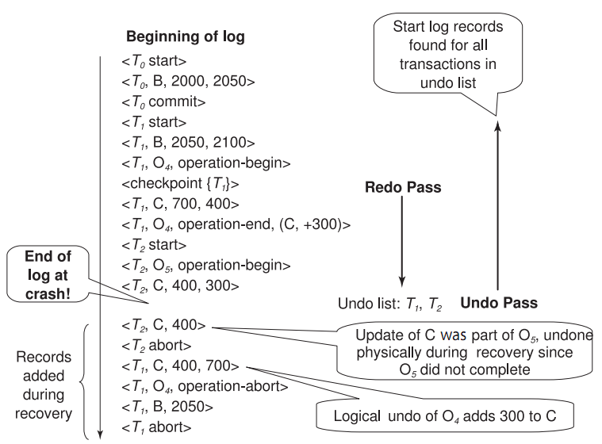
Failure Recovery with Logical Undo

Slide 48
ARIES Recovery Algorithm

Slide 49
ARIES
ARIES is a state of the art recovery method
Incorporates numerous optimizations to reduce overheads during normal processing and to speed up recovery
The recovery algorithm we studied earlier is modeled after ARIES, but greatly simplified by removing optimizations
Unlike the recovery algorithm described earlier, ARIES
Uses log sequence number (LSN) to identify log records
Stores LSNs in pages to identify what updates have already been applied to a database page
Physiological redo
Dirty page table to avoid unnecessary redos during recovery
Fuzzy checkpointing that only records information about dirty pages, and does not require dirty pages to be written out at checkpoint time

Slide 50
ARIES Optimizations
Physiological redo
Affected page is physically identified, action within page can be logical
Used to reduce logging overheads
e.g. when a record is deleted and all other records have to be moved to fill hole within the same page.
Physiological redo can log just the record deletion
Physical redo would require logging of old and new values for much of the page
Requires page to be output to disk atomically
Easy to achieve with hardware RAID, also supported by some disk systems
Incomplete page output can be detected by checksum techniques,
But extra actions are required for recovery
Treated as a media failure

Slide 51
ARIES Data Structures
ARIES uses several data structures
Log sequence number (LSN) identifies each log record
Must be sequentially increasing
Typically an offset from beginning of log file to allow fast access
Easily extended to handle multiple log files
Page LSN
Log records of several different types
Dirty page table

Slide 52
ARIES Data Structures: Page LSN
Each page contains a PageLSN which is the LSN of the last log record whose effects are reflected on the page
To update a page:
X-latch the page, and write the log record
Update the page
Record the LSN of the log record in PageLSN
Unlock page
To flush page to disk, must first S-latch page
Thus page state on disk is operation consistent
Required to support physiological redo
PageLSN is used during recovery to prevent repeated redo
Thus ensuring idempotence

Slide 53
ARIES Data Structures: Log Record
Each log record contains LSN of previous log record of the same transaction
LSN in log record may be implicit
Special redo-only log record called compensation log record (CLR) used to log actions taken during recovery that never need to be undone
Serves the role of operation-abort log records used in earlier recovery algorithm
Has a field UndoNextLSN to note next (earlier) record to be undone
Records in between would have already been undone
Required to avoid repeated undo of already undone actions
LSN TransID PrevLSN RedoInfo UndoInfo
LSN TransID UndoNextLSN RedoInfo
1
2
3
4
4'
3'
2'
1'

Slide 54
ARIES Data Structures: DirtyPage Table
DirtyPageTable
List of pages in the buffer that have been updated
Contains, for each such page
PageLSN of the page
RecLSN is an LSN such that log records before this LSN have already been applied to the page version on disk
Set to current end of log when a page is inserted into dirty page table (just before being updated)
Recorded in checkpoints, helps to minimize redo work

Slide 55
ARIES Data Structures

Slide 56
ARIES Data Structures: Checkpoint Log
Checkpoint log record
Contains:
DirtyPageTable and list of active transactions
For each active transaction, LastLSN, the LSN of the last log record written by the transaction
Fixed position on disk notes LSN of last completed checkpoint log record
Dirty pages are not written out at checkpoint time
Instead, they are flushed out continuously, in the background
Checkpoint is thus very low overhead
can be done frequently

Slide 57
ARIES Recovery Algorithm
ARIES recovery involves three passes
Analysis pass: Determines
Which transactions to undo
Which pages were dirty (disk version not up to date) at time of crash
RedoLSN: LSN from which redo should start
Redo pass:
Repeats history, redoing all actions from RedoLSN
RecLSN and PageLSNs are used to avoid redoing actions already reflected on page
Undo pass:
Rolls back all incomplete transactions
Transactions whose abort was complete earlier are not undone
Key idea: no need to undo these transactions: earlier undo actions were logged, and are redone as required

Slide 58
Aries Recovery: 3 Passes
Analysis, redo and undo passes
Analysis determines where redo should start
Undo has to go back till start of earliest incomplete transaction
Last checkpoint
End of Log
Time
Log
Analysis pass
Redo pass
Undo pass

Slide 59
ARIES Recovery: Analysis
Analysis pass
Starts from last complete checkpoint log record
Reads DirtyPageTable from log record
Sets RedoLSN = min of RecLSNs of all pages in DirtyPageTable
In case no pages are dirty, RedoLSN = checkpoint record’s LSN
Sets undo-list = list of transactions in checkpoint log record
Reads LSN of last log record for each transaction in undo-list from checkpoint log record
Scans forward from checkpoint
.. Cont. on next page …

Slide 60
ARIES Recovery: Analysis (Cont.)
Analysis pass (cont.)
Scans forward from checkpoint
If any log record found for transaction not in undo-list, adds transaction to undo-list
Whenever an update log record is found
If page is not in DirtyPageTable, it is added with RecLSN set to LSN of the update log record
If transaction end log record found, delete transaction from undo-list
Keeps track of last log record for each transaction in undo-list
May be needed for later undo
At end of analysis pass:
RedoLSN determines where to start redo pass
RecLSN for each page in DirtyPageTable used to minimize redo work
All transactions in undo-list need to be rolled back

Slide 61
ARIES Redo Pass
Redo Pass: Repeats history by replaying every action not already reflected in the page on disk, as follows:
Scans forward from RedoLSN. Whenever an update log record is found:
If the page is not in DirtyPageTable or the LSN of the log record is less than the RecLSN of the page in DirtyPageTable, then skip the log record
Otherwise fetch the page from disk. If the PageLSN of the page fetched from disk is less than the LSN of the log record, redo the log record, otherwise, skip the log record.
NOTE: if either test is negative the effects of the log record have already appeared on the page. First test avoids even fetching the page from disk!

Slide 62
ARIES Undo Actions
When an undo is performed for an update log record
Generate a CLR containing the undo action performed (actions performed during undo are logged physicaly or physiologically).
CLR for record n noted as n’ in figure below
Set UndoNextLSN of the CLR to the PrevLSN value of the update log record
Arrows indicate UndoNextLSN value
ARIES supports partial rollback
Used e.g. to handle deadlocks by rolling back just enough to release reqd. locks
Figure indicates forward actions after partial rollbacks
records 3 and 4 initially, later 5 and 6, then full rollback
1
2
3
4
4'
3'
5
6
6'
5'
1'
2'

Slide 63
ARIES: Undo Pass
Undo pass:
Performs backward scan on log undoing all transaction in undo-list
Backward scan optimized by skipping unneeded log records as follows:
Next LSN to be undone for each transaction set to LSN of last log record for transaction found by analysis pass.
At each step pick largest of these LSNs to undo, skip back to it and undo it
After undoing a log record
For ordinary log records, set next LSN to be undone for transaction to PrevLSN noted in the log record
For compensation log records (CLRs) set next LSN to be undo to UndoNextLSN noted in the log record
All intervening records are skipped since they would have been undone already
Undos performed as described earlier

Slide 64
Recovery Actions in ARIES
RedoLSN=7564
UndoList: (T145,7567)
Dirtypages:
4894 7567 7564
7200 7565 7565
2390 7570 7570

Slide 65
Other ARIES Features
Recovery Independence
Pages can be recovered independently of others
E.g. if some disk pages fail they can be recovered from a backup while other pages are being used
Savepoints:
Transactions can record savepoints and roll back to a savepoint
Useful for complex transactions
Also used to rollback just enough to release locks on deadlock

Slide 66
Other ARIES Features (Cont.)
Fine-grained locking:
Index concurrency algorithms that permit tuple level locking on indices can be used
These require logical undo, rather than physical undo, as in earlier recovery algorithm
Recovery optimizations: For example:
Dirty page table can be used to prefetch pages during redo
Out of order redo is possible:
redo can be postponed on a page being fetched from disk, and performed when page is fetched.
Meanwhile other log records can continue to be processed

