Slide 1
Entity-Relationship Model
Design Process
Overview of Entity-Relationship Model
Entity Sets
Relationship Sets
Constraints
Mapping Constraints
Participation Constraints
Keys
Extended E-R Features
Weak Entity Sets
Aggregations
Specialization and Generalization
E-R Model Design Issues
Reduction of an E-R Schema to Tables

Slide 2
Design Process
Requirement analyze: to characterize fully the data needs of the prospective database users. The outcome is a specification of user requirements.
Conceptual design: To translate these requirements into a conceptual schema of the database, which provides a detail overview of the enterprise. Entity-Relationship model is the most widely used tools for conceptual schema design.
Also gives the specification of functional requirements, which describe the kind of operations ( or transactions ) that will be performed on the data.
Logical Design: to map the conceptual schema onto the implementation data model of the database system, e.g. relational data model.
To decide how to implement a good database model.
Physical Design: Deciding on the physical layout of the database, e.g. Indexing and partitioning. Resulting system-specific database schema in real system, e.g. Oracle/SQL Server.
Notes:
1. 需求分析：不能做什么（边界）
2. 概念设计：用什么方式（介于人与计算机之间->不能二义性、准确->ER模型）
3. 逻辑设计：语义模型映射到数据库管理系统能够支持的关系模型
4. 物理设计：用一个关系模型，选择数据库系统软件

Slide 3
Design Alternatives
A major part of the database design process is deciding how to represent in the design the various types of “things”, such as people, places, products, etc.
We must ensure the we avoid two major pitfalls
Redundancy: A bad design may repeat information.
Waste of space;
Difficult to modify;
Incompleteness: A bad design may make certain aspect of the enterprise difficult or impossible to model.
Avoiding bad designs is not enough. There may be a large number of good design from which we must choose.
Entity vs. Relationship
Notes:
在数据库设计范畴里面，需要注意数据表达的合理性问题。
比如冗余问题、数据不完整的问题（需求分析阶段的边界）。
如何针对ER模型，表达一个具体的问题。

Slide 4
Overview of Entity-Relationship Model
The ER data mode was developed to facilitate database design by allowing specification of an enterprise schema that represents the overall logical structure of a database.
The entity-relationship (E-R) data model perceives the real world as consisting of:
Entities: basic objects
Relationships: among the entities
A database can be modeled as:
a collection of entities,
relationship among entities.
One of the semantic data model
Maybe the most successful one
Many database design tools draw on concepts from E-R model
ER diagram: the diagrammatic representation of ER model.
Notes:
ER模型——实体关系模型，是最成功的语义模型
E: 实体（一堆对象，只表示东西）
R: 关系（对象之间的联系）
ER模型的元素=对象+对象的联系
能够清晰的表达对象之间的联系

Slide 5
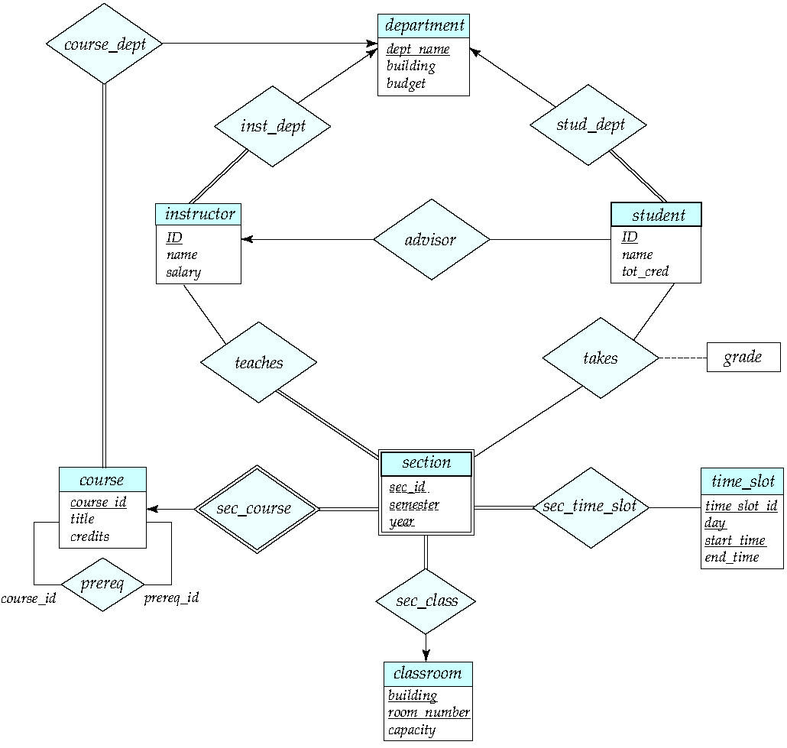
E-R Diagram for a University Enterprise

Slide 6
Entity Sets
An entity is an object that exists and is distinguishable from other objects.
Example: specific person, company, event, plant
An entity is represented by a set of attributes.
instructor has attributes (ID, name, street, city, salary ) course has attributes (course_id, title, credits)
An entity set is a set of entities of the same type that share the same properties.
Example: set of all persons, companies, trees, holidays
Entity set has the similar concepts of keys as relational data model (super/candidate/primary keys)
Entity sets do not need to be disjoint 同一个对象可能属于不同的对象集
Example: employee vs. customer; people vs. student
Notes:
Entity(attributes)->Entity Set(set of entities which has similar concepts of keys)

Slide 7
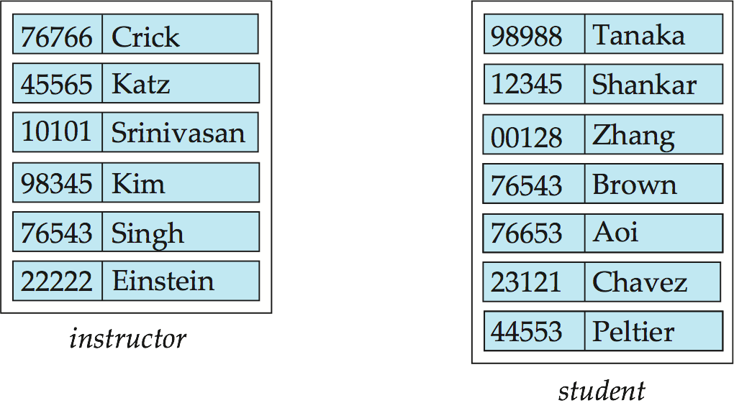
Entity Sets -- instructor and student
instructor_ID instructor_name salary(missing?) student-ID student_name

Slide 8
Entity Sets
Entities can be represented graphically as follows:
Rectangles represent entity sets.
Attributes listed inside entity rectangle
Underline indicates primary key attributes
Notes:
图比文字表述更加直接 primary key 加下划线(“_”)

Slide 9
Attributes
An entity is represented by a set of attributes, that is descriptive properties possessed by all members of an entity set.
Domain – the set of permitted values for each attribute
Attribute types:
Simple and composite attributes.
Single-valued and multi-valued attributes
E.g. multivalued attribute: phone-numbers
Derived attributes
Can be computed from other attributes
E.g. age, given date of birth
An attribute can take a null value
Does not have a value for it at this point
Example: customer = (customer-id, customer-name, customer-street, customer-city) loan = (loan-number, amount)
Notes:
Domain null的概念同样存在
属性封装成一个语义
·组合属性——放在一起可以更清晰地表达语义
·多值属性——多个电话号码
·Derived attributes——根据另外的属性算出来的属性（用一个函数方式去表达）

Slide 10
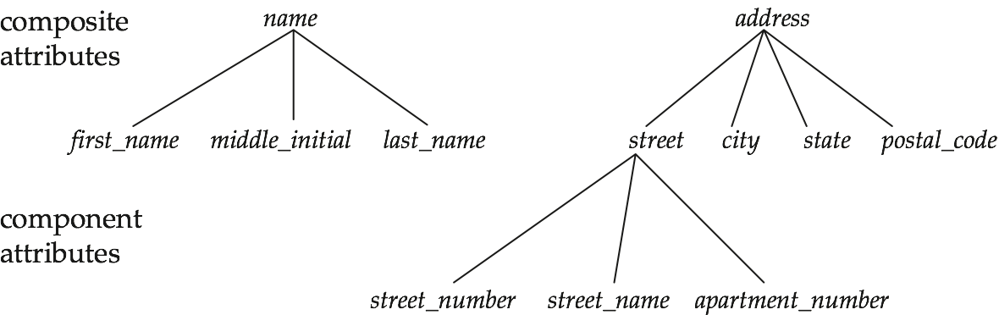
Composite Attributes

Slide 11
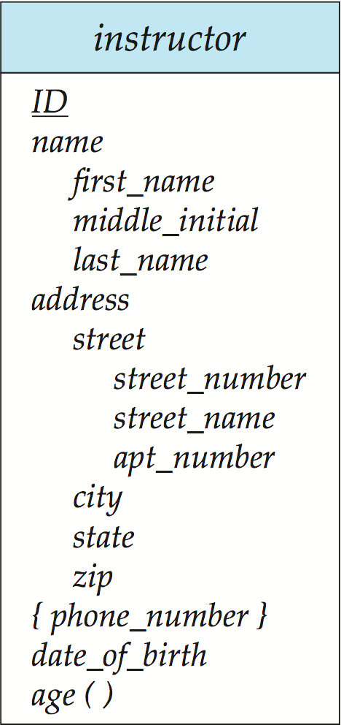
Notation to Express Entity with Complex Attributes
Composite attribute
multi-valued attribute
Derived attribute
Notes:
各种属性的表示方式

Slide 12
Relationship Sets
A relationship is an association among several entities
Example: 44553 (Peltier) advisor 22222 (Einstein) student entity relationship instructor entity
A relationship set is a set of relationships of the same type.
A relationship set is a mathematical relation among n ≥ 2 entities, each taken from entity sets 数学表达
{(e₁, e₂, … e_{n}) | e₁ ∈ E₁, e₂ ∈ E₂, …, e_{n} ∈ E_{n}} where (e₁, e₂, …, e_{n}) is a relationship
Example: 例子
(44553,22222) ∈ advisor
Notes:
相同类型的relationship所构成的集合成为relationship sets

Slide 13
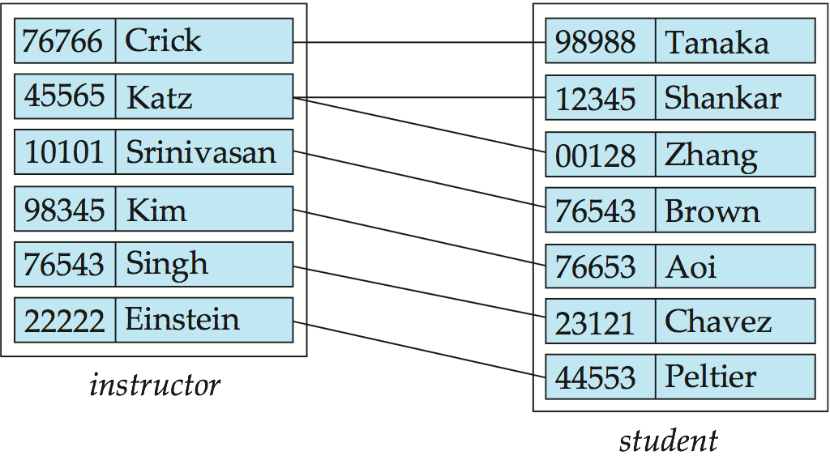
Relationship Set advisor

Slide 14
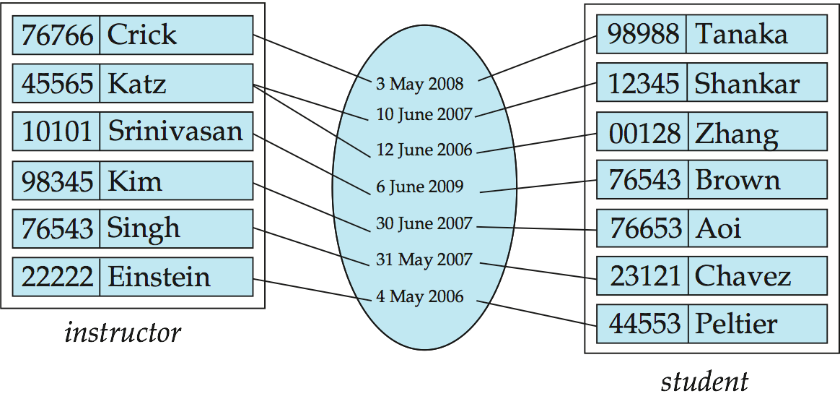
Relationship Sets (Cont.)
An descriptive attribute can also be associated with a relationship set. 关联的线上可以加上属性
For instance, the advisor relationship set between entity sets instructor and student may have the attribute date which tracks when the student started being associated with the advisor

Slide 15
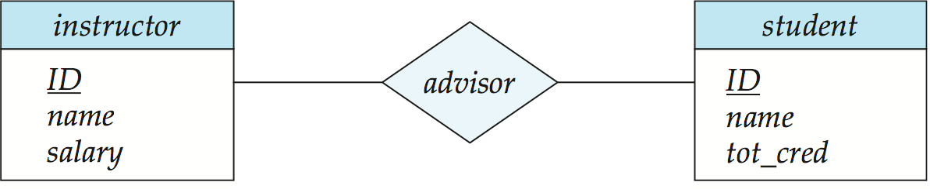
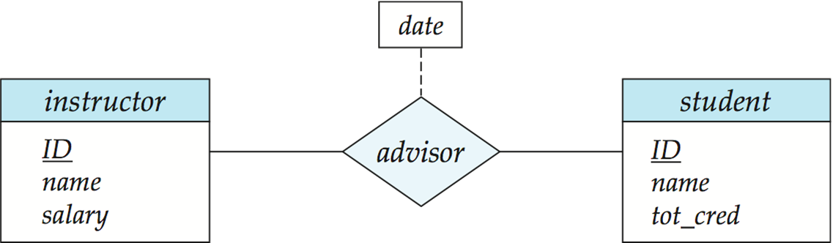
Relationship Sets
Diamonds represent relationship sets.
Relationship Sets with Attributes

Slide 16
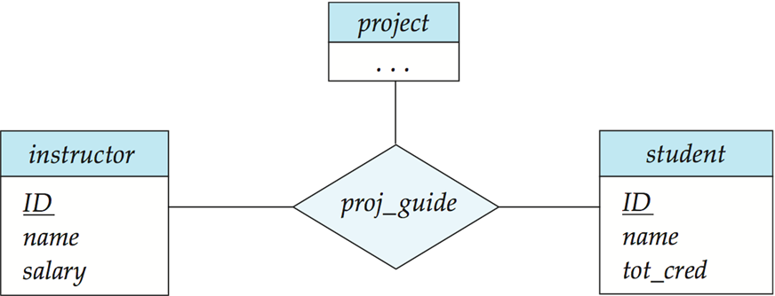
Degree of a Relationship Set
Refers to number of entity sets that participate in a relationship set.
Relationship sets that involve two entity sets are binary (or degree two).
Relationships between more than two entity sets are rare. Most relationships are binary. (More on this later.)
Example: students work on research projects under the guidance of an instructor.
Notes:
多于两个对象之间的关系结构：三元、多元
超过三元的一般就不用了，解释性会很差

Slide 17
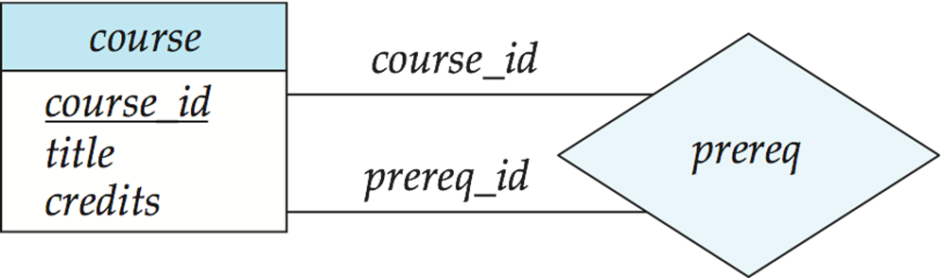
Entity’s role in relationship
The function that an entity plays in a relationship is called that entity’s role.
Usually it is implicit
Same entity set participate in a relationship set more then once, in different roles.
Need explicit role description
Example: course and prereq_course
The labels “course_id” and “prereq_id” are roles.
Notes:
一元关系：参与关系的是同一个set——本质上是个二元关系
在这种关系下要清晰各种对象在关系中的角色
为了避免二义性，常在一元关系的线上标上角色进行区分（course_id, prereq_id）

Slide 18
Constraints
Constraints: certain constraints of a database must conform, to represent some level of semantics.
Data model general constraints
User defined constraints
E-R model general constrains
Mapping cardinalities
Participation constraints
Keys
Notes:
在语义层面上，约束可以分为两个内容：
模型本身表示的约束（没有foreign key的概念）
2. 用户定义的约束

Slide 19
Mapping Cardinalities
Express the number of entities to which another entity can be associated via a relationship set.
Most useful in describing binary relationship sets.
For a binary relationship set the mapping cardinality must be one of the following types:
One to one
One to many
Many to one
Many to many
Notes:
对应关系（所有关系都不需要要求全部参与——可以不对应）：
·一对一
·一对多
·多对一
·多对多

Slide 20
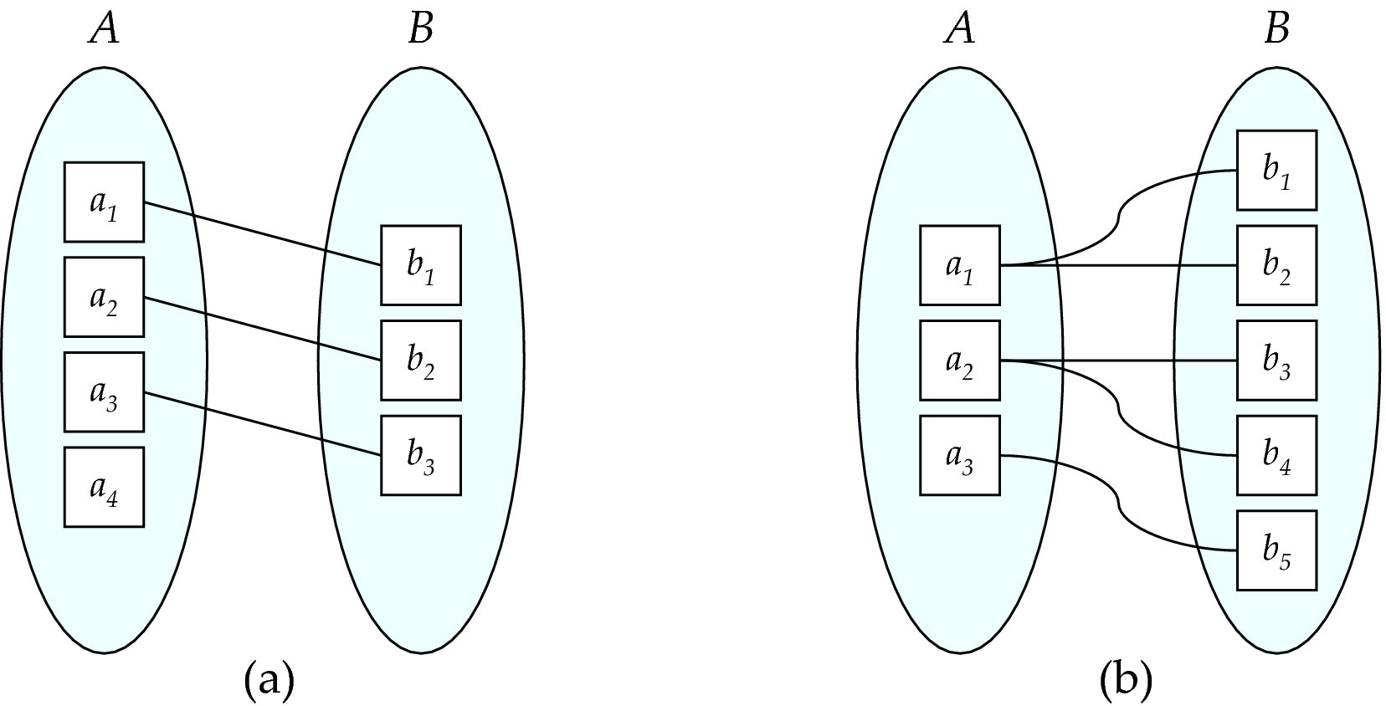
Mapping Cardinalities
One to one
(at most)
One to many
Note: Some elements in A and B may not be mapped to any
elements in the other set

Slide 21
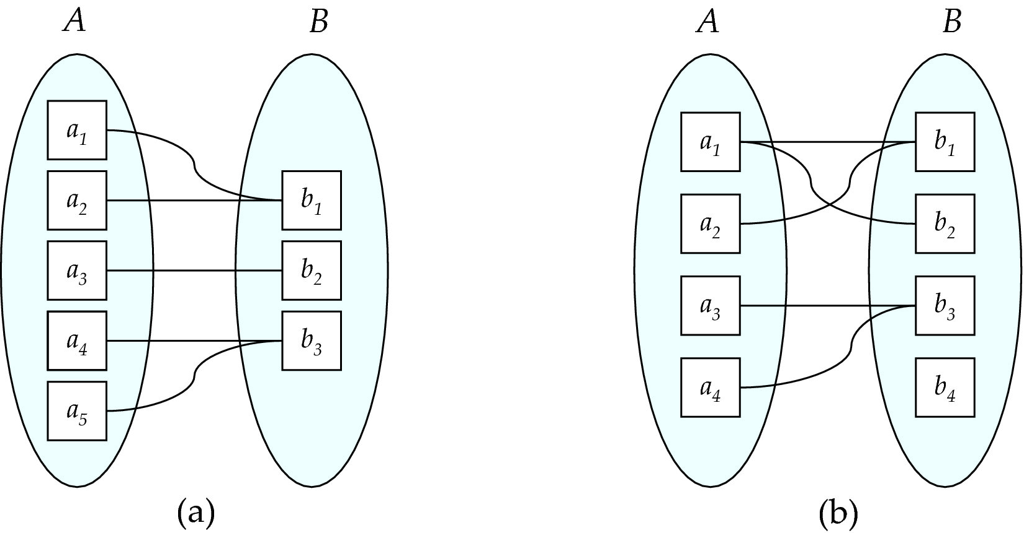
Mapping Cardinalities
Many to one
Many to many 不受限制
Note: Some elements in A and B may not be mapped to any
elements in the other set

Slide 22
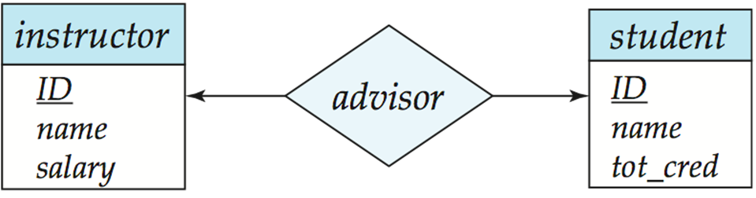
Cardinality Constraints
We express cardinality constraints by drawing either a directed line (→), signifying “one,” or an undirected line (—), signifying “many,” between the relationship set and the entity set.
E.g.: One-to-one relationship:
A student is associated with at most one instructor via the relationship advisor
An instructor is associated with at most one student via advisor
Notes:
箭头指向“1”——跟函数的映射结合起来
箭头是很重要的：区分是“1”还是“多”

Slide 23
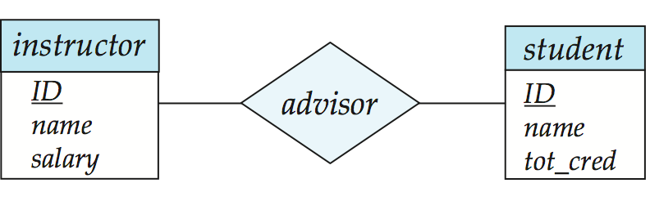
One-to-Many Relationships “at most 1”
In an one-to-many relationship between an instructor and a student,
An instructor is associated with several (including 0) students via advisor
A student is associated with at most one instructor via advisor
Notes:
一个学生的老师最多只能有一个
映射的概念：学生确定，老师就唯一确定（老师可能是NULL，也是唯一的）

Slide 24
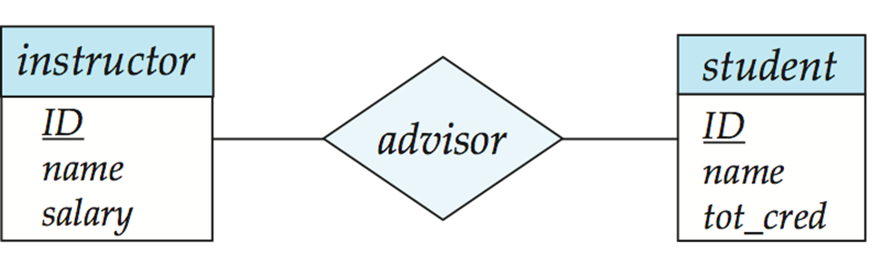
Many-to-Many Relationship
An instructor is associated with several (possibly 0) students via advisor
A student is associated with several (possibly 0) instructors via advisor
Notes:
没有箭头，就没有任何限制了

Slide 25
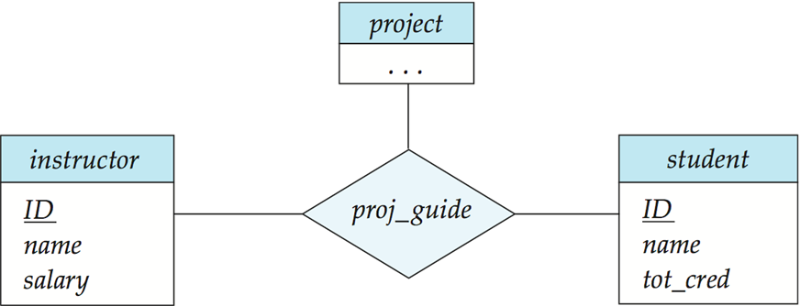
Cardinality Constraints on Ternary Relationship
We allow at most one arrow out of a ternary (or greater degree) relationship to indicate a cardinality constraint
For exampe, an arrow from proj_guide to instructor indicates each student has at most one guide for a project
Notes:
多元关系，带箭头就非常麻烦了
学生+项目的组合只能指向一个老师

Slide 26
Cardinality Constraints on Ternary Relationship
If there is more than one arrow, there are two ways of defining the meaning.
Each project is associated with a unique instructor and student
Each pair of (project, instructor) is associated with a unique student, and each pair (project, student) is associated with a unique instructor
Each alternative has been used in different formalisms
To avoid confusion we outlaw more than one arrow
Notes:
一个项目只能指向一个（老师+学生）的组合
在绝大部分情况下，三元关系通常就不用箭头了，或者只用一个箭头
三元关系的两个箭头的情况：二义性就很难判定了

Slide 27
Participation Constraints
To specify how many entities in the entity set are participate in a relationship set.
Total participation (indicated by double line) : every entity in the entity set participates in at least one relationship in the relationship set
participation of student in advisor relation is total, every student must have an associated instructor
Partial participation (default): some entities may not participate in any relationship in the relationship set
E.g. participation of instructor in advisor is partial
Notes:
（右边双线）所有学生的实体必须在relation(advisor)语义里面出现，并且只出现一次：学生有且只能有一个导师
（左边单线）老师可以没有学生

Slide 28
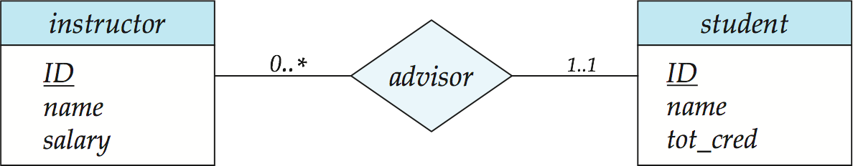
Notation for Expressing More Complex Constraints
A line may have an associated minimum and maximum cardinality, shown in the form l..h, where l is the minimum and h the maximum cardinality
A minimum value of 1 indicates total participation.
A maximum value of 1 indicates that the entity participates in at most one relationship
A maximum value of * indicates no limit.
Instructor can advise 0 or more students. A student must have 1 advisor; cannot have multiple advisors
Notes:
0..*：最少0，最多不受限制（老师可以不需要1有学生，或者可以有多个学生，且学生数量不受限制）
1..1：必须并且只有一个导师
这是后来扩展的ER模型的功能

Slide 29
Keys
To specify how entities within a given entity set are distinguished.
A super key of an entity set is a set of one or more attributes whose values uniquely determine each entity.
A candidate key of an entity set is a minimal super key
course-id is candidate key of course
ID is candidate key of student
Although several candidate keys may exist, one of the candidate keys is selected to be the primary key.

Slide 30
Keys for Relationship Sets
The combination of primary keys of the participating entity sets forms a super key of a relationship set.
(student.id, instructor.id) is the super key of advisor
NOTE: this means a pair of entity sets can have at most one relationship in a particular relationship set.
Must consider the mapping cardinality of the relationship set when deciding the what are the candidate keys
If advisor is a one-to-many relationship set, (student.id, instructor.id) is Not the candidate key of advisor
Need to consider semantics of relationship set in selecting the primary key in case of more than one candidate key
Notes:
Entity之间的关系是唯一的

Slide 31
Entity-Relationship Model
Extended E-R Features
Weak Entity Sets
Aggregations
Specialization and Generalization
E-R Model Design Issues
Reduction of an E-R Schema to Tables

Slide 32
Weak Entity Sets
Consider a section entity, which is uniquely identified by a course_id, semester, year, and sec_id.
Clearly, section entities are related to course entities. Suppose we create a relationship set sec_course between entity sets section and course.
Note that the information in sec_course is redundant, since section already has an attribute course_id, which identifies the course with which the section is related.
One option to deal with this redundancy is to get rid of the relationship sec_course; however, by doing so the relationship between section and course becomes implicit in an attribute, which is not desirable.

Slide 33
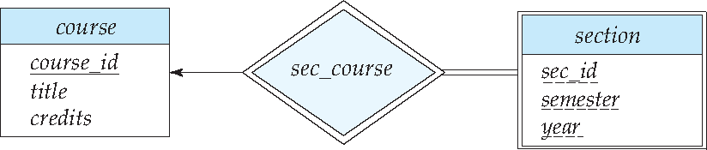
Weak Entity Sets (Cont.)
An alternative way to deal with this redundancy is to not store the attribute course_id in the section entity and to only store the remaining attributes section_id, year, and semester. However, the entity set section then does not have enough attributes to identify a particular section entity uniquely;
To deal with this problem, we treat the relationship sec_course as a special relationship that provides extra information, in this case, the course_id, required to identify section entities uniquely.
The notion of weak entity set formalizes the above intuition. A weak entity set is one whose existence is dependent on another entity, called its identifying entity.
Notes:
Weak entity set : Entity 依赖于另外一个 Relation
没有足够的属性以形成主码的实体集
弱实体集只有和强实体关联才有意义

Slide 34
Weak Entity Sets
An entity set that does not have a primary key is referred to as a weak entity set.
The existence of a weak entity set depends on the existence of a identifying entity set
it must relate to the identifying entity set via a total, one-to-many relationship set from the identifying to the weak entity set
Identifying relationship depicted using a double diamond
The discriminator (or partial key) of a weak entity set is the set of attributes that distinguishes among all the entities of a weak entity set.
The primary key of a weak entity set is formed by the primary key of the strong entity set on which the weak entity set is existence dependent, plus the weak entity set’s discriminator.
Primary key for section – (course_id, sec_id, semester, year)

Slide 35
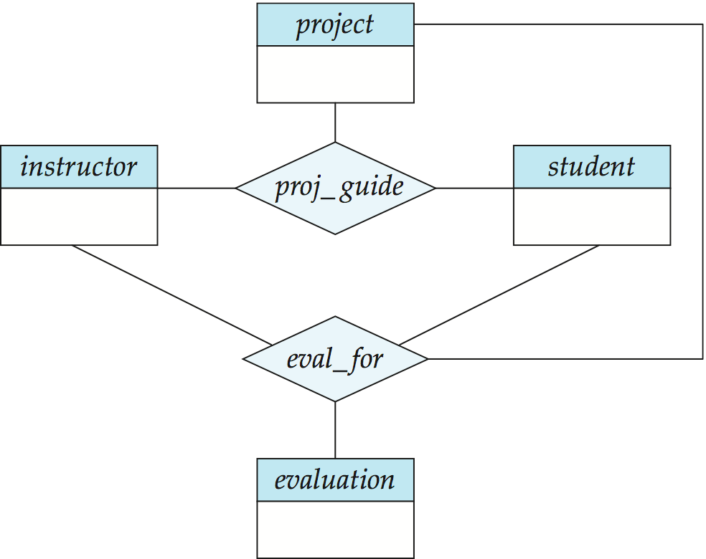
Aggregation
Consider the ternary relationship proj_guide, which we saw earlier
Suppose we want to record evaluations of a student by a guide on a project
Notes:
把relation抽象成一个entity，到上游和其他的relation构成关系（封装的思想）
这个抽象的过程就是aggregation

Slide 36
Aggregation (Cont.)
Relationship sets eval_for and proj_guide represent overlapping information
Every eval_for relationship corresponds to a proj_guide relationship
However, some proj_guide relationships may not correspond to any eval_for relationships
So we can’t discard the proj_guide relationship
Eliminate this redundancy via aggregation
Treat relationship as an abstract entity, abstraction of relationship into new entity
Allows relationships between relationships

Slide 37
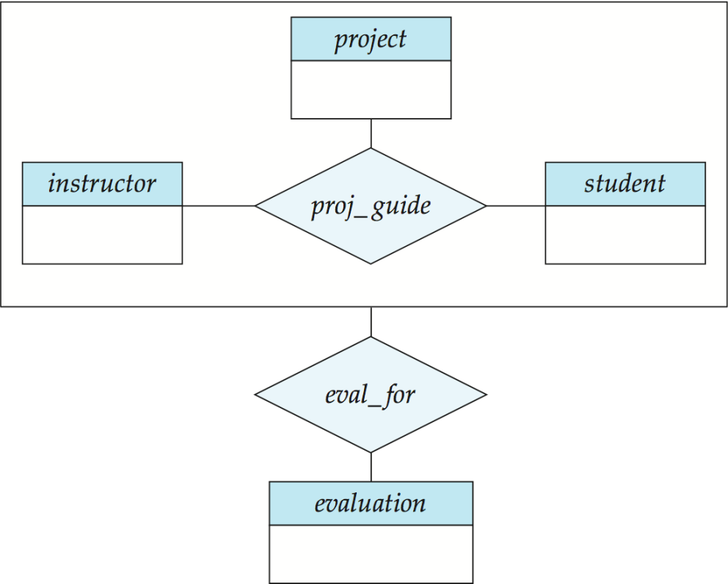
Aggregation (Cont.)
Eliminate this redundancy via aggregation without introducing redundancy, the following diagram represents:
A student is guided by a particular instructor on a particular project
A student, instructor, project combination may have an associated evaluation
Notes:
37

Slide 38
Specialization
Top-down design process; we designate subgroupings within an entity set that are distinctive from other entities in the set.
These subgroupings become lower-level entity sets that have attributes or participate in relationships that do not apply to the higher-level entity set.
Depicted by a hollow arrow-head pointing from the specialized entity to the other entity. Referred as ISA relationship.
Attribute inheritance – a lower-level entity set inherits all the attributes and relationship participation of the higher-level entity set to which it is linked.
Notes:
数据模型的继承概念：类比面向对象程序设计的继承
自上而下

Slide 39
Generalization
A bottom-up design process – combine a number of entity sets that share the same features into a higher-level entity set.
Specialization and generalization are simple inversions of each other; they are represented in an E-R diagram in the same way.
The terms specialization and generalization are used interchangeably.
Notes:
自底向上的设计方向

Slide 40
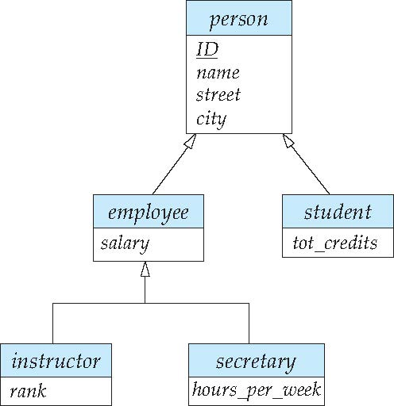
Specialization Example
Overlapping – employee and student
Disjoint – instructor and secretary
Total and partial
ISA relationship
Notes:
上层的箭头没有连接：表示没有约束（缺省就是overlapping），有可能不是employee, 不是student；也有可能又是employee，又是student。
下层的箭头有关联（可以写上disjoint）：只能是老师和秘书的一个之一，或者未知

Slide 41
Design Constraints on a Specialization/Generalization
Constraint on which entities can be members of a given lower-level entity set.
condition-defined
E.g. all citizens over 65 years are members of senior-citizen entity set; senior-citizen ISA person.
user-defined
The database user(application program) assigns entities to a given lower-level entity set.
Constraint on whether or not entities may belong to more than one lower-level entity set within a single generalization.
Disjoint
an entity can belong to only one lower-level entity set
Overlapping
an entity can belong to more than one lower-level entity set

Slide 42
Design Constraints on a Specialization/Generalization (Contd.)
Completeness constraint -- specifies whether or not an entity in the higher-level entity set must belong to at least one of the lower-level entity sets within a generalization.
Total : an entity must belong to one of the lower-level entity sets
Partial(default): an entity need not belong to one of the lower-level entity sets
The student generalization is total: All student entities must be either graduate or undergraduate.
student
Total
graduate
undergraduate
Notes:
必须明确学生要么是研究生，要么是本科生（写上total）

Slide 43
Specialization and Generalization (Contd.)
Can have multiple specializations of an entity set based on different features.
E.g. permanent-employee vs. temporary-employee, in addition to instructor vs. officer vs. secretary
Each particular employee would be
a member of one of permanent-employee or temporary-employee.
and also a member of one of instructor, officer, or secretary.
The ISA relationship also referred to as superclass - subclass relationship

Slide 44
Database Design
Design Phases
Requirements specification
Data to be managed in the enterprise
Functional requirements of the enterprise
Conceptual design
Logical design
Physical design
Database conceptual design
E-R modeling

Slide 45
E-R Model Design Issues
Use of Entity sets vs. Attributes Choice mainly depends on the structure of the enterprise being modeled, and on the semantics associated with the attribute in question.
Use of Entity sets vs. Relationship sets Possible guideline is to designate a relationship set to describe an action that occurs between entities
Binary versus n-ary relationship sets Although it is possible to replace any nonbinary (n-ary, for n > 2) relationship set by a number of distinct binary relationship sets, a n-ary relationship set shows more clearly that several entities participate in a single relationship.
Placement of relationship attributes
Notes:
基于需求的概念设计范畴，已经足够简单。
思考的问题主要是：
属性 or 实体集
实体集 or 关系集
二元关系 or 多元关系
属性放在relationship set 还是 放在新的实体集上

Slide 46
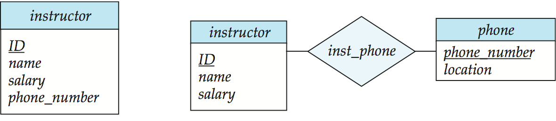
Entities vs. Attributes
Use of entity sets vs. attributes
Use of phone as an entity allows extra information about phone numbers (plus multiple phone numbers)
假设带着更多的语义和进一步的需求，更合适用entity set分出去表示；如果没有更多的需求，就用attributes进行存储即可
{ }
Notes:
46

Slide 47
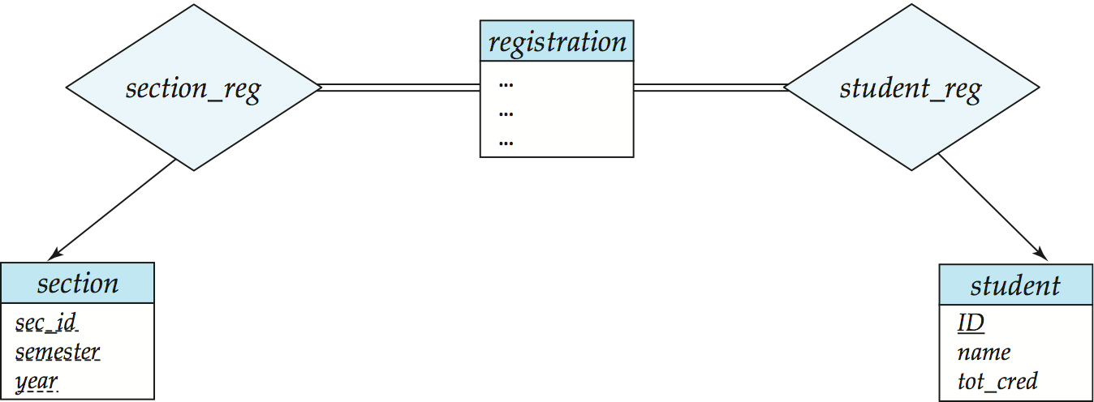
Entities vs. Relationship sets
Use of entity sets vs. relationship sets
Possible guideline is to designate a relationship set to describe an action that occurs between entities
Placement of relationship attributes
For example, attribute date as attribute of advisor or as attribute of student
Notes:
47

Slide 48
Binary Vs. Non-Binary Relationships
Some relationships that appear to be non-binary may be better represented using binary relationships
E.g. A ternary relationship parents, relating a child to his/her father and mother, is best replaced by two binary relationships, father and mother
Using two binary relationships allows partial information (e.g. only mother being know)
But there are some relationships that are naturally non-binary
E.g. proj_guide

Slide 49
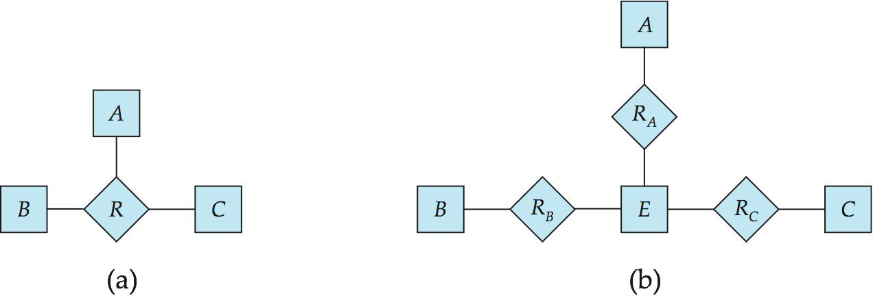
Converting Non-Binary Relationships to Binary Form
In general, any non-binary relationship can be represented using binary relationships by creating an artificial entity set.
Replace R between entity sets A, B and C by an entity set E, and three relationship sets:
1. R_{A}, relating E and A 2. R_{B}, relating E and B 3. R_{C}, relating E and C
Create an identifying attribute for E and add any attributes of R to E
For each relationship (a_{i} , b_{i} , c_{i}) in R, create
1. a new entity e_{i} in the entity set E 2. add (e_{i} , a_{i} ) to R_{A}
3. add (e_{i} , b_{i} ) to R_{B} 4. add (e_{i} , c_{i} ) to R_{C}
Notes:
49
任何一个二元以上的关系都可以表示成为一个二元关系的变种

Slide 50
E-R Diagram for a University Enterprise

Slide 51
Database Design
Design Phases
Requirements specification
Data to be managed in the enterprise
Functional requirements of the enterprise
Conceptual design – ER modeling
Logical design - Converting to Relational model
Physical design

Slide 52
Reduction of an E-R Diagram to Relation Schemas
A database which conforms to an E-R diagram can be represented by a collection of relation schemas.
For each entity set and relationship set there is a unique relation which is assigned the name of the corresponding entity set or relationship set.
Primary keys allow entity sets and relationship sets to be expressed uniformly as relations which represent the contents of the database.
Converting an E-R diagram to a table format is the basis for deriving a relational database design from an E-R diagram.

Slide 53
Representing Entity Sets
A strong entity set reduces to a schema with the same attributes
student(ID, name, tot_cred)
A weak entity set becomes a table that includes a column for the primary key of the identifying strong entity set
section ( course_id, sec_id, sem, year )
Notes:
Weak entity set的primary key是其依赖的strong entity set的primary key

Slide 54
Representation of Entity Sets with Composite Attributes
Composite attributes are flattened out by creating a separate attribute for each component attribute
Example: given entity set instructor with composite attribute name with component attributes first_name and last_name the schema corresponding to the entity set has two attributes name_first_name and name_last_name
Prefix omitted if there is no ambiguity (name_first_name could be first_name)
Ignoring multivalued attributes, extended instructor schema is
instructor(ID, first_name, middle_initial, last_name, street_number, street_name, apt_number, city, state, zip_code, date_of_birth)
Notes:
54

Slide 55
Representation of Entity Sets with Multivalued Attributes
A multivalued attribute M of an entity E is represented by a separate schema EM
Schema EM has attributes corresponding to the primary key of E and an attribute corresponding to multivalued attribute M
Example: Multivalued attribute phone_number of instructor is represented by a schema: inst_phone= ( ID, phone_number)
Each value of the multivalued attribute maps to a separate tuple of the relation on schema EM
For example, an instructor entity with primary key 22222 and phone numbers 456-7890 and 123-4567 maps to two tuples: (22222, 456-7890) and (22222, 123-4567)
Notes:
55

Slide 56

Representing Relationship Sets
A many-to-many relationship set is represented as a relation with attributes for the primary keys of the two participating entity sets, and any descriptive attributes of the relationship set.
Example: schema for relationship set advisor
advisor = (s_id, i_id)

Slide 57
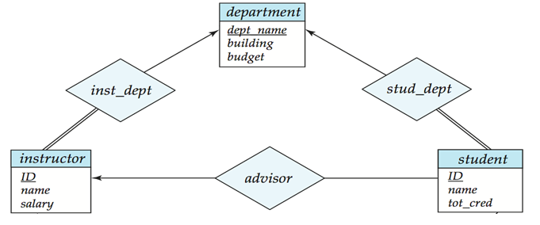
Redundancy of Schemas
Many-to-one and one-to-many relationship sets that are total on the many-side can be represented by adding an extra attribute to the “many” side, containing the primary key of the “one” side
Example: Instead of creating a relation schema for relationship set inst_dept, add an attribute dept_name to the schema arising from entity set instructor
Notes:
多对一的场景，通常情况下中间的表示不用的。除非是表有属性很重要。
双线（加上约束not null）

Slide 58
Redundancy of Tables (Cont.)
For one-to-one relationship sets, either side can be chosen to act as the “many” side
That is, extra attribute can be added to either of the tables corresponding to the two entity sets
If participation is total on the many side, replacing a table by an extra attribute in the relation corresponding to the “many” side could result in Not null constraint.
The table corresponding to a relationship set linking a weak entity set to its identifying strong entity set is redundant.
E.g. The section table already contains the information that would appear in the sec_course table.
Notes:
一对一的情况，加语义愿意加哪边加哪边

Slide 59
Determining Keys from E-R Sets
Strong entity set. The primary key of the entity set becomes the primary key of the relation.
Weak entity set. The primary key of the relation consists of the union of the primary key of the strong entity set and the discriminator of the weak entity set.
Relationship set. The union of the primary keys of the related entity sets becomes a super key of the relation.
For binary many-to-one relationship sets, the primary key of the “many” entity set becomes the relation’s primary key.
For one-to-one relationship sets, the relation’s primary key can be that of either entity set.
For many-to-many relationship sets, the union of the primary keys becomes the relation’s primary key

Slide 60
Representing Specialization via Schemas
Method 1:
Form a schema for the higher-level entity
Form a schema for each lower-level entity set, include primary key of higher-level entity set and local attributes
Drawback: getting information about, an employee requires accessing two relations, the one corresponding to the low-level schema and the one corresponding to the high-level schema
schema attributes
person ID, name, street, city
student ID, tot_cred
Employee ID, salary
Notes:
60
非继承的建表方法
好处：信息除了ID，其他没有冗余，数据一致性没有问题
不足：有些信息要进行joint才能查询到；插入的时候，要在每个表分别插入

Slide 61
Representing Specialization as Schemas (Cont.)
Method 2:
Form a schema for each entity set with all local and inherited attributes
Drawback: name, street and city may be stored redundantly for people who are both students and employees
schema attributes
person ID, name, street, city
student ID, name, street, city, tot_cred
Employee ID, name, street, city, salary
Disjoin or Overlapping ?
Totally or Partially specialization?
Notes:
61
继承的建表方法
好处：
坏处：disjoint or overlapping;
total or partially

Slide 62
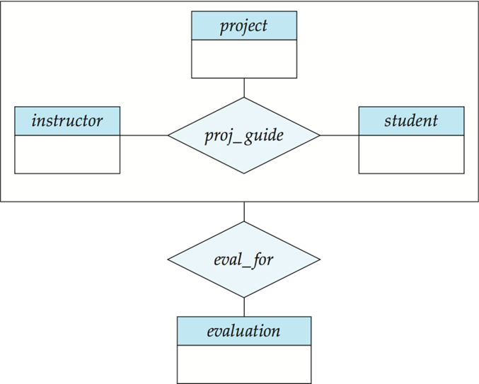
Representing Aggregation via Schemas
To represent aggregation, create a schema containing
Primary key of the aggregated relationship,
The primary key of the associated entity set
Any descriptive attributes
In our example:
eval_for (s_ID, project_id, i_ID, evaluation_id)
The schema proj_guide is redundant. We can store null value for evaluation_id in eval_for

Slide 63
End of Lecture

Slide 64
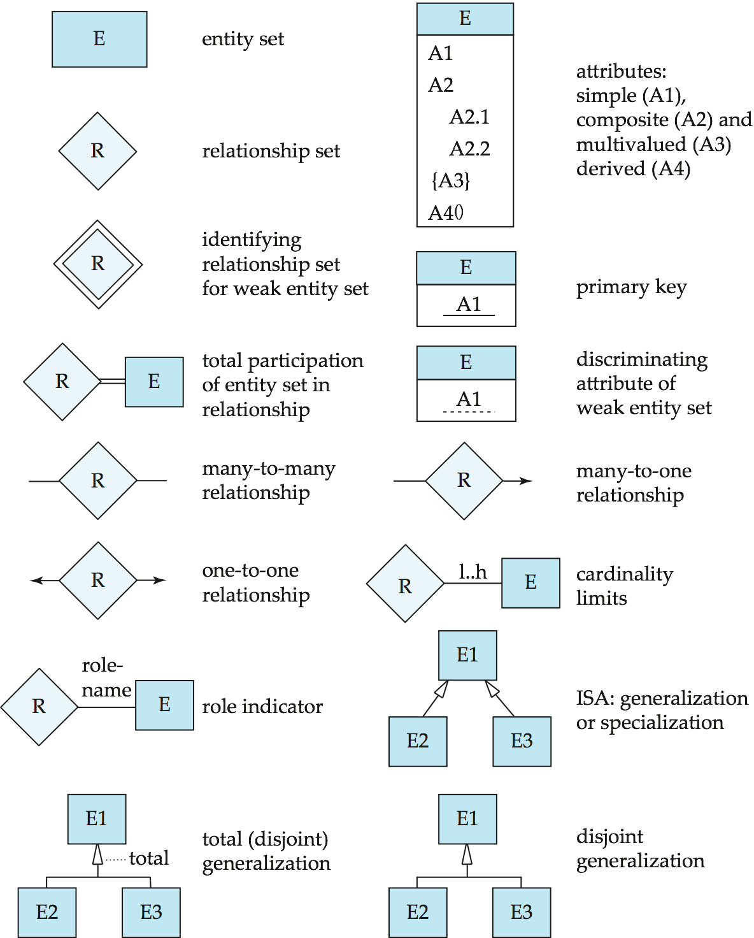
Summary of Symbols Used in E-R Notation

Slide 65
Symbols Used in E-R Notation (Cont.)

Slide 66
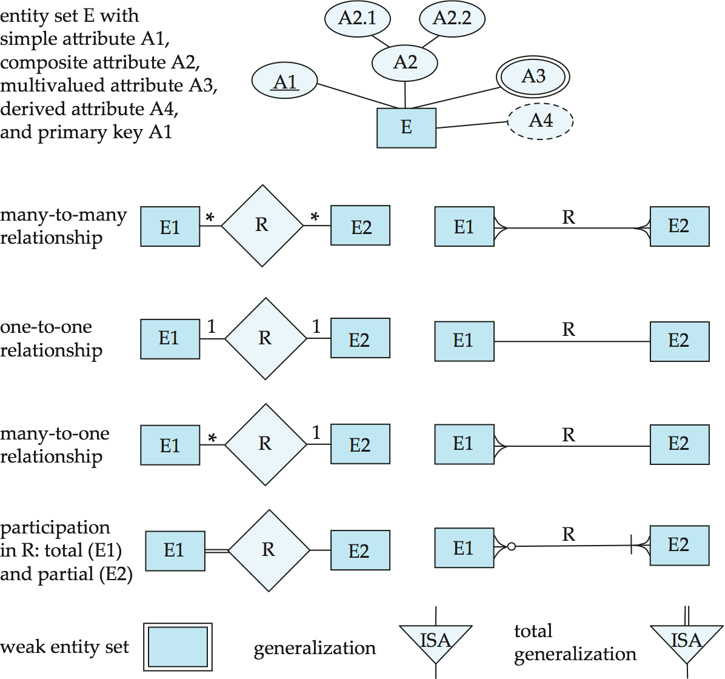
Alternative ER Notations

Slide 67
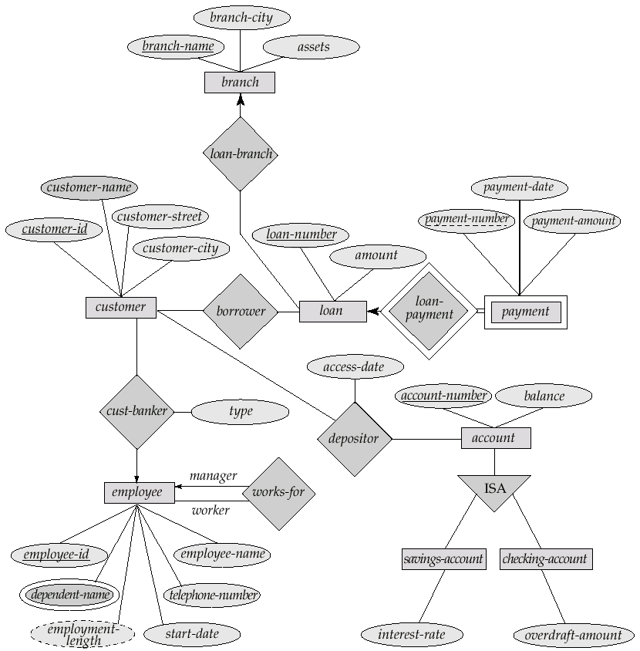
Alternative E-R Diagram

