Slide 1
Storage and File Structure
Overview of Physical Storage Media
Introduction of some non-volatile storages
RAID
Record storage
Organization of Records in Files
Block based buffer manager
Data Dictionary Storage

Slide 2
Physical Storage Medias
Characteristic of Physical Storage
Speed with which data can be accessed
Reliability
data loss on power failure or system crash
physical failure of the storage device
Cost per unit of data ➔ the capacity of single device
Can differentiate storage into:
volatile storage: loses contents when power is switched off
non-volatile storage:
Contents persist even when power is switched off.
Includes secondary and tertiary storage, as well as batter-backed up main-memory.
Notes:
物理存储
1. 读写性能：快慢
2. 可靠性
3. 价格：不是经济性指标，而是技术性指标

Slide 3
Storage Hierarchy
primary storage: Fastest media but volatile (cache, main memory).
secondary storage: next level in hierarchy, non-volatile, moderately fast access time
also called on-line storage 可以直接访问，有即时访问定位的能力
E.g. flash memory, magnetic disks
tertiary storage: lowest level in hierarchy, non-volatile, slow access time, but Large volume 空间大
and cheap
also called off-line storage 不可以直接访问
E.g. magnetic tape, optical storage

Slide 4
Some Physical Storage Media
Cache – fastest and most costly form of storage; volatile; managed by the computer system hardware.
Main memory:
fast access (10s to 100s of nanoseconds; 1 nanosecond = 10^{–9} seconds)
generally too small (or too expensive) to store the entire database
capacities of up to a few Gigabytes widely used currently
Capacities have gone up and per-byte costs have decreased steadily and rapidly (roughly factor of 2 every 2 to 3 years)
Volatile — contents of main memory are usually lost if a power failure or system crash occurs.

Slide 5
Some Physical Storage Media (Cont.)
Flash memory
Data survives power failure
Data can be written at a location only once, but location can be erased and written to again
Can support limited number of write/erase cycles.
Erasing of memory has to be done to an entire bank of memory
Reads are roughly as fast as main memory
But writes are slow (few microseconds), erase is slower
Cost per unit of storage is lower than main memory, but higher than magnetic-disk
Is replacing the magnetic-disk as the secondary storage.

Slide 6
Some Physical Storage Media (Cont.)
Magnetic-disk
Data is stored on spinning disk, and read/written magnetically
Primary medium for the long-term storage of data; typically stores entire database.
Data must be moved from disk to main memory for access, and written back for storage
Much slower access than main memory (more on this later)
direct-access – possible to read data on disk in any order, unlike magnetic tape
Capacities range up to roughly 10~100TB currently
Much larger capacity and cost/byte than main memory/flash memory
Growing constantly and rapidly with technology improvements (factor of 2 to 3 every 2 years)
Survives power failures and system crashes
disk failure can destroy data, but is very rare

Slide 7
Some Physical Storage Media (Cont.)
Optical storage
non-volatile, data is read optically from a spinning disk using a laser
CD-ROM (640 MB) and DVD (4.7 to 17 GB) most popular forms
Write-one, read-many (WORM) optical disks used for archival storage (CD-R and DVD-R)
Multiple write versions also available (CD-RW, DVD-RW, and DVD-RAM)
Reads and writes are slower than with magnetic disk
Juke-box systems, with large numbers of removable disks, a few drives, and a mechanism for automatic loading/unloading of disks available for storing large volumes of data

Slide 8
Some Physical Storage Media (Cont.)
Tape storage
non-volatile, used primarily for backup (to recover from disk failure), and for archival data
sequential-access – much slower than disk
very high capacity (40 to 300 TB tapes available)
tape can be removed from drive ⇒ storage costs much cheaper than disk, but drives are expensive
Tape jukeboxes available for storing massive amounts of data
hundreds of terabytes (1 terabyte = 10⁹ bytes) to even a petabyte (1 petabyte = 10¹² bytes) -----this was 10 years ago
hundreds of perabytes (1 perabyte = 1024 terabtyes) to even a Exabyte (1 exabyte = 1024 perabytes) ----this is going to be very soon.

Slide 9
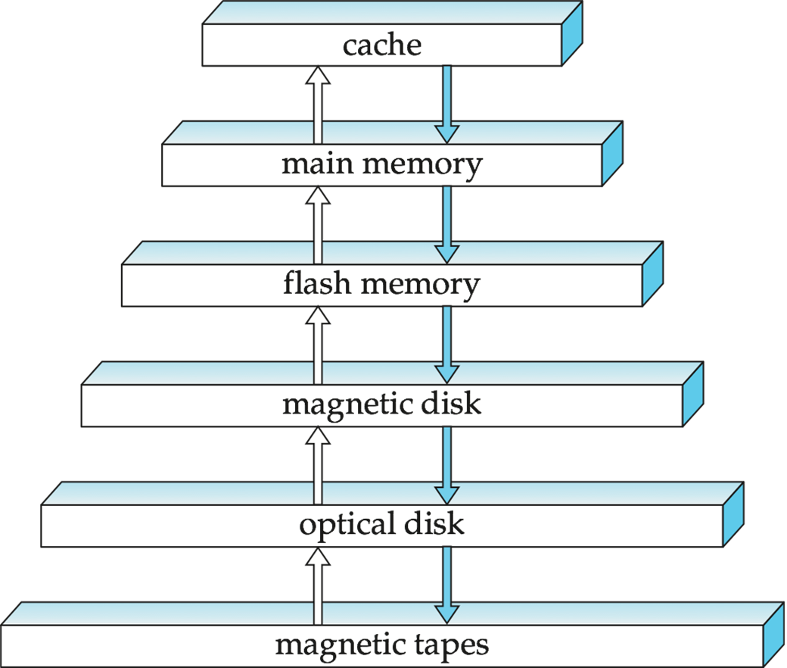
Storage Hierarchy

Slide 10
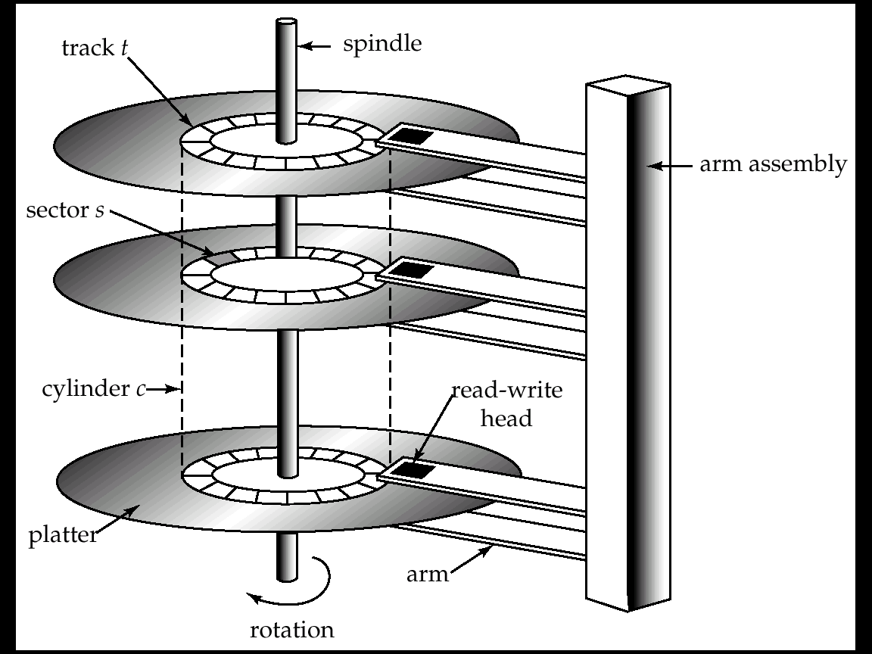
Magnetic Hard Disk Mechanism
NOTE: Diagram is schematic, and simplifies the structure of actual disk drives

Slide 11
Magnetic Disks
Read-write head
Positioned very close to the platter surface (almost touching it)
Reads or writes magnetically encoded information.
Surface of platter divided into circular tracks
Over 50K~100K tracks per platter on typical hard disks
Each track is divided into sectors.
A sector is the smallest unit of data that can be read or written.
Sector size typically 512 bytes
Typical sectors per track: 500 (on inner tracks) to 1000 (on outer tracks)
To read/write a sector
disk arm swings to position head on right track
platter spins continually; data is read/written as sector passes under head
Head-disk assemblies
multiple disk platters on a single spindle (typically 1 to 5)
one head per platter, mounted on a common arm.
Cylinder i consists of i^{th} track of all the platters

Slide 12
Magnetic Disks (Cont.)
Disk controller – interfaces between the computer system and the disk drive hardware.
accepts high-level commands to read or write a sector
initiates actions such as moving the disk arm to the right track and actually reading or writing the data
Computes and attaches checksums to each sector to verify that data is read back correctly
If data is corrupted, with very high probability stored checksum won’t match recomputed checksum
Ensures successful writing by reading back sector after writing it
Performs remapping of bad sectors

Slide 13
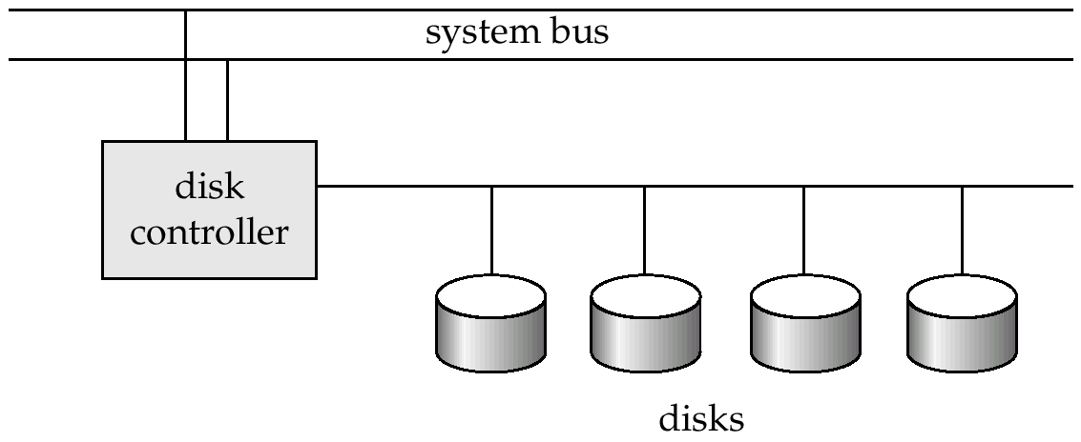
Disk Subsystem
Multiple disks connected to a computer system through a controller
Controllers functionality (checksum, bad sector remapping) often carried out by individual disks; reduces load on controller
Disk interface standards families
ATA (AT adaptor) range of standards, IDE
SATA ( Serial ATA) the currant use of personal computer
SCSI (Small Computer System Interconnect) range of standards
SAS (Serial Attached SCSI)
Several variants of each standard (different speeds and capabilities)

Slide 14
Performance Measures of Disks
Access time – the time it takes from when a read or write request is issued to when data transfer begins. Consists of:
Seek time – time it takes to reposition the arm over the correct track.
Average seek time is 1/2 the worst case seek time.
Would be 1/3 if all tracks had the same number of sectors, and we ignore the time to start and stop arm movement
4 to 10 milliseconds on typical disks
Rotational latency – time it takes for the sector to be accessed to appear under the head.
Average latency is 1/2 of the worst case latency.
4 to 11 milliseconds on typical disks (5400 to 15000 r.p.m.)
Data-transfer rate – the rate at which data can be retrieved from or stored to the disk.
25 to 100 MB per second is typical
Multiple disks may share a controller, so rate that controller can handle is also important
E.g. SATA: 150 MB/sec, SATA-II 3Gb (300 MB/sec)
Ultra 320 SCSI: 320 MB/s, SAS (3 to 6 Gb/sec)
Fiber Channel (FC2Gb or 4Gb): 256 to 512 MB/s

Slide 15
Performance Measures (Cont.)
Mean time to failure (MTTF) – the average time the disk is expected to run continuously without any failure.
Typically 3 to 5 years
Probability of failure of a single new disks is quite low, corresponding to a “theoretical MTTF” of 30,000 to 1,200,000 hours for a new disk.
MTTF is mainly been used to measure the probability of multiple disk’s failure.
E.g., an MTTF of 1,200,000 hours for a new disk means that given 1000 relatively new disks, on an average one will fail every 1200 hours
MTTF decreases as disk ages
Notes:
平均故障时间，平均多长时间会挂

Slide 16
Optimization of Disk-Block Access
Block – a contiguous sequence of sectors from a single track
data is transferred between disk and main memory in blocks
sizes range from 512 bytes to several kilobytes
Smaller blocks: more transfers from disk
Larger blocks: more space wasted due to partially filled blocks
Typical block sizes today range from 4 to 16 kilobytes
Buffering
Read-ahead When a disk block is accessed, consecutive blocks from the same track are read into an in-memory buffer.
Disk-arm-scheduling algorithms order pending accesses to tracks so that disk arm movement is minimized
elevator algorithm : move disk arm in one direction (from outer to inner tracks or vice versa), processing next request in that direction, till no more requests in that direction, then reverse direction and repeat

Slide 17
Optimization of Disk Block Access (Cont.)
File organization – optimize block access time by organizing the blocks to correspond to how data will be accessed
E.g. Store related information on the same or nearby cylinders.
Files may get fragmented over time
E.g. if data is inserted to/deleted from the file
Or free blocks on disk are scattered, and newly created file has its blocks scattered over the disk
Sequential access to a fragmented file results in increased disk arm movement
Some systems have utilities to defragment the file system, in order to speed up file access

Slide 18
Optimization of Disk Block Access (Cont.)
Nonvolatile write buffers speed up disk writes by writing blocks to a non-volatile RAM buffer immediately
Non-volatile RAM: battery backed up RAM or flash memory
Even if power fails, the data is safe and will be written to disk when power returns
Controller then writes to disk whenever the disk has no other requests or request has been pending for some time
Database operations that require data to be safely stored before continuing can continue without waiting for data to be written to disk
Writes can be reordered to minimize disk arm movement
Log disk – a disk devoted to writing a sequential log of block updates
Used exactly like nonvolatile RAM
Write to log disk is very fast since no seeks are required
No need for special hardware (NV-RAM)
File systems typically reorder writes to disk to improve performance
Journaling file systems write data in safe order to NV-RAM or log disk
Reordering without journaling: risk of corruption of file system data

Slide 19
Flash Storage
NOR flash vs NAND flash
NAND flash
used widely for storage, since it is much cheaper than NOR flash
requires page-at-a-time read (page: 512 bytes to 4 KB)
transfer rate around 20 MB/sec
solid state disks: use multiple flash storage devices to provide higher transfer rate of 100 to 200 MB/sec
erase is very slow (1 to 2 millisecs)
erase block contains multiple pages
remapping of logical page addresses to physical page addresses avoids waiting for erase
translation table tracks mapping
also stored in a label field of flash page
remapping carried out by flash translation layer
after 100,000 to 1,000,000 erases, erase block becomes unreliable and cannot be used
wear leveling to manage the block erasing equally distributed across the flash storage device.
Notes:
闪存：
NOR
NAND

Slide 20
RAID
RAID: Redundant Arrays of Independent Disks
disk organization techniques that manage a large numbers of disks, providing a view of a single disk of
high capacity and high speed by using multiple disks in parallel, and
high reliability by storing data redundantly, so that data can be recovered even if a disk fails
The chance that some disk out of a set of N disks will fail is much higher than the chance that a specific single disk will fail.
E.g., a system with 100 disks, each with MTTF of 100,000 hours (approx. 11 years), will have a system MTTF of 1000 hours (approx. 41 days)
Techniques for using redundancy to avoid data loss are critical with large numbers of disks
Originally a cost-effective alternative to large, expensive disks
I in RAID originally stood for ``inexpensive’’
Today RAIDs are used for their higher reliability and bandwidth.
The “I” is interpreted as independent
Notes:
冗余/独立磁盘阵列
大、快、可靠

Slide 21
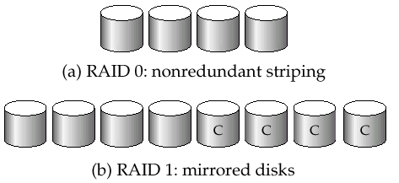
Why RAID?
Improvement of Reliability via Redundancy
store extra information that can be used to rebuild information lost in a disk failure.
Improvement in Performance via Parallelism
Load balance multiple small accesses to increase throughput
Parallelize large accesses to reduce response time.

Slide 22
HOW RAID?
Improve transfer rate by striping data across multiple disks.
Bit-level striping – split the bits of each byte across multiple disks
In an array of eight disks, write bit i of each byte to disk i.
Each access can read data at eight times the rate of a single disk.
Block-level striping – with n disks, block i of a file goes to disk (i mod n) + 1
Requests for different blocks can run in parallel if the blocks reside on different disks
A request for a long sequence of blocks can utilize all disks in parallel
RAID Level 0,1,2,3,4,5,6
RAID1 and RAID 5 are most wide used.

Slide 23

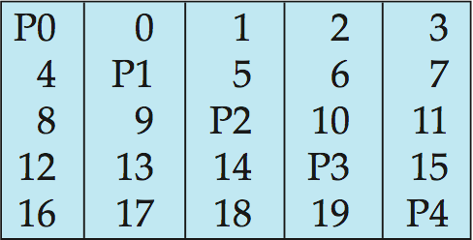
RAID Level 5
RAID Level 5: Block-Interleaved Distributed Parity; partitions data and parity among all N + 1 disks, rather than storing data in N disks and parity in 1 disk.
E.g., with 5 disks, parity block for nth set of blocks is stored on disk (n mod 5) + 1, with the data blocks stored on the other 4 disks.

Slide 24
Choice of RAID Level
Level 1 provides much better write performance than level 5
Level 5 requires at least 2 block reads and 2 block writes to write a single block, whereas Level 1 only requires 2 block writes
Level 1 preferred for high update environments such as log disks
Level 1 had higher storage cost than level 5
disk drive capacities increasing rapidly (50%/year) whereas disk access times have decreased much less (x 3 in 10 years)
I/O requirements have increased greatly, e.g. for Web servers
When enough disks have been bought to satisfy required rate of I/O, they often have spare storage capacity
so there is often no extra monetary cost for Level 1!
Level 5 is preferred for applications with low update rate, and large amounts of data
Level 1 is preferred for all other applications

Slide 25
File Organization
The database is stored as a collection of files. Each file is a sequence of records. A record is a sequence of fields.
The fundamental consideration of database file organization:
Each file is logically partitioned into fixed-length storage units called blocks, which are the units of both storage allocation and data transfer.
A block may contain several records, there are two assumptions in traditional database system:
No record is larger then a block;
Each record is entirely contained in a single record.
One simple approach:
assume record size is fixed
each file has records of one particular type only
different files are used for different relations
This case is easiest to implement; will consider variable length records
later.

Slide 26
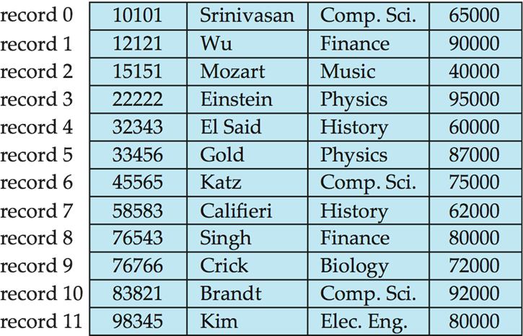
Fixed-Length Records
Simple approach:
Store record i starting from byte n ∗ (i – 1), where n is the size of each record.
Record access is simple but records may cross blocks
Modification: do not allow records to cross block boundaries
Deletion of record I: alternatives:
move records i + 1, . . ., n to i, . . . , n – 1
move record n to i
do not move records, but link all free records on a free list

Slide 27
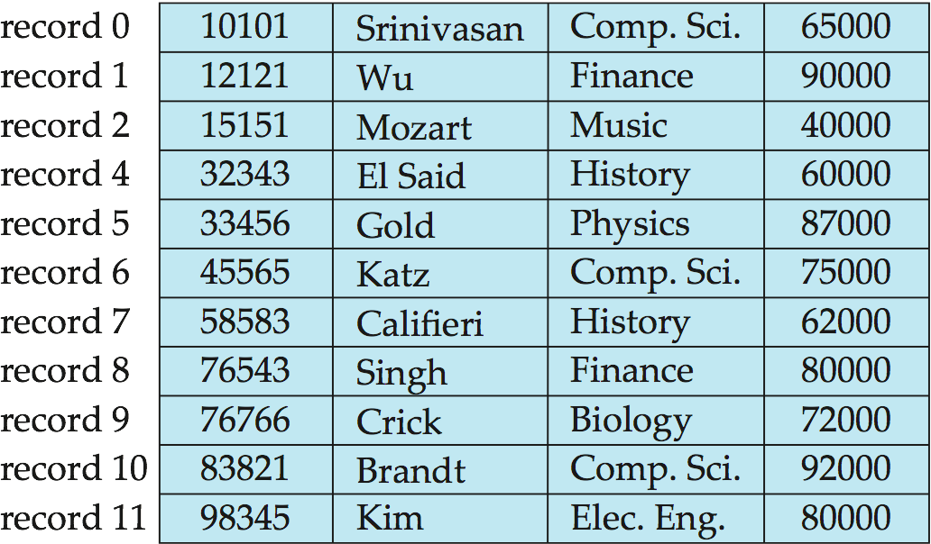
Deleting record 3 and compacting

Slide 28
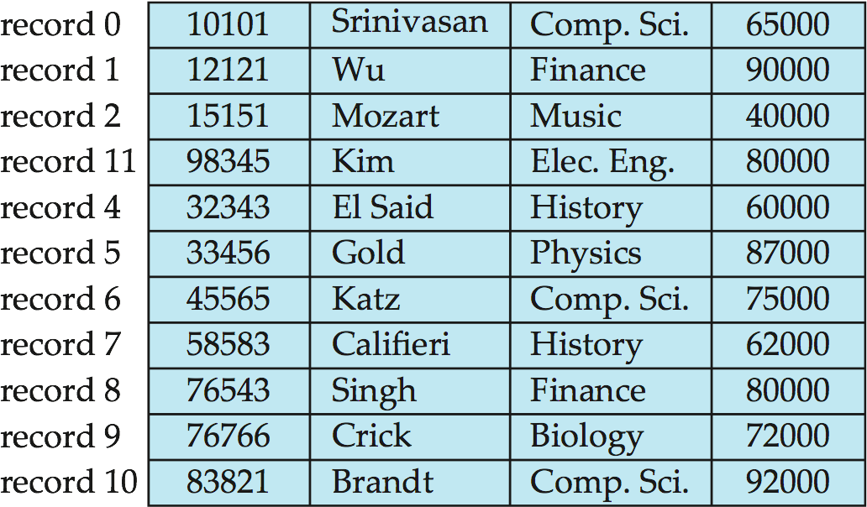
Deleting record 3 and moving last record

Slide 29
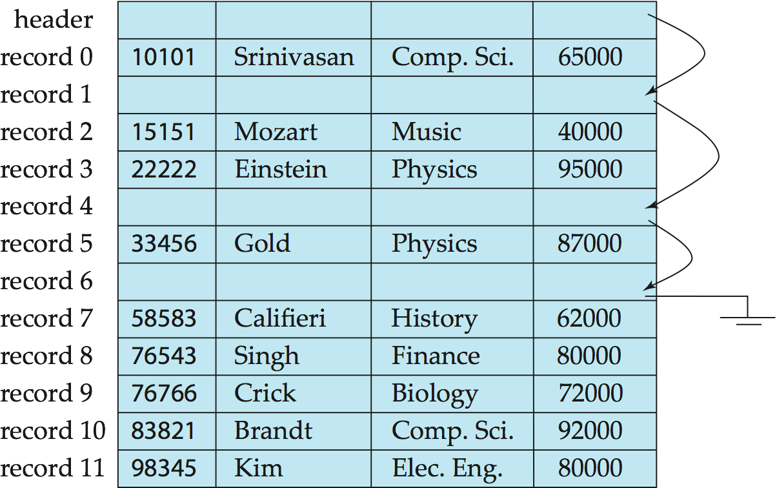
Free Lists
Store the address of the first deleted record in the file header.
Use this first record to store the address of the second deleted record, and so on
Can think of these stored addresses as pointers since they “point” to the location of a record.
More space efficient representation: reuse space for normal attributes of free records to store pointers. (No pointers stored in in-use records.)

Slide 30
Variable-Length Records
Variable-length records arise in database systems in several ways:
Storage of multiple record types in a file.
Record types that allow variable lengths for one or more fields.
Record types that allow repeating fields, such as array.
How to store a variable-length record
Typical variable-length record
How to store variable-length records in a block
Slotted Page Structure
Notes:
变长记录的存放
经典基本的关系库范畴

Slide 31
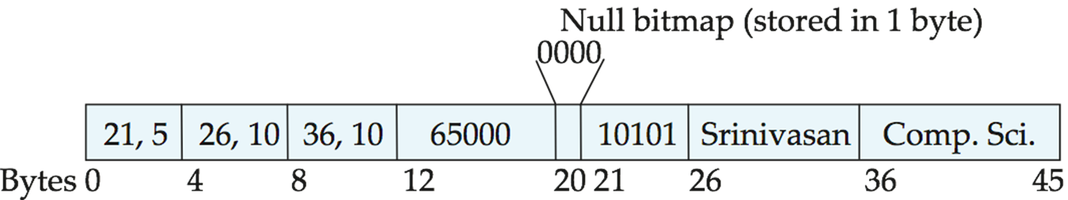
Structure of Variable-Length Record
Typical Variable-length record:
Attributes are stored in order
Variable length attributes represented by fixed size (offset, length), with actual data stored after all fixed length attributes
Null values represented by null-value bitmap
A sample record of instructor

Slide 32
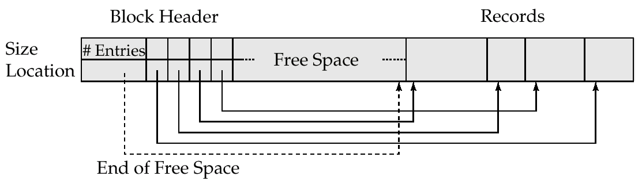
Slotted Page Structure
Slotted page header contains:
number of record entries
end of free space in the block
location and size of each record
Records can be moved around within a page to keep them contiguous with no empty space between them; entry in the header must be updated.
Pointers should not point directly to record — instead they should point to the entry for the record in header. <page#, record#>

Slide 33
Restriction of record size
Most of relational database restrict the size of a record to be no larger than the size of block.
No record is larger then a block;
Each record is entirely contained in a single record.
The record and block structure is the reason of the restriction.
More important, the disk access method and written atomic is the fundamental reason of the structure.
Blob and Clob：Database store data that can be much larger than a disk block.

Slide 34
Organization of Records in Files
Heap – a record can be placed anywhere in the file where there is space
Sequential – store records in sequential order, based on the value of the search key of each record
Hashing – a hash function computed on some attribute of each record; the result specifies in which block of the file the record should be placed
Records of each relation may be stored in a separate file. In a multi-table clustering file organization records of several different relations can be stored in the same file
Motivation: store related records on the same block to minimize I/O

Slide 35
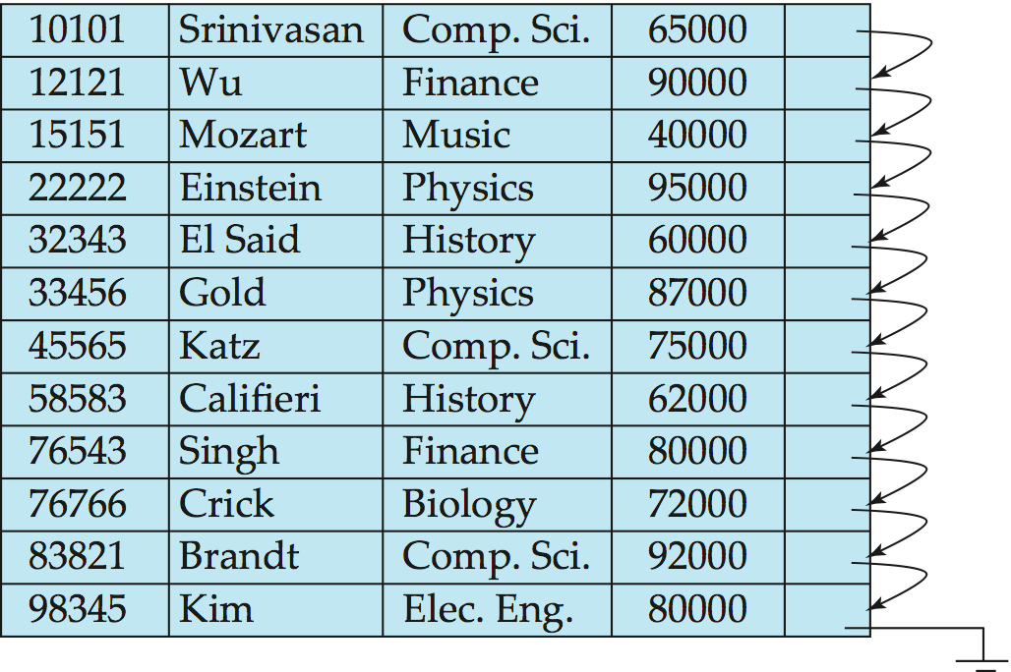
Sequential File Organization
Suitable for applications that require sequential processing of the entire file
The records in the file are ordered by a search-key

Slide 36
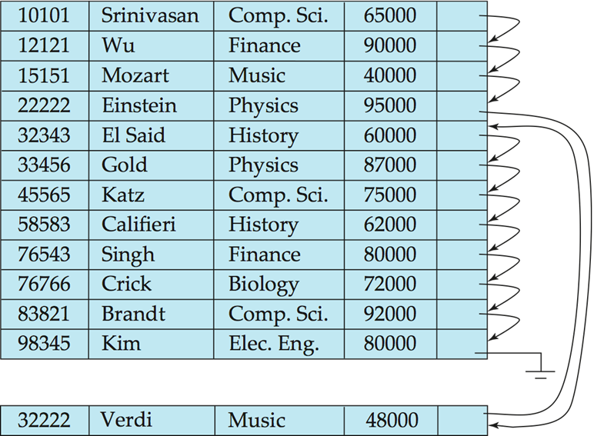
Sequential File Organization (Cont.)
Deletion – use pointer chains
Insertion –locate the position where the record is to be inserted
if there is free space insert there
if no free space, insert the record in an overflow block
May cause block split
In either case, pointer chain must be updated
Need to reorganize the file from time to time to restore sequential order

Slide 37
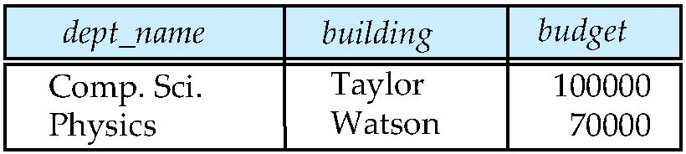
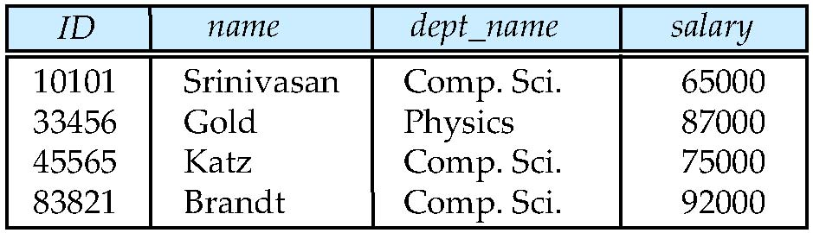
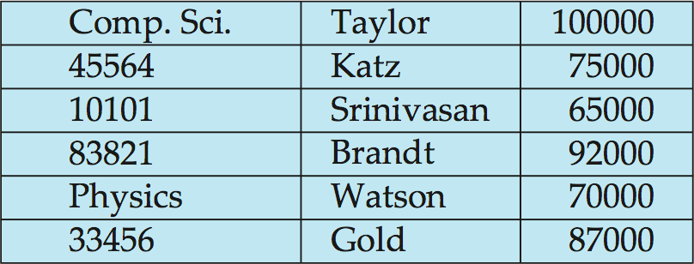
Multitable Clustering File Organization
Store several relations in one file using a multitable clustering file organization
department
instructor
multitable clustering
of department and
instructor

Slide 38
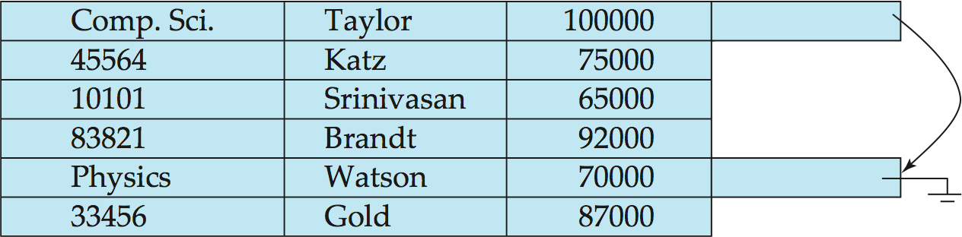
Multitable Clustering File Organization (cont.)
results in variable size records
good for queries involving department instructor, and for queries involving one single department and its instructors
bad for queries involving only department
Can add pointer chains to link records of a particular relation

Slide 39
Storage Buffer Management
A database file is partitioned into fixed-length storage units (blocks).
Blocks are units of both storage allocation and data transfer.
Database system seeks to minimize the number of block transfers between the disk and memory to improve the overall system performance
We can reduce the number of disk accesses by keeping as many blocks as possible in main memory.
Buffer – portion of main memory available to store copies of disk blocks.
Buffer manager – subsystem responsible for allocating buffer space in main memory.
Notes:
数据缓存管理的问题

Slide 40
Buffer Manager
Other modules call on the buffer manager when they need a block from disk.
If the block is already in the buffer, the requesting program is given the address of the block in main memory
If the block is not in the buffer,
the buffer manager allocates space in the buffer for the block. if required, replacing (throwing out) some other block to make space for the new block.
The block that is thrown out is written back to disk only if it was modified since the most recent time that it was written to/fetched from the disk.
Once space is allocated in the buffer, the buffer manager reads the block from the disk to the buffer, and passes the address of the block in main memory to requester.

Slide 41
Buffer-Replacement Policies
Most operating systems replace the block least recently used (LRU strategy)
Idea behind LRU – use past pattern of block references as a predictor of future references
DBMS can have more sophisticate strategy, because Queries have well-defined access patterns (such as sequential scans), and DBMS can use the information to predict future references
LRU can be a bad strategy for certain access patterns involving repeated scans of data
e.g. when computing the join of 2 relations r and s by a nested loops for each tuple tr of r do for each tuple ts of s do if the tuples tr and ts match …
In this case, Most recently used (MRU) strategy should be used
Mixed strategy with hints on replacement strategy provided by the query optimizer is preferable
Notes:
LRU Stractegy省出的空间给后面的人用，最近最少使用的模块

Slide 42
Buffer-Replacement Policies (Cont.)
Pinned block – memory block that is not allowed to be written back to disk.
Block in processing
Block is not the right time to be written out (Recovery)
Buffer managers need support forced output of blocks for the purpose of recovery (more later)
Buffer manager can use statistical information regarding the probability that a request will reference a particular relation
E.g., the data dictionary is frequently accessed. Heuristic: keep data-dictionary blocks in main memory buffer

Slide 43
Data Dictionary
The Data dictionary (also called system catalog) stores metadata; that is, data about data, such as
Information about relations
names of relations
names, types and lengths of attributes of each relation
names and definitions of views
integrity constraints
Statistical and descriptive data
number of tuples in each relation
number of the blocks in each relation
distinct values of some attributes
Physical file organization information
How relation is stored (sequential/hash/…)
Physical location of relation
Information about indices ( next lecture )
User and accounting information, including passwords

Slide 44
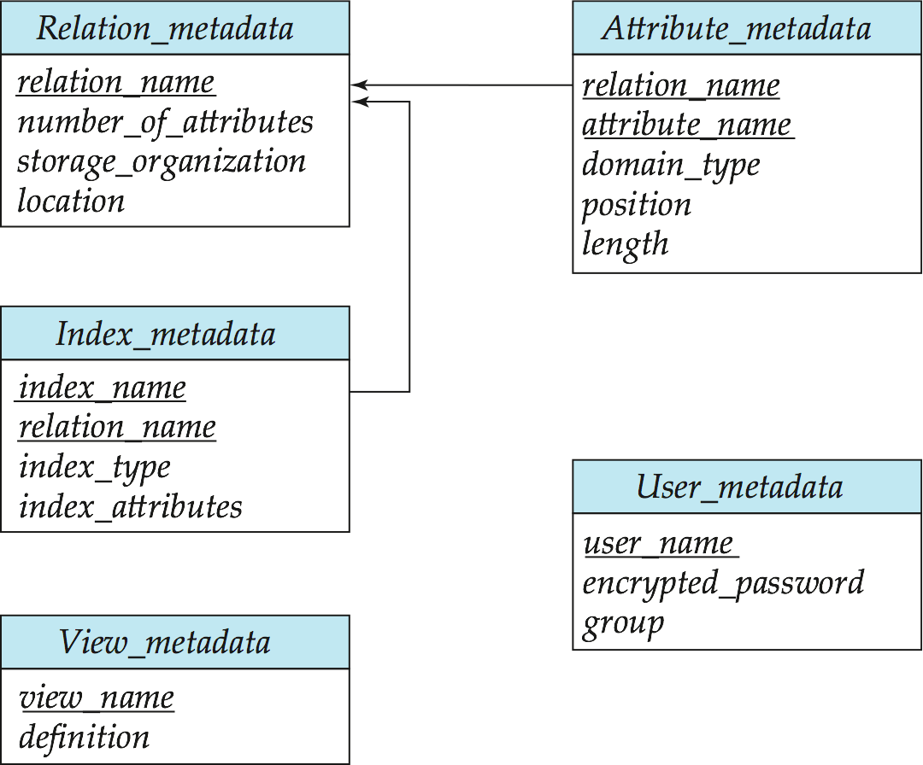
Data Dictionary Storage
Relational representation on disk with pre-defined schema
Specialized data structures designed for efficient access, in memory

