Slide 1
《高级数据结构与算法分析》 复 习

Slide 2
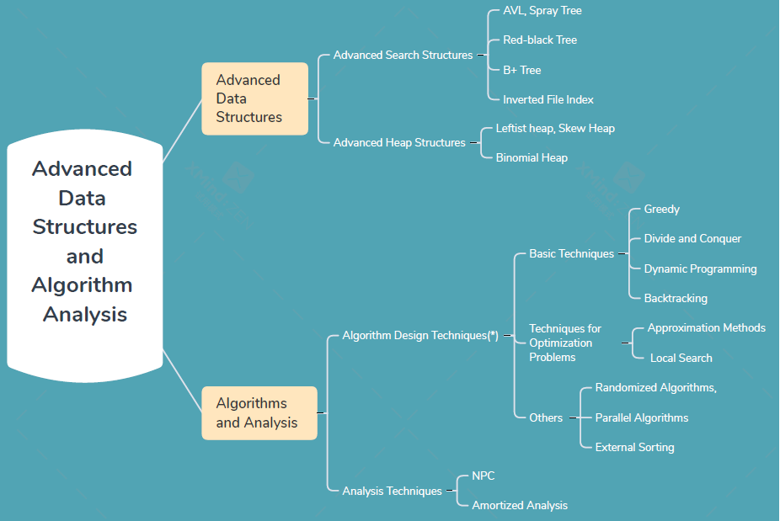
内容概览

Slide 3
一、Advanced Search Structure
1、Kernel problem: search tree balance, reduce the height of the tree
2、Search tree:
Binary Search Tree
AVL树：概念、结点数与层次关系
四种平衡方法（LL、RR、LR、RL）以及判别方法
四种平衡方法实现（基于singleRotation、doubleRotation）并熟悉有关例程。
SPLAY树：概念、具体操作（Zig-zag, Zig-zig）
Red-black tree: contains the same number of black nodes
m-tree , B树：概念、具体操作(insert, delete)。
3、Inverted File Index：文档分析、结果排序；概念、数据结构设计思想、评价

Slide 4
二、Advanced heap structure
1、Kernel problem: merge operation
2、Binary tree representation
Leftist heap：
order property and structure property
merge: based on the right path, time complexity
insert and delete based on merge
merge实现，熟悉有关例程。
Skew heap：amortized cost，merge：unconditional swap
3、Forest representation
Binomial queue：
B_{i} tree，compare to the binary number
merge实现方法，compare to the “add” of two binary number
具体实现，熟悉有关例程。

Slide 5
三、Advanced algorithms：basic techniques
1、Greedy Algorithms
Main ideas
Typical problems：
Activity Selection Problem: earliest finish first
Huffman codes
2、Divide and Conquer Algorithms
Main ideas: three steps
Running time: Substitution method, Recursion-tree method, Master method
Typical problems: quick/merge sort、closest points
3、Dynamic Programming
Main ideas：top-down analysis (reduce the complexity) and bottom-up implementation
Typical problems
Ordering Matrix Multiplications: ideas, 熟悉程序。
Optimal binary search tree: ideas
All-pairs shortest path: ideas, 熟悉程序
Product Assembly: ideas
4、Backtracking Algorithms
Main idea: exhaustive search + elimination
Typical problems:
8-queens
Turnpike Reconstruction
Game Tree: α pruning, β pruning

Slide 6
四、Advanced algorithms： techniques for optimization problems
1、Approximate
Main idea: find near-optimal solutions in polynomial time, Approximation Ratio
Typical problems:
Bin Packing: online/offline, next/best/first fit
Knapsack Problem: fractional vs 0/1
K-center: given r, delete all s’ : dist(s’, s) ≤ 2r;
Select s from S with maximum dist(s, C);
Binary search for r;
Unless P = NP, there is no ρ -approximation for any ρ < 2.
2、Local Search
Main idea: local (define neighborhoods)、search
Typical problems:
Vertex Cover Problem: deleting a single node
Metropolis Algorithm (Randomly chosen+ With a probability)、Simulated Annealing
Hopfield Neural Networks: all nodes are satisfied, State-flipping
Maximum Cut Problem（A special case of Hopfield Neural Network）：
State-flipping 、ρ =2 ；K-L heuristic （k-flip）;

Slide 7
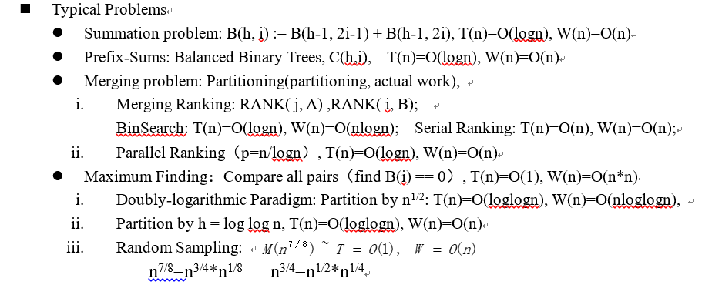
五、Advanced algorithms： others
1、Randomized Algorithms
Main idea: make random decisions
Typical problems:
Hiring Problem: Permute array, Online Hiring(best value of k to maximize the probability)
Quicksort: at least n/4, the expected number of iterations is at most 2
2. Parallel Algorithms
Main idea: pardo for multi-processors
Parallel Random Access Machine (PRAM), Work-Depth (WD)
To resolve access conflicts: EREW, CREW, CRCW
Complexity: W(n) operations and T(n) time

Slide 8
六、Algorithms Analysis
1、NP-Completeness Problem
concepts、relations of the concepts、typical problems
undecidable problem
decidable problem: NP problem、NP-complete
deterministic machine and non-deterministic machine
A Formal-language Framework, and Formal-language Theory
2、Amortized Analysis
idea of amortized cost
how to analysis amortized cost: T_{actual} + ∆Potential = T_{amortized}
typical examples:
Binomial queues: ∆Potential =T_{i} –T_{i-1}, Φ _{i}= number of trees
Splay tree:
multi_Pop: Φ _{i}= number of elements in stack
Skew Heaps： Φ _{i} =number of heavy nodes

Slide 9
注意了解各project内容。
题型：判断题（13*2）、选择题（20*3）、程序填空题（2*3）、函数题（1*8）
各部分内容要点（视频）：“学在浙大”平台
《高级数据结构与算法分析》要点：课程访问邀请码 500HKEASRIV

