Slide 1
Project 6 Skip Lists
GROUP 5
Jiajun CHEN, Zhichao ZHAI, Haoyi DUAN

Slide 2
Table of Contents
01
Introduction
02
Algorithm Specification
03
Testing Result
04
Analysis

Slide 3
Chapter 1 Introduction

Slide 4
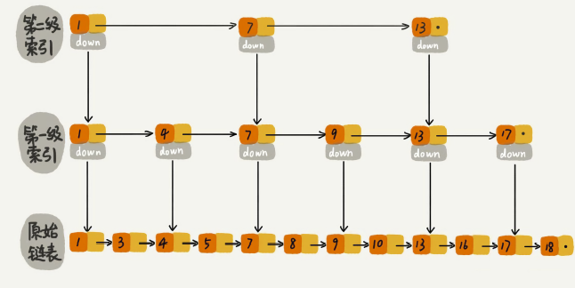
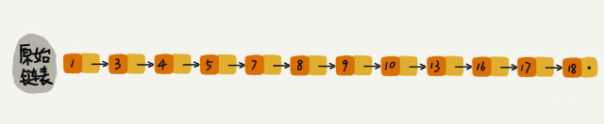
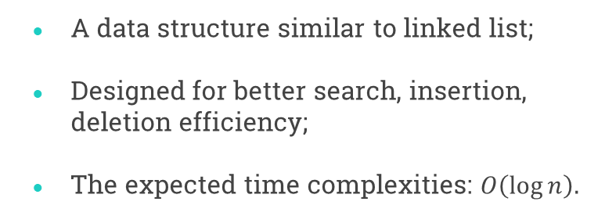
Introduction
Background
A data structure similar to linked list;
Designed for better search, insertion, deletion efficiency;
The expected time complexities: $O\left(\log{n}\right).$

Slide 5
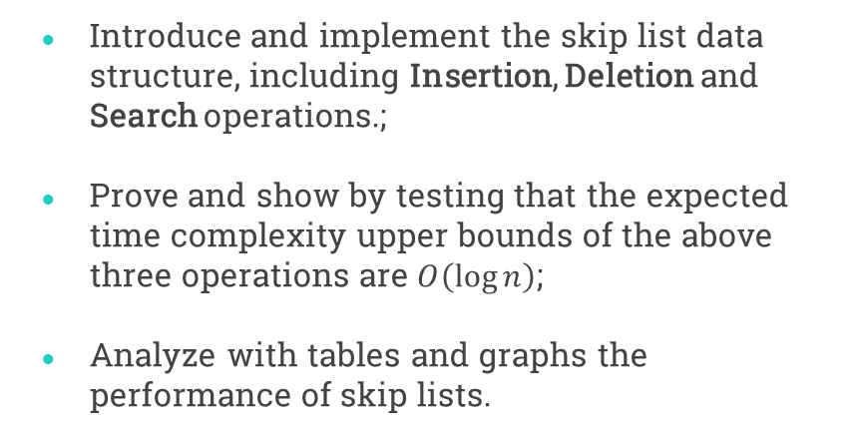
Introduction
Our Task
Introduce and implement the skip list data structure, including Insertion, Deletion and Search operations.;
Prove and show by testing that the expected time complexity upper bounds of the above three operations are $O\left(\log{n}\right)$;
Analyze with tables and graphs the performance of skip lists.

Slide 6
Chapter 2 Algorithm

Slide 7
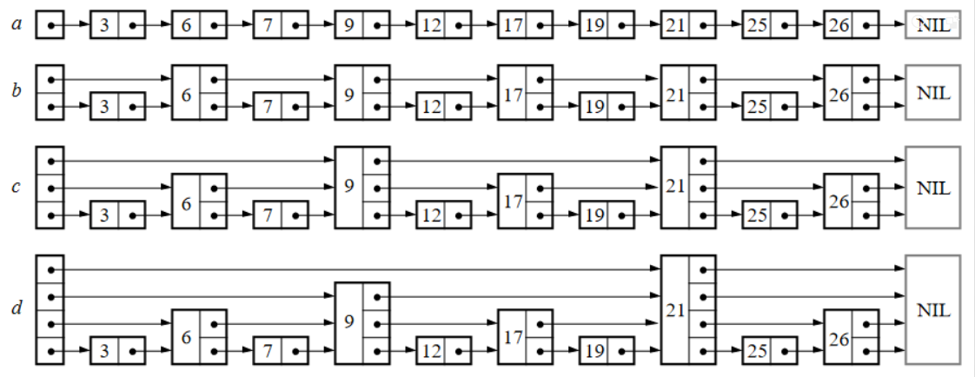
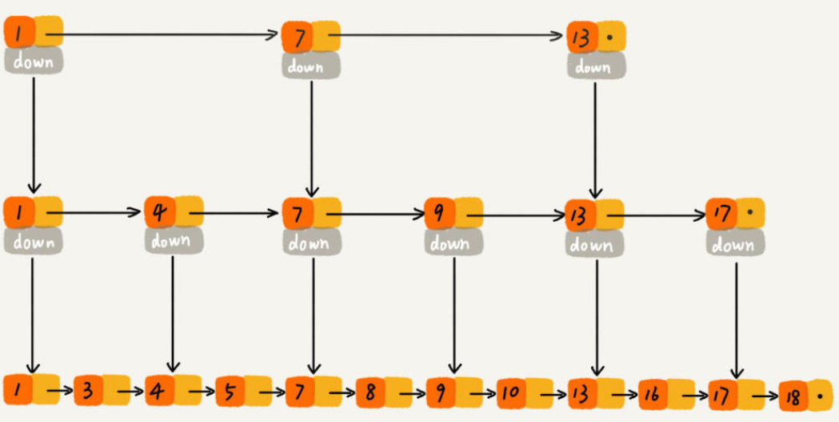
The Original Form
There are several ways to implement skip lists.
One is to present each node with a value and many pointers, each pointing to certain node after it.
However, we are to implement it in another way, where each node consists of a value, a next pointer, and a down pointer.
Our Implementation

Slide 8
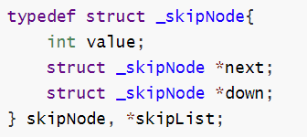
Data Structure
value stores the data element;
next is a pointer to the next node in the same layer, or NULL when there's no next node.
down is a pointer to the node with the same value in the next lower layer, or NULL if it's already in the bottom layer.

Slide 9
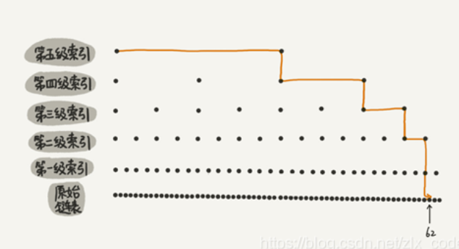
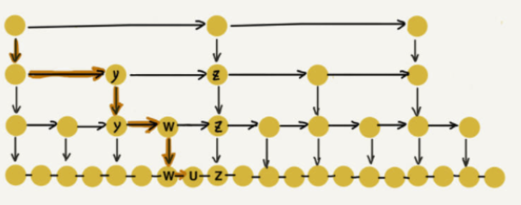
Search: To decide if a given element, say X, is in the skip list.
Start from the head of the highest layer of the list;
While next_node.value < X, jump next;
If next_node.value = X, return true;
If this not the bottom layer, jump down and go to step 2. Else it means that the given value doesn’t exists, so return false.

Slide 10
Deletion: To remove an element X from the skip list.
Start from the head of the highest layer of the list;
While next_node.value < X, jump next;
If next_node.value = X, delete that node, and delete the current layer if it becomes empty;
If this not the bottom layer, jump down and go to step 2. Else return 0 if there’s ever any deletion, otherwise return -1.

Slide 11
get_random_level: To decide the highest level that an element will be present
Set initial level as 0;
Run a trial procedure which will succeed with an upgrade probability p,
If the trial succeeds, level += 1 and rerun the trial (repeat step 2);
If it fails, return the level.

Slide 12
Insertion: To insert an element X into the skip list.
Call find() to decide whether X already exists, if so return -1;
Call get_random_level() to decide the “level” of the value. If inserted level > max current level, create all needed new layers;
Start from the head of the highest layer of the list;
While next_node.value < X, jump next;
If current level <= inserted level, insert the value;
If this not the bottom layer, jump down and go to step 4, return 0.

Slide 13
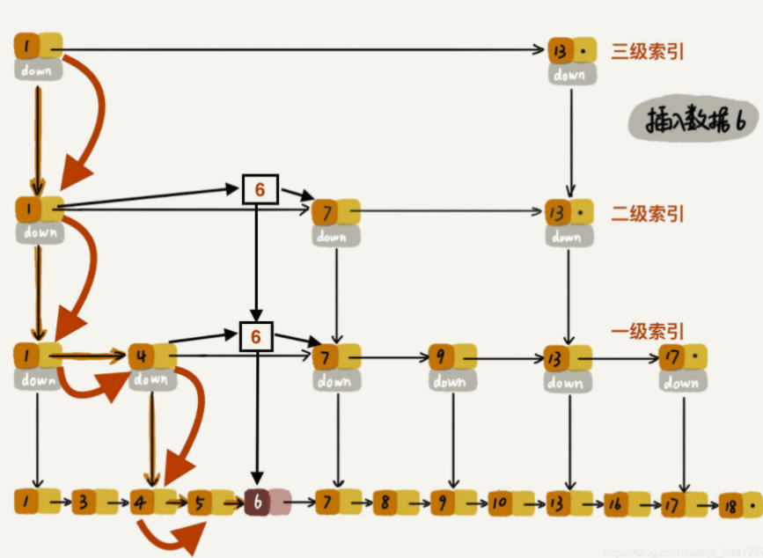
Insertion: To insert an element X into the skip list.

Slide 14
Chapter 3 Testing

Slide 15
TESTING RESULT
Time vs. Input Size
Time vs. Data Structure
Time vs. Upgrade Probability
Space vs. Upgrade Probability

Slide 16
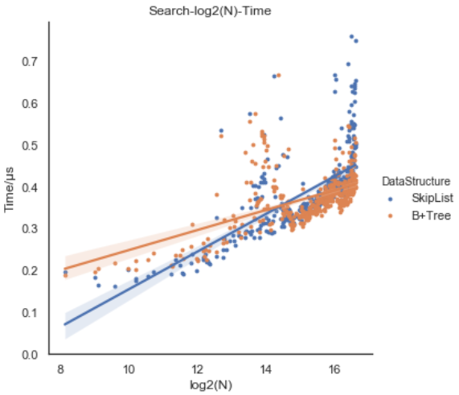
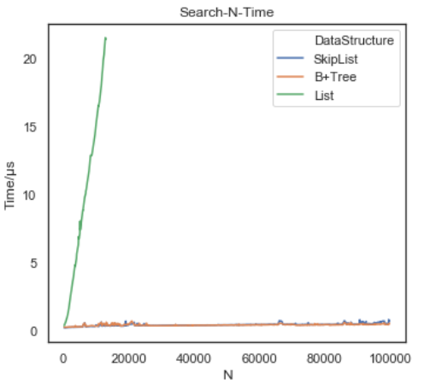
Time Cost -- Search

Slide 17
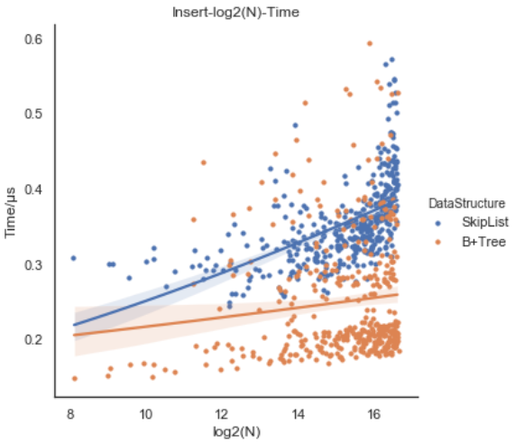
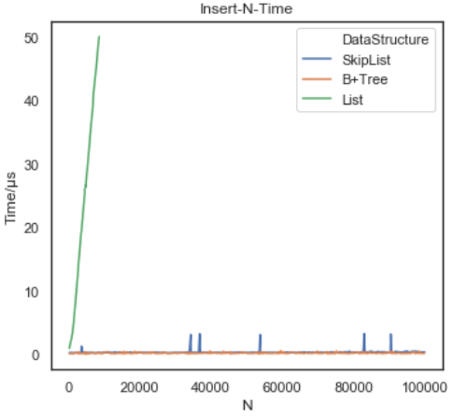
Time Cost -- Insert

Slide 18
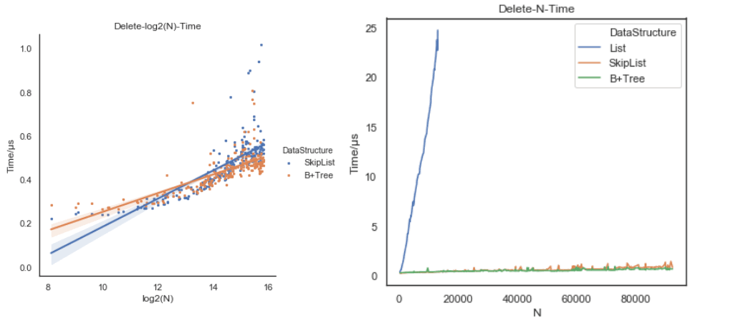
Time Cost -- Delete

Slide 19
Time Cost - Regarding p

Slide 20
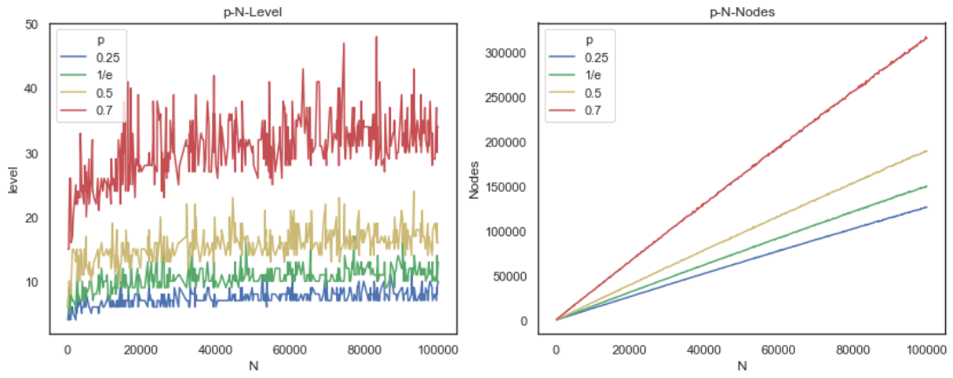
Space Cost - Regarding p

Slide 21
Chapter 4 Analysis

Slide 22
ANALYSIS
Time Complexity
Space Complexity

Slide 23


Time Complexity -- Search
->Average (Expected) Case
Claim: O(log n)
Analysis 1: A Rough Proof
1. What’s the expected number of nodes in each level?
Define
And the number of nodes in each level

Slide 24



Time Complexity -- Search
->Average (Expected) Case
Analysis 1: A Rough Proof
1. What’s the expected number of nodes in each level?
We have
And thus
From which

Slide 25


Time Complexity -- Search
->Average (Expected) Case
Analysis 1: A Rough Proof
2. What’s the expected maximum level?
We obtain this by solving
Hence

Slide 26
Time Complexity -- Search
->Average (Expected) Case
Analysis 1: A Rough Proof
3. What’s the expected number of nodes we’ll traverse at each level?

Slide 27

Time Complexity -- Search
->Average (Expected) Case
Analysis 1: A Rough Proof
4. What’s the time complexity of search?

Slide 28
Time Complexity -- Search
->Average (Expected) Case
Analysis 2: A More Detailed Proof Inspired by the Primary Paper
The main idea: backtrack the search path and act as if the level of each node is not determined until we observe it in the backtracking process.
At any particular point in the backward path, we will be at a certain node in the skip list. Now we have two choice: climb up and climb left.
Probability of climbing up: p
Probability of climbing left: 1-p

Slide 29

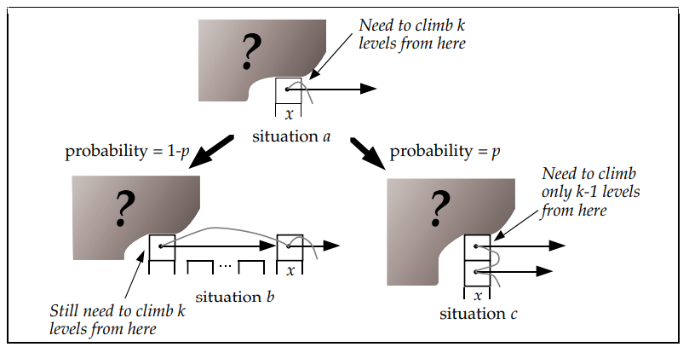
Time Complexity -- Search
->Average (Expected) Case
Analysis 2: A More Detailed Proof Inspired by the Primary Paper
Define C(k) as the number steps we’ve gone through in the backtrack path when we still have k layers to climb. Then
which implies

Slide 30
Time Complexity -- Search
->Average (Expected) Case
Analysis 2: A More Detailed Proof Inspired by the Primary Paper
Note that this is based on the assumption that the list is infinite, that is, we are able to climb left for infinite times.
When we’ve already reached the head, we simply climb upwards, increase the C(k) by 1 instead of 1/p.
And since 1/p > 1, k/p is just a upper bound for C(k), which doesn’t matter.

Slide 31



Time Complexity -- Search
->Average (Expected) Case
Analysis 2: A More Detailed Proof Inspired by the Primary Paper
In addition, the probability of maximum level greater than k is
which is at most due to the Bernoulli Inequality.
From this we can calculate that the expected maximum level is at most

Slide 32
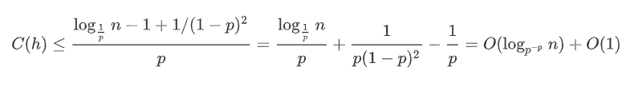
Time Complexity -- Search
->Average (Expected) Case
Analysis 2: A More Detailed Proof Inspired by the Primary Paper
Combine our results, the steps are no more than
which indicates that the complexity is O(log n).

Slide 33
Time Complexity -- Search
->Worst Case
In worst case, the skip list degrades into a normal linked list!
↓
O(n) for search

Slide 34
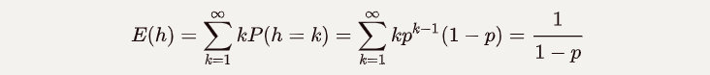
Time Complexity -- Insertion
->Average (Expected) Case
Judge if insertion needed - O(log n)
Process of finding positions to insert - O(log n)
Insert one node - O(1)
Times of insertion (layers) - O(1)
Total - O(log n) + O(log n) + O(1) * O(1) = O(log n)

Slide 35
Time Complexity -- Insertion
->Worst Case
Judge if insertion needed - O(n)
Process of finding positions to insert - O(n)
Insert one node - O(1)
Times of insertion (layers) - ∞ ? --->Set a maximum level m (const), then O(1)
Total - O(n) + O(n) + O(1) * O(1) = O(n)

Slide 36
Time Complexity -- Deletion
->Average (Expected) Case
Process of finding the node - O(log n)
Delete one node - O(1)
Times of deletion - O(log n) ( < maximum level )
Total - O(log n) + O(1) * O(log n) = O(log n)

Slide 37
Time Complexity -- Deletion
->Worst Case
Process of finding the node - O(n)
Delete one node - O(1)
Times of deletion - O(log n)
Total - O(n) + O(1) * O(log n) = O(n)

Slide 38

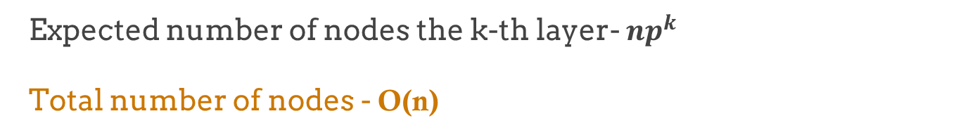
Space Complexity
->Average (Expected) Case
Expected number of nodes the k-th layer- ${np}^{k}$
Total number of nodes - O(n)

Slide 39
Space Complexity
->Worst Case
In worst case, every element can occupy an infinite number of layers!
--->Set a maximum level m (const), then O(n)

Slide 40


Further Corollary – Think about p
Expected time complexity: O(log n) →
Expected space complexity: O(n) →
which means…

Slide 41
Further Corollary – Think about p
Expected space complexity -
p↑, space↑
Expected time complexity -
when smallest?
$f\left(p\right)=p^{−p}=e^{−p\ln{p}}$reaches its maximum when $p=\frac{1}{e}$
$$g\left(p\right)=p\ln{p},g^{′}\left(p\right)=1+\ln{p}=0 →p=\frac{1}{e}$$

Slide 42
THANKS!
Reference:
Pugh W . Skip lists: a probabilistic alternative to balanced trees[C]
// Workshop on Algorithms & Data Structures. 1990.

