Slide 1
Logic and Computer Design Fundamentals
Digital Systems and Information
Haifeng Liu
haifengliu@zju.edu.cn
College of Computer Science and Technology, Zhejiang University

Slide 2
Chapter 1 Digital Computers and Information
Signal
Digital Computer
Computer Structure
Computer Abstraction
Number Systems and Coding

Slide 3
Signal
An information variable represented by physical quantity.
For digital systems, the variable takes on discrete values.
binary values are the most popular representations in digital systems. Binary values are represented by:
  Digits: 0 and 1
  Symbols
    False (F) and True (T)
    Low (L) and High (H)
    On and Off.
Binary values are represented by values or ranges physical values, such as two level voltages

Slide 4
Signal Examples Over Time
Time
Continuous in value & time
Analog
Digital
Discrete in value & continuous in time
Asynchronous
Synchronous
Discrete in value & time

Slide 5
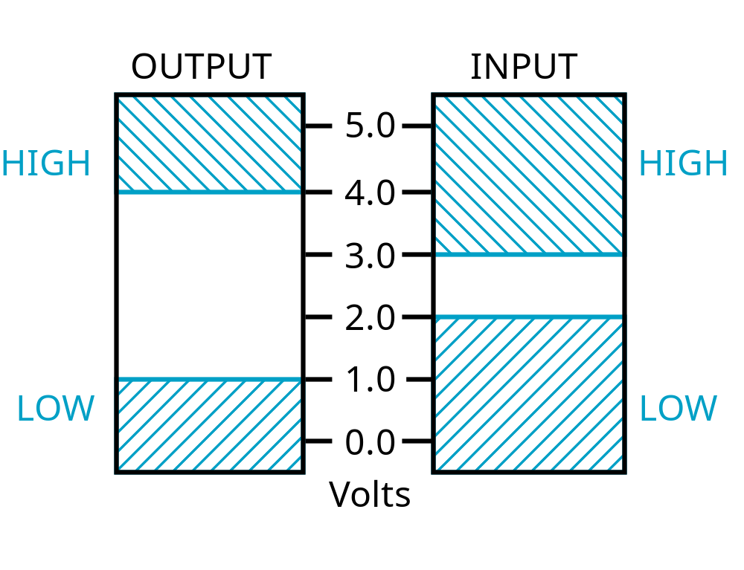
Signal Example – Physical Quantity: Voltage
The most commonly used binary information signal is electrical signal - voltage or current. The range of voltage values ​​is used to represent two different discrete values.
Why not decimal？
Threshold Region
Figure 1-1: An Example of Voltage Ranges for Binary Signals

Slide 6
Binary Values: Other Physical Quantities
Other physical quantities that can be used to represent 0 and 1
  CPU Voltage
  Disk Magnetic Field Direction
  CD Surface Pits/Light
  DRAM Electrical Charge

Slide 7
Digital System
Digital System takes a set of discrete information inputs and discrete internal system state information and generates a set of discrete information outputs.
Discrete
Information
Discrete
Processing
Discrete
Inputs
System
Outputs
System State

Slide 8
Typical Digital System
Combinational Logic System
  No state present
  Output Function: Output = Function(Input)
Sequential Logic System
  State present
  State updated at discrete times
    Synchronous Sequential System
  State updated at any time
    Asynchronous Sequential System
  State Equation: State = Function (State, Input)
  Output Function: Output = Function (State , Input)
  or Function (State)

Slide 9
Digital System Example
A Digital Counter (e.g., odometer):
Count Up
0
0
1
3
5
6
4
Reset
Inputs:
Count Up, Reset
Outputs:
Visual Display
State:
"Value" of stored digits
Synchronous or Asynchronous?

Slide 10
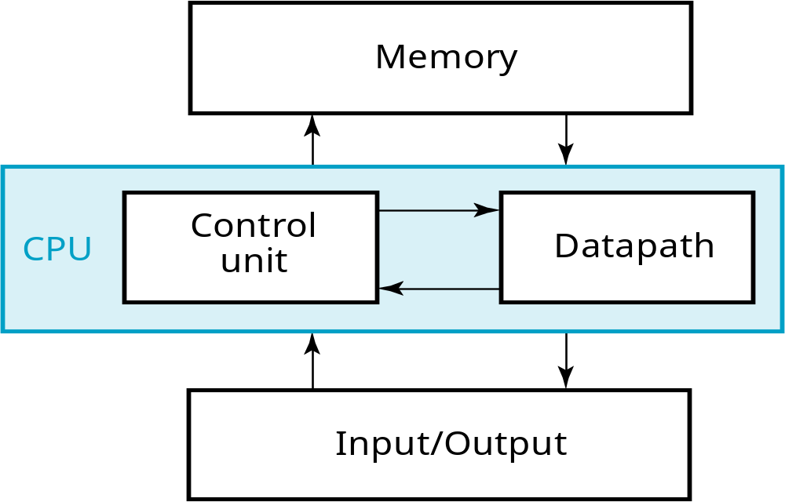
A Digital Computer Example
A general-purpose system used to process the discrete values
Inputs: Keyboard, mouse, modem, microphone
Outputs: CRT, LCD, modem, speakers
Figure 1-2: Block Diagram of Digital Computer
Synchronous or Asynchronous?

Slide 11
Digital Computer
Digital Computer: A general-purpose system used to process the discrete values
  Features: flexibility and versatility
Information Representation in Computer
  Binary number system: 0 and 1
  A binary digit is called a bit
  Groups of bits can be used to represent the computer instructions and executed data.
  Quantization of the signal in both value and time can be performed automatically by an analog-to-digital conversion device.

Slide 12
And Beyond – Embedded Systems
Computers as integral parts of other products
Examples of embedded computers
  Microcomputers
  Microcontrollers
  Digital signal processors
Examples of Embedded Systems Applications
  Smart phones, Automobiles, Video games, Dishwashers, Flat Panel TVs, Global Positioning Systems, Copiers, etc.
Chapter 1 <number>

Slide 13
Embedded Systems
Examples of Embedded Systems Applications
  Smart phones
  Automobiles
  Video games
  Copiers
  Dishwashers
  Flat Panel TVs
  Global Positioning Systems
Chapter 1 <number>

Slide 14
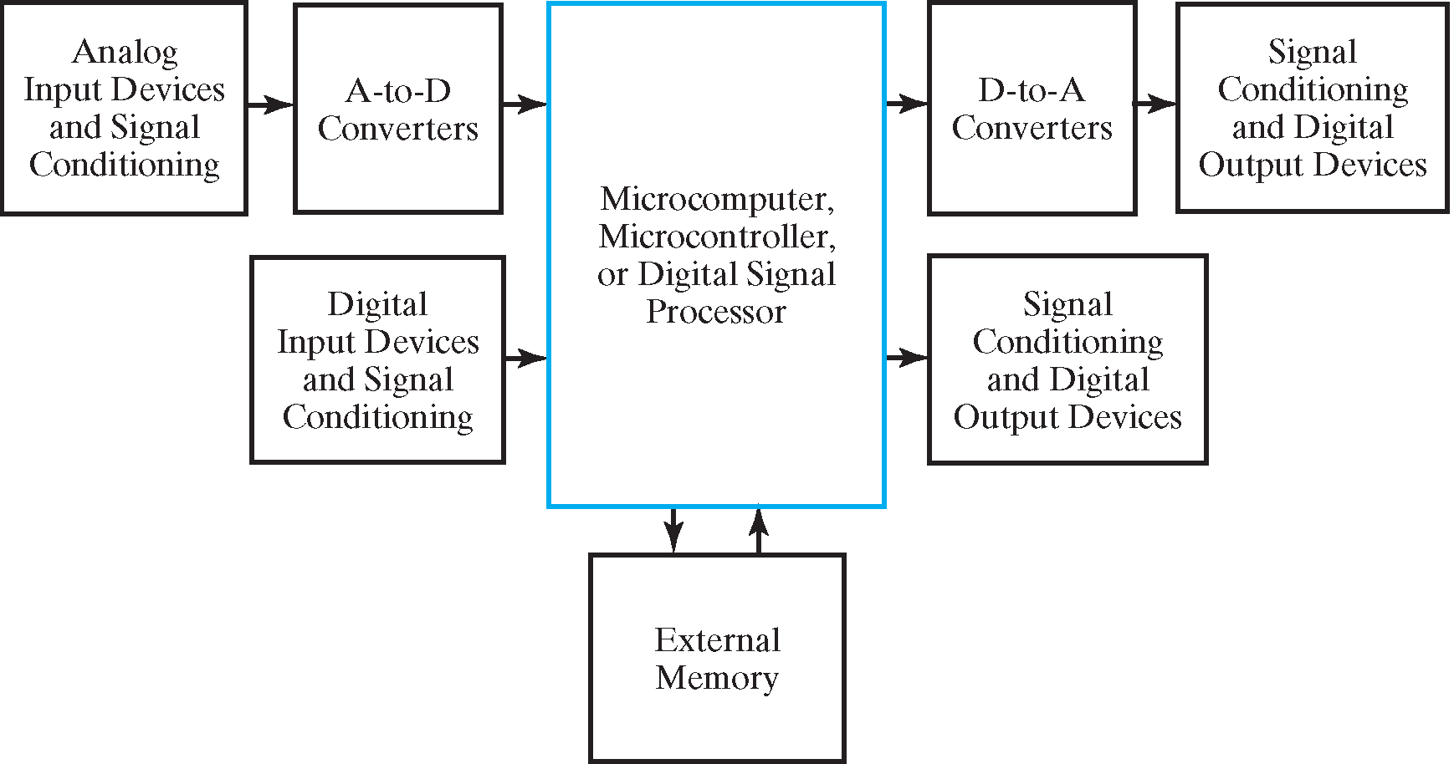
Embedded Systems
Block Diagram of Embedded Systems
Chapter 1 <number>

Slide 15
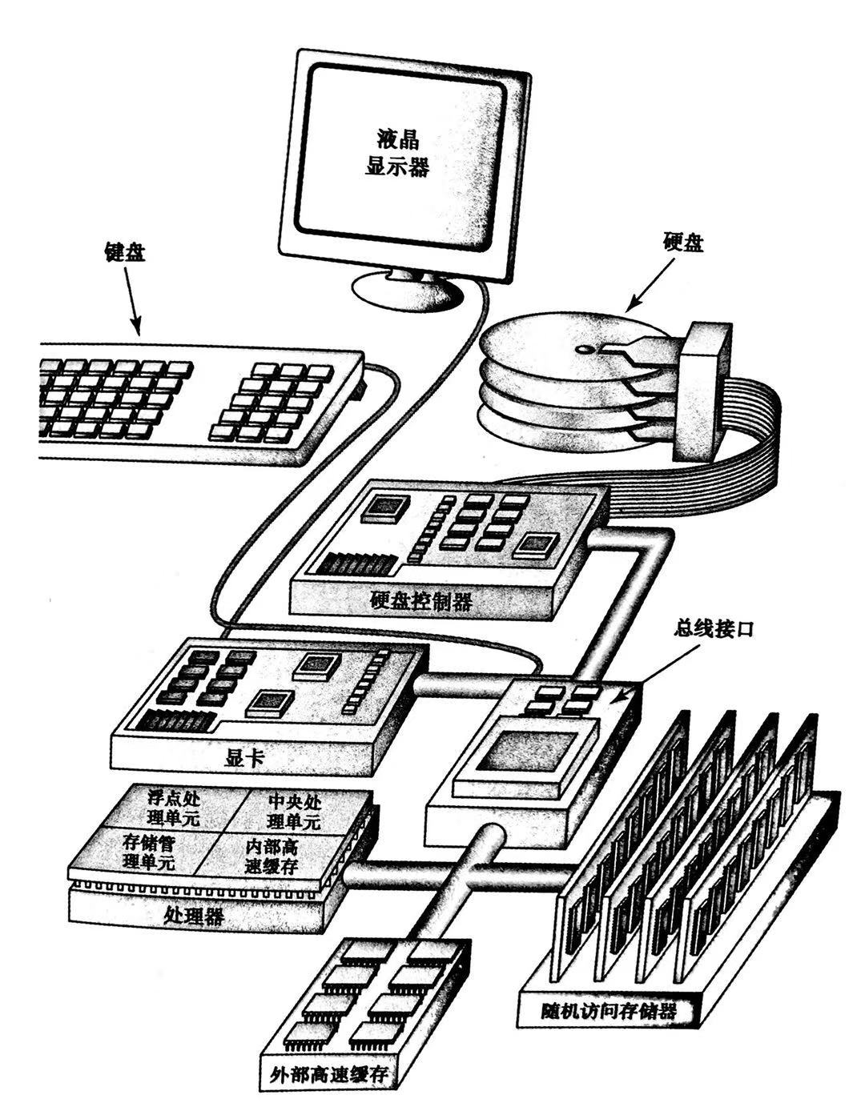
General-purpose Computer

Slide 16
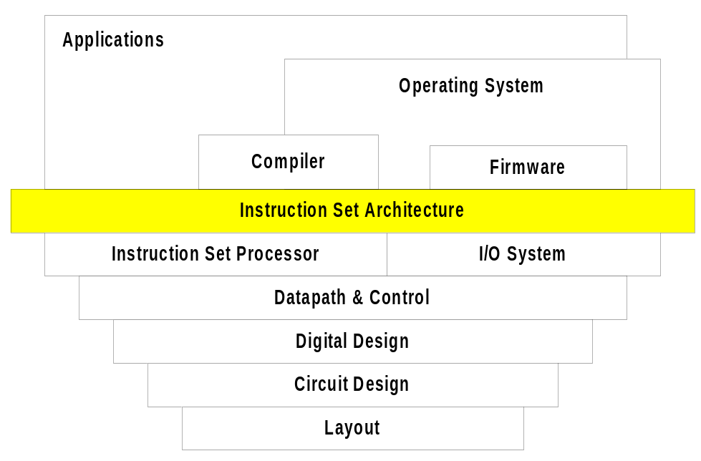
Computer Abstraction
Algorithm
Programming Language
Operation System
Instruction Set Architecture (ISA)
Microarchitecture
Register Transfer
Logic Circuit
Transistor Circuit

Slide 17
Design Procedure
Specification
  Write a specification for the circuit if one is not already available (text, HDL)
Formulation
  Derive a truth table or initial Boolean equations that define the required relationships between the inputs and outputs, if not in the specification
Optimization
  Apply 2-level and multiple-level optimization
  Draw a logic diagram or provide a netlist for the resulting circuit using ANDs, ORs, and inverters

Slide 18
Design Procedure
Technology Mapping
  Map the logic diagram or netlist to the implementation technology selected
Verification
  Verify the correctness of the final design

Slide 19
Number System and Coding
Number system is employed in everyday arithmetic to represent numbers by string of digits. Number system with radix10 is most commonly used in daily life, while systems with radix 2, 8 and 16 are more widely used in computer work.
1. Radix(Base)
Radix – collection of numberal symbols used to represent numbers in number system
Radix number – size of the collection
Example: Suppose radix is R,
0, 1, 2……, R-1 are the R basic numeral symbols

Slide 20
2. Weight
digit weight: the counting unit value of basic digital symbols in different position. ie, weight W
Example: the weight of 3 in 2336 in decimal number system is 10².
Example: the weight of the highest digit in 8421 code is 8.

Slide 21
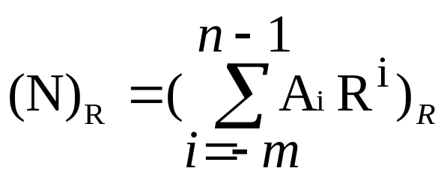
3. Representation of a number in radix R
(digits of a number N are listed From left to right, length n+m)
String of Digits 0≤A_{i}<R
(N)_{Ｒ}＝(A_{n－1}A _{n－2}A _{n－3}…A ₁A ₀ • A₋₁A _{-２}A…A _{–m+1}A _{-m})_{R}
MSB
radix point
LSB
Power Series
Notes:
MSB：Most Significant Bit 最高有效位
LSB：Least Significant Bit 最低有效位

Slide 22
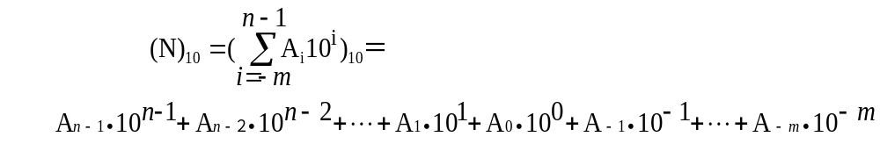
Example of Decimal Number Representation
Radix: R=10
Basic symbols: 0,1,2,3…9
Weight: W_{i}＝10^{i}
Power series :
Example: (123.45)₁₀=1∙10²+2∙10¹+3∙10⁰+4∙10⁻¹+5∙10⁻²

Slide 23
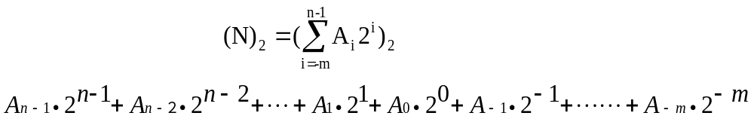
Example of Binary Number Representation
1. Representation of binary number
Radix: R=2
Basic symbols : 0，1
Weight: W_{i}＝2^{i}
Power series:
Example: (1011.101)₂=1∙2³+0∙2²+1∙2¹+1∙2⁰+1∙2⁻¹+0∙2⁻²+1∙2⁻³

Slide 24

2. Operation Rules
Addition: ０＋０＝０、０＋１＝１、
１＋０＝１、１＋１＝１０
Multiplication :
０＊０＝０、０＊１＝０、
１＊０＝０、１＊１＝１
3. Representation in Physical
Pros – record by transistor or magnetic medium
Cons – Writing, Memory – Use hexadecimal in short
Digital value 1/0 can be represented by voltage level high/low
1
1
1
0
0
0
0
4. Boolean algebra can be applied

Slide 25
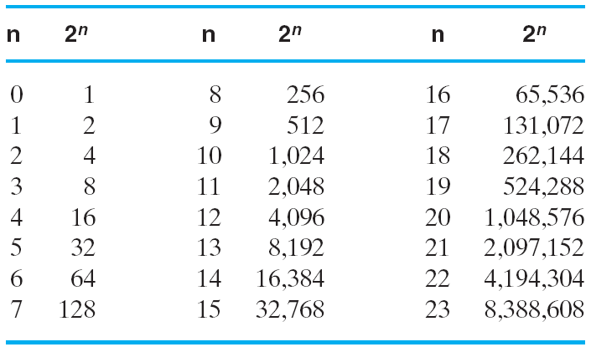
Useful for Base Conversion
Table1-1 Power of 2

Slide 26
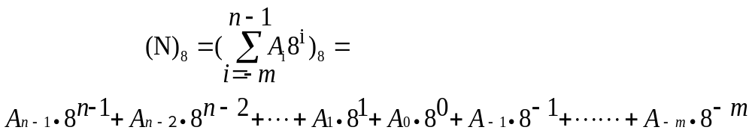
Example of Octal Number Representation
Radix: R=8
Basic Symbol: 0、1、2、…、7
Weight: W_{i}＝8^{i}
Power series :
Example: (567.125)8

Slide 27
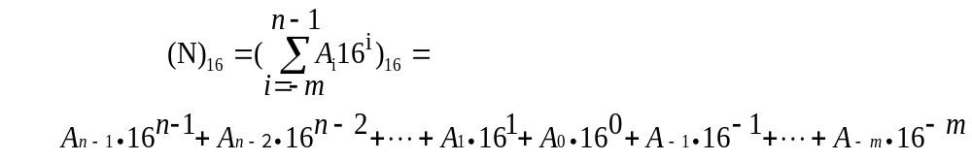
Example of Hexadecimal Number Representation
Radix: R=16
Basic Symbols: 0、1、2…、9、A、B、C、D、E、F
Weight: W_{i}＝16^{i}
Power series :
Example: (5AF.9B)16

Slide 28
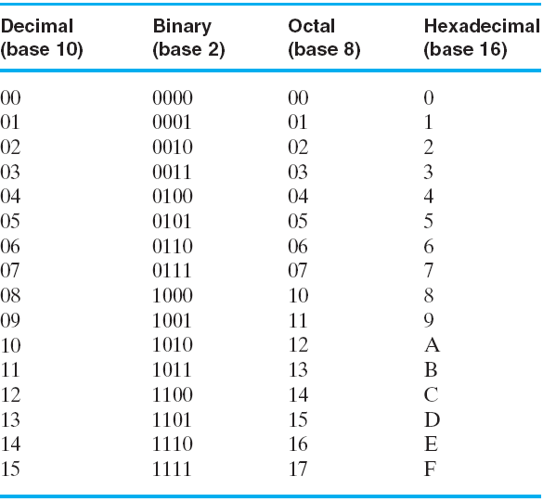
Useful for Base Conversion
Table 1-2: Number with Different Bases

Slide 29
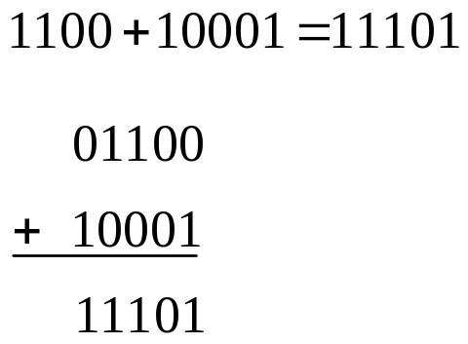
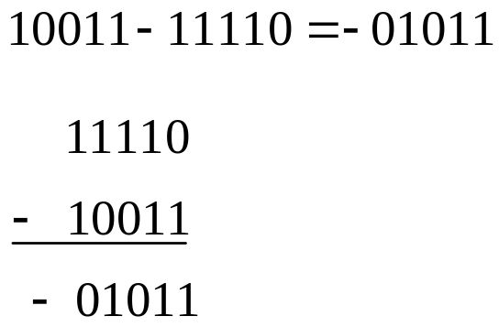
Arithmetic Operations
1. Addition and subtraction operations
Example 1:
Example 2:
(When minuend is smaller than subtrahend, swap minuend with subtrahend, and add Negative sign to the new result )

Slide 30
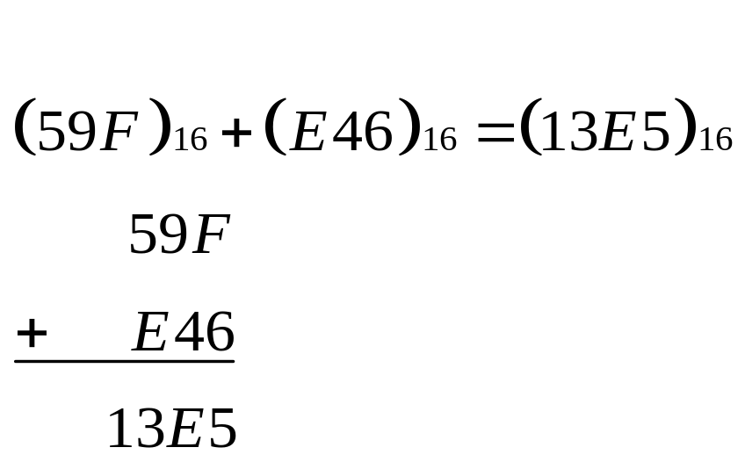
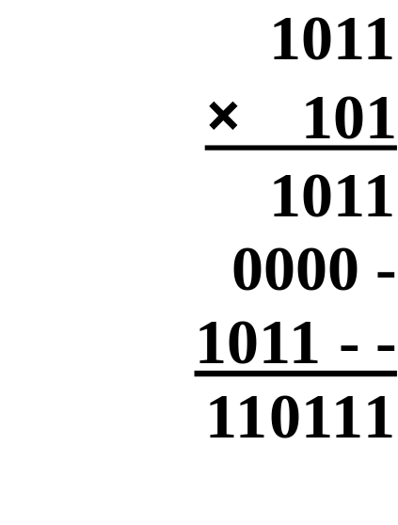
Arithmetic Operation
Example 3:
2. Multiplication
Example 1:
Example 2: (762)₈x(45)₈

Slide 31
Converting among Binary,
Octal, Hexadecimal
and Decimal Numbers

Slide 32
Conversion Details
To Convert the Integral Part
  Repeatedly divide the number by the new radix and save the remainders. The digits for the new radix are the remainders in reverse order of their computation. If the new radix is > 10, then convert all remainders > 10 to digits A, B, …
To Convert the Fractional Part
  Repeatedly multiply the fraction by the new radix and save the integer digits that result. The digits for the new radix are the integer digits in order of their computation. If the new radix is > 10, then convert all integers > 10 to digits A, B, …
Chapter 1 <number>

Slide 33
1. Binary and Octal Conversion
Principle:
2³ = 8, thus 3 binary digits and 1 octal digit can represent exactly the same value
Example:
(67.731) ₈ ＝（110 111 .111 011 001)₂
(312.64)₈＝(011 001 010 . 110 1)₂
(11 111 101 . 010 011 11)₂＝(375.236)₈
(10 110.11)₂＝(26.6)₈

Slide 34
2. Binary and Hexadecimal Conversion
Principle:
2⁴ = 16, thus 4 binary digits and 1 Hexadecimal digit can represent exactly the same value
Example: (3AB4.1) ₁₆ ＝（0011 1010 1011 0100 .0001)₂
(21A.5)₁₆＝(0010 0001 1010 . 0101)₂
(1001101.01101)₂= ( 0100 1101. 0110 1000 )₂=(4D.68)₁₆
(111 1101 . 0100 1111)₂＝(7D.4F)₁₆
(110 0101.101)₂＝(65.A)₁₆

Slide 35
3. Binary and Decimal Conversion
1. Binary to Decimal
Principle: Power Series
Method: sum the digits times their respective powers
Example:
(110 0101.101)₂ ＝1*2⁶+1*2⁵+0*2⁴+0*2³+
+1*2²+0*2¹+1*2⁰+1*2⁻¹+0*2⁻²+1*2⁻³
＝(101.625)₁₀

Slide 36
1. Decimal to Binary
Principle:
Integral Part - Repeatedly divide the
number by the new radix and save the remainders.
Fractional Part - Repeatedly multiply the fraction by the
new radix and save the integer digits that result.
Example: (725.678)＝(10 1101 0101.1010 1101 1001)₂
＝(2D5.AD9)₁₆

Slide 37
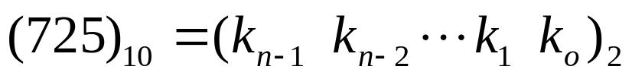
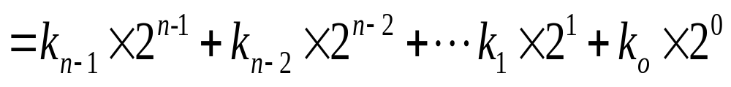
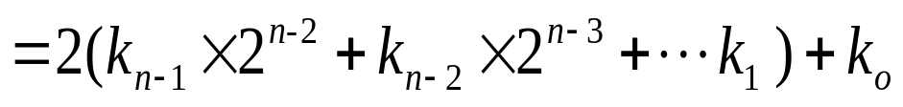
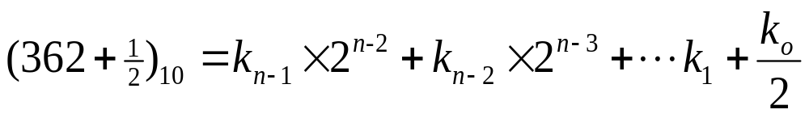
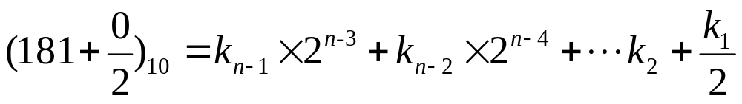
1. Integral Part
Example: Convert (725)₁₀ to Binary
1
0
…
(725)₁₀ = (10 1101 0101)₂

Slide 38
2 7 2 5
(725)₁₀ = (10 1101 0101)₂
2 3 6 2…………1
2 1 8 1…………0
2 9 0…………1
2 4 5…………0
2 2 2…………1
2 1 1…………0
2 5…………1
2 2…………1
2 1…………0
2 0…………1

Slide 39
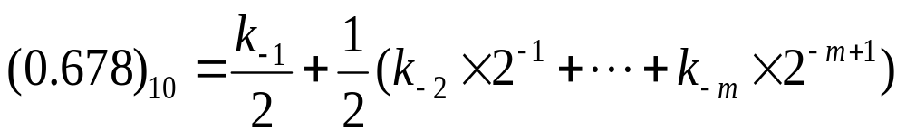
2.Fractional Part
1
Example: Convert (0.678)₁₀ to Binary
1
0
…
(0.678)₁₀ = (0.1010 1101 1001)₂
Note that: repeated multiplications in the fractional part may never end!

Slide 40
Repeatedly multiply the fraction by 2
(0.678)₁₀ = (0.1010 1101 1001)₂
2× 0.678………… = 1.356
3.3
2× 0.356………… = 0.712
Digits in binary correspond to 1 digit in decimal
2× 0.712………… = 1.424
2× 0.424………… =0.848
2× 0.848………… =1.696
2× 0.696………… =1.392
2× 0.392………… =0.784
2× 0.784………… =1.568
2× 0.568………… =1.136
2× 0.136………… =0.272
2× 0.272………… =0.544
2× 0.544………… =1.088

Slide 41
Codes
Coding Factors:
Data types - decimals, integers, real numbers, complex numbers, symbols
Value range - indicates the size of the number
Numerical accuracy - the accuracy of the number value
Hardware cost – data storage and process
Convenient representation
- both actual value and process value are needed
Coding Types:
Fixed-point format – simple with small range
Floating-point format – complex with wide range
Encoding format - For symbolic processing
Details about encoding of signed numbers in binary will be introduced in chapter 5

Slide 42
Binary Coding for Decimal
Binary Coded Decimal (BCD), use several (4) binary digits to represent one decimal digit.

Slide 43
1. Weighted Code
1. 8421 code (BCD code)
This code is the simplest, most intuitive binary code for decimal digits and uses the same powers of 2 as a binary number, but only encodes the first ten values from 0 to 9. The last 6 values are considered to be illegal.
8421 code is a weighted code, the weight from the most significant bit to least significant is 8, 4, 2, 1.
8421 code: 0111 = 0×8+1×4+1×2+1×1=7
Example: If N = (93)₁₀, then N = (1001 0011)_{8421BCD}

Slide 44
8421 BCD Code
BCD Addition
Example:
Note that: When the binary sum is greater than or equal to 1010, the decimal carry and the correct BCD sum digit are forced by adding 6 in binary.
8
1000
+5
+0101
13
1101
+0110
Carry = 1
0011
0001 | 0011

Slide 45
8421 BCD Code
BCD Addition
Example:
2905_{BCD} ＋ 1897_{BCD} = 4802_{BCD}
1 1 1
0
0001 1000 1001 0111
+ 0010 1001 0000 0101
0100 10010 1010 1100
+ 0000 + 0110 + 0110 + 0110
0100 1000 0000 0010

Slide 46
5421 BCD code
5421 code in short. The digit bit B₃ is set to 0 for number 0~4, 1 for number 5~9.
5421 code is weighted code, and its weight from the most significant bit to least significant is 5, 4, 2, 1.
Example:
  if N = (93)₁₀, then
  N=(1100 0011)_{5421BCD}

Slide 47
2421 BCD code
2421 code in short. It encodes the first 8 values of (B₃B₂B₁B₀) from 0 to 7 as binary code, 1110 for 8 and 1111 for 9 in decimal number system.
5421 code is weighted code, and its weight from the most significant bit to least significant is 2, 4, 2, 1.
Example:
  if N = (93)₁₀, then
  N=(1111 0011)_{2421BCD}

Slide 48
2. nonweighted code
Excess 3 Code
In excess 3 code, numbers are represented as decimal digits, and each digit is represented by four bits as the BCD code plus 3. Excess 3 code is a nonweighted code.
When do addition for each digit, we need to subtract binary 0011 (decimal 3) if the resulting is less than or equal to decimal 10, otherwise add binary 0011.

Slide 49
Example: 0100+0110=0111
1000+1001= 1 0 1 0 0
0 1 0 0
＋) 0 1 1 0
1 0 0 0
＋) 1 0 0 1
1 0 1 0
1 0 0 0 1
－)
0 0 1 1
+)
0 0 1 1
0 1 1 1
1 0 1 0 0

Slide 50
Reliable code
Codes that can reduce error, detect error and correct error are called reliable code.

Slide 51
1. Gray Code
Also known as cyclic permutation code, is a binary numeral system where two successive values differ in only one bit.
Gray code are widely used in counters, to prevent multiple counts or less counts.
Decimal | 8,4,2,1 | Gray
0 | 0000 | 0000
1 | 0001 | 0001
2 | 0010 | 0011
3 | 0011 | 0010
4 | 0100 | 0110
5 | 0101 | 0111
6 | 0110 | 0101
7 | 0111 | 0100
8 | 1000 | 1100
9 | 1001 | 1000

Slide 52
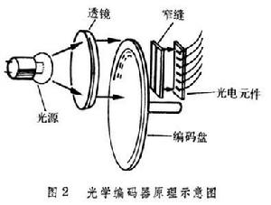
1. 格雷码
111
000
100
000
B
0
B
1
110
001
101
001
B
2
G
2
G
1
010
111
G
0
101
011
100
011
110
010
(a) Binary Code for Positions 0 through 7
(b) Gray Code for Positions 0 through 7
Optical Shaft Angle Encoder

Slide 53
2. Parity Code
Consist of the original data bits and a parity bit. The Parity bit indicates whether the number of bits in the data bits with the value 1 is even or odd.

Slide 54
2. Parity Code
Original data even parity odd parity
1000001 01000001 11000001
1010100 11010100 01010100
An extra bit appended onto the code word to make the number of 1’s odd or even. Parity can detect all single-bit errors and some multiple-bit errors.
Example: 1 0 0 1 1 0 1 0→ 1 0 0 1 1 0 0 1

Slide 55
Several Codes for Numbers 0 ~ 9
Decimal | 8421 | 5421 | 2421 | Excess 3 Code | Gray Code1
0 | 0000 | 0000 | 0000 | 0011 | 0000
1 | 0001 | 0001 | 0001 | 0100 | 0001
2 | 0010 | 0010 | 0010 | 0101 | 0011
3 | 0011 | 0011 | 0011 | 0110 | 0010
4 | 0100 | 0100 | 0100 | 0111 | 0110
5 | 0101 | 1000 | 0101 | 1000 | 0111
6 | 0110 | 1001 | 0110 | 1001 | 0101
7 | 0111 | 1010 | 0111 | 1010 | 0100
8 | 1000 | 1011 | 1110 | 1011 | 1100
9 | 1001 | 1100 | 1111 | 1100 | 1000

Slide 56
Alphanumeric Codes
Applications require the handling of data consisting not only numbers but also letters, symbols and other media.
But computer can only handle binary data, thus encoded these symbols to binary code.

Slide 57
7-Bits ASCII Code
American Standard Code for Information Interchange. It uses 7-bits to represent:
94 Graphic printing characters.
  10 digits:
  26 uppercase letter
  26 lowercase letter
  32 special printable characters
34 Non-printing characters
  For format (e.g. BS = Backspace, CR = carriage return)
  For text (e.g. STX and ETX )
  For communication (e.g. ACK)
Chapter 1 <number>

Slide 58
7 BIT ASCII CODE TABLE
b6b5b4 B3b2b1b0 | 000 | 001 | 010 | 011 | 100 | 101 | 110 | 111
0000 | NUL | DLE | SP | 0 | @ | P | ， | p
0001 | SOM | DC | ! | 1 | A | Q | a | q
0010 | STX | DC | “ | 2 | B | R | b | r
0011 | ETX | DC | # | 3 | C | S | c | s
0100 | EOT | DC | $ | 4 | D | T | d | t
0101 | ENQ | NAA | % | 5 | E | U | e | u
0110 | ACA | SYN | & | 6 | F | V | f | v
0111 | BEL | ETB | ， | 7 | G | W | g | w
1000 | BS | CAN | ( | 8 | H | X | h | x
1001 | HT | EM | ) | 9 | I | Y | i | y
1010 | LF | SUB | * | : | J | Z | j | z
1011 | VT | ESC | + | ; | A | [ | k
1100 | FF | FS | ， | < | L | \ | l | |
1101 | CR | GS | － | = | M | ] | m
1110 | SO | RS | ． | > | N |  | n | ~
1111 | SI | US | / | ? | O | ← | o | DEL

Slide 59
2. UNICODE
UNICODE extends ASCII to 16 bits (65,536) universal characters codes
  For encoding characters in world languages
  Available in many modern applications
  2 byte (16-bit) code words
  See Reading Supplement – Unicode on the Companion Website http://www.prenhall.com/mano

Slide 60
Assignment
Reading: chapter 1
Problem Assignment:
1-3,1-9, 1-12, 1-13, 1-16, 1-18, 1-19, 1-28

Slide 61
Thank You !

Slide 62
1. Real value: using ‘+’ and ‘-’ to represent positive and negative, can’t be used in machine
2. Machine value: encode the value together with signed symbols, can be used in machine
3. The sign bit is usually the most significant bit and it can’t be omitted. 0 for positive number and 1 for negative
Example: +1011→
0 1 0 1 1
-1011→
1 1 0 1 1

