Slide 1
Logic and Computer Design
Fundamentals
Combinational Logic Circuits
Haifeng Liu
haifengliu@zju.edu.cn
College of Computer Science and Technology, Zhejiang University

Slide 2
Overview
Part 1 – Gate Circuits and Boolean Equations
  Binary Logic and Gates
  Boolean Algebra
  Standard Forms
Part 2 – Circuit Optimization
  Two-Level Optimization
  Map Manipulation
  Multi-Level Circuit Optimization
Part 3 – Additional Gates and Circuits
  Other Gate Types
  Exclusive-OR Operator and Gates
  High-Impedance Outputs

Slide 3
Overview
Part 1 – Gate Circuits and Boolean Equations
  Binary Logic and Gates
  Boolean Algebra
  Standard Forms
Part 2 – Circuit Optimization
  Two-Level Optimization
  Map Manipulation
  Multi-Level Circuit Optimization
Part 3 – Additional Gates and Circuits
  Other Gate Types
  Exclusive-OR Operator and Gates
  High-Impedance Outputs

Slide 4
Part 1
Binary Logic and Gates
  Binary Logic
  Logic Gates
Boolean Algebra
  Basic Identities of Boolean Algebra
  Algebraic Manipulation
  Complement of a Function
Standard Forms
  Minterms and Maxterms
    Sum of minterms (SOM)
    Product of maxterms (POM)
  Sum of Products (SOP)
  Product of Sums (POS)

Slide 5
Part 1
Binary Logic and Gates
  Binary Logic
  Logic Gates
Boolean Algebra
  Basic Identities of Boolean Algebra
  Algebraic Manipulation
  Complement of a Function
Standard Forms
  Minterms and Maxterms
    Sum of minterms (SOM)
    Product of maxterms (POM)
  Sum of Products (SOP)
  Product of Sums (POS)

Slide 6
2.1 Binary Logic and Gates
Digital circuits are hardware components that process binary information which is based on binary logic.
1. Binary Logic
  Binary variables:
  Binary values:
    1/0
    True/False
    On/Off
    Yes/No
  Variable identifier examples:
    A, B, y, z, or X₁ for now
    RESET, START_IT, or ADD1 later
Notes:
正负逻辑

Slide 7


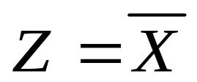
Logical Operations
The three basic logical operations are:
  AND OR NOT
AND is denoted by a dot (·) or symbol (∧).
OR is denoted by a plus (+) or symbol (v).
NOT is denoted by an overbar ( ¯ ), a single quote mark (') after, or (~) before the variable.

Slide 8
Basic Logic Gates
Basic Logic Gates
Logic gates are electronic circuits that operate on one or more input signals to produce an output signal. Electrical signals such as voltages or currents in a digital system represent value 1 or 0.
logic gate
  Basic circuit of integrated circuits. Need not to concerned with the internal electronics properties, but with their external logic properties.
  Intermediate region
  Transition (Edge triggered)
  Delay

Slide 9
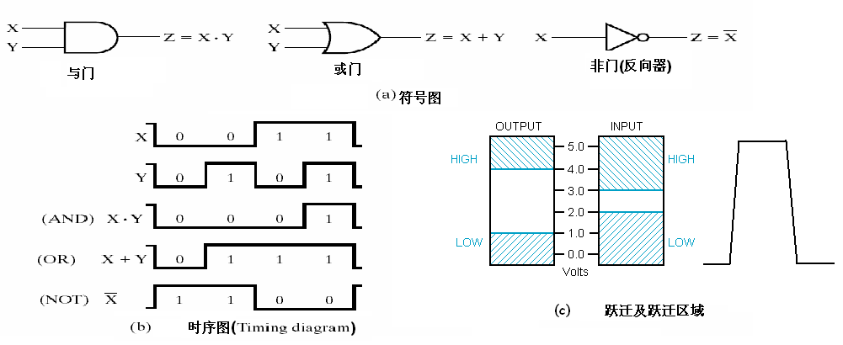
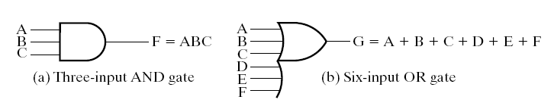
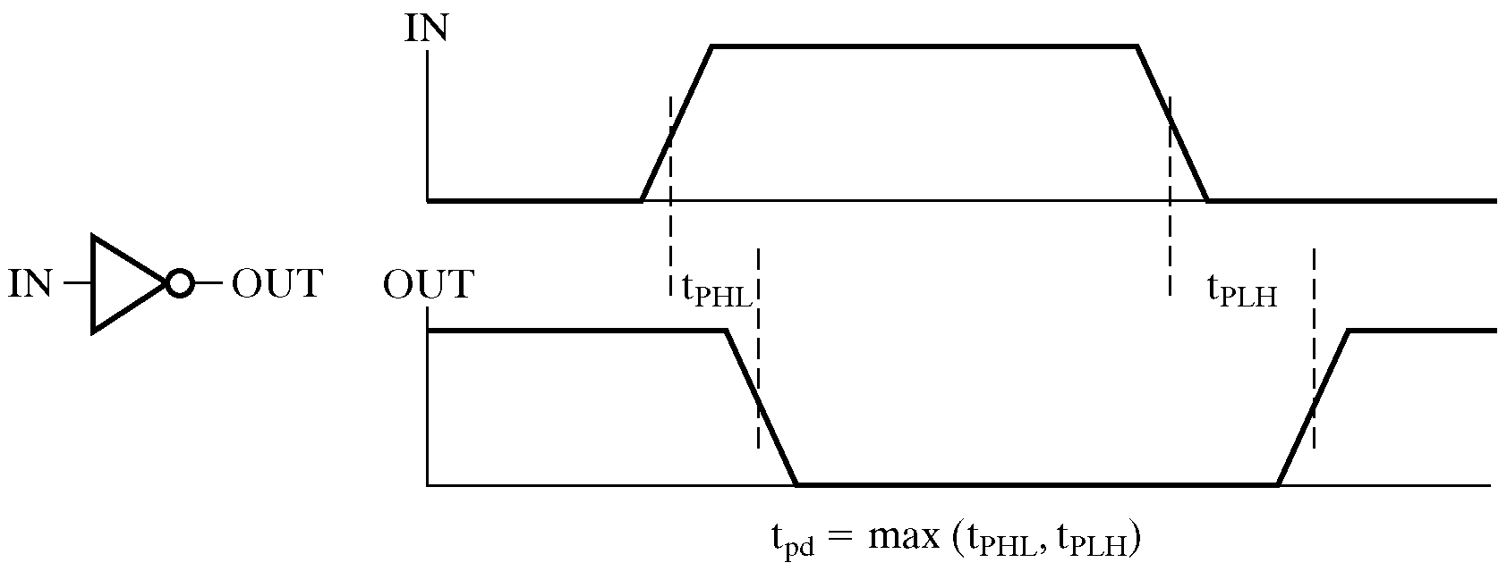
Figure 2-1: Digital Logic Gates
Figure 2-2: Gates with More than Two Inputs

Slide 10
Operation ‘AND’
When a statement is true, it means that all the conditions of this statement must be true. And the above logic is called logic ‘AND’.
In logic algebra, ‘AND’ operation is used to describe the logic ‘AND’. The symbol used for AND is the same as that used for multiplication in binary arithmetic.
The operation is represented by a dot (‘⋅’), ‘∩’ or by the absence of an operator:
  F＝A ⋅ B ；F=AB；F=A×B； F=A∩ B
  F is true, iff A and B are both true.

Slide 11
True Table for AND Logical Operation
A B L
F F F
F T F
T F F
T T T
A B L
0 0 0
0 1 0
1 0 0
1 1 1
F⋅ F = F T ⋅ F = F
F ⋅ T =F T ⋅ T = T
0⋅ 0 = 0 0⋅ 1 = 0 1⋅ 0 = 0 1⋅ 1 = 1
Rule of Logical AND Operation:
In digital system, the circuit that produces the
equivalents of AND operation is called AND gate

Slide 12
Graphics Symbol for Logic AND
A
B
Logic event: AND
L ＝A ⋅ B
A
B
C
&
F=ABC
A B
General logic symbol
Logical symbol in GB

Slide 13
Operation OR
If an event can be triggered by many conditions, then the happening of any condition means that the event occurs. And the above logic is called logic OR.
In logic algebra, ‘OR’ operation is used to describe the logic ‘OR’. The symbol used for OR is the same as that is used for addition in binary arithmetic.
The operation is represented by a ‘+’ or ‘∪’
  F=A+B or F=A∪B
  F is true if either A or B is True

Slide 14
True Table for OR Logical Operation
A | B | F
L | L | L
L | H | H
H | L | H
H | H | H
A | B | F
0 | 0 | 0
0 | 1 | 1
1 | 0 | 1
1 | 1 | 1
Rule of Logical OR Operation:
F+ F = F; T+ F = T
F + T =T; T+ T = T
0+0= 0 0+1 = 1 1+0 = 1 1+1 = 1
In digital system, the circuit that produces the
equivalents of OR operation is called OR gate

Slide 15

Graphics Symbol for Logic OR
A
B
F ＝A+ B
Logic event: OR
+
A
B
C
F=A+B+C
A B
Logical symbol in GB
General logic symbol

Slide 16
Operation NOT
If the happening of an event depends on whether the negative of a condition, this type of logic is called logic NOT.
In logic algebra, ‘NOT’ operation is used to describe the logic ‘NOT’. The NOT operator is also referred to as the complement operation, since it changes a 1 to 0 and a 0 to 1.
The operation is represented by a ‘－’, ‘¬’
F=A or F= ¬A
read “F is equal to NOT A”
F is True if A is false, and F is false if A is true

Slide 17
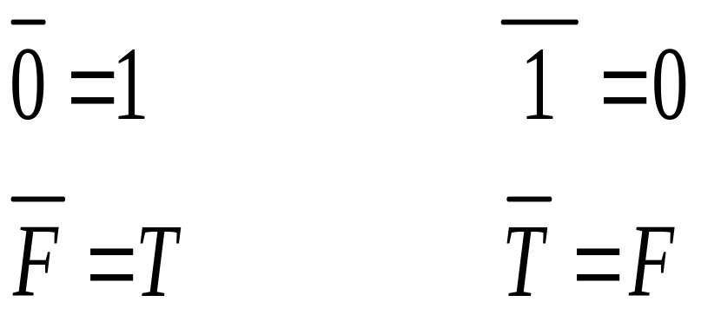
True Table for NOT Logical Operation
A F
L H
H L
A F
0 1
1 0
Rule of Logical NOT Operation:
In digital system, the circuit that produces the
equivalents of NOT operation is called NOT gate

Slide 18
Graphics Symbol for Logic NOT
always closed switch
A
F=A
F=A
F ＝A
Circuit for Logic NOT
1
1
A
A
A
A
General logic symbols
Logical symbol in GB

Slide 19
Logic Function Implementation
What’s the logic function of the following circuits?
L(A, B, C, D) =
Useful model for relay circuits and for CMOS gate circuits, the foundation of current digital logic technology
A
B
C
D

Slide 20
Logic Gates
In the earliest computers, switches were opened and closed by magnetic fields produced by energizing coils in relays. The switches in turn opened and closed the current paths.
Later, vacuum tubes that open and close current paths electronically replaced relays.
Today, transistors are used as electronic switches that open and close current paths.

Slide 21
About CMOS
CMOS
  Complementary Metal Oxide Semiconductor
high noise immunity and low static power consumption, complicated producing process
Three terminals of CMOS：
  g gate
  d drain
  s source
Features:
V_{gs} > Threshold, d-s unblocked (low resistance)
V_{gs}< Threshold, d-s blocked (high resistance)
d
g
s

Slide 22
Implementation of Logic Gates
Implementation of logic gates with transistors (See Reading Supplement − CMOS Circuits)
+V
+V
•
•
•
•
+V
• •
X
.
Y
•
F
•
•
•
X
X
•
G = X +
Y
•
X
•
X
•
Y
•
Y
•
•
(a) NOR
(b) NAND
(c) NO
T
Transistor or tube implementations of logic functions are called logic gates or just gates
Notes:
The transistor without the “bubble” on its input is an N-type field effect
transistor. It acts like a closed switch between its top and bottom terminals
with an H (1) applied to its input on its left. It acts like an open switch with
an L (0) applied to its input. The transistor with the “bubble” on its input is a
P-type field effect transistor. The +V at the top provides an H (1) and the
Ground symbol at the bottom provides an L (0). By modeling the two types
of field effect transistors as switches, one can see how the series and
parallel interconnections can produce 1’s and 0’s on the outputs on the
right in response to applied 1’s and 0’s on the inputs on the left. NOR and
NAND are OR and AND, each followed by a NOT respectively.

Slide 23
Part 1
Binary Logic and Gates
  Binary Logic
  Logic Gates
Boolean Algebra
  Basic Identities of Boolean Algebra
  Algebraic Manipulation
  Complement of a Function
Standard Forms
  Minterms and Maxterms
    Sum of minterms (SOM)
    Product of maxterms (POM)
  Sum of Products (SOP)
  Product of Sums (POS)

Slide 24
Basic Concepts of Boolean Algebra
Boolean algebra is also known as logic algebra or switching algebra.
  An algebra dealing with binary variables and logic operations
  Fundamental in the development of computer science and digital logic
    Logic variables take on one of two values. We use 1 and 0 (or True and false) to denote the two values.
      the value of variables is not comparable, and it only represents the state of an event.
      For example, logic 1 may indicate switch is closed and logic 0 for switch open
    Three basic logic operations: AND, OR and NOT

Slide 25
Definition of Boolean Function
Definition of Boolean Function!!!
Define that X₁, X₂, …, X_{n} are input signals of some logic circuit and F is the output signal. Once the input signals X₁, X₂, …, X_{n} are fixed, the output signal is fixed as well. F is called the Boolean function of X₁, X₂, …, X_{n.} The Boolean equation representing function F is
F=f (X₁, X₂, …, X_{n})
Note that: if we have X+Y=X+Z or XY=XZ, it doesn’t mean we have Y=Z

Slide 26
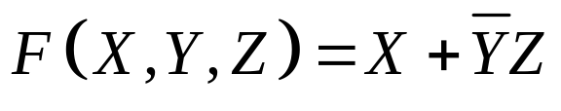
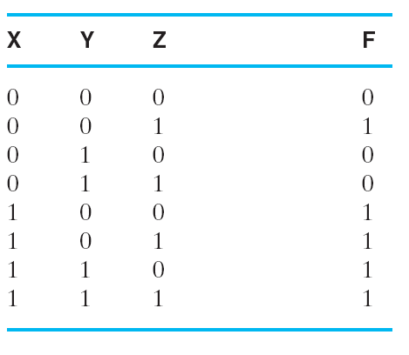
Expression of Boolean Function
Boolean expression is an algebraic expression formed by using binary variables, the constants 0 and 1, the logic operation symbols, and parentheses.
  A Boolean function can be described by no less than one Boolean equation
There are Single-output Boolean function and Multiple-output Boolean function. And Multiple-output Boolean function has more than one function for the output signals.
  A Boolean function can also be
  described by truth table.
    The truth table is unique!
Table 2-2 Truth Table for the Function F

Slide 27

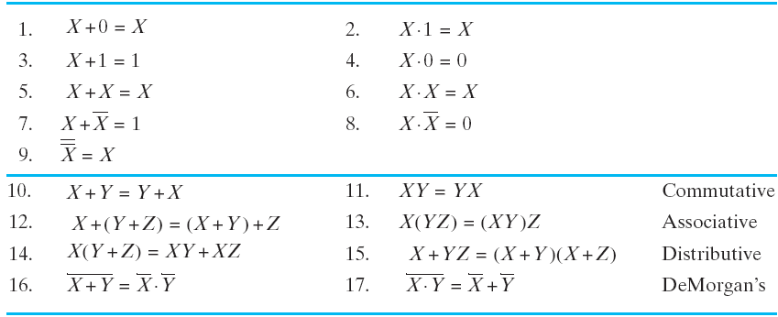








Some Properties of Identities & the Algebra
1. Basic Identities
For the Simplification of Boolean Expression
0－1 law
Overlapping law
Complementary law
Involution law
Commutative law
Associative law
Distributive law
DeMorgan’s law
18
Absorptive law
Including law
Table 2-3: Basic Identities of Boolean Algebra

Slide 28
Equivalence of Boolean Function
For the following Boolean functions:
F₁=f₁ (X₁, X₂, …, X_{n})
F₂=f₂ (X₁, X₂, …, X_{n})
If Any input signal values of X₁, X₂, …, X_{n,} produces the same outputs F₁ and F_{2,} Then we say that F₁ and F₂ are equal:
F₁= F₂

Slide 29
Complement of a Function
F, the complement of a function F, is obtained from an interchange of 1’s to 0’s and 0’s to 1’s for the values of F in the truth table.
Use DeMorgan's Theorem to complement a function:
    Interchange AND and OR operators
    Complement each constant value and literal
Example: the complement of function
F＝AB＋CD
F＝(A+B) ⋅(C+D)

Slide 30



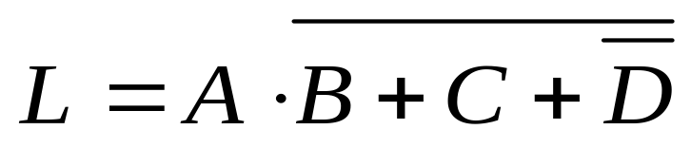
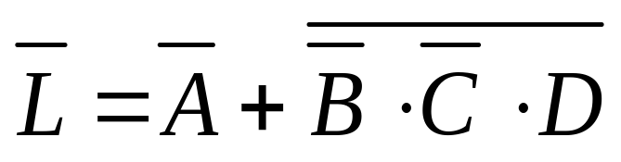
Note that on Complementing Functions:
① Keep Operator precedence, and add parentheses when necessary
② Do not complement terms
Example 1:
Example 2:

Slide 31
Duality Principle
F’, the dual of a function F, is obtained from interchanging AND and OR operations and 1’s and 0’s. Do not complement the variables in expression!!!
Keep Operator precedence
If F’ is dual of F, F is dual of F’ as well. F and F’ are duals for each other.
If F and G are equal, F’ and G’ are equal as well.

Slide 32
Substitution Rule
Any Boolean function containing literal A equals function with A replaced by equivalence of A.
Example:
For function X(Y+Z)=XY+XZ, if we have X+YZ=X, then (X+YZ) (Y+Z)=(X+YZ)Y+(X+YZ)Z
Similarly,
f (X₁, X₂, …, X_{n})＋f (X₁, X₂, …, X_{n})＝1

Slide 33
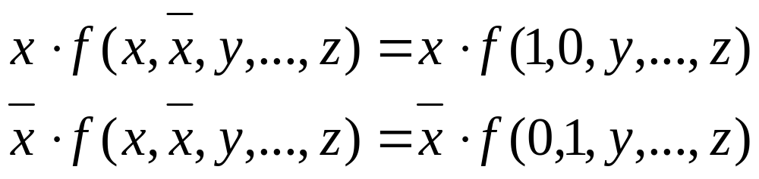
Additional Formula
Formula 1：
Extension of X∙X=0 and X ∙ X=X

Slide 34
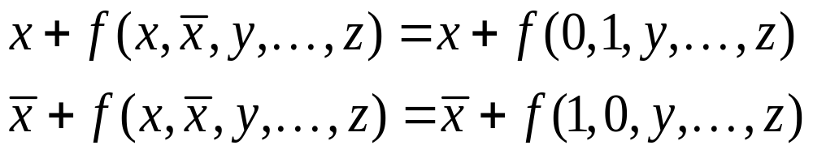
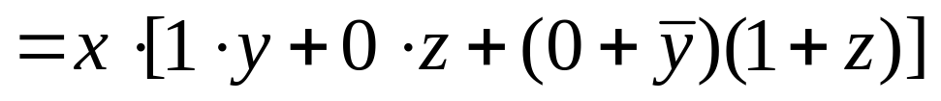
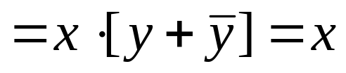
Similarly, according to A+A=1, A+AB=A+B and A+AB=A, we have:
Simplify Expression with Formula 1:

Slide 35
Formula 2：For a function containing literal x and x
f(x,x,y…z)= x∙f(x,x,y,…z)+x∙f(x,x,y…z)
= xf(1,0,y,…z)+xf(0,1,y…z)
Similarly, dual of the f is as follows:
f(x,x,y,..z)=[x+f(0,1,y…z)]∙[ x+f(1,0,y,…z)]
Applying formula 1 and formula 2 in simplification:
f(x₁,x₂,x₃)=x₁x₂x₃f(1,1,1)+ x₁x₂x₃f(1,1,0)
+ x₁x₂x₃f(1,0,1)+ x₁x₂x₃f(1,0,0)
+ x₁x₂x₃f(0,1,1)+ x₁x₂x₃f(0,1,0)
+ x₁x₂x₃f(0,0,1)+ x₁x₂x₃f(0,0,0)

Slide 36
Part 1
Binary Logic and Gates
  Binary Logic
  Logic Gates
Boolean Algebra
  Basic Identities of Boolean Algebra
  Algebraic Manipulation
  Complement of a Function
Standard Forms
  Minterms and Maxterms
    Sum of minterms (SOM)
    Product of maxterms (POM)
  Sum of Products (SOP)
  Product of Sums (POS)

Slide 37
2.3 Standard Forms
A Boolean function expressed algebraically can be written in a variety of ways.
It is useful to specify Boolean functions in a form that:
  Allows comparison for equality.
  Has a correspondence to the truth tables
Standard Forms in common usage:
  Contains product terms and sum terms
  Sum of Minterms (SOM)
  Product of Maxterms (POM)

Slide 38
Minterms
  Minterms are AND terms with every variable present just once in either true or complemented form.
  Given that each binary variable may appear normal (e.g., x) or complemented (e.g., x), there are 2^{n} Minterms for n variables.
Properties of Minterms:
It represents exactly one combination in truth table
Product of any two Minterms is 0. m_{i} ∙m_{j}=0, i≠j
Sum of all Minterms is 1. Σm_{i}=1, i=0~2^{n}-1
Each Minterm is either in function F or in the function’s complement F

Slide 39
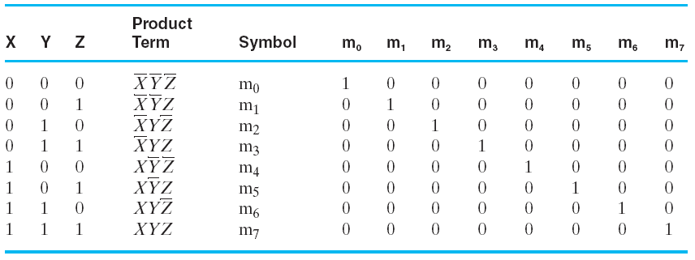
Minterms for Three Variables
Table 2-6: Minterms for Three Variables

Slide 40
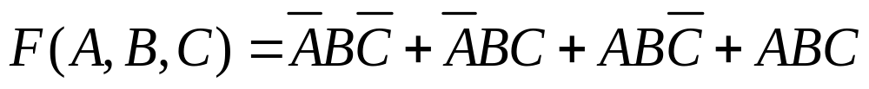
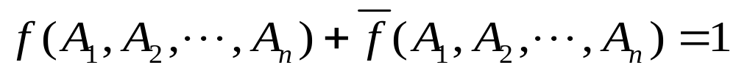
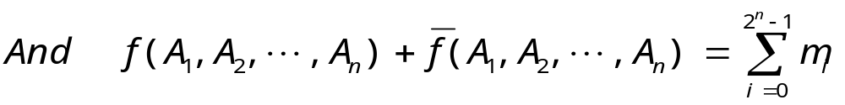
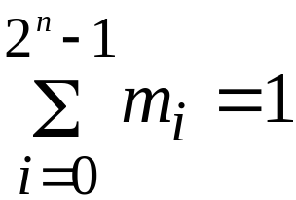
Any Boolean Function can be expressed by sum of Minterms
Example:
=m₂+ m₃+ m₆+ m₇
=Σ m³(2, 3, 6, 7)
Since:
Thus
Confirm Property 3

Slide 41
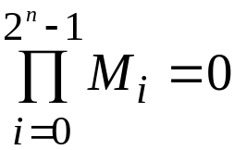
Maxterms
  Maxterms are OR terms with every variable appearing just once in true or complemented form.
  Given that each binary variable may appear normal (e.g., x) or complemented (e.g., x), there are 2^{n} maxterms for n variables.
Properties of Maxterms:
only one combination in truth table produces 0 result
Sum of any two Maxterms is 1. M_{i}+M_{j}=1, i≠j
Product of all Maxterms is 0.
Each Maxterm is either in function F or in the function’s complement F

Slide 42
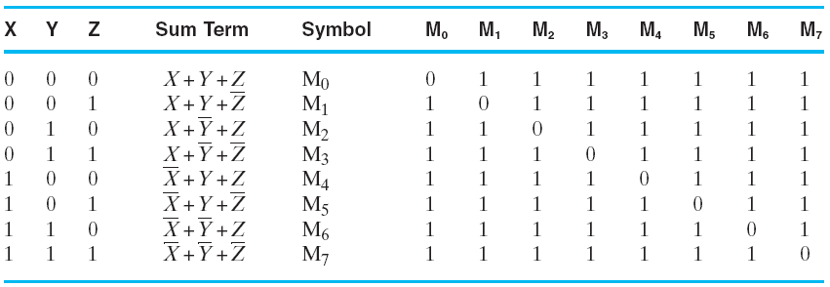
Maxterms for Three Variables
Table 2-7: Maxterms for Three Variables

Slide 43
Maxterms and Minterms
1) M_{i} and m_{i} are complementary for each other.
M_{i}=m_{i} and m_{i}=M_{i}
Example: m₃ = A B C and M₃=A+B+C
2) Boolean Function F = Σm_{i} = ПM_{i}

Slide 44

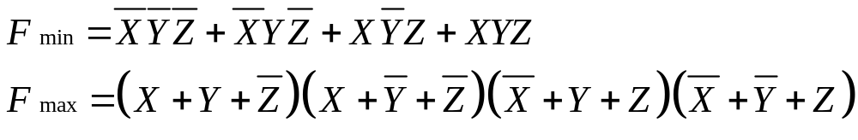
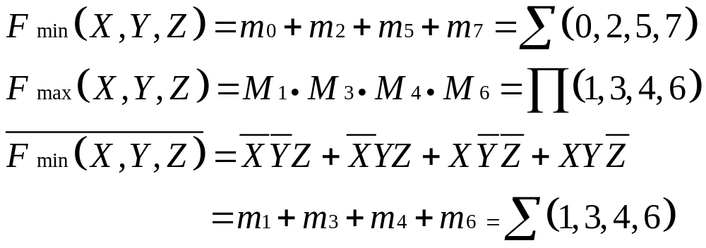
Example: Describe Minterms and Maxterms with Truth Table
X | Y | Z |  | F
0 | 0 | 0 |  | 1 | 0
0 | 0 | 1 |  | 0 | 1
0 | 1 | 0 |  | 1 | 0
0 | 1 | 1 |  | 0 | 1
1 | 0 | 0 |  | 0 | 1
1 | 0 | 1 |  | 1 | 0
1 | 1 | 0 |  | 0 | 1
1 | 1 | 1 |  | 1 | 0
Minterms
Maxterms

Slide 45
Standard Forms
Sum-of-Products (SOP) form: equations are written as an OR of AND terms
Product-of-Sums (POS) form: equations are written as an AND of OR terms
Examples:
  SOP:
  POS:
These “mixed” forms are neither SOP nor POS
A
B
C
+
A
B
C
+
B
(A
+
B)
·
(A
+
B
+
C
)
·
C
(A
B
+
C)
(A
+
C)
A
B
C
+
A
C
(A
+
B)

Slide 46
Sum-of-Products (SOP)
A Simplification Example:
Writing the minterm expression:
F = A’B’C + AB’C’ + AB’C + ABC’ + ABC
Simplifying:
F = A’B’C + AB’(C’ + C) + AB(C’ + C)
= A’B’C + AB’ + AB
= A’B’C + A
= B’C + A
Simplified F contains 3 literals compared to 15 in minterm F

Slide 47
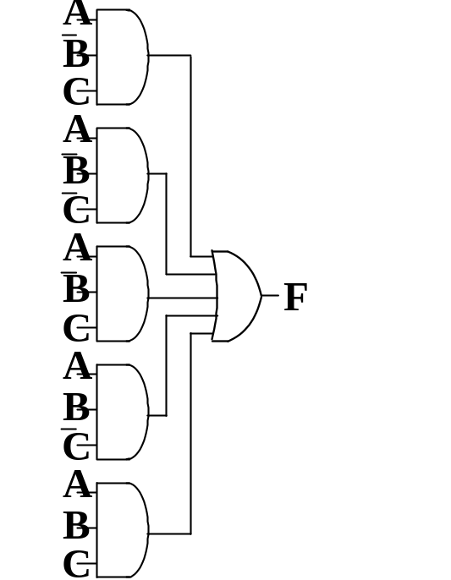
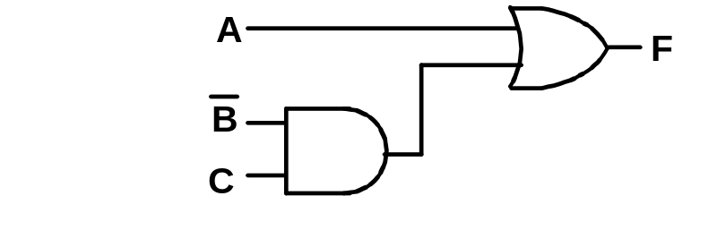
Two-level Implementation of SOP Expression
The two implementations for F are shown below – it is quite apparent which is simpler!

Slide 48
SOP and POS Observations
The previous examples show that:
  Standard Forms (Sum-of-minterms, Product-of-Maxterms), or other standard forms (SOP, POS) differ in complexity
  Boolean algebra can be used to manipulate equations into simpler forms.
  Simpler equations lead to simpler two-level implementations
Questions:
  How can we attain a “simplest” expression?
  Is there only one minimum cost circuit?
  The next part will deal with these issues.

Slide 49
Overview
Part 1 – Gate Circuits and Boolean Equations
  Binary Logic and Gates
  Boolean Algebra
  Standard Forms
Part 2 – Circuit Optimization
  Two-Level Optimization
  Map Manipulation
  Multi-Level Circuit Optimization
Part 3 – Additional Gates and Circuits
  Other Gate Types
  Exclusive-OR Operator and Gates
  High-Impedance Outputs

Slide 50
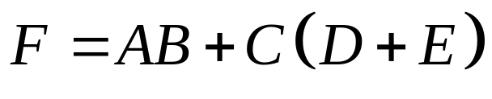
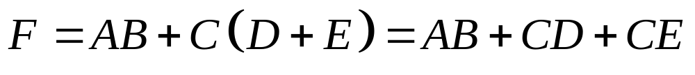
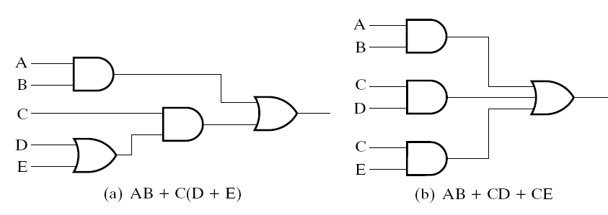
Different Circuit Implementation
Example: Give the two-level circuit of the Boolean function with AND gates and OR gates.
Figure 2-6 Three-Level and Two-Level Implementation

Slide 51
Circuit Optimization
Goal: To obtain the simplest implementation for a given function
Optimization is a more formal approach to simplification that is performed using a specific procedure or algorithm
Optimization requires a cost criterion to measure the simplicity of a circuit
Two distinct cost criteria we will use:
  Literal cost (L)
  Gate input cost (G)
  Gate input cost with NOTs (GN)

Slide 52
Literal Cost
Literal – a variable or its complement
Literal cost – the number of literal appearances in a Boolean expression corresponding to the logic circuit diagram
Examples:
  F = BD + ABC + ACD L = 8
  F = BD + ABC + ABD + ABC L =
  F = (A + B)(A + D)(B + C + D)(B + C + D) L =
  Which solution is the best?
Notes:
2nd Literal Cost = 11
3rd Literal Cost = 10
The first solution is best

Slide 53
Literal Cost
Another Example:
  F = ABCD+ABCD
  F = (A + B)(B + C)(C + D)(D + A)
  Which one is better?

Slide 54
Gate Input Cost
Gate input costs - the number of inputs to the gates in the implementation corresponding exactly to the given equation or equations. (G - inverters not counted, GN - inverters counted)
For SOP and POS equations, it can be found from the equation(s) by finding the sum of:
  all literal appearances
  the number of terms excluding terms consisting only of a single literal,(G) and
  optionally, the number of distinct complemented single literals (GN).
Example:
  F = BD + ABC + ACD G = 11, GN = 14
  F = BD + ABC + ABD + ABC G = , GN =
  F = (A + B)(A + D)(B + C + D)(B + C + D) G = , GN =
  Which solution is the best?
Notes:
G = 15, GN = 18 (second value includes inverter inputs)
G = 14, GN = 17
1st solution is best

Slide 55
Cost Criteria (continued)
GN = G + 2 = 9
Example 1:
F = A + B C +
L = 5
C
B
G = L + 2 = 7
B
C
A
F
L (literal count) counts the AND inputs and the single literal OR input.
G (gate input count) adds the remaining OR gate inputs
GN(gate input count with NOTs) adds the inverter inputs

Slide 56
Cost Criteria (continued)
A
Example 2:
F = A B C +
L = 6 G = 8 GN = 11
F = (A + )( + C)( + B)
L = 6 G = 9 GN = 12
Same function and same
literal cost
But first circuit has less
gate input count and less
gate input count with NOTs
Select it!
B
C
B
A
C
F
C
B
A
A
B
C
F

Slide 57
Expression Simplification
Generally, the simpler of a Boolean function, the simpler of the implemented circuit. Expression Simplification is to simplify a Boolean expression to contain the smallest number of literals (complemented and uncomplemented variables).
Basic methods:
  Rules and principles
  Karnaugh Map
  Q-M

Slide 58



“AND - OR” Simplification
Two conditions:
① The number of product terms in expression is minimized
② With ① satisfied, the number of literals in every product term is minimized

Slide 59

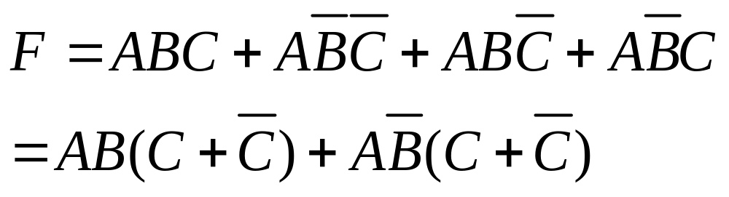
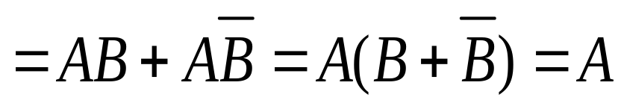
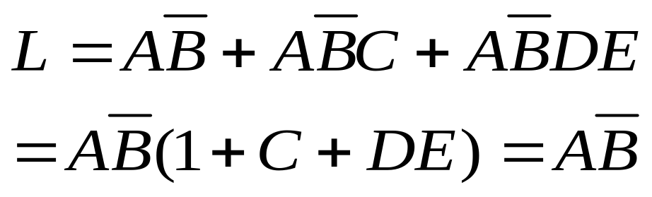
Several Methods
(1) Merge Terms
Applying Formula:
(2) Absorb Terms
Applying Absorptive law: A+AB=A

Slide 60
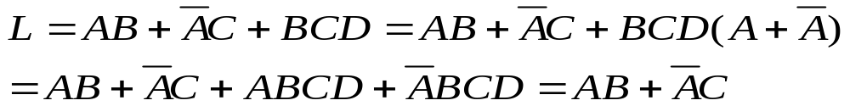
(3) Match Terms
Applying Formula: A+A=1, AA=0, add new terms
(4) Eliminate Terms
Applying Absorptive law: A+AB=A+B

Slide 61
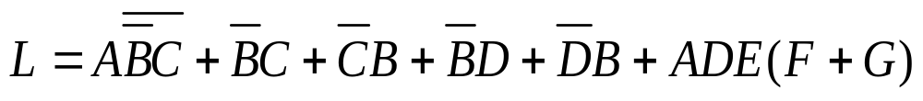
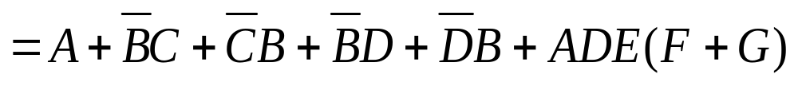

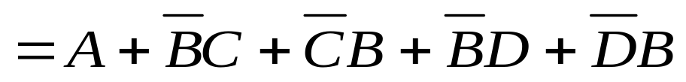
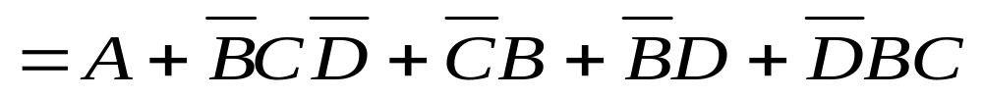
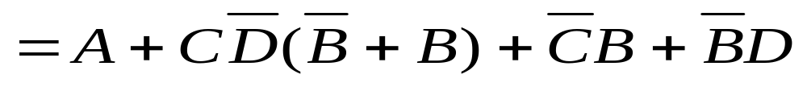
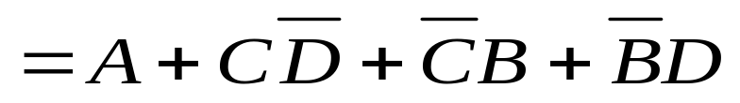
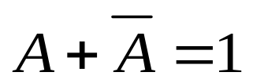
Simplification Example
(DeMorgan’s law)
( )
(A+AB=A)
(Match Terms)
(A+AB=A)
( )

Slide 62
“OR - AND” Simplification
Two conditions:
① The number of sum terms in expression is minimized
② With ① satisfied, the number of product terms in every sum term is minimized
Solution:
1. Obtain the dual of “OR - AND” expression, which is “AND - OR” expression.
2. Simplify the “AND - OR” expression
3. Obtain the dual of simplified “AND - OR” expression again

Slide 63
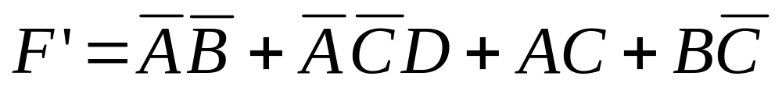
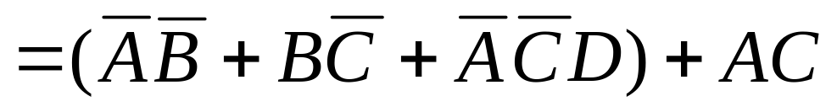
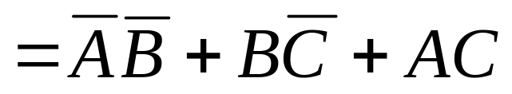
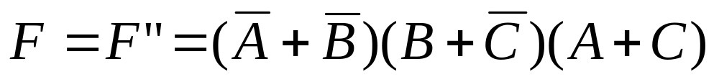
Example:
Dual:
Obtain Dual again

Slide 64
Karnaugh Maps (K-map)
Commonly used in Two-Variable, Three-Variable and Four-Variable Boolean functions
  Graphical representation of a Boolean function
      Simple, intuitive, easy to grasp
Widely used in logic design
Basic ideas:
    AND-OR Expression
    Complementary law: A+A’=1, and A·1 = A

Slide 65
Karnaugh Maps (K-map)
A K-map is a collection of squares (2^{K}). And each square represents a Minterm. Adjacent squares differ in the value of one variable.
  Alternative algebraic expressions for the same function are derived by recognizing patterns of squares.
  Since a Boolean function is sum of Minterms, it can also be expressed by sum of the squares.

Slide 66
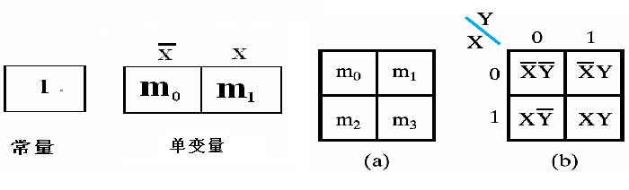
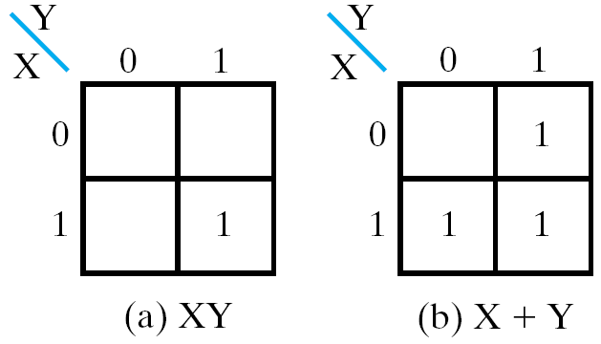
Two-Variable Map
Figure 2-8: Two-Variable Map
Figure 2-9: Representation of Functions in the Map

Slide 67
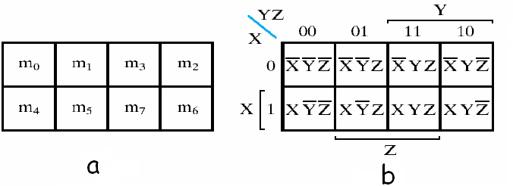
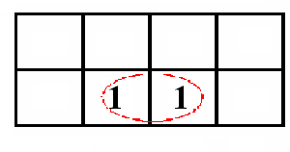
Three-Variable Map
2³ Minterms, consist of 8 squares
y
y
x
0
1
3
2
x
4
5
7
6
z
z
z
Figure 2-10: Three-Variable Map
Example

Slide 68
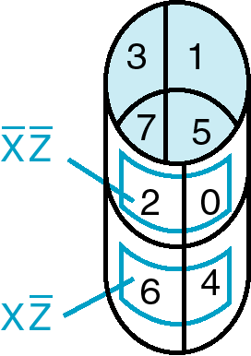
Three-Variable Maps
Topological warps of 3-variable K-maps that show all adjacencies:
  Venn Diagram  Cylinder
0
X
4
6
5
7
Y
3
Z
2
1

Slide 69
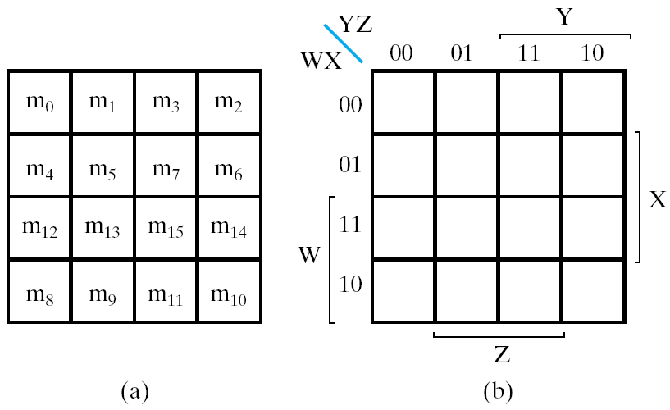
Four-Variable Map
2⁴ Minterms, consists of 16 squares
i is short for m_{i}
YZ
00 01 11 10
WX
00
01
11
10
0 | 1 | 3 | 2
4 | 5 | 7 | 6
12 | 13 | 15 | 14
8 | 9 | 11 | 10
Figure 2-17: Four-Variable Map

Slide 70
Five-Variable Map
2⁵ Minterms, consists of 32 squares
XYZ
VW
000 001 011 010 110 111 101 100
00
01
11
10
0 | 1 | 3 | 2 | 6 | 7 | 5 | 4
8 | 9 | 11 | 10 | 14 | 15 | 13 | 12
24 | 25 | 27 | 26 | 30 | 31 | 29 | 28
16 | 17 | 19 | 18 | 22 | 23 | 21 | 20

Slide 71
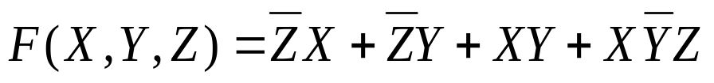
K-Map Function Representation
Squres in K-Map is labeled 1 when the corresponding Minterms are contained in the Boolean function.
Then K-Map Representation for the function is obtained.
Example:
YZ
X
00 01 11 10
K-Map:
01
1
1
1
1
1

Slide 72
Principles of Optimization with K-Map
Since AB+AB=A, two adjacent minterms can be merged into one term to eliminate the redundant variable.
In K-Map, the adjacent squares (each square refer to one minterm in the Boolean function) can be combined in similar way. And the combined squares are called Karnaugh Circles.
Finding adjacent squares is very important in simplification with K-Map.
  The number of adjacent squares in Karnaugh Circles is a power of 2.

Slide 73
Adjacent and Karnaugh Circles
YZ
X
00 01 11 10
X (2 degree)
01
m_{o} m₁ m₃ m₂
m₄ m₅ m₇ m₆
XY (1 degree)
XY (1 degree)
Y (2 degree)
XZ (1 degree)
1-degree with 1 redundant variable eliminated
2-degree with 2 redundant variable eliminated
N-degree with N redundant variable eliminated

Slide 74
Combining Squares for Two-Variable Map
Y
Y
Y
0 1
0 1
0 1
X
X
X
01
01
1 1
01
1
1 1
1 1
Typical cases in combining squares for Two-Variable Map

Slide 75
Combining Squares for Three-Variable Map
YZ
XY
00 01 11 10
X
00 01 11 10
X
01
1 1
1 1
01
1 1 1 1
YZ
X
00 01 11 10
01
1 1 1 1
1 1 1 1
Typical cases in combining squares for Three-Variable Map

Slide 76
Combining Squares for Four-Variable Map
ZW
ZW
XY
00 01 11 10
XY
00 01 11 10
0001
11
10
1
1
0001
11
10
1
1
1
1
1
1
1
1
1
1
1
1
ZW
1
1
XY
00 01 11 10
0001
11
10
1
1
1
1
1
1
1
1
1
1
Typical cases in combining squares for Four-Variable Map

Slide 77
Simplification with K-Map
Expression with minterms
Truth Table
Entering values into the map
Step 1: Minterms of function
Step 2: K-Map
Step 3: Find the Largest Implicant
One or more minterms included in an implicant
No minterm left
Step 4: Eliminate the redundant variables

Slide 78
Essential Prime Implicant
Implicant: squares in the map
  product term obtained by combining adjacent squares in the map into a rectangle with the number of squares a power of 2.
A Prime Implicant is a product term obtained by combining the maximum possible number of adjacent squares in the map into a rectangle with the number of squares a power of 2.
A prime implicant is called an Essential Prime Implicant if it is the only prime implicant that covers (includes) one or more minterms.

Slide 79
Example of Essential Prime Implicant
Find all Prime Implicants
CD
Essential Prime Implicant
C
C
B
D
B
D
1
1
1
1
1
1
BD
1
1
BD
1
1
B
B
1
1
1
1
A
A
1
1
1
1
1
1
1
1
A
B
D
D
AD
Minterms covered by single prime implicant
B
C

Slide 80


Simplification with K-Map
Example: Simplify the Boolean function with K-Map
Prime Implicant
Figure 2-14: Maps for Example 2-4

Slide 81





Simplification with K-Map
Example: Simplify the
Boolean function with K-Map
Figure 2-15
Figure 2-16

Slide 82
Three-Variable Map Simplification
Use a K-map to find an optimum SOP equation for
Notes:
F = Z’ + X’ Y’ + X Y

Slide 83





Simplification with K-Map
Example: Simplify the Boolean function with K-Map
Figure 2-19: Map for function F(W,X,Y,Z)
Figure 2-19: Map for function F(A,B,C,D)

Slide 84
Four-Variable Map Simplification
F(W,
X,
Y,
Z)
=
Σ
(0,
2,4,5,6,7,
8,10,13,15)
m
Notes:
F = XZ + X'Z'

Slide 85



Maxtems in K-Map
In previous examples, K-MAP with minterms is used to simplify the Boolean functions.
Maxterms can also be applied in optimization: maxterms are concerned in K-Map
POS Expression:
Figure 2-24: Map for Function F(A,B,C,D)

Slide 86




Maxtems in K-Map: Complement
POS Expression
The Complement
Merge “1”:
Merge ”0”:
Thus:
This is already the simplest expression
CD
 | 00 | 01 | 11 | 10
00 | 0 | 1 | 1 | 0
01 | 1 | 1 | 1 | 1
11 | 0 | 0 | 1 | 1
10 | 0 | 1 | 1 | 0
AB

Slide 87
Don’t-Care Conditions
Sometimes a function table or map contains entries for which it is unknown:
    the input values for the minterm will never occur, or
    The output value for the minterm is not used
In K-Map, “×”and “d” are used to represent Don’t-Cares.
By placing “don't cares” ( an “x” entry) in the function table or map, the cost of the logic circuit may be lowered.

Slide 88




Example of Don’t-Cares in K-Maps
Example:
Also possible to obtain an optimized POS expression for the function, which combines the 0’s.
Figure 2-25 Example with Don’t-Care Conditions

Slide 89
Multiple-Level Circuit Optimization
Multiple-level circuits can have reduced gate input cost compared to two-level (SOP and POS) circuits
  Reduce cost of input
Multiple-level optimization
  Cost
  Circuit implementation limitation

Slide 90
Transformations
Factoring - finding a factored form from SOP or POS expression
Decomposition - function expression as a new functions
Substitution of G into F - expression function F as a function of G and some or all of its original variables
Elimination
Extraction

Slide 91

Optimization Example
Optimize the function through transformations, and reduce the gate input cost.
Example: Optimize these multi-level Boolean functions:
(a) gate input cost: 17;
(b) gate input cost: 13;
(c) gate input cost: 12;
(d) gate input cost: 9

Slide 92
Overview
Part 1 – Gate Circuits and Boolean Equations
  Binary Logic and Gates
  Boolean Algebra
  Standard Forms
Part 2 – Circuit Optimization
  Two-Level Optimization
  Map Manipulation
  Multi-Level Circuit Optimization
Part 3 – Additional Gates and Circuits
  Other Gate Types
  Exclusive-OR Operator and Gates
  High-Impedance Outputs

Slide 93
Other Gate Types
Why?
  Implementation feasibility and low cost
  Power in implementing Boolean functions
  Convenient conceptual representation

Slide 94
Other Gate Types
Primitive gate - a gate that can be described using a single primitive operation type (AND or OR) plus an optional inversion(s).
  AND, OR, NOT, NAND, NOR …
Complex gate - a gate that requires more than one primitive operation type for its description
  Example: Exclusive-OR (XOR), Exclusive-NOR (XNOR), AND-OR-INVERT (AOI) …
Truth table and logic symbols of above circuits are as follows

Slide 95

Other Gate Types
1. Graphics symbol and truth table for primitive gates
Primitive gate is simple and fast
Figure 2-28: primitive Digital Logic Gates

Slide 96
Buffer
A buffer is a gate with the function
F = X
In terms of Boolean function, a buffer is the same as a connection!
So why use it?
  A buffer is an electronic amplifier used to improve circuit voltage levels
  To increase the speed of circuit operation.
X
F

Slide 97
NAND Gate
The basic NAND gate has the following symbol, illustrated for three inputs:
  AND-Invert (NAND)
NAND represents NOT AND, i. e., the AND function with a NOT applied. The symbol shown is an AND-Invert. The small circle (“bubble”) represents the invert function.
X
Y
F
(
X
,
Y
,
Z
)
=
X
Y
Z
Z

Slide 98
NAND Gates (continued)
Applying DeMorgan's Law gives Invert-OR (NAND)
This NAND symbol is called Invert-OR, since inputs are inverted and then ORed together.
AND-Invert and Invert-OR both represent the NAND gate. They both makes visualization of circuit function easier.
A NAND gate with one input degenerates to an inverter.
X
Y
F
(
X
,
Y
,
Z
)
=
X
+
Y
+
Z
Z

Slide 99
NAND Gates (continued)
Note that
NAND equals NOT-OR
But they have different meanings
  NAND：the output is 0 only when all the input is 1
  Not-OR：the output is 1 when any of the input contains 0
X
X
F
Y
F
Y
Z
Z

Slide 100
NAND Gates (continued)
The NAND gate is the natural implementation for the simplest and fastest electronic circuits
Universal gate - a gate type that can implement any Boolean function.
The NAND gate is a universal gate as shown in Figure 2-30 of the text.

Slide 101
NOR Gate
The basic NOR gate has the following symbol, illustrated for three inputs:
  OR-Invert (NOR)
NOR represents NOT - OR,
X
Y
F
(
X
,
Y
,
Z
)
=
X
+
Y
+
Z
Z

Slide 102
NOR Gate (continued)
represents Invert-AND (NOR)
Invert of AND
Note that on analyzing the circuits
  the output is 1 when all the input is 0
  Invert symbol on input indicate that input use 0 as default value
Feature: Same As NAND
X
Y
Z

Slide 103

Other Gate Types
2. Graphics symbols and truth table for complex gates
Complex circuit Lower the cost and transmit time in circuit
Figure 2-29: Complex Digital Logic Gates

Slide 104
Exclusive OR/ Exclusive NOR
The eXclusive OR (XOR) function is an important Boolean function used extensively in logic circuits.
The XOR function may be;
    implemented directly as an electronic circuit (truly a gate) or
    implemented by interconnecting other gate types (used as a convenient representation)
The eXclusive NOR function is the complement of the XOR function
By our definition, XOR and XNOR gates are complement gates.

Slide 105
Truth Tables for XOR/XNOR
X
Y
X
⊕
Y
X
Y
(X
⊕
Y)
Operator Rules:
The XOR function means:
X OR Y, but NOT BOTH
XOR
or X
≡
Y
0
0
0
0
0
1
0
1
1
0
1
0
1
0
1
1
0
0
1
1
0
1
1
1
X
⊕
Y
=
X
Y
+
X
Y
XNOR
X
⊕
Y
=
X
Y
+
X
Y

Slide 106
XOR Implementations
The simple SOP structure:
A implementation with just NAND is:
  What’s the expression?
  What’s the logic graph?
X
X
⊕
Y
=
X
Y
+
X
Y
X
Y
Y
X
X
Y
Y

Slide 107
Application of XOR/XNOR
XOR / XNOR
  Adders / subtractors / multipliers
  Counters / incrementers / decrementers
  Parity generators / checkers

Slide 108

XOR Identities
X
⊕
0
=
X
X
⊕
1
=
X
X
⊕
X
=
0
X
⊕
X
=
1
X
⊕
Y
=
Y
⊕
X
(
X
⊕
Y
)
⊕
Z
=
X
⊕
(
Y
⊕
Z
)
=
X
⊕
Y
⊕
Z
The complement of the odd function is the even function.
Symbol ⊕ can be replaced by other Boolean equivalence.

Slide 109


XOR function extended to 3 or more variables.
Figure 2-31 Maps for Multiple-Variable Odd Functions
Figure 2-32 Multiple-Input Odd Function

Slide 110
Parity Generators and Checkers
Parity Generators and Checkers
Parity bit
  a parity bit added to n-bit code to produce an n + 1 bit code
  Add odd parity bit to generate code words with even parity
  Add even parity bit to generate code words with odd parity
Example: n = 3. Generate even parity code words of length 4 with odd parity generator
(X,Y,Z) = (0,0,1) gives
(X,Y,Z,P) = (0,0,1,1) and E = 0.
Generator: generator parity bit
Checker: check the change of received data, for example:
  If Y changes from 0 to 1 between generator and checker, then E = 1 indicates an error.

Slide 111
Parity Generators and Checkers
Even parity checker in the right circuit
P
  parity generator
  Xyz has odd 1，P=1
  Xyz has even 1，P=0
E
  parity checker
  E=0，OK
  E=1，Error
X
Y
P
Z
X
Y
E
Z
P

Slide 112
Hi-Impedance Outputs
Logic gates introduced thus far
  have 1 and 0 output values
  cannot have their outputs connected together, and
  transmit signals on connections in only one direction.
Imagine:
  What will happen if the gate outputs are connected together?
Cannot Do It！
Hi-Z state - Hi-z，Hiz，HiZ

Slide 113
Hi-Impedance Outputs (continued)
What is a Hi-Z value?
  1 —— high voltage
  0 —— low voltage
  Hi-Z value —— Open circuit，disconnected.
    It is as if a switch between the internal circuitry and the output has been opened.
Hi-Z may appear on the output of any gate, but we restrict gates to:
  a 3-state buffer
  a transmission gate
Feature: each of which has one data input and one control input.

Slide 114
The 3-State Buffer
The 3-State Buffer
  Symbol and truth table
  IN, data input,
  Out， Data Output
  EN, Control input，Enabled.
EN = 0
regardless of the value on IN (denoted by X), the output value is Hi-Z.
EN = 1 OUT = IN
Variations:
  Data input, IN, can be inverted
  Control input, EN, can be inverted
Symbol
IN
OUT
EN
Truth Table
EN
IN
OUT
0
X
Hi-Z
1
0
0
1
1
1

Slide 115


The 3-State Buffer
IN
OUT
EN

Slide 116


Multiplexed Line OL
Figure 2-34 Three-state Buffers Forming a Multiplexed Line OL

Slide 117

Transmission Gates
2. Transmission Gates（TG）
The transmission gate is one of the designs for an electronic switch for connecting and disconnecting two points in a circuit
Figure 2-35 Transmission Gates（TG）

Slide 118

Transmission Gates
Figure 2-36 Transmission Gate Exclusive OR

Slide 119
Assignment
Reading:
  Chapter two
Problems:
  2-1a; 2-2a, c; 2-3a, c; 2-6b, d; 2-10a, c; 2-11a, c, d; 2-12b;
  2-15; 2-17b; 2-19a; 2-22a; 2-25b; 2-29; 2-30;2-31c

Slide 120
Thank You !

