Slide 1
Logic and Computer Design Fundamentals
Chapter 3 Combinational Logic Design
Haifeng Liu
haifengliu@zju.edu.cn
College of Computer Science and Technology, Zhejiang University

Slide 2
Overview
  Part 1 -- Design Concepts and Procedure
    Combinational Circuit Design
    Combinational Circuit Analysis
  Part 2 – Functional Blocks
  Rudimentary logic functions
  Decoding
  Encoding
  Selecting
  Part 3 – Hardware Implementation
    Design Space
    Programmable logic technology

Slide 3
Part 1
  Design Concepts and Automation
    Fundamental concepts of design and computer-aided design techniques
  Design Procedure
    The major design steps: specification, formulation, optimization, technology mapping, and verification
  Technology Mapping
    From AND, OR, and NOT to other gate types
  Verification
    Does the designed circuit meet the specifications?
  Combinational Logic Analysis

Slide 4
3.1 Design Concepts and Automation
Logic Circuits
Combinational Logic Circuit
Two Types:
Sequential Logic Circuit
Definition of Combinational Circuit
A combinational circuit consists of logic gates whose output at any time are determined by logic operations on the input values.

Slide 5
Combinational Logic Circuit
A combinational logic circuit has:
  A set of n Boolean inputs,
  A set of m Boolean outputs, and
  m Boolean functions, each mapping the 2^{n} input combinations to an output such that the current output depends only on the current input values
A block diagram:
x₁
Combinational Logic Circuit
F₁
x₂
F₂
…
n Boolean Inputs
…
…
m Boolean Outputs
x_{n}
F_{m}
F_{i}=f_{i}(x₁，x₂，…x_{n})， i=1，2，…，m
(Without any memory devices, feedback loops, one-way transmission of input signal)

Slide 6
Method of Describing Logic Events
S₃ | S₂ | S₁ | F
0 | 0 | 0 | 0
0 | 0 | 1 | 1
0 | 1 | 0 | 1
0 | 1 | 1 | 0
1 | 0 | 0 | 1
1 | 0 | 1 | 0
1 | 1 | 0 | 0
1 | 1 | 1 | 1
S₂ S₁
Truth Table
Boolean Function
Karnaugh Maps
Timing Diagram
Logic Circuit
S₃
00 01 11 10
01
1
1
1
1
S₁
a
F
t_{pd}
S₂
+
d
e
S₃
g
1
2
F
Notes:
波形图：引起跳变和跳变的关系对齐，最好用虚线表示出来

Slide 7
Hierarchical Design
To control the complexity of the function mapping from inputs to outputs:
  Decompose the function into smaller pieces called blocks
  Decompose each block’s function into smaller blocks, repeating as necessary until all blocks are small enough
  Any block that cannot be further decomposed is called a primitive block
  The collection of all blocks including the decomposed ones is a hierarchy
Example: 9-input parity generator (see next slide)
  Top Level: 9 inputs, one output
  2nd Level: Four integrated 3-input odd function blocks
  3rd Level: 3-input odd function circuit as interconnected exclusive-OR blocks
  Primitives: exclusive-OR block as 4 interconnected four NAND gates
  Design requires 4 X 2 X 4 = 32 2-input NAND gates

Slide 8
Hierarchy for 9-Input Parity Checker Example
X
0
X
1
X
2
9-Input
X
3
odd
X
4
Z
O
X
5
function
X
X
6
0
A
0
3-Input
X
7
A
odd
X
8
X
1
1
function
B
O
(a) Symbol for Circuit
X
2
A
2
X
3
A
0
3-Input
A
0
3-Input
X
4
A
1
odd
B
O
A
1
odd
B
O
Z
O
X
A
function
A
function
5
2
2
X
6
A
0
3-Input
X
7
A
1
odd
B
O
X
A
function
8
2
(b) Circuit as interconnected 3-input odd
function blocks
A
0
A
1
B
O
A
2
(c) 3-input odd function circuit as
interconnected exclusive-OR
blocks
(d) Exclusive-OR block as interconnected
NANDs

Slide 9
Reusable Function Blocks and CAD
Whenever possible, we try to decompose a complex design into common, reusable function blocks
These blocks are
  verified and well-documented
  placed in libraries for future use
Representatives of Computer-Aided Design Tools:
  Schematic Capture
  Logic Simulators
  Tools for Timing Verification
  Hardware Description Languages
    Verilog and VHDL
  Logic Synthesizers
  Integrated Circuit Layout

Slide 10
Top-Down versus Bottom-Up
A top-down design proceeds from an abstract, high-level specification to a more and more detailed design by decomposition and successive refinement
A bottom-up design starts with detailed primitive blocks and combines them into larger and more complex functional blocks
Designs usually proceed from both directions simultaneously
  Top-down design answers: What are we building?
  Bottom-up design answers: How do we build it?
Top-down controls complexity while bottom-up focuses on the details
Notes:
Bottom-up: textbook的结构就是一种自底向上的编排，先是讲logic design, 然后是digital system design, 最后是computer design

Slide 11
3.2 Design Procedure
Specification
  Write a specification for the circuit if one is not already available (text, HDL)
Formulation
  Derive a truth table or initial Boolean equations that define the required relationships between the inputs and outputs, if not in the specification
Optimization
  Apply 2-level and multiple-level optimization
  Draw a logic diagram or provide a netlist for the resulting circuit using ANDs, ORs, and inverters

Slide 12
Design Procedure
Technology Mapping
  Map the logic diagram or netlist to the implementation technology selected
Verification
  Verify the correctness of the final design

Slide 13
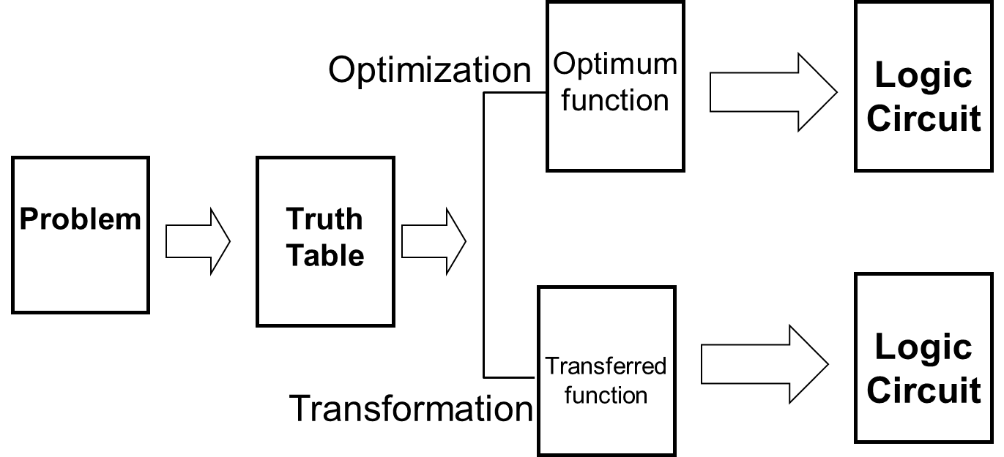
Logic abstraction
assignment

Slide 14
Design Example 1
Example: The only light in the room is controlled by three switches, and each switch can control the light separately. Please design the logic circuit for the light and switches with least gates.
Solutions: 1. Specification
Analysis result:
input signal: switches S₁,S₂,S₃
output signal: light F
“1” for switch closed and “0” for opened
“1” for light on and “0” for light off
Truth table
S₃ | S₂ | S₁ | F
0 | 0 | 0 | 0
0 | 0 | 1 | 1
0 | 1 | 0 | 1
0 | 1 | 1 | 0
1 | 0 | 0 | 1
1 | 0 | 1 | 0
1 | 1 | 0 | 0
1 | 1 | 1 | 1
2. Formulation

Slide 15
S₃ | S₂ | S₁ | F
0 | 0 | 0 | 0
0 | 0 | 1 | 1
0 | 1 | 0 | 1
0 | 1 | 1 | 0
1 | 0 | 0 | 1
1 | 0 | 1 | 0
1 | 1 | 0 | 0
1 | 1 | 1 | 1
3. Optimization
S₂ S₁
S₃
00 01 11 10
01
1
1
1
1
Already optimized
真值表：
Notes:
奇函数，三变量异或

Slide 16
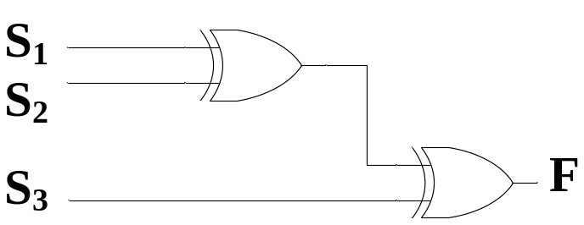
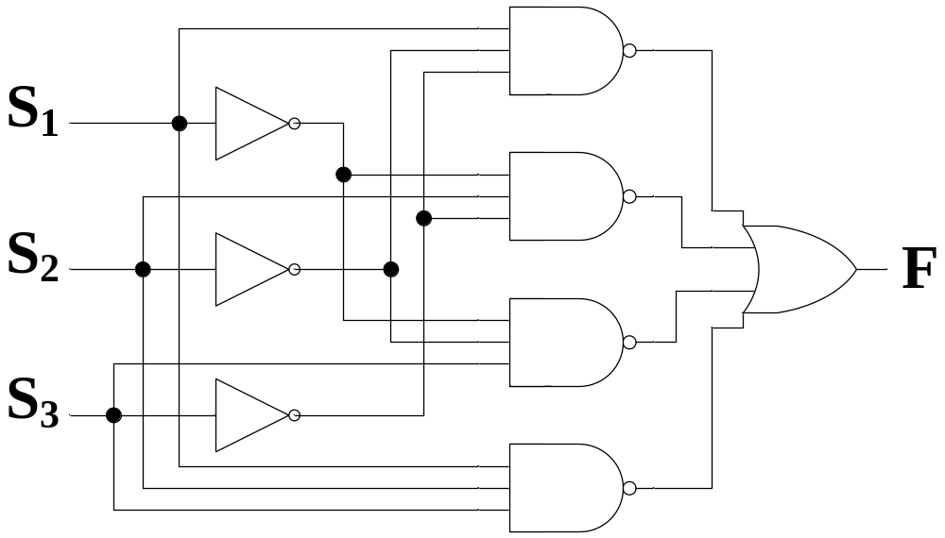
4. Technology Mapping
Least use of gates?

Slide 17
Verilog Programming
module lamp_control(s1,s2,s3,F );
input s1,s2,s3;
output F;
wire s1,s2,s3,f;
assign F= (~s3&~s2&s1) | (~s3&s2&~s1) | (s3&~s2&~s1) | (s3&s2&s1) ;
endmodule

Slide 18
Design Example 2
Specification
  BCD to Excess-3 code converter
  Transforms BCD code for the decimal digits to Excess-3 code for the decimal digits
  BCD code words for digits 0 through 9: 4-bit patterns 0000 to 1001, respectively
  Excess-3 code words for digits 0 through 9: 4-bit patterns consisting of 3 (binary 0011) added to each BCD code word
  Implementation:
    multiple-level circuit
    NAND gates (including inverters)

Slide 19
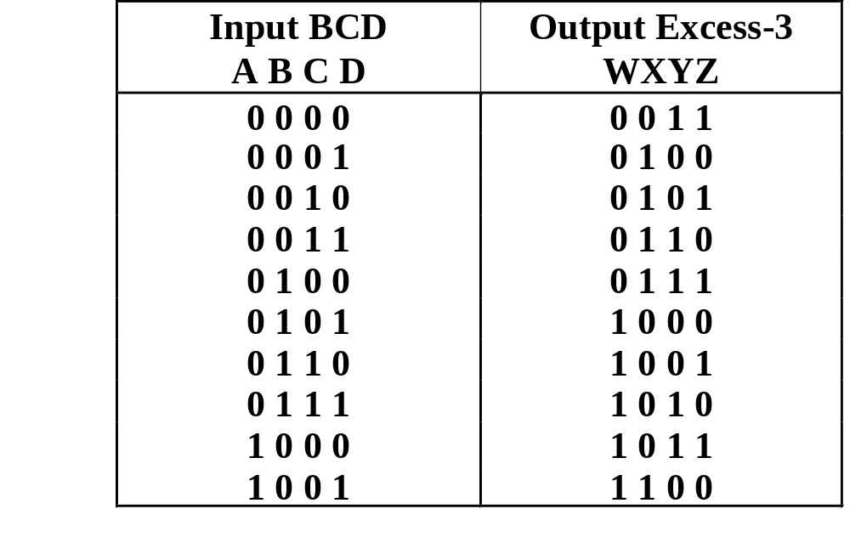
Design Example 2 (continued)
Formulation
  Conversion of 4-bit codes can be most easily formulated by a truth table
  Variables
  - BCD:
  A,B,C,D
  Variables
  - Excess-3
  W,X,Y,Z
  Don’t Cares
  - BCD 1010
  to 1111
Notes:
四个函数，每个函数四个自变量

Slide 20
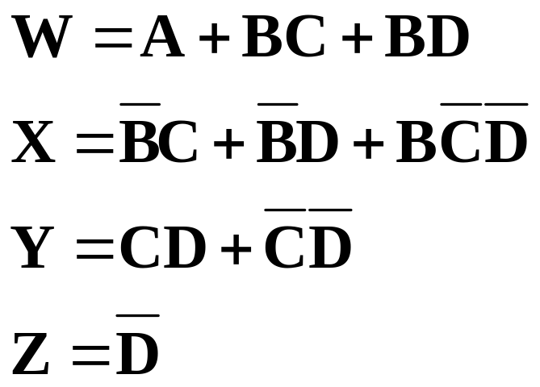
Design Example 2 (continued)
Optimization
  2-level using
  K-maps
z
C
y
C
1
1
1
1
0
1
3
2
0
1
3
2
1
1
1
1
4
5
7
6
B
4
5
7
6
B
X
X
X
X
X
X
X
X
A
12
13
15
14
A
12
13
15
14
1
X
X
1
X
X
8
9
11
10
8
9
11
10
D
D
x
C
w
C
1
1
1
0
1
3
2
0
1
3
2
1
1
1
1
4
5
7
6
B
4
5
7
6
B
X
X
X
X
X
X
X
X
A
12
13
15
14
A
12
13
15
14
1
X
X
1
1
X
X
8
9
11
10
8
9
11
10
D
D

Slide 21
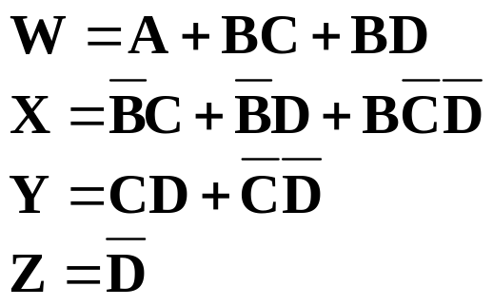
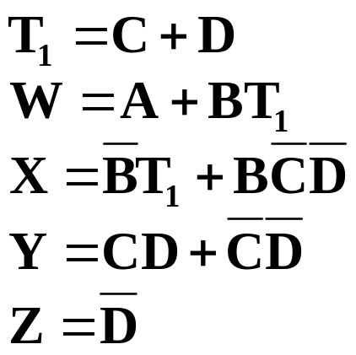
Design Example 2 (continued)
Optimization (continued)
  Multiple-level using transformations
  Perform extraction, finding factor: T₁ = C + D
G = 7 + 10+ 6 + 0 = 23
G = 2+4+7+6+0=19

Slide 22
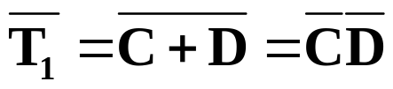
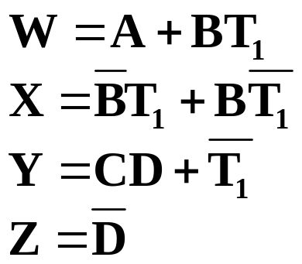
Design Example 2 (continued)
Optimization (continued)
  Multiple-level using transformations
  An additional extraction not shown in the text since it uses a Boolean transformation:
G = 2+4+7+6+0=19
G = 2 +1 + 4 + 6 + 4 + 0 = 17!

Slide 23
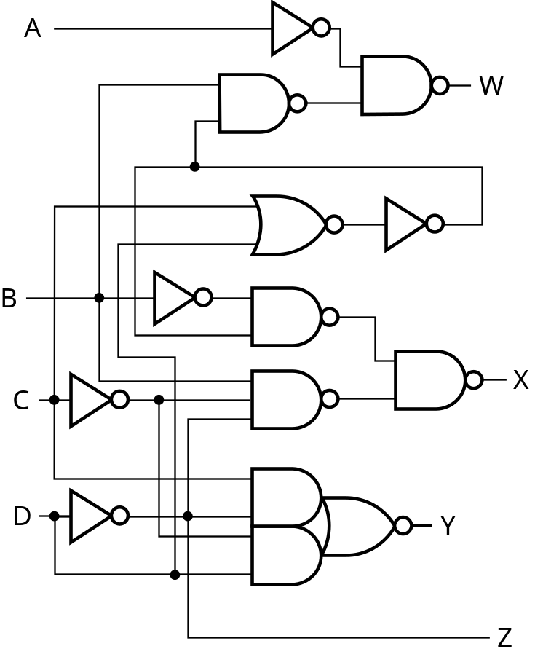
Design Example 2 (continued)
Technology Mapping
  Mapping with a library containing inverters and 2-input NAND, 3-input NAND, 2-input NOR, and 2-2 AOI gates
A
W
B
X
T₁
C
Y
D
Z

Slide 24
Verilog Programming
module BCD_ Excess_3( A,B,C,D,W,X,Y,Z );
input A,B,C,D;
output W,X,Y,Z;
wire A,B,C,D , W,X,Y,Z,T1;
assign T1 = C|D;
assign W = A|B&C|B&D ;
assign X = ~B&T1|B&~T1;
assign Y = C&D|~T1;
assign Z= ~D ;
endmodule

Slide 25
3.3 Technology Mapping
Chip design styles
Cells and cell libraries
Mapping Techniques
  NAND gates
  NOR gates
  Multiple gate types

Slide 26
Chip Design Styles
Full customized - the entire design of the chip down to the details of the layout is finished
  Expensive
  Justifiable only for dense, fast chips with high sales volume
Standard cell - blocks have been designed ahead of time or as part of previous designs
  Intermediate cost
  Less density and speed compared to full customized
Gate array - regular patterns of gate and transistors that can be used in many designs built into chip - only the interconnections between gates are specific to a design
  Lowest cost
  Less density compared to full customized and standard cell
Notes:
门阵列：PAL(programmable array logic)，GAL，PLA(programmable logic array), FPGA(Field Programmable Gate Array)

Slide 27
Cell Libraries
Cell - a pre-designed primitive block
Cell library - a collection of cells available for design using a particular implementation technology
Cell characterization - a detailed specification of a cell for use by a designer - often based on actual cell design and fabrication and measured values
Cells are used for gate array, standard cell, and in some cases, full custom chip design

Slide 28
Typical Cell Characterization Components
Schematic or logic diagram
Area of cell
  Often normalized to the area of a common, small cell such as an inverter
Input loading (in standard loads) presented to outputs driving each of the inputs
Delays from each input to each output
One or more cell templates for technology mapping
One or more hardware description language models
If automatic layout is to be used:
  Physical layout of the cell circuit
  A floorplan layout providing the location of inputs, outputs, power and ground connections on the cell

Slide 29
Example Cell Library
Typical
Typical
Input-to-
Basic
Cell
Cell
Normalized
Input
Output
Function
Name
Schematic
Area
Load
Delay
Templates
Inverter
1.00
1.00
0.04
＋
0.012
*
SL
2NAND
1.25
1.00
0.05
＋
0.014
*
SL
2NOR
1.25
1.00
0.06
＋
0.018
*
SL
2-2 AOI
2.25
0.95
0.07
＋
0.019
*
SL

Slide 30
3.3 Technology Mapping
Chip design styles
Cells and cell libraries
Mapping Techniques
  NAND gates
  NOR gates
  Multiple gate types

Slide 31
Mapping to NAND gates
Assumptions:
  Gate loading and delay are ignored
  Cell library contains an inverter and n-input NAND gates, n = 2, 3, …
  An AND, OR, inverter schematic for the circuit is available
The mapping is accomplished by:
  Replacing AND and OR symbols,
  Pushing inverters through circuit fan-out points, and
  Canceling inverter pairs

Slide 32
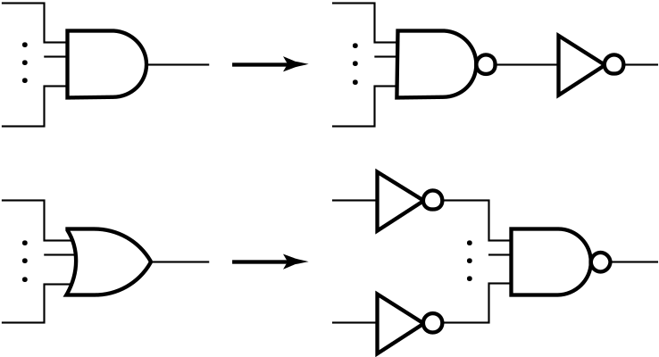
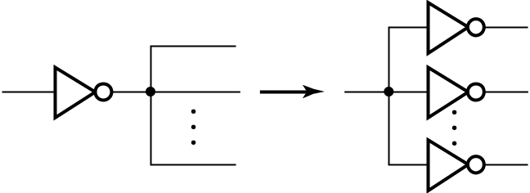

NAND Mapping Algorithm
Replace ANDs and ORs:
Repeat the following steps until there is at most one inverter between :
  A circuit input or driving NAND gate output, and
  The attached NAND gate inputs.

Slide 33
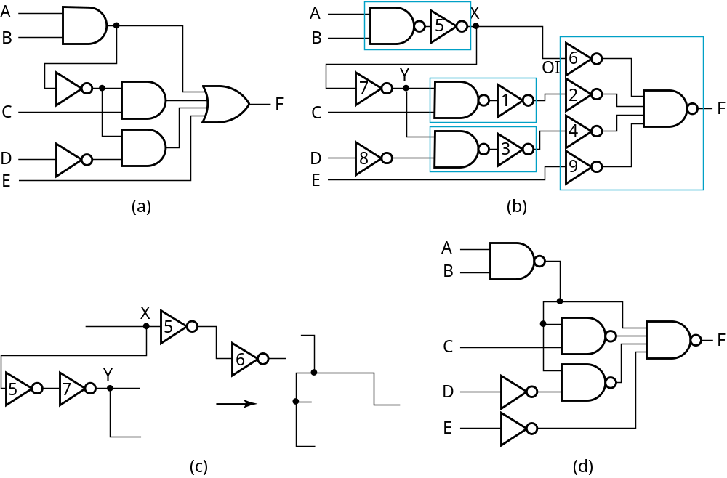
NAND Mapping Example

Slide 34
Mapping to NOR gates
Assumptions:
  Gate loading and delay are ignored
  Cell library contains an inverter and n-input NOR gates, n = 2, 3, …
  An AND, OR, inverter schematic for the circuit is available
The mapping is accomplished by:
  Replacing AND and OR symbols,
  Pushing inverters through circuit fan-out points, and
  Canceling inverter pairs

Slide 35
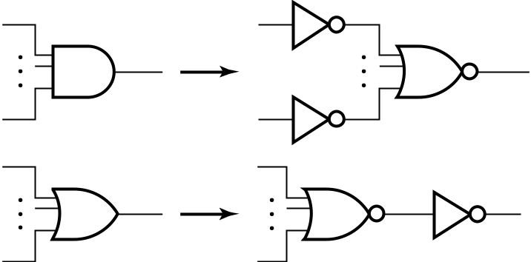
NOR Mapping Algorithm
Replace ANDs and ORs:
Repeat the following pair of actions until there is at most one inverter between :
  A circuit input or driving NOR gate output, and
  The attached NOR gate inputs.

Slide 36
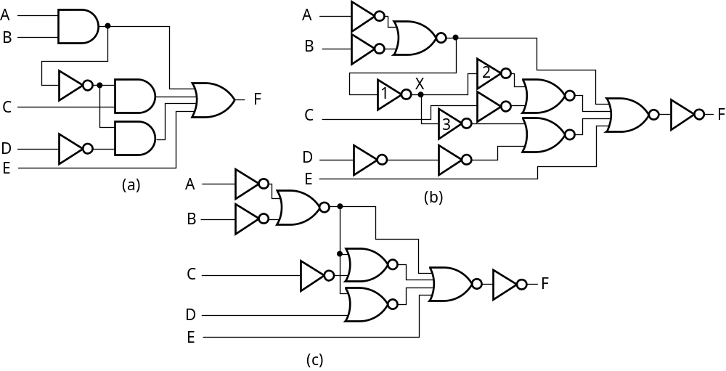
NOR Mapping Example

Slide 37
Mapping Multiple Gate Types
Algorithm is available in the Advanced Technology Mapping reading supplement
Cell library contains more than one “type” of gates
Concept Set 1
  Steps
    Replace all AND and OR gates with optimum equivalent circuits consisting only of 2-input NAND gates and inverters.
    Place two inverters in series on each line in the circuit containing NO inverters
  Justification
    Breaks up the circuit into small standardize pieces to allow maximum flexibility in the mapping process
    For the equivalent circuits, could use any simple gate set that can implement AND, OR and NOT and all of the cells in the cell library

Slide 38
Mapping Multiple Gate Types
Concept Set 2
  Fan-out free subcircuit - a circuit in which a single output cell drives only one other cell
  Steps
    Use an algorithm that guarantees an optimum solution for “fan-out free” subcircuits by replacing interconnected inverters and 2-input NAND gates with cells from the library
    Perform inverter “canceling” and “pushing” as for the NAND and NOR
  Justification
    Steps given optimize the total cost of the cells used within “fan-out free” subcircuits of the circuit
Final result: An optimum mapping solution within the “fan-out free subcircuits”

Slide 39
Example: Mapping Multiple Cell Types
Uses same example circuit as NAND mapping and NOR mapping
Cell library: 2-input and 3-input NAND gates, 2-input NOR gate, and inverter
Circuits on next slide
  (a) Optimized multiple-level circuit
  (b) Circuit with AND and OR gates replaced with circuits of 2-input NAND gates and inverters (Outlines show 2-input NANDs and inverter sets mapped to library cells in next step)
  (c) Mapped circuit with inverter pairs cancelled
  (d) Circuit with remaining inverters minimized

Slide 40
Example: Mapping Multiple Gate Types
A
A
B
B
C
F
C
F
D
D
E
E
(a)
(b)
A
B
A
B
C
F
C
F
D
D
E
E
(c)
(d)

Slide 41
3.4 Verification
Verification - show that whether the final designed circuit implements the original specification
Simple specifications are:
  truth table
  Boolean equations
  HDL code
If the above result from formulation are not the original specification, it is critical that the formulation process be flawless for the verification to be valid!

Slide 42
Basic Verification Methods
Manual Logic Analysis
  Find the truth table or Boolean equations for the final circuit
  Compare the final circuit truth table with the specified truth table, or
  Show that the Boolean equations for the final circuit are equal to the specified Boolean equations
Simulation
  Simulate the final circuit (or its netlist, possibly written as an HDL) and the specified truth table, equations, or HDL description using test input values that fully validate correctness.
  The obvious test for a combinational circuit is application of all possible “care” input combinations from the specification

Slide 43
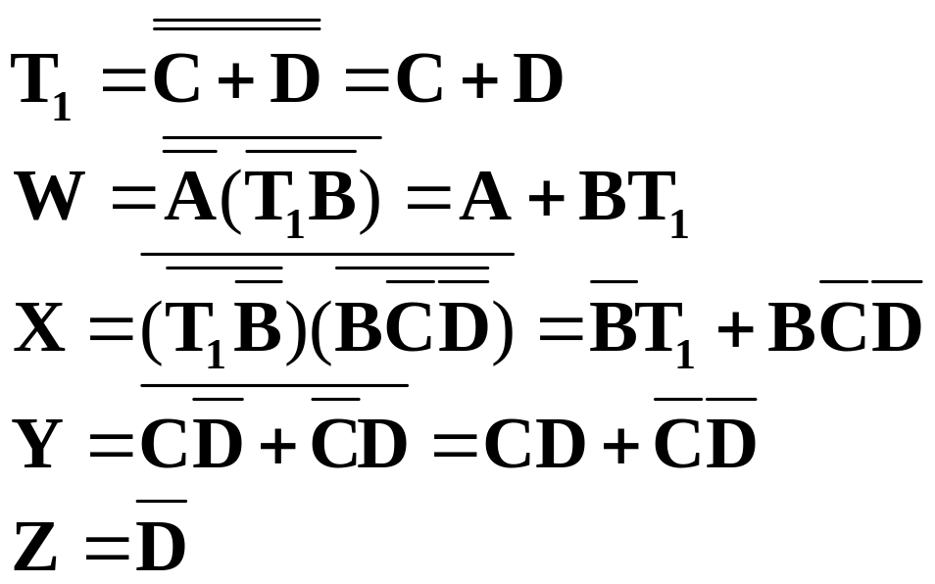
Verification Example: Manual Analysis
BCD-to-Excess 3 Code Converter
  Find the SOP Boolean equations from the final circuit.
  Find the truth table from these equations
  Compare to the formulation truth table
Finding the Boolean Equations:

Slide 44
Verification Example: Manual Analysis
Find the circuit truth table from the equations and compare to specification truth table:
Input BCD
Output Excess
-
3
Input BCD
Output Excess
-
3
A B C D
WXYZ
A B C D
WXYZ
0 0 0 0
0 0 1 1
0 0 0 0
0 0 1 1
0 0 0 1
0 1 0 0
0 0 0 1
0 1 0 0
0 0 1 0
0 1 0 1
0 0 1 0
0 1 0 1
0 0 1 1
0 1 1 0
0 0 1 1
0 1 1 0
0 1 0 0
0 1 1 1
0 1 0 0
0 1 1 1
0 1 0 1
1 0 0 0
0 1 0 1
1 0 0 0
0 1 1 0
1 0 0 1
0 1 1 0
1 0 0 1
0 1 1 1
1 0 1 0
0 1 1 1
1 0 1 0
1 0 0 0
1 0 1 1
1 0 0 0
1 0 1 1
1 0 0 1
1 1 0 0
1 0 0 1
1 1 0 0
The tables match!

Slide 45
Verification Example: Simulation
Simulation procedure:
  Use a schematic editor or text editor to enter a gate level representation of the final circuit
  Use a waveform editor or text editor to enter a test consisting of a sequence of input combinations to be applied to the circuit
    This test should guarantee the correctness of the circuit if the simulated responses to it are correct
    Short of applying all possible “care” input combinations, generation of such a test can be difficult

Slide 46
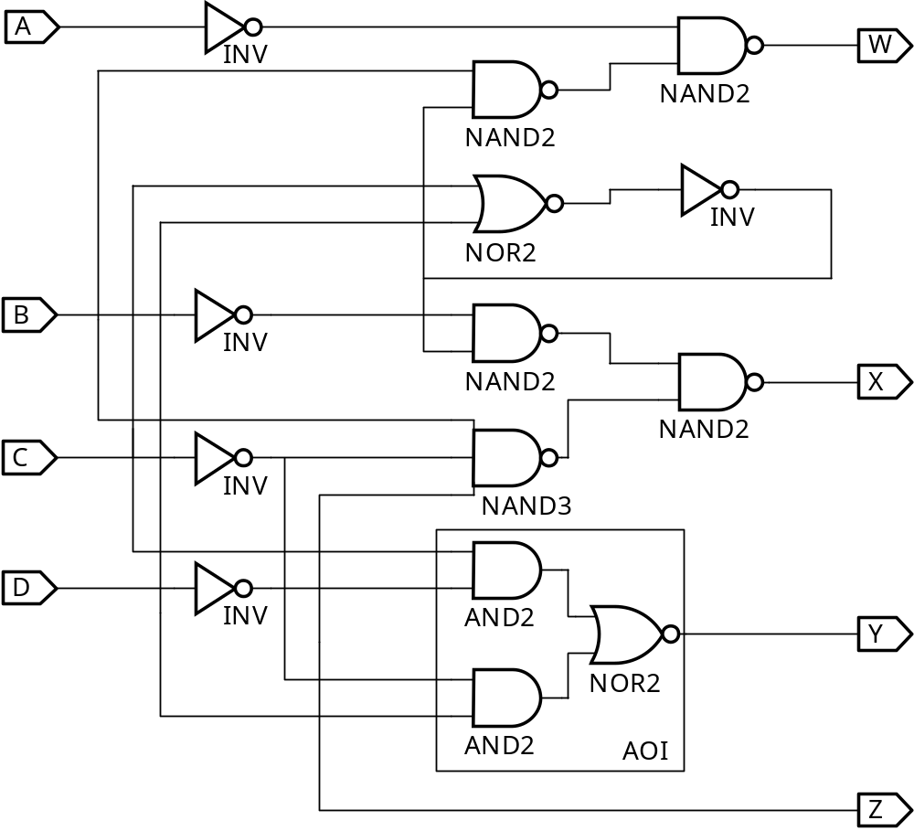
Verification Example: Simulation
Enter BCD-to-Excess-3 Code Converter Circuit Schematic
AOI symbol
not available

Slide 47
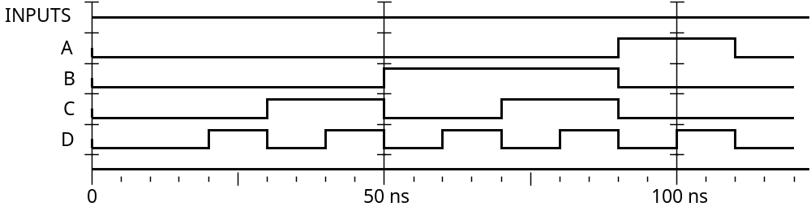
Verification Example: Simulation
Enter waveform that applies all possible input combinations:
Are all BCD input combinations present? (Low is a 0 and high is a one)
Notes:
Yes, 0000 through 1001 are present.

Slide 48
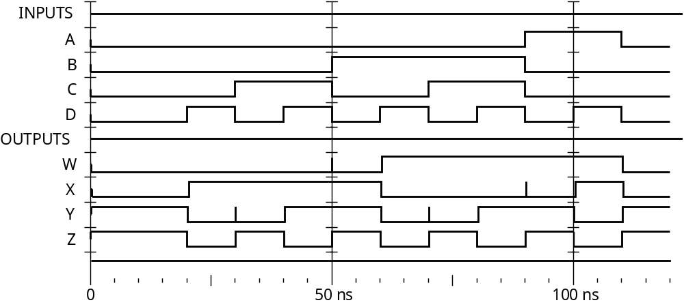
Verification Example: Simulation
Run the simulation of the circuit for 120 ns
Do the simulation output combinations match the original truth table?
Notes:
Yes, the output combinations 0011 through 1100 occur in response to 0000 through 1001, respectively.

Slide 49
3.5 Analysis of Logic Circuits
Write the Boolean function for the circuit
  begin with the input signal
  Define the relationship of each gate
  optimization
Derive a truth table
  Define the relationships between the inputs and outputs,
Functional Analysis
  Define the function of each signal and the whole circuit
  Draw the timing diagram of the circuit
Verification
  Verify the correctness of the final design

Slide 50
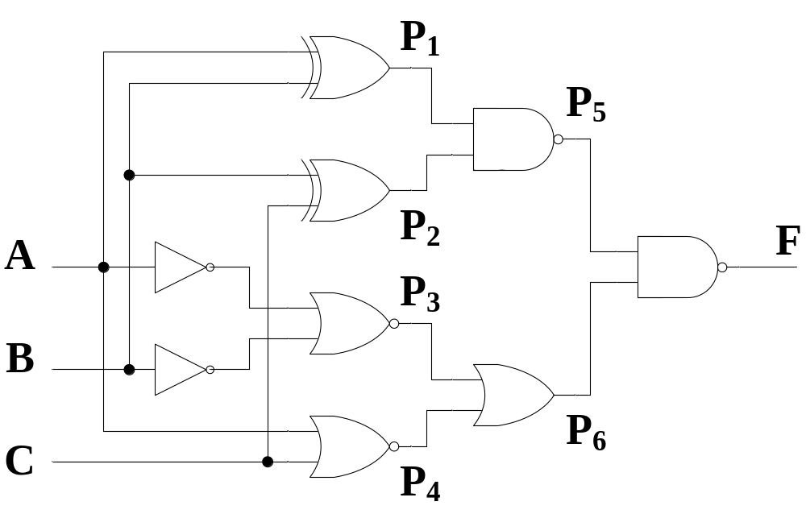
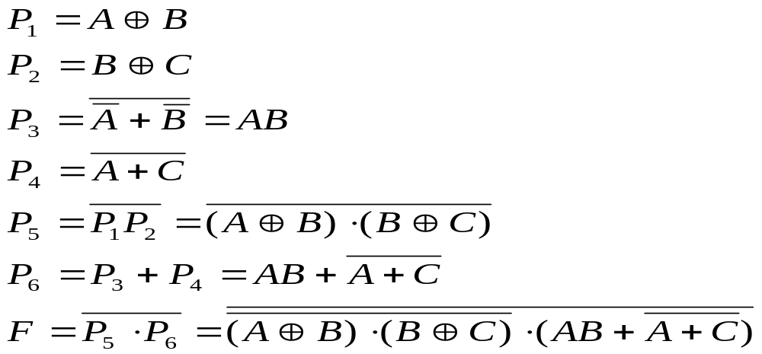
Analyze the Function of the Logic Circuit
Logic Circuits
List the Boolean functions for all signals

Slide 51
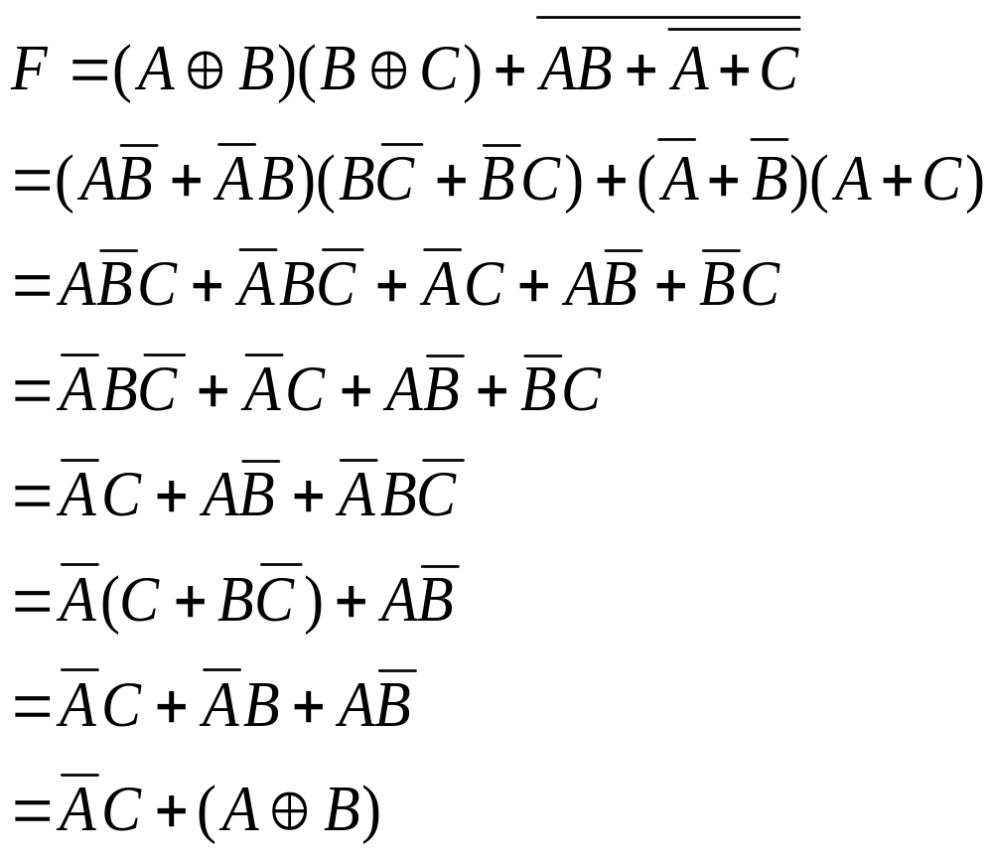
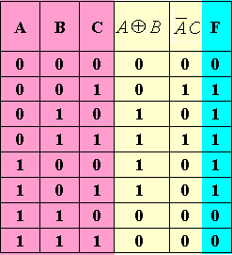
Boolean Function Simplification
Derive the truth table

Slide 52
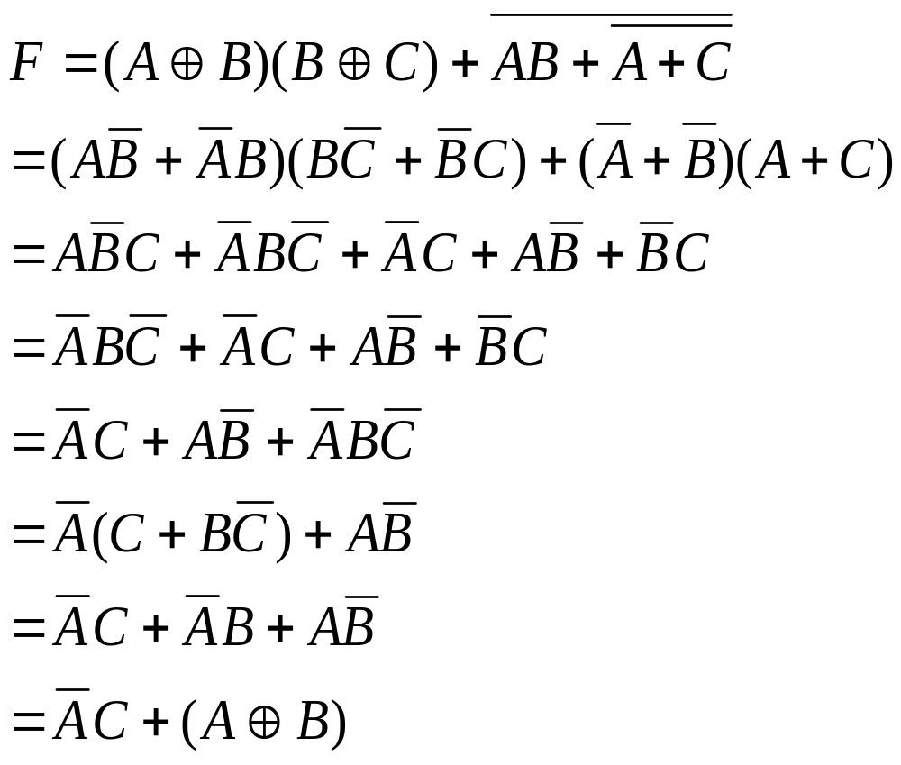
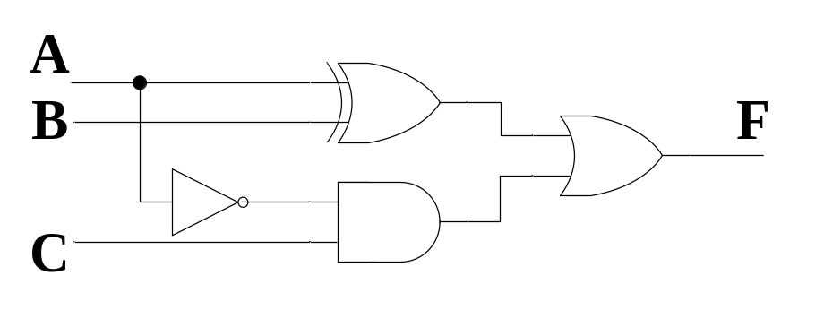
Boolean Function Simplification
Derive the truth table
From the truth table, we can see that F=1 if A≠B or B<C.
The original design is not
the best. Use the following
circuits instead.

Slide 53
Assignment
Reading: chapter 3.1, 3.2
Problem Assignment:
3-7；3-8；3-11；3-13；3-14；3-16；

