Slide 1
Logic and Computer Design Fundamentals
Chapter 3 Combinational
Logic Design II
Haifeng Liu
haifengliu@zju.edu.cn
College of Computer Science and Technology, Zhejiang University

Slide 2
Overview
Functions and functional blocks
Rudimentary logic functions
Decoding
Encoding
Selecting
Chapter 4 <number>

Slide 3
Functions and Functional Blocks
The functions considered are those found to be very useful in design
Corresponding to each of the functions is a combinational circuit implementation called a functional block.
In the past, many functional blocks were implemented as SSI, MSI, and LSI circuits.
Today, they are often simply parts within a VLSI circuits.
Chapter 4 <number>

Slide 4
Rudimentary Logic Functions
Four elementary combinational logic functions
  Value-Fixing: F = 0 or F = 1 , no Boolean operator
  Transferring: F = X , no Boolean operator
  Inverting: F = X , involves one logic gate
  Enabling: F = X·EN or F = X + EN , involves one or two logic gates
  The first three are functions of a single variable X
Table 4-1
Functions of one variable
V
CC
or V
DD
1
F
=
1
F
=
1
X
F
=
X
X
F
=0
F
=X
F
=
X
F=1
(c)
0
0
0
1
1
0
F
=
0
F
=
0
X
F
=
X
1
0
1
0
1
(a)
(b)
(d)
Chapter 4 <number>

Slide 5
Multiple-bit Rudimentary Functions
Multi-bit Examples:
A wide line is used to represent
a bus which is a vector signal
In (b) of the example, F = (F₃, F₂, F₁, F₀) is a bus.
The bus can be split into individual bits as shown in (b)
Sets of bits can be split from the bus as shown in (c)
for bits 2 and 1 of F.
The sets of bits need not be continuous as shown in (d) for bits 3, 1, and 0 of F.
A
F
A
3
3
2
1
F
1
2
4
4
2:1
F(2:1)
2
F
0
F
0
F
1
1
A
0
(c)
F
0
A
(a)
(b)
3
4
3,1:0
F(3), F(1:0)
F
(d)
Chapter 4 <number>

Slide 6
Enabling Function
Enabling permits an input signal to pass through to an output
Disabling blocks an input signal from passing through to an output, replacing it with a fixed value
The value on the output when it is disable can be Hi-Z (as for three-state buffers and transmission gates), 0 , or 1
When disabled, 0 output
When disabled, 1 output
See Enabling App in text
X
F
EN
(a)
X
F
EN
(b)
Chapter 4 <number>

Slide 7
Decoding
Decoding - the conversion of an n-bit input code to an m-bit output code with
n ≤ m ≤ 2^{n} such that each valid code word produces a unique output code
Circuits that perform decoding are called decoders
Here, functional blocks for decoding are
  called n-to-m line decoders, where m ≤ 2^{n}, and
  generate 2^{n} (or fewer) minterms for the n input variables
Chapter 3 <number>

Slide 8
Decoder
？
What’s the bit length of data?
Controller
0
1
2
3
4
5
6
7
Chapter 4 <number>

Slide 9
Decoder
A | B | C | Y0 | Y1 | Y2 | Y3 | Y4 | Y5 | Y6 | Y7
0 | 0 | 0 | 1 | 0 | 0 | 0 | 0 | 0 | 0 | 0
0 | 0 | 1 | 0 | 1 | 0 | 0 | 0 | 0 | 0 | 0
0 | 1 | 0 | 0 | 0 | 1 | 0 | 0 | 0 | 0 | 0
0 | 1 | 1 | 0 | 0 | 0 | 1 | 0 | 0 | 0 | 0
1 | 0 | 0 | 0 | 0 | 0 | 0 | 1 | 0 | 0 | 0
1 | 0 | 1 | 0 | 0 | 0 | 0 | 0 | 1 | 0 | 0
1 | 1 | 0 | 0 | 0 | 0 | 0 | 0 | 0 | 1 | 0
1 | 1 | 1 | 0 | 0 | 0 | 0 | 0 | 0 | 0 | 1
Chapter 4 <number>

Slide 10
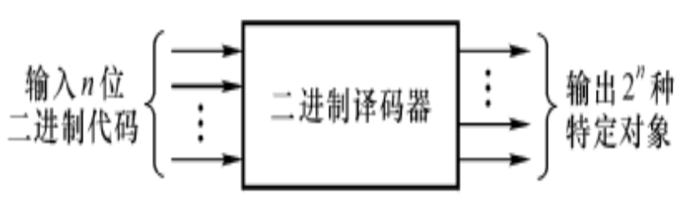
Decoder
Decoding - the conversion of an n-bit input code to an m-bit output code with n ≤ m ≤ 2^{n} such that each valid code word produces a unique output code
Decoders:
decoder with 2 input and 4 output, 74LS139 (2-to-4-Line Decoder)
decoder with 3 input and 8 output, 74LS138 (3-to-8-Line Decoder)
decoder with 4 input and 16 output, MC14514(4-to-16-Line Decoder)
Chapter 4 <number>

Slide 11
Decoder Examples
1-to-2-Line Decoder
2-to-4-Line Decoder
A
D
0
D
1
D
0
=
A
0
1
0
1
0
1
A
D
=
A
1
(a)
(b)
A
0
A
1
A
1
A
0
D
0
D
1
D
2
D
3
D
0
=
A
1
A
0
0
0
1
0
0
0
0
1
0
1
0
0
D
1
=
A
1
A
0
1
0
0
0
1
0
1
1
0
0
0
1
D
=
A
A
2
1
0
(a)
Note that the 2-4-line
made up of 2 1-to-2-
line decoders and 4 AND gates.
D
3
=
A
1
A
0
(b)
Chapter 4 <number>

Slide 12
Decoder Expansion
Decider with n input can have 2^{n} output. When n is large, the circuit is very complex.
General procedure:
  Let k = n.
  If k is even, divide k by 2 obtain k/2. Use 2^{k} AND gates driven by two decoders of output size 2^{k/2}. If k is odd, obtain (k+1)/2 and (k-1)/2. Use 2^{k} AND gates driven by a decoder of output size 2 ^{(k+1)/2} and a decoder of output size 2 ^{(k-1)/2} .
  For each decoder resulting from step 2, repeat step 2 with k equal to the values obtained in step 2 until k = 1. For k = 1, use a 1-to-2 decoder.
Still valid when output ≠ 2^{n}
Chapter 4 <number>

Slide 13
Example: 3-to-8-Line Decoder
3-to-8-Line Decoder
  Construct directly, drive 8 3-input ANDs
  Hierarchically, divide the input signals equally
    2-to-4-Line decoder
    1-to-2-Line decoder
2-to-4-Line Decoder
  drive 4 2-input ANDs
  divide the input signals equally
    1-to-2-Line decoder
Chapter 4 <number>

Slide 14
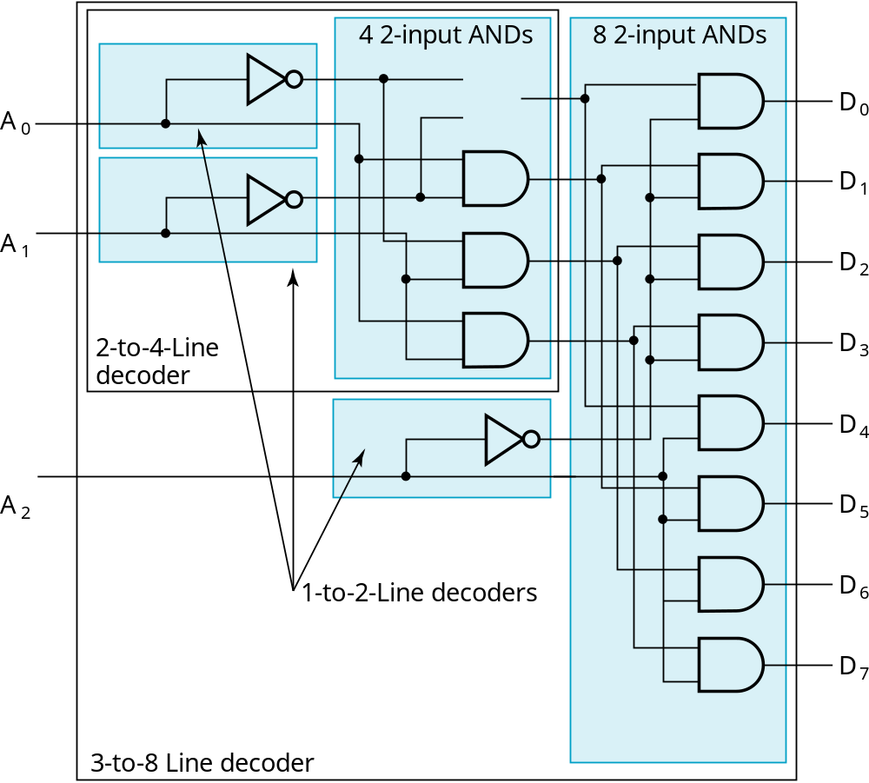
Circuit of 3-to-8-Line Decoder
Result
Chapter 4 <number>

Slide 15
Example: 7-to-128-Line Decoder
7-to-128-Line Decoder
  128 7-input ANDs are needed if constructed directly
  Hierarchically , level 1:
    4-to-16-Line Decoder
    3-to-8-Line Decoder
  4-to-16-Line decoder
    16 2-input ANDs
    Level 2:
      2 2-to-4-Line Decoder
  Constructed by the known 3-to-8-Line Decoders and 2-to-4-Line Decoders
Chapter 4 <number>

Slide 16
Decoder with Enable
In general, attach m-enabling circuits to the outputs
See truth table below for function
  Note use of X’s to denote both 0 and 1
  Combination containing two X’s represent four binary combinations
Alternatively, can be viewed as distributing value of signal EN to 1 of 4 outputs
In this case, called a
demultiplexer
EN
A
1
A
0
D
0
EN
A
1
A
0
D
0
D
1
D
2
D
3
D
1
0
X
X
0
0
0
0
1
0
0
1
0
0
0
D
2
1
0
1
0
1
0
0
1
1
0
0
0
1
0
D
1
1
1
0
0
0
1
3
(a)
(b)
Chapter 4 <number>

Slide 17
Combinational Circuit based on Decoder and OR Gates
Any combinational circuit with n inputs and m outputs can be implemented with:
  an n-to-2^{n}-line decoder, and
  m OR gates (one for each output)
Approach 1:
  Find the truth table for the functions
  Make a connection to the corresponding OR from the corresponding decoder output wherever a 1 appears in the truth table
Approach 2:
  Find all the minterms in the Boolean function
  Map the minterms with OR gates.
Chapter 4 <number>

Slide 18
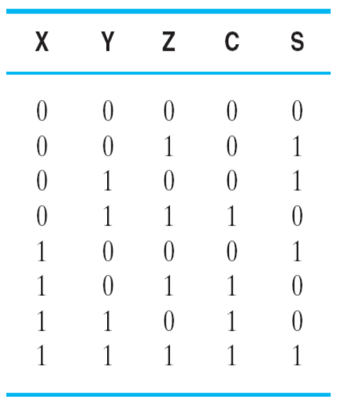
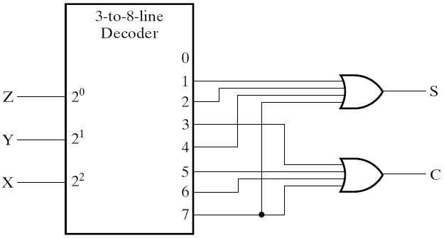
Decoder and OR Gates Example
Implement one bit binary adder
  Truth table
  Sum of minterms expressions
S（X，Y，Z）
=Σm（1，2，4，7）
C（X，Y，Z）
=Σm（3，5，6，7）
  Logic Circuit:
Chapter 4 <number>

Slide 19
Decoder and OR Gates Example
Implement the following set of odd parity functions of (A₇, A₆, A₅, A₃)
P₁ = A₇ A₅ A₃
P₂ = A₇ A₆ A₃
P₄ = A₇ A₆ A₅
Sum of
minterms expressions
P₁ = Σ_{m}(1,2,5,6,8,11,12,15)
P₂ = Σ_{m}(1,3,4,6,8,10,13,15)
P₄ = Σ_{m}(2,3,4,5,8,9,14,15)
Draw circuit
Is this a good idea?
₊
₊
_{A7}
_{A6}
_{A5}
_{A3}
_{P1}
₀
₁
₂
₃
₄
₅
₆
₇
₈
₉
₁₀
₁₁
₁₂
₁₃
₁₄
₁₅
₊
₊
₊
₊
_{P2}
_{P4}
Chapter 4 <number>
Notes:
No. The complexity is high. Much better to implement the functions with XOR gates.
Also, the sharing of logic can cause 2 bits in error, which for this application
(a Hamming encoder) is not detectable! Note that XOR gates should not be shared in the implementation as well.

Slide 20
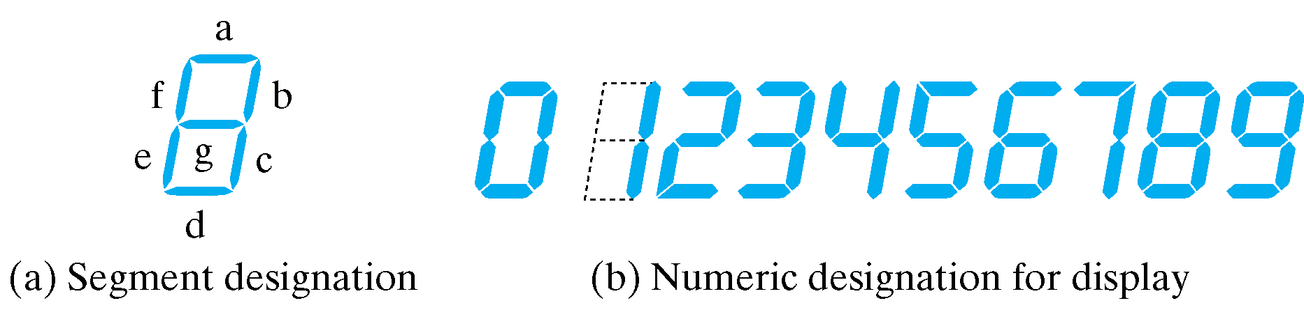
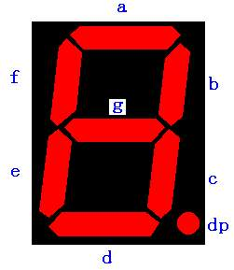
BCD-to-Segment Decoder
Seven-Segment Displayer
Chapter 4 <number>

Slide 21
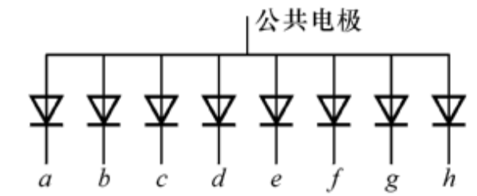
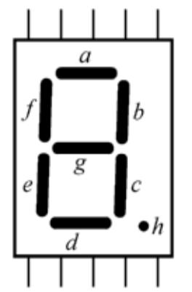
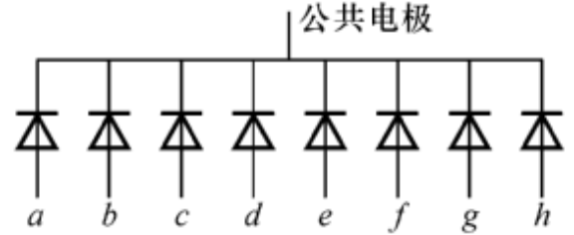
Seven-Segment Displayer
Common anode connected to +5V
Com.
Com.
d
c
b
a
a
Common anode
R
“0”
Com.
Common Cathode connected to GND
e
f
g
h
Com.
a
Common Cathode
R
“1”

Slide 22
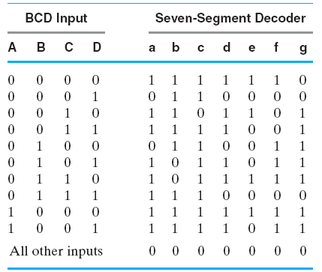
BCD-to-Segment Decoder (Cont.)
Truth Table for BCD-to-Seven-Segment Decoder
Chapter 4 <number>

Slide 23
Encoding
Encoding - the opposite of decoding - the conversion of an m-bit input code to a n-bit output code with n ≤ m ≤ 2^{n} such that each valid code word produces a unique output code
Circuits that perform encoding are called encoders
An encoder has 2^{n} (or fewer) input lines and n output lines which generate the binary code corresponding to the input values
Typically, an encoder converts a code containing exactly one bit that is 1 to a binary code corres-ponding to the position in which the 1 appears.
Chapter 3 <number>

Slide 24
Encoder
？
What’s the bit width of data?
Monitor
0
1
2
3
4
5
6
7
Workpiece
Workpiece
Chapter 4 <number>

Slide 25
Encoder Example
A decimal-to-BCD encoder
  Inputs: 10 bits corresponding to decimal digits 0 through 9, (D₀, …, D₉)
  Outputs: 4 bits with BCD codes
  Function: If input bit D_{i} is a 1, then the output (A₃, A₂, A₁, A₀) is the BCD code for i,
The truth table could be formed, but alternatively, the equations for each of the four outputs can be obtained directly.
Chapter 3 <number>

Slide 26
Encoder Example (continued)
Input D_{i} is a term in equation A_{j} if bit A_{j} is 1 in the binary value for i.
Equations:
  A₃ = D₈ + D₉
  A₂ = D₄ + D₅ + D₆ + D₇
  A₁ = D₂ + D₃ + D₆ + D₇
  A₀ = D₁ + D₃ + D₅ + D₇ + D₉
F₁ = D₆ + D₇ can be extracted from A₂ and A₁ Is there any cost saving?
Chapter 3 <number>
Notes:
No. The total gate input cost remains the same.

Slide 27
Priority Encoder
The above encoder does not work when the input signal contains multiple “1”s.
One encoder that can accept all possible combinations of input values and produce a meaningful result is a priority encoder.
Among the 1s that appear, it selects the most significant input position (or the least significant input position) containing a 1 and responds with the corresponding binary code for that position.
Chapter 4 <number>

Slide 28
Priority Encoder Example
Priority encoder with 5 inputs (D₄, D₃, D₂, D₁, D₀) - highest priority to most significant 1 present - Code outputs A2, A1, A0 and V where V indicates at least one 1 present.
Xs in input part of table represent 0 or 1; thus table entries correspond to product terms instead of minterms. The column on the left shows that all 32 minterms are present in the product terms in the table
No. of Min-terms/Row | Inputs |  |  |  |  | Outputs
 | D4 | D3 | D2 | D1 | D0 | A2 | A1 | A0 | V
1 | 0 | 0 | 0 | 0 | 0 | X | X | X | 0
1 | 0 | 0 | 0 | 0 | 1 | 0 | 0 | 0 | 1
2 | 0 | 0 | 0 | 1 | X | 0 | 0 | 1 | 1
4 | 0 | 0 | 1 | X | X | 0 | 1 | 0 | 1
8 | 0 | 1 | X | X | X | 0 | 1 | 1 | 1
16 | 1 | X | X | X | X | 1 | 0 | 0 | 1
Chapter 4 <number>
Notes:
Go over table explaining how entries were obtained, particularly those containing Xs

Slide 29
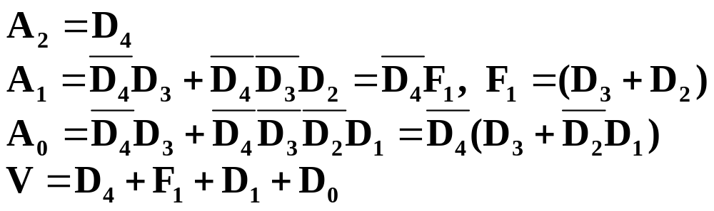
Priority Encoder Example (continued)
Could use a K-map to get equations, but can be read directly from table and manually optimized if careful:
Chapter 4 <number>

Slide 30
Selecting
Selecting of data or information is a critical function in digital systems and computers
Circuits that perform selecting have:
  A set of information
  inputs from which the
  selection is made
  A single output
  A set of control lines
  for making the selection
Logic circuits that perform selecting are called multiplexers
Selecting can also be done by three-state logic or transmission gates
Circuit
DBUS
Y
CBUS
Chapter 4 <number>

Slide 31
Multiplexers
A multiplexer selects information from an input line and directs the information to an output line
A typical multiplexer has n control inputs (S_{n − 1}, … S₀) called selection inputs, 2^{n} information inputs (I₂n ₋ ₁, … I₀), and one output Y
A multiplexer can be designed to have m information inputs with m < 2^{n} as well as n selection inputs
Chapter 4 <number>

Slide 32
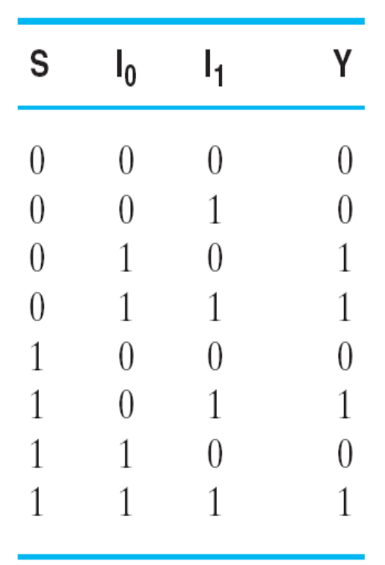
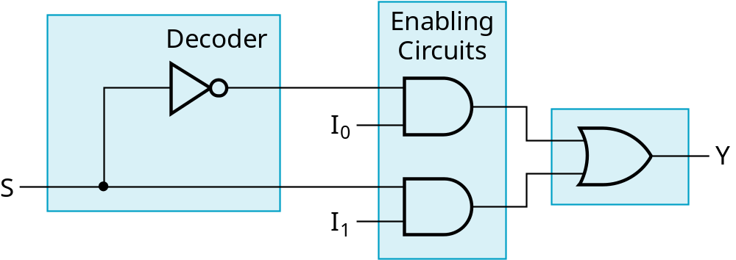
2-to-1-Line Multiplexer
Since 2 = 2¹, n = 1
The single selection variable S has two values:
  S = 0 selects input I₀
  S = 1 selects input I₁
The equation:
Y = I₀ + SI₁
The circuit:
S
Chapter 4 <number>

Slide 33
2-to-1-Line Multiplexer (continued)
Note the regions of the multiplexer circuit shown:
  1-to-2-line Decoder
  2 Enabling circuits
  2-input OR gate
To obtain a basis for multiplexer expansion, we combine the Enabling circuits and OR gate into a 2 × 2 AND-OR circuit:
  1-to-2-line decoder
  2 ⋅ 2 AND-OR
In general, for an 2^{n}-to-1-line multiplexer:
  n-to-2^{n}-line decoder
  2^{n} ⋅ 2 AND-OR
Chapter 4 <number>

Slide 34
Example: 4-to-1-line Multiplexer
2-to-2²-line decoder
2² ⋅ 2 AND-OR
S
Decoder
1
S
4
×
2 AND-OR
0
I
0
I
1
Y
I
2
I
3
Chapter 4 <number>

Slide 35
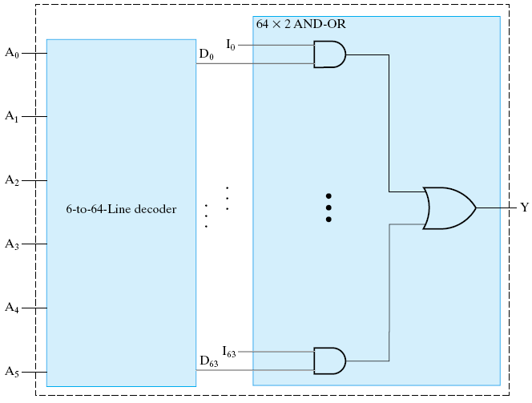
Example: 64-to-1-line Multiplexer
6-to-2⁶-line decoder
2⁶ ⋅ 2 AND-OR
Chapter 4 <number>

Slide 36
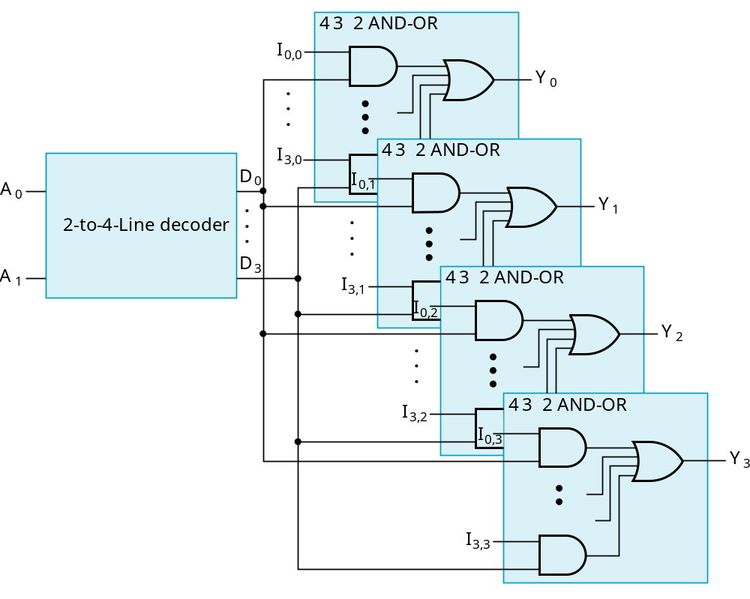
Multiplexer Width Expansion
Select “vectors of bits” instead of “bit”
Use multiple copies of 2^{n} ⋅ 2 AND-OR in parallel
Example:
4-to-1-line quad multiplexer
Chapter 4 <number>

Slide 37
Other Selection Implementations
Three-state logic in place of AND-OR
Gate input cost = 18
S
1
S
0
I
0
I
1
Y
I
2
I
3
Chapter 4 <number>

Slide 38
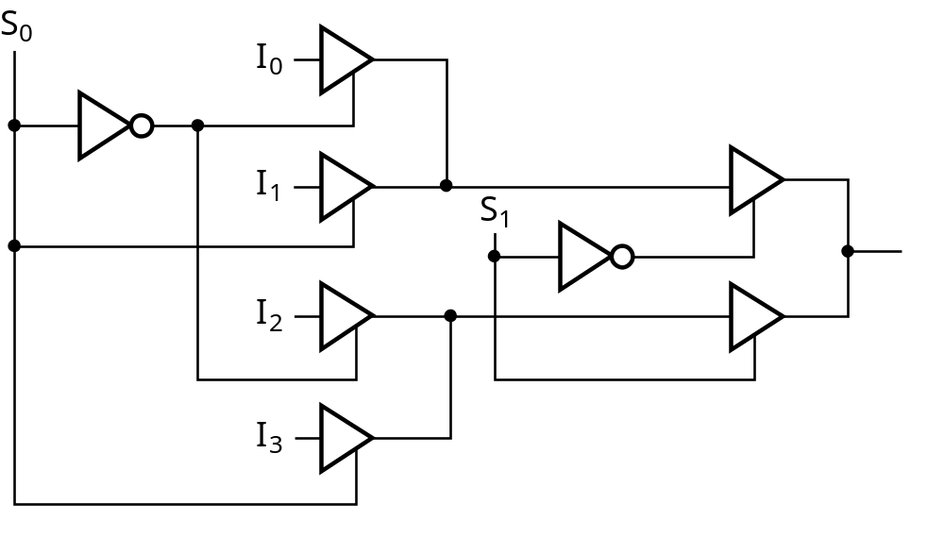
Other Selection Implementations
Distributing the decoding across the three-state drivers
Gate input cost = 14
GN of AND-OR gate implementation:22
GN of implementation with AND-OR gate replaced by three-state drivers: 18
Chapter 4 <number>

Slide 39
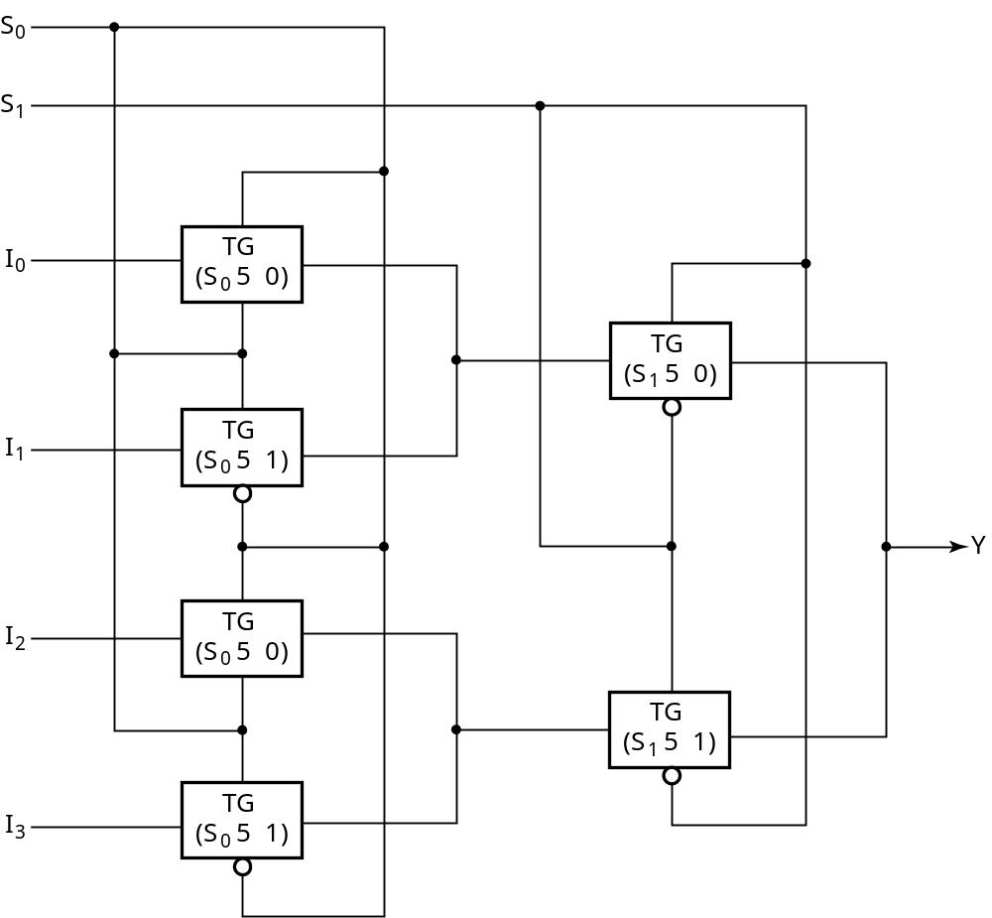
Other Selection Implementations
Transmission Gate Multiplexer
Gate input cost = 8
＝
＝
＝
＝
＝
＝
Chapter 4 <number>

Slide 40
Combinational Logic Implementation
- Multiplexer Approach 1
Implement m functions of n variables with:
  Sum-of-minterms expressions
  An m-wide 2^{n}-to-1-line multiplexer
Design:
  Find the truth table for the functions.
  In the order they appear in the truth table:
    Apply the function input variables to the multiplexer inputs S_{n − 1}, … , S₀
    Label the outputs of the multiplexer with the output variables
  Value-fix the information inputs to the multiplexer using the values from the truth table (for don’t cares, apply either 0 or 1)
Chapter 3 <number>

Slide 41
Example: Gray to Binary Code
Design a circuit to
convert a 3-bit Gray
code to a binary code
The formulation gives
the truth table on the
right
It is obvious from this
table that X = C and the
Y and Z are more complex
Gray
Binary
A B C
x y z
0
0
0
0
0
0
1 0
0
0
0 1
1
1 0
0 1 0
0 1 0
0 1
1
0 1
1
1 0
0
1
1
1
1 0 1
1 0 1
1
1 0
0
0 1
1
1
1
Chapter 3 <number>

Slide 42
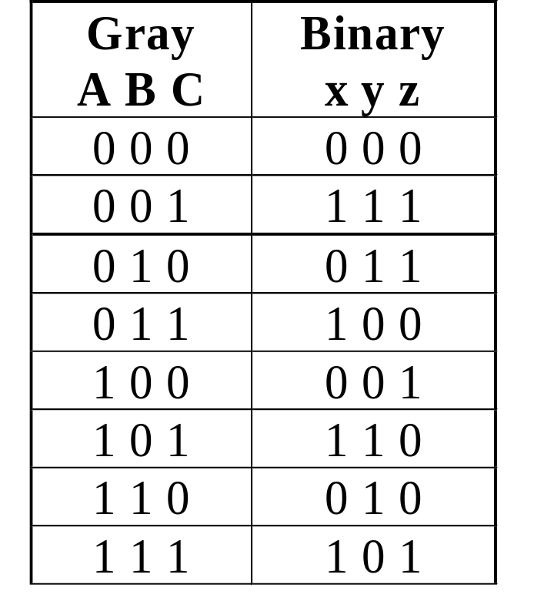
Gray to Binary (continued)
Rearrange the table so
that the input combinations
are in counting order
Functions y and z can
be implemented using
a dual 8-to-1-line
multiplexer by:
  connecting A, B, and C to the multiplexer select inputs
  placing y and z on the two multiplexer outputs
  connecting their respective truth table values to the inputs
Chapter 3 <number>

Slide 43
Gray to Binary (continued)
Note that the multiplexer with fixed inputs is identical to a ROM with 3-bit addresses and 2-bit data!
0
D00
0
D10
1
D01
1
D11
1
D02
1
D12
0
D03
0
D13
0
D04
1
D14
1
Out
Y
0
Out
Z
D05
D15
1
D06
0
D16
0
D07
1
D17
A
S2
A
S2
8-to-1
8-to-1
B
S1
B
S1
MUX
S0
MUX
C
S0
C
Chapter 3 <number>

Slide 44
Combinational Logic Implementation
- Multiplexer Approach 2
Implement any m functions of n + 1 variables by using:
  An m-wide 2^{n}-to-1-line multiplexer
  A single inverter
Design:
  Find the truth table for the functions.
  Based on the values of the first n variables, separate the truth table rows into pairs
  For each pair and output, define a rudimentary function of the final variable (0, 1, X, )
  Using the first n variables as the index, value-fix the information inputs to the multiplexer with the corresponding rudimentary functions
  Use the inverter to generate the rudimentary function
X
X
Chapter 3 <number>

Slide 45
Example: Gray to Binary Code
Design a circuit to
convert a 3-bit Gray
code to a binary code
The formulation gives
the truth table on the
right
It is obvious from this
table that X = C and the
Y and Z are more complex
Gray
Binary
A B C
x y z
0
0
0
0
0
0
1 0
0
0
0 1
1
1 0
0 1 0
0 1 0
0 1
1
0 1
1
1 0
0
1
1
1
1 0 1
1 0 1
1
1 0
0
0 1
1
1
1
Chapter 3 <number>

Slide 46
Gray to Binary (continued)
Rearrange the table so that the input combinations are in counting order, pair rows, and find rudimentary functions
Gray A B C | Binary x y z | Rudimentary Functions of C for y | Rudimentary Functions of C for z
0 0 0 | 0 0 0
0 0 1 | 1 1 1
0 1 0 | 0 1 1
0 1 1 | 1 0 0
1 0 0 | 0 0 1
1 0 1 | 1 1 0
1 1 0 | 0 1 0
1 1 1 | 1 0 1
F = C
F = C
F = C
F = C
F = C
F = C
F = C
F = C
Chapter 3 <number>

Slide 47
Gray to Binary (continued)
Assign the variables and functions to the multiplexer inputs:
Note that this approach (Approach 2) reduces the cost by almost half compared to Approach 1.
This result is no longer ROM-like
Extending, a function of more than n variables is decomposed into several sub-functions defined on a subset of the variables. The multiplexer then selects among these sub-functions.
C
D00
C
D10
C
D01
C
D11
C
C
C
D02
Out
Y
C
D12
Out
Z
C
D03
C
D13
A
S1
4-to-1
A
S1
4-to-1
B
S0
MUX
B
S0
MUX
Chapter 3 <number>

Slide 48
Combinational Logic Implementation
- Multiplexer Approach 2
Another Example
Using a 8-to-1 MUX to implement the function:
Input: A B C D | Output: X
0 0 0 0 | 0
0 0 0 1 | 1
0 0 1 0 | 1
0 0 1 1 | 0
0 1 0 0 | 0
0 1 0 1 | 0
0 1 1 0 | 0
0 1 1 1 | 1
1 0 0 0 | 1
1 0 0 1 | 1
1 0 1 0 | 1
1 0 1 1 | 1
1 1 0 0 | 1
1 1 0 1 | 0
1 1 1 0 | 0
1 1 1 1 | 0
Chapter 3 <number>

Slide 49
Assignment
_{Reading: pp. 107--139}
_{Problem Assignment:}
3-24; 3-25; 3-27; 3-28; 3-29; 3-37; 3-44; 3-47

