Slide 1
Logic and Computer Design Fundamentals
Chapter 3 – Arithmetic Functions and Circuits
Haifeng Liu
haifengliu@zju.edu.cn
College of Computer Science and Technology, Zhejiang University

Slide 2
Overview
Iterative combinational circuits
Binary adders
  Half and full adders
  Ripple carry and carry lookahead adders
Binary subtraction
Binary adder-subtractors
  Signed binary numbers
  Signed binary addition and subtraction
  Overflow
*Binary Multiplication
Other Arithmetic Functions
  Design by contraction
Chapter 5 <number>
Notes:
Value fixing, transferring, and inverting on inputs can be combined with function blocks to implement new functions. We can implement new functions by using similar techniques on a given circuit or on its equations and then contracting it for a specific application to a simpler circuit. We will call the procedure contraction.

Slide 3
Iterative Combinational Circuits
Arithmetic functions
  Operate on binary vectors
  Use the same subfunction in each bit position
Can design functional block for subfunction and repeat to obtain functional block for overall function
Cell - subfunction block
Iterative array - a array of interconnected cells
An iterative array can be in a single dimension (1D) or multiple dimensions
Chapter 5 <number>

Slide 4
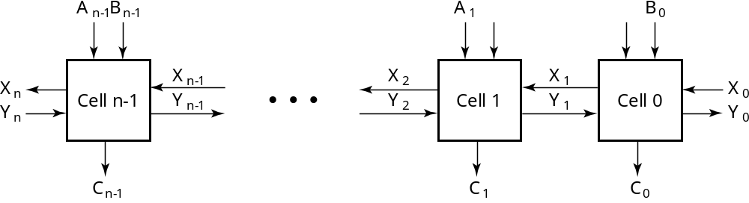
Block Diagram of a 1D Iterative Array
Example: n = 32
  Number of inputs = ? 66
  Truth table rows = ? 2⁶⁶
  Equations with up to ? Input 66 variables
  Equations with huge number of terms
  Design impractical!
Iterative array takes advantage of the regularity to make design feasible
Chapter 5 <number>

Slide 5
Functional Blocks: Addition
Binary addition used frequently
Addition Development:
  Half-Adder (HA), a 2-input bit-wise addition functional block,
  Full-Adder (FA), a 3-input bit-wise addition functional block,
  Ripple Carry Adder, an iterative array to perform binary addition, and
  Carry-Look-Ahead Adder (CLA), a hierarchical structure to improve performance.
Chapter 5 <number>

Slide 6
Functional Block: Half-Adder
A 2-input, 1-bit width binary adder that performs the following computations:
A half adder adds two bits to produce a two-bit sum
The sum is expressed as a sum bit , S and a carry bit, C
The half adder can be specified as a truth table for S and C ⇒
X
0
0
1
1
+ Y
+ 0
+ 1
+ 0
+ 1
C S
0 0
0 1
0 1
1 0
X
Y
C
S
0
0
0
0
0
1
0
1
1
0
0
1
1
1
1
0
Chapter 5 <number>

Slide 7
Logic Simplification: Half-Adder
The K-Map for S, C is:
This is a pretty trivial map!
By inspection:
and
These equations lead to several implementations.
S
Y
C
Y
1
0
1
0
1
X
1
X
1
S
=
X
Y
+
X
Y
=
X
⊕
Y
2
3
2
3
S
=
(
X
+
Y
)
(
X
+
Y
)
C
=
X
Y
C
=
(
(
X
Y
)
)
Chapter 5 <number>

Slide 8
Five Implementations: Half-Adder
We can derive following sets of equations for a half-adder:
(a), (b), and (e) are SOP, POS, and XOR implementations for S.
In (c), the C function is used as a term in the AND-NOR implementation of S, and in (d), the function is used in a POS term for S.
(
a
)
S
=
X
Y
+
X
Y
(
d
)
S
=
(
X
+
Y
)
C
C
=
X
Y
C
=
(
X
+
Y
)
(
b
)
S
=
(
X
+
Y
)
(
X
+
Y
)
(
e
)
S
=
X
⊕
Y
C
=
X
Y
C
=
X
Y
(
c
)
S
=
(
C
+
X
Y
)
C
=
X
Y
C
Chapter 5 <number>

Slide 9
Implementations: Half-Adder
The most common half adder implementation is: (e)
A NAND only implementation is:
X
S
Y
S
=
X
⊕
Y
C
=
X
Y
C
C
X
S
=
(
X
+
Y
)
C
C
=
(
)
S
(
X
Y
)
Y
Chapter 5 <number>

Slide 10
Functional Block: Full-Adder
A full adder is similar to a half adder, but includes a carry-in bit from lower stages. Like the half-adder, it computes a sum bit, S and a carry bit, C.
  For a carry-in (Z) of 0, it is the same as the half-adder:
  For a carry- in
  (Z) of 1:
Z
0
0
0
0
X
0
0
1
1
+ Y
+ 0
+ 1
+ 0
+ 1
C S
0
0
0 1
0 1
1 0
Z
1
1
1
1
X
0
0
1
1
+ Y
+ 0
+ 1
+ 0
+ 1
C S
0 1
1 0
1 0
1
1
Chapter 5 <number>

Slide 11
Logic Optimization: Full-Adder
Full-Adder Truth Table:
Full-Adder K-Map:
X
Y
Z
C
S
0
0
0
0
0
0
0
1
0
1
0
1
0
0
1
0
1
1
1
0
1
0
0
0
1
1
0
1
1
0
1
1
0
1
0
1
1
1
1
1
S
Y
C
Y
1
1
1
0
1
3
2
0
1
3
2
X
1
1
X
1
1
1
4
5
7
6
4
5
7
6
Z
Z
Chapter 5 <number>

Slide 12
Equations: Full-Adder
From the K-Map, we get:
The S function is the three-bit XOR function (Odd Function):
The Carry bit C is 1 if both X and Y are 1 (the sum is 2), or if the sum is 1 and a carry-in (Z) occurs. Thus C can be re-written as:
The term X·Y is carry generate.
The term X⊕Y is carry propagate.
S
=
X
Y
Z
+
X
Y
Z
+
X
Y
Z
+
X
Y
Z
C
=
X
Y
+
X
Z
+
Y
Z
S
=
X
⊕
Y
⊕
Z
C
=
X
Y
+
(
X
+
Y
)
Z
Chapter 5 <number>

Slide 13
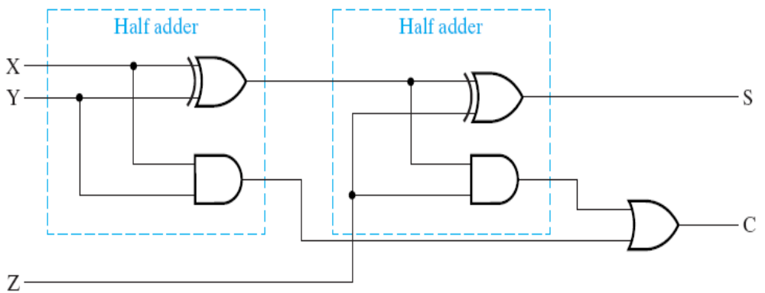
Implementation: Full Adder
Ai
Bi
Logic Diagram of Full Adder
A_{i}, B_{i}, C_{i} and C_{i+1} in the left circuit equals
to X, Y, Z and C in the right circuit
G_{i} is called generate function
P_{i} is called propagate function
Note: S_{i} is the XOR result of variable A_{i}, B_{i} and C_{i} . And carry function C_{i+1} can be expressed as bellow:
C_{i+1} = G_{i} + P_{i} · C_{i}
Gi
Pi
Ci
Ci+1
Si
Chapter 5 <number>

Slide 14
Ripple-Carry Binary Adders
To add multiple operands, we “bundle” logical signals together into vectors and use functional blocks that operate on the vectors
Example: 4-bit ripple carry
adder: Adds input vectors A(3:0) and B(3:0) to get
a sum vector S(3:0)
Note: carry out of cell i
becomes carry in of cell
i + 1
Subscript
Description
Name
3 2 1 0
Carry In
0 1 1 0
Ci
Augend
1 0 1 1
Ai
Addend
0 0 1 1
Bi
Sum
1 1 1 0
Si
Carry out
0 0 1 1
Ci+1
Chapter 5 <number>

Slide 15
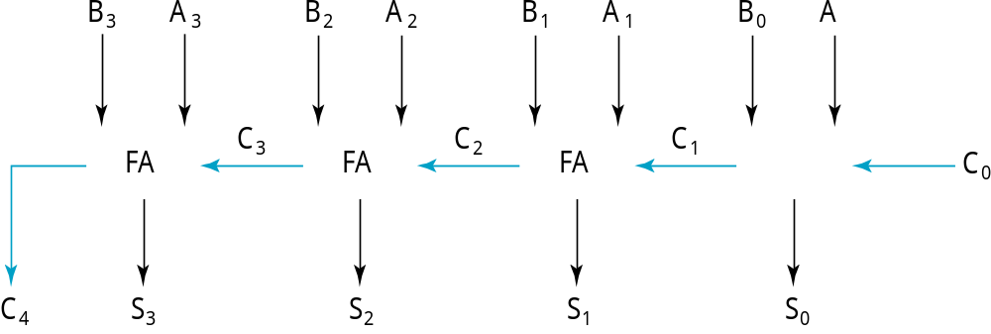
4-bit Ripple-Carry Binary Adder
A four-bit Ripple Carry Adder made from four 1-bit Full Adders:
Chapter 5 <number>

Slide 16
Carry Propagation & Delay
One problem with the addition of binary numbers is the length of time to propagate the ripple carry from the least significant bit to the most significant bit.
The gate-level propagation path for a 4-bit ripple carry adder of the last example:
Note: The "long path" is from A₀ or B₀ though the circuit to S₃ (3 + (4-1)*2 + 3 = 12 gate delay).
A3
A2
A1
A0
B3
B2
B1
B0
C3
C2
C1
C0
C4
S3
S2
S1
S0
Chapter 5 <number>

Slide 17
Carry Lookahead Adder
For a given i-bit binary adder,
  If A_{i} = B_{i} = “1” and whatever C_{i} is, we have carry out as 1,
  that is C_{i+1} = 1
  If the output of half adder is 1 and we have carry in as 1, we have carry out as 1.
  that is C_{i+1} = 1
This two condition of setting carry out as 1 is called generate (G_{i}) and propagate (P_{i}).
Ai
Bi
Gi
Pi
Ci
Ci+1
Si
Chapter 5 <number>

Slide 18
Carry Lookahead Adder (Cont.)
In Ripple-Carry Binary Adders:
  G_{i}, P_{i}, and S_{i} are generated by devices itself
  C_{i+1} is generated by itself while it also depend on C_{i}
In Carry Lookahead Adder, to reduce the delay of long carry path, C_{i+1} is generated directly by input signals.
Adder defined by P_{i} and G_{i} is as follows:
P
=
A
⊕
B
G
=
A
B
i
i
i
i
i
i
S
=
P
⊕
C
C
=
G
+
P
C
i
i
i
i
+
1
i
i
i
Chapter 5 <number>

Slide 19
Carry Lookahead Development
C_{i+1} can be removed from the cells and used to derive a set of carry equations spanning multiple cells.
Beginning at the cell 0 with carry in C₀:
C
=
G
+
P
C
i
+
1
i
i
i
C1 = G0 + P0 C0
C2 = G1 + P1 C1 = G1 + P1(G0 + P0 C0)
= G1 + P1G0 + P1P0 C0
C3 = G2 + P2 C2 = G2 + P2(G1 + P1G0 + P1P0 C0)
= G2 + P2G1 + P2P1G0 + P2P1P0 C0
C4 = G3 + P3 C3
= G3 + P3G2 + P3P2G1+ P3P2P1G0 + P3P2P1P0 C0
Chapter 5 <number>

Slide 20
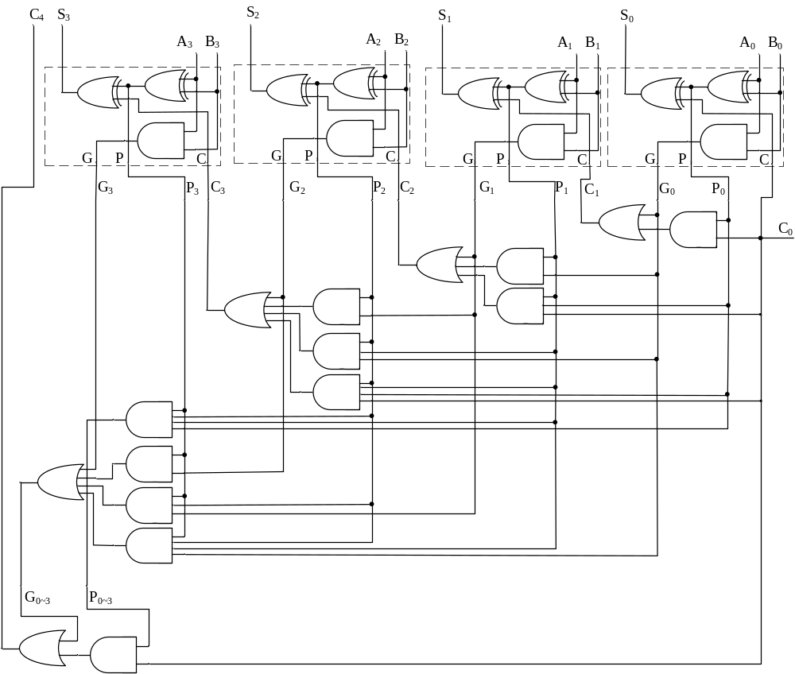
Carry Look-ahead Adder
Chapter 5 <number>

Slide 21
Group Carry Lookahead Logic
Figure 5-6 in the text shows the implementation of these equations for four bits. This could be extended to more than four bits; in practice, due to limited gate fan-in, such extension is not feasible.
C₄= G₃ + P₃G₂ + P₃P₂G₁+ P₃P₂P₁G₀ + P₃P₂P₁P₀ C₀
Instead, the concept is extended another level by considering group generate (G₀₋₃) and group propagate (P₀₋₃) functions:
Using these two equations:
Thus, it is possible to have four 4-bit adders use one of the same carry lookahead circuit to speed up 16-bit addition
G
=
G
+
P
G
+
P
P
G
+
P
P
P
P
G
0
∼
3
3
3
2
3
2
1
3
2
1
0
0
P
=
P
P
P
P
0
∼
3
3
2
1
0
C
=
G
+
P
C
4
0
∼
3
0
∼
3
0
Chapter 5 <number>

Slide 22
Group Carry Lookahead Logic (Cont.)
C₄ = G₃ + P₃G₂ + P₃P₂G₁ + P₃P₂P₁G₀ + P₃P₂P₁P₀C₀= G_{0~3}+ P_{0~3}C₀
C₈ = G₇ + P₇G₆ + P₇P₆G₅ + P₇P₆P₅G₄ + P₇P₆P₅P₄C₄= G_{4~7}+ P_{4~7}C₄
C₁₂ =G₁₁+P₁₁G₁₀+P₁₁P₁₀G₉+P₁₁P₁₀P₉G₈+ P₁₁P₁₀P₉P₈C₈= G_{8~11}+ P_{8~11}C₈
C₁₆=G₁₅+P₁₅G₁₄+P₁₅P₁₄G₁₃+P₁₅P₁₄P₁₃G₁₂+P₁₅P₁₄P₁₃P₁₂C₁₂= G_{12~15}+ P_{12~15}C₁₂
Chapter 5 <number>

Slide 23
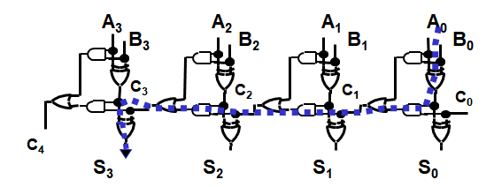
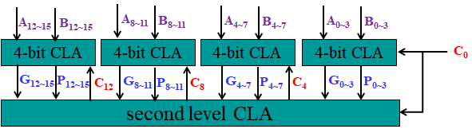
Carry Lookahead Example
S₁₅
Specifications:
  16-bit CLA
  Delays:
    NOT = 1
    AND-OR = 2
    XOR = Isolated AND = 3
Longest Delays:
  Ripple carry adder* = 3 + 15 ⋅ 2 + 3 = 36
    time complexity: O(n)
  CLA = 3 + 3 ⋅ 2 + 3 = 12
    time complexity: O(log n)
3
3
P0
CLA
CLA
CLA
CLA
C₁₅
2
2
G_{0~3}
CLA
2
C₁₂
Chapter 3 <number>
Notes:
CLA: carry-lookahead adder
复杂度为什么由O(1)降到了O(logn)，这个是由于limited fan in，导致采用多层电路抽象的缘故，不过复杂度还是降低了。
hint:
1.XOR consists of a NOT and a AND-OR, therefore its delay is the sum of NOR(1) and AND-OR(2), namely 3.
2.delays calculation:
1)Ripple carry adder: 两头两个XOR，carry C15穿越15个full adder. Its adder time complexity is O(n), while its space complexity also is O(n).
2)CLA计算依据: 第一个3是产生P信号，需要1个XOR；穿越2个CLA（2 level CLA，一个是4 bit CLA 产生G₀₋₃和P₀₋₃，一个是16 bit CLU产生C₁₂），产生C12后；再进入最后一组CLA，产生组内的C₁₅信号，需要1级AND-OR延迟；最后产生S₁₅，还需1个XOR. Its adder time complexity is O(log n), while its space complexity also is O(n*log n).

Slide 24
Unsigned Subtraction
Algorithm:
  Subtract the subtrahend N from the minuend M
  If no end borrow occurs, then M ≥ N, and the result is a non-negative number and correct.
  If an end borrow occurs, the N > M and the difference M − N + 2^{n} is subtracted from 2^{n}, and a minus sign is appended to the result.
Examples:
0 1
1001 0100
− 0111 − 0111
0010 1101
10000
− 1101
(−) 0011
Chapter 5 <number>

Slide 25
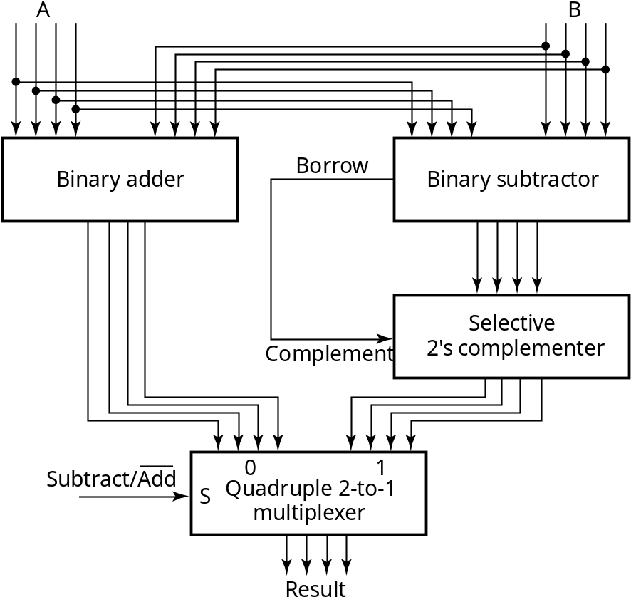
Unsigned Subtraction (continued)
The subtraction, 2^{n} − N, is taking the 2’s complement of N
To do both unsigned addition and unsigned subtraction requires:
Quite complex!
Goal: Shared simpler
logic for both addition
and subtraction
Introduce complements
as an approach
Chapter 5 <number>

Slide 26
Complements
Two complements:
  Diminished Radix Complement of N
    (r − 1)’s complement for radix r
    1’s complement for radix 2
    Defined as (r^{n} − 1) − Ν
  Radix Complement
    r’s complement for radix r
    2’s complement in binary
    Defined as r^{n} − N
Subtraction is done by adding the complement of the subtrahend
If the result is negative, takes its 2’s complement
Chapter 4 <number>

Slide 27
Binary 1's Complement(反码)
For r = 2, N = 01110011₂, n = 8 (8 digits):
(r^{n} – 1) = 256 -1 = 255₁₀ or 11111111₂
The 1's complement of 01110011₂ is then:
11111111
– 01110011
10001100
Since the 2^{n} – 1 factor consists of all 1's and since 1 – 0 = 1 and 1 – 1 = 0, the one's complement is obtained by complementing each individual bit (bitwise NOT).
Chapter 4 <number>

Slide 28
Binary 2's Complement(补码)
For r = 2, N = 01110011₂, n = 8 (8 digits), we have:
(r^{n} ) = 256₁₀ or 100000000₂
The 2's complement of 01110011 is then:
100000000
– 01110011
10001101
Note the result is the 1's complement plus 1, a fact that can be used in designing hardware
Chapter 4 <number>

Slide 29
Alternate 2’s Complement Method
Given: an n-bit binary number, beginning at the least significant bit and proceeding upward:
  Copy all least significant 0’s
  Copy the first 1
  Complement all bits thereafter.
2’s Complement Example:
  10010100
  Copy underlined bits:
  100
  and complement bits to the left:
  01101100
Chapter 4 <number>

Slide 30
Subtraction with 2’s Complement
For n-digit, unsigned numbers M and N, find M − N in base 2:
  Add the 2's complement of the subtrahend N to the minuend M:
  M + (2^{n} − N) = M − N + 2^{n}
  If M > N, the sum produces end carry r^{n} which is discarded; from above, M − N remains.
  If M < N, the sum does not produce an end carry and, from above, is equal to 2^{n} − ( N − M ), the 2's complement of ( N − M ).
  To obtain the result − (N – M) , take the 2's complement of the sum and place a − to its left.
Chapter 4 <number>

Slide 31
Unsigned 2’s Complement Subtraction Example 1
Find 01010100₂ – 01000011₂
01010100 01010100
– 01000011 + 10111101
00010001
The carry of 1 indicates that no correction of the result is required.
1
2’s comp
Chapter 4 <number>

Slide 32
Unsigned 2’s Complement Subtraction Example 2
Find 01000011₂ – 01010100₂
01000011 01000011
– 01010100 + 10101100
11101111
00010001
The carry of 0 indicates that a correction of the result is required.
Result = – (00010001)
0
2’s comp
2’s comp
Chapter 4 <number>

Slide 33
Signed Integers
Positive numbers and zero can be represented by unsigned n-digit, radix r numbers. We need a representation for negative numbers.
To represent a sign (+ or –) we need exactly one more bit of information (1 binary digit gives 2¹ = 2 elements which is exactly what is needed).
Since computers use binary numbers, by convention, the most significant bit is interpreted as a sign bit:
s a_{n–2} … a₂a₁a₀
where:
s = 0 for Positive numbers
s = 1 for Negative numbers
and a_{i} = 0 or 1 represent the magnitude in some form.
Chapter 4 <number>

Slide 34
Signed Integer Representations
Signed-Magnitude – here the n – 1 digits are interpreted as a positive magnitude.
Signed-Complement – here the digits are interpreted as the rest of the complement of the number. There are two possibilities here:
  Signed 1's Complement
    Uses 1's Complement Arithmetic
  Signed 2's Complement
    Uses 2's Complement Arithmetic
Chapter 4 <number>

Slide 35
Signed Integer Representation Example
r =2, n=3
Number
Sign
-
Mag.
1's Comp.
2's Comp.
+3
011
011
011
+2
010
010
010
+1
001
001
001
+0
000
000
000
–
0
100
111
—
–
1
101
110
111
–
2
110
101
110
–
3
111
100
101
–
4
—
—
100
Chapter 4 <number>

Slide 36
Signed-Magnitude Arithmetic
If the parity of the three signs （two operands and the operator) is 0:
    1. Add the magnitudes.
    2. Check for overflow (a carry out of the MSB)
    3. The sign of the result is the same as the sign of the
    first operand.
If the parity of the three signs is 1:
    1. Subtract the second magnitude from the first.
    2. If a borrow occurs:
      take the two’s complement of result
      make the result sign the complement of the sign of the first operand.
    3. Overflow will never occur.
Chapter 4 <number>
Notes:
Parity = 0( 同号数相加或异号数相减)：magnitude相加，符号与第一个操作数相同。
Parity = 1(同号数相减或异号数相加)：magnitude相减，取绝对值较大的符号。

Slide 37
Sign-Magnitude Arithmetic Examples
Example 1: 0010
+ 0101
Example 2: 0010
+ 1101
Example 3: 1010
− 0101
Chapter 4 <number>
Notes:
Example 1: Since the parity of the signs is 0: ADD magnitudes giving 111
Append the sign of the first operand to obtain 0111
Example 2: Since the parity of the signs is 1: SUBTRACT 010
- 101
101 Borrow of 1
Taking the 2’s complement and appending the complement of the sign: 1011
Example 3: Since the parity of the signs is 0, ADD the magnitudes 010
101
111
Appending the sign if the top operand: 1111

Slide 38
Signed-Complement Arithmetic
Addition:
  1. Add the numbers including the sign bits, discarding a carry out of the sign bits (2's Complement), or using an end-around carry (1's Complement).
  2. If the sign bits were the same for both numbers and the sign of the result is different, an overflow has occurred.
  3. The sign of the result is computed in step 1.
Subtraction:
  Form the complement of the number you are subtracting and follow the rules for addition.
Chapter 4 <number>
Notes:
End-round carry: 符号位有进位时，应在结果的最低位再加1

Slide 39
Signed 2’s Complement Examples
Example 1: 1101
+ 0011
Example 2: 1101
− 0011
Chapter 4 <number>
Notes:
Example 1: Result is 0000. The carry out of the MSB is discarded.
Example 2: Complement 0011 to 1101 and add. Result is 1010. The carry out of the MSB is discarded.

Slide 40
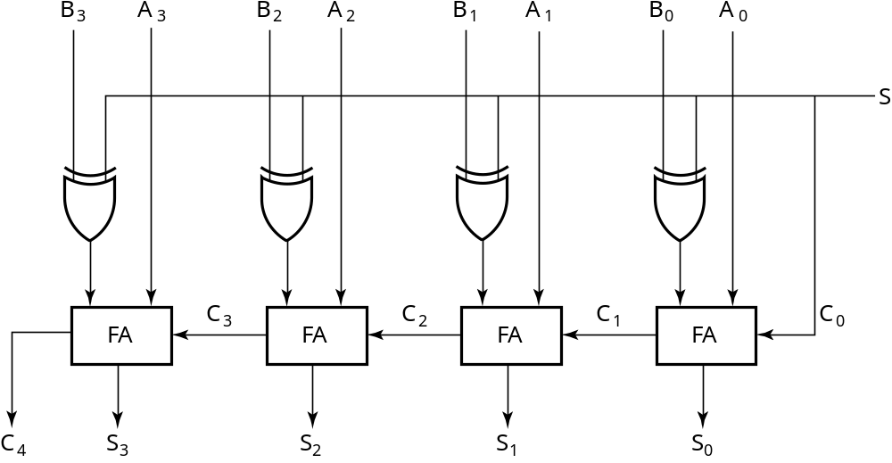
2’s Complement Adder/Subtractor
Subtraction can be done by addition of the 2's Complement.
1. Complement each bit (1's Complement.)
2. Add 1 to the result.
The circuit shown computes A + B and A – B:
For S = 1, subtract,
the 2’s complement
of B is formed by using
XORs to form the 1’s
comp and adding the 1
applied to C₀.
For S = 0, add, B is
passed through
unchanged
Chapter 4 <number>

Slide 41
Arithmetic Logic Unit (ALU)
Arithmetic circuit design
  Decompose the arithmetic circuit into:
    An n-bit parallel adder
    A block of logic that selects four choices for the B input to the adder
    See next slide for diagram
Chapter 5 <number>

Slide 42
Arithmetic Circuit Design (continued)
There are only four functions of B to select as Y in G = A + Y:
  0
  B
  B
  1
What functions are implemented with carry-in to the adder = 0? =1?
Y_{i}=B_{i}S₀+B_{i}S₁
Cin = 0
Cin = 1
G = A
G = A + 1
G = A + B
G = A + B + 1
G = A + B
G = A + B + 1
G = A – 1
G = A
C
in
n
A
X
n
n-bit
n
=
+
+
B
parallel
G
X
Y
C
in
B input
n
adder
S
logic
Y
0
S
1
C
Chapter 5 <number>
out

Slide 43
Overflow
Overflow occurs if n + 1 bits are required to contain the result from an n-bit addition or subtraction
For Unsigned number
  Overflow occurs when there is a carry of 1 for addition
  No overflow occurs, but correction may be required
For signed number, overflow can occur for:
  Addition of two operands with the same sign
  Subtraction of operands with different signs
Detection can be performed by examining the result signs which should match the signs of the top operand
Chapter 4 <number>

Slide 44
Overflow Detection
Signed number cases with carries C_{n} and C_{n−1} shown for correct result signs:
0 0 0 0 1 1 1 1
0 0 1 1
+ 0 − 1 − 0 + 1
0 0 1 1
Signed number cases with carries shown for erroneous result signs (indicating overflow):
0 1 0 1 1 0 1 0
0 0 1 1
+ 0 − 1 −0 + 1
1 1 0 0
Simplest way to implement overflow V = C_{n} + C_{n − 1}
This works correctly only if 1’s complement and the addition of the carry in of 1 is used to implement the complementation! Otherwise fails for − 10 ... 0
Chapter 4 <number>

Slide 45
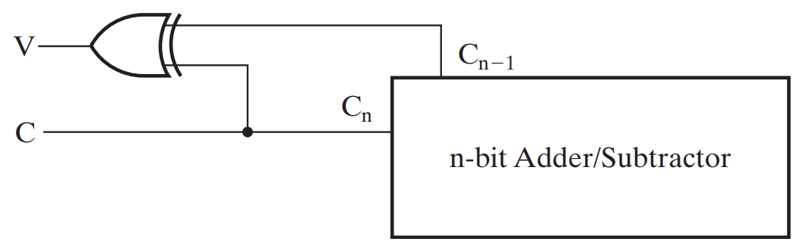
Overflow Detection
For unsigned number
  Addition
    C=1 : overflow
    C=0: no overflow
  Subtraction: no overflow
    C=1: no correction required
    C=0: correction required
For signed number
  V=0: no overflow
  V=1: overflow
Chapter 5 <number>

Slide 46
Other Arithmetic Functions
Convenient to design the functional blocks by contraction - removal of redundancy from circuit to which input fixing has been applied
Functions
  Incrementing
  Decrementing
  Multiplication by Constant
  Division by Constant
  Zero Fill and Extension
Chapter 4 <number>

Slide 47
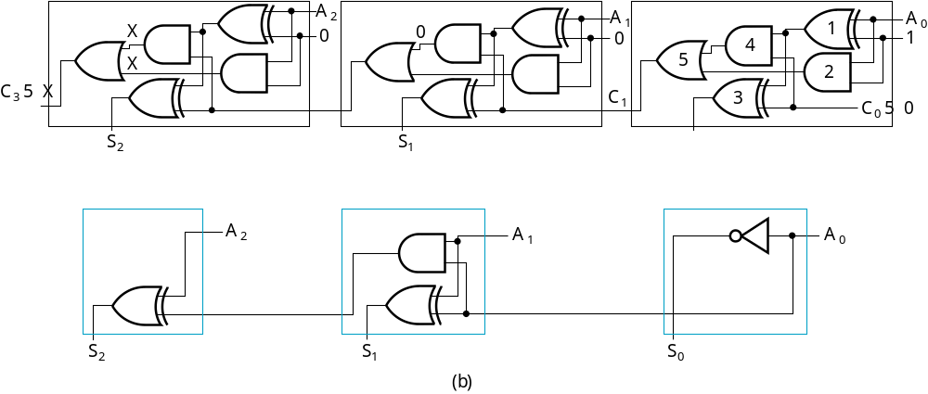
Design by Contraction Example
Contraction of a ripple carry adder to incrementer for n = 3
  Set B = 001
  The middle cell can be repeated to make an incrementer with n > 3.
Chapter 4 <number>

Slide 48
Incrementing & Decrementing
Incrementing
  Adding a fixed value to an arithmetic variable
  Fixed value is often 1, called counting (up)
  Examples: A + 1, B + 4
  Functional block is called incrementer
Decrementing
  Subtracting a fixed value from an arithmetic variable
  Fixed value is often 1, called counting (down)
  Examples: A − 1, B − 4
  Functional block is called decrementer
Chapter 4 <number>

Slide 49
Multiplication/Division by 2^{n}
(a) Multiplication
by 100
  Shift left by 2
(b) Division
by 100
  Shift right by 2
  Remainder
  preserved
B
3
B
2
B
1
B
0
0
0
C
5
C
4
C
3
C
2
C
1
C
0
(a)
B
3
B
2
B
1
B
0
0
0
C
3
C
2
C
1
C
0
C
2
1
C
2
2
(b)
Chapter 4 <number>

Slide 50
Multiplication by a Constant
Multiplication of B(3:0) by 101
See text Figure 513 (a) for contraction
B
B
B
B
0
0
B
B
B
B
3
2
1
0
3
2
1
0
4-bit Adder
Carry
output
Sum
C
6
C
5
C
4
C
3
C
2
C
1
C
0
Chapter 4 <number>

Slide 51
Zero Fill
Zero fill - filling an m-bit operand with 0s to become an n-bit operand with n > m
Filling usually is applied to the MSB end of the operand, but can also be done on the LSB end
Example: 11110101 filled to 16 bits
  MSB end: 0000000011110101
  LSB end: 1111010100000000
Chapter 4 <number>

Slide 52
Sign Extension
Extension - increase in the number of bits at the MSB end of an operand by using a complement representation
  Copies the MSB of the operand into the new positions
  Positive operand example: 01110101 extended to 16 bits:
  0000000001110101
  Negative operand example: 11110101 extended to 16 bits:
  1111111111110101
Chapter 4 <number>

Slide 53
Assignment
Problems: 3-50; 3-51; 3-52; 3-55；3-59
Chapter 5 <number>

