Slide 1
Logic and Computer Design Fundamentals
Digital Hardware Implementation
Haifeng Liu
haifengliu@zju.edu.cn
College of Computer Science and Technology, Zhejiang University

Slide 2
Overview
Design Space
Programming Logic
  Why programmable logic?
  Programmable logic technologies
  Programmable Configurations

Slide 3

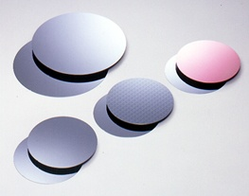
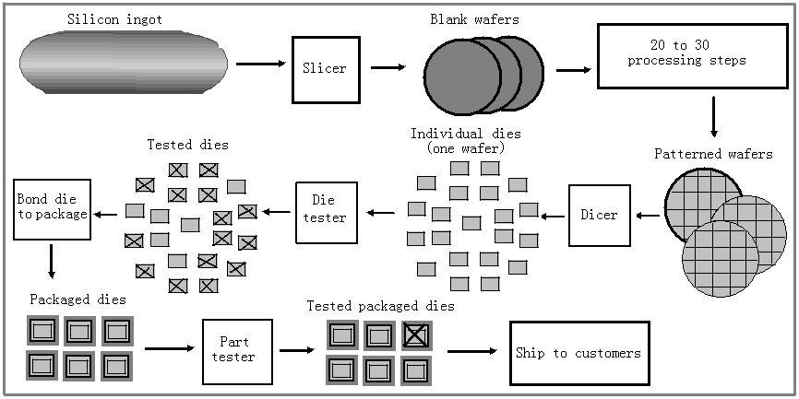
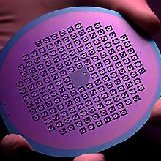
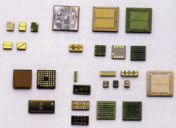
5.1 The Design Space
Gate Properties
Digital Circuit Integrated Circuit Semiconductor

Slide 4
Integrated Circuits
Integrated circuit (informally, a “chip”) is a semiconductor crystal (most often silicon) containing the electronic components for the digital gates and storage elements which are interconnected on the chip.
Terminology - Levels of chip integration
  SSI (small-scale integrated) - fewer than 10 gates
  MSI (medium-scale integrated) - 10 to 100 gates
  LSI (large-scale integrated) - 100 to 1000s of gates
  VLSI (very large-scale integrated) - s to 100s of millions of gates

Slide 5
Technology Parameters
Specific gate implementation technologies are characterized by the following parameters:
  Fan-in – the number of inputs available on a gate
  Fan-out – the number of standard loads driven by a gate output
  Noise Margin – the maximum external noise voltage imposed on a normal input value that will not cause an undesirable change in the circuit output
  Cost for a gate - a measure of the contribution of the gate to the cost of the integrated circuit
  Propagation Delay – The time required for a change in the value of a signal to propagate from an input to an output
  Power Dissipation – the power drawn from the power supply and consumed by the gate

Slide 6
Propagation Delay
Propagation delay is the time for a change on an input of a gate to propagate to the output.
Delay is usually measured at the midpoint between the H and L output voltage levels.
High-to-low (t_{PHL}) and low-to-high (t_{PLH}) output signal changes may have different propagation delays.
High-to-low (HL) and low-to-high (LH) transitions are defined with respect to the output, not the input.
An HL input transition causes:
  an LH output transition if the gate inverts and
  an HL output transition if the gate does not invert.

Slide 7
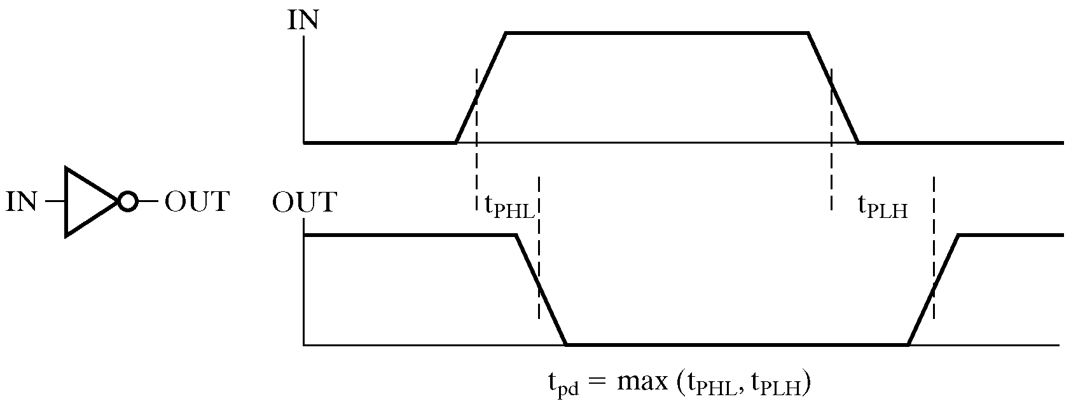
Propagation Delay (continued)
Propagation delays measured at the midpoint between the L and H values

Slide 8
Propagation Delay Example
Find the t_{PHL}, t_{PLH} and t_{pd} for the given signals
IN (volts)
OUT (volts)
t (ns)
1.0 ns per division

Slide 9
Delay Models
Transmission delay - a change of the output in response to a change on the inputs occurred after a fixed specified delay
Inertial delay - similar to transport delay, except that if input changes cause the output to changes twice in an interval less than the rejection time, then the first of the output changes does not occur. This models typical electronic circuit behavior, namely, rejects narrow “pulses” on the outputs

Slide 10
Delay Model Example
A
B
A B:
No Delay
(ND)
a
b
c
d
e
Transport
Delay (TD)
Inertial
Delay (ID)
0
2
4
6
8
10
12
14
16
Time (ns)
Propagation Delay = 2.0 ns Rejection Time = 1.0 ns

Slide 11
Fan-out
Fan-out can be defined in terms of a standard load
  Example: 1 standard load equals the load contributed by the input of 1 inverter.
  Transition time -the time required for the gate output to change from H to L, t_{HL}, or from L to H, t_{LH}
  The maximum fan-out that can be driven by a gate is the number of standard loads the gate can drive without exceeding its specified maximum transition time

Slide 12
Fan-out and Delay
The fan-out loading of a gate’s output affects the gate’s propagation delay
Example:
  One equation for t_{pd} for a NAND gate with 4 inputs is:
    t_{pd} = 0.07 + 0.021 SL ns
  SL is the number of standard loads the gate is driving, i. e., its fan-out in standard loads
  For SL = 4.5, t_{pd} = 0.1645 ns

Slide 13
Gate Cost
In an integrated circuit:
  The cost of a gate is proportional to the chip area occupied by the gate
  The gate area is roughly proportional to the number and size of the transistors and the amount of wiring connecting them
  Ignoring the wiring area, the gate area is roughly proportional to the gate input count
  So gate input count is a rough measure of gate cost
If the actual chip layout area occupied by the gate is known, it is a far more accurate measure

Slide 14
Design Trade-Offs
Cost - performance tradeoffs
Gate-Level Example:
  NAND gate G with 20 standard loads on its output has a delay of 0.45 ns and has a normalized cost of 2.0
  A buffer H has a normalized cost of 1.5. The NAND gate driving a buffer with 20 standard loads gives a total delay of 0.33 ns
  In which of the following cases should the buffer be added?
    The cost of this portion of the circuit cannot be more than 2.5
    The delay of this portion of the circuit cannot be more than 0.40 ns √
    The delay of this portion of the circuit must be less than 0.30 ns and the cost less than 3.0
Tradeoffs can also be accomplished much higher in the design hierarchy
Constraints on cost and performance have a major role in making tradeoffs

Slide 15
Positive and Negative Logic
The same physical gate has different logical meanings depending on the interpretation of the signal levels.
Positive Logic
  HIGH (more positive) signal levels represent Logic 1
  LOW (less positive) signal levels represent Logic 0
Negative Logic
  LOW (more negative) signal levels represent Logic 1
  HIGH (less negative) signal levels represent Logic 0
A gate that implements a Positive Logic AND function will implement a Negative Logic OR function, and vice-versa.

Slide 16
Positive and Negative Logic (continued)
Given this signal level table:
What logic function is implemented?
Input
Output
X Y
L
L
L
L H
H
H L
H
H
H
H
Positive
(H = 1)
Negative
(H = 0)
Logic
(L = 0)
Logic
(L = 1)
0 0
0
1 1
1
0 1
1
1 0
0
1 0
1
0 1
0
1 1
1
0 0
0

Slide 17
Positive and Negative Logic (continued)
Rearranging the negative logic terms to the standard function table order:
Positive
(H = 1)
Negative
(H = 0)
Logic
(L = 0)
Logic
(L = 1)
0 0
0
0 0
0
0 1
1
0 1
0
1 0
1
1 0
0
1 1
1
1 1
1
F=A+B
F=AB

Slide 18
Logic Symbol Conventions
Use of polarity indicator to represent use of negative logic convention on gate inputs or outputs
X
Y
Z
X
CKT
Z
L
L
L
Y
L
H
H
Logic Circuit
H
L
H
H
H
H
X
X
Z
Z
Y
Y
Positive Logic
Negative Logic

Slide 19
5.2 Programmable Logic?
Facts:
  It is most economical to produce an IC in large volumes
  Many designs required only small volumes of ICs
Need an IC that can:
  Be produced in large volumes
  Handle many designs required in small volumes
A programmable logic part can be:
  made in large volumes
  programmed to implement large numbers of different low-volume designs

Slide 20
Programmable Logic - Additional Advantages
Many programmable logic devices are field- programmable, i. e., can be programmed outside of the manufacturing environment
Most programmable logic devices are erasable and reprogrammable.
  Allows “updating” a device or correction of errors
  Allows reuse the device for a different design - the ultimate in re-usability!
  Ideal for course laboratories
Programmable logic devices can be used to prototype design that will be implemented for sale in regular ICs.
  Complete Intel Pentium designs were actually prototype with specialized systems based on large numbers of VLSI programmable devices!

Slide 21
Programming Technologies
  Control connections
    Mask programming
    Fuse
    Antifuse
    Single-bit storage element
  Build lookup tables
    Storage elements (as in a memory)
  Control transistor switching
    Stored charge on a floating transistor gate
      Erasable
      Electrically erasable
      Flash (as in Flash Memory)
    Storage elements (as in a memory)

Slide 22
Technology Characteristics
Permanent - Cannot be erased and reprogrammed
    Mask programming
    Fuse
    Antifuse
Reprogrammable
  Volatile - Programming lost if chip power lost
    Single-bit storage element
  Non-Volatile
    Erasable
    Electrically erasable
    Flash (as in Flash Memory)

Slide 23
Programmable Configurations
Read Only Memory (ROM) - a fixed array of AND gates and a programmable array of OR gates
Programmable Array Logic (PAL)® - a programmable array of AND gates feeding a fixed array of OR gates.
Programmable Logic Array (PLA) - a programmable array of AND gates feeding a programmable array of OR gates.
Complex Programmable Logic Device (CPLD) /Field- Programmable Gate Array (FPGA) - complex enough to be called “architectures” - See VLSI Programmable Logic Devices reading supplement

Slide 24
ROM, PAL and PLA Configurations
Fixed
Programmable
Programmable
Inputs
AND array
Connections
OR array
Outputs
(decoder)
(a) Programmable read-only memory (PROM)
Inputs
Programmable
Programmable
Fixed
Connections
AND array
OR array
Outputs
(b) Programmable array logic (PAL) device
Programmable
Programmable
Programmable
Programmable
Inputs
Connections
AND array
Connections
OR array
Outputs
(c) Programmable logic array (PLA) device

Slide 25
Read Only Memory
Read Only Memories (ROM) or Programmable Read Only Memories (PROM) have:
  N input lines,
  M output lines, and
  2^{N} decoded minterms.
Fixed AND array with 2^{N} outputs implementing all N-literal minterms.
Programmable OR Array with M outputs lines to form up to M sum of minterm expressions.
A program for a ROM or PROM is simply a multiple-output truth table
  If a 1 entry, a connection is made to the corresponding minterm for the corresponding output
  If a 0, no connection is made
Can be viewed as a memory with the inputs as addresses of data (output values), hence ROM or PROM names!

Slide 26
Read Only Memory Example
Example: A 8 X 4 ROM (N = 3 input lines, M= 4 output lines)
The fixed "AND" array is a
“decoder” with 3 inputs and 8
outputs implementing minterms.
The programmable "OR“
array uses a single line to
represent all inputs to an
OR gate. An “X” in the
array corresponds to attaching the
minterm to the OR
Read Example: For input (A₂,A₁,A₀)
= 001, output is (F₃,F₂,F₁,F₀ ) = 0011.
What are functions F₃, F₂ , F₁ and F₀ in terms of (A₂, A₁, A₀)?
D7
X
X
X
D6
D5
X
X
D4
X
A
A2
D3
X
B
D2
X
X
A1
D1
C
A0
D0
X
F3
F2
F1
F0
Notes:
F3 = D7 + D5 + D2 = A2 A0 + A2’ A1 A0’
F2 = D7 + D0 = A2 A1 A0 + A2’ A1’ A0’
F1 = D4 + D1 = A1 A1’ A0’ + A2’ A1’ A0
F0 = D7 + D5 + D1 = A2 A0 + A1’ A0
或门其实有8个输入端

Slide 27
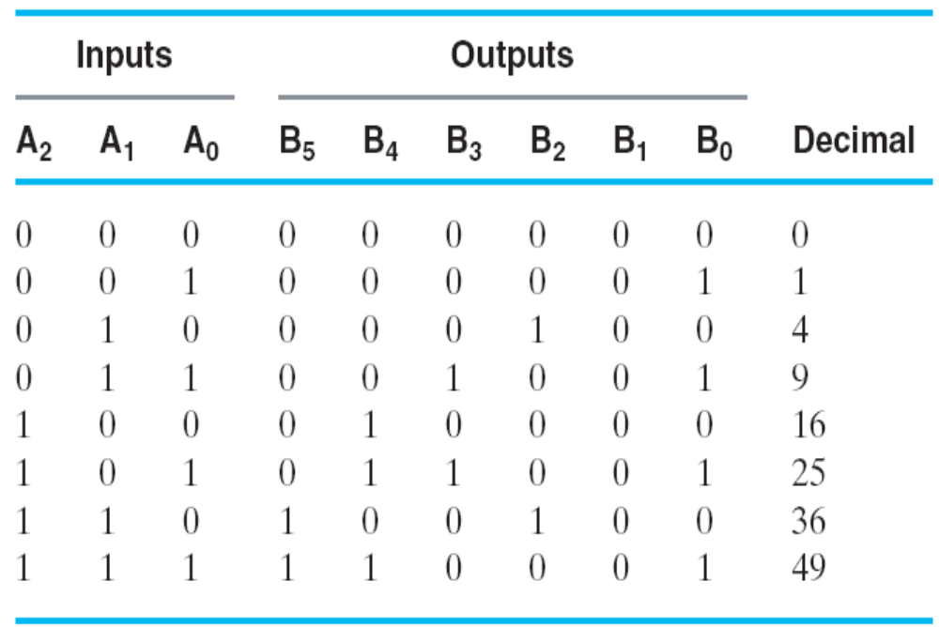
ROM Example: Square of 3-bit input number
Functions are implemented by storing the truth table
Other representations such as equations more convenient
Generation of programming information from equations usually done by software
_{B0 = A0}
_{B1 = 0}
_{8×4bit} _{ROM can be selected}
Chapter 4 <number>

Slide 28
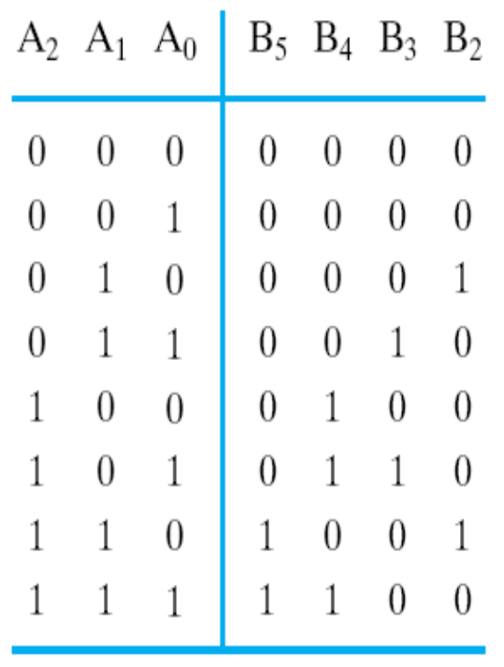
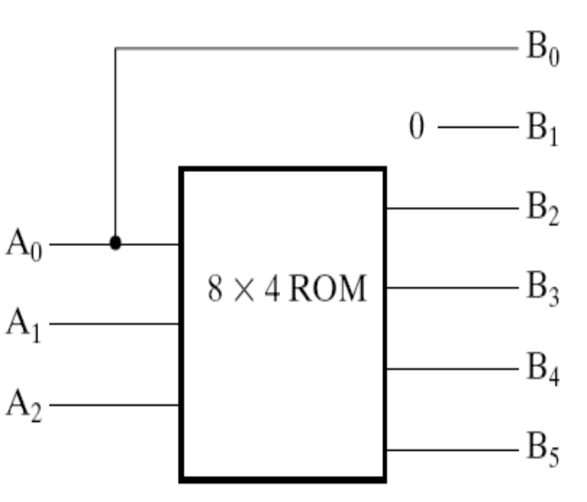
Square of 3-bit input number
ROM Truth Table
8 × 4 ROM are selected
The equations input the address of ROM, and ROM ouput the square of input
How to choose ROM?
Chapter 4 <number>

Slide 29
Programmable Array Logic (PAL)
The PAL is the opposite of the ROM, having a programmable set of ANDs combined with fixed ORs.
Disadvantage
  ROM guaranteed to implement any M functions of N
  inputs. PAL may have too few inputs to the OR gates.
Advantages
  For given internal complexity, a PAL can have larger N and M
  Some PALs have outputs that can be complemented, adding POS functions
  No multilevel circuit implementations in ROM (without external connections from output to input). PAL has
  outputs from OR terms as internal inputs to all AND
  terms, making implementation of multi-level circuits easier.

Slide 30
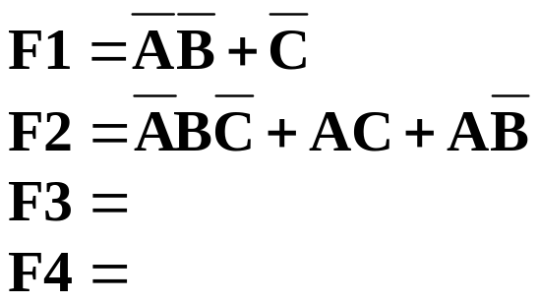
Programmable Array Logic Example
AND gates inputs
4-input, 4-output PAL with fixed, 3-input OR terms
What are the equations for F1 through F4?
0
1
2
3
4
5
6
7
8
9
Product
1
X
term
2
X
X
F
1
3
I
1
=
A
4
X
X
X
5
X
X
F
2
6
X
X
I
2
=
B
7
X
X
8
X
X
F
3
9
X
I
3
=
C
10
X
X
11
X
X
F
4
12
X
I
4
=
D
0
1
2
3
4
5
6
7
8
9
Notes:
F3 = AD + BD + F1 = AD + BD + A’B+ C’ = AD + BD + A’B’ + C’
F4 = AB + CD + F1’ = AB + CD + (A’B’ + C’)’ = AB + CD + AC + BC

Slide 31
Programmable Array Logic Design
Design requires fitting functions within the limited number of ANDs per OR gate
Single function optimization is the first step to fitting
If the number of product terms in a function is greater than the number of ANDs per OR gate, then factoring is necessary
Chapter 4 <number>

Slide 32
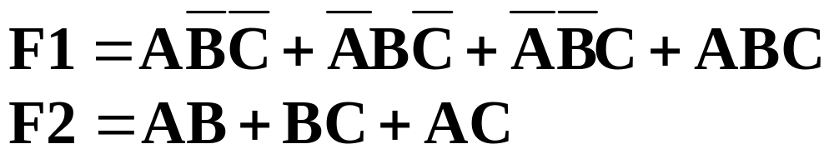

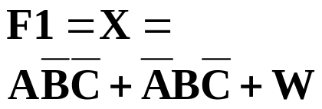
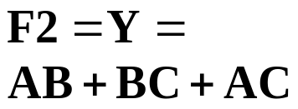
PAL Example
Equations:
F1 must be
factored
Factor out
last two
terms as W
AND
Inputs
Pr
od
uc
t
term
A B C D
W
Outputs
1
0
0
1
—
—
2
1
1
1
—
—
3
—
—
—
—
—
4
1
0
0
—
—
5
0
1
0
—
—
6
—
—
—
—
1
7
1
1
—
—
—
8
—
1
1
—
—
9
1
—
1
—
—
10
—
—
—
—
—
11
—
—
—
—
—
12
—
—
—
—
—
Chapter 4 <number>

Slide 33
PAL Example
AND gates inputs
Product
A
A
B
B
C
C
D
D
W
W
term
1
X
X
X
2
X
X
X
W
3
X
A
4
X
X
X
All fuses intact
(always
=
0)
5
X
X
X
F1
6
X
B
7
X
X
8
X
X
F2
9
X
X
C
10
11
12
D
X
Fuse intact
1
Fuse blown
Chapter 4 <number>
A
A
B
B
C
C
D
D
W
W

Slide 34
Programmable Logic Array (PLA)
Compared to a ROM and a PAL, a PLA is the most flexible having a programmable set of ANDs combined with a programmable set of ORs.
Advantages
  A PLA can have large N and M permitting implementation of equations that are impractical for a ROM (because of the number of inputs, N, required)
  A PLA has all of its product terms connectable to all outputs, overcoming the problem of the limited inputs to the PAL Ors
  Some PLAs have outputs that can be complemented, adding POS functions
Disadvantage
  Often, the product term count limits the application of a PLA. Two-level multiple-output optimization reduces the number of product terms in an implementation, helping to fit it into a PLA.

Slide 35
Programmable Logic Array Example
A
What are the equations for F₁ and F₂?
Could the PLA implement the
functions without the XOR gates?
B
C
X
X
1
X
X
A B
X
X
2
X
B C
X
Fuse intact
A C
Fuse blown
X
X
3
X
X
X
4
X
A B
C
C
B
B
A
A
X
0
3-input, 2-output PLA with 4 product terms
X
1
F
1
F
2
Notes:
多了异或门
F1 = AB +BC + AC
F2 = (AB + A’B’)’ = (A’ + B’) (A + B) = A’B + AB’
No. If only SOP functions used, requires at least 5 AND gates.

Slide 36
Programmable Logic Array Design
The set of functions to be implemented must fit the available number of product terms
The number of literals per term is less important in fitting
The best approach to fitting is multiple-output, two-level optimization (which has not been discussed)
Since output inversion is available, terms can implement by either a function or its complement
For small circuits, K-maps can be used to visualize product term sharing and use of complements
For larger circuits, software is used to do the optimization including use of complemented functions
Chapter 4 <number>

Slide 37
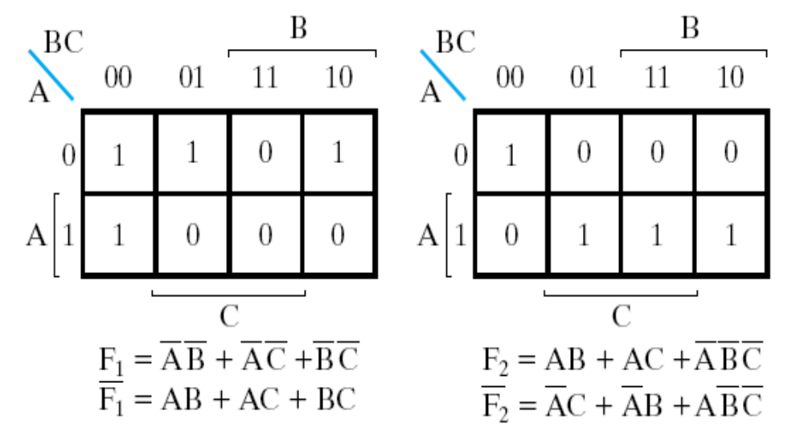
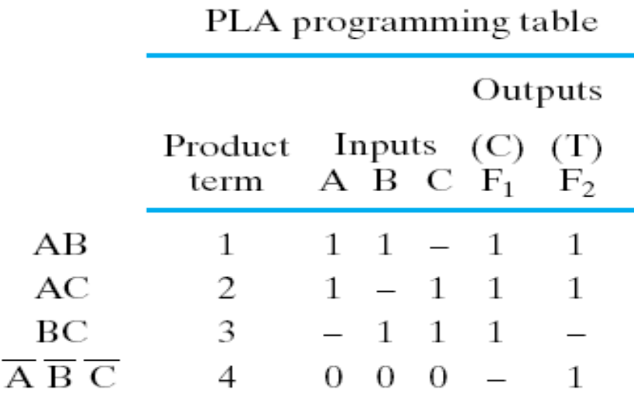
PLA Design Example
Implement functions:
F1(A,B,C)
=Σm(0,1,2,4)
F2(A,B,C)
=Σm(0,5,6,7)
K-map
specification
How can this
be implemented
with the least product terms?
Complete the
programming table
Chapter 4 <number>

Slide 38
PLA Example
A
B
C
X
X
1
X
X
X
X
2
X
X
X
Fuse intact
＋
Fuse blown
X
X
3
X
X
X
X
4
X
C
C
B
B
A
A
X
0
X
1
F
1
F
2
Chapter 4 <number>

Slide 39
Assignment
Reading: chapter 5
Problem Assignment:
2-29；2-30；2-31C；5-3; 5-4, 5-12

