Slide 1
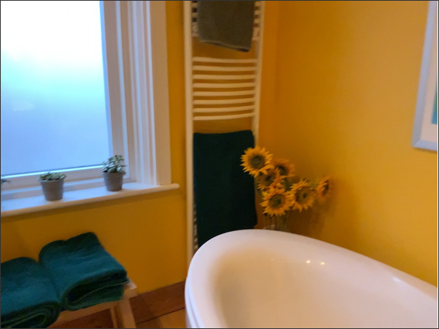
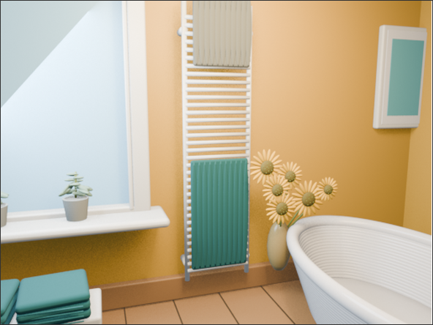
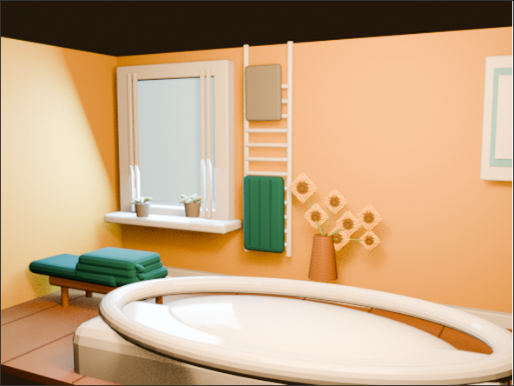
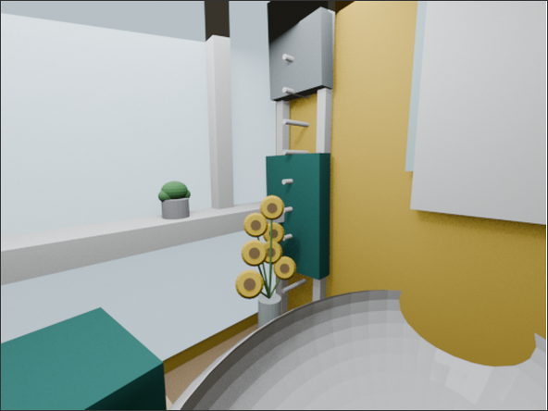
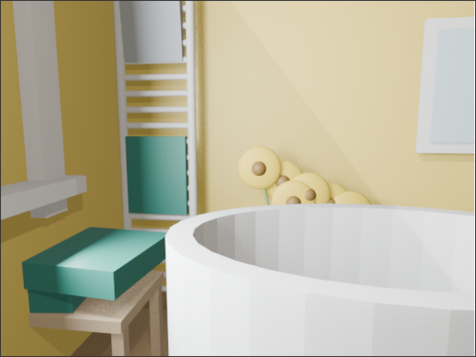
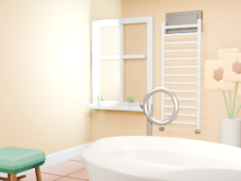
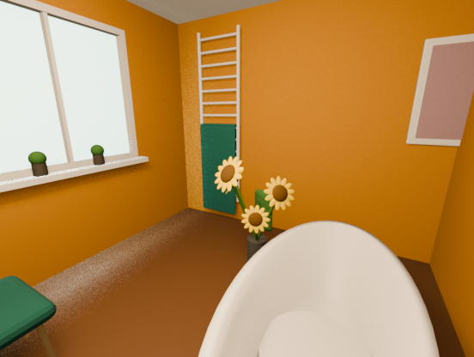
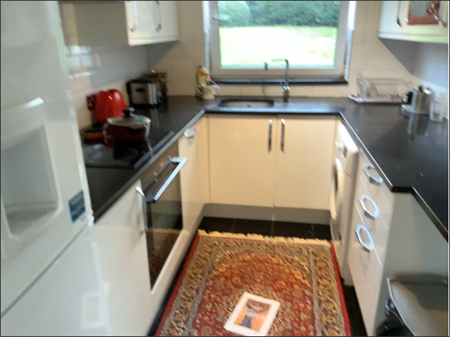
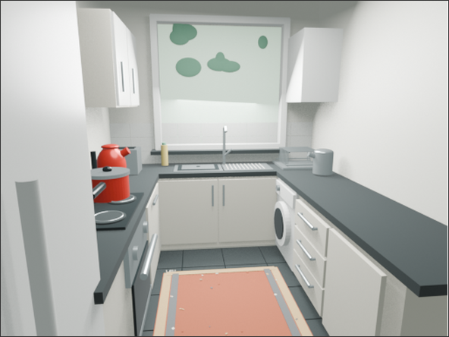
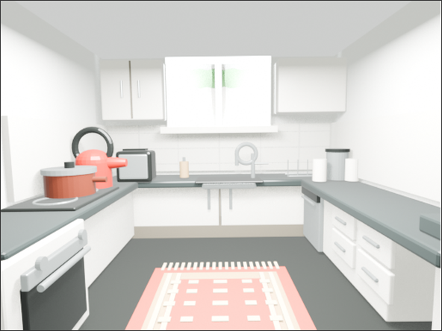
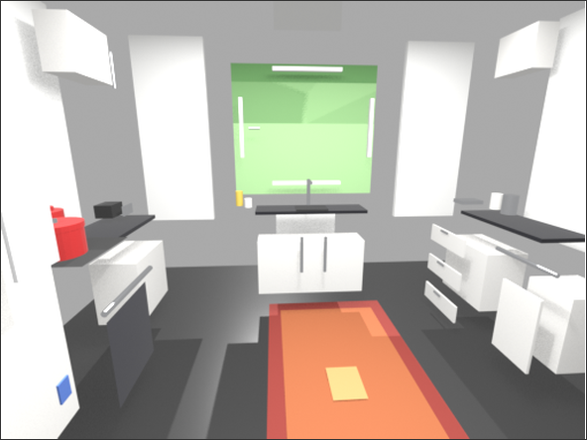
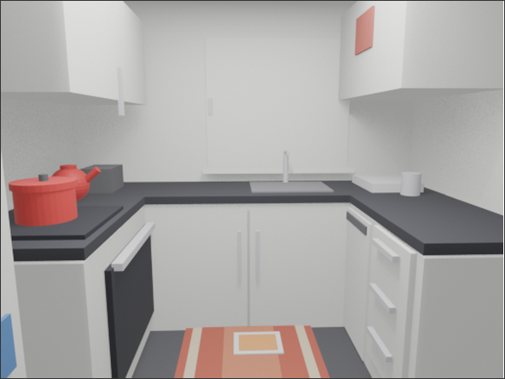
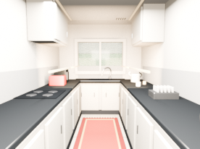
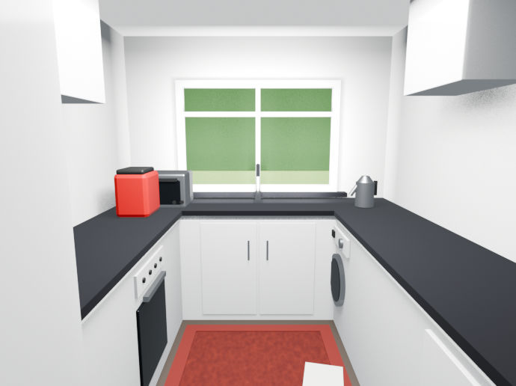
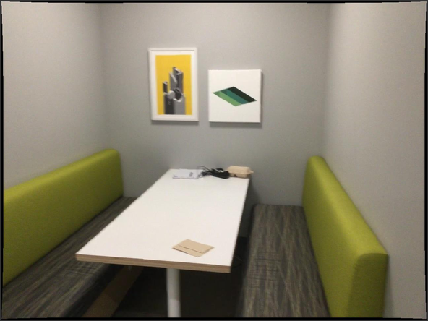
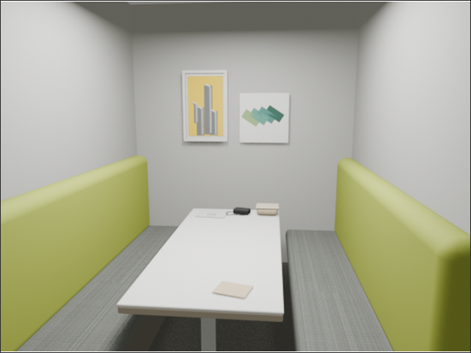
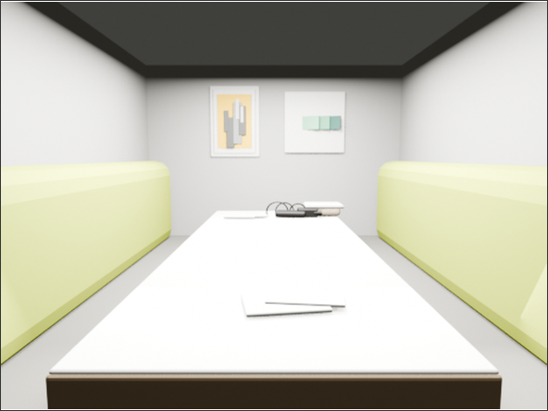
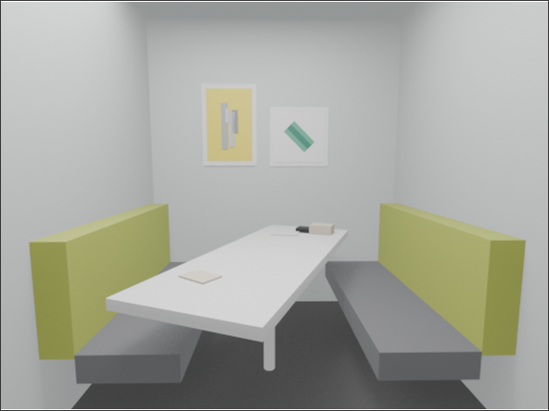
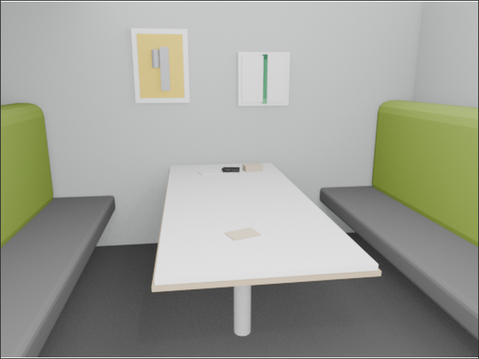
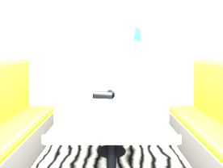
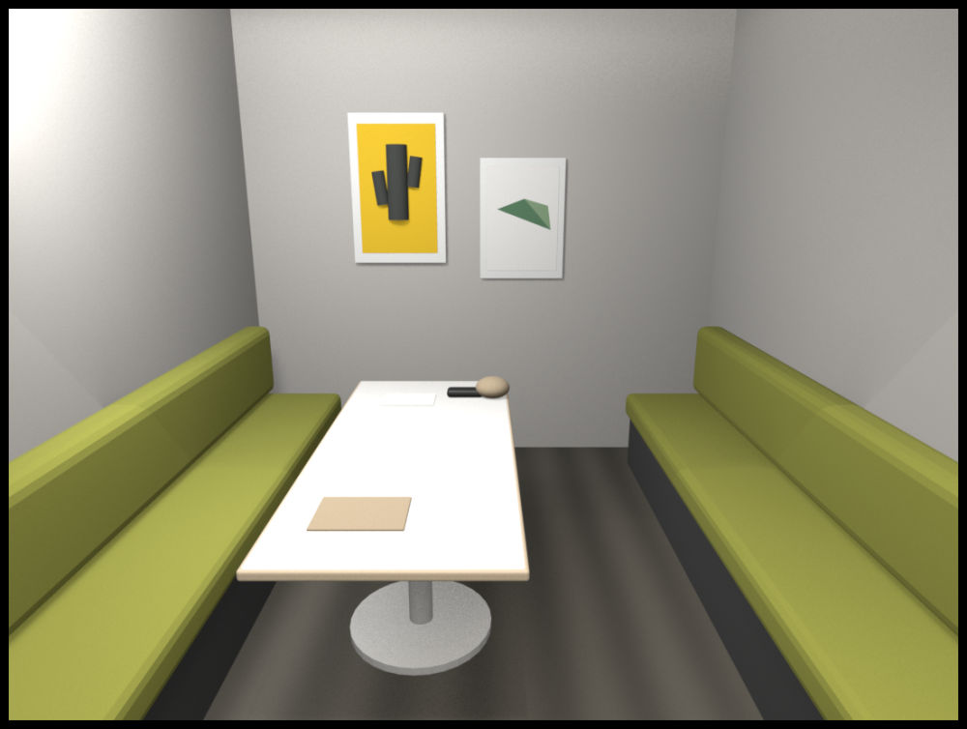
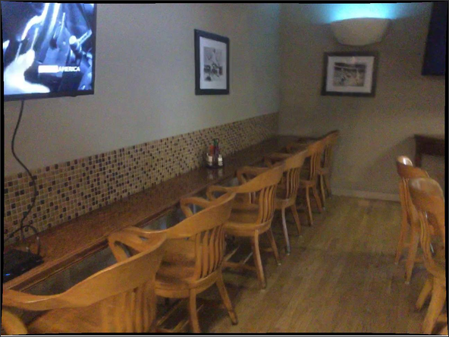
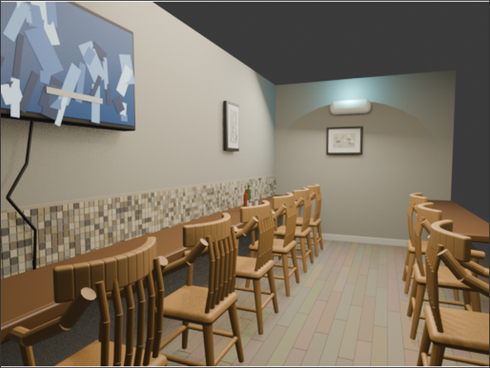
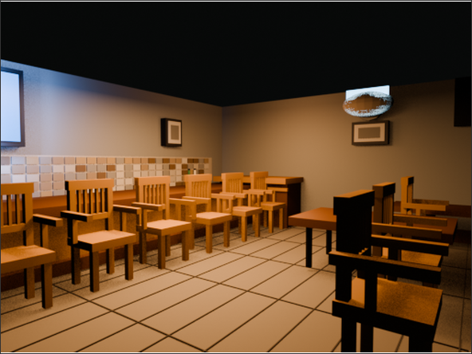
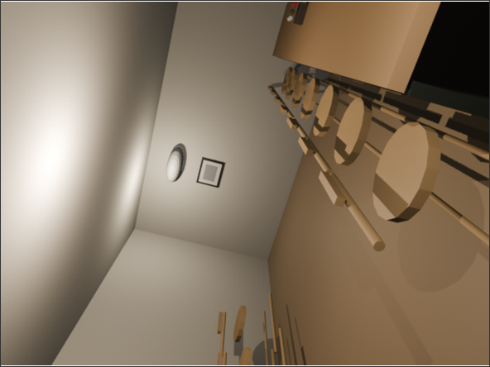
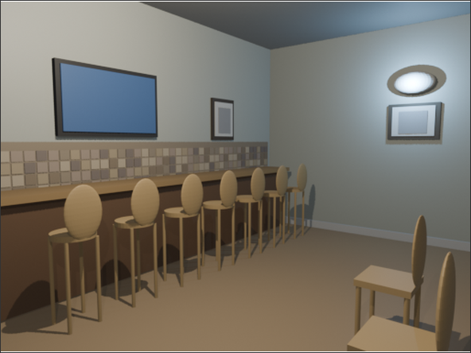
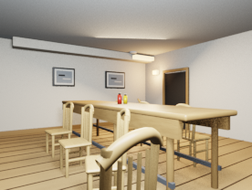
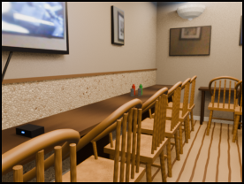
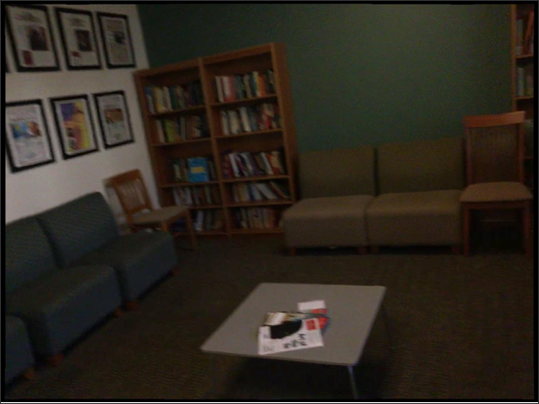
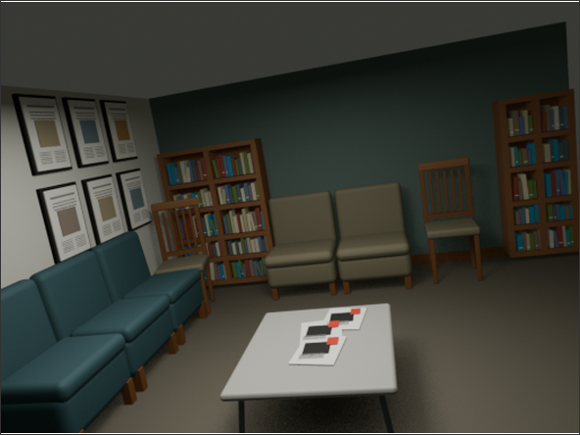
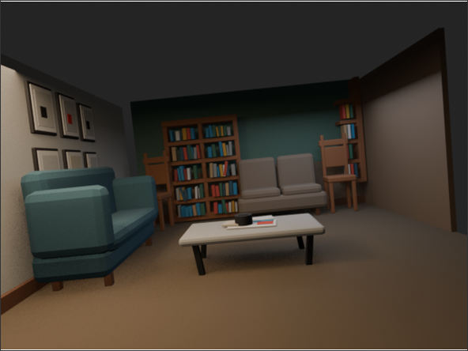
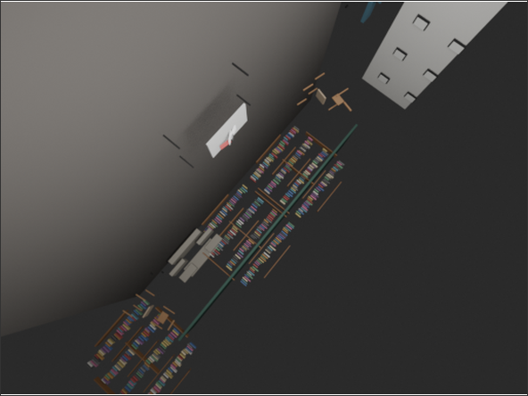
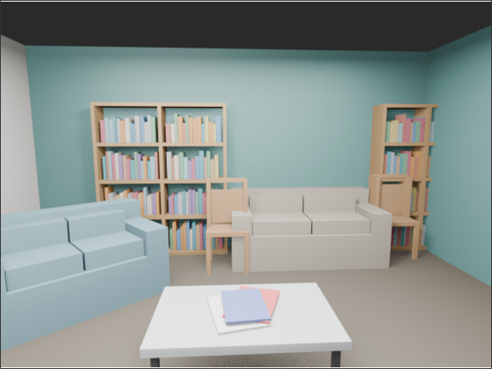
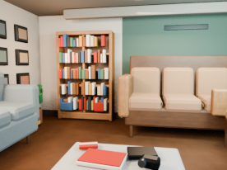
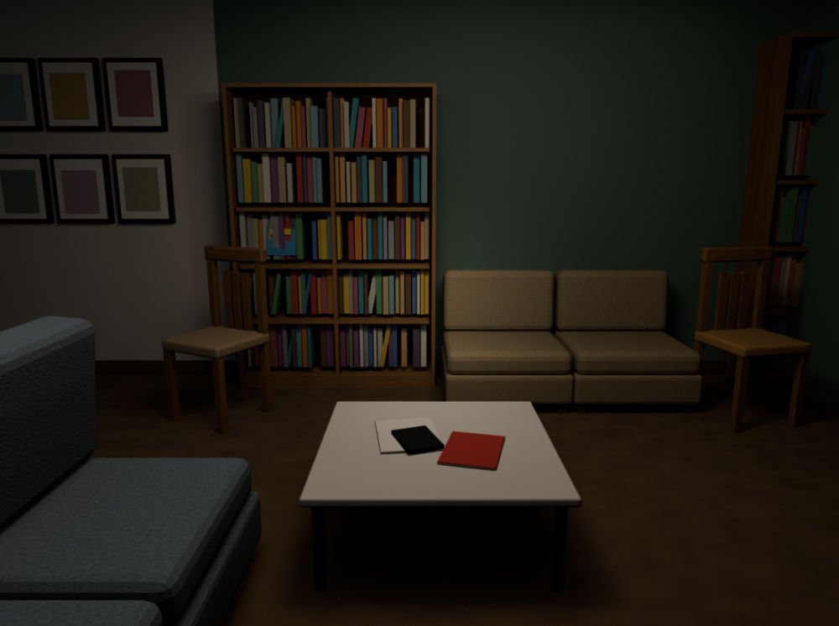
Reference
GPT-6-Astra
GPT-5.6-Sol
Qwen3.8-27B
Qwen3.8-27B w/ Ours
Kimi-K3
Kimi-K3 w/ Ours

Slide 2
Harness: mean quality, inference time and cost
Equal-weight means across ARKitScenes, CA-1M and ScanNet
(a) Reconstruction Quality
(b) Inference time
(c) Equivalent cost
92.87% of GPT-sol similarity
47.03% less inference time
47.45% of GPT-sol cost
DINOv2 Similarity ↑
Time (s / scene) ↓
Cost (USD / scene) ↓
Qwen (xhigh)
Qwen (xhigh) + Harness
GPT-sol (none)
GPT-astra (none)
Means of dataset summaries. Similarity ratios are descriptive; no statistical equivalence claim is implied.
Notes:
Sources: user-provided arkitscenes_comparison(1).xlsx, ca1m_comparison(1).xlsx, scannet_comparison(1).xlsx; first worksheet, E4:E11 DINOv2-S, F4:F11 seconds per scene, J4:J11 equivalent USD per scene. Aggregation: unweighted arithmetic mean of the three dataset means; sample counts unavailable. Qwen uses xhigh; GPT-sol and GPT-astra use none. No uncertainty estimates or significance tests supplied. Cost is the supplied workbook equivalent, not a current API price. Icons: existing local SVG assets from https://raw.githubusercontent.com/lobehub/lobe-icons/master/packages/static-svg/icons/openai.svg and https://raw.githubusercontent.com/lobehub/lobe-icons/master/packages/static-svg/icons/qwen.svg. Actual data: {"ARKitScenes":{"qwen-xhigh-harness":{"dino":0.3381975697619574,"time":798.9571428571428,"cost":0.1589285502545122},"qwen-xhigh":{"dino":0.2191854092691626,"time":1501.785714285714,"cost":0.1082594499826373},"sol-none":{"dino":0.3606311423437936,"time":349.8142857142857,"cost":0.2650234285714286},"sol-low":{"dino":0.3492131190640586,"time":467.7,"cost":0.2848302857142858},"sol-medium":{"dino":0.4081249684095383,"time":495.7,"cost":0.3026091428571429},"astra-none":{"dino":0.5185926258563995,"time":503.9571428571429,"cost":0.4934571428571428},"astra-low":{"dino":0.4750159042222159,"time":539.8285714285714,"cost":0.48854},"astra-medium":{"dino":0.5279478643621717,"time":638.4571428571428,"cost":0.5981871428571428}},"CA-1M":{"qwen-xhigh-harness":{"dino":0.3915335908532143,"time":746.9100000000001,"cost":0.1388244352878401},"qwen-xhigh":{"dino":0.1336088161915541,"time":1663.24,"cost":0.1796002994011976},"sol-none":{"dino":0.387359057366848,"time":397.06,"cost":0.3120024},"sol-low":{"dino":0.415531762316823,"time":223.48,"cost":0.232542},"sol-medium":{"dino":0.4110262960195541,"time":315.11,"cost":0.2575924},"astra-none":{"dino":0.5559729784727097,"time":692.61,"cost":0.559533},"astra-low":{"dino":0.5518090337514877,"time":572.28,"cost":0.452853},"astra-medium":{"dino":0.5570222109556198,"time":554.52,"cost":0.431988}},"ScanNet":{"qwen-xhigh-harness":{"dino":0.3805277142673731,"time":854.6133333333332,"cost":0.1130939111875259},"qwen-xhigh":{"dino":0.2403283049662908,"time":1367.06,"cost":0.1462679788936977},"sol-none":{"dino":0.4474447170893351,"time":362.4666666666666,"cost":0.2888845333333333},"sol-low":{"dino":0.3820285396029552,"time":313.9,"cost":0.2464853333333333},"sol-medium":{"dino":0.3748224791139364,"time":413.42,"cost":0.311256},"astra-none":{"dino":0.5903549750645956,"time":406.6066666666667,"cost":0.3726746666666667},"astra-low":{"dino":0.5959333002567291,"time":394.72,"cost":0.3829966666666667},"astra-medium":{"dino":0.5791741490364075,"time":387.46,"cost":0.36472}}}

Slide 3
Reconstruction Quality
Inference Time
Equivalent Cost
DINOv2 Similarity ↑
Seconds / Scene ↓
USD / Scene ↓
ScanNet
DINOv2 Similarity ↑
Seconds / Scene ↓
USD / Scene ↓
CA-1M
DINOv2 Similarity ↑
Seconds / Scene ↓
USD / Scene ↓
ARKitScenes
Notes:
Sources: user-provided arkitscenes_comparison(1).xlsx, ca1m_comparison(1).xlsx, scannet_comparison(1).xlsx; first worksheet, E4:E11 DINOv2-S, F4:F11 seconds per scene, J4:J11 equivalent USD per scene. Aggregation: unweighted arithmetic mean of the three dataset means; sample counts unavailable. Qwen uses xhigh; GPT-sol and GPT-astra use none. No uncertainty estimates or significance tests supplied. Cost is the supplied workbook equivalent, not a current API price. Icons: existing local SVG assets from https://raw.githubusercontent.com/lobehub/lobe-icons/master/packages/static-svg/icons/openai.svg and https://raw.githubusercontent.com/lobehub/lobe-icons/master/packages/static-svg/icons/qwen.svg. Actual data: {"ARKitScenes":{"qwen-xhigh-harness":{"dino":0.3381975697619574,"time":798.9571428571428,"cost":0.1589285502545122},"qwen-xhigh":{"dino":0.2191854092691626,"time":1501.785714285714,"cost":0.1082594499826373},"sol-none":{"dino":0.3606311423437936,"time":349.8142857142857,"cost":0.2650234285714286},"sol-low":{"dino":0.3492131190640586,"time":467.7,"cost":0.2848302857142858},"sol-medium":{"dino":0.4081249684095383,"time":495.7,"cost":0.3026091428571429},"astra-none":{"dino":0.5185926258563995,"time":503.9571428571429,"cost":0.4934571428571428},"astra-low":{"dino":0.4750159042222159,"time":539.8285714285714,"cost":0.48854},"astra-medium":{"dino":0.5279478643621717,"time":638.4571428571428,"cost":0.5981871428571428}},"CA-1M":{"qwen-xhigh-harness":{"dino":0.3915335908532143,"time":746.9100000000001,"cost":0.1388244352878401},"qwen-xhigh":{"dino":0.1336088161915541,"time":1663.24,"cost":0.1796002994011976},"sol-none":{"dino":0.387359057366848,"time":397.06,"cost":0.3120024},"sol-low":{"dino":0.415531762316823,"time":223.48,"cost":0.232542},"sol-medium":{"dino":0.4110262960195541,"time":315.11,"cost":0.2575924},"astra-none":{"dino":0.5559729784727097,"time":692.61,"cost":0.559533},"astra-low":{"dino":0.5518090337514877,"time":572.28,"cost":0.452853},"astra-medium":{"dino":0.5570222109556198,"time":554.52,"cost":0.431988}},"ScanNet":{"qwen-xhigh-harness":{"dino":0.3805277142673731,"time":854.6133333333332,"cost":0.1130939111875259},"qwen-xhigh":{"dino":0.2403283049662908,"time":1367.06,"cost":0.1462679788936977},"sol-none":{"dino":0.4474447170893351,"time":362.4666666666666,"cost":0.2888845333333333},"sol-low":{"dino":0.3820285396029552,"time":313.9,"cost":0.2464853333333333},"sol-medium":{"dino":0.3748224791139364,"time":413.42,"cost":0.311256},"astra-none":{"dino":0.5903549750645956,"time":406.6066666666667,"cost":0.3726746666666667},"astra-low":{"dino":0.5959333002567291,"time":394.72,"cost":0.3829966666666667},"astra-medium":{"dino":0.5791741490364075,"time":387.46,"cost":0.36472}}}

Slide 4








(a) Capacity-Efficiency Trade-off
(b) Capacity-Cost Trade-off
DINOv2 Similarity ↑
DINOv2 Similarity ↑
0.6
Astra-Medium
Astra-High
0.6
Astra-Medium
Astra-High
0.5
Astra-Low
0.5
Sol-High
Sol-Medium
Opus-Low
Opus-Medium
Sol-High
Astra-Low
Opus-None
Opus-High
Gemini-High
Opus-High
0.4
Sol-Low
0.4
SceneEvolve
Opus-Medium
Gemini-Low
Opus-Low
Gemini-Low
Gemini-High
SceneEvolve
Opus-None
0.3
Gemini-Medium
0.3
Gemini-Medium
Sol-Low
Sol-Medium
Reconstruction Quality
Reconstruction Quality
0.2
0.2
Qwen-3.8-27B-xHigh
Qwen-3.8-27B-xHigh
0.1
0.1
0.0
0.0
0
600
1200
1800
0.0
0.2
0.4
0.6
Seconds / Scene
USD / Scene
Inference Time
Equivalent Cost
Opus / Gemini time and cost are estimates. Similarity: mean DINOv2-S across three datasets.
Notes:
Sources: user-provided arkitscenes_comparison(1).xlsx, ca1m_comparison(1).xlsx, scannet_comparison(1).xlsx; first worksheet, E4:E11 DINOv2-S, F4:F11 seconds per scene, J4:J11 equivalent USD per scene. Aggregation: unweighted arithmetic mean of the three dataset means; sample counts unavailable. Qwen uses xhigh; GPT-sol and GPT-astra use none. No uncertainty estimates or significance tests supplied. Cost is the supplied workbook equivalent, not a current API price. Icons: existing local SVG assets from https://raw.githubusercontent.com/lobehub/lobe-icons/master/packages/static-svg/icons/openai.svg and https://raw.githubusercontent.com/lobehub/lobe-icons/master/packages/static-svg/icons/qwen.svg. Actual data: {"ARKitScenes":{"qwen-xhigh-harness":{"dino":0.3381975697619574,"time":798.9571428571428,"cost":0.1589285502545122},"qwen-xhigh":{"dino":0.2191854092691626,"time":1501.785714285714,"cost":0.1082594499826373},"sol-none":{"dino":0.3606311423437936,"time":349.8142857142857,"cost":0.2650234285714286},"sol-low":{"dino":0.3492131190640586,"time":467.7,"cost":0.2848302857142858},"sol-medium":{"dino":0.4081249684095383,"time":495.7,"cost":0.3026091428571429},"astra-none":{"dino":0.5185926258563995,"time":503.9571428571429,"cost":0.4934571428571428},"astra-low":{"dino":0.4750159042222159,"time":539.8285714285714,"cost":0.48854},"astra-medium":{"dino":0.5279478643621717,"time":638.4571428571428,"cost":0.5981871428571428}},"CA-1M":{"qwen-xhigh-harness":{"dino":0.3915335908532143,"time":746.9100000000001,"cost":0.1388244352878401},"qwen-xhigh":{"dino":0.1336088161915541,"time":1663.24,"cost":0.1796002994011976},"sol-none":{"dino":0.387359057366848,"time":397.06,"cost":0.3120024},"sol-low":{"dino":0.415531762316823,"time":223.48,"cost":0.232542},"sol-medium":{"dino":0.4110262960195541,"time":315.11,"cost":0.2575924},"astra-none":{"dino":0.5559729784727097,"time":692.61,"cost":0.559533},"astra-low":{"dino":0.5518090337514877,"time":572.28,"cost":0.452853},"astra-medium":{"dino":0.5570222109556198,"time":554.52,"cost":0.431988}},"ScanNet":{"qwen-xhigh-harness":{"dino":0.3805277142673731,"time":854.6133333333332,"cost":0.1130939111875259},"qwen-xhigh":{"dino":0.2403283049662908,"time":1367.06,"cost":0.1462679788936977},"sol-none":{"dino":0.4474447170893351,"time":362.4666666666666,"cost":0.2888845333333333},"sol-low":{"dino":0.3820285396029552,"time":313.9,"cost":0.2464853333333333},"sol-medium":{"dino":0.3748224791139364,"time":413.42,"cost":0.311256},"astra-none":{"dino":0.5903549750645956,"time":406.6066666666667,"cost":0.3726746666666667},"astra-low":{"dino":0.5959333002567291,"time":394.72,"cost":0.3829966666666667},"astra-medium":{"dino":0.5791741490364075,"time":387.46,"cost":0.36472}}}
Added Opus and Gemini series. Source: user-provided comparison table PNG. Similarity is the unweighted arithmetic mean of ScanNet, CA-1M and ARKitScenes DINOv2-S, using displayed three-decimal values. Time and cost are illustrative estimates requested by the user, not measurements or API prices. Same-effort Opus costs are above Sol and below Astra on the existing chart. Logo silhouettes extracted from the supplied table. Color intensity and logo size increase with reasoning effort, with model-specific hue families. Added values: [{"model": "Opus", "effort": "None", "dino": [0.398, 0.423, 0.356], "time": 700, "cost": 0.33, "color": "8995A2", "size": 24, "mean": 0.39233333333333337}, {"model": "Opus", "effort": "Low", "dino": [0.416, 0.419, 0.391], "time": 930, "cost": 0.36, "color": "E6BA96", "size": 29, "mean": 0.4086666666666667}, {"model": "Opus", "effort": "Medium", "dino": [0.444, 0.432, 0.409], "time": 1170, "cost": 0.39, "color": "D89859", "size": 35, "mean": 0.4283333333333333}, {"model": "Opus", "effort": "High", "dino": [0.438, 0.441, 0.417], "time": 1430, "cost": 0.415, "color": "AC5A24", "size": 41, "mean": 0.432}, {"model": "Gemini", "effort": "Low", "dino": [0.337, 0.341, 0.336], "time": 90, "cost": 0.025, "color": "A5B7E7", "size": 25, "mean": 0.338}, {"model": "Gemini", "effort": "Medium", "dino": [0.361, 0.358, 0.334], "time": 190, "cost": 0.055, "color": "708ECF", "size": 31, "mean": 0.351}, {"model": "Gemini", "effort": "High", "dino": [0.358, 0.365, 0.341], "time": 300, "cost": 0.085, "color": "3D59A7", "size": 37, "mean": 0.3546666666666667}]

Slide 5
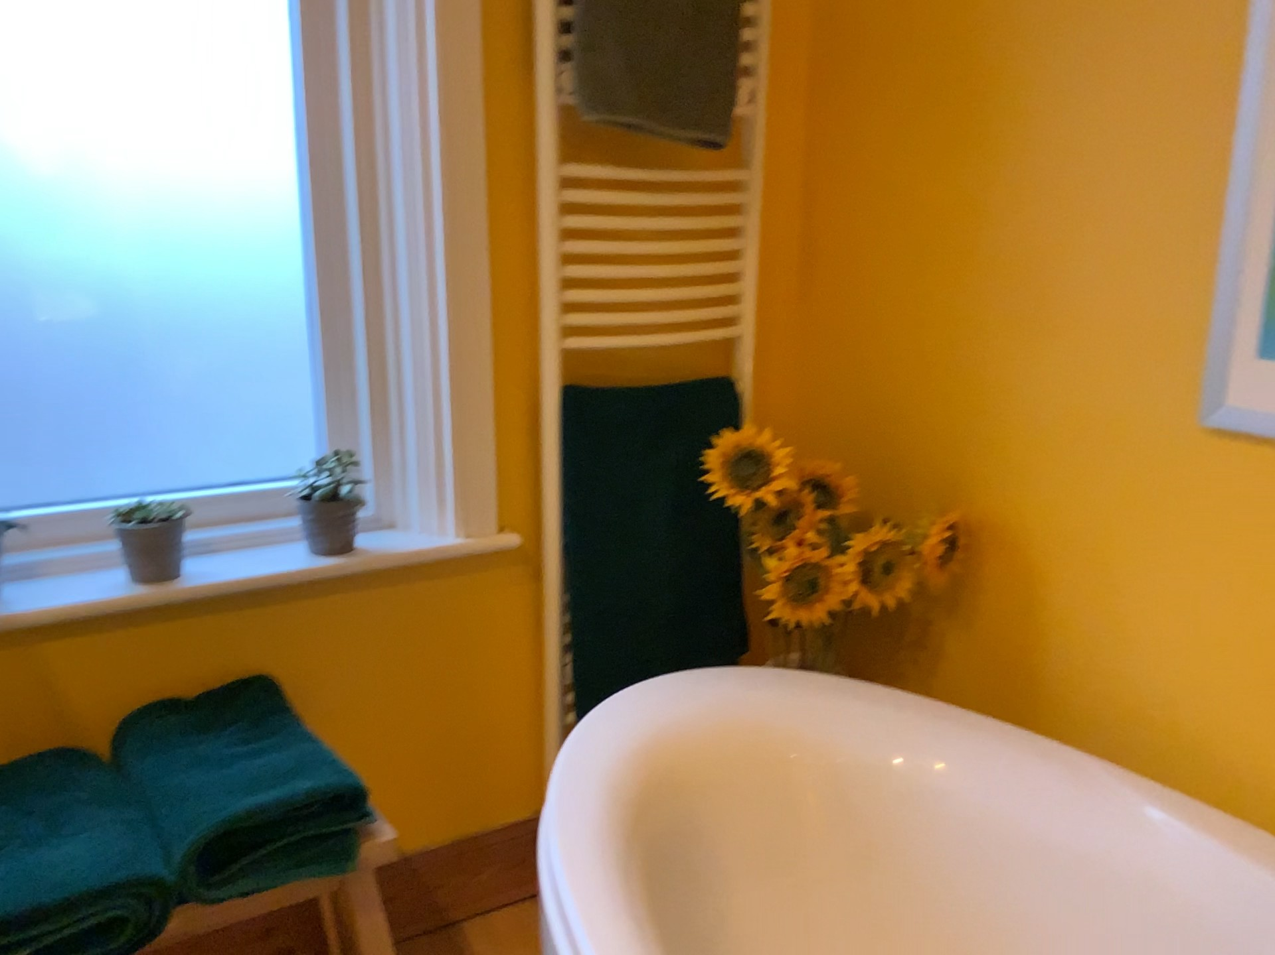
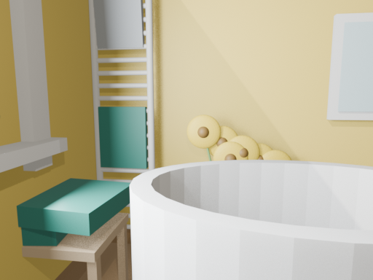
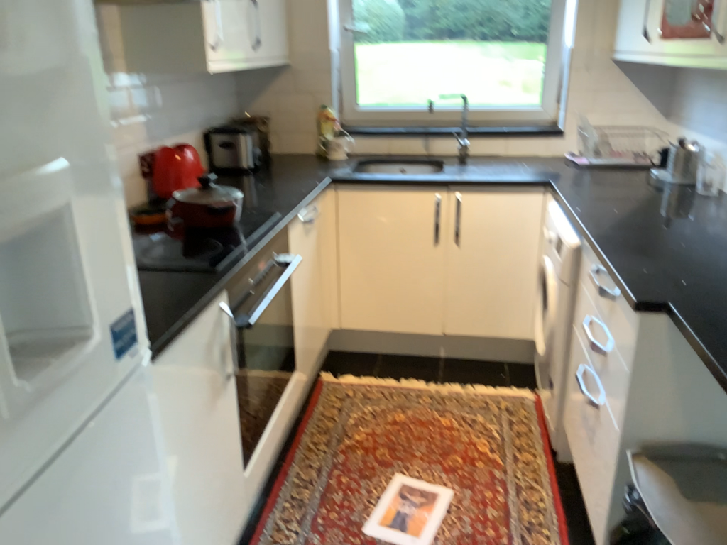

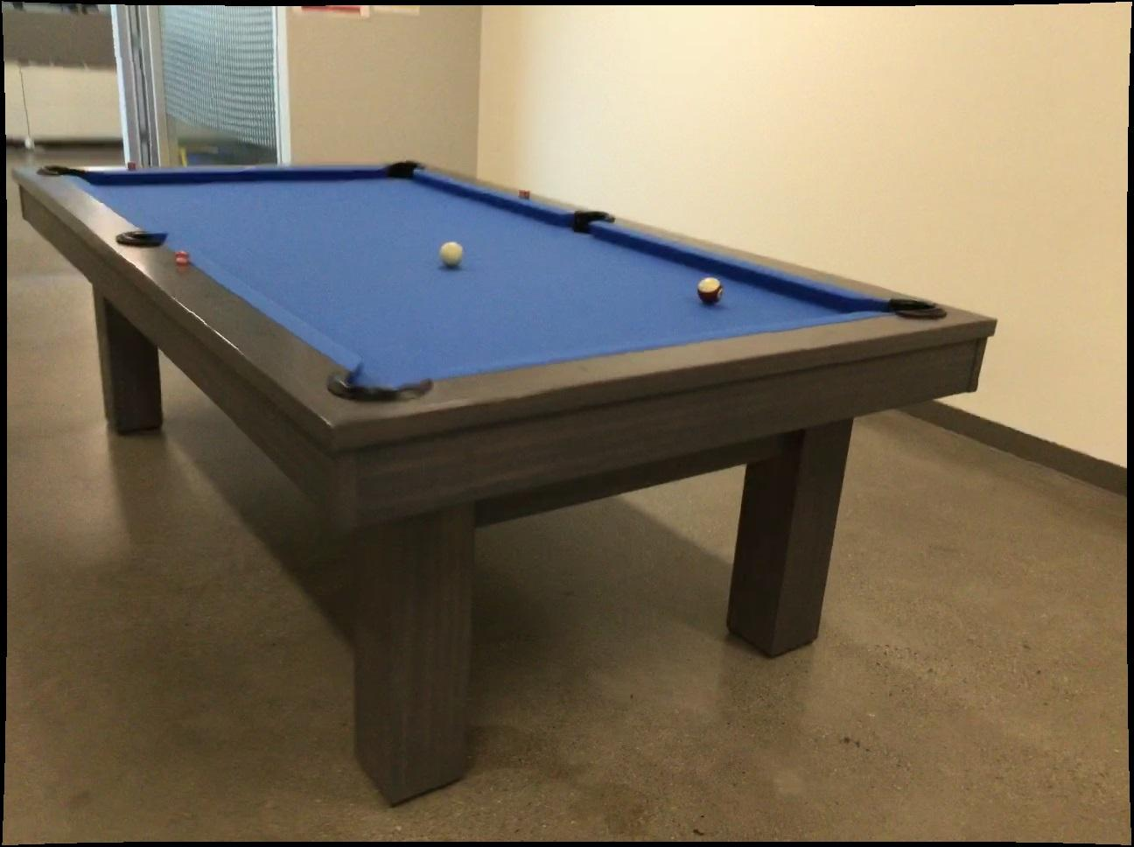
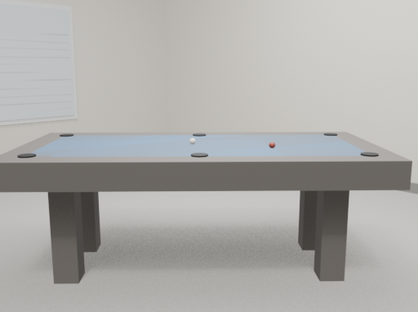

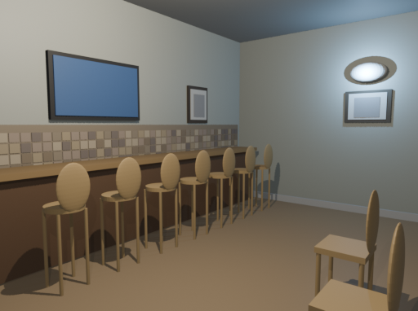
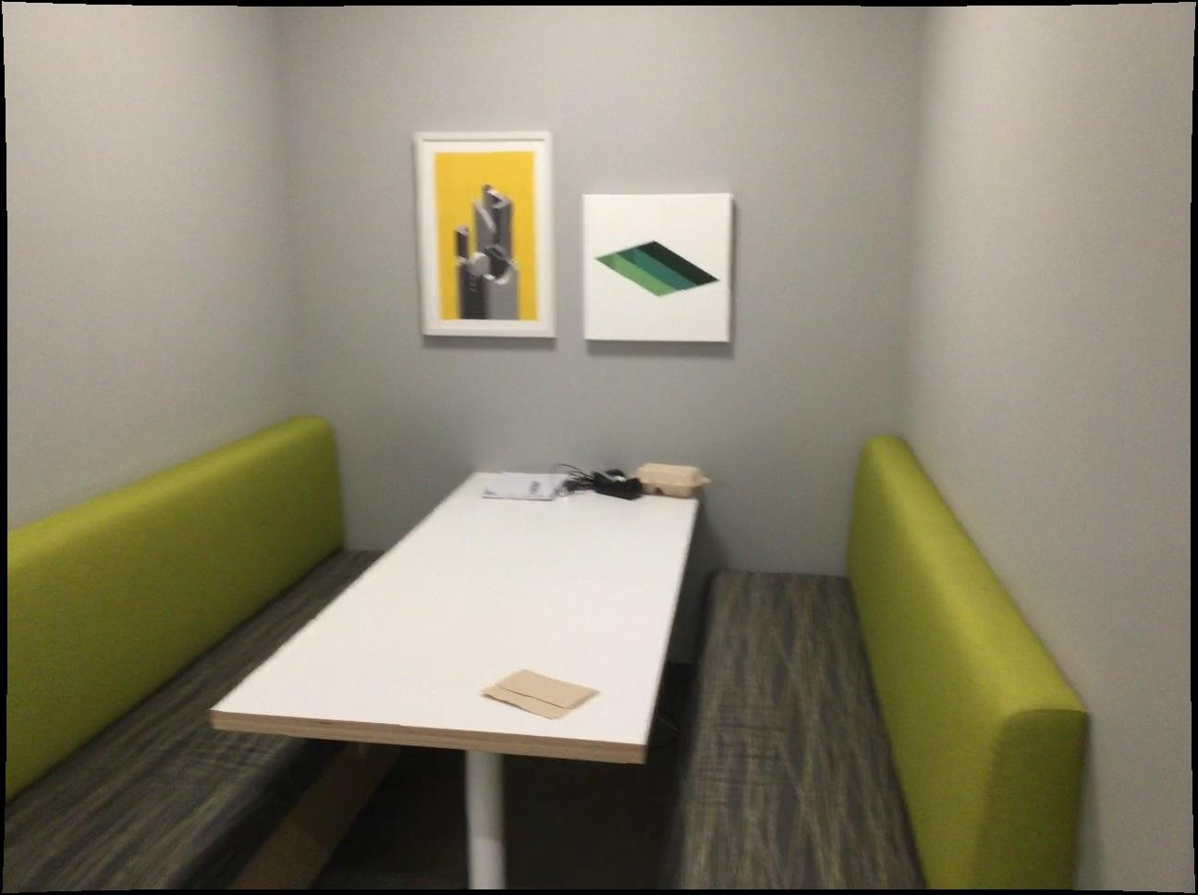
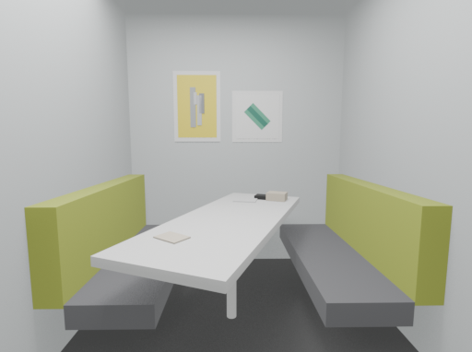

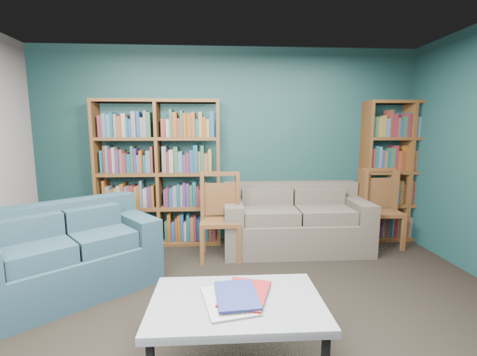
SceneEvolve
Single-image 3D reconstruction with an evolved harness
Reference
SceneEvolve
Reference
SceneEvolve
Reference
SceneEvolve
Better reconstruction, same model
DINOv2 similarity (higher is better)
+55.3%
mean DINOv2 similarity
0.213 to 0.331 across 37 shared valid scenes
Frozen Qwen-3.8-27B
No weight updates. No teacher at inference.
SceneEvolve turns a single image into an editable 3D scene by evolving the reconstruction harness of a frozen model.
Notes:
SceneEvolve is the method name supplied by the user. Single-image setting and frozen student / teacher-free inference are described in related_work.tex, lines 19 and 29-31, and paper_draft_zh.md. Reference images and scene renders come from the local ref/ref and results/results/qwen-xhigh-adsl-*-15/camera_renders folders. Six qualitative examples are selected and are not a random sample. Chart values are recomputed from outputs/visual_comparison/candidates.json, originally matched from evaluations/*.json. Common valid scene set is the 37 cases shared by astra-medium, sol-medium, qwen-xhigh, and qwen-xhigh-adsl: ARKitScenes n=13, CA1M n=12, ScanNet n=12. Comparison shown is qwen-xhigh versus qwen-xhigh-adsl, both xhigh. Failures are excluded, so these are conditional quality results, not all-task averages or success rates. Pooled DINOv2 0.21305445173906312 versus 0.3309093301461355; relative increase 55.3%. No speed, cost, or simulation-readiness claim is made.

