Slide 1
An Application of Natural Language Processing to Explore Machine Learning Hot Topics
------ case study on Reddit
Presenter: Haoyun Zhang

Slide 2
Motivation:
When talking about Machine Learning, what do people usually discuss or what topics are they interested in?
There are many online forums for us to post and discuss questions. For machine learning, which topics have high frequency and which topics do people reply and support a lot?
Aims:
The project aims to:
1). Analyze the frequency of keywords in the topic titles
2). Explore differences of topics in 5 genres (discussion, research, news, project, general)
3). Find the relationships of word counts and number of supports
4). Find the relationships of word counts and number of replies

Slide 3
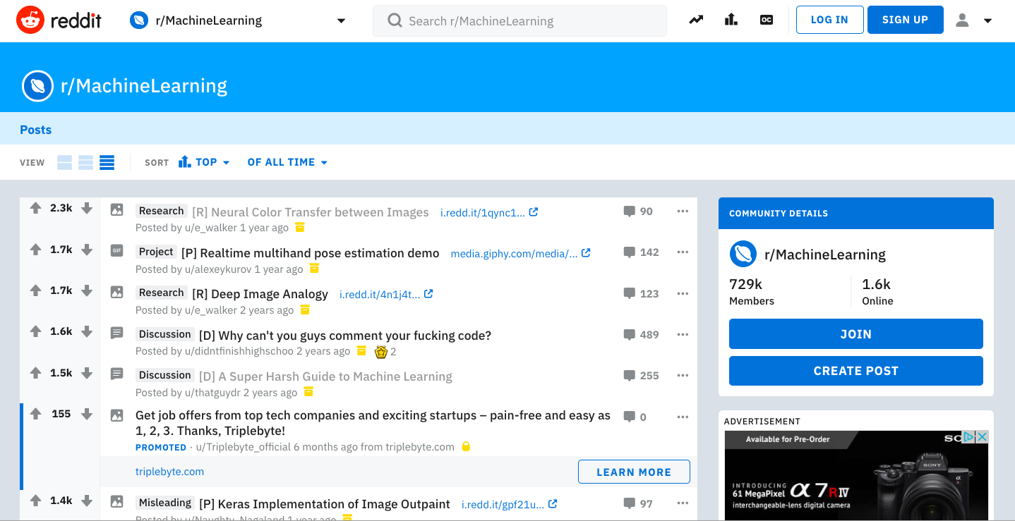
Web Scraping -> Selenium
# of Sup
Genre
Title
# of Rep
https://www.reddit.com/r/MachineLearning/top/?t=all
Date

Slide 4
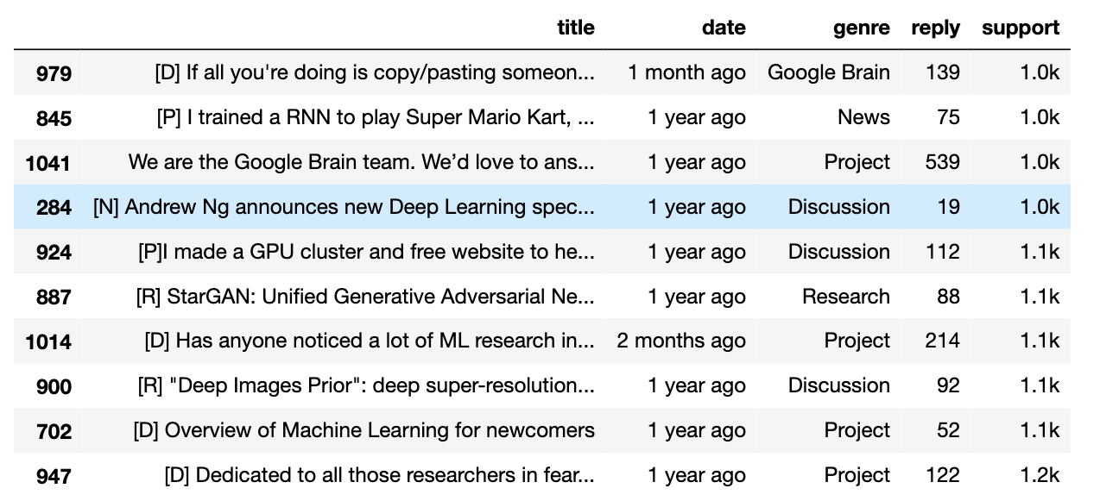
Raw Data Before Cleaning and Analysis

Slide 5
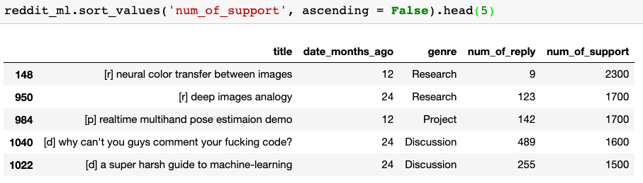
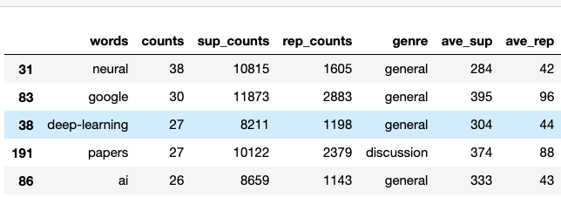
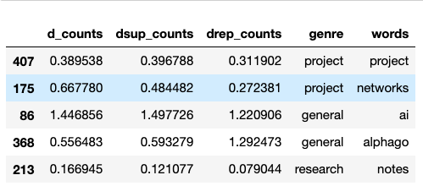
Data Cleanliness and Analysis
NLP Analysis
Ratio Cal.

Slide 6
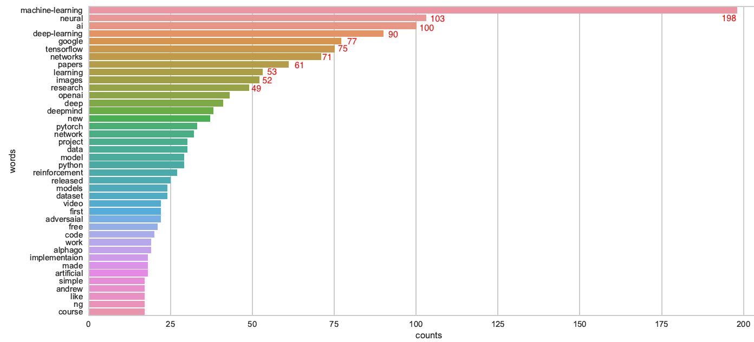
Data Visualization -> Counts of Keywords
Top 10 keywords:
Neural
AI
Deep-Learning
Google
Tensorflow
Networks
Papers
Images
Research
OpenAI
Andrew Ng

Slide 7
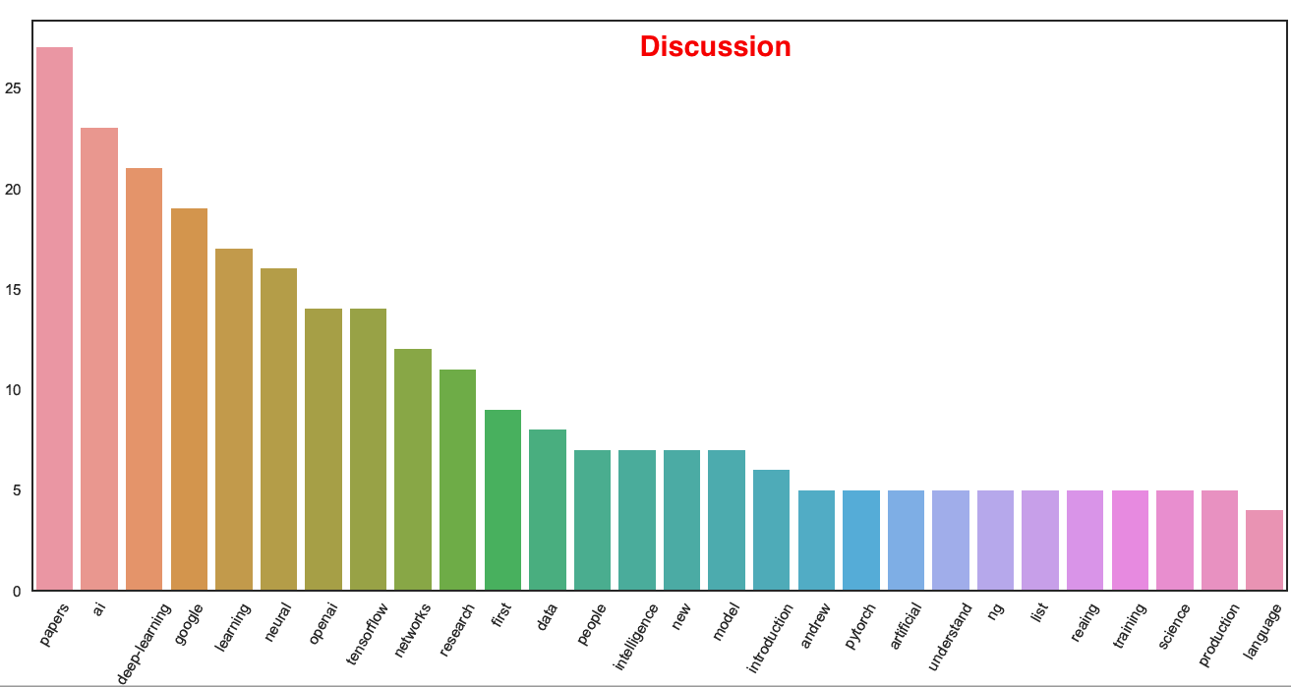
Keywords Counts In different Genre

Slide 8
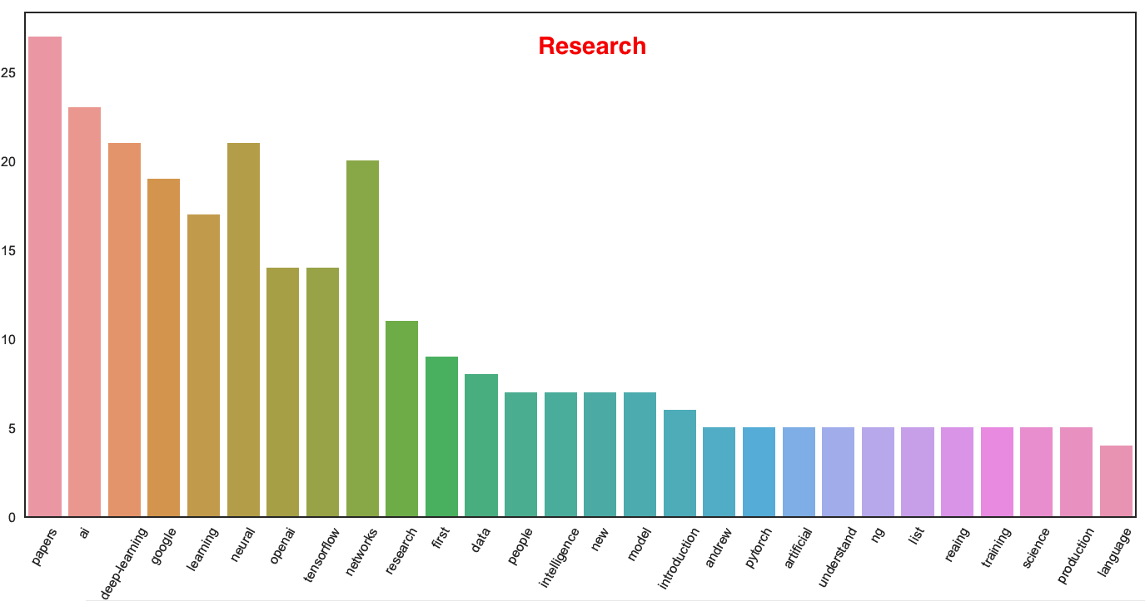
Keywords Counts In different Genre

Slide 9
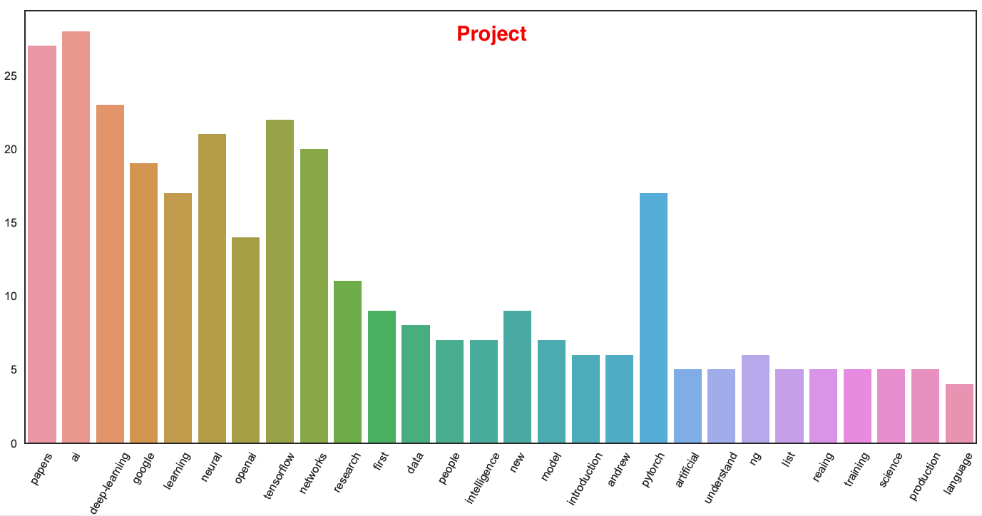
Keywords Counts In different Genre

Slide 10
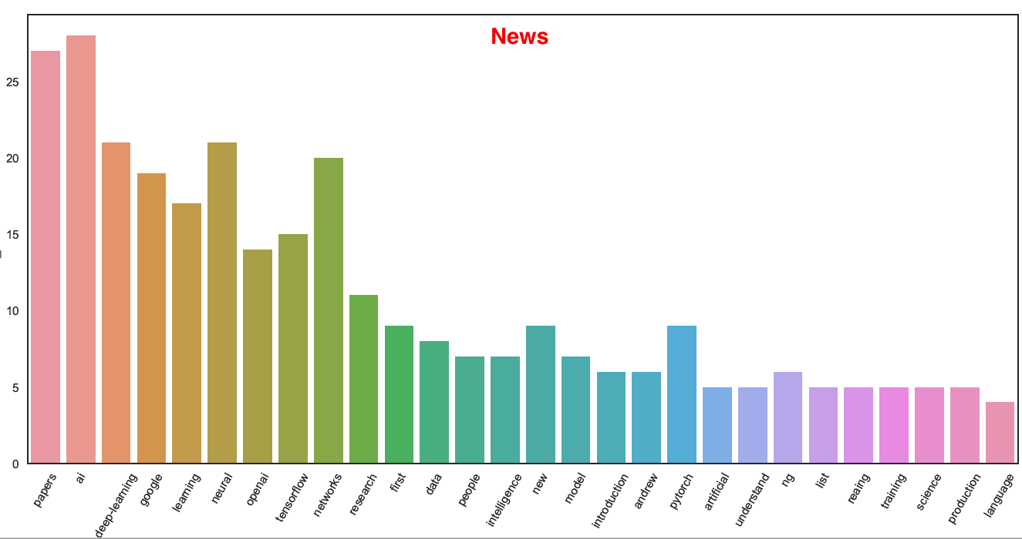
Keywords Counts In different Genre

Slide 11
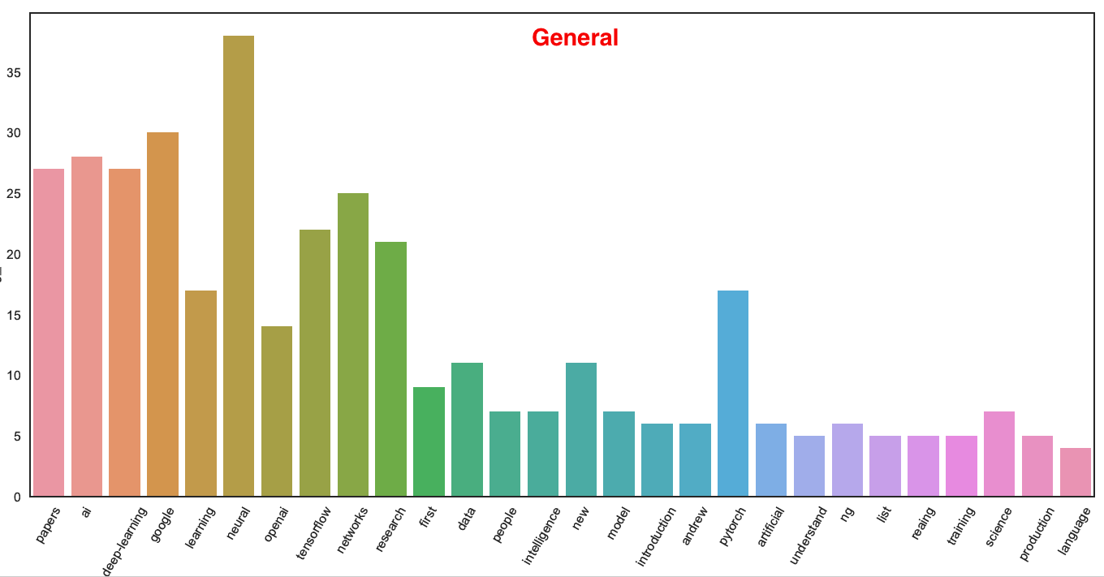
Keywords Counts In different Genre

Slide 12
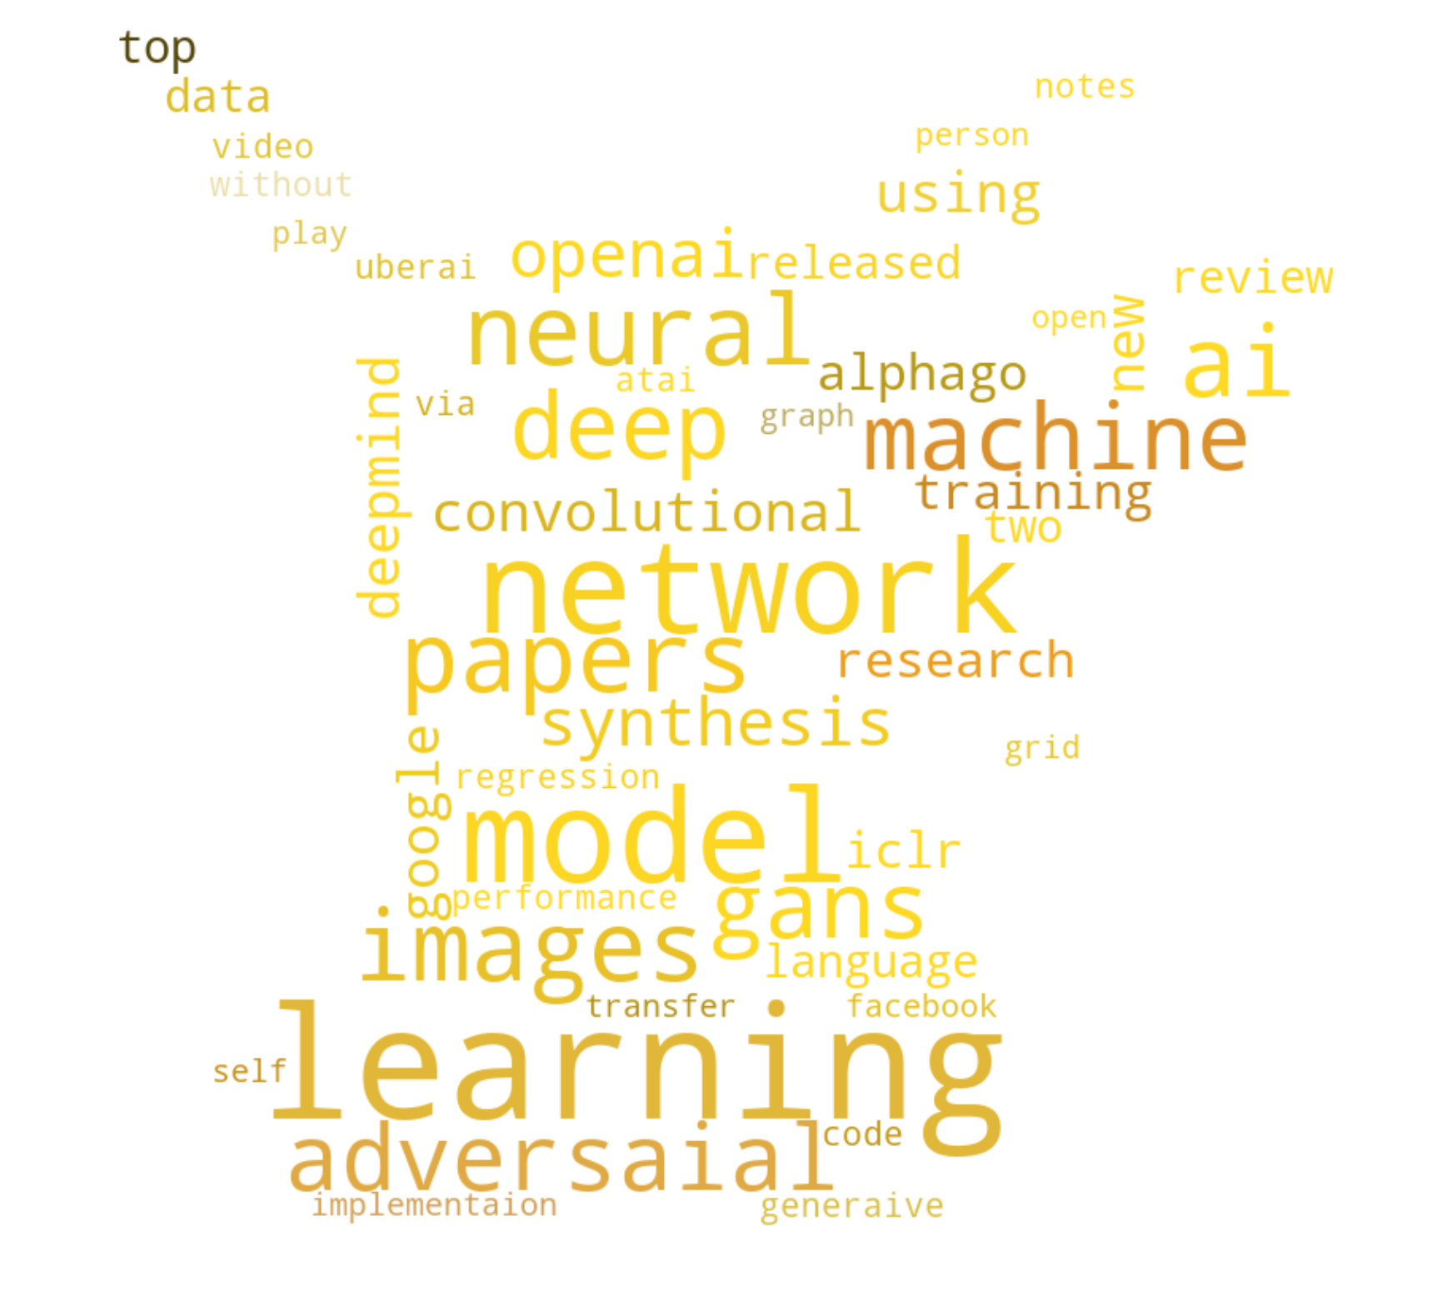
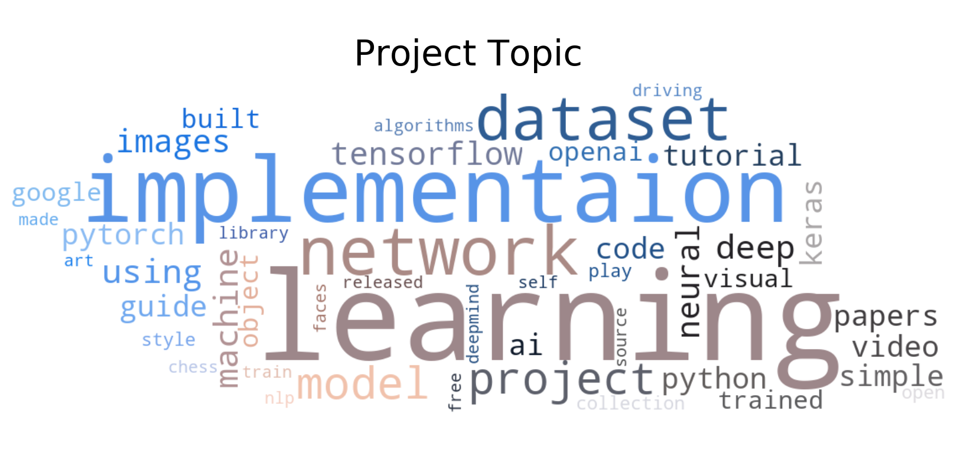
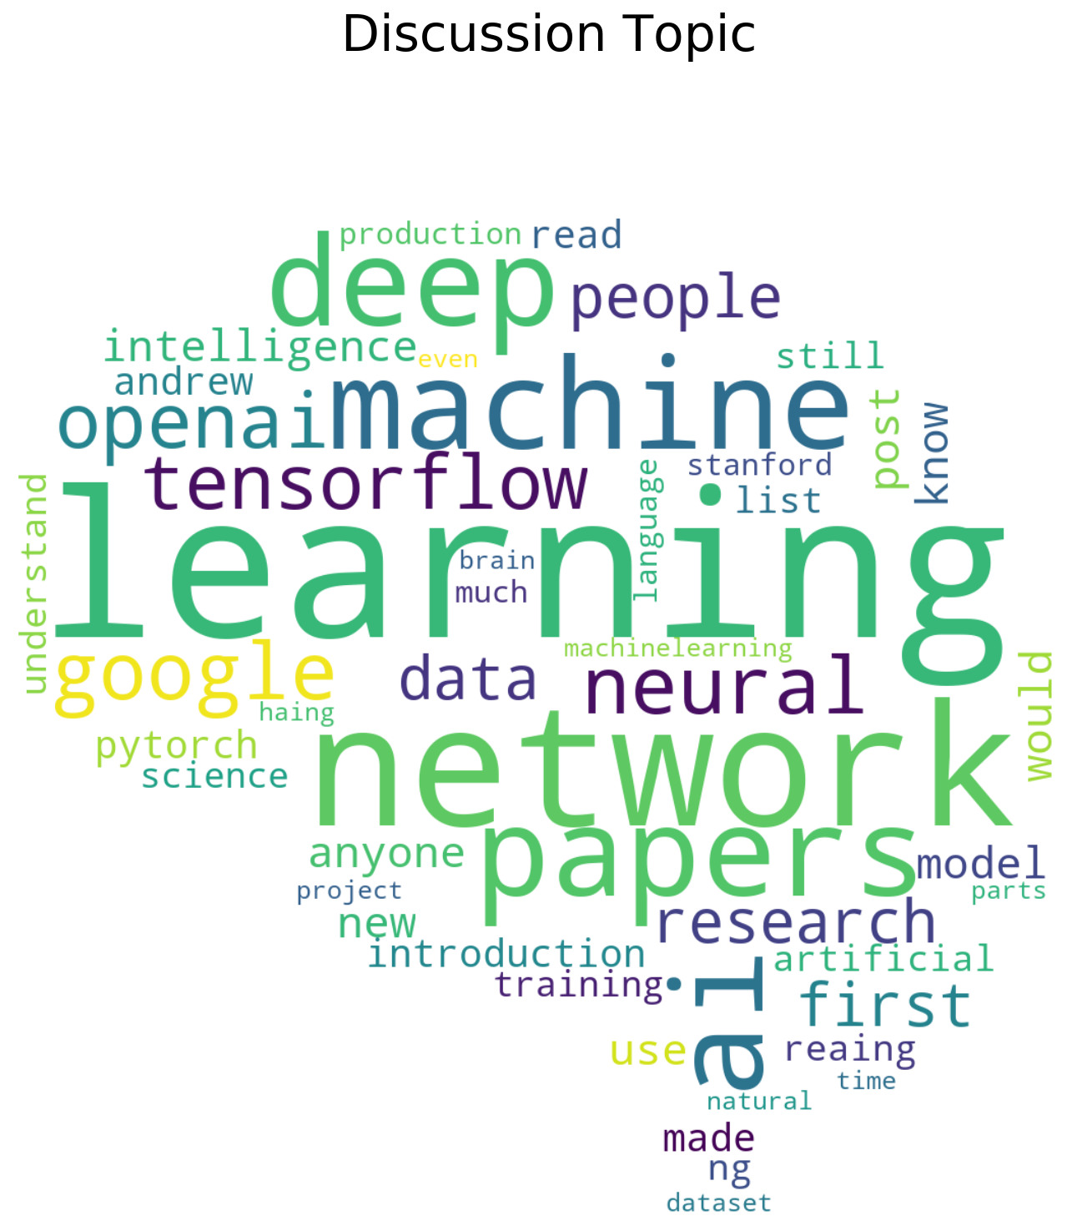
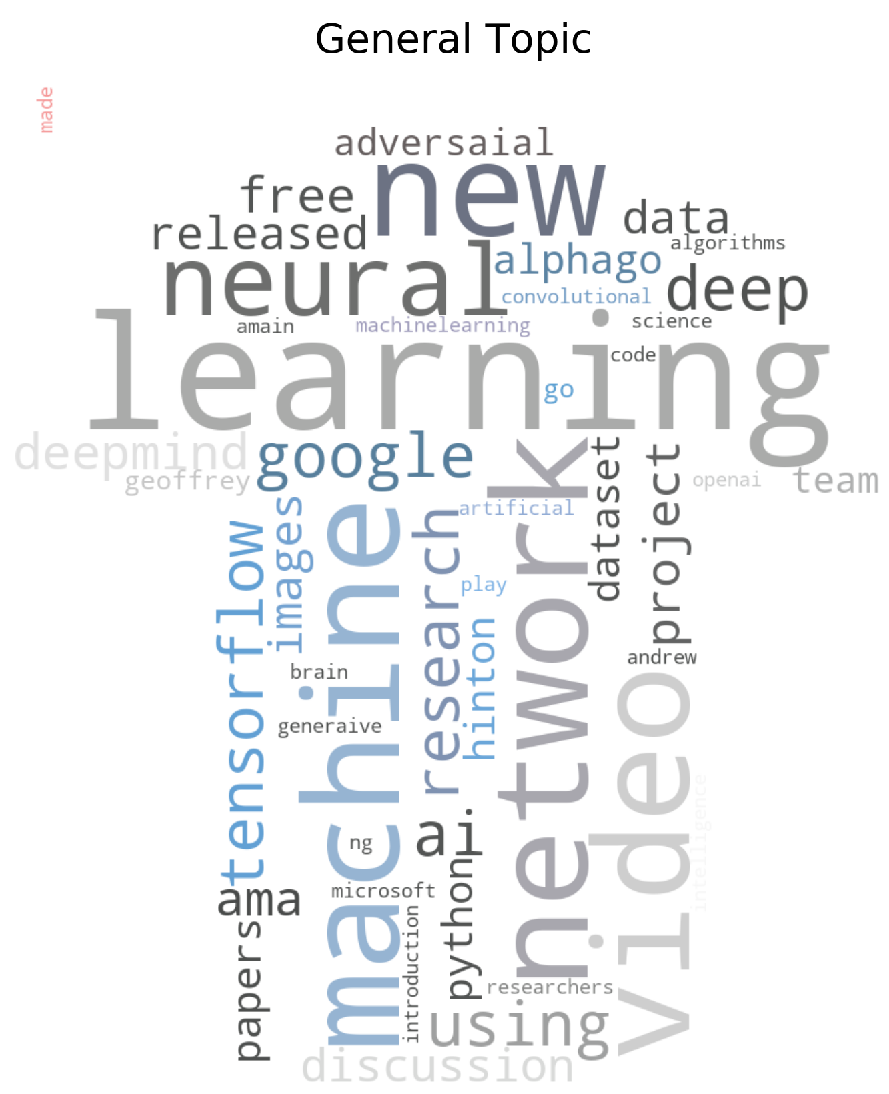
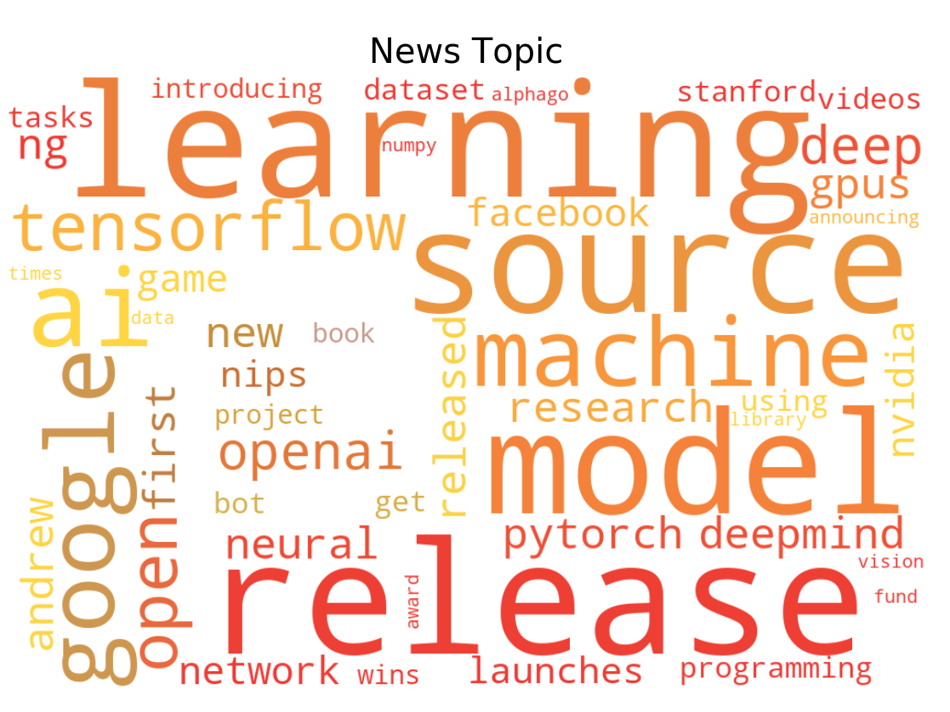
Research Topic
Word Clouds

Slide 13
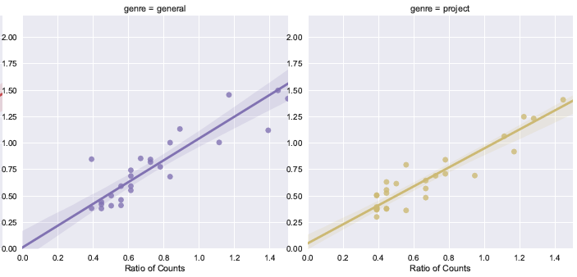
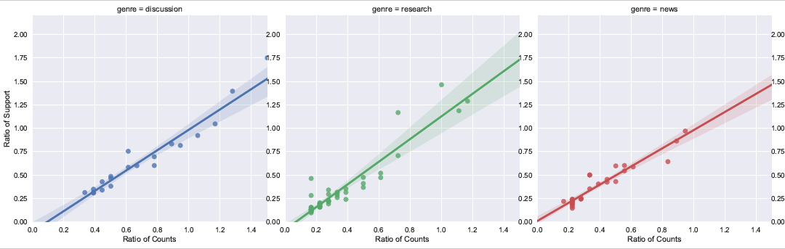
Support Ratio Plot

Slide 14
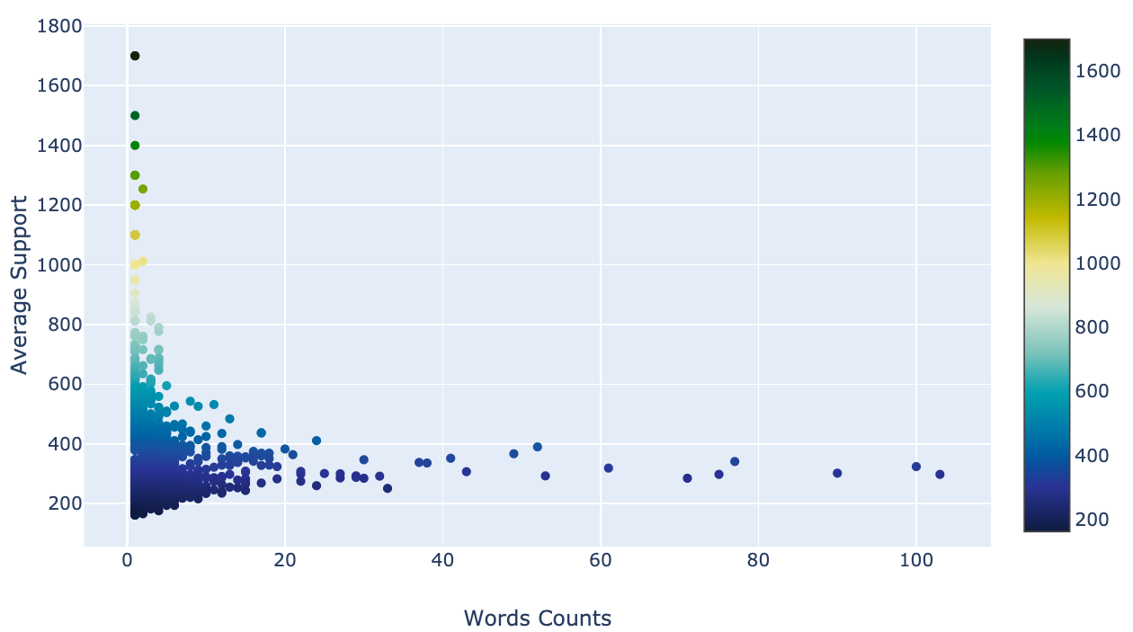
Average Support Plot

Slide 15
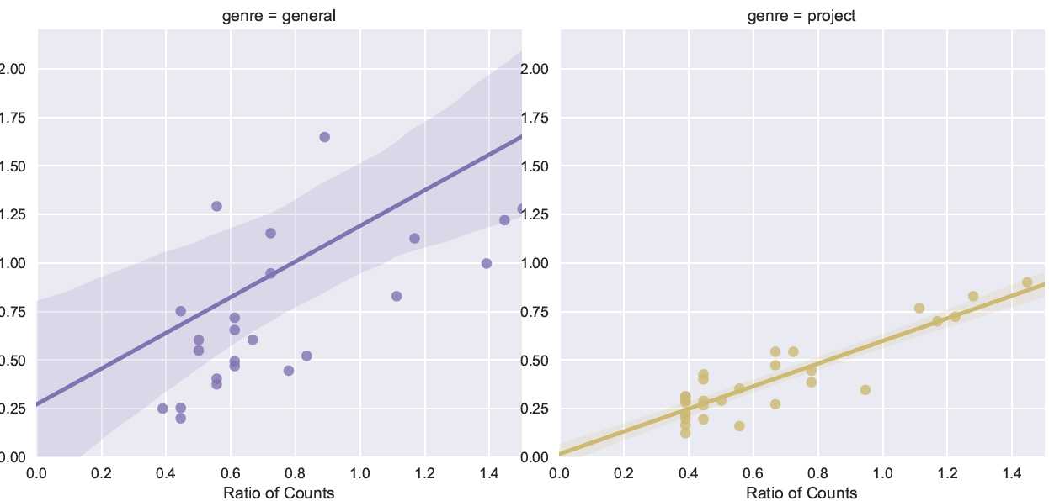
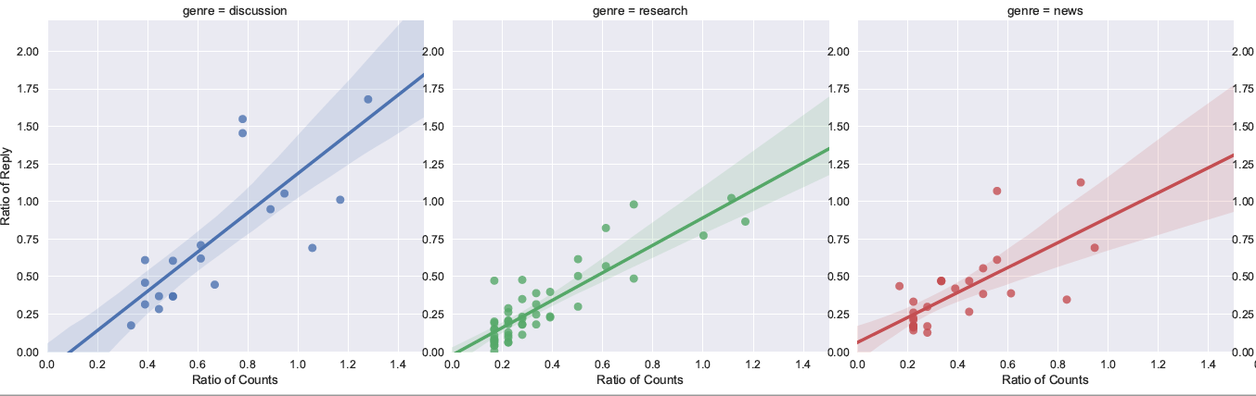
Reply Ratio Plot

Slide 16
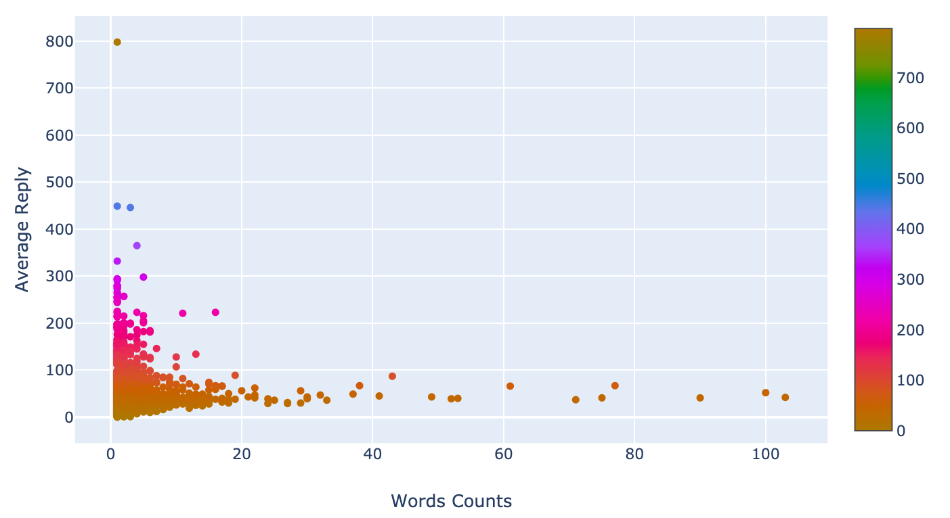
Average Reply Plot

Slide 17
Future Work
Try to scrape the date and study the topic changes terms of time.
Apply NLP on contents behind the titles
https://www.reddit.com/r/MachineLearning/top/?t=all

