Slide 1

5th Generation Wireless – where is that going and what’s in it for me?
3-6 GHz Dual-pol Reconfigurable Intelligent Surface
(RIS) Interface Control Document
Jurui Qi
Prof. Gabriel M. Rebeiz
ECE Department
University of California, San Diego
La Jolla, CA 92093-0407
12-18-2024

Slide 2
Content of ICD
Part 1: RIS Board, Mechanical, RF/Electrical Specs
Part 2: 3-6 GHz RIS Control
Appendix: 2x2 Feed Array Specs
Attached:
RIS Holder 3D STEP Files
MATLAB Control Files

Slide 3
Part 1: RIS Board, Mechanical, RF/Electrical Specs

Slide 4
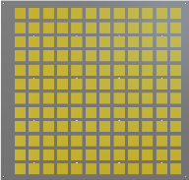
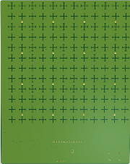
RIS System Block Diagram
Array Area
Digital I/O
Arduino
Due
USB
GND
VCC

Slide 5
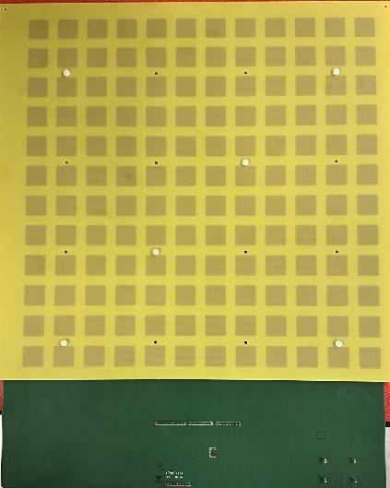
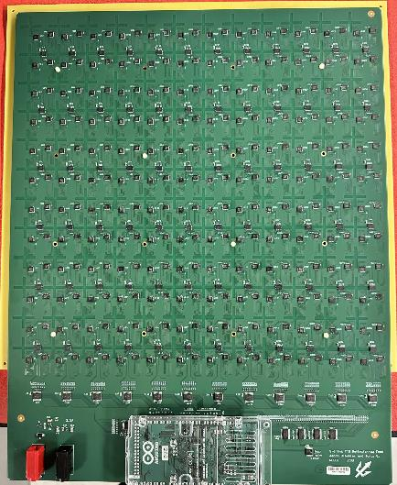
RIS System Block Diagram: System View
31.5 cm
31.5 cm
Array Area
SP4T & PS
V-pol
39.7 cm
H-pol
39.7 cm
Power & Digital Controls
Array Front View
Array Back View
The boards are ESD sensitive, please use ESD strap when handling the array

Slide 6
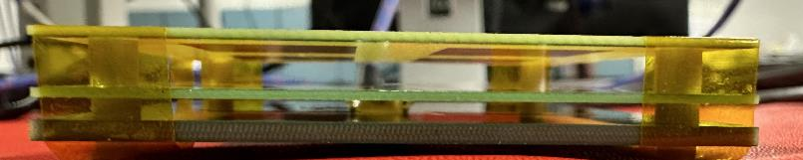

RIS System Block Diagram: System View
Array Area
Upper Patch Board
3mm 3D-printed spacer
Lower Patch Board
1.35mm 3D-printed spacer
Feed Board
Array Side View
Board Name: 3-6 GHz TTD Reflectarray Feed
Board size: 31.5 x 39.7 cm
144 elements planar antenna array with 2.5 cm spacing: (0.5λ @ 6GHz)
Stacked patch antenna with S11 bandwidth from 3-6GHz
The RIS is powered and controlled by the DC/Digital pins with Arduino Due microcontroller
VCC
GND
Banana
Cables
USB
VCC (5V)
GND

Slide 7
3-6 GHz RIS: Voltage & Current Consumption
Power consumption of 3-6 GHz RIS
Voltage | Current | Total Power Consumption
VCC (5V) | 0.035 A | 0.18 W
This is at regular setting. Current consumption can vary slightly depending on the states and
Absolute Maximum Ratings
VCC | Current
5V | 0.05 A

Slide 8
3-6 GHz RIS: RF Performance
RIS Performance Summary
Parameter | Value | Comment
Frequency Range | 3-6 GHz | Operational BW
Scanning Range (Deg.) | +/- 60º | @ 3-6 GHz
Sidelobe level | <-10 dB | Focal and Planewave Feed

Slide 9
Part 2: 3-6 GHz RIS Control

Slide 10
3-6 GHz RIS: Control Configuration
Every two antennas are considered as one element in control
For each element, an 8-digit state code is required to set phase shifter
Another 11-digit is required to select which element is going to be set
All digital IO are using Arduino Due
All codes are written in MATLAB and require the MATLAB Arduino connected IO support package
67
13
7
1
68
14
8
2
69
15
9
3
70
16
10
4
General Control Schematic
A. Send 8-digit state code (function: set_latch() )
B. Enable the selected element to implement the state code (function: pulse_decoder() )
C. Redo above steps for another element
Example control code
for n=1:72 %go through all 72 elements
set_latch(Ard_obj, state_code_dec) %8-digit state code to set PS
pulse_decoder(Ard_obj, n) %enable corresponding element to implement
end
71
11
5
72
12
6
Digital I/O
Arduino
Due
USB
GND
VCC
Array Front View

Slide 11
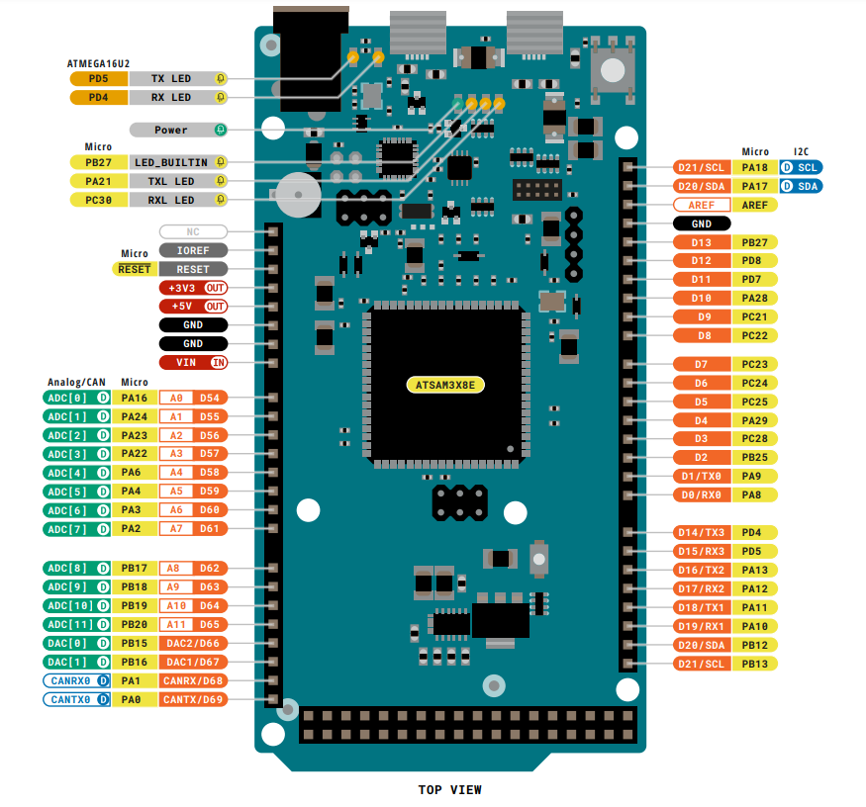
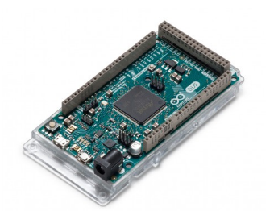
Digital Control Components
Arduino Due
The Arduino Due is the first Arduino board based on a 32-bit RAM core microcontroller. With 54 digital input/output pins, 12 analog inputs.
More information about the Arduino Due controller can be found:
https://store.arduino.cc/usa/due

Slide 12
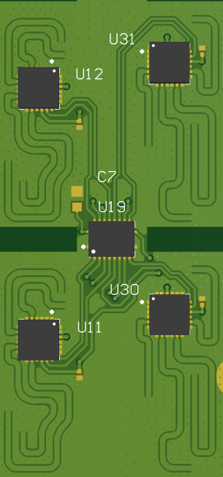
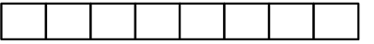
3-6 GHz RIS: Matlab Function set_latch()
Ant 1
state_code_bin
bin2dec
Ant 1: H-pol
2-bit PS
Ant 1: V-pol
Ant 1: H-pol
Ant 2: H-pol
Ant 2: V-pol
state_code_dec(n) = 0-255
Ant 1: V-pol
2-bit PS
D6
D7
D8
D9
D10
D11
D12
D13
Corresponding Arduino IO Pin
2-bit phase shifter for each antenna and polarization
Use code “phase2decoder.m” to generate required 8-digit state code for all 72 elements from a pre-defined phase map
function: set_latch(Ard_obj, state_code_dec)
Ard_obj: Arduino Due Object
state_code_dec: 8-digit state code in decibel
Ant 2: H-pol
2-bit PS
Ant 2: V-pol
2-bit PS
Ant 2

Slide 13
3-6 GHz RIS: Matlab Function pulse_decoder()
Total 72 elements = (Element 1~8) + (Element 9~72)
Element 1-8 EN are controlled by a 3-to-8 decoder
Element 9-72 EN are controlled by a 6-to-64 decoder
function: pulse_decoder(Ard_obj, n)
Ard_obj: Arduino Due Object
n: element number
Corresponding Arduino IO Pin
67
13
7
1
68
14
8
2
69
15
9
3
70
16
10
4
Control bit | Explanation
D5 | 6-64: Address0
D4 | 6-64: Address1
D3 | 6-64: Address2
D2 | 6-64: Address3
D14 | 6-64: EN
D19 | 6-64: A
D20 | 6-64: B
D15 | 3-8: Address0
D16 | 3-8: Address1
D17 | 3-8: Address2
D18 | 3-8: EN
71
11
5
72
12
6
Digital I/O
Arduino
Due
USB
GND
VCC
Array Front View
Please refer to the “pulse_decoder.m” code for detailed mapping

Slide 14
3-6 GHz RIS: Implementing Pre-defined Phase Map
Several things to note when implementing a pre-defined phase map
For example, we have a pre-defined phase map at f = 4.5 GHz and we set f0 = 3 GHz
A. Every element refer to the lowest phase value as 0 deg (i.e. every phase number should be positive)
B. The final phase map = pre-defined phase map / f * f0
C. Load the final phase map into “phase2decoder.m” with the configuration file “mixed_matrix_planewave_-20inc_test3.mat” and you will get the required state codes for all 72 elements in decibel
Example pre-defined phase map at 4.5 GHz

Slide 15
Appendix: 2x2 Feed Array Specs

Slide 16
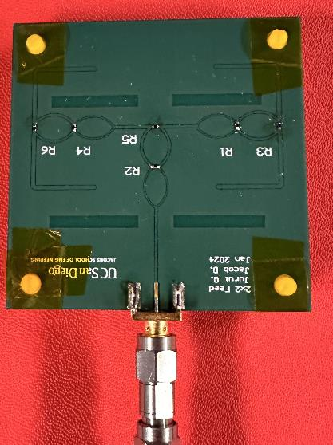
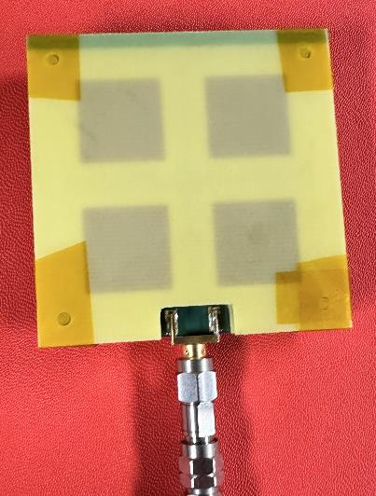
2x2 Feed Array
Upper Patch Board
4mm spacer
Lower Patch Board
2x2 Patch Array
1.7mm spacer
Feed Board
R1, R2, R4: 69.8 ohm
R3, R5, R6: 150 ohm
Back View
Front View
Side View

Slide 17
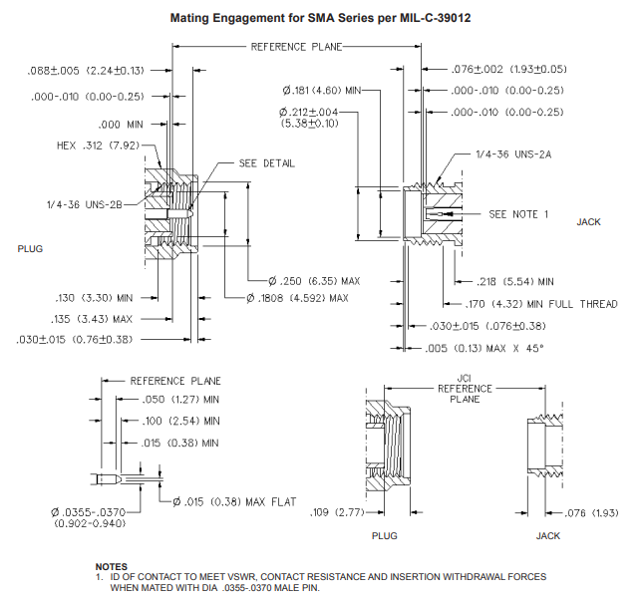
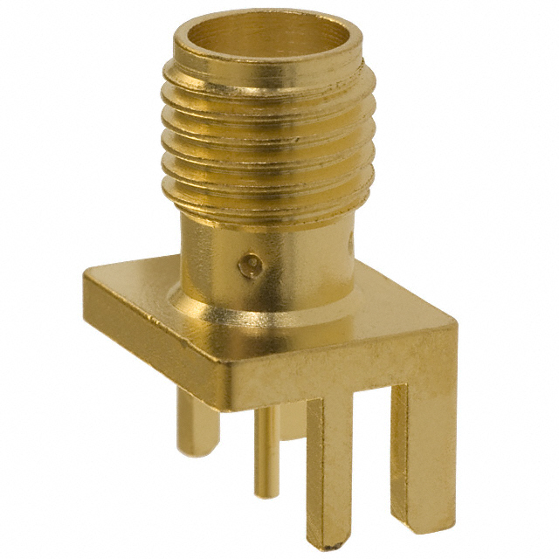
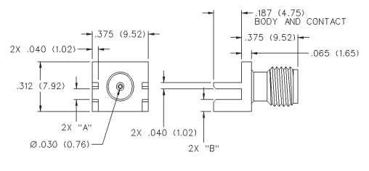
2x2 Feed Array: SMA RF Connector
142-0701-801 SMA 18GHz
Edge Launch Connector
Dimension of SMA Connector (142-0701-801)
More information can be found:
https://www.belfuse.com/resources/productinformations/cinchconnectivitysolutions/johnson/pi-ccs-john-142-0701-801.pdf

Slide 18
End of Document

