Slide 1
Haiku Generator
LIGN 167 Final Project
Mengyi Liu, Kangxian Xie, Haozhe An

Slide 2
Haiku
A poetry form originated in Japan in the sixteenth century.
It’s a short poem consisting of three lines of five, seven and five syllables.

Slide 3
Goal
We would prompt the user to input five words.
Then our generator would output a complete haiku based on the theme and rhyme of the input.

Slide 4
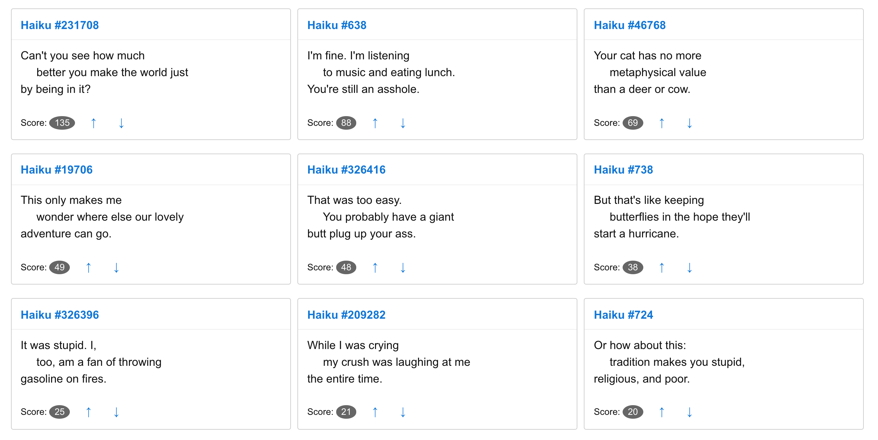
TRAINING DATASET
Reddit Haikus (http://haiku.somebullshit.net/)
It collects every haiku that occurred on a Reddit comment between December 2005 and October 2016 (10.8 years). Some intentional, most unintentional.
The haikus make up 24,450,805 (24.4 million) characters or 4,519,927 (4.5 million) words.

Slide 5
MethoD
Step 1: Find common themes from the dataset
Algorithm: count occurrence of each word, and derive 5 themes from the most popular words
Themes chosen: Time, Game, Life, Money, Person
Assign a vector representation to these five words using word2vec
Step 2: Train the neural networks with each of the theme
Resulting in 5 neural networks

Slide 6
METHOD (CONTINUED)
Step 3: Given a user input (5 words)
Use word2vec to convert each input word into a vector (e.g. v1 … v5)
For each input vector:
find the distance (similarity) between the input vector and each of the theme vector
Assign score to each of the theme
Choose the corresponding theme based on the highest score
Step 4: Use the correct NN to generate Haiku

Slide 7
Generating haiku Workflow
NO
INPUT
5 words?
YES
DETECT THEMES
RNN1
RNN2
RNN3
RNN4
RNN5
Haiku
Haiku
Haiku
Haiku
Haiku

Slide 8
More about generating haiku
When generating each word
Count the number of syllables generated
Get rid of the words that go over 17 syllables
When reaching the last word
replace this last word with a rhyming word by:
generating a list of rhyming words
selecting the one that has the correct number of syllables and has a better similarity with the initial prediction of the last word

Slide 9
result
summer is such a great time to make sure to get a trip to make wage
i am running late today but i am still in the next holiday

Slide 10
OUR GENERATOR TELLS HORROR STORIES…
it was raining yesterday and i didnt know what to do with the blood

Slide 11
IT CURSES SOMETIMES TOO…
my flight takes off tomorrow to get the fuck out of here motto

Slide 12
OTHER EXAMPLES
it is a good time to remind someone to later find out their thyme
my phone is ringing now and then i can see the other stuff like plow
we shall leave as soon as i get out of the house and whispers to room
I am dying now but I must have been drunk in my friends house pub

Slide 13
POTENTIAL IMPROVEMENTS
Right now most of the generated Haikus have 17 syllables and the last word rhymes well with the fifth word in user’s input, however:
some of the haikus cannot be separated into 5,7,5 syllables per line (e.g. due to the syllables of words, a haiku can only be separated into 6,6,5 syllables for example)
some haikus do not make much sense to human even if the grammar is right

Slide 14
THANKS!

