Slide 1


kableExtra: Complex tables made easy
Hao Zhu @haozhu233
Institute for Aging Research
Slide available @ bit.ly/kableExtra_JSM
Notes:
The kableextra package is now about 3 years old. It came from an attempt I tried to add some footnotes to the output of the kable function from Yihui’s knitr. Since then I’ve been working on that, and thanks to the help from our colleagues at institute for Aging research and later the tremendous amount of support I got on github, we extend the scope of the package far beyond what I originally thought about. Before I get started, I would like to thank my colleagues listed here and everyone who have made contributions to this package and makes it better.

Slide 2
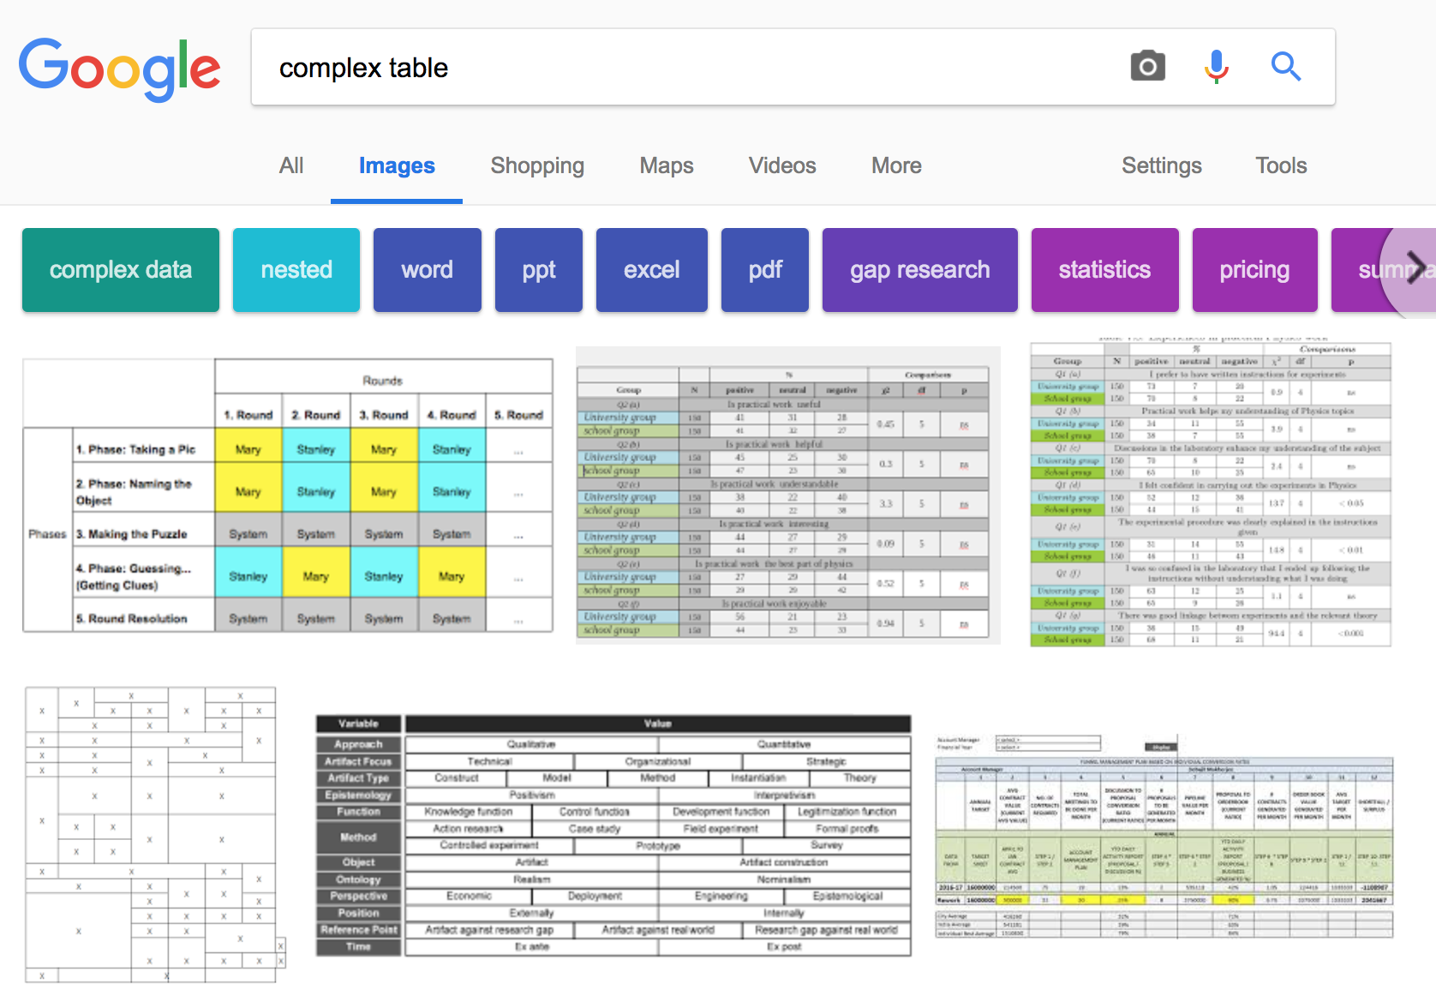
Notes:
I won’t judge these tables’ design but you get the idea.

Slide 3
Common Needs for Complex Tables
Add striped rows
Highlight a cell/row/column
Group rows or columns
...

Slide 4
However, creating complex tables is...
Easy in Excel or Word.
Way more difficult in a programming language.

Slide 5
R relies on HTML & LaTeX to generate tables. Those syntaxes are very powerful...
We need a simplified language to talk about complex tables.
...if you know how.

Slide 6
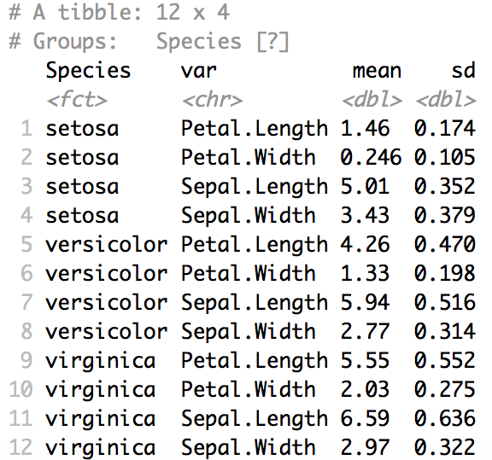
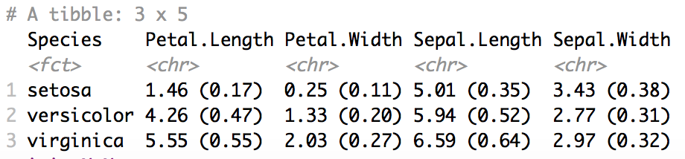
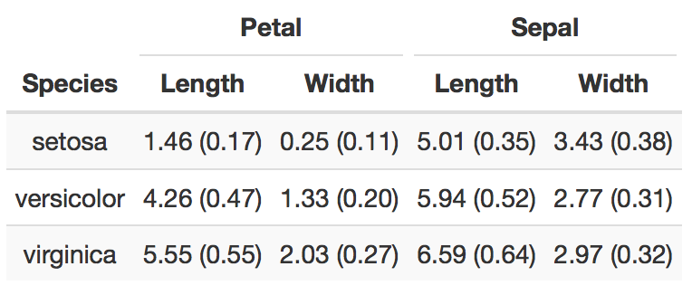
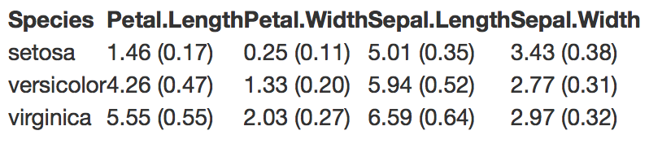
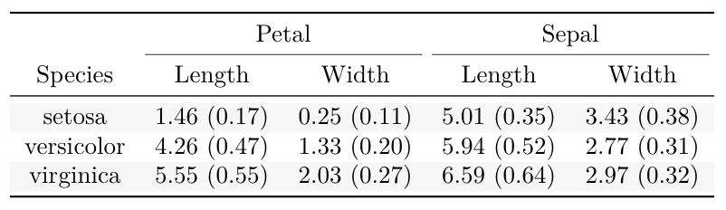
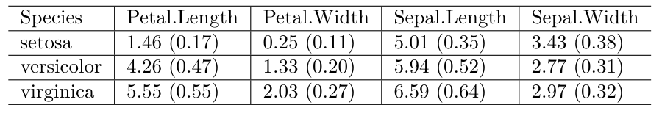
?
?
Notes:
Let’s take a look at this actual example

Slide 7
Life stages of a table
Grammar of tables?
Data
%>%
Summary Stats / Model Results
%>%
Organized Results
%>%
Basic Tables
%>%
Fancy Complex Tables
kableExtra
knitr::kable()

Slide 8
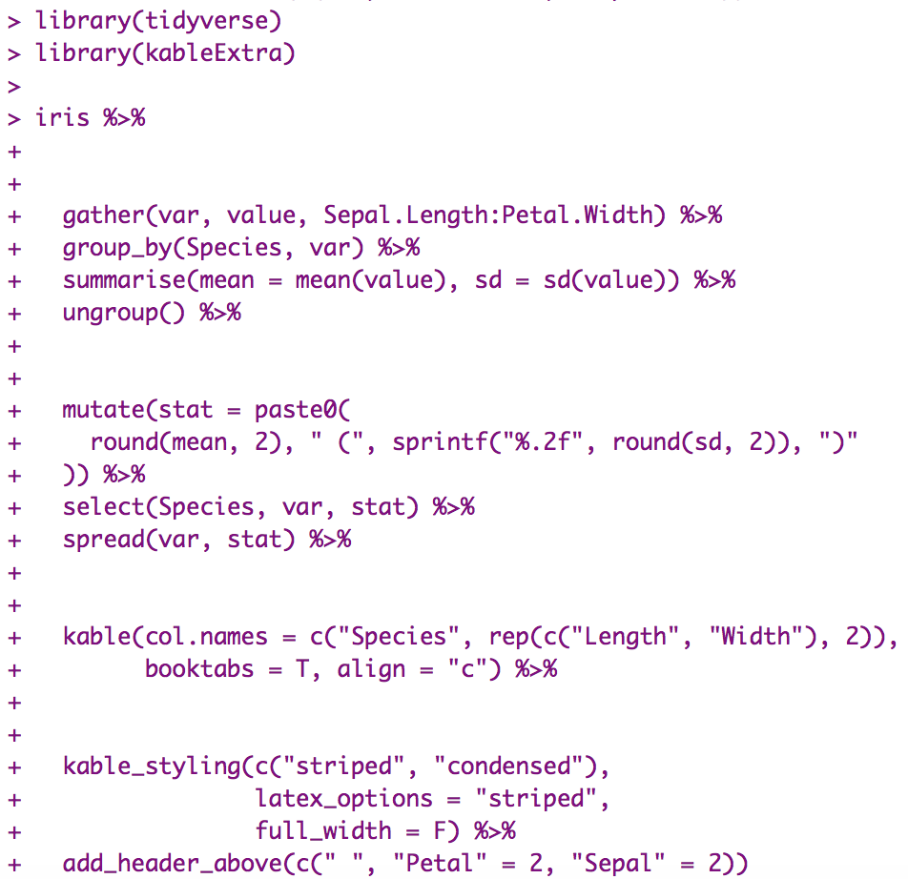
Data
Summary Stats
Reorganize
Results
Basic Table
Fancy Table

Slide 9
Goals & Design
Easy to learn
Easy to use
Works for both HTML and LaTeX
Works for 95% of complex tables.
1. Simple functions + Pipes
2. Smart & Automated
3. Higher level language that translates to HTML & LaTeX
4. Top priority: Simplicity

Slide 10
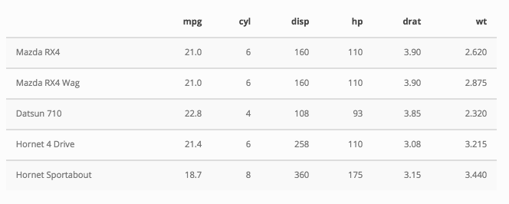
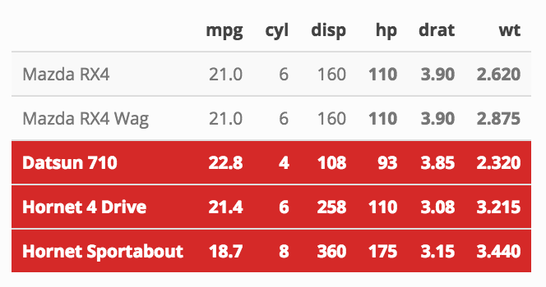
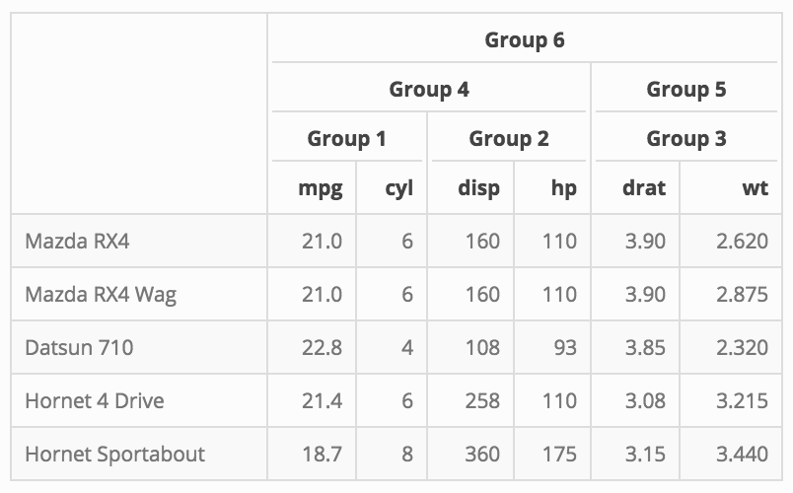
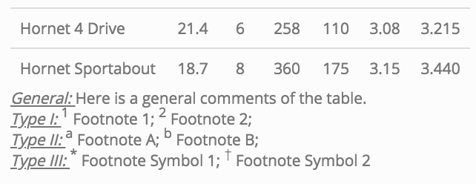
Geranal
General setup: Table themes, striped rows, position, font size etc
kable_styling
Spec family
column_spec
Specify formats (bold, font color etc) for selected columns, rows & cells
row_spec
cell_spec
Grouping
add_header_above
Add columns/rows labels to indicate certain elements belong to the same group
group_rows
collapse_rows
Footnote
footnote
Add table footnotes

Slide 11
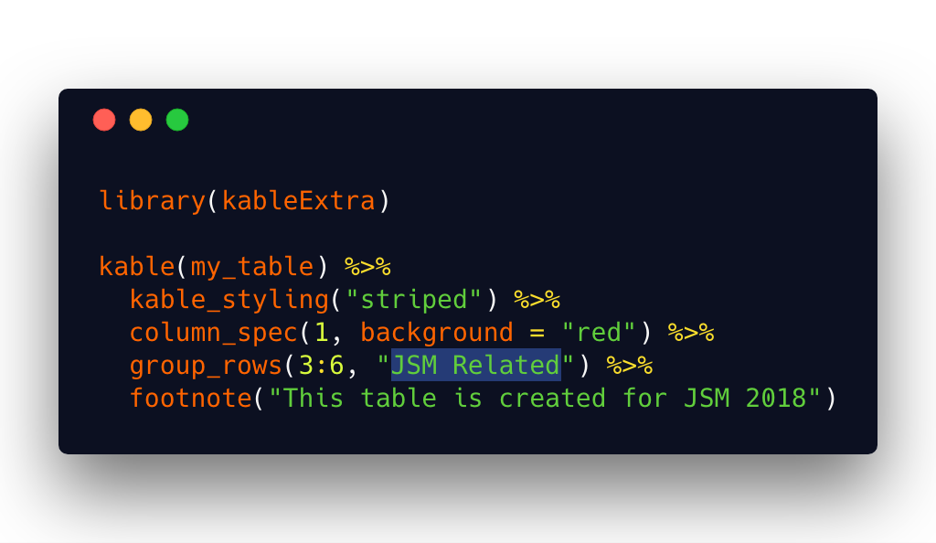
Readability
Notes:
Almost like pseudo code for tables

Slide 12
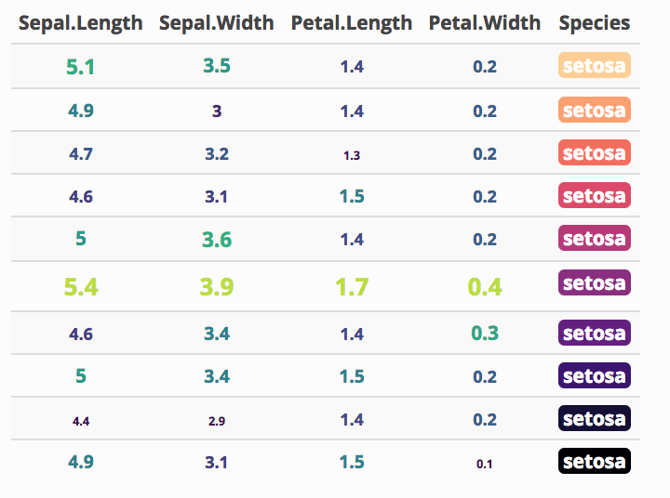
Gallery (HTML) 1 / 3
See the package documentation site for more examples: http://haozhu233.github.io/kableExtra/

Slide 13
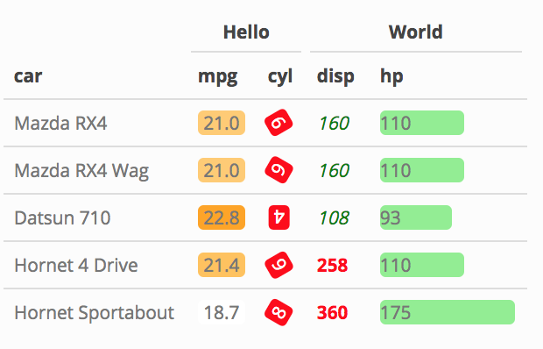
Gallery (HTML) 2 / 3
See the package documentation site for more examples: http://haozhu233.github.io/kableExtra/

Slide 14
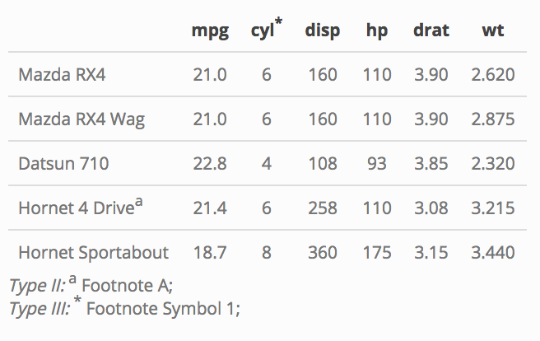
Gallery (HTML) 3 / 3
See the package documentation site for more examples: http://haozhu233.github.io/kableExtra/

Slide 15
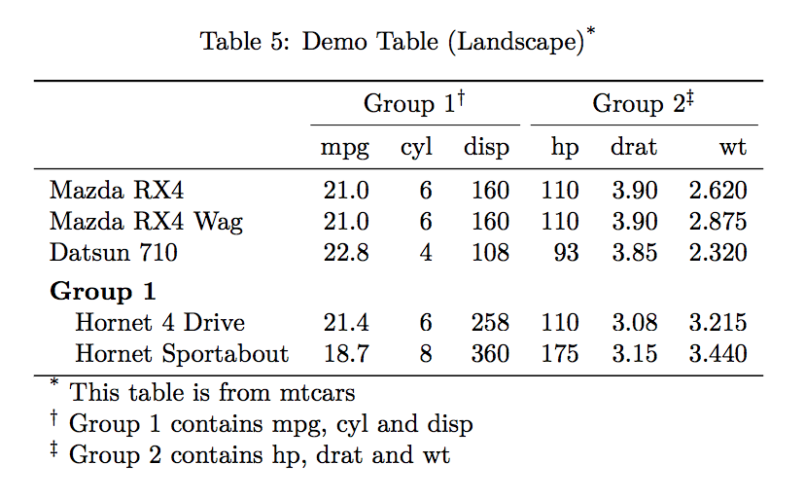
Gallery (LaTeX) 1 / 3
See the package documentation site for more examples: http://haozhu233.github.io/kableExtra/

Slide 16
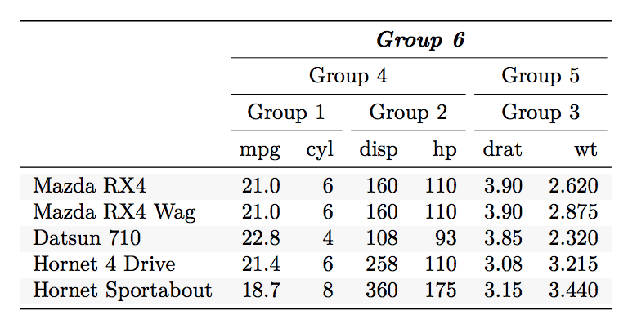
Gallery (LaTeX) 2 / 3
See the package documentation site for more examples: http://haozhu233.github.io/kableExtra/

Slide 17
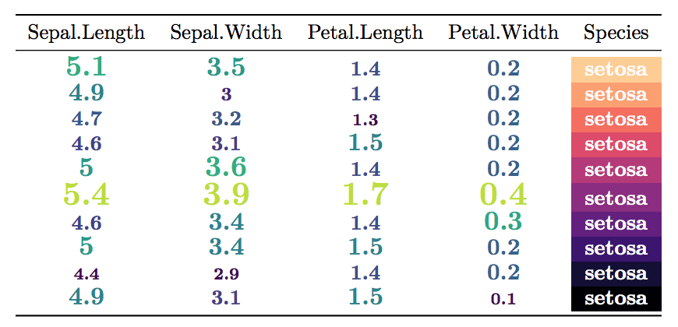
Gallery (LaTeX) 3 / 3
See the package documentation site for more examples: http://haozhu233.github.io/kableExtra/

Slide 18
Cross-format support for HTML & LaTeX
kableExtra now asks kable to render appropriated format of table based on the current rmarkdown environment.
It’s no longer necessary to define format in kable.
You can write your code and preview it in HTML but get a PDF table when you render the document.
Notes:
From the very beginning, functions in kableExtra automatically pick appropriated methods based on the kable object feeded in.

Slide 19
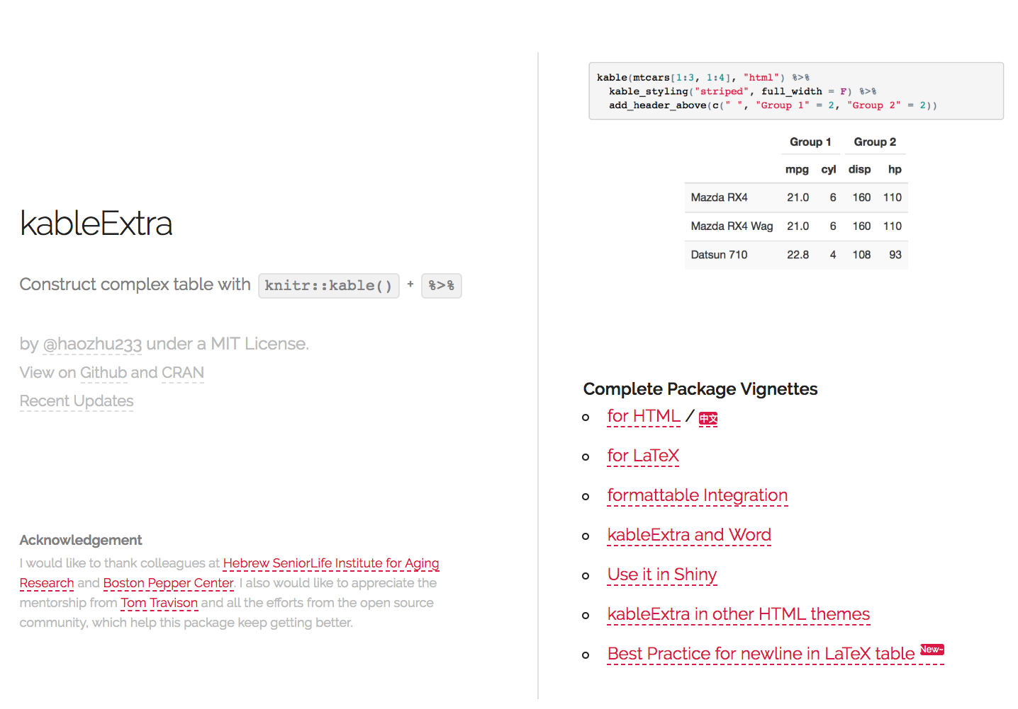
Read More @
http://haozhu233.github.io/kableExtra/

Slide 20
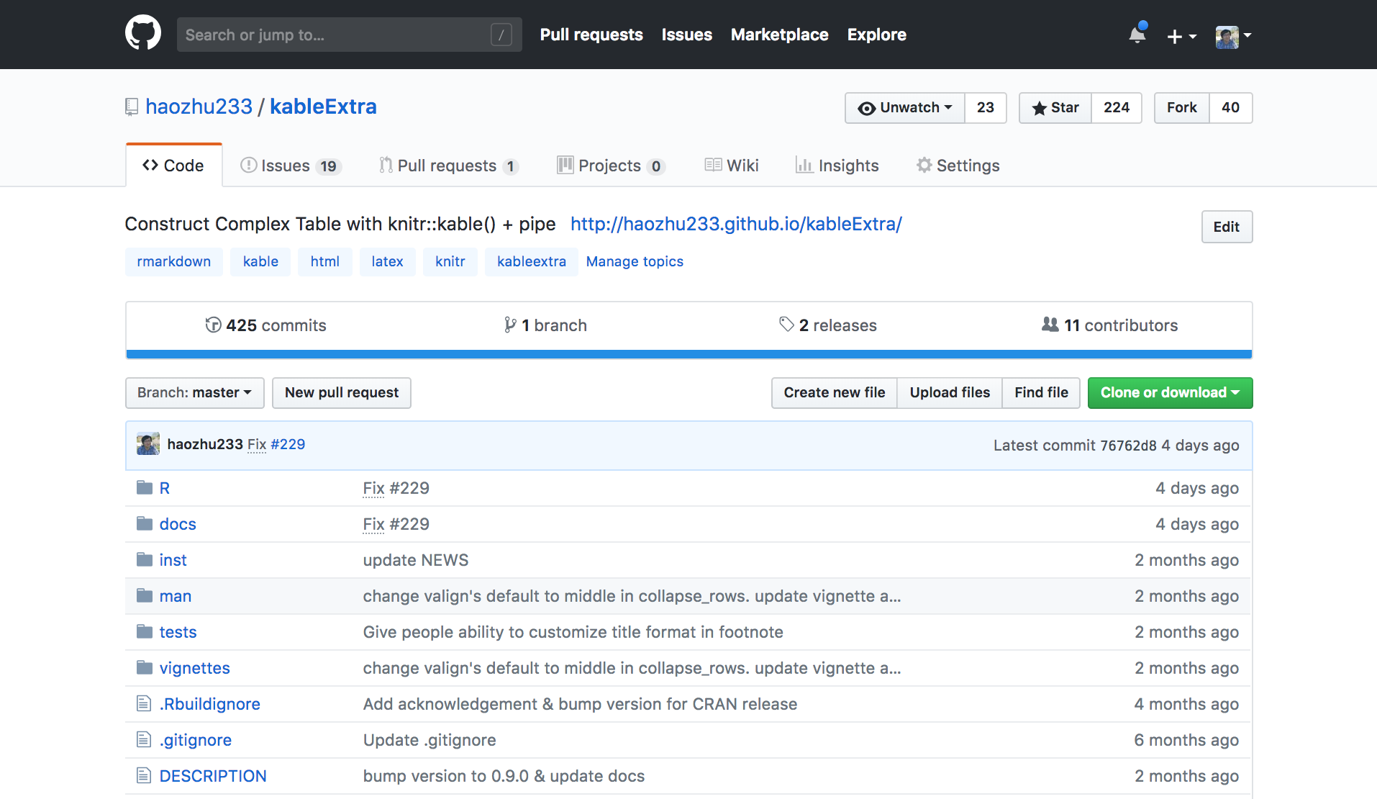
Contribute @
https://github.com/haozhu233/kableExtra

Slide 21
Acknowledgement
A special thanks to:
Dr Tom Travison
For giving me freedom and encouragement for exploring and creating new things.
Also, I appreciate Tim Tsai and my other colleagues at Institute for Aging Research and Boston Pepper Center for their thoughts and support.

