Slide 1
Standardizing Access to Heliophysics Data: HAPI Specification Overview
Jon Vandegriff, JHU/APL
Sandy Antunes, JHU/APL
Robert Weigel, George Mason University
Jeremy Faden, Cottage Systems, Inc.
Aaron Roberts, GSFC
Robert Candey, GSFC
Bernard Harris, GSFC
Eric Grimes, UCLA
Todd King, UCLA
Scott Boardsen, UMBC / GSFC
short welcome and overview of HAPI (why and what) (10 min)
quick demo of several HAPI capabilities (10 minutes)
discussion of GitHub HAPI projects and other helpful tools we've made available (10 min)
Q&A – gauging interest level, how to connect?, concerns?, desire for future topics / tutorials?

Slide 2
What is HAPI?
HAPI = Heliophysics Application Programmer’s Interface
A standard interface for serving time series data.

Slide 3
NASA Science
Astrophysics
Earth
Science
Heliophysics
Planetary
Science
Biological and
Physical Science
you are here:
Solar Physics
data is mostly images
Aeronomy
images and
time series
Magnetospheric / Heliospheric Physics
data is mostly time series
Time | data1 | scalar2 | array | multiDimArray
t0 | d0 | s0 | a0[11] | m0[3,8]
t1 | d1 | s1 | a1[11] | m1[3,8]
t1 | d2 | s2 | a2[11] | m2[3,8]
t2 | d3 | s3 | a3[11] | m3[3,8]
t4 | d4 | s4 | a4[11] | m4[3,8]
t5 | d5 | s5 | a5[11] | m5[3,8]
t6 | d6 | s6 | a6[11] | m6[3,8]
and here:

Slide 4
HOWEVER!! HAPI is not really Heliophysics-specific!
One possible discipline detail is the way HAPI represents time.
ISO8601 string values:
2021-351T14:35:00.000Z Day-of-year -- or --
2021-12-16T14:35:00.000Z Yr-Mon-Day both allowed

Slide 5
When data centers use a custom interface,
interoperability is harder.
unique code needed
to read from each interface
Software 1
Software 2
Software 3
Software 4
client side
server side
LaTiS
Service
das2
Service
File
Service
Web
Service
various Heliophysics and
planetary data centers
GSFC
LASP
Univ. of Iowa
PDS
at UCLA

Slide 6
If a data center adds a HAPI server => interoperability increased.
Common
Software
client side
server side
LaTiS
Service
HAPI
das2
Service
HAPI
File
Service
Web
Service
HAPI
HAPI
GSFC
LASP
Univ. of Iowa
PDS
at UCLA

Slide 7
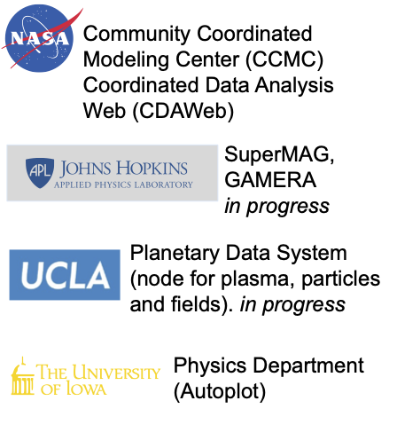
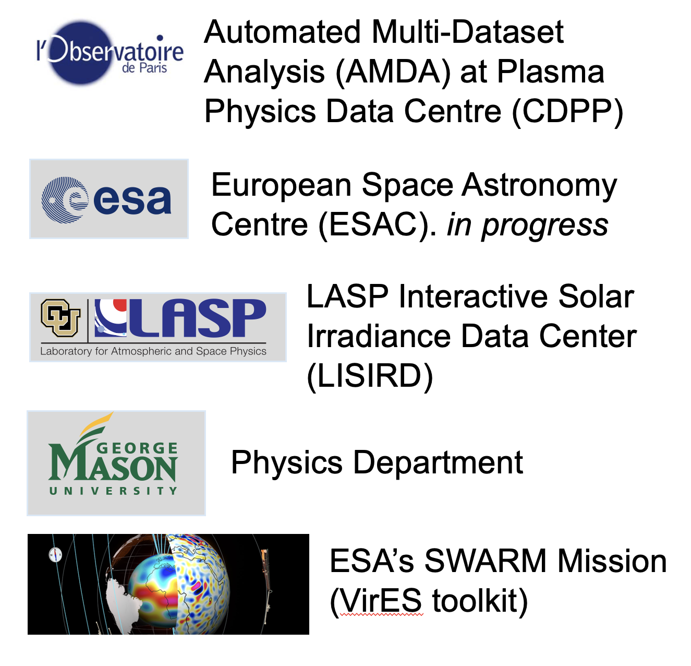
HAPI
Adoption
HAPI is also a COSPAR recommended standard for time series Space Weather data.

Slide 8
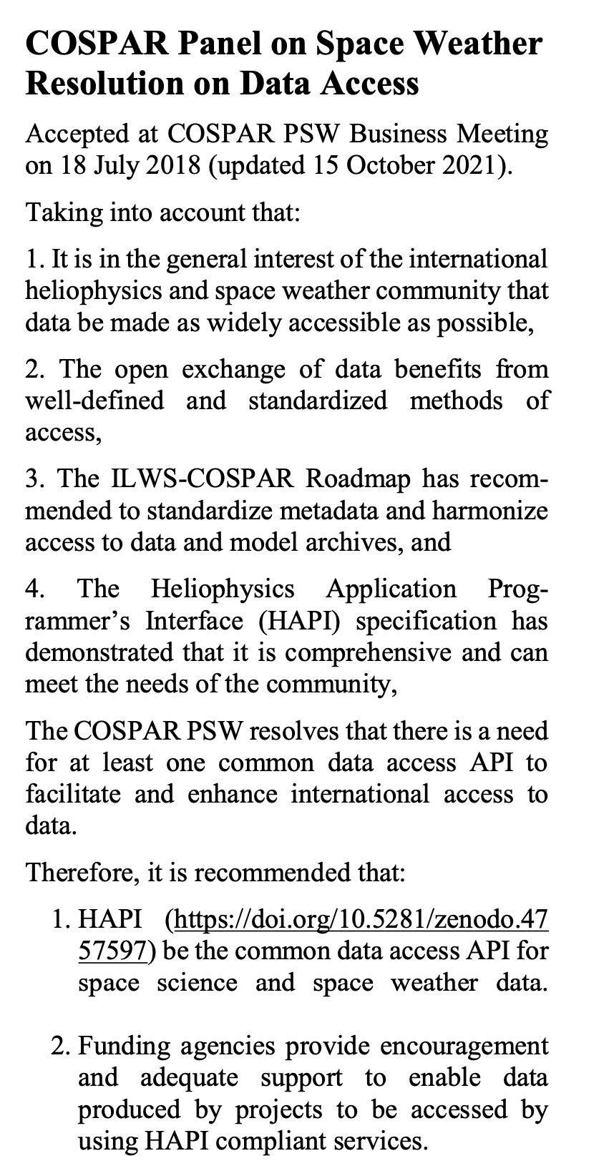
HAPI is primarily a specification:
https://github.com/hapi-server/data-specification
In 2018, it was approved by COSPAR as the recommended standard for Space Weather and space science data.

Slide 9
HAPI – how it works
HAPI as a specification – what to do on your server to make your data accessible
https://hapi-server.org/
two key parts:
request interface – very simple URLs
response format – independent of underlying file format and streaming (no file boundaries)
Comma Separated Values (CSV) data response is default – very easy to interpret (faster options are supported too)

Slide 10
HAPI: a RESTful interface with 5 endpoints
All endpoints must be directly below a URL that ends with ‘hapi’
Endpoint | Inputs | Outputs | Output Format
http://example.com/hapi/about |  | server contact and citation info | JSON
http://example.com/hapi/capabilities |  | which options are implemented (which data formats) | JSON
http://example.com/hapi/catalog |  | list of dataset ids and names | JSON
http://example.com/hapi/info | dataset id | header-like metadata with a list of parameters and record structure, units, fill, etc | JSON
http://example.com/hapi/data | dataset id, time range, parameters (optional) | stream of data from requested parameters in given time range | CSV (reqd) JSON (opt) binary (opt)

Slide 11
Request:
http://example.com/hapi/info
Response:
{
"HAPI": "2.0",
"status": { "code": 1200, "message": "OK"},
"startDate": "2004-001T00:00:04.734Z",
"stopDate": "2017-258T10:31:10.425Z",
"sampleStartDate": "2004-183T00:00:00.000Z",
"sampleStopDate": "2004-184T00:00:00.000Z",
"description": "Cassini magnetometer data as used by the MIMI team",
"cadence": "PT5S"
"parameters": [
{ "name": "epoch",
"type": "isotime",
"length": 24,
"units": "UTC",
"fill": null,
"description": "time as ISO 8601 UTC string to milliseconds"
},
{ "name": "B_SSO",
"type": "double",
"units": "nt",
"size": [3],
"fill": "-1.0e+38",
"description": "magnetic field vector in the SSO frame"
}
],
}

Slide 12
Other topics today
demo of ways to use HAPI to get data
overview of HAPI-related efforts on Github
open-mic Q&A

Slide 13
HAPI Server Verifier
If you implement your own server, how can you test it?
Github project with code to run through a series of tests (that you can run locally).
https://github.com/hapi-server/verifier-nodejs
https://hapi-server.org/verify/

Slide 14
Q&A
Discussion priming topics:
If you want to serve data:
How do I implement a server?
Verifying a server?
Doing science analysis:
what datasets are available now?
what clients can read form HAPI servers?
can I write my own client in Python, IDL, Matlab, Java, R, etc.
How stable is the spec? What changes are planned?
How do I get connected or get help?

