Slide 1
HL7 Message Profile Constraint Analyzing Tool
David Kong, 372-8620
August 2002
Queen's University

Slide 2
Preview
The HL7 Message Standard
The HL7 v2.x Parser API
HL7 Conformance - Message Profiles
The HL7 Message Profile Constraint Analyzing Tool

Slide 3
The HL7 Message Standard
What is it?
Why use it?
The HL7 Message Structure

Slide 4
HL7 - What is it?
a message specification
designed for the exchange of healthcare data
globally recognized

Slide 5
HL7 - Why use it?
need to integrate systems
describes common healthcare processes as “trigger” events
standardizes message structures

Slide 6
HL7 - Messages
modeled after real-life events
trigger -> HL7 message
Trigger event!
Send
HL7 message
Receive
HL7 message
network
Send
HL7-ACK
Receive
HL7-ACK
System A
System B

Slide 7
HL7 - Message Structure
MSH|^~\&|ADT1|MCM|LABADT|MCM|199807201126||ADT^A01
|MSG00001|P|2.3|<cr>
EVN|A01|199807201123|<cr>
PID|1||PATID1234^5^M11||Jones^Sam^Houston||1967032
9|M||C|1200 N ELM STREET^^GREENVILLE^NC^27401-
1020|GL|(919)379-1212|(919)271-3434||S||X454337
^2^M10|123456789|987654^NC|<cr>
NK1|1|JONES^BARBARA^K|WIFE||||CP^Contact
person|<cr>
PV1|1|I|2000^2012^01|E||||004777^LEBAUER^SARA^J.||
TRMA||||ADM|A0|<cr>
message type and trigger event

Slide 8
HL7 - Message Structure
message = groups of segments
segments = group of fields
fields = data, datatypes
component = compound datatypes
segment
NK1|1|JONES^BARBARA^K|WIFE||||CP^Contact person|<cr>
component
field

Slide 9
HL7 - Transmission
lossy message (ack-recp)
assumes error-free, perfect transmission
messages can be “wrapped” (e.g., LLP, XML).

Slide 10
The HL7 v2.x Parser API (HAPI)
Why use it?
The HAPI Message Model
Sample Use

Slide 11
HAPI - Why use it?
pre-prepared objects -> less time to implement
object-oriented message model
- reference specific objects, error-trapping
generated message model
- source generator

Slide 12
HAPI - Message Model
Structure
Segment
Group
Data Type
Message
Primitive
getValue()
setValue()
Composite

Slide 13
HAPI - Sample Use
ACK testMessage = new ACK(); // create a new Acknowledgement HL7
messagetestMessage.getMSH().getDateTimeOfMessage().setValue(ValidTS.toHL7TSFormat(System.currentTimeMillis())));
Parser parser = new myParser();
myWriter.write(parser.encode(testMessage));
SimpleServer
UHN Query Services
UHN Dr. Doctor Letter

Slide 14
HL7 Conformance
problem: custom specifications, no standard semantics!
require: standard semantics, but still allow customization
HL7 Message Profiles (XML)

Slide 15
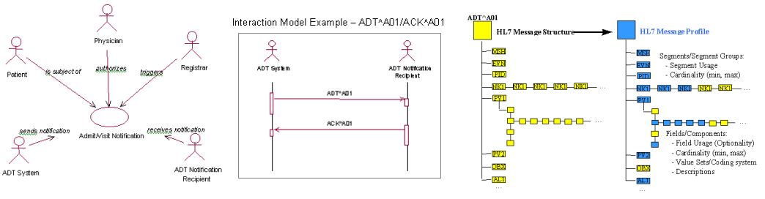
HL7 Message Profiles
standard semantics & grammar
- follow the Document Object Model (DOM), so a Document Type Definition (DTD) can be used to validate.
consists of:
- use case
- interaction diagram
- definition of message structure.

Slide 16
Custom HL7 Message Profiles?
can still occur using “constraints”.
three profile types:
- standard profiles
- constrainable profiles
- implementation profiles

Slide 17
Custom HL7 Message Profiles?
<Segment Name="AL1" LongName="patient allergy information segment"
Optionality="C" Min="0" Max="10">
<Predicate/>
<Field Name="Set ID - AL1" Optionality="O" Min=”0" Max=”5"
ItemNo="" Datatype="SI" Length="4"><Reference>"3.3.6.1"</Reference>
<DataValues ExValue=""/></Field>
<Segment Name="AL1" LongName="patient allergy information segment”
Optionality="C" Min="0" Max="10">
<Predicate/>
<Field Name="Set ID - AL1" Optionality="R" Min="1" Max="1" ItemNo=""
Datatype="SI" Length="4"><Reference>"3.3.6.1"</Reference>
<DataValues ExValue=""/></Field>

Slide 18
Checking for HL7 Conformance
right now: use the DTD and manually check it. (tedious!)
central registry (under construction)
the HL7 message profile Constraint Analyzing Tool

Slide 19
Constraint Checking Tool (CAT)
automates constraint checking of two HL7 message profiles
allows for custom constraint rules and grouping of rules
rules return boolean values, so boolean logic

Slide 20
Constraint Checking Tool (CAT)
uses existing DOM parser (Xerces)
stores parsed data a tree
DocumentObject
DocumentObject
DocumentObject
DocumentObject
AttributeList
AttributeValue
AttributeValue

Slide 21
CAT - Traversal
concurrent traversal required
variation on depth-first
- caters to HL7 “presence” property
constraint check at every recursion

Slide 22
CAT - Rules
devised from documentation
can be customized
  How? Abstract class
returns a boolean, so complex rules can be made
rule has to belong to at least one Rule Set.

Slide 23
CAT - Rule Sets
groups of rules with similar behaviour
  - e.g., act on particular message profile elements.
can be user-defined
  abstract class
only references Rules, doesn’t instantiate them

Slide 24
CAT - Rule & RuleSets
GenericRuleSet
SegmentRuleSet
RuleObject1
execute()
RuleObject2
execute()
RuleObject3
execute()
RuleObject4
execute()
reference

Slide 25
CAT - Applying Rules
applied during traversal of the trees
gathers references to appropriate rules
sequential instantiation and execution of rules
results of rules “AND”ed with checkpoint boolean
rule failure -> JAVA exception (log or halt)

Slide 26
CAT - Demo Application
pre-alpha, just demonstrates model and concept
constraint rules are incomplete, haven’t been specified by HL7 Conformance SIG
run the demo

Slide 27
CAT - Future Considerations
automatic generation of Rule Set objects from a DTD
GUI interface for rule/rule set creation/modification
revise data structure for storing parsed message profiles
pair with HL7 API source generator so can create conformant HAPI message objects from HL7 message profiles.

Slide 28
FIN
QUESTIONS?

