Slide 1
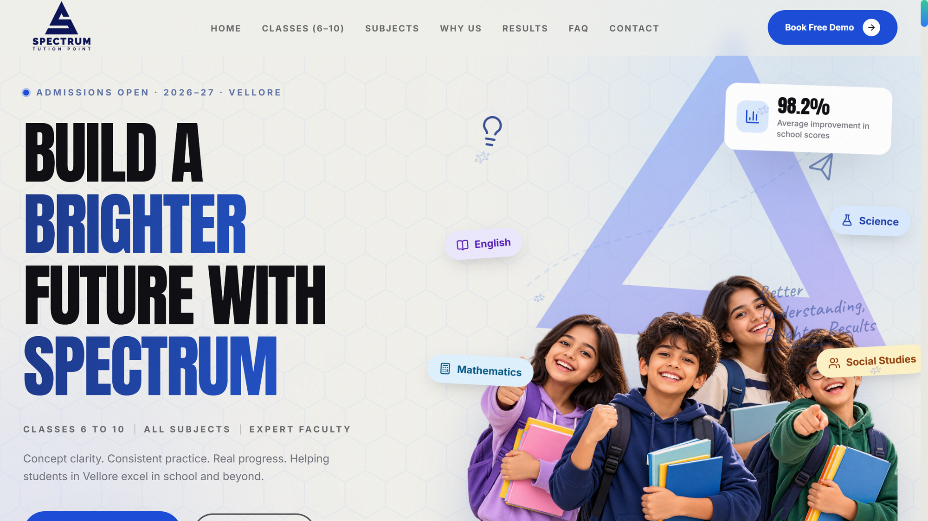
WEBSITE REVAMP PROPOSAL · 2026
A WEBSITE WORTHY OF 35 YEARS OF EXCELLENCE
THE NEW EXPERIENCE
Spectrum Tution Point, Vellore — rebuilt as a modern, animated, admissions-driving experience for Classes 6–10.
CBSE · ICSE · State Board
Classes 6–10
Notes:
Open with the promise, not the tech: 'You've spent 35 years building Spectrum's reputation; this proposal makes the website finally show it.' Let the hero screenshot do the talking. 30 seconds max.

Slide 2
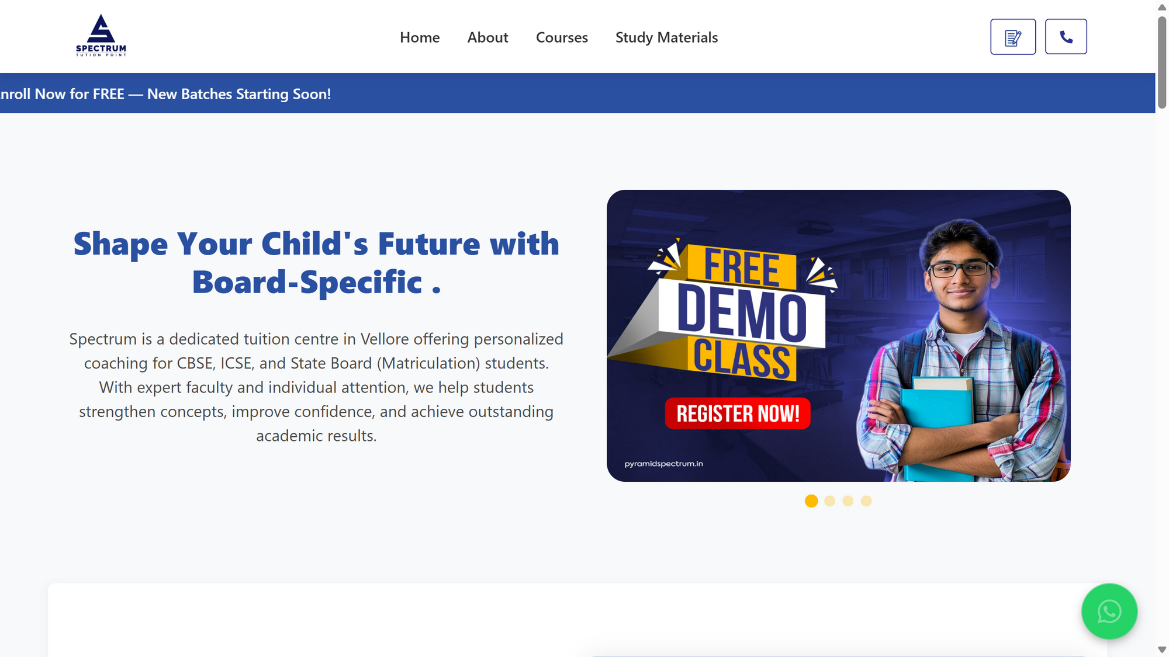
THE PROBLEM
YOUR CURRENT WEBSITE IS INVISIBLE
CURRENT SITE — LIVE TODAY
• Looks like a generic template
The same as every competitor — parents can't tell Spectrum apart from a centre that started last year.
• The headline itself fails to render
The page reads 'Board-Specific .' — the most important sentence is broken.
• Zero motion — the page feels abandoned
A static page reads as 'this business isn't active' to a first-time parent.
• Nothing guides a visitor toward admissions
Notes:
Be factual, not insulting — point at the screenshot and name what you see. Goal: 'the current site undersells Spectrum.' Pause after the broken-headline point and let them react.

Slide 3
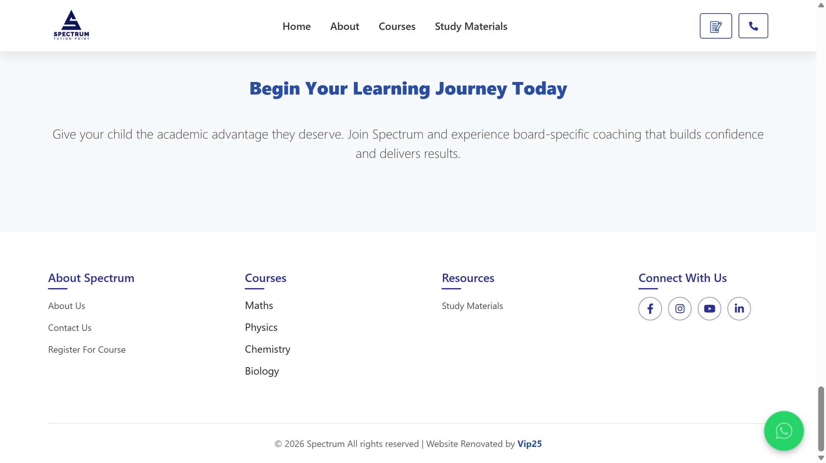
COST OF DOING NOTHING
EVERY SILENT VISIT IS A LOST ADMISSION
THE CURRENT 'CALL TO ACTION'
• The entire call-to-action is a paragraph of text
No form, no countdown, no phone button — interest evaporates.
• Parents shortlist 3–4 centres online before visiting any
The centre that looks alive and modern wins the walk-in.
• A hoarding costs ₹20,000+ a month — and expires
A website works 24/7 for every admission season, at ₹0/month.
• One enrolment pays for this entire project
Every admission is worth years of fees.
Notes:
Anchor on what they already understand: print ads and hoardings. 'You already spend on visibility that expires. This is the one marketing asset that never expires.' Don't rush past the empty-space screenshot — it's the punchline.

Slide 4
THE NEW EXPERIENCE
FIRST IMPRESSIONS NOW DO JUSTICE TO SPECTRUM
NEW HERO — FULLY ANIMATED
Everything moves, pops and guides — it feels like a national brand, not a local flyer.
Floating subject pills
Live 98.2% stat card
Student energy, brand colours
Notes:
One breath: 'Same information parents already need — presented the way their eyes want to receive it.' Describe the feeling; don't list features. If possible, open the live site and scroll the hero for them.

Slide 5
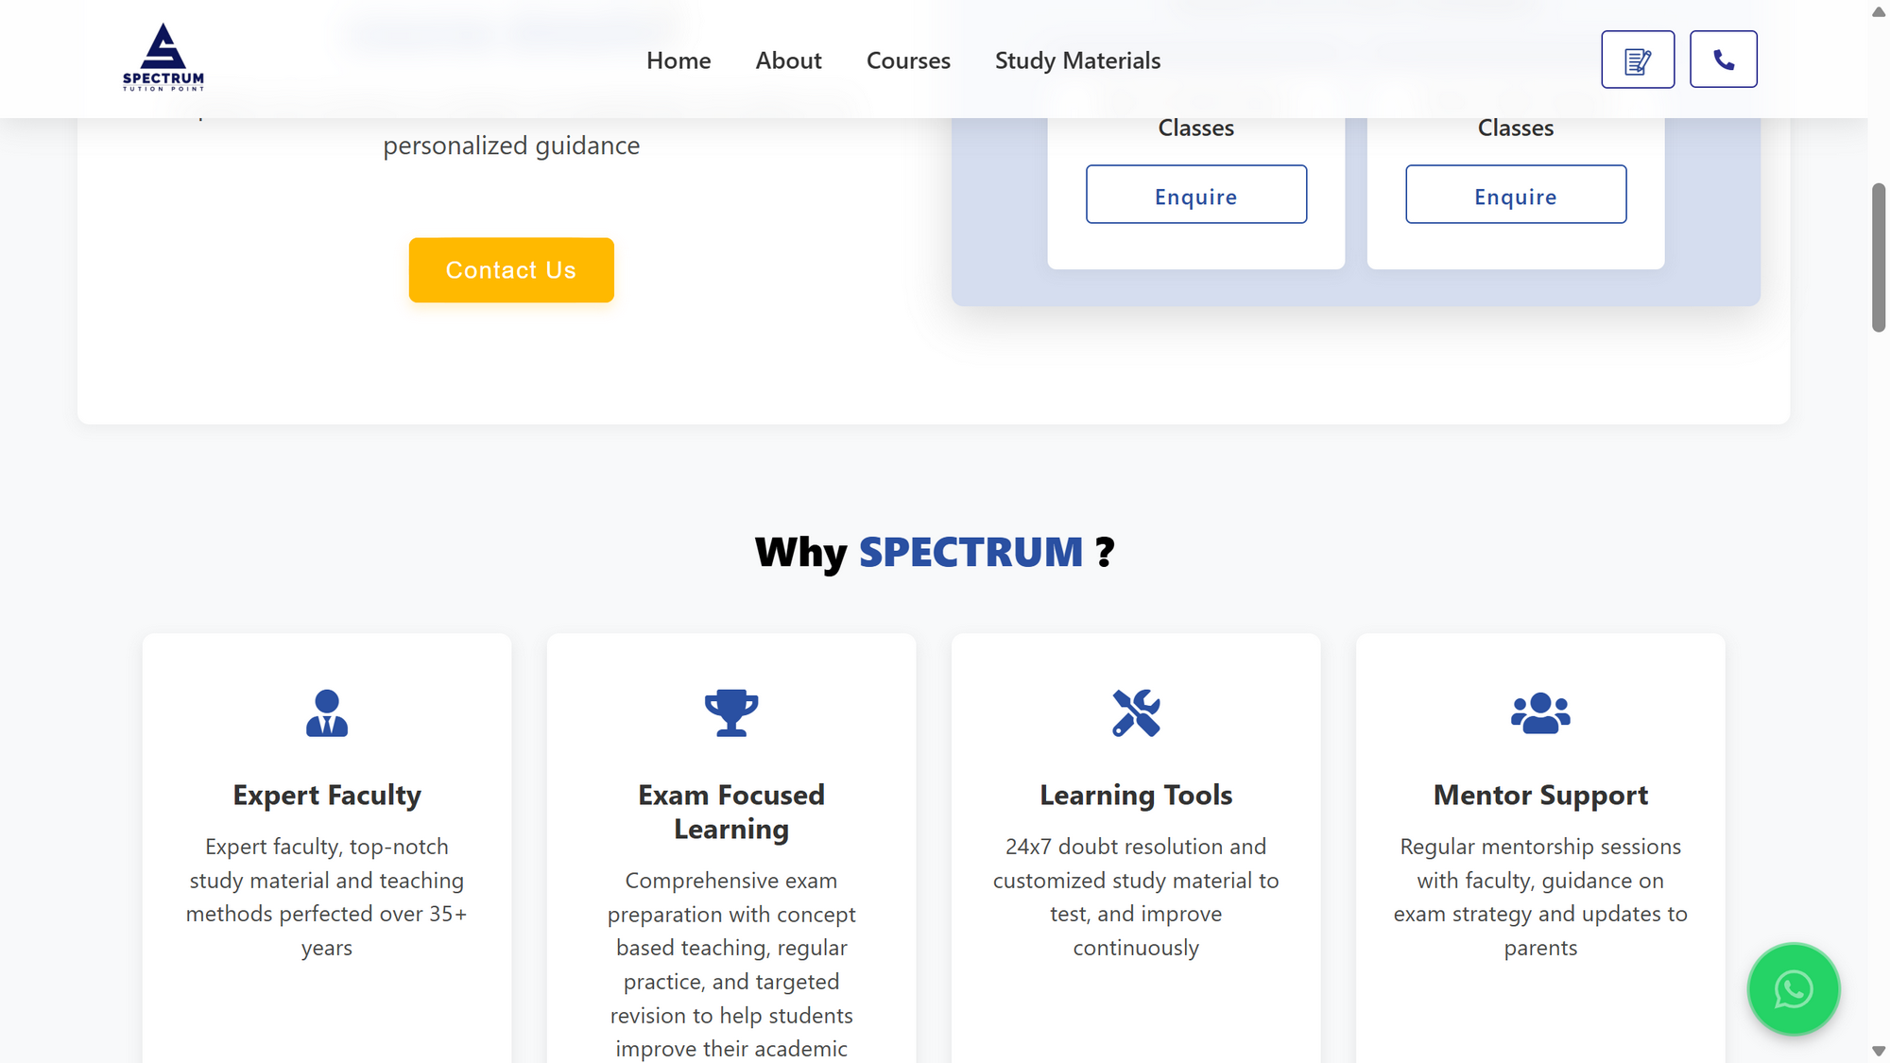
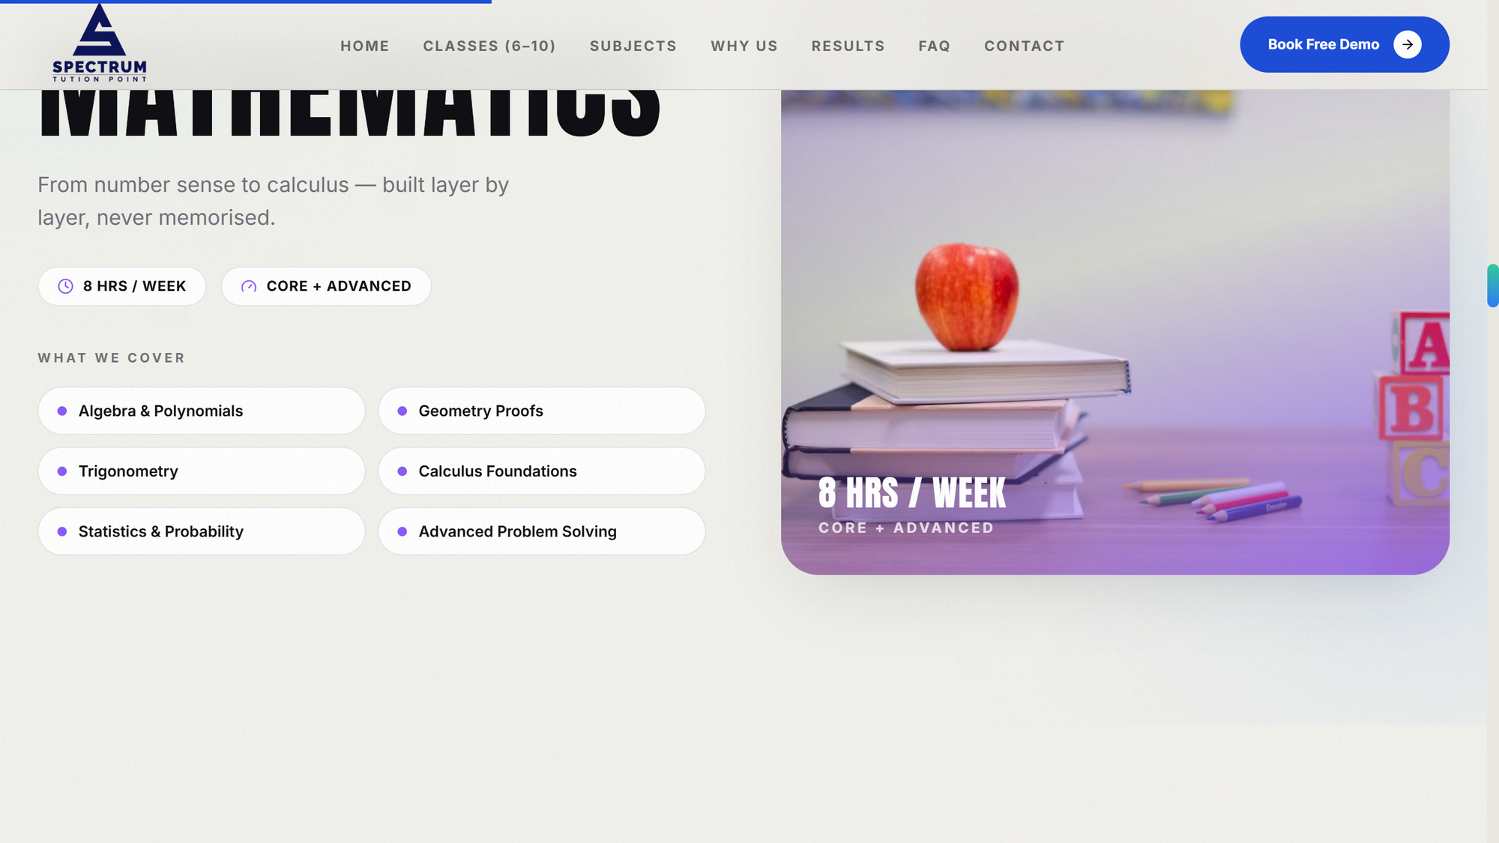
SIDE BY SIDE
OLD VS NEW — THE DIFFERENCE IS THE DETAILS
OLD: STATIC SECTION
NEW: INTERACTIVE TABS
 | CURRENT WEBSITE | NEW WEBSITE
Design | Generic template, dated | Custom, editorial, brand-first
Motion | None — static page | 30+ animations, marquees, live counters
Results & faculty | Plain text lists | Photo carousels with scores & credentials
Admissions | One paragraph of text | Countdown + demo-class form + confirmation
Editing | Developer needed per change | All content editable from one file
Running cost | Current hosting bills | ₹0/month hosting
The point: same school, same fees, same faculty — but the new site makes Spectrum look like the obvious choice before a parent ever calls.
Notes:
Don't read the table row by row. Pick the two rows that stung earlier (motion, admissions) and let them scan the rest. The screenshots above the table carry the slide.

Slide 6
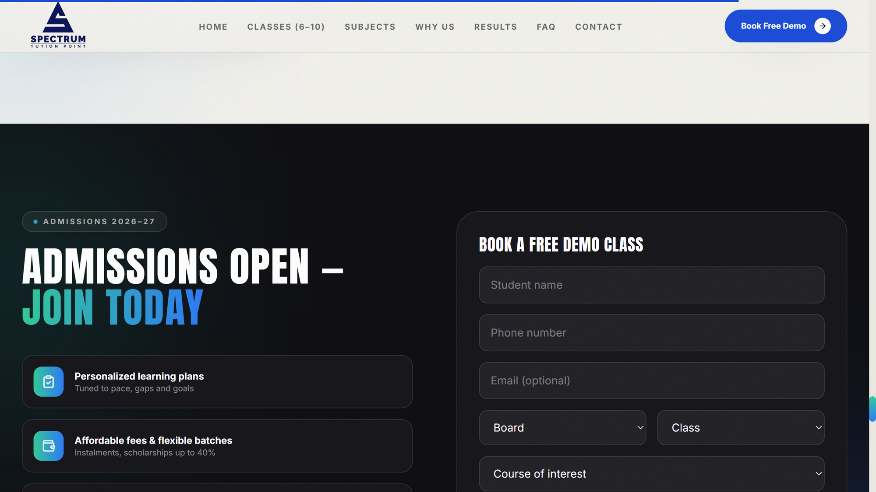
ADMISSIONS FUNNEL
EVERY SCROLL MOVES A PARENT CLOSER TO “BOOK A DEMO”
LIVE ADMISSIONS SECTION
• Live countdown to the deadline
Urgency that text alone can't create.
• Demo-class form with instant confirmation
Interest is captured the moment it happens — not lost to 'call us later'.
• Phone & WhatsApp one tap away, everywhere
• Designed mobile-first
Where parents actually browse.
Notes:
Frame it as a machine: Interest → urgency → action → confirmation. The old page stops at interest. If asked about the form backend: connecting submissions to email/WhatsApp is a small add-on, quoted separately.

Slide 7
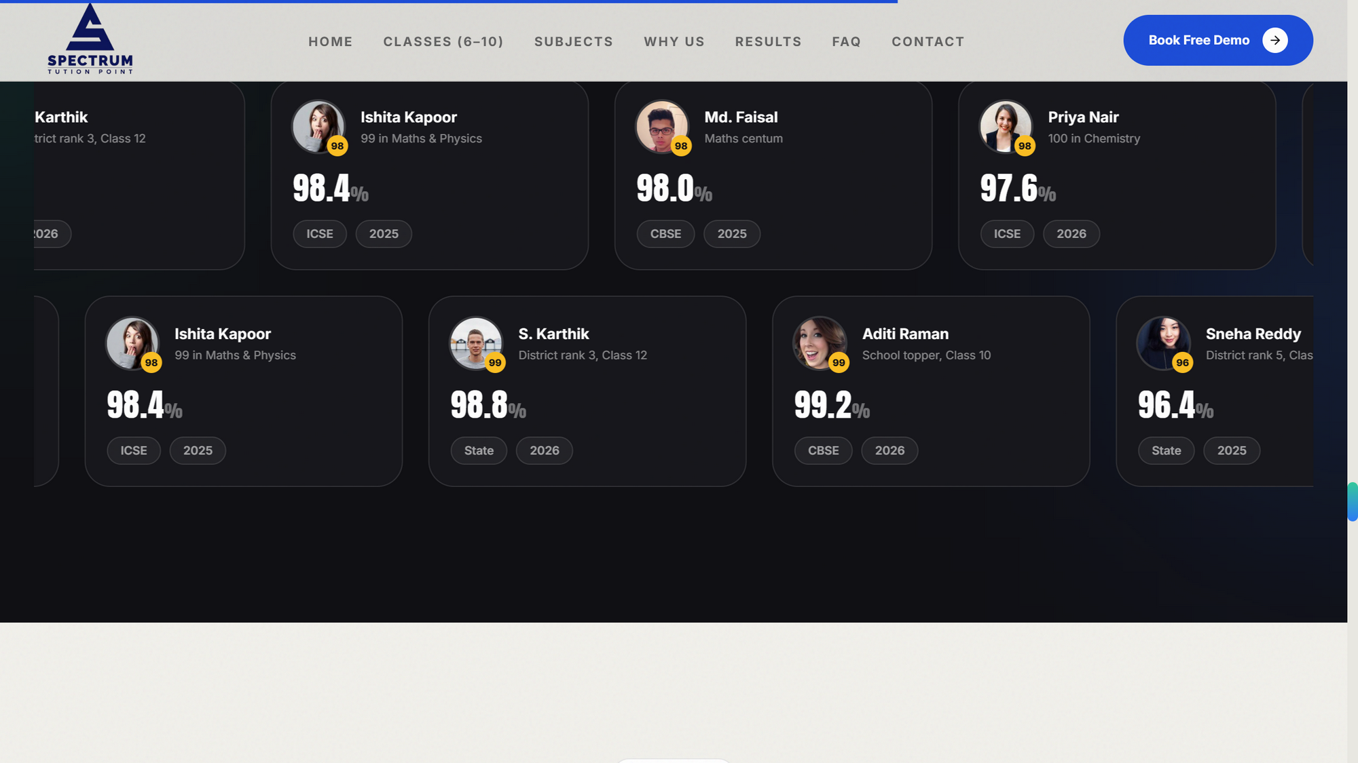
TRUST ON DISPLAY
RESULTS AND MENTORS, FRONT AND CENTER
TOPPER CAROUSELS — AUTO-SCROLLING
• Toppers scroll by with photos & scores
Proof beats claims — parents see faces, not a numbered list.
• Faculty marquee with portraits & credentials
• Parent reviews in an infinite wall
• 98.6% distinction story woven through the page
Notes:
This is Spectrum's 35-year moat made visible. One line: 'The reputation already exists — the new site finally displays it.' Real topper and faculty photos drop straight in later.

Slide 8
SCOPE
EVERYTHING IS INCLUDED — ONE PACKAGE
✓ 14-section complete website
✓ Full custom motion design — hero, carousels, counters
✓ Mobile, tablet & desktop
✓ Your logo & brand colours throughout
✓ All current content, reorganised
✓ Demo-class enquiry form + countdown
✓ Hosting setup done for you — ₹0/month
✓ Handover docs + 15-min walkthrough
Outside this package: the domain (~₹900/year, paid to the registrar) and future photo/content swaps.
Notes:
Naming what's excluded is deliberate — it prevents 'I thought that was included' later and quietly scopes the ₹15,000.

Slide 9
INVESTMENT
ONE-TIME INVESTMENT. ZERO MONTHLY COST.
₹ 15,000 one-time
₹0 / month hosting — forever
Only ~₹900/yr domain
100% yours — full ownership
A single hoarding costs more per month — and expires. This works every admission season, for years.
LAUNCH PRICING FOR SPECTRUM · 50% TO BEGIN, 50% AT GO-LIVE
Notes:
Say the number once, then stop talking. If there's silence, let it sit — the next person to speak makes the concession. The 50/50 line answers the budget question before it's asked.

Slide 10
NEXT STEPS
LIVE WITHIN DAYS, NOT MONTHS
1
Approve & share final content
Real topper/faculty photos, current fees, contact numbers.
2
We deploy & connect your domain
Hosting, SSL, and the domain pointed to the new site.
3
Go live + 15-minute handover walkthrough
You see exactly how to update anything, anytime.
35 YEARS OF TEACHING EXCELLENCE — NOW WITH A WEBSITE THAT SHOWS IT.
Notes:
Close on emotion, then logistics. Hand over a one-page summary and ask directly: 'Shall we start with the photos and fees?' An actual question — not 'let me know if you're interested.'

