Slide 1
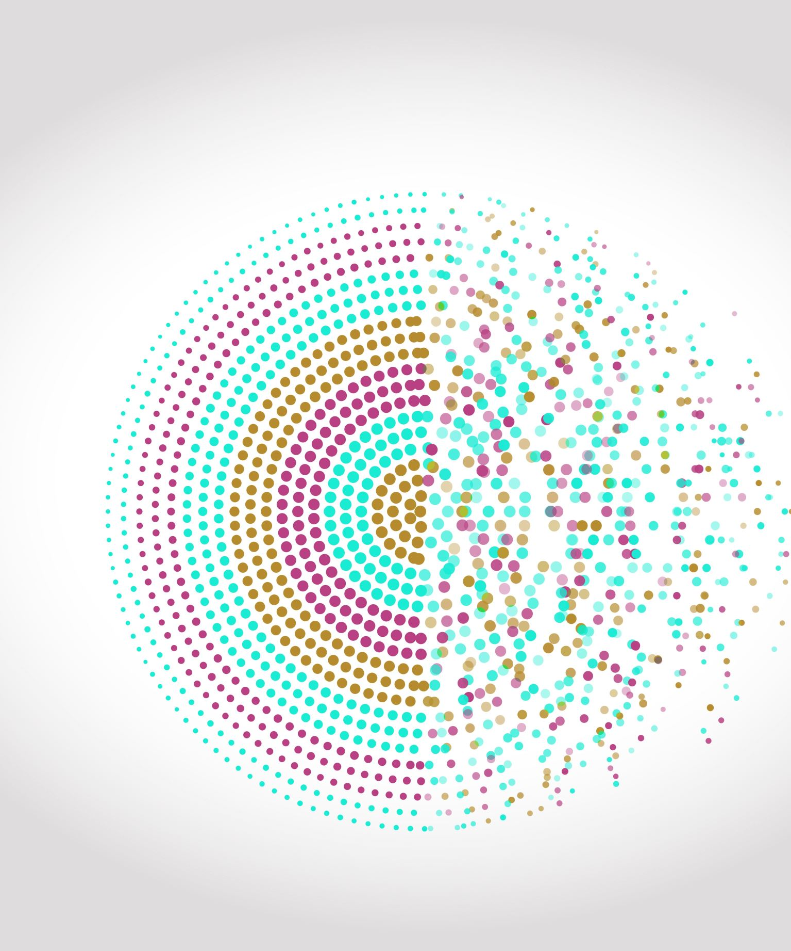
Identifying Duplicate Questions
Mini Project V
By Hugo Perdomo

Slide 2
Project Workflow
EDA
Data Cleaning
Feature Engineering
Modeling

Slide 3
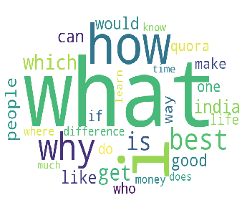
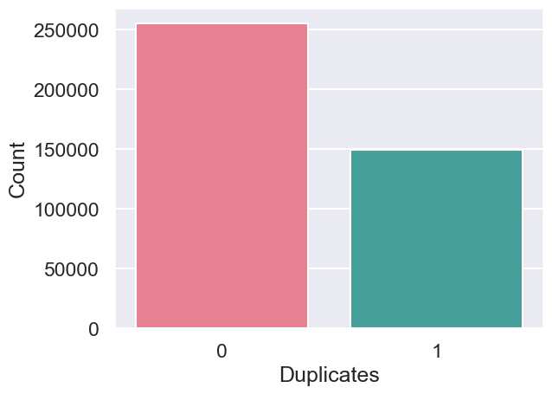
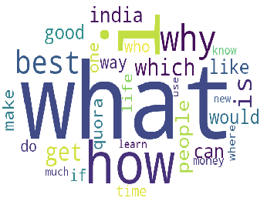
EDA
Question 1
Categories unbalanced (36% duplicated)
Question 2

Slide 4
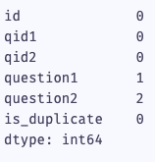
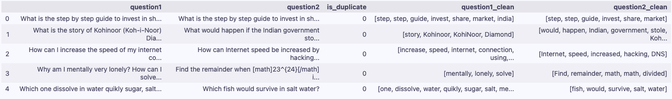
Data Cleaning
Only 3 Null values were dropped.
Applied cleaning methods for questions:
Tokenization
Removal of English stop-words
Remove punctuation
Normalization
Lemmatization

Slide 5
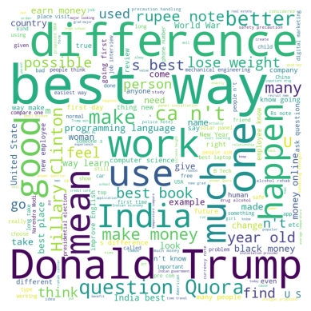
Feature Engineering
Used TDfidVectorizer to calculate similarity.
Added vectors for each question using Word2Vec.
Word counting for each clean question.
Common word column

Slide 6
Modelling
Use SMOTE oversampling to balance training data
Tested Logistic Regression and XGBoost
Logistic Regression | XGBoost | XGBoost (After Tuning)
Accuracy 65.59% AUC Score 66.67% | Accuracy 65% AUC Score 69.7% | Accuracy 67.14% AUC Score 68.69%

Slide 7
Challenges
Calculate cosine similarity

Slide 8

Thank You!
Questions?

