Slide 1

Model Deployment Mini Project IV
By Hugo Perdomo

Slide 2
Project Goals
Create a Machine Learning model that predicts if a loan for an applicant will be approved.
Implement the model using pipelines.
Create an API using Flask and pickle files to predict if the new applicant will get the loan approved.
Deploy the API in AWS Cloud and test using Python test file.

Slide 3
Project Process
EDA
1
Data Cleaning / Feature Engineering
2
Modelling
3
Deployment
4

Slide 4
Hypotheses
Married applicants have a better chance of getting a loan.
Are male applicants more likely to get a loan?
Applicants with a credit score are more likely to get a loan.
Applicants with co-applicant are more likely to get a loan.

Slide 5
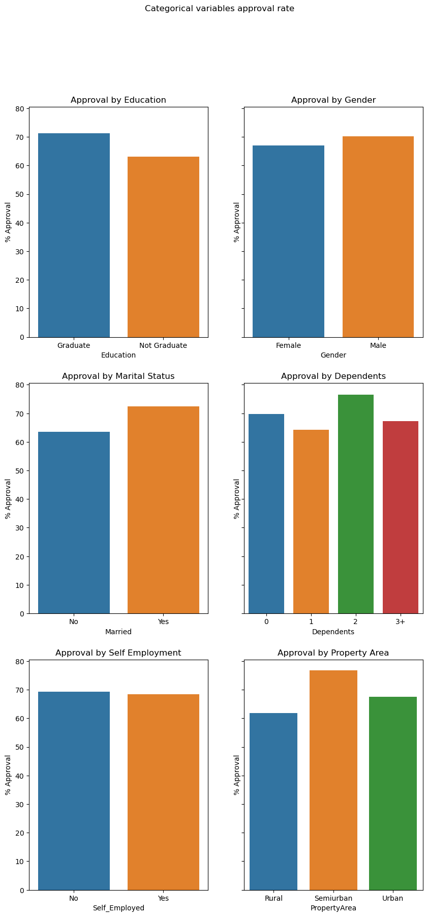
Data from Hypotheses

Slide 6
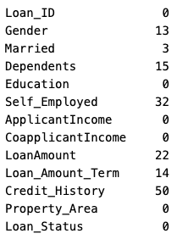
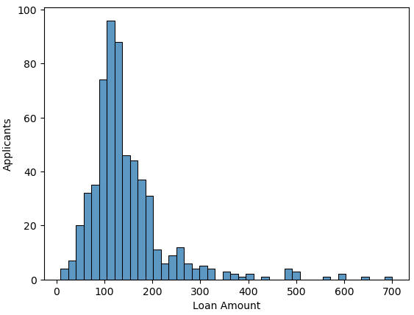
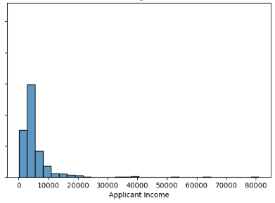
EDA
Some columns had null values.
Data for Income and Loan Amounts skewed

Slide 7
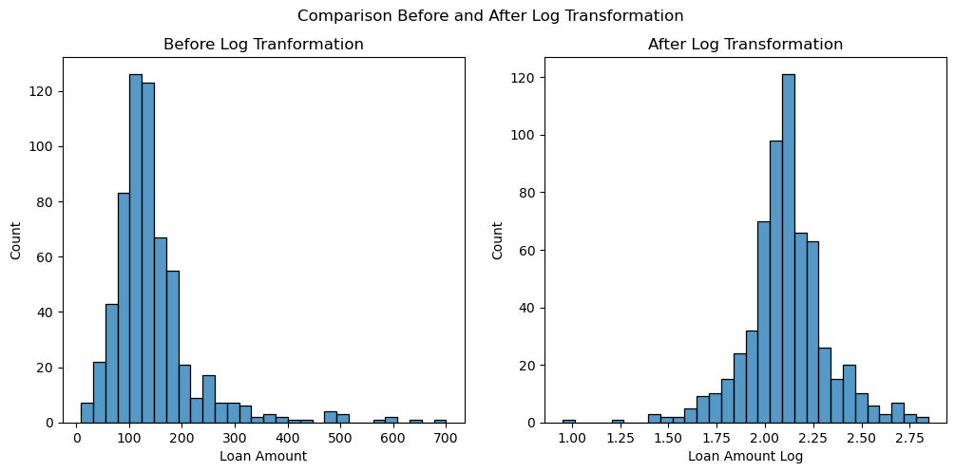
Data Cleaning and Feature Engineering
Transformation of variables Loan Amount and Combined Income into log values.
Transform categorical variables into dummies for better handling on the ML model.

Slide 8
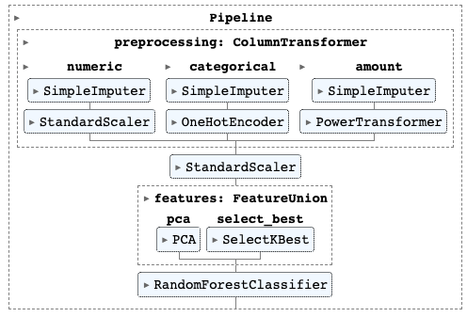
Modelling
Used RandomForestClassifier
Without tuning: Accuracy 72.36%
After running GridSearchCV I got an accuracy of 75.96%
Implemented model again using pipelines using PCA and SelectKBest, got an accuracy of 80.49
Saved model as a pickle.

Slide 9
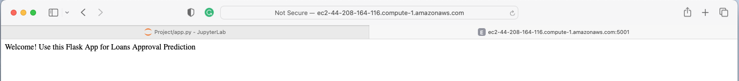

Deployment
Deployed model on the cloud using AWS.
Used pickle to implement the app with Flask.
Created a test file on python to test

Slide 10

Thank You! Questions?

