Slide 1

Predicting Flight Delays
Mid Term Project
By Josh Graham and Hugo Perdomo

Slide 2
Project Workflow
Data Preparation
EDA
Feature Selection
Model Evaluation
Hyperparameter Tuning
Prediction

Slide 3
Objective
Create a machine learning model based on US domestic flights data (2019 – 2020 ) to predict delays in January 2020

Slide 4
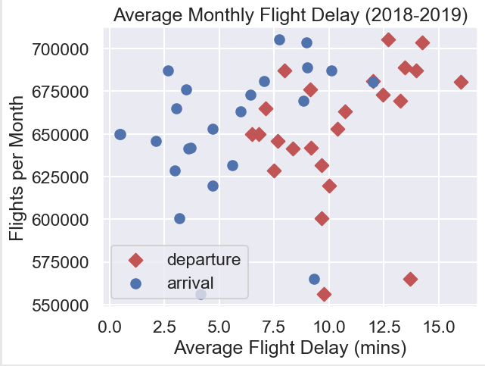
Average Flight Delay 2018-2019

Slide 5
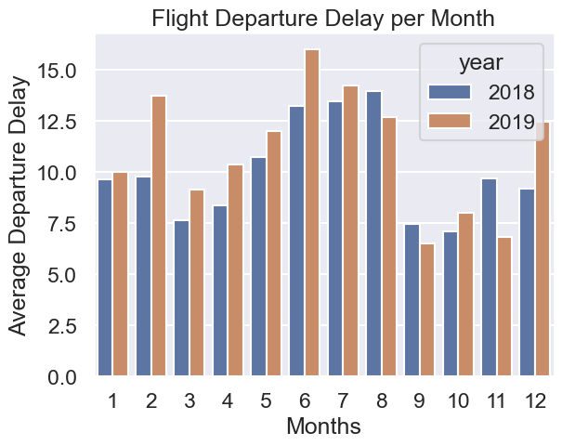
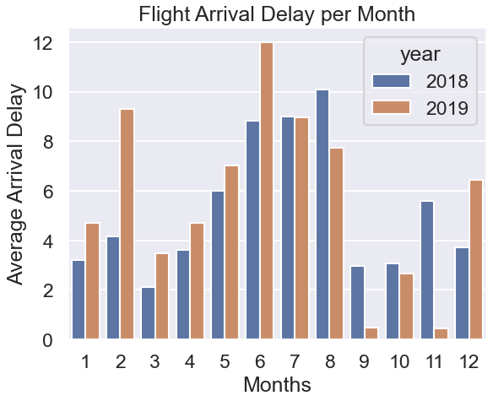
Flight Delays Departures/Arrivals

Slide 6
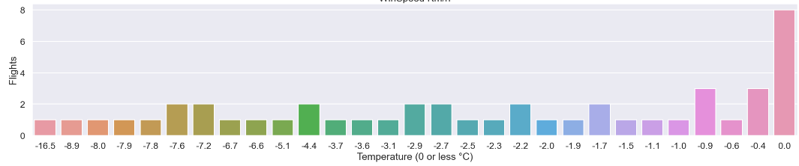
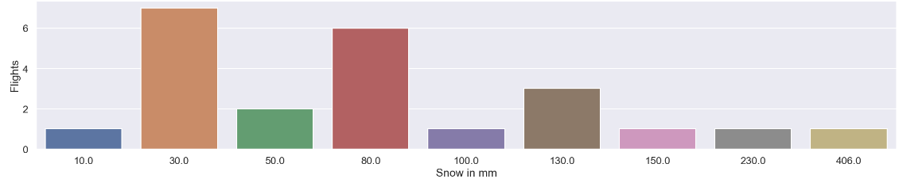
Weather Impact on flights
Sample size 200 flights randomly selected

Slide 7
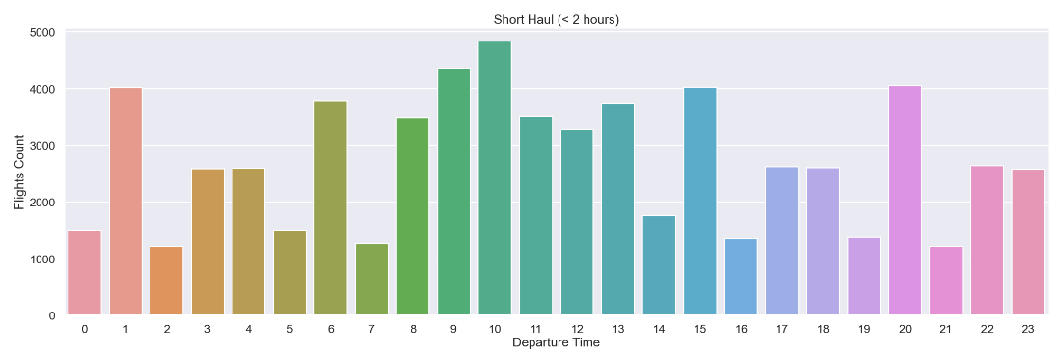
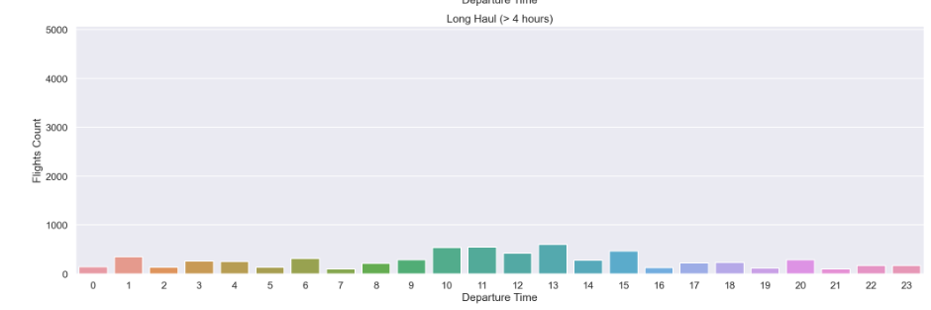
Departure Time Short Haul vs Long Haul

Slide 10

Thank you!

