Slide 1

Predicting Flight Delays
Mid Term Project
By Josh Graham and Hugo Perdomo

Slide 2
Project Workflow
Data Preparation
EDA
Feature Selection
Model Evaluation
Hyperparameter Tuning
Prediction

Slide 3
Objective
Create a machine learning model based on US domestic flights data (2019 – 2020 ) to predict arrival delays in January 2020

Slide 4
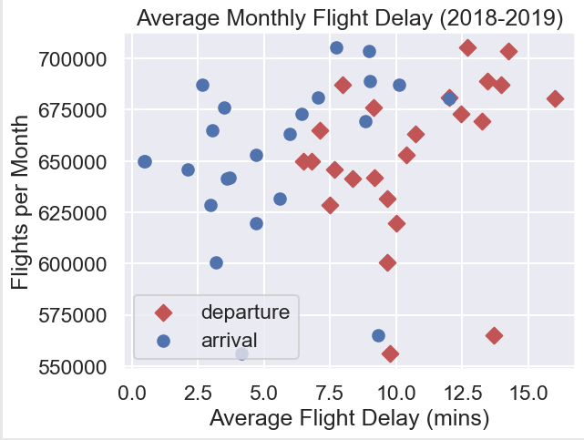
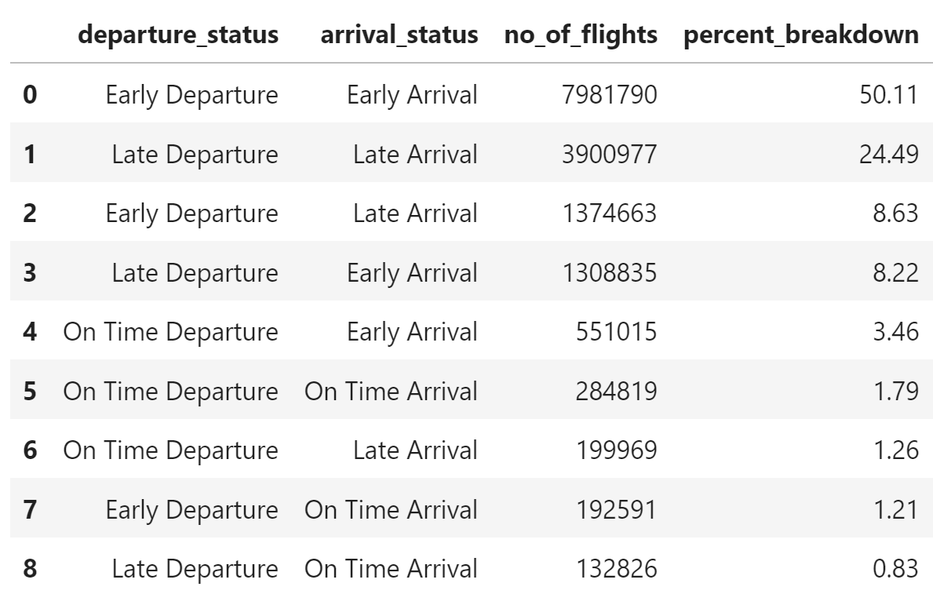
Flight Delays 2018-2019

Slide 5
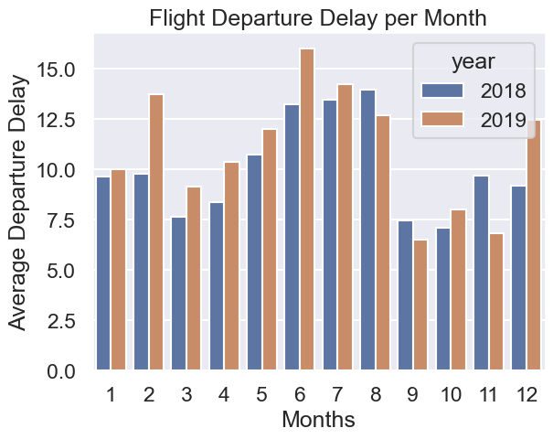
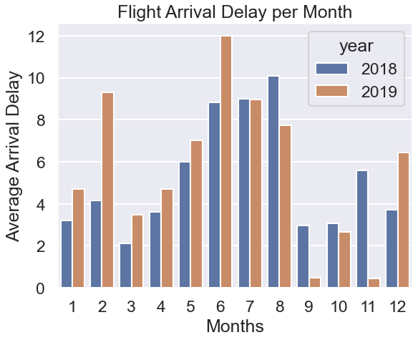
Flight Delays Departures/Arrivals

Slide 6
Weather API Extraction
Get Airports Coordinates
Bring Historic Information Using Meteostat
Merge Information / Feature Engineering
We used the Meteostat API Library for the extraction of weather information.
We used the library that Meteostat provides to read historical weather information.
Meteostat takes its information from organizations such as : NOAA, DWD and Environment Canada.
For more information visit https://meteostat.net/en/

Slide 7
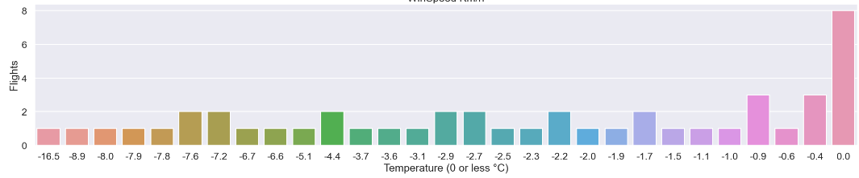
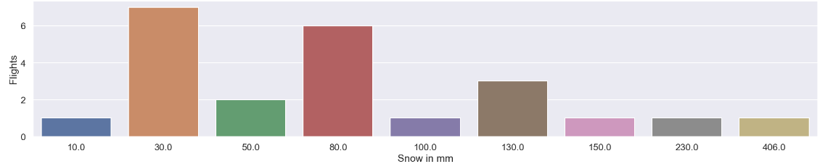
Weather Impact on flights
Sample size 200 flights randomly selected

Slide 8
Feature Selection Workflow
Choose data from flight SQL database to be model inputs
Export 100,000 randomly selected line items from SQL
Merge airport latitude and longitude location data to flight data
Merge weather information corresponding to airport geographical information and flight date
Transform categorical variables (flight number & flight route) into numeric data
Drop any NA values from the DataFrame

Slide 9
Modeling
Model Input: US domestic flight and weather data
Model Output: Arrival Delays
Tried multiple algorithms:
Linear Regression (including Ridge and Lasso)
Random Forest Classifier, SVM & Naïve Bayes
XGBoost

Slide 10
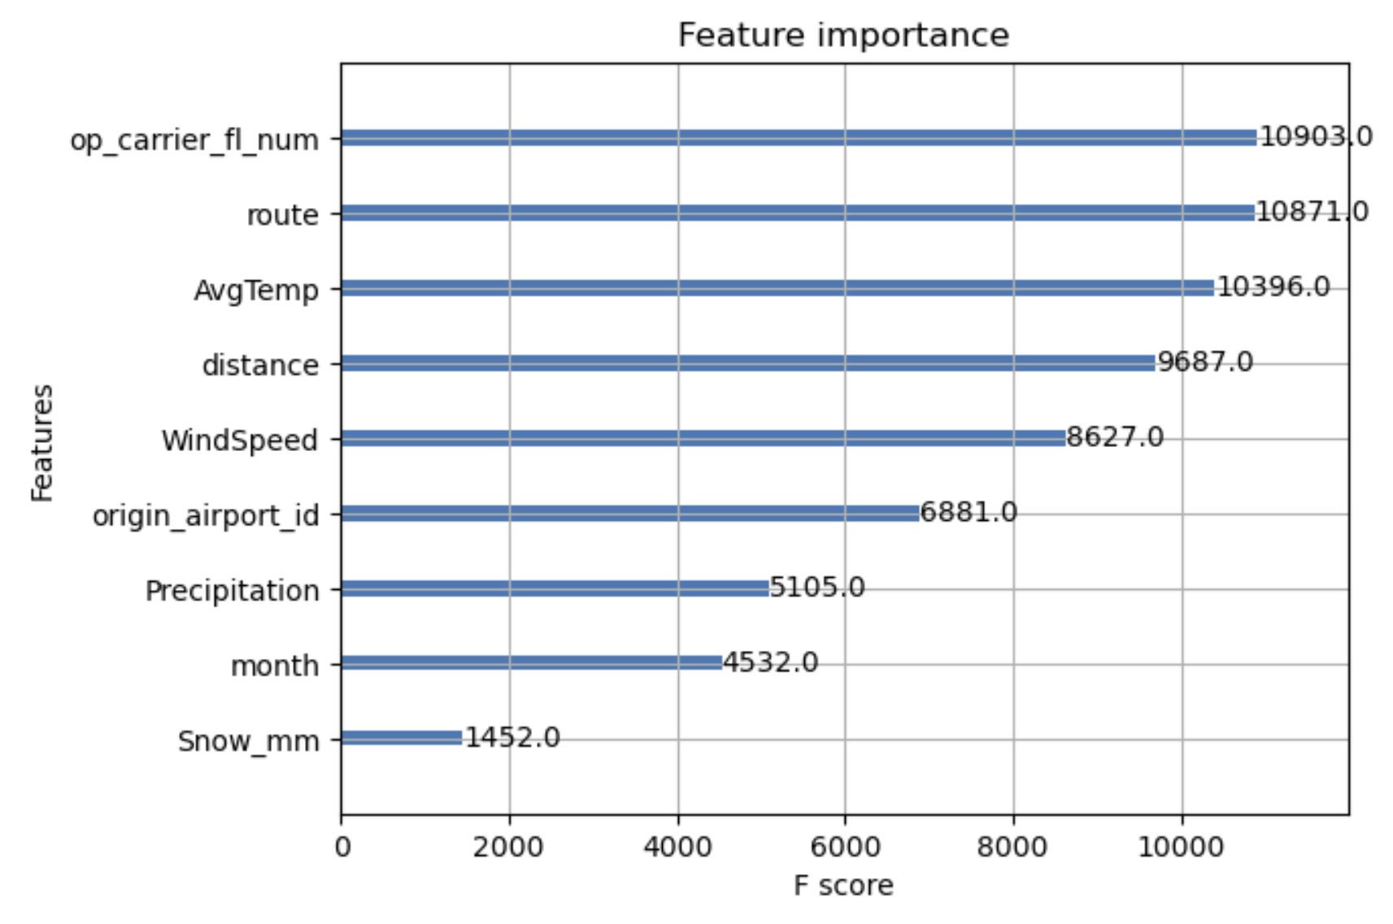
Linear Regression & XG Boost
XGboost Regression
Model Inputs:
Flight Number
Origin Airport Id
Distance
Route
Month
Avg Temp
Precipitation
Snow mm
Windspeed
Airport Longitude
Model | MSE | RMSE | R^2
Linear Regression | 2753.377 | 52.5 | 0.0145
Linear Reg Lasso | 2753.392 | 52.5 | 0.0145
Linear Reg Ridge | 2753.382 | 52.5 | 0.0145
XGBoost Regression | 2304.377 | 48.0 | 0.0232

Slide 11
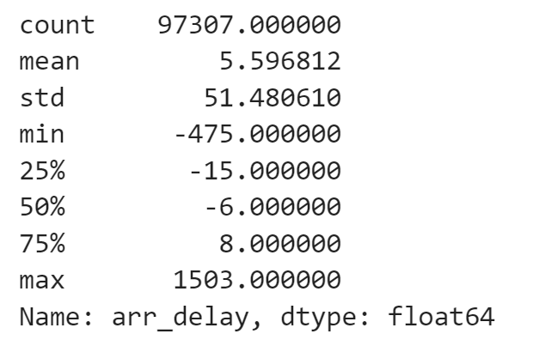
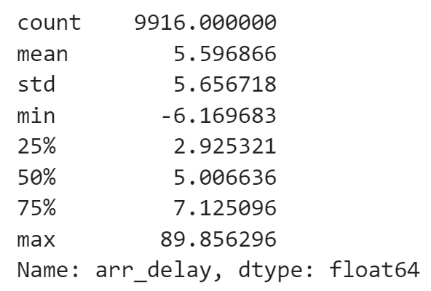
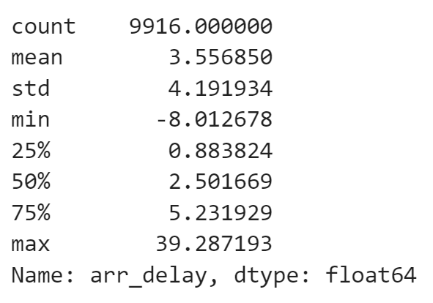
Models Results with Jan 2020 Data
Model Training Arrival Delay
Linear Regression
XGboost Regression

Slide 12

Thank you!

