Slide 1

Predicting Flight Delays
Mid Term Project
By Josh Graham and Hugo Perdomo

Slide 2
Project Workflow
Data Preparation
EDA
Feature Selection
Model Evaluation
Hyperparameter Tuning
Prediction

Slide 3
Objective
Create a machine learning model based on US domestic flights data (2019 – 2020 ) to predict delays in January 2020

Slide 4
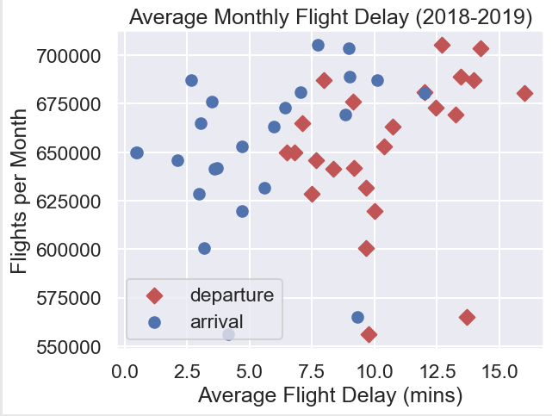
Average Flight Delay 2018-2019

Slide 5
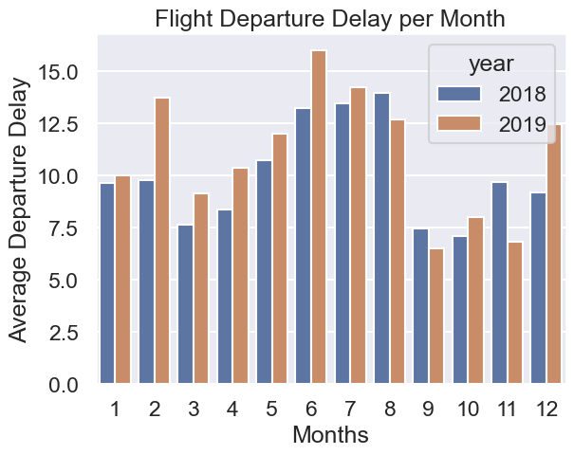
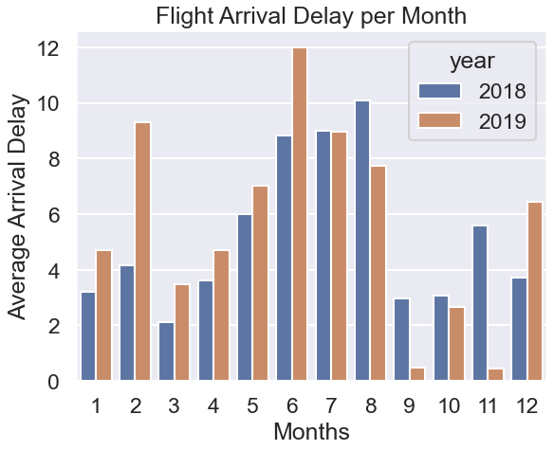
Flight Delays Departures/Arrivals

Slide 6
Weather API Extraction
Get Airports Coordinates
Bring Historic Information Using Meteostat
Merge Information / Feature Engineering
We used Meteostat API Library for the extraction of weather information.
We used the library that Meteostat provides to read historical weather information.
Meteostat takes its information from organizations such as : NOAA, DWD and Environment Canada.
For more information visit https://meteostat.net/en/

Slide 7
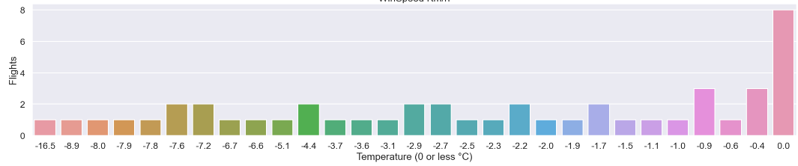
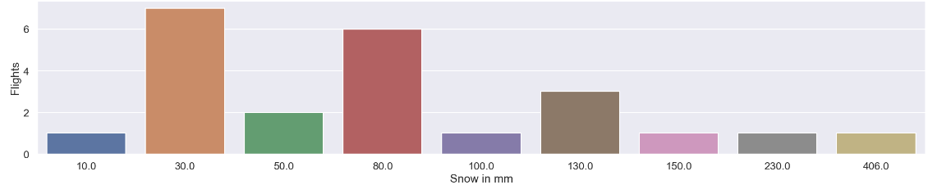
Weather Impact on flights
Sample size 200 flights randomly selected

Slide 8
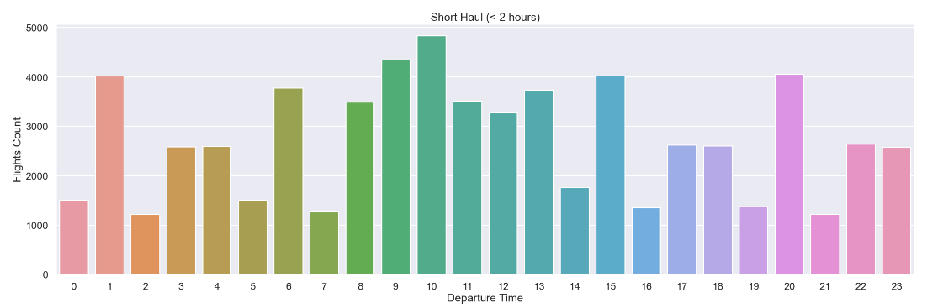
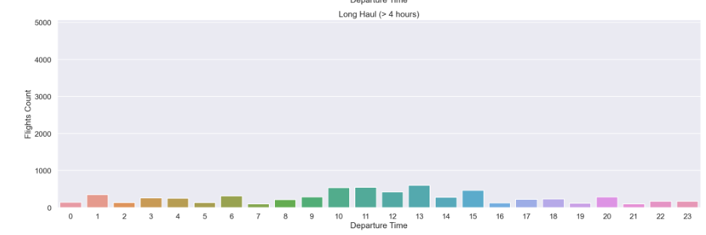
Departure Time Short Haul vs Long Haul

Slide 9
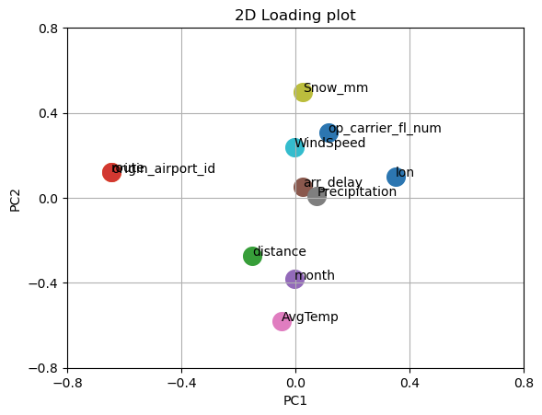
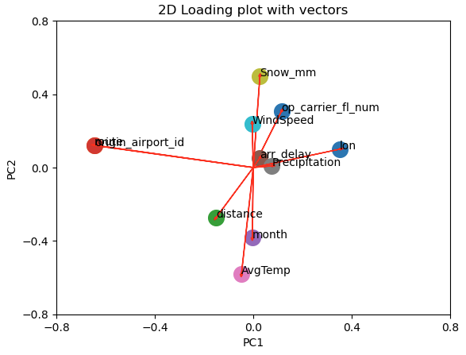
PCA

Slide 10
Modeling
Ur of GridSearchCV to get the best parameters to use with models.
Tried multiple algorithms:
Linear Regression (including Ridge and Lasso)
Random Forest Classifier
SVM
XGBoost

Slide 11
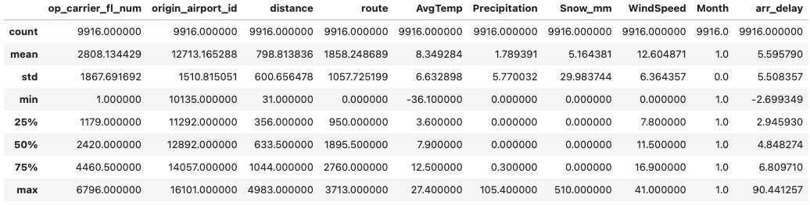
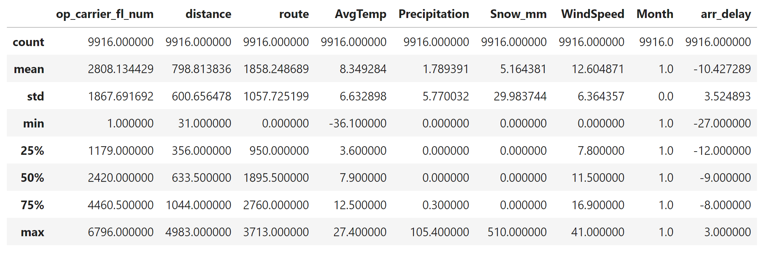
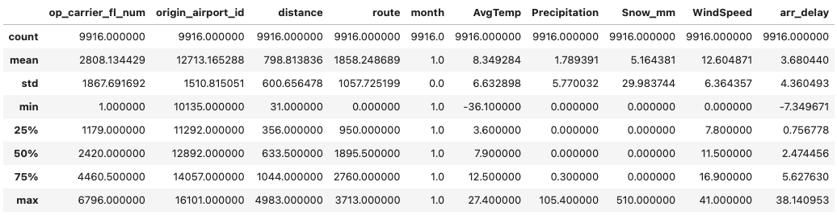
Models Results
Linear Regression
Random Forest Classifier
Xboost Regression

Slide 12
Models Results
Model | RMSE | R2 | Training Score | Test Score
Linear Regression | 2753.377 | 0.0145 | 0.0112 | 0.0145
Linear Reg Lasso |  | 0.0145
Linear Reg Ridge |  | 0.0145
XGBoost Regression | 2304.377 | 0.0232 | 0.1276 | 0.0231

Slide 13

Thank you!

