Slide 1

By Lin Lae Aung

Slide 2
Being Near The Equator
The Main Reason is Myanmar is located Near The equator,
so it gets direct sunlight all year.

Slide 3
Global Warming
Like everywhere else, climate change is making it hotter

Slide 4
Urban Heat
City is hot because there are many buildings and cars. There are
not many trees. Cars and machines produce heat. The city stays
hot at night. This is why city is hotter.

Slide 5
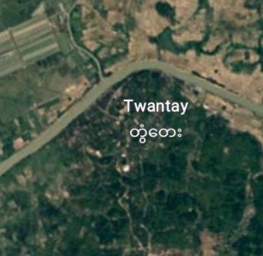
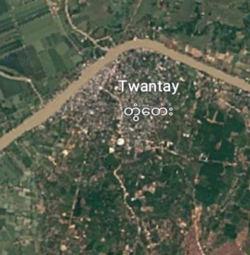
Deforestation
Forest were deforested to build infrastructure like cities, buildings and Some are deforested to create farms or create empty area. It make nature hotter than it has to be.
OLD
NOW

Slide 6
What should we do to prevent this?
Plant More Trees
Should use renewable energy like solar, wind instead burning fossil fuels.
Protect nature
Should use ecofriendly products
Planning urban should prioritize green spaces

Slide 7


