Slide 1
Smart Air Quality Monitoring
& Prediction System
A low-cost, open-data approach for Dhaka using OpenAQ + Machine Learning
Lutful Ahmed Nadim
Mysha Maliha
Jannatun Nayem Aurpy
Alvee Ahnaf
Meher Nigar Anonna
Raisul Islam
Abdullah Al Yamin
Tahmid Alam
Project 01 · June 2026

Slide 2
The Problem: Dhaka's Air
One of the world's most polluted megacities — yet citizens lack affordable, real-time, predictive air-quality information.
68–78
≈ 15×
Top 10
µg/m³ annual PM2.5
the WHO safe limit (5 µg/m³)
most polluted cities, globally
Pollution peaks in the dry winter months, driven by brick kilns, road and construction dust, vehicle exhaust, and household combustion.
Sources: WHO 2021; IQAir; The Business Standard.

Slide 3
Objectives
1
Acquire data
2
Standard AQI
Real, continuous hourly readings for multiple Dhaka locations.
Compute the Air Quality Index from PM2.5 (U.S. EPA 2024).
3
Predict
4
Evaluate
Nowcast next-hour PM2.5 / AQI with machine learning.
Benchmark models with MAE, RMSE and R² on unseen data.
5
Visualise
6
Low cost
An interactive dashboard: live readings, trends, validation, forecast.
A reproducible alternative to custom IoT hardware via open data.

Slide 4
From Costly Hardware to Open Data
Original plan
Our approach
Custom IoT sensor nodes
Open data via OpenAQ
ESP32 + PM2.5 / CO₂ / DHT sensors
Real monitors already deployed in Dhaka
Soldering, enclosures, power, Wi-Fi
Pulled through the OpenAQ v3 API
Manual calibration vs. reference
Multiple nodes, multi-pollutant
Expensive & fragile for a city-scale net
Zero hardware cost, instant data
Same data-to-dashboard learning objectives — without the cost and calibration risk.

Slide 5
System Architecture
Deployed
IoT monitors
OpenAQ v3
API
Python
pipeline
ML model
Flask API
Web
dashboard
Dhaka
data source
clean → AQI → features
LR / RF nowcast
JSON endpoints
Chart.js + Leaflet
The expensive custom-hardware sensing layer is replaced by open data from monitors already operating across the city — everything downstream is unchanged.

Slide 6
Methodology
Data acquisition
Cleaning
Hourly PM2.5 (+ PM10/PM1/temp/humidity) from OpenAQ v3 nodes.
Regular hourly index; drop nulls, noise and implausible values.
AQI computation
Feature engineering
EPA 2024 breakpoints; worst-pollutant (dominant) rule.
Hour-of-day, day-of-week and lagged PM2.5 values.
Modelling
Evaluation
Linear Regression vs. Random Forest; time-based train/test split.
MAE, RMSE and R² on the unseen, most-recent tail.

Slide 7
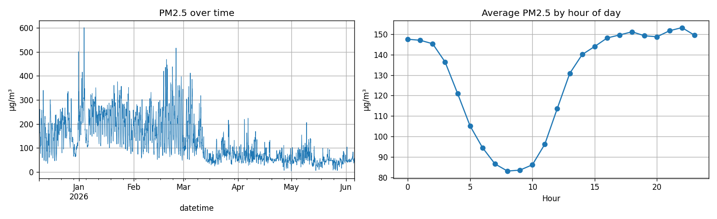
Data & Exploratory Analysis
4,256
hourly samples (modelling)
PM2.5
primary; + PM1, temp, humidity
Uttara
primary continuous node
Hourly
temporal resolution
PM2.5 over time and the clear diurnal cycle the lag features exploit.

Slide 8
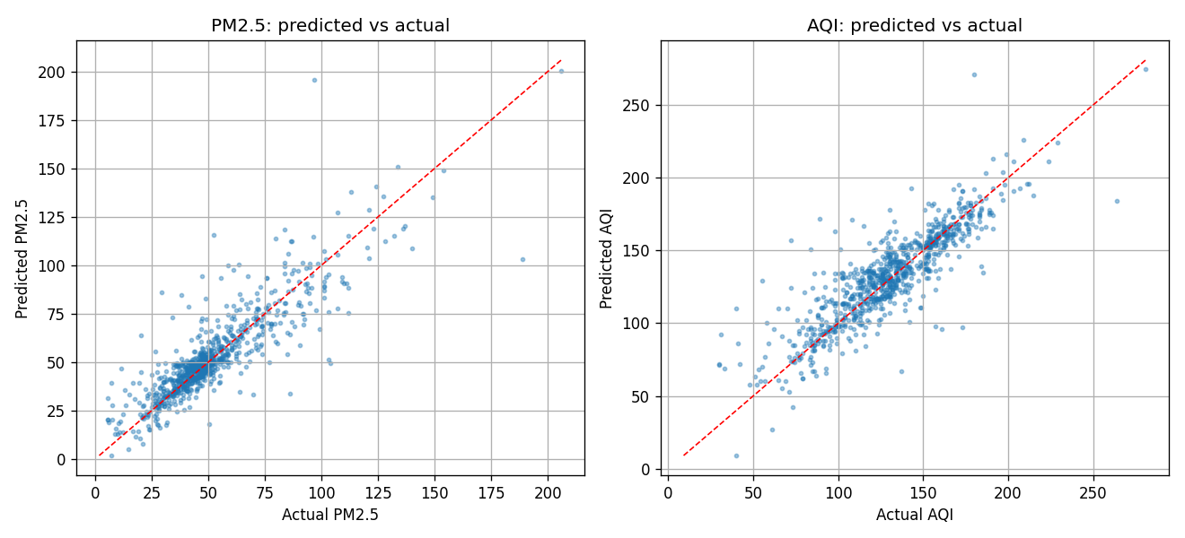
Model Performance
Model
PM2.5 MAE
PM2.5 RMSE
PM2.5 R²
AQI MAE
Linear Regression
7.45
11.88
0.738
11.73
Random Forest
8.05
12.53
0.708
12.47
Best model: Linear Regression
R² = 0.74 · PM2.5 MAE = 7.45 µg/m³ — a simple baseline wins.
Predicted values track the ideal diagonal closely for both PM2.5 and AQI on unseen data.

Slide 9
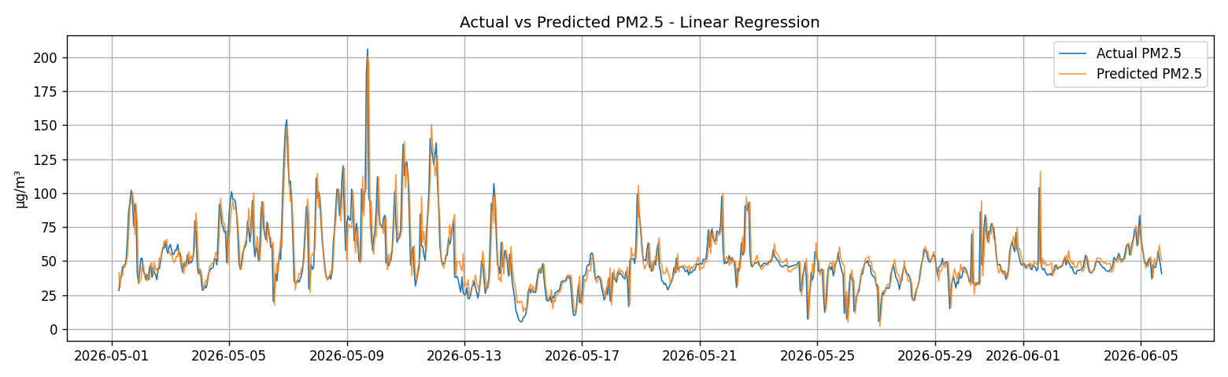
Validation: Actual vs. Predicted
On the held-out test tail, predicted PM2.5 tracks the real series closely, capturing both calm periods and pollution spikes.

Slide 10
The Dashboard
Flask + Chart.js + Leaflet — served straight from the model artifacts.
Live AQI orb
City sensor map
Area comparison
Colour-coded current index + latest PM2.5
Every node, every channel, worst-pollutant AQI
30-day daily means, switchable per pollutant
Trends
Validation
Forecast
7-day / 30-day / 1-year history
Actual vs. predicted on the test set
Recursive next 12 / 24 / 48 hours
Meets and exceeds the brief — the map and forecast were listed as optional/advanced.

Slide 11
Insights & Limitations
What we learned
Limitations
A simple Linear Regression matched / beat Random Forest.
No CO₂ / gaseous pollutants (low-cost nodes report particulates).
Lagged PM2.5 is the dominant predictor of the next hour.
No physical sensor node built (hardware out of scope).
Open data can power a real, city-scale system.
One-hour nowcast horizon, not multi-day.
Model complexity must be justified by the data.
Single city; development-grade server.

Slide 12
Conclusion & Next Steps
A complete, low-cost air-quality monitoring + prediction system for Dhaka — open data in, EPA-standard AQI, ML nowcast (R² 0.74), live dashboard out.
Future work
Add gases (NO₂/SO₂/O₃/CO) via reference stations
Optional: deploy own calibrated low-cost nodes
Try gradient boosting / LSTM on richer features
Multi-hour forecasts, health alerts, public deploy
Thank you · Team of 8 · Project 01 · June 2026

