Slide 1

Using DQN to predict the evolution of the nucleic acid sequence of the spike glycoprotein of SARS-CoV-2
利用深度強化學習預測新型冠狀病毒的
棘蛋白核酸序列演化
Team 13
7112019015 Huang, Kai-Wei
7112093064 周耿賢

Slide 2
Outline
Ch. 1 Motivation
Ch. 2 Related Works
Ch. 3 Proposed Design

Slide 3
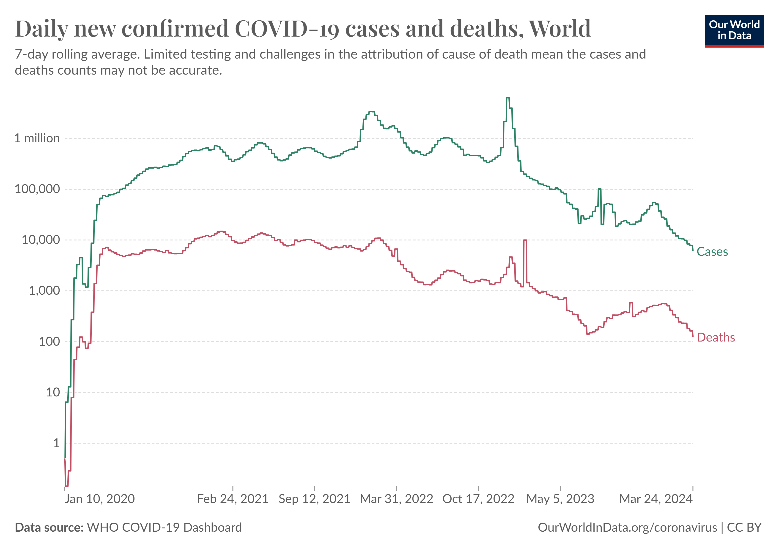
Ch. 1 Motivation
The Global Impact of COVID-19: case, death
Persistent high Infection and Mortality, even after vaccine distribution
World Health Organization – processed by Our World in Data. “Deaths” [dataset]. World Health Organization [original data].

Slide 4
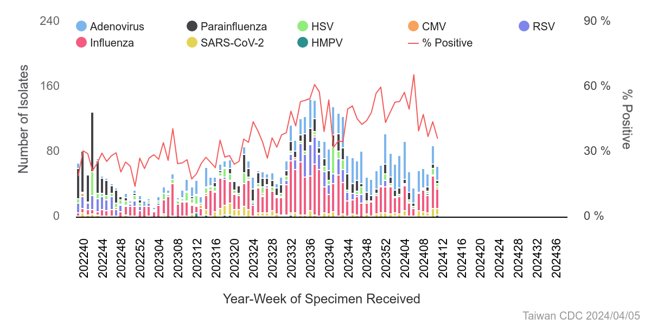
Ch. 1 Motivation
In Taiwan: Sustained Infection of SARS-CoV-2
衛生福利部疾病管制署-全國每周呼吸道病毒分離情形 https://nidss.cdc.gov.tw/

Slide 5
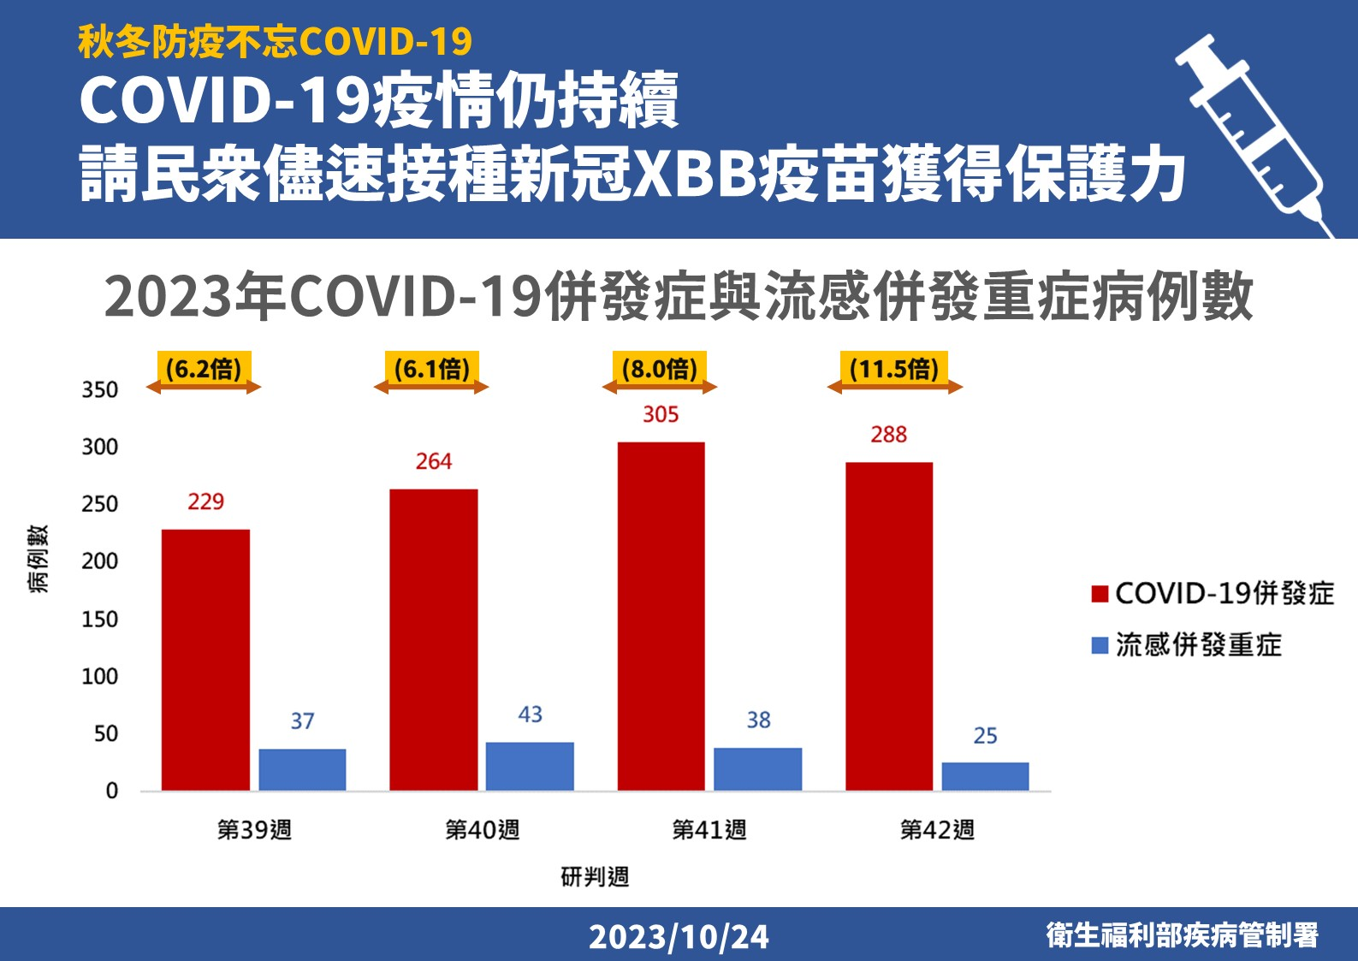
Ch. 1 Motivation
In Taiwan: Comparing the Ratio of Severe Complications in
Influenza and COVID-19 Co-infections

Slide 6
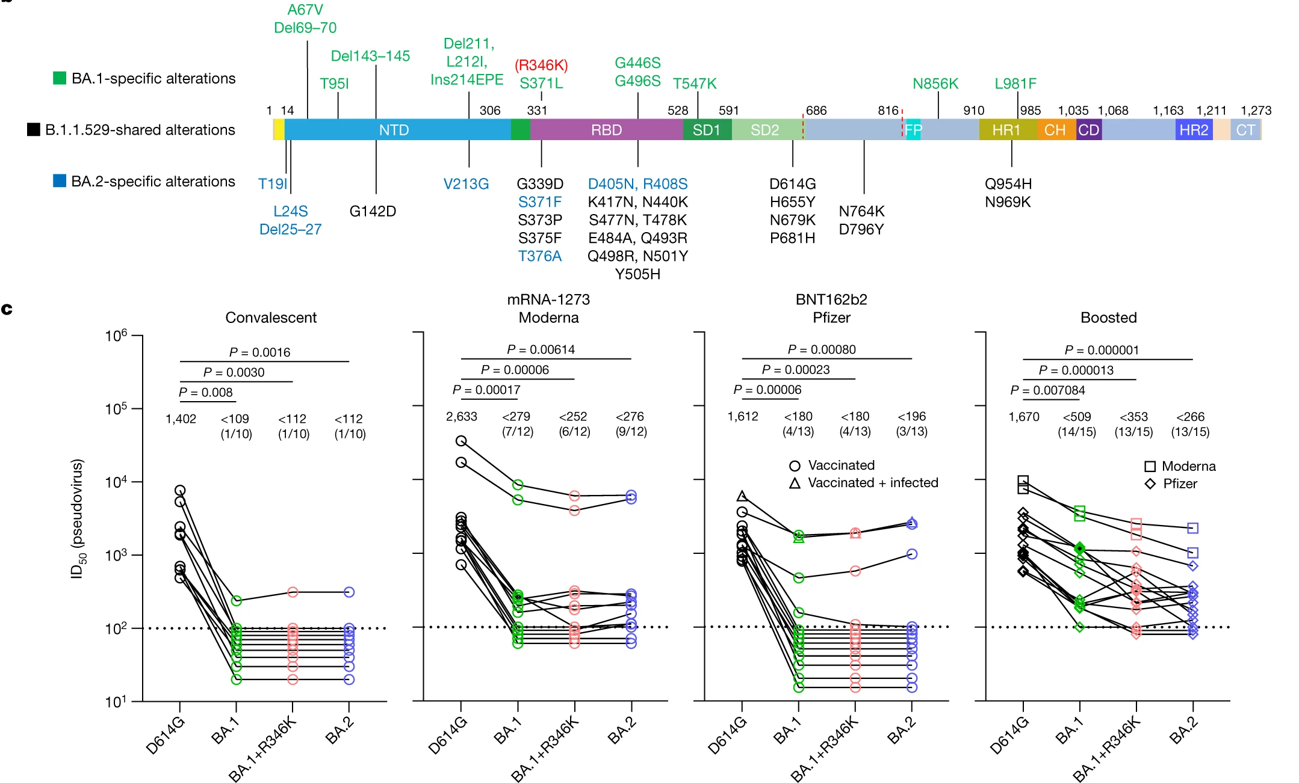
Ch. 1 Motivation
The Diverse Mutations in the spike Render Current Antibodies Ineffective
no longer effective !!
Iketani, S. et al. Antibody evasion properties of SARS-CoV-2 Omicron sublineages. Nature 604, 553–556 (2022).

Slide 7
Ch. 2 Related Works
Interaction with
Antibody & ACE2
protein-protein interaction
ex: MLAEP
evolutionary trends
directly related by kinship
phylogenetic tree
ex: MutaGAN
Han, W. et al. Predicting the antigenic evolution of SARS-COV-2 with deep learning. Nature Communications 14 (2023)
Berman DS, Howser C, Mehoke T, Ernlund AW, Evans JD. MutaGAN: A sequence-to-sequence GAN framework to predict mutations of evolving protein populations. Virus Evol. 2023 Apr 7;9(1)

Slide 8
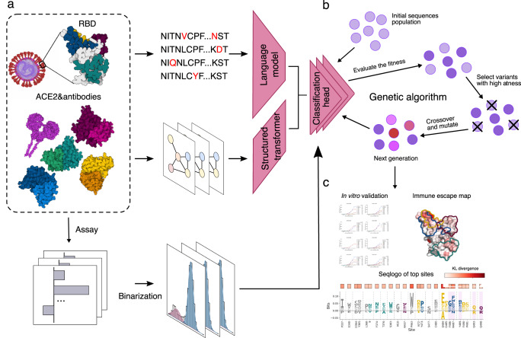
Ch. 2 Related Works
MLAEP
Genetic algorithm to generate new protein
Ingraham, J., Garg, V., Barzilay, R. & Jaakkola, T. Generative models for graph-based protein design. ICLR, 32 (2019).
Rives A, et al. Biological structure and function emerge from scaling unsupervised learning to 250 million protein sequences. Proc. Natl Acad. Sci. USA. 2021;118:e2016239118. doi: 10.1073/pnas.2016239118

Slide 9
Ch. 2 Related Works
MLAEP
Advantages:
Effective in predicting PPI
Disadvantages:
Poor correlation between evolutionary trends and PPI trends
Need structure data of antibody
Features Used:
Antibody structure -> KNN -> Transformer
Spike protein sequences -> Transformer
Model:
MLP – classification head
ESM-1b
Ingraham, J., Garg, V., Barzilay, R. & Jaakkola, T. Generative models for graph-based protein design. ICLR, 32 (2019).
Rives A, et al. Biological structure and function emerge from scaling unsupervised learning to 250 million protein sequences. Proc. Natl Acad. Sci. USA. 2021;118:e2016239118. doi: 10.1073/pnas.2016239118

Slide 10
Ch. 2 Related Works
MutaGAN
Build phylogenetic tree
Get DNA sequence
Mutiple Alignment with Fast Fourier Transformer
(MAFFT)
↓
Cut sequences to coding region
↓
Maximum likelihood (ML) tree
Rooting in influenza A virus A/Hong Kong/1/68(H3N2)
Generalized time reversible model
Gamma model of rate heterogeneity
Child 1
parent
Child 2

Slide 11
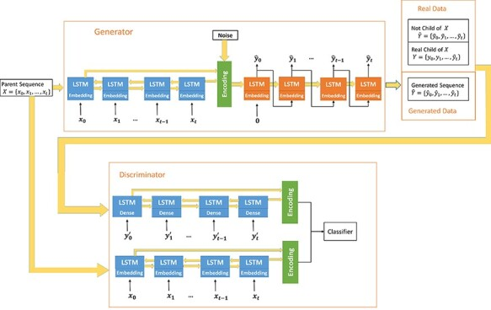
Ch. 2 Related Works
MutaGAN
Parent sequence

Slide 12
Ch. 2 Related Works
MutaGAN
A’₁
A
A’₂
B’₁
Advantages:
Requires only sequence data
Disadvantages:
Lack of date information, only aware of the next evolutionary branch
Need appropriate parameters for the phylogenetic tree
Features Used:
HA sequences DNA sequences -> LSTM
Model:
GAN
B
B’₂

Slide 13
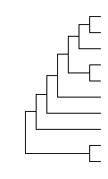

Ch. 3 Proposed Design –
(3.) System
State
Sequences around this period
Action
mution the sequence
Delection
Insertion
Substitution
Reward
score with the sequence of the next period
Simility
Edit distance
Wuhan
time

Slide 14
Ch. 3 Proposed Design –
System - state
time
sequence
Wuhan

Slide 15
Ch. 3 Proposed Design –
System - action
R23P
Wuhan

Slide 16
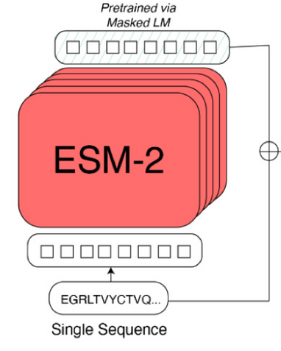
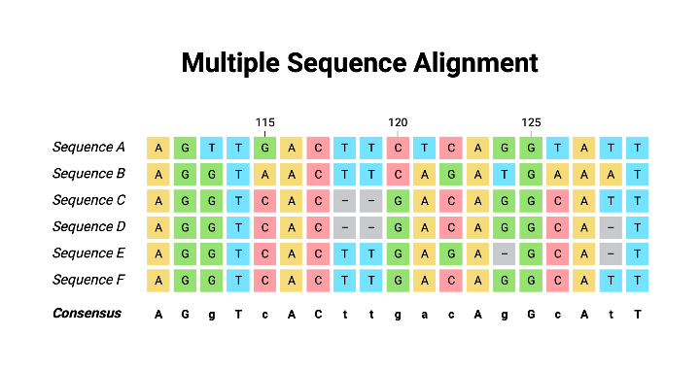
Ch. 3 Proposed Design – Find Mutation Hotspot
Database
National Center for Biotechnology Information’s (NCBI) Virus
deduplication
Align
BLAST
ESM2
https://www.biorender.com/template/multiple-sequence-alignment-dna

Slide 17
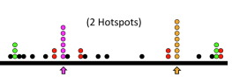
Ch. 3 Proposed Design
Align
BLAST
ESM2
Find Mutaion hotspot
Deletion
Insertion
Substitution

Slide 18
Ch. 3 Proposed Design –
System - reward
if (simility < threshold) or (Edit distance > threshold)
Fail
else
Next turn
time
sequence
Wuhan

Slide 19
Ch. 3 Proposed Design –
Determine the difference score : predicted sequence ←→ actual sequence
Simility
Edit distance
Score (reward)

Slide 20
Ch. 3 Proposed Design –
Different from MutaGAN
period(3 month)
Not only consider parent sequence, but all sequences in the period
Not actual evolutionary distance, but sampling time
Wuhan

Slide 21
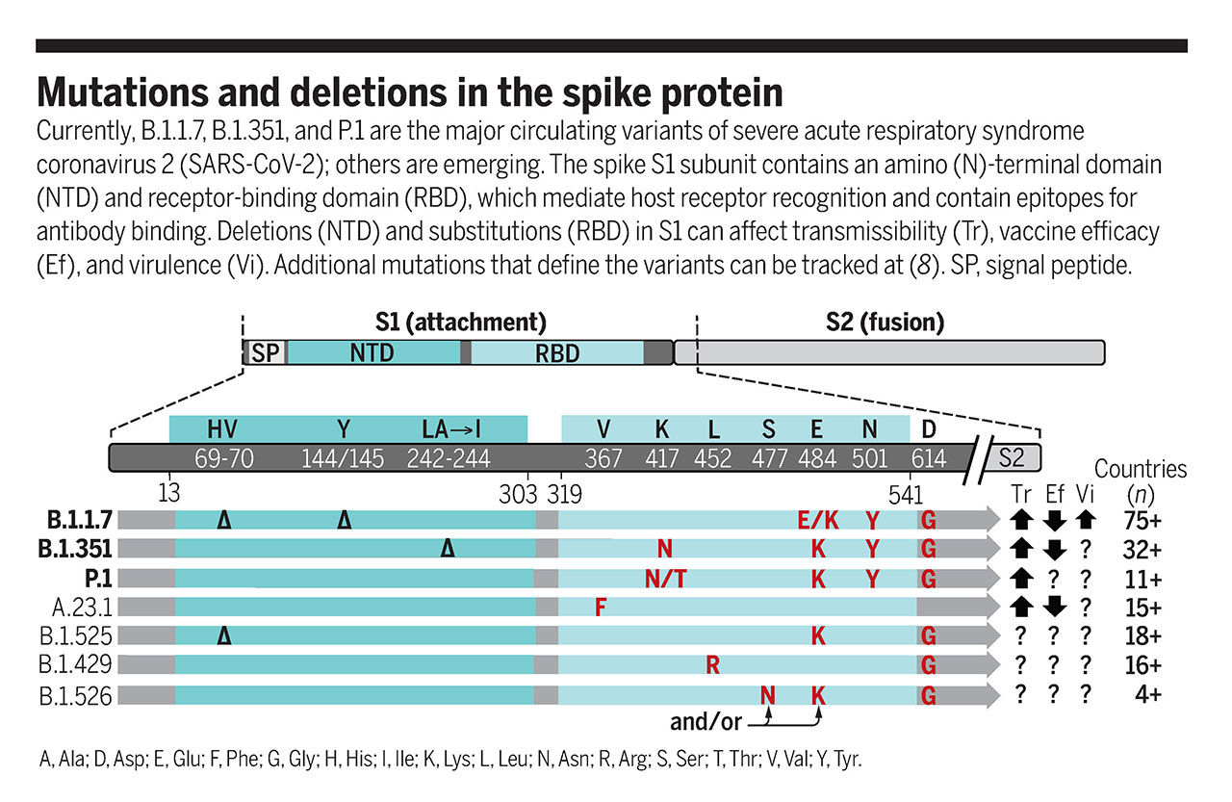
Ch. 1 Motivation
The Diverse Mutations in the RBD Render Current Antibodies Ineffective
McCormick, K. D., Jacobs, J. L. & Mellors, J. W. The emerging plasticity of SARS-CoV-2. Science 371, 1306–1308 (2021).

Slide 22
Ch. 3 Proposed Design –
System - reward
(1.)
if len(Filter similar sequences) = 0
Fail
else
(2.)
time
sequence
Wuhan

