Slide 1

Using DQN to predict the evolution of the nucleic acid sequence of the spike glycoprotein of SARS-CoV-2
利用深度強化學習預測新型冠狀病毒的
棘蛋白核酸序列演化
Team 13
7112019015 Huang, Kai-Wei
7112093064 周耿賢

Slide 2
Outline
Ch. 1 Motivation
Ch. 2 Related Works
Ch. 3 Proposed Design
Ch. 4 Results

Slide 3
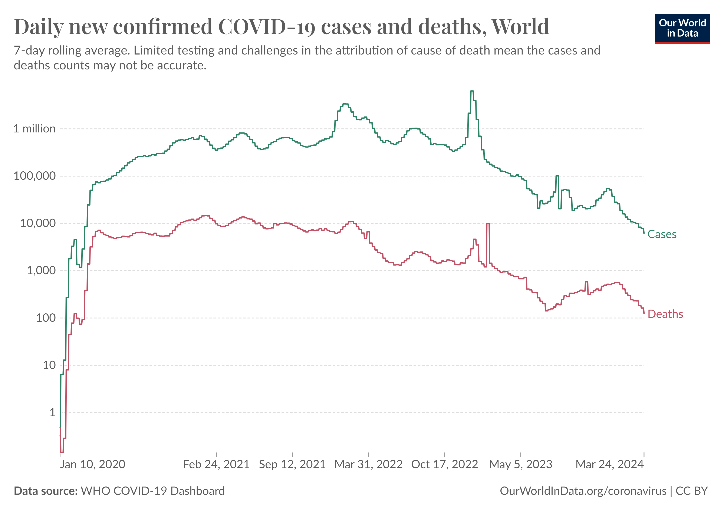
Ch. 1 Motivation
The Global Impact of COVID-19: case, death
Persistent high Infection and Mortality, even after vaccine distribution
World Health Organization – processed by Our World in Data. “Deaths” [dataset]. World Health Organization [original data].

Slide 4
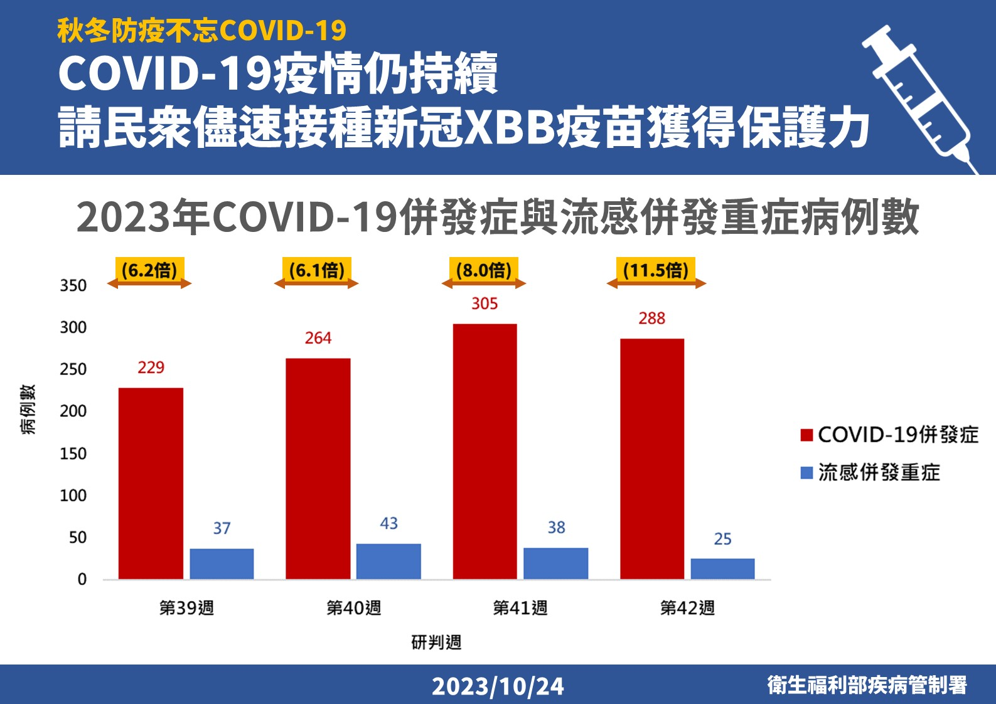
Ch. 1 Motivation
In Taiwan: Comparing the Ratio of Severe Complications in
Influenza and COVID-19 Co-infections

Slide 5
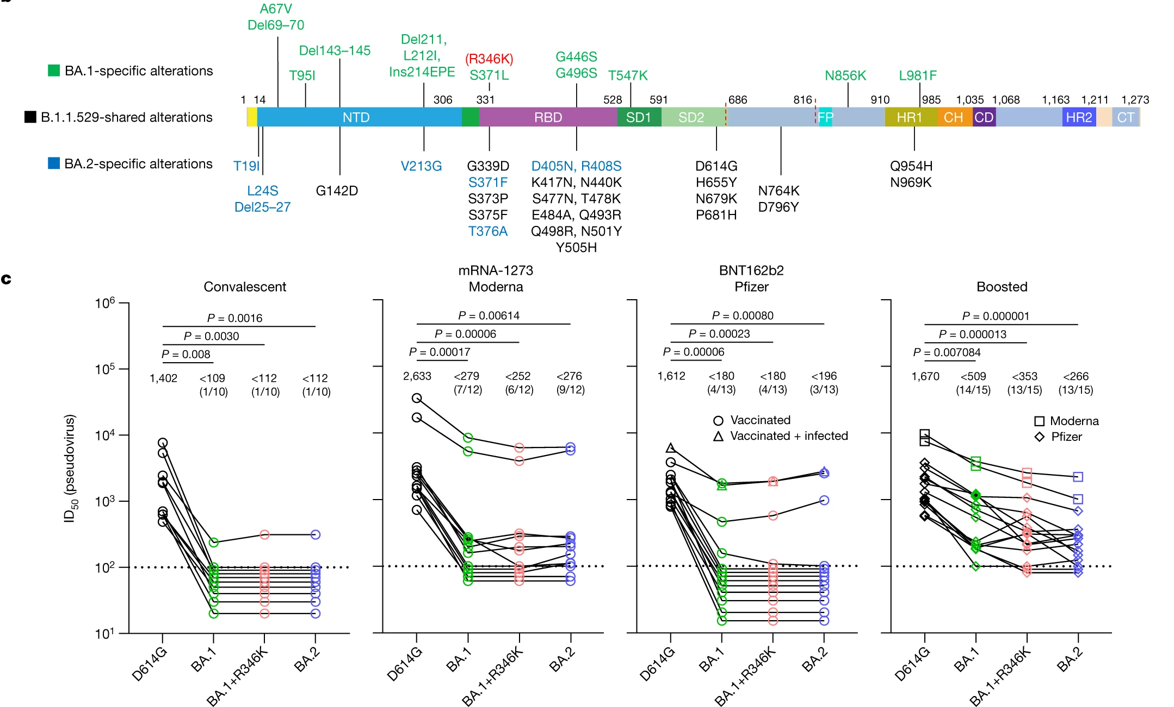
Ch. 1 Motivation
The Diverse Mutations in the spike Render Current Antibodies Ineffective
no longer effective !!
Iketani, S. et al. Antibody evasion properties of SARS-CoV-2 Omicron sublineages. Nature 604, 553–556 (2022).

Slide 6
Ch. 2 Related Works
MutaGAN
A’₁
A
A’₂
B’₁
Advantages:
Requires only sequence data
Disadvantages:
Lack of date information, only aware of the next evolutionary branch
Need appropriate parameters for the phylogenetic tree
B
B’₂

Slide 7
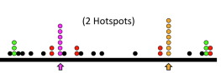
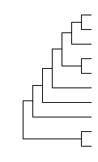
Ch. 3 Proposed Design –
ideal
Wuhan
location: 111,aminoac: S
location: 111,aminoac: S
location: 111,aminoac: S
location: 111,aminoac: S
...

Slide 8
Ch. 3 Proposed Design –
System
Set parent-child pair by Bio.Phylo
Child 1
parent
Child 2
Wuhan
(HA nucleic acid sequence)
Parent-Child sequence pair
Parent_{i} – Child_{i}1
Parent_{i} – Child_{i}2
time

Slide 9
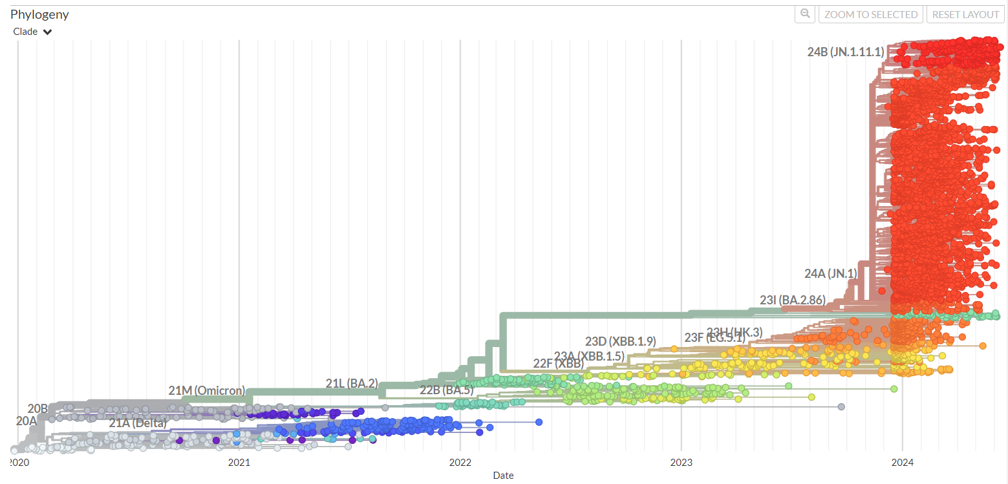
GISAID (Global Initiative on Sharing All Influenza Data，全球共享流感數據倡議組織)

Slide 10
3.
MutaGAN
Real
child sequence
OR
Predicted
child sequence
Parent sequencec
Classifier
Notes:
With the GAN framework , the generator convert the parent sequence to child sequence.And the discriminator identify whether they are real parent-child sequence pair.

Slide 11
Generator
Predicted
child sequence
Parent sequence
{Parent sequence} – {Predicted child sequence}
potential mutations

Slide 12
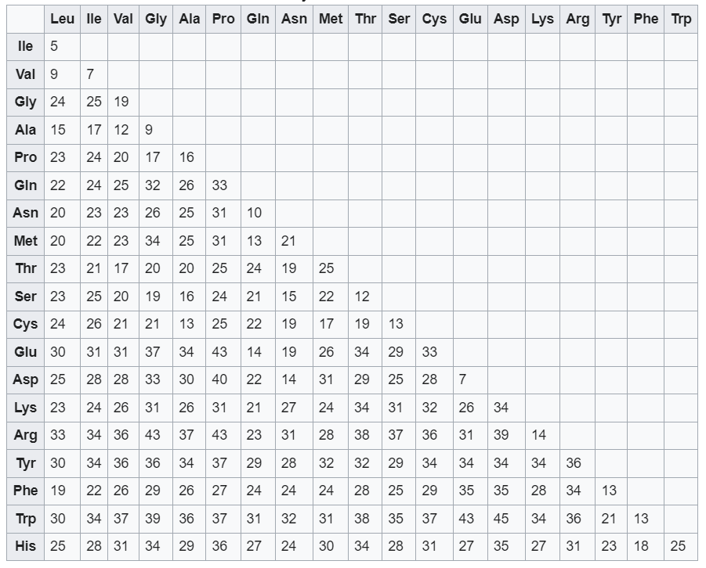
True-positive rate
0. 41
0. 93
True positive rate
weighted true-positive rate - sneath’s index (similarity < 0.85)
TPR << weighted TPR majority of the predicted mutations
in same location and similar
in biochemical and physical properties
to real mutations
/ 134

Slide 13
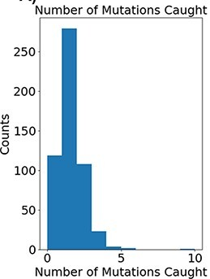
potential mutations
(Mutaion hotspot)
Top 5 sequence
-> action

Slide 14
Ch. 3 Proposed Design –
ESM-1b
sequencec
ESM-1b
env. sequence

Slide 15
Ch. 3 Proposed Design –
reward
dataset_next = dataset[(dataset['year'] * 12 + dataset['month']) == ym_next.to_month()]
sequence_next = dataset_next['sequence'].to_list()
# 計算粗略相似性
similarity_scores = [sum(a == b for a, b in zip(sequence, seq_next)) for seq_next in sequence_next]
max_similarity = max(similarity_scores)
# 找到最相近序列的索引
closest_indices = [i for i, score in enumerate(similarity_scores) if score == max_similarity]
# 計算最相近序列的 Levenshtein Distance
ld_values = [levenshtein(sequence, sequence_next[i]) for i in closest_indices]
ld_min = min(ld_values)

Slide 16
Ch. 3 Proposed Design –
reward
if ld_min == 0:
if ym_next == self.ym_end:
score = 50
next = True
else:
score = 5
next = True
elif ld_min <= 1:
if ym_next == self.ym_end:
score = 10
next = True
else:
score = 5
next = True
elif ld_min <= 5:
score = -1
time
sequence

Slide 17
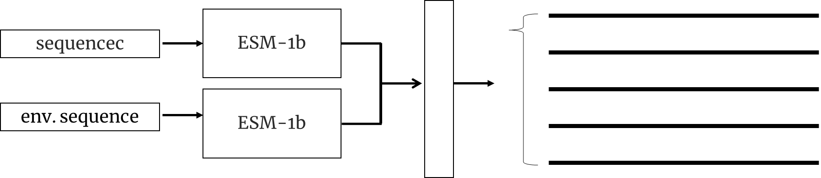
Generator
Predicted
child sequence
sequence
{sequence} – {Predicted child sequence}
potential mutations

Slide 18
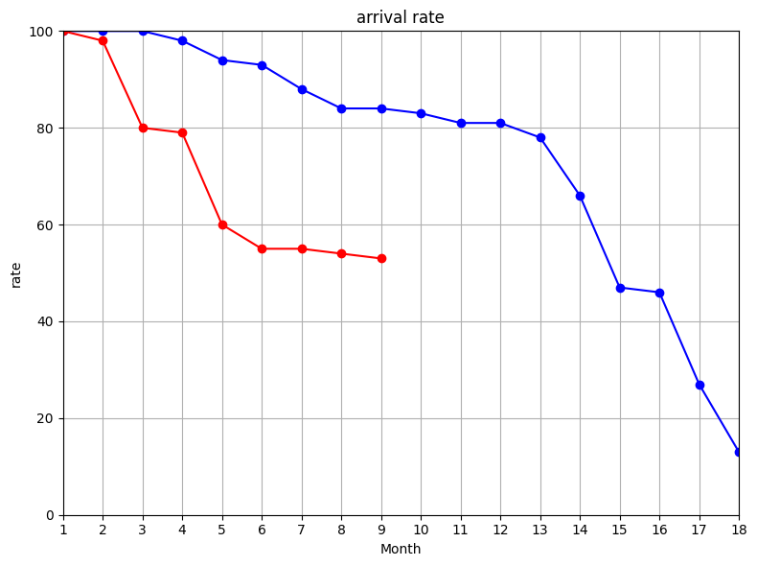
4. Evaluate
TrainRange = [YearMonth(2019, 12), YearMonth(2021, 6)]
TestRange = [YearMonth(2021, 7), YearMonth(2023, 1)]

Slide 19
Ch. 3 Proposed Design –
['-max_dis',’3’]
predict sequencec
DR
i
XGBoost
1 or 0
DR
history
sequence
i - 9
model | test_accuracy_list | interval | testShift
XGBClassifier | [0.9225, 0.9125, 0.93, 0.925, 0.905, 0.7875, 0.56, 0.4725, 0.445] | 9 | 9

Slide 20
4. Evaluate
TrainRange = [YearMonth(2019, 12), YearMonth(2021, 6)]
TestRange = [YearMonth(2021, 7), YearMonth(2023, 1)]

Slide 21
5. Disscusion
Some sequences are difficult to mutate.
To train the network to decide the amino acids to change

