Slide 1
I Promise You
by Vladimir Yurkevich

Slide 2
Synchronous Languages
var a = readFileContents("a.txt");
var b = readFileContents("b.txt");
writeFileContents("ab.text", a + b);
console.log("we are done");

Slide 3
Asynchronous Languages
readFileContents("a.txt", function (a){
readFileContents("b.txt", function (b){
writeFileContents("ab.txt", a + b, function(){
console.log("we are done");
});
});
});
users.get(5, function(err, data){
messges.get(data.userId, function(err, data){
replies.get(data.messageId, function(err, data) {
...
});
});
})

Slide 4
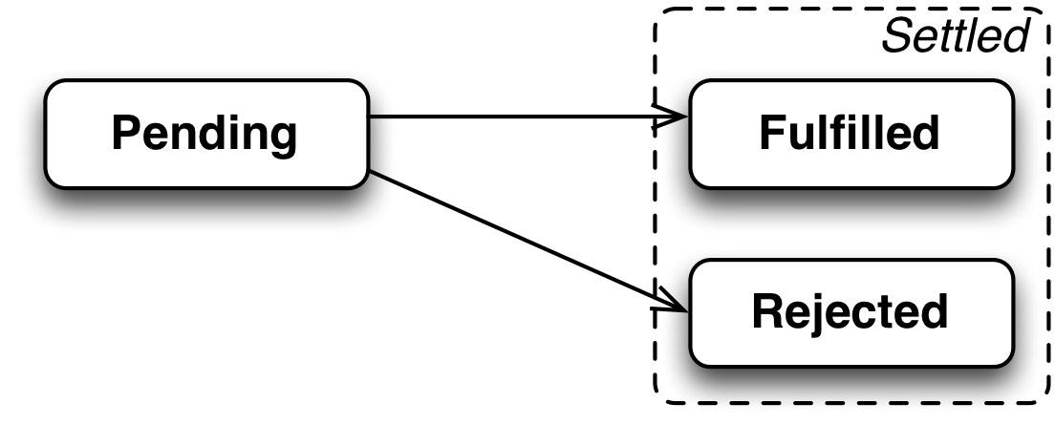
What is Promise

Slide 5
Main Things
States: pending, fulfilled, or rejected.
A promise must provide a then method to access its current or eventual value or reason.
A promise’s then method accepts two arguments: promise.then(onFulfilled, onRejected)
then may be called multiple times on the same promise.
If/when promise is fulfilled, all respective onFulfilled callbacks must execute in the order of their originating calls to then.
If/when promise is rejected, all respective onRejected callbacks must execute in the order of their originating calls to then.
then must return a promise: promise2 = promise1.then(onFulfilled, onRejected);

Slide 6
Promises
promise.then(function() { doSomething1(); }).then(function() { doSomething2(); }).then(function() { doSomething3(); });

Slide 7
Basic Example
https://bevacqua.github.io/promisees/#code=var+p+%3D+fetch('%2Ffoo')%0A+.then(res+%3D%3E+res.status%2C+err+%3D%3E+console.error(err))%0A%0Ap.catch(err+%3D%3E+console.error(err))%0A%0Ap.then(status+%3D%3E+console.log(status))%0A%0Ap.then(status+%3D%3E+status.a.b.c)%0A+.catch(err+%3D%3E+console.error(err))

Slide 8
Chaining
https://bevacqua.github.io/promisees/#code=%2F%2F+Chaining+example%0Anew+Promise(resolve+%3D%3E+setTimeout(resolve%2C+2000))%0A.then((resolve%2C+reject)+%3D%3E+%7B%0A++return+new+Promise(resolve+%3D%3E+setTimeout(resolve%2C+2000))%3B%0A%7D)%0A.then((resolve%2C+reject)+%3D%3E+%7B%0A++return+new+Promise(resolve+%3D%3E+setTimeout(resolve%2C+3000))%3B%0A%7D)%0A.then(c+%3D%3E+console.info(c))%0A.catch(err+%3D%3E+console.error(err))%3B

Slide 9
Chaining With Values
https://bevacqua.github.io/promisees/#code=new+Promise(resolve+%3D%3E+setTimeout(resolve%2C+1500))%0A.then((resolve%2C+reject)+%3D%3E+%7B%0A++return+1%3B%0A%7D)%0A.then((resolve%2C+reject)+%3D%3E+%7B%0A++return+new+Promise(resolve+%3D%3E+setTimeout(resolve%2C+1500))%3B%0A%7D)%0A.then((resolve%2C+reject)+%3D%3E+%7B%0A++return+2%3B%0A%7D)%0A.then(c+%3D%3E+console.info(c))%0A.catch(err+%3D%3E+console.error(err))%3B

Slide 10
Chaining With Errors
https://bevacqua.github.io/promisees/#code=new+Promise((resolve%2C+reject)+%3D%3E+%7B%0A++reject(%22error%22)%3B%0A%7D)%0A.then(r+%3D%3E+console.log(r))%0A.catch(e+%3D%3E+console.error(e))%0A.then(r+%3D%3E+%7B+return+%22new+value%22%3B%7D)%0A.then(r+%3D%3E+console.log(r))%0A.catch(e+%3D%3E+console.error(e))%3B

Slide 11
More Chaining Examples
https://jsfiddle.net/ah3322/396o81xb/
https://jsfiddle.net/rwsdn95n/

Slide 12
Promise All
https://bevacqua.github.io/promisees/#code=Promise.all(%5B%0A++new+Promise(resolve+%3D%3E+setTimeout(resolve%2C+1500))%2C%0A++new+Promise(resolve+%3D%3E+setTimeout(resolve%2C+900))%2C%0A++new+Promise((resolve%2C+reject)+%3D%3E+setTimeout(reject%2C+2200))%0A%5D)%0A.then(results+%3D%3E+results.length.b.c)%0A.then(c+%3D%3E+console.info(c))%0A.catch(err+%3D%3E+console.error(err))

Slide 13
Handling Errors
https://bevacqua.github.io/promisees/#code=new+Promise(resolve+%3D%3E+setTimeout(resolve%2C+1500))%0A.then(p+%3D%3E+%7B%0A++setTimeout(function()%7B%0A++++throw+new+Error('error!!')%3B%0A++%7D%2C+1)%3B%0A++throw+new+Error('error!!')%3B%0A++return+function()%7B%7D%3B%0A%7D)%0A.then(p+%3D%3E+%7B%0A++console.log(p)%3B%0A++return+new+Promise(resolve+%3D%3E+setTimeout(resolve%2C+1500))%3B%0A%7D)%0A.then(p+%3D%3E+%7B%0A++console.log(p)%3B%0A++return+2%3B%0A%7D)%0A.then(c+%3D%3E+console.info(c))%0A.catch(err+%3D%3E+console.error(err))%3B

Slide 14
Thenable
https://bevacqua.github.io/promisees/#code=%2F%2F+Break+everything%0Anew+Promise(resolve+%3D%3E+setTimeout(resolve%2C+1500))%0A.then(p+%3D%3E+%7B%0A++return+%7B%0A++++a%3A+1%2C%0A++++b%3A+2%2C%0A++++then%3A+function(onFulfilled%2C+onRejected)%7B%0A++++++onRejected()%3B%0A++++%7D%0A++%7D%3B%0A%7D)%0A.then(p+%3D%3E+%7B%0A++console.log(p)%3B%0A++return+new+Promise(resolve+%3D%3E+setTimeout(resolve%2C+1500))%3B%0A%7D)%0A.then(p+%3D%3E+%7B%0A++console.log(p)%3B%0A++return+2%3B%0A%7D)%0A.then(c+%3D%3E+console.info(c))%0A.catch(err+%3D%3E+console.error(err))%3B

Slide 15
Mooore
Changing promise value: https://jsfiddle.net/6mt89jzh/
onFulfilled or onRejected must not be called until the execution context stack contains only platform code: https://www.promisejs.org/implementing/
Use promises everywhere!
Don’t resolve promises in ui-router
https://bevacqua.github.io/promisees/#code=var+returnedPromise%3B%0Avar+thenPromise+%3D+new+Promise(resolve+%3D%3E+setTimeout(resolve%2C+2000))%0A.then((resolve%2C+reject)+%3D%3E+%7B%0A++console.log('1')%3B%0A++returnedPromise+%3D+new+Promise(resolve+%3D%3E+setTimeout(resolve%2C+2000))%3B%0A++return+returnedPromise%3B%0A%7D)%0A%0Aconsole.log('2')%3B%0AthenPromise.then(()+%3D%3E+%7B%0A++console.log(thenPromise+%3D%3D+returnedPromise)%3B%0A%7D)%3B

Slide 16
Links
https://promisesaplus.com/
https://www.promisejs.org/implementing/
https://github.com/kriskowal/q/wiki/API-Reference
https://docs.angularjs.org/api/ng/service/$q

