Slide 1

Physical Components of a Network
Week 2

Slide 2

Objectives
3.1 Topologies
3.2 Media Types
3.3 Network Devices

Slide 3
3.1 Topologies

Slide 4
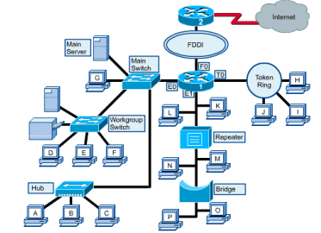
3.1 Topologies
3.1.1 The Network Topology
The network topology defines the layout of the network.
It shows how devices on the network are interconnected.
Devices on the network are termed nodes.
A network has both a physical topology and a logical topology.

Slide 5
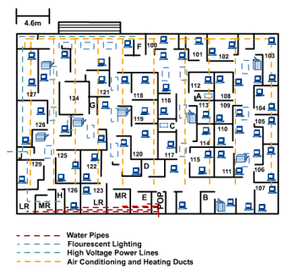
3.1 Topologies
3.1.1.1 Physical Topology
Physical topology shows the physical configuration of a network, which refers to the actual physical layout of the devices and media.

Slide 6
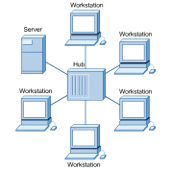
3.1 Topologies
3.1.1.2 Logical Topology
Logical topology refers to the paths that signals travel from one point on the network to another.

Slide 7
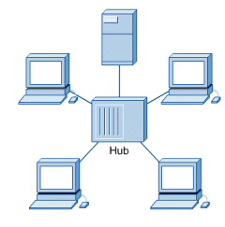
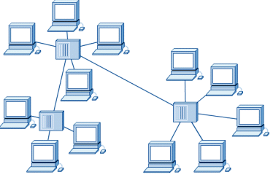
3.1.2 Identifying Network Topologies
3.1.2.1 Star Topology
The star topology is the most used architecture in Ethernet LANs and resembles spokes in a bicycle wheel.
A star topology generally costs more to implement than the bus topology because more cable is used and a central device is needed, such as a hub, switch, or router.

Slide 8
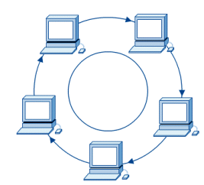
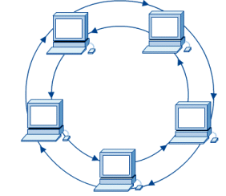
3.1.2 Identifying Network Topologies
3.1.2.2 Ring Topology
A frame, called a token, travels around the ring and stops at each node.
If a node wants to transmit data, it adds that data and the addressing information to the frame.
The advantage of using this method is that there are no collisions of data packets.

Slide 9
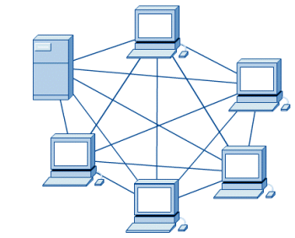
3.1.2 Identifying Network Topologies
3.1.2.3 Mesh Topology
The mesh topology connects all devices (nodes) to each other for redundancy and fault tolerance.
It is used in wide-area networks (WANs) to interconnect LANs and for critical networks.
The mesh topology is expensive and difficult to implement.

Slide 10
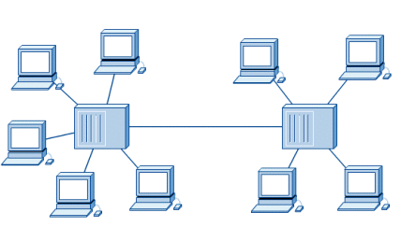
3.1.2 Identifying Network Topologies
3.1.2.3 The Hybrid Topology
The hybrid topology combines more than one type of topology.
When a bus line joins two hubs of different topologies, the configuration is called a star bus.
The bus line is used to transfer the data between the star topologies.

Slide 11
3.2 Media Types

Slide 12
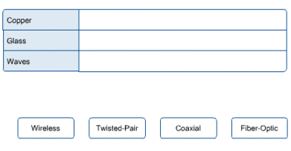
3.2 Media Types
3.2.1 Networking Media
Networking media can be defined simply as the means by which signals (data) are sent from one computer to another.
This includes cable or wireless means.
There are a wide variety of networking media in the marketplace.

Slide 13
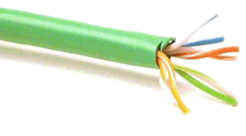
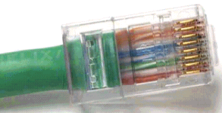
3.2.1 Networking Media
3.2.1.1 Twisted – Pair Cable
Twisted-pair is a type of cabling that is used for telephone communications and most modern Ethernet networks.
A pair of wires forms a circuit that can transmit data.
The pairs are twisted to prevent cross talk.

Slide 14
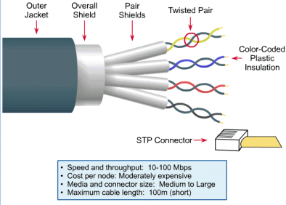
3.2.1.1 Twisted – Pair Cable
3.2.1.1.1 Shielded twisted-pair (STP)
STP cable combines the techniques of cancellation and twisting of wires with shielding.
Each pair of wires is wrapped in metallic foil to further shield the wires from noise.
The four pairs of wires are then wrapped in an overall metallic braid or foil.

Slide 15
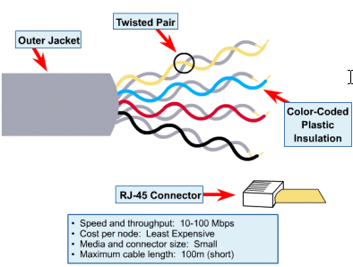
3.2.1.1 Twisted – Pair Cable
3.2.1.1.2 Un-Shielded twisted-pair (UTP)
Unshielded twisted-pair (UTP) has two or four pairs of wires.
UTP is the most commonly used cabling in Ethernet networks.

Slide 16
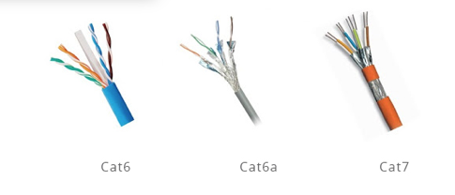
3.2.1 Networking Media
3.2.1.2 10 Gb Ethernet Cable
Demands for high bandwidth keep increasing. 10Gbps calls for new specifications of twisted pair copper cabling.
Ethernet cable with higher bandwidth such as Cat6, Cat6a, and Cat7 cables are introduced for high-speed applications

Slide 17
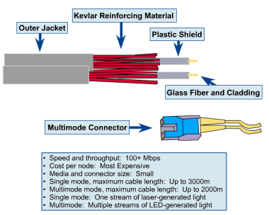
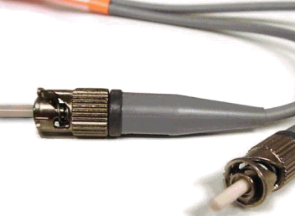
3.2.1 Networking Media
3.2.1.3 Fiber-Optic Cable
Fiber-optic cable is a networking medium that is capable of conducting modulated light transmissions.
To modulate light is to manipulate it so that it travels in the way that it transmits data.
It refers to cabling that has a core of glass or plastic (instead of copper), through which light pulses carry signals.

Slide 18
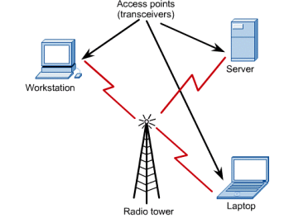
3.2.1 Networking Media
3.2.1.4 Wireless
Wireless networks use radio frequency (RF), laser, infrared (IR), and satellite/microwaves to carry signals from one computer to another without a permanent cable connection.
No physical medium is necessary for wireless signals.
Mobile phones are a common application of wireless.

Slide 19
3.3 Network Devices

Slide 20
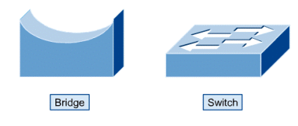
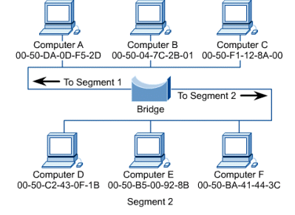
3.3 Network Devices
3.3.1 Bridge
The function of the bridge is to make intelligent decisions about whether or not to pass signals on to the next segment of a network.
When a bridge sees a frame on the network, it looks at the destination MAC address and compares it to the forwarding table to determine whether to filter, flood, or copy the frame onto another segment.

Slide 21
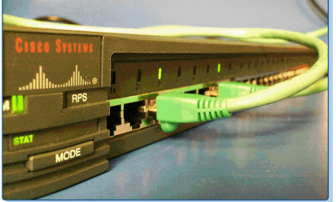
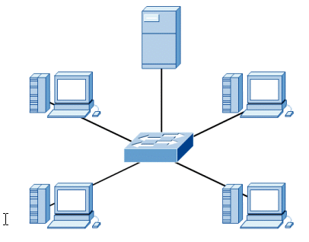
3.3 Network Devices
3.3.2 Switches
Switches learn certain information about the data packets that they receive from computers on the network.
They use this to build forwarding tables to determine the destination of data being sent by one computer to another on the network.
They help segment a network and reduce network traffic congestion by limiting each port to its own collision domain.

Slide 22
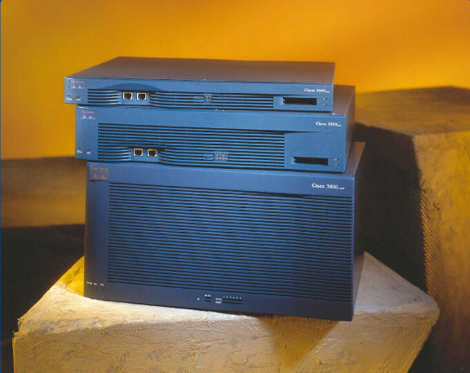
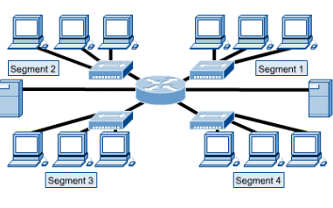
3.3 Network Devices
3.3.2 Routers
Routers can be computers with special network software installed on them or they can be other devices built by network equipment manufacturers.
Routers are capable of segmenting the network.
Routers are capable of segmenting a network into multiple collision domains as well as into multiple broadcast domains.

Slide 23

Conclusion
Topologies
Media Types
Network Devices

Slide 24
Thank You

